Slide 1

Assessing Future Urban Flood
Risks: High-Resolution
Modeling of Compound
Coastal and Pluvial Flooding
Erfan Amini, Reza Marsooli, Philip Orton, Shima Kasaei, and Muhammad Hajj
Davidson Lab, Stevens Institute of Technology, New Jersey
Photo by Michael Bocchieri/Getty Images

Slide 2
Introduction
Motivations
Rising Sea Levels & Intensified Rainfall
Complex Dynamics of Compound Flooding
Limitations of Existing Flood Models
Need for fast yet accurate urban flood risk assessments
Urban coastal areas are increasingly vulnerable to compound flooding—where storm surge, sea level rise, and intense rainfall interact in ways that make flooding more severe. They are all projected to intensify with climate change.
But the challenge is:
High-fidelity flood models are often too slow for street-scale analysis.
Ignoring compound effects leads to underestimations of flood risks.
Introduction | Methods | Results | Conclusions
Notes:
Rising Sea Levels and Intensified Rainfall: Climate change is driving higher sea levels and more extreme rainfall, increasing urban flood risks.
Complex Dynamics of Compound Flooding: Interactions between coastal and pluvial flooding amplify flood hazards in urban areas.
Limitations of Existing Flood Models: Current models lack the resolution to capture street-scale flood dynamics and their impacts effectively.
Need for Advanced Urban Flood Risk Assessment: These challenges highlight the need for innovative modeling to assess compound flooding and its effects on critical infrastructure.

Slide 3
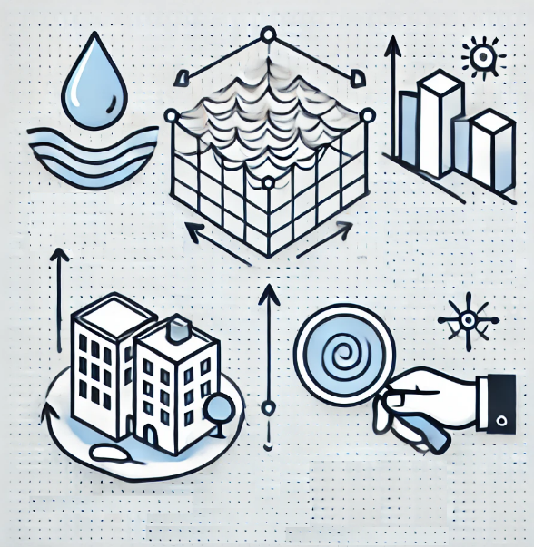
Introduction
Objectives
Develop a High-Resolution Urban Flood Model: Develop and validate a street-scale hydrodynamic model to simulate compound flooding scenarios in Hoboken City, incorporating storm surge, rainfall, and urban features.
Assess Future Compound Flood: Evaluate the impacts of projected sea level rise (SLR) and intensified rainfall (IR) under various climate change scenarios on flood extent, depth, and duration in the city.
Quantify Damage to Critical Infrastructure (ongoing): Analyze the vulnerability of critical buildings and infrastructure in Hoboken to future compound flooding events, estimating potential physical damage and economic losses to motivate adaptation strategies.
Precipitation
Sea Level
Rise
Validated Urban
Flood Model
Damage Assessment
Introduction | Methods | Results | Conclusions

Slide 4
Methods

Slide 5


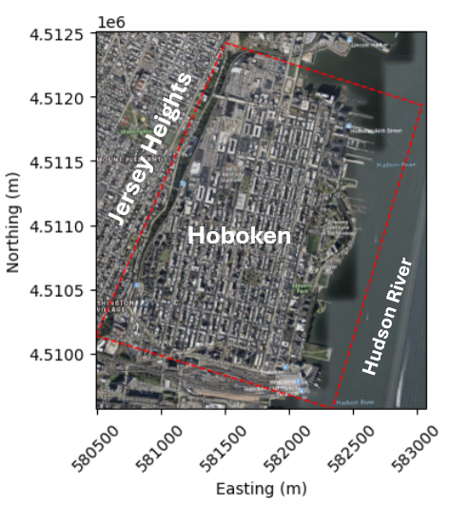
Methods
Numerical Model
SFINCS
HydroMT
In this project, we use the SFINCS (Super-Fast INundation of CoastS) model which is a reduced-complexity hydrodynamic model for compound flood modeling developed by Deltares®.
To streamline the process of generating input files for our model, we employed HydroMT-SFINCS, an extension of the HydroMT (Hydro Model Tools) Framework designed for Deltares® products setup.
Computational domain is about 3.5 km². We used a grid resolution of 1.5 m (5 feet). This results in 2.7 million computational cells.
Introduction | Methods | Results | Conclusions
Notes:
The domain is a self-contained drainage system, as it is bordered by a line of steep cliffs (the Palisades) on the west, the Hudson River on the east, and elevated lands on the south and north.

Slide 6
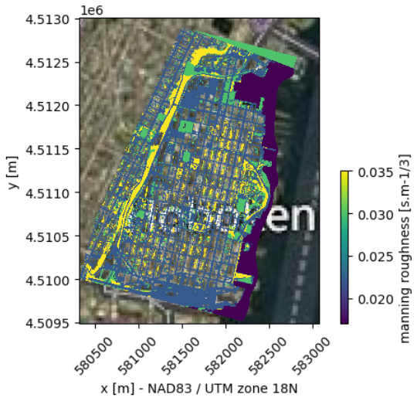
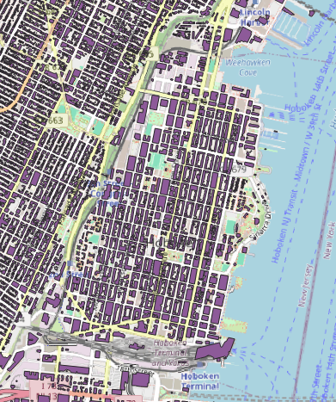
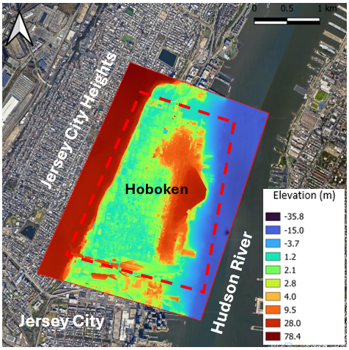
Methods
Datasets
DEM: Coastal National Elevation Database (CoNED) developed by the U.S. Geological Survey (USGS) – resolution: 1-1.5 m
Building Footprints: Open-access Microsoft dataset – resolution: 0.3-0.6 m.
Land Cover Maps: NOAA C-CAP High-Resolution – resolution: 1 m
Jersey Heights
Hoboken
Hudson River
OpenStreetMap®, Microsoft®
The total number of active cells is 1.5 million grid cells, given the high density of buildings in the domain.
Manning roughness is set based on the land cover: open waters/roads and paved surfaces/bare soil/vegetated land.
Introduction | Methods | Results | Conclusions

Slide 7
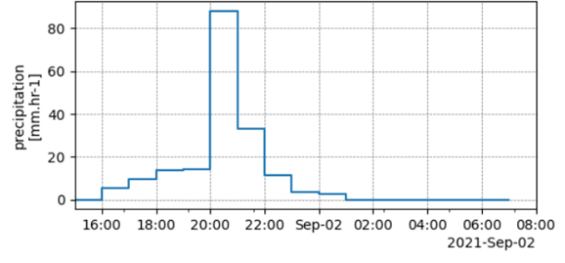
Methods
Flood
Water Level
(tide + surge)
Rainfall
Forcing
Evaluate the model performance for rainfall-induced flooding, and water levels (tide + surge) during Ida (Sep 1-2, 2021).
Hourly rainfall data is received from the National Centers for Environmental Information (NCEI) at the Central Park station
Spatially uniform (temporally varied) rainfall rates mm/hr are used.
The model’s water level boundary conditions along the Hudson River is based on the hourly measurements from the NOAA tide gauge at the Battery station.
Introduction | Methods | Results | Conclusions

Slide 8
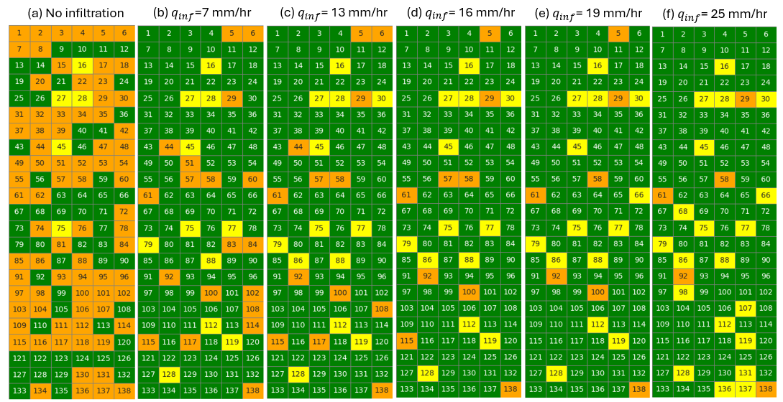
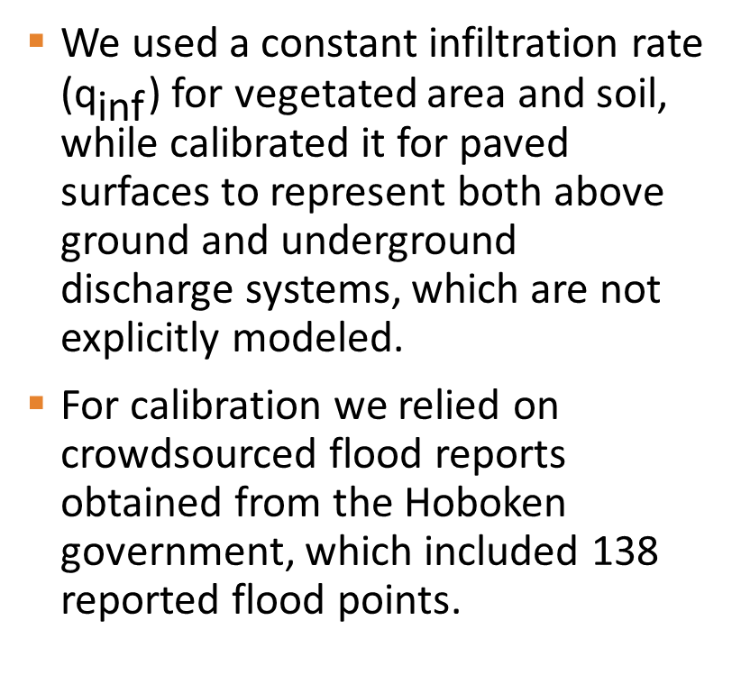
Methods
Calibration
Overestimation
Underestimation
We used a constant infiltration rate (${\text{q}}_{\text{inf}}$) for vegetated area and soil, while calibrated it for paved surfaces to represent both above ground and underground discharge systems, which are not explicitly modeled.
For calibration we relied on crowdsourced flood reports obtained from the Hoboken government, which included 138 reported flood points.
Flood Point Match Ratios (%)
39% 78% 81% 84% 85% 79%
Best result
Introduction | Methods | Results | Conclusions
Notes:
Heatmaps illustrating model results of flood conditions at observation points in Hoboken under varying infiltration rates (qinf). (a) where no infiltration is considered in the model, (b) to (f) correspond to infiltration rates of 7, 13, 16, 19, and 25, respectively. Each cell represents an observation point, with colors indicating different flooding scenarios: yellow cells denote no flood or minimal water accumulation (<3 cm), green cells indicate flooded points, and orange cells highlight areas of flood overestimation (0.5 m) based on crowd-sourced data in Hoboken. The numbering of the points is based on the latitude (O.P.1 is the most north point, and O.P.138 is the most south point)

Slide 9
Methods
Future Projections
We considered projections under low- Shared Socioeconomic Pathways (SSP2-4.5)- and high emissions scenario (SSP5-8.5) for SLR and precipitation.
For SLR, we utilized the NASA Sea Level Projection Tool.
For IR, we applied future projections on the rainfall by estimating how much it would be intensified using four representative factors based on the literature survey.
# | Emission scenario | Timeframe | Forcing change | SLR (m) | Rainfall Increase (%)
0 | - | 2021 | Control scenario | - | -
I | Low | mid-century | +SLR | 0.358 | -
II | High | mid-century | +SLR | 0.584 | -
III | Low | end-of-century | +SLR | 0.814 | -
IV | High | end-of-century | +SLR | 1.618 | -
V | Low | mid-century | +IR | - | 15%
VI | High | mid-century | +IR | - | 25%
VII | Low | end-of-century | +IR | - | 30%
VIII | High | end-of-century | +IR | - | 50%
IX | Low | mid-century | +Combined | 0.358 | 15%
X | High | mid-century | +Combined | 0.584 | 25%
XI | Low | end-of-century | +Combined | 0.814 | 30%
XII | High | end-of-century | +Combined | 1.618 | 50%
Introduction | Methods | Results | Conclusions

Slide 10
Results

Slide 11
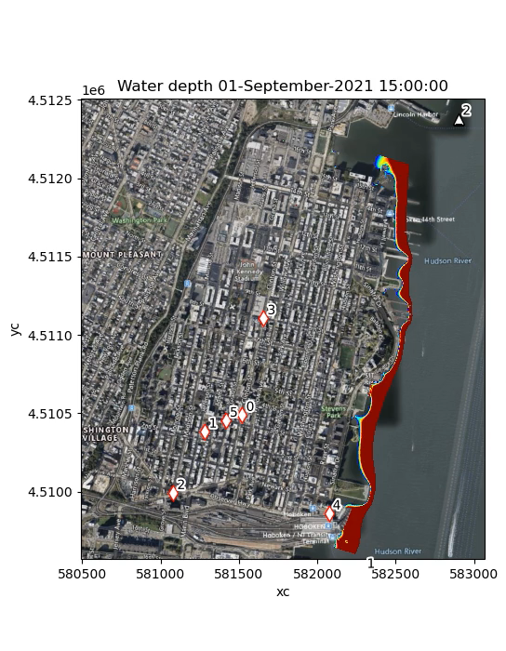


Results – High Emission Scenario (SLR+IR)
2021
2050
2100
Northing [m]
31.6%
56.5%
64.1%
Easting [m]
Easting [m]
Easting [m]
Introduction | Methods | Results | Conclusions

Slide 12
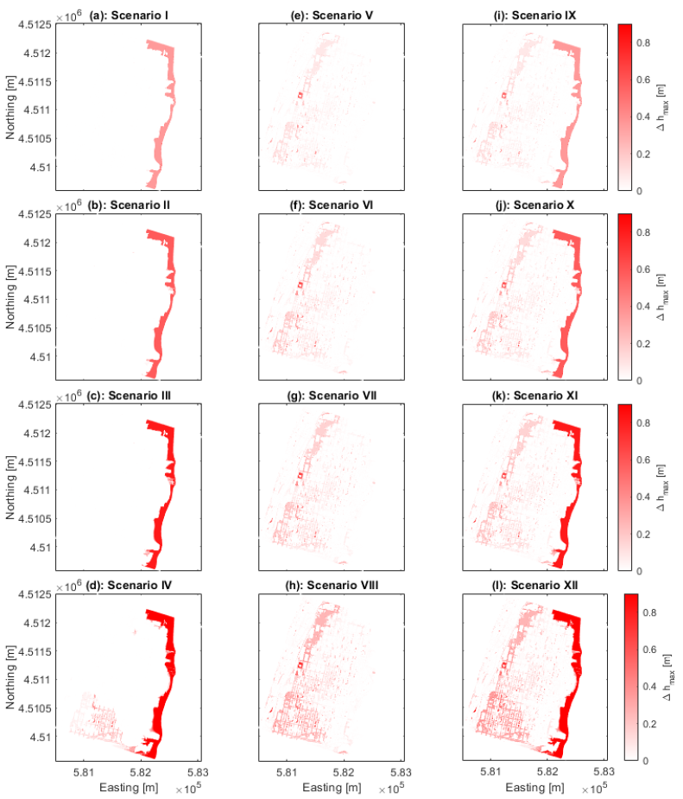
Results
SLR
IR
Both
Compound flood coverage (% of active grid cells)
6.4%
18.3%
21.2%
2050–Low Em.
Compounding Effect
0.2%
Flood depth and extent coverage(%) increase compared to 2021 are shown.
The effect of SLR is most pronounced on the riverfront while intensified rainfall affects primarily western side.
High water level due to SLR breaches into the city, particularly from the southern zone.
A significant compounding effect is observed under the high-emission scenario projected for the end-of-century.
6.9%
19.5%
24.9%
2050–High Em.
0.7%
7.3%
21.2%
26.4%
2100–Low Em.
1.1%
14.5%
23.6%
32.5%
2100–High Em.
18.2%
Introduction | Methods | Results | Conclusions

Slide 13
Results
Flood Duration
While SLR makes river front area inundated, it make central and western part of the city flooded for more than 10 hours. IR increases the flood duration of those parts as well.
SLR under SSP5 in 2100
IR under SSP5 in 2100
Combined
Duration
>2 hours flood coverage (% of active grid cells)
56.69%
62.43%
67.11%
Introduction | Methods | Results | Conclusions

Slide 14
Conclusions
The SFINCS model effectively captures flood dynamics and assesses future climate scenarios.
SLR and IR pose significant risks, with varying impacts across Hoboken City.
Over 18% of the domain faces compound flooding under high-emission scenarios by the end of the century.
In that case, more than 67% percent of the city will be flooded (>10 cm) for more than 2 hours.
Future work
Enhance the model to include the capacity of pumping stations in mitigating excessive floodwaters.
Introduction | Methods | Results | Conclusions

Slide 15










Invitation to Contribution
Research Topic: Nature-Based Solutions for Coastal Flood Resilience: Opportunities, Challenges, and Adaptation to Climate Change
Benefits for coastal erosion control, storm surge and wave mitigation, and flood risk reduction.
Approaches for designing, modeling, and optimizing NbS, including hybrid green-gray approaches.
Incorporating NbS into coastal management and climate adaptation plans.
Regulatory and institutional challenges for scaling NbS.
Economic assessments and valuation of NbS flood risk reduction benefits.
Community engagement and social acceptance of NbS.
Predicting NbS performance under future climate scenarios.
Decision-support tools, risk assessment frameworks, and climate models for NbS.
Lessons learned from successful and challenging NbS projects.
Impact Factor = 2.9
CiteScore = 5.1
Deadline
for Submissions:
Nov 3rd, 2025

Slide 16
Thank You
Contact: eamini@stevens.edu

Slide 17
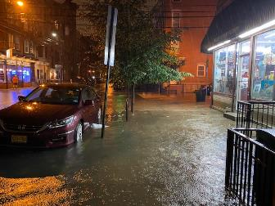
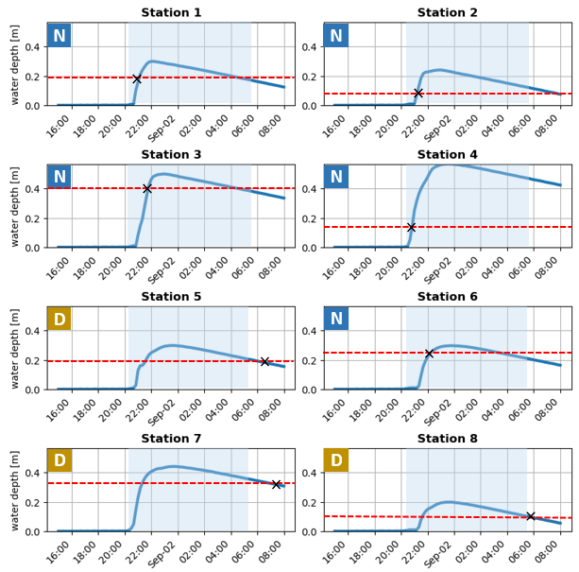
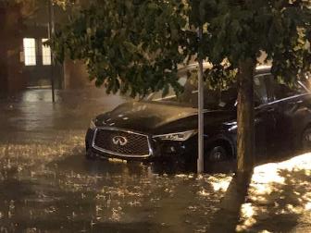
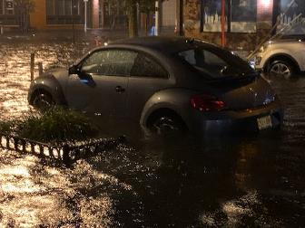
Methods
Validation
To validate our model against estimated flood depths derived from selected photos, we plotted the time series of the modeled flood.
These plots are intersected with observed flood levels from the photos, represented by red dashed lines.
The backgrounds of the subplots indicate the time of day: blue for night and white for daytime.
Introduction | Methods | Results | Conclusions

Slide 18
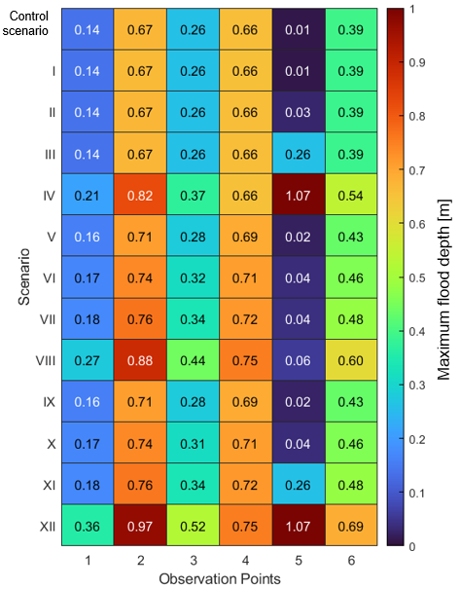
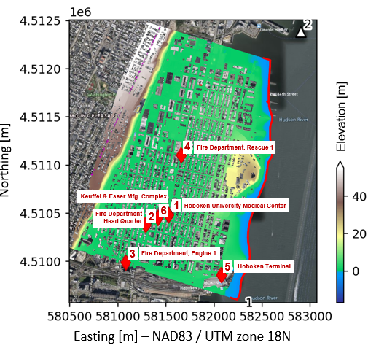
Results
Effects on Critical Buildings
Six critical buildings within the city are analyzed.
The impact of sea level rise (SLR) and intensified rainfall (IR) on maximum flood depth varies across different locations and scenarios.
Buildings in the central part of the city experience the largest flood depth changes primarily due to increased rainfall, whereas SLR significantly contributes to the flood depth increase at a building in the southeastern area (#5).
Introduction | Methods | Results | Conclusions

Slide 19
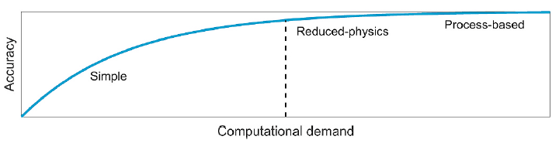
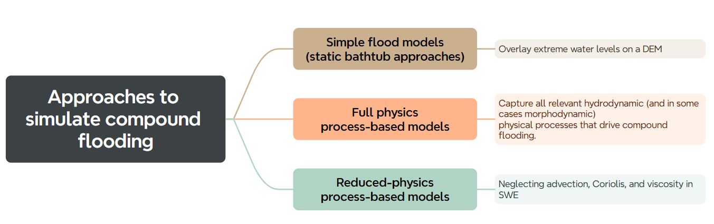
Why SFINCS?
SFINCS model is characterized by its reduced complexity, allowing it to handle large-scale flood simulations with high efficiency and speed.
Runtime for our domain: ~20 minutes on a single core
Source: Leijnse et al. 2021

Slide 20
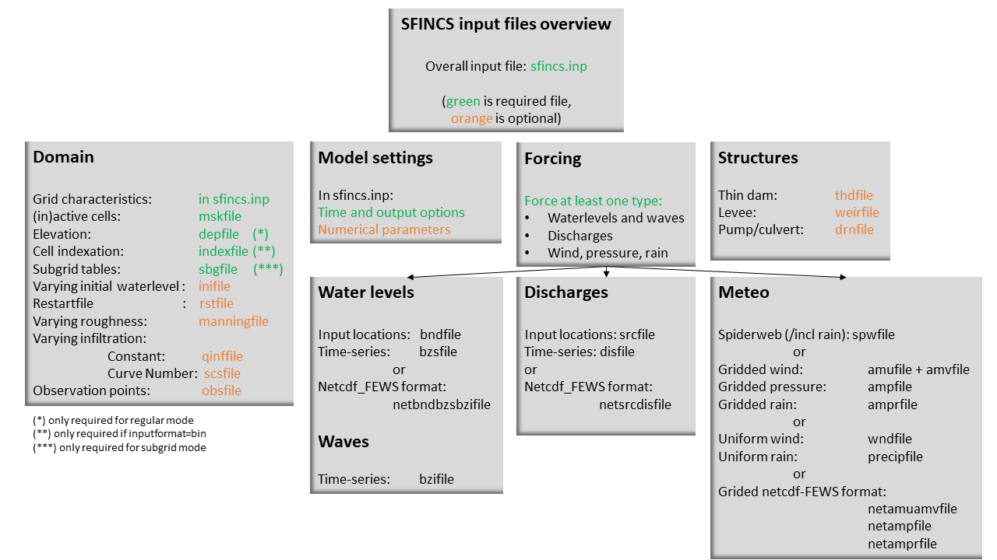
Input Files

Slide 21
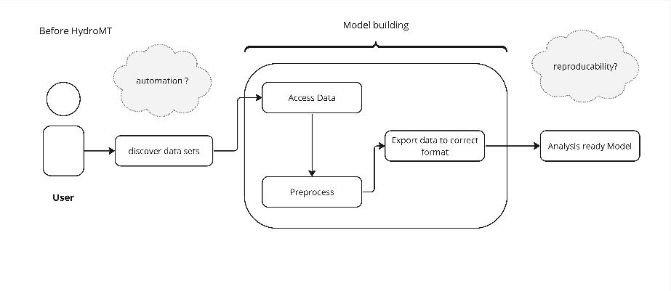
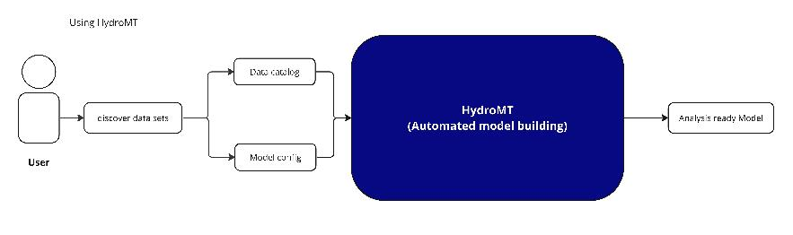
HydroMT
HydroMT (Hydro Model Tools) is an open-source Python package that facilitates the process of building and analyzing spatial geoscientific models with a focus on water system models.
It does so by automating the workflow to go from raw data to a complete model instance which is ready to run and to analyze model results.
Can be used with different Deltares models (SFINCS, Delft3D, FIAT, wflow, etc.)

Slide 22
Manning file (sfincs.man)
We set the manning’s roughness coefficient to 0.017 s.m^{–1/3} for open waters, 0.022 s.m^{–1/3} for roads and paved surfaces, 0.03 s.m^{–1/3} for bare soil, and 0.035 s.m^{–1/3} for vegetated land.
(Coefficients were selected based on recommended values in Marsooli & Wang 2020).
Northing [m]
Easting [m] – NAD83 / UTM zone 18N

Slide 23
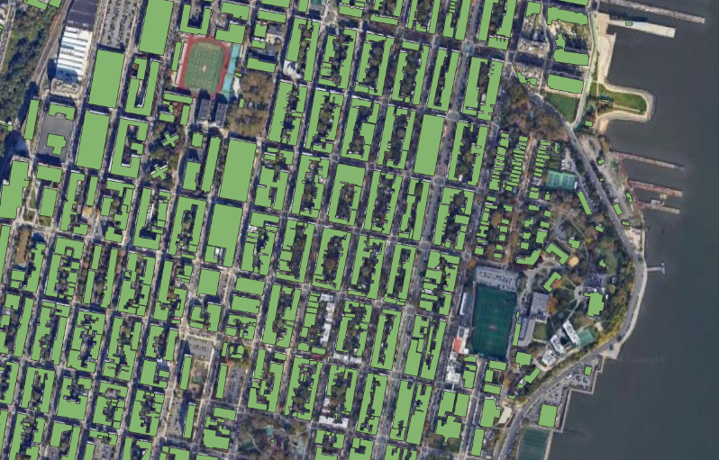
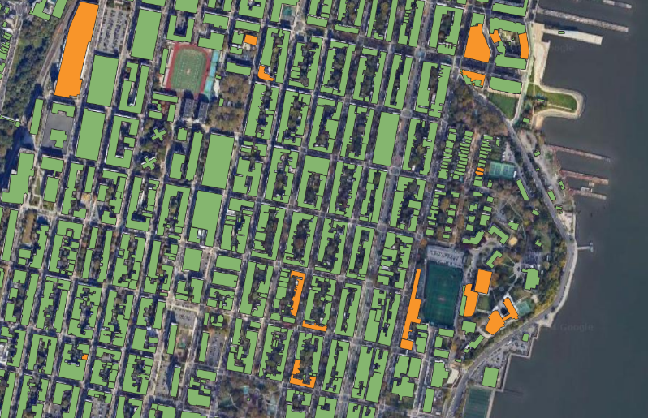
BFP enhancement
Original
Enhanced

Slide 24
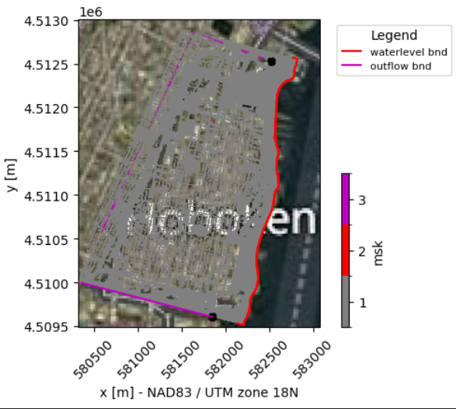
Boundary Conditions
Cells that are inactive, active(1), inflow(2) or outflow(3) boundary.
closed
4
Northing [m]
outflow
inflow
inactive
Easting [m] – NAD83 / UTM zone 18N

Slide 25
Infiltration
We used a constant infiltration rate to represent both above ground and underground discharge systems, which are not explicitly modeled.
In accordance with the Stormwater Management design rules* allowable discharge rate requirement for stormwater runoff quantity control, the for the 100-year storm is 80% of the pre-construction peak flow rate.
In fact, intense rainfall of greater than 0.8 inch/hr (~20.32 mm/hr) could result in flooding in low-lying areas per Office of Emergency Management of Hoboken**.
*NJ Stormwater BMP Manual Chapter 5, New Jersey Department of Environmental Protection
**https://www.hobokennj.gov/news/mayor-bhalla-encourages-city-of-hoboken-residents-to-prepare-for-heavy-rainfall-flooding

Slide 26
Water Level Boundary Conditions
The model’s water level boundary conditions along the Hudson River is based on the hourly measurements from the NOAA tide gauge at the Battery station, which is in the vicinity of the study area.

Slide 27
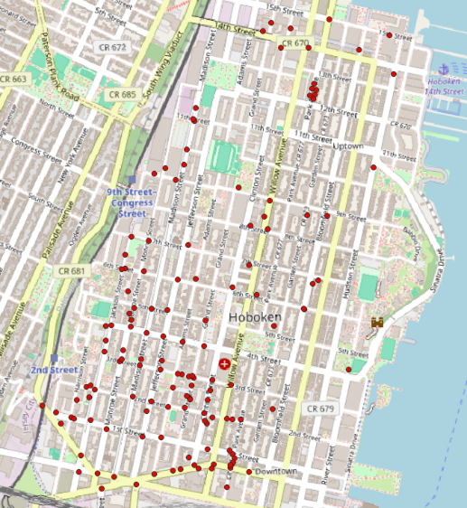
Validation
Calibration &Validation
Qualitative
Quantitative
Wet/Dry
Reports
Flood depth
Images
Method
Criteria
Data Source
Number of observation points
138 points
8 points
Point 1
Jersey Heights
Hoboken
Hudson River
Point 138
© Mapbox © OpenStreetMap

Slide 28
Case_12

Slide 29
