Slide 1
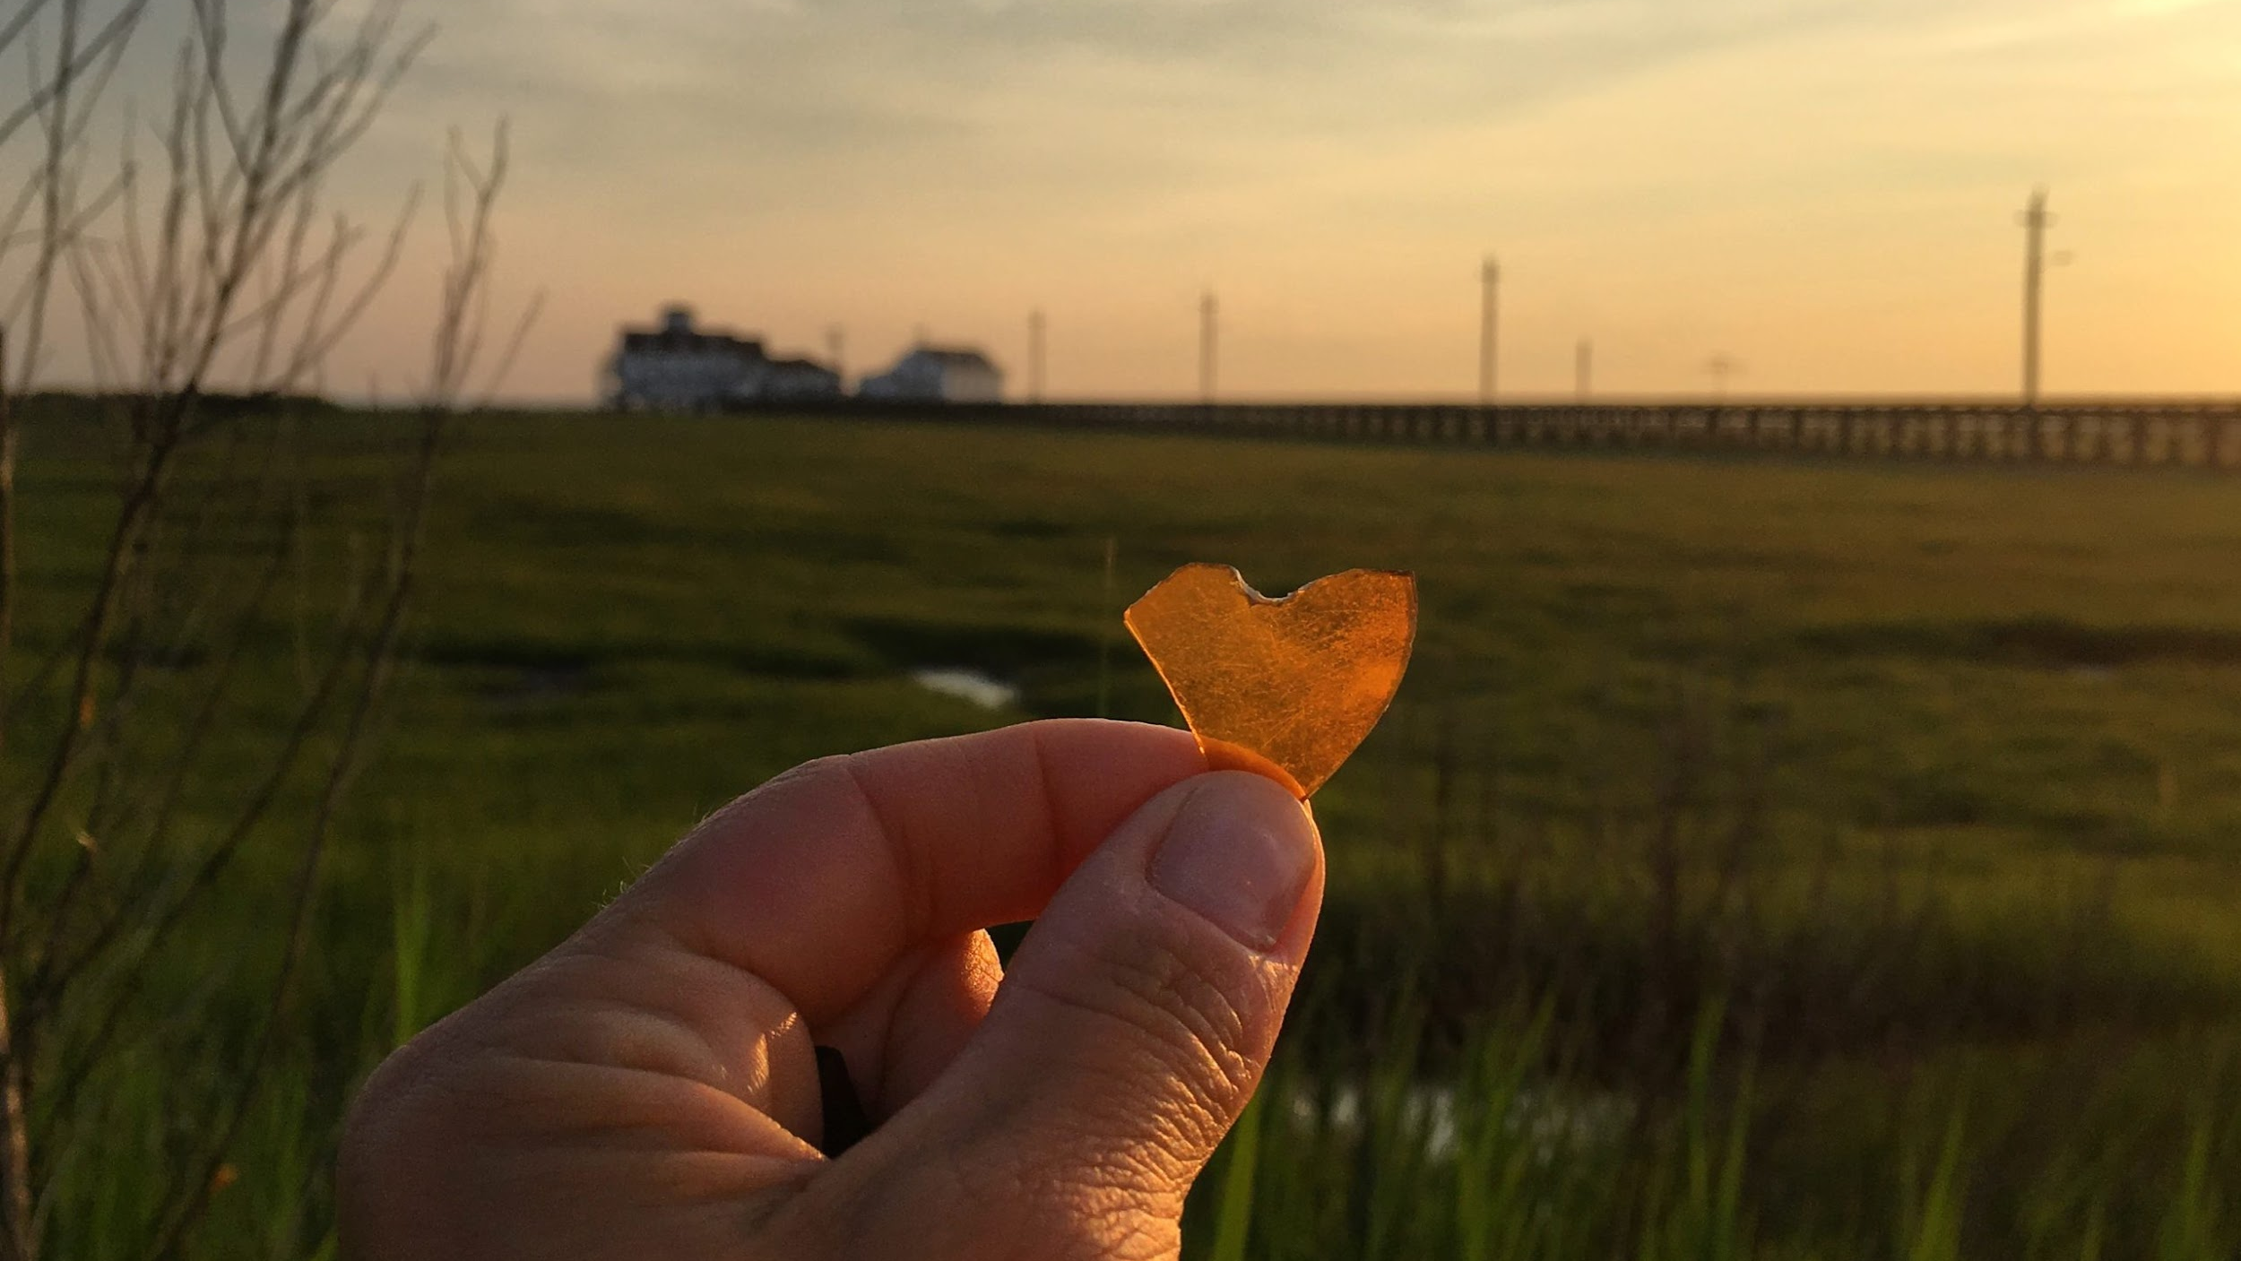

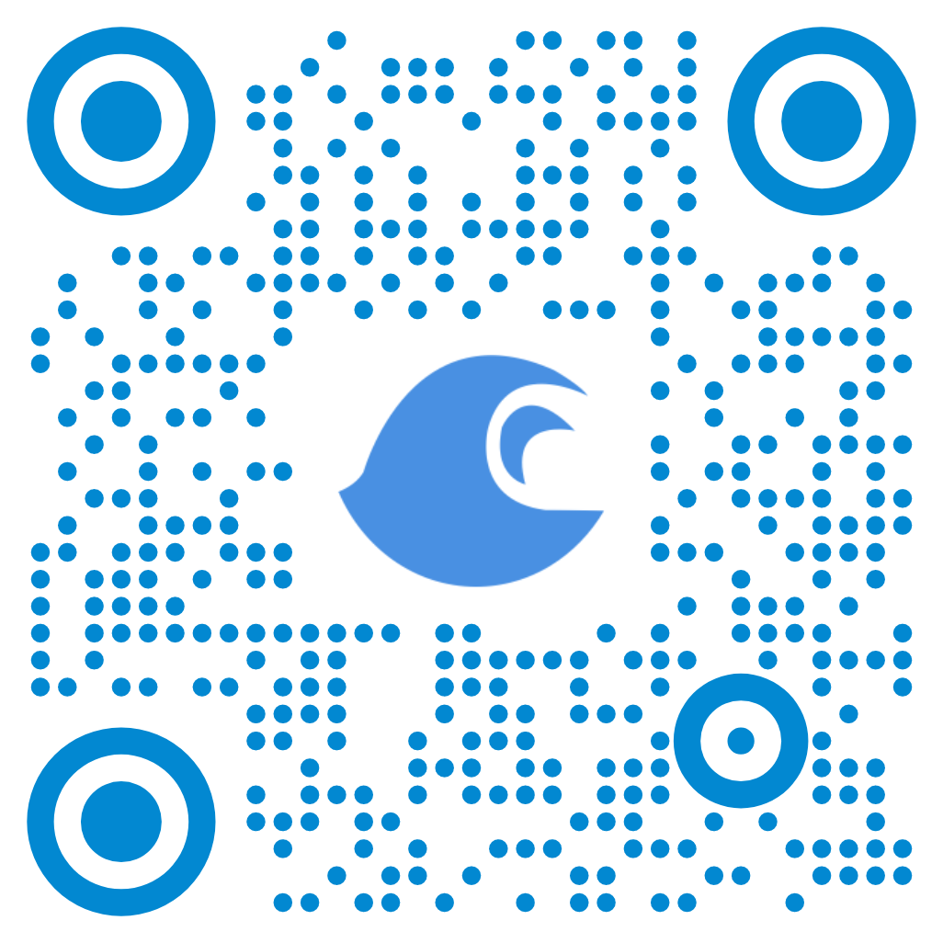
New Brunswick, NJ
NJCRC COASTAL FLOODING TECHNICAL WORKSHOP 3/19/2025
Amanda Archer, Jacques Cousteau National Estuarine Research Reserve – Rutgers University

Slide 2
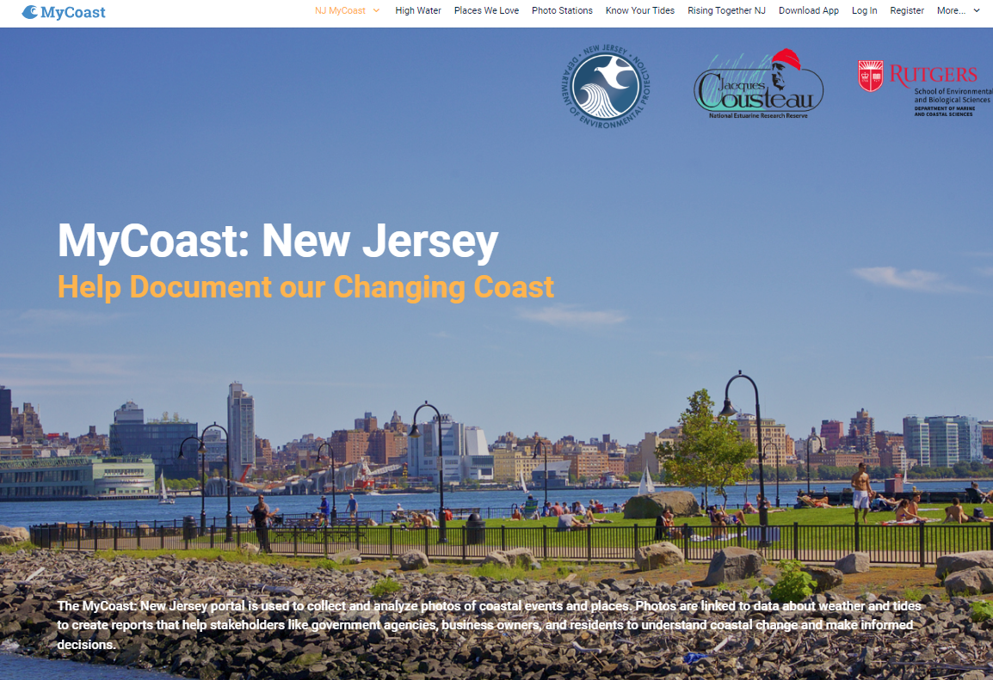
Portal used to collect and analyze photos of coastal events and places.
Photos are linked to data about weather and tides to create reports that help stakeholders like government agencies, business owners, and residents understand coastal change and make informed decisions.

Slide 3
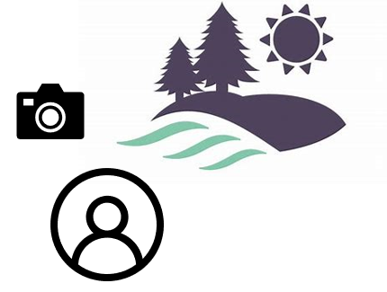
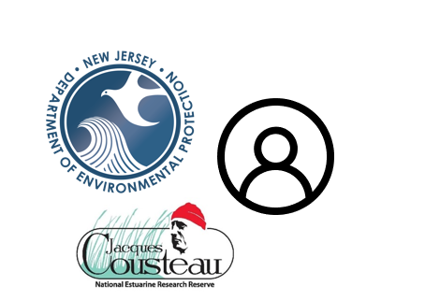



Education & Outreach
Visual Science & Storytelling
Informed Management Decisions

Slide 4
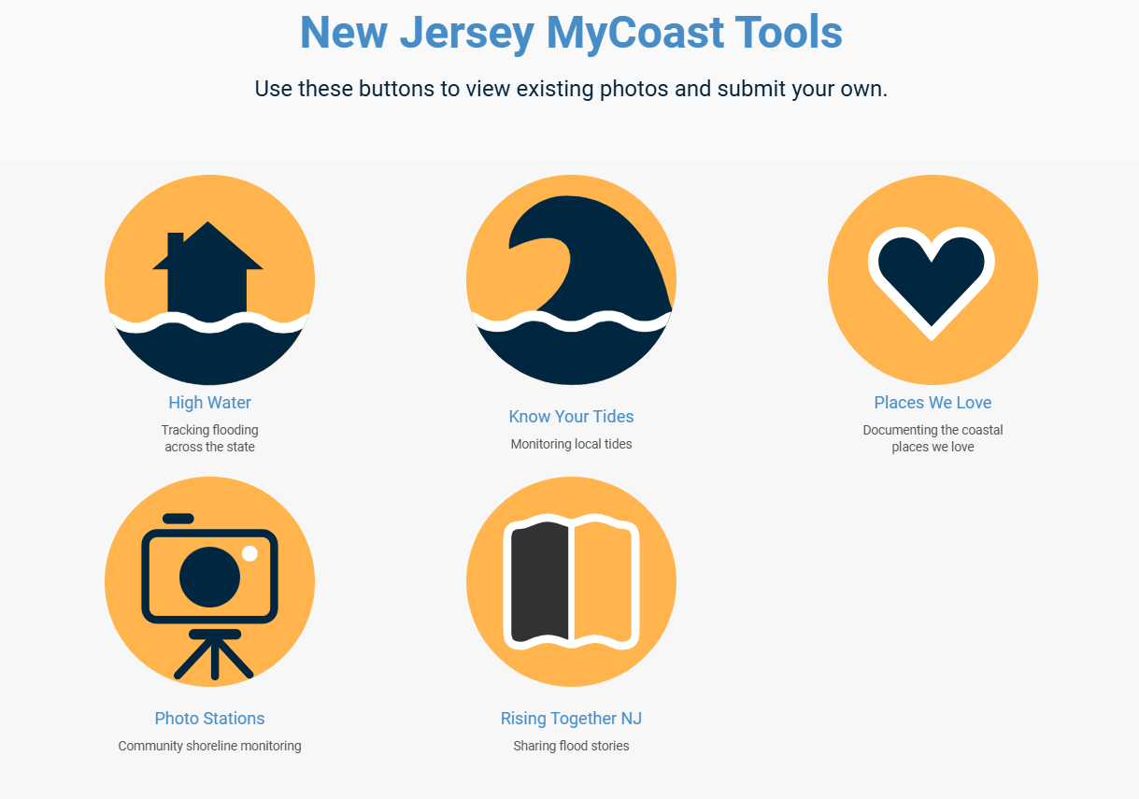

Slide 5

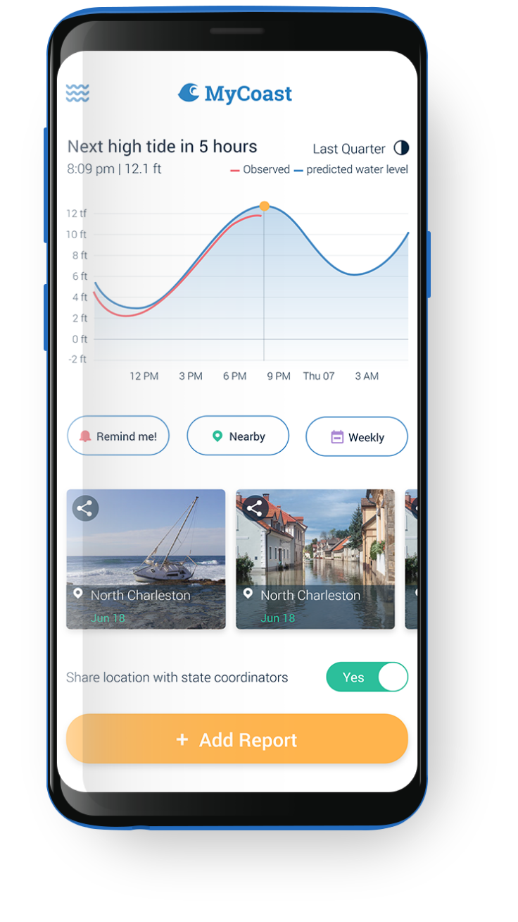
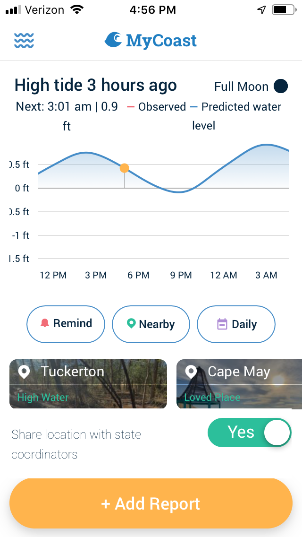
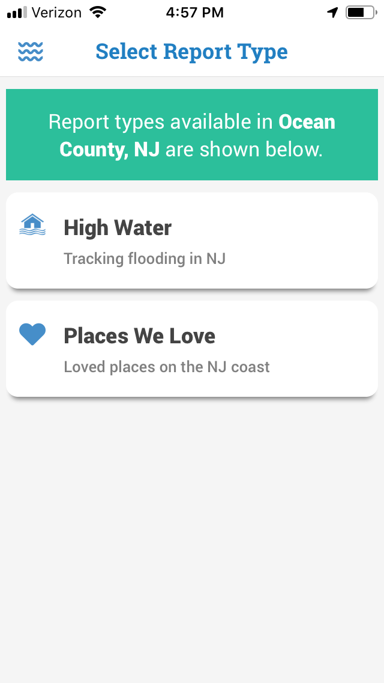
: New Jersey

Slide 6
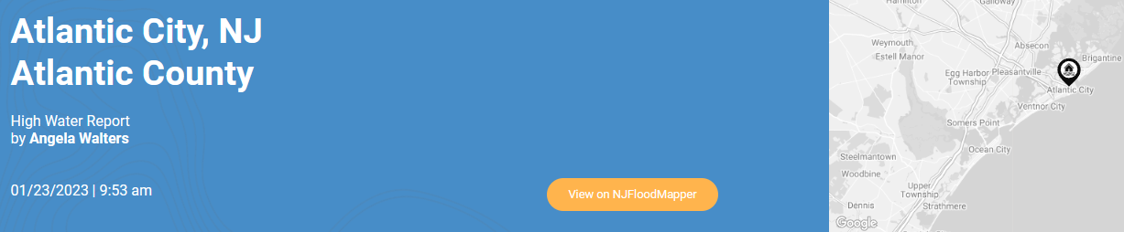

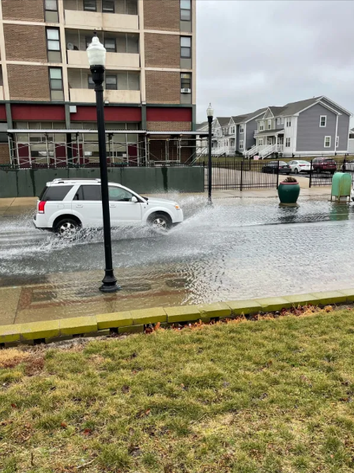
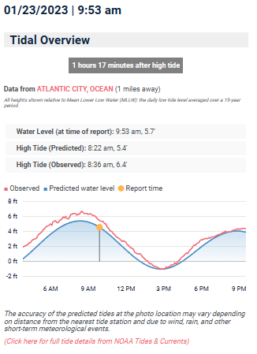
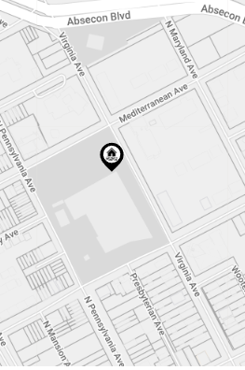
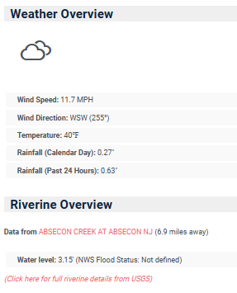
High Water

Slide 7
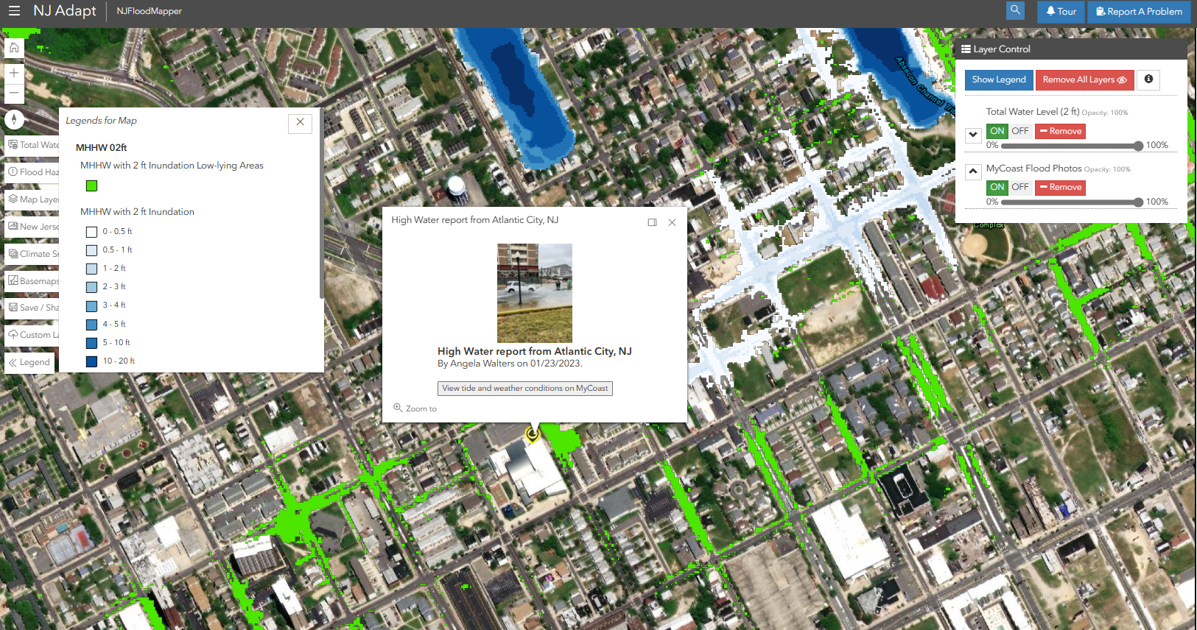

Slide 8
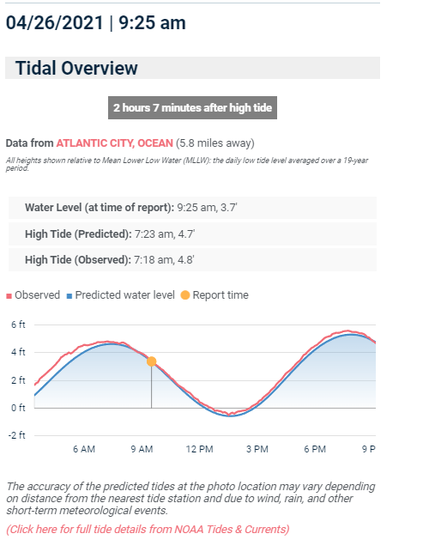
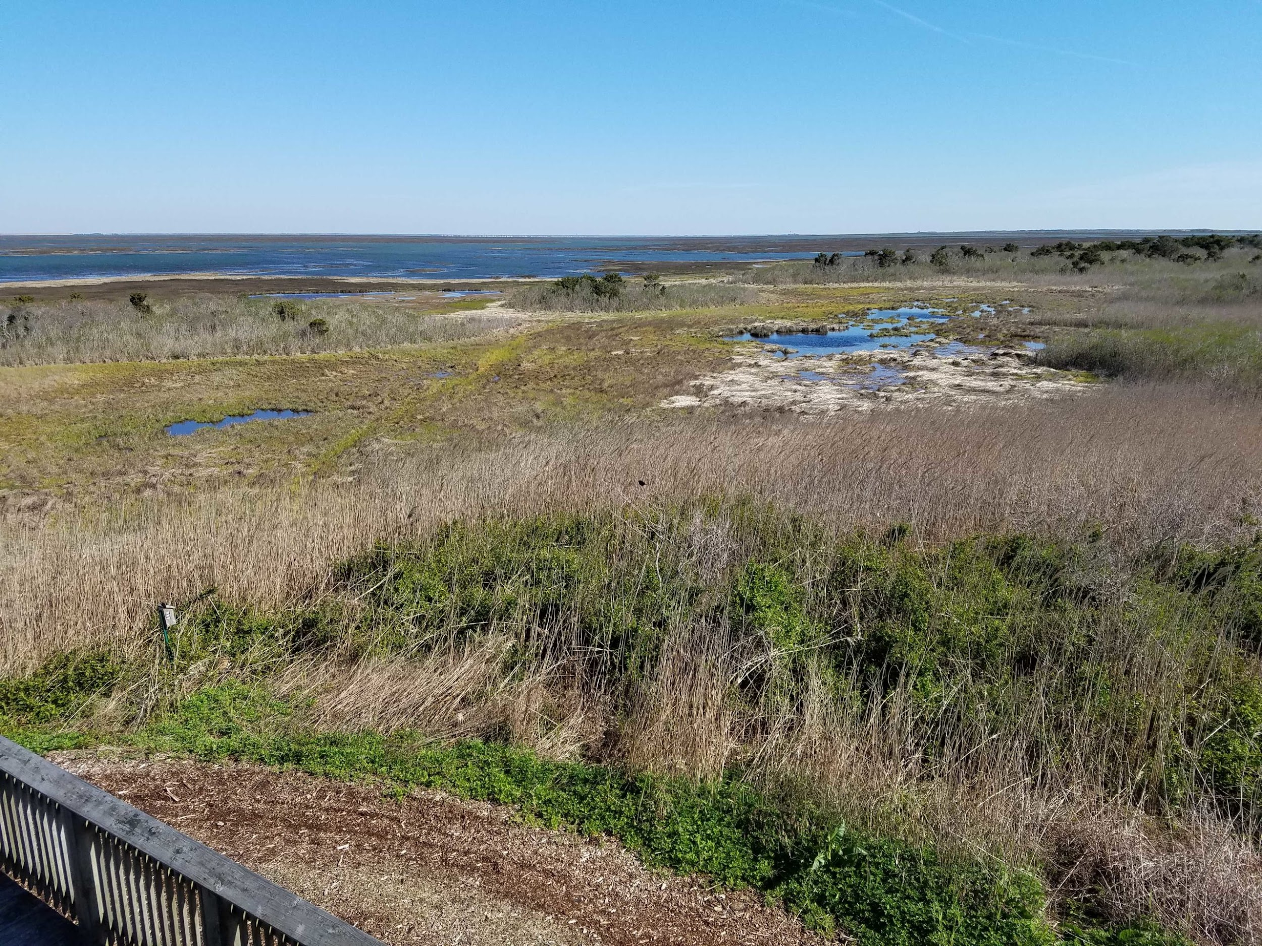
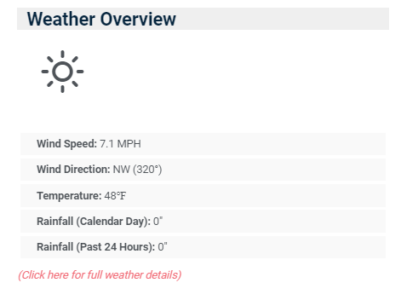

Places We Love

Slide 9
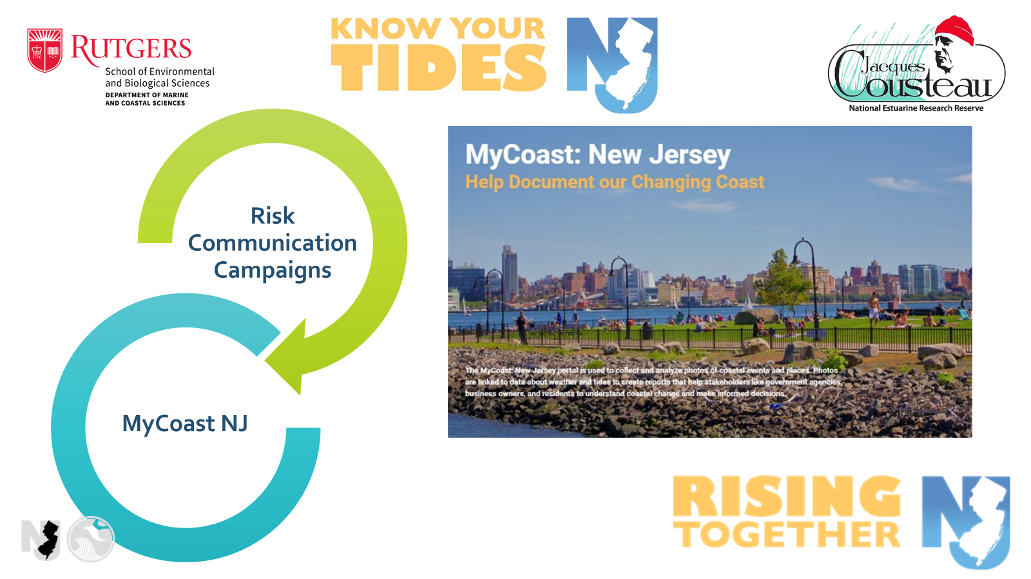

Slide 10
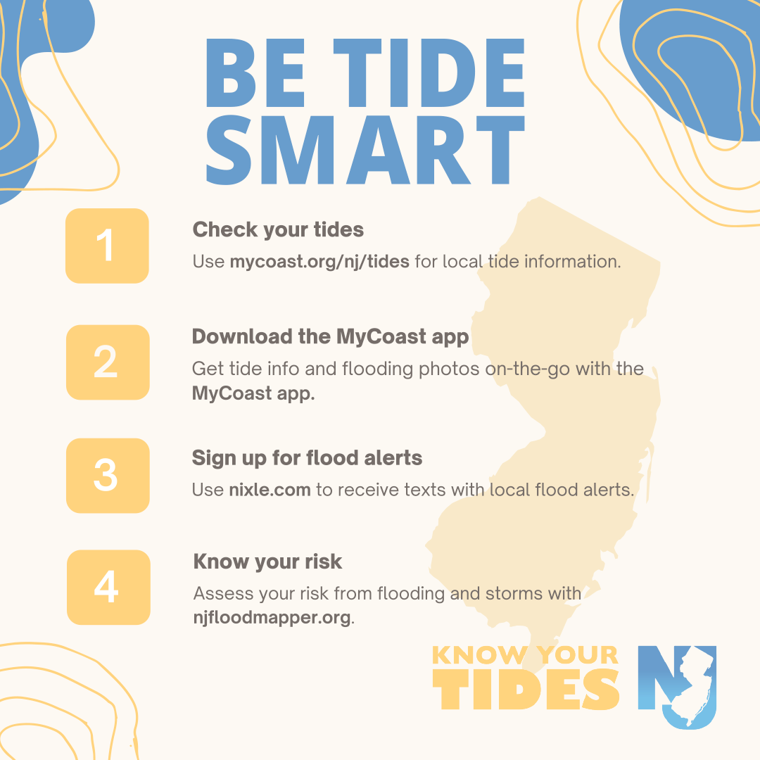
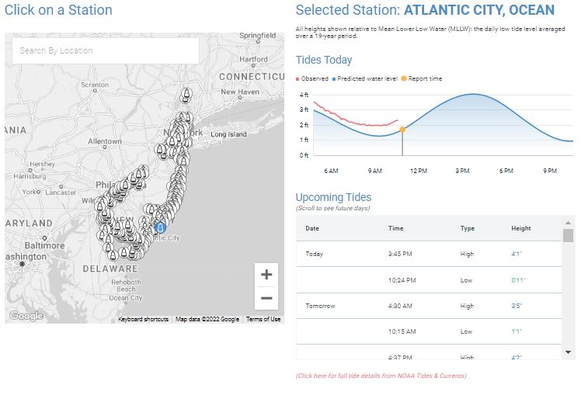
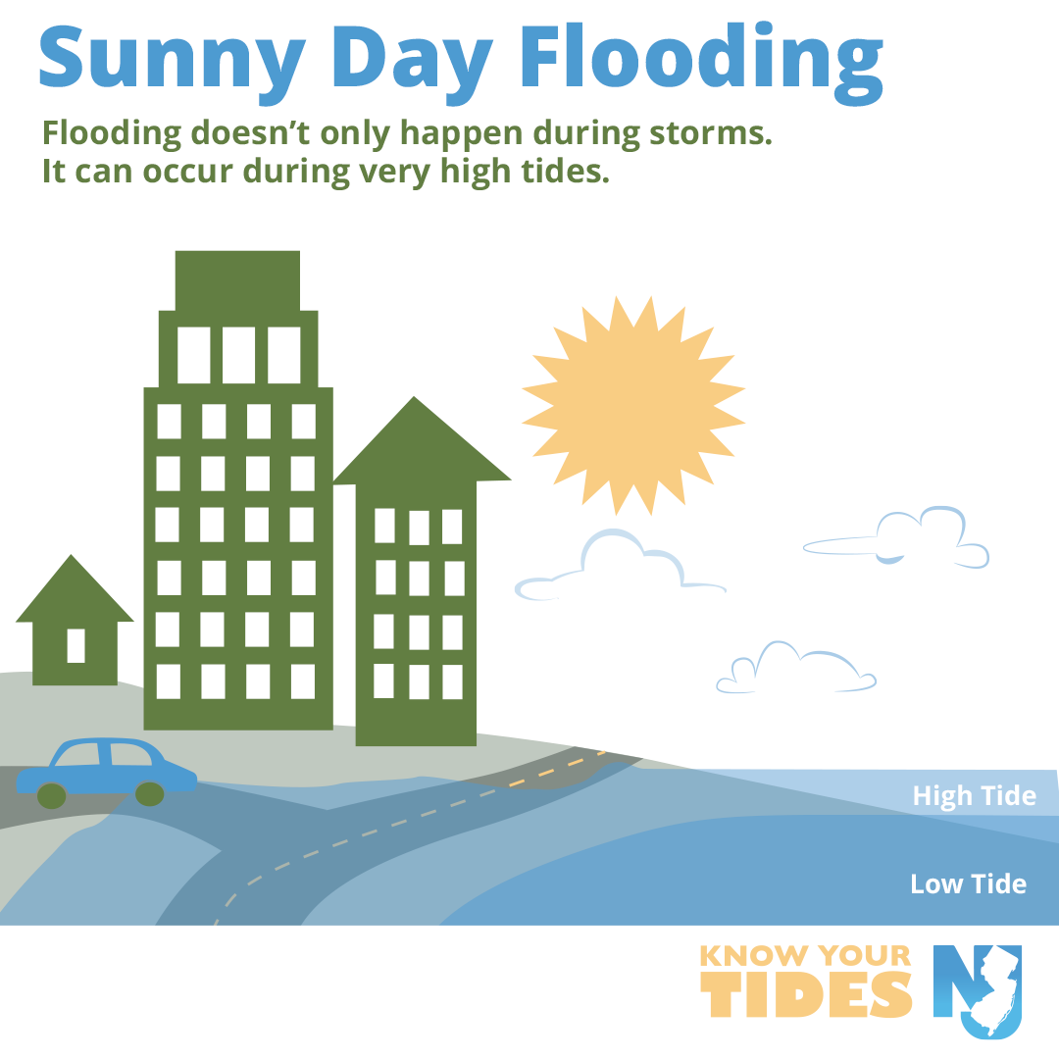

Know Your Tides

Slide 11
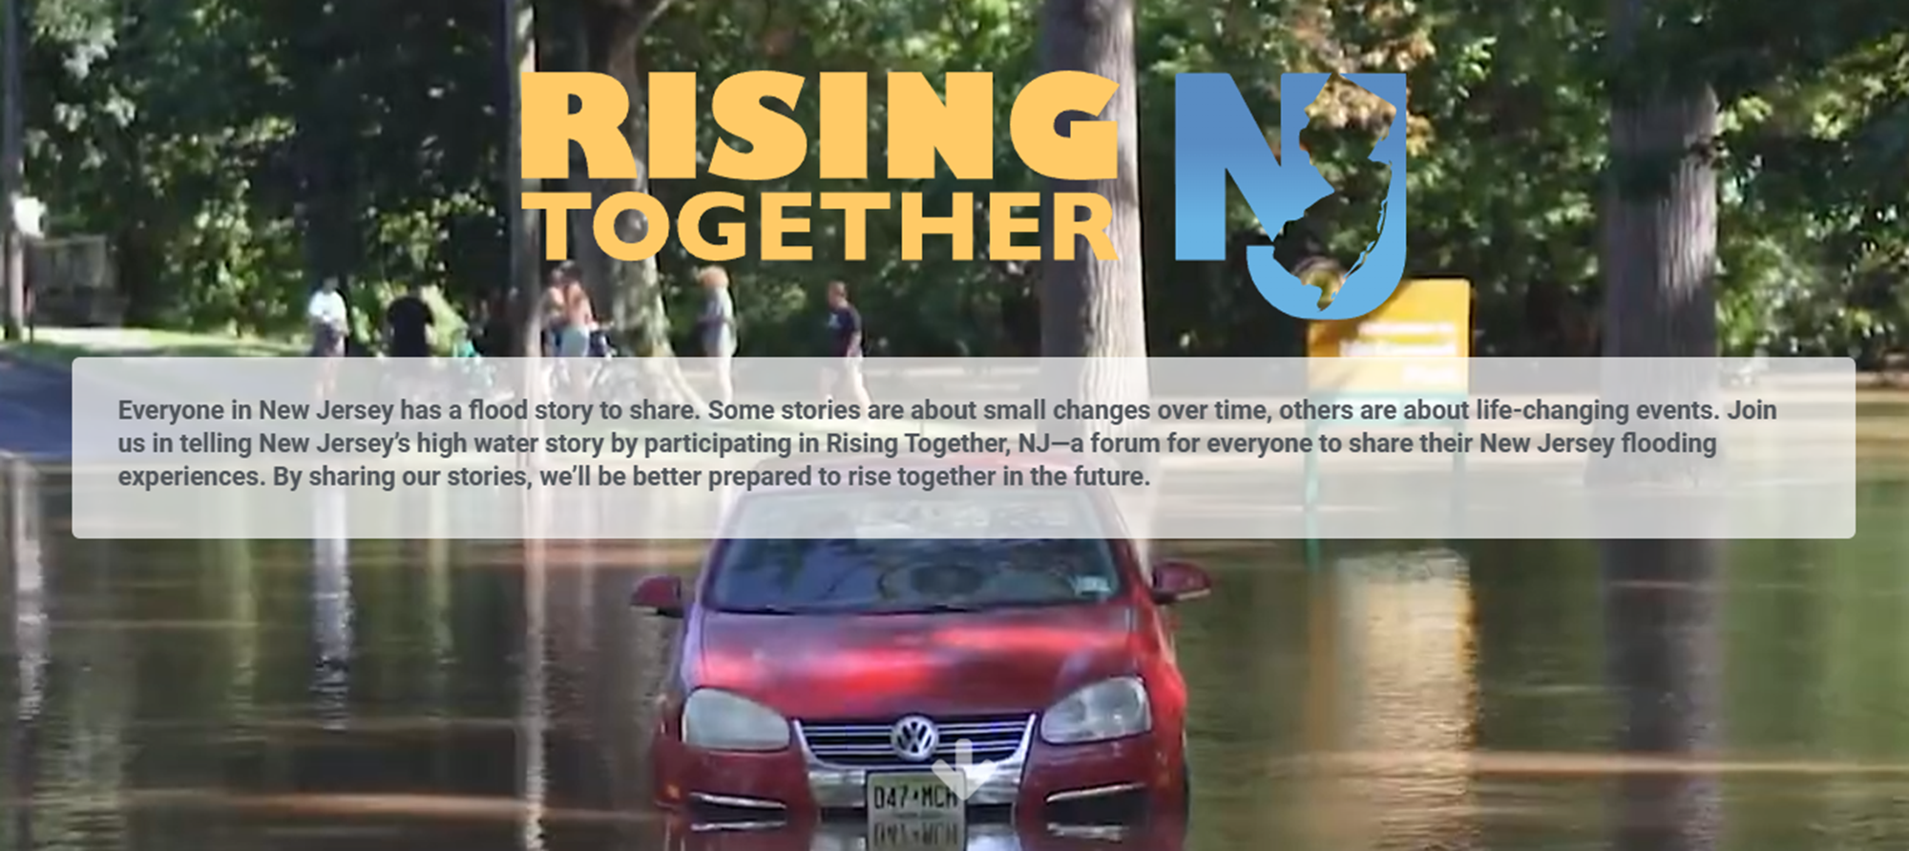
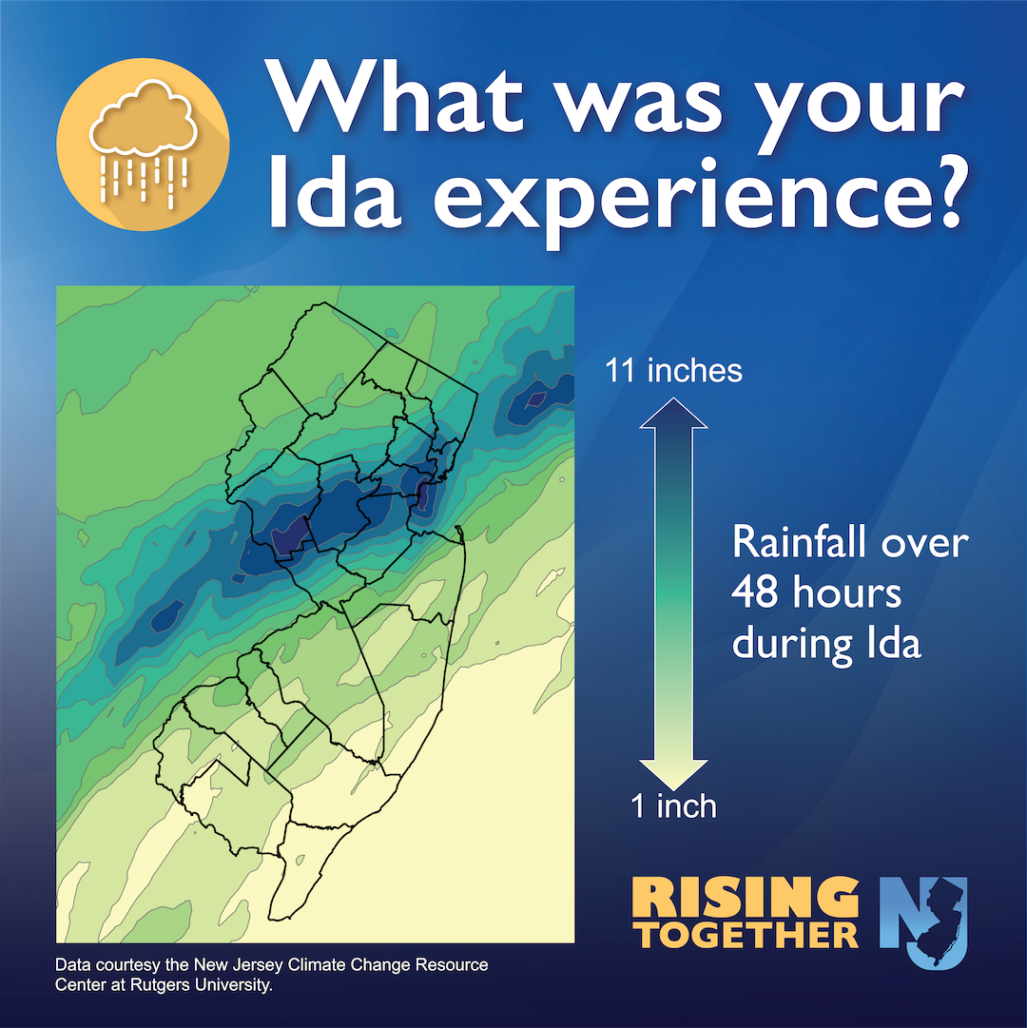


Slide 12
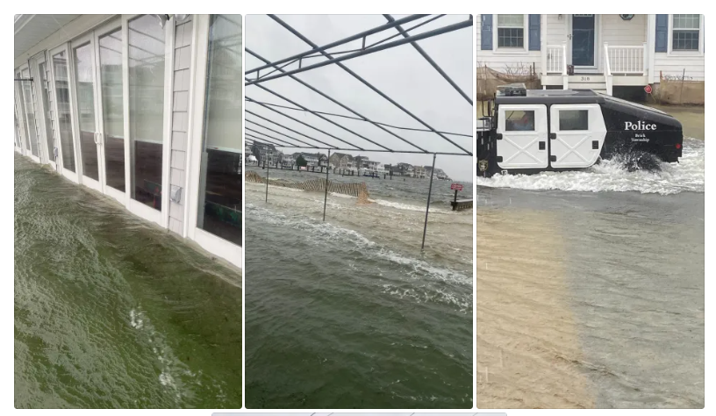

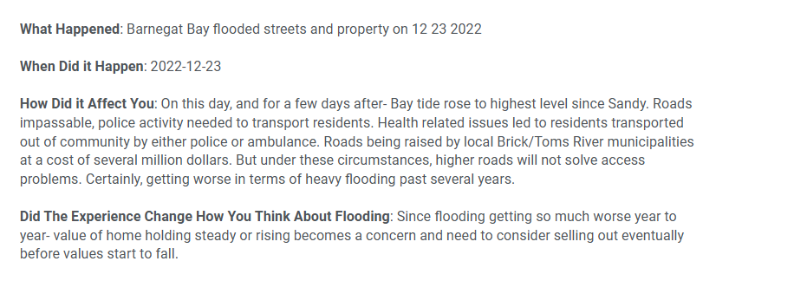

Slide 13
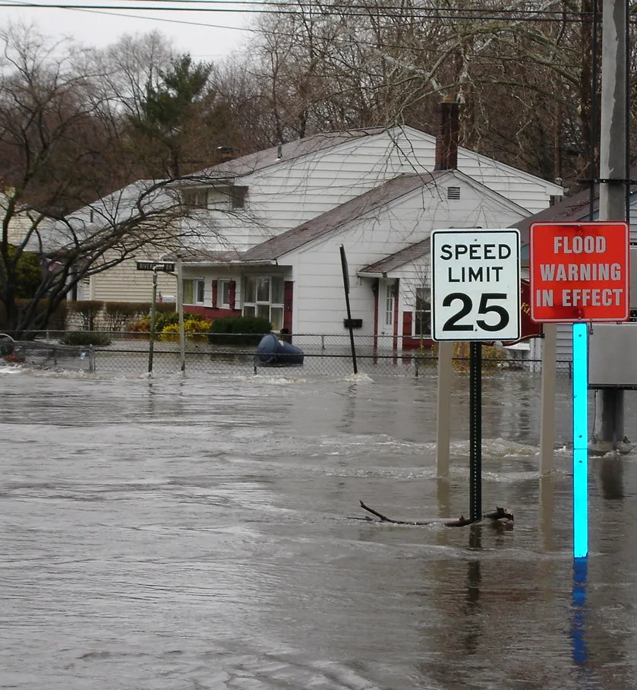
Can Submit Past Reports
MyCoast allows you to upload pictures from any past flooding event. The date, time, and location of the photo will automatically be linked upon submission.
If the photo is not embedded with that information, it is important to review when and where the photo was taken to ensure an accurate report.
We encourage submissions of past flooding so that we can compare them to recent reports.

Slide 14
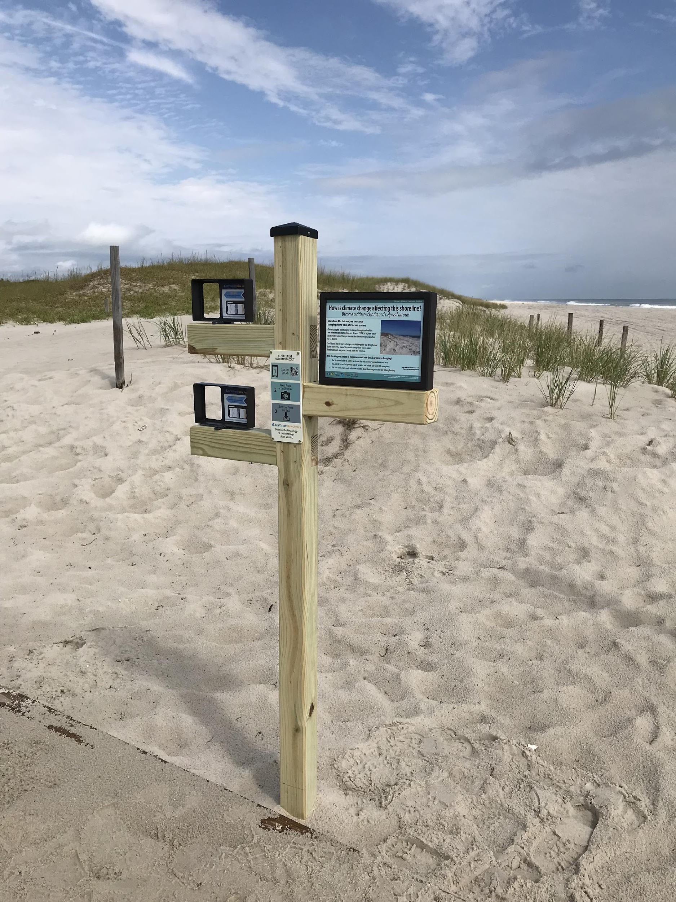
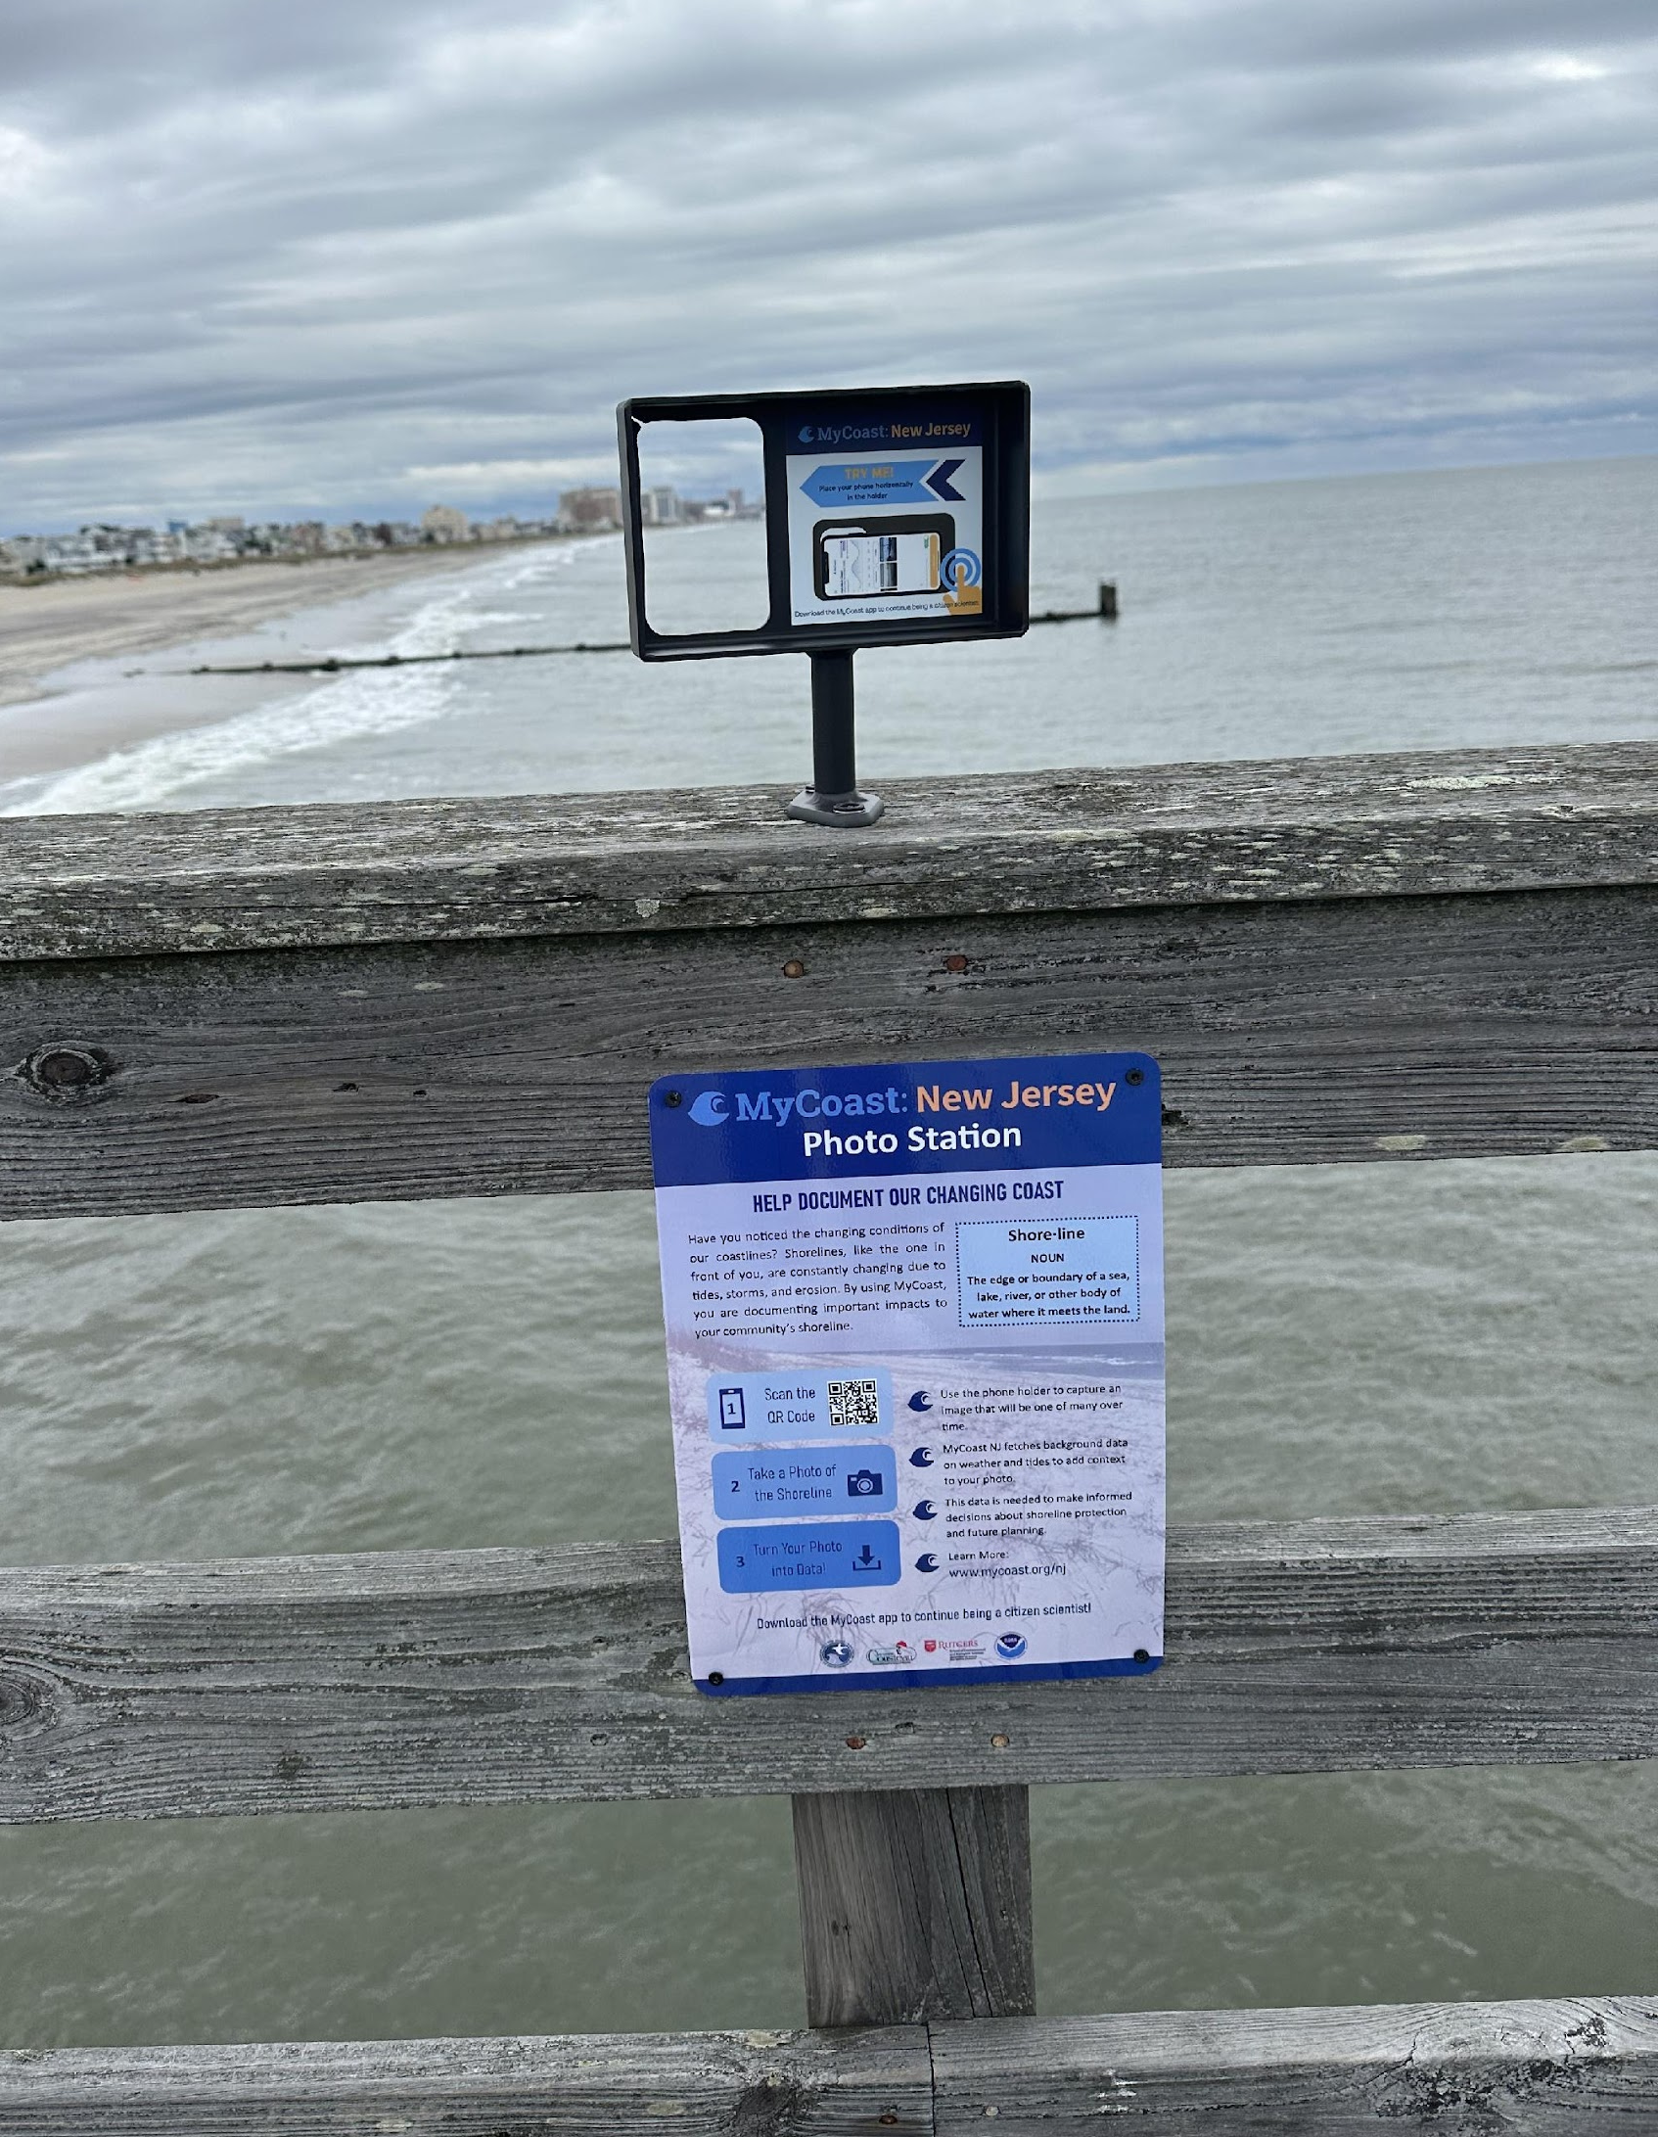

Photo Stations
Six locations
  Various coastlines
Document climate/coastal changes
Time-lapse of photos collected
Installed for climate week launch September 2023

Slide 15
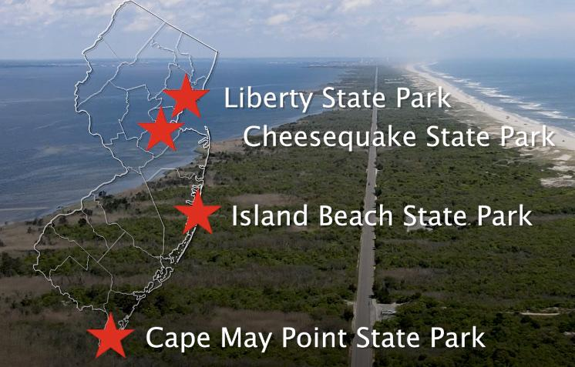
Photo Station locations
5 Locations | 6 Photo Stations
Margate City

Slide 16
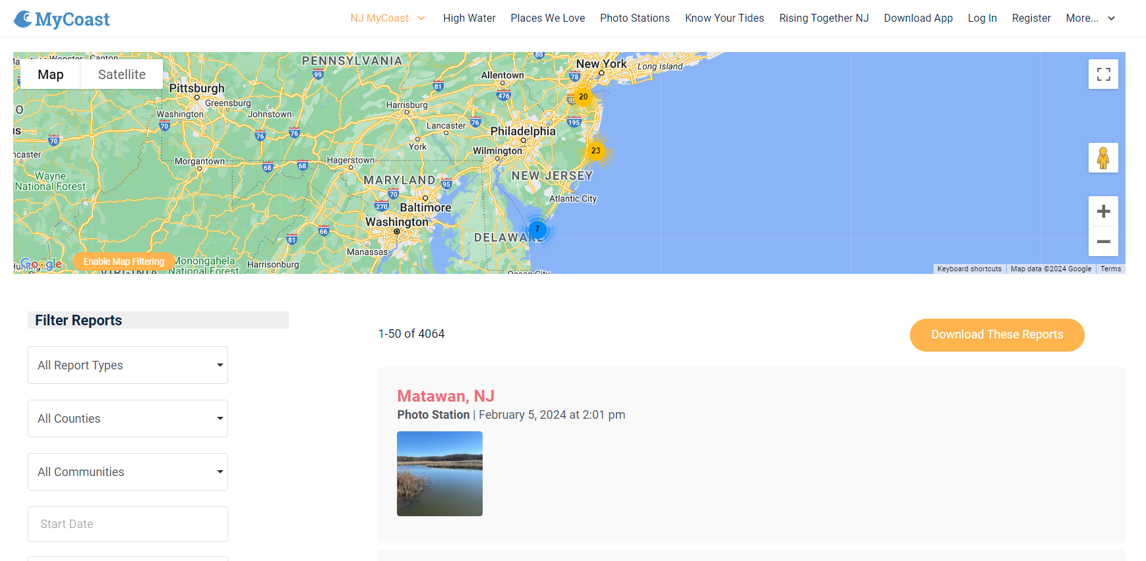

Slide 17

Ways practitioners can use MyCoast data and photos!
Real – time awareness
Planning
Project siting/design
Permit review
Grant proposals
Model calibration/ground-truthing
Notes:
local planning and CRS activities
using images to track local flooding in coastal communities
a link to community members to learn about climate issues in their locality
tidal data and photos for future grants, permit apps, funding requests, construction information etc. - if there is data for a location of interest - the more the better.
restoration project photos during or after major flooding and storm events

Slide 18


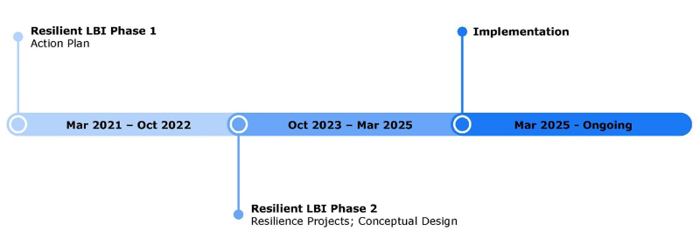
https://resilient-nj-long-beach-island-rambollglobal.hub.arcgis.com/

Slide 19
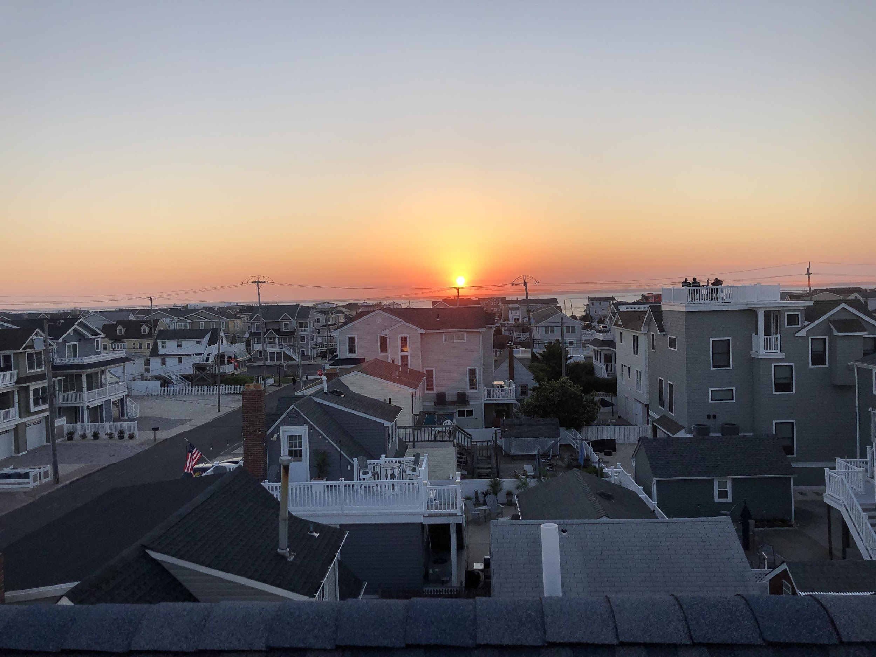





Contact
Questions?
https://jcnerr.org/
Amanda Archer | amanda.archer@marine.rutgers.edu
https://mycoast.org/nj

