Slide 2
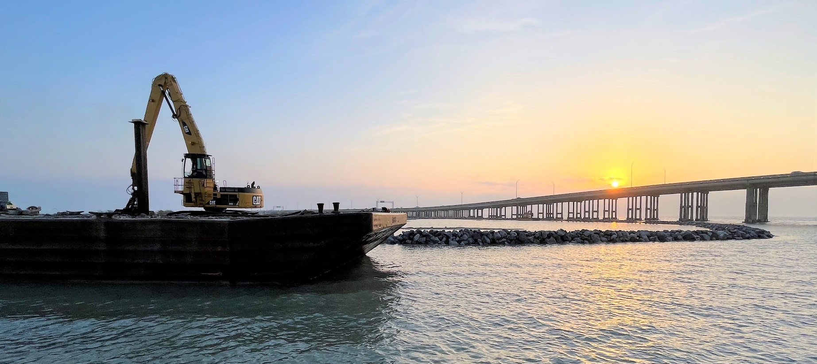
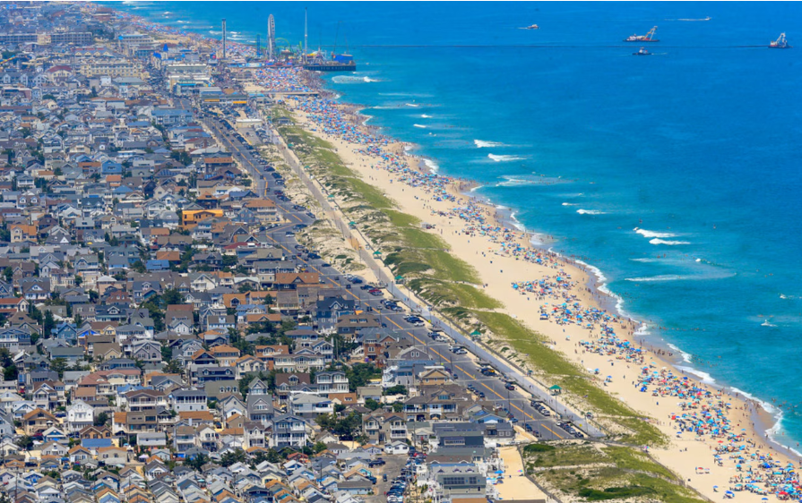
Strategic Realignment and Managed Retreat:
Effective Use of Adaptation Tools
NJ.com
Nick Brown, Ph.D., CFM
NJCRC Coastal Flooding Workshop
3/19/2025

Slide 3

What is Resilience?
Resilience:
  Capacity for people, buildings, and infrastructure to endure, rapidly respond, and prosper despite impacts from shocks and stress
4 R’s of Resilience
  Robustness
  Redundancy
  Resourcefulness
  Rapidity

Slide 4
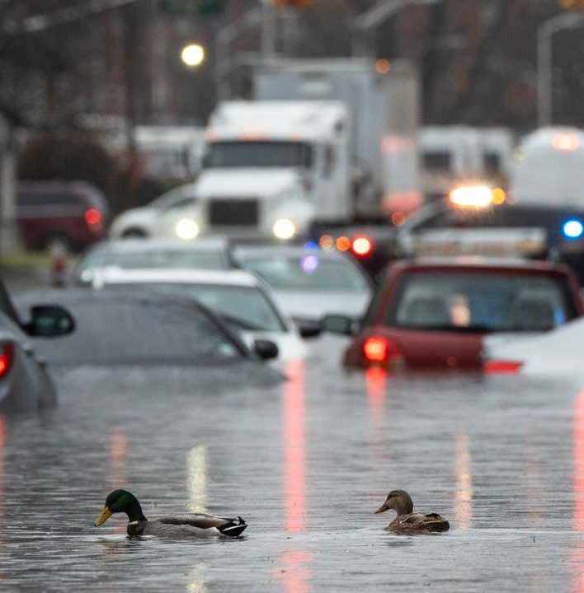
Threats
NJ.com
Sea level rise
  Relative SLR
Increased storm intensity and frequency
Intense rainfall events
Increased flooding further inland
Development
Erosion…
Notes:
Storm intensity – wind speeds, surge in tidally influenced areas
Overtone – the data shows this is happening.

Slide 5
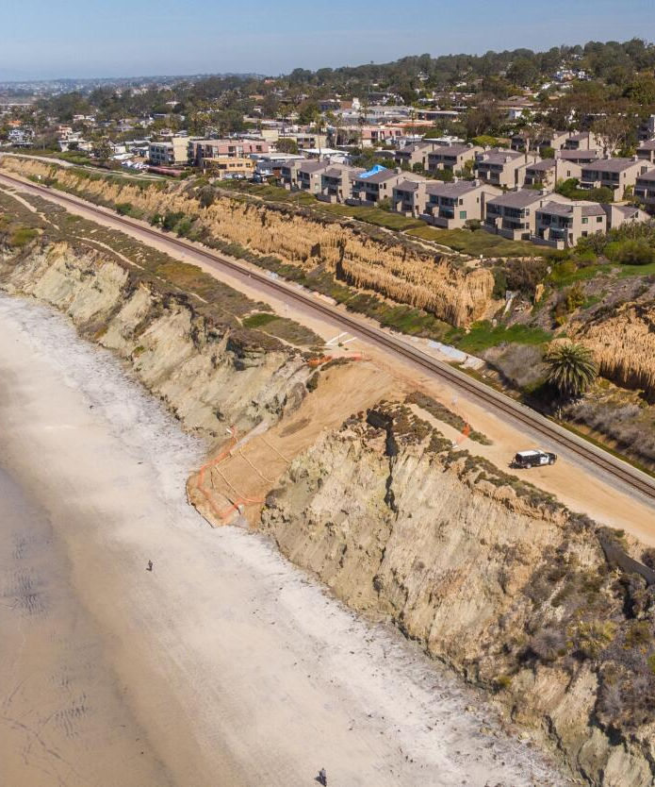
Erosion
NJ.com
LA Times
Compounding issues driving erosion
  Stabilized dynamic systems
    Limited room (if any) for migration
  Limited sediment supply/Interruption of natural sources
    Dams, seawalls, etc.
  RSLR
  Storm impacts
  Subsidence
Notes:
Storm intensity – wind speeds, surge in tidally influenced areas
Overtone – the data shows this is happening.

Slide 6
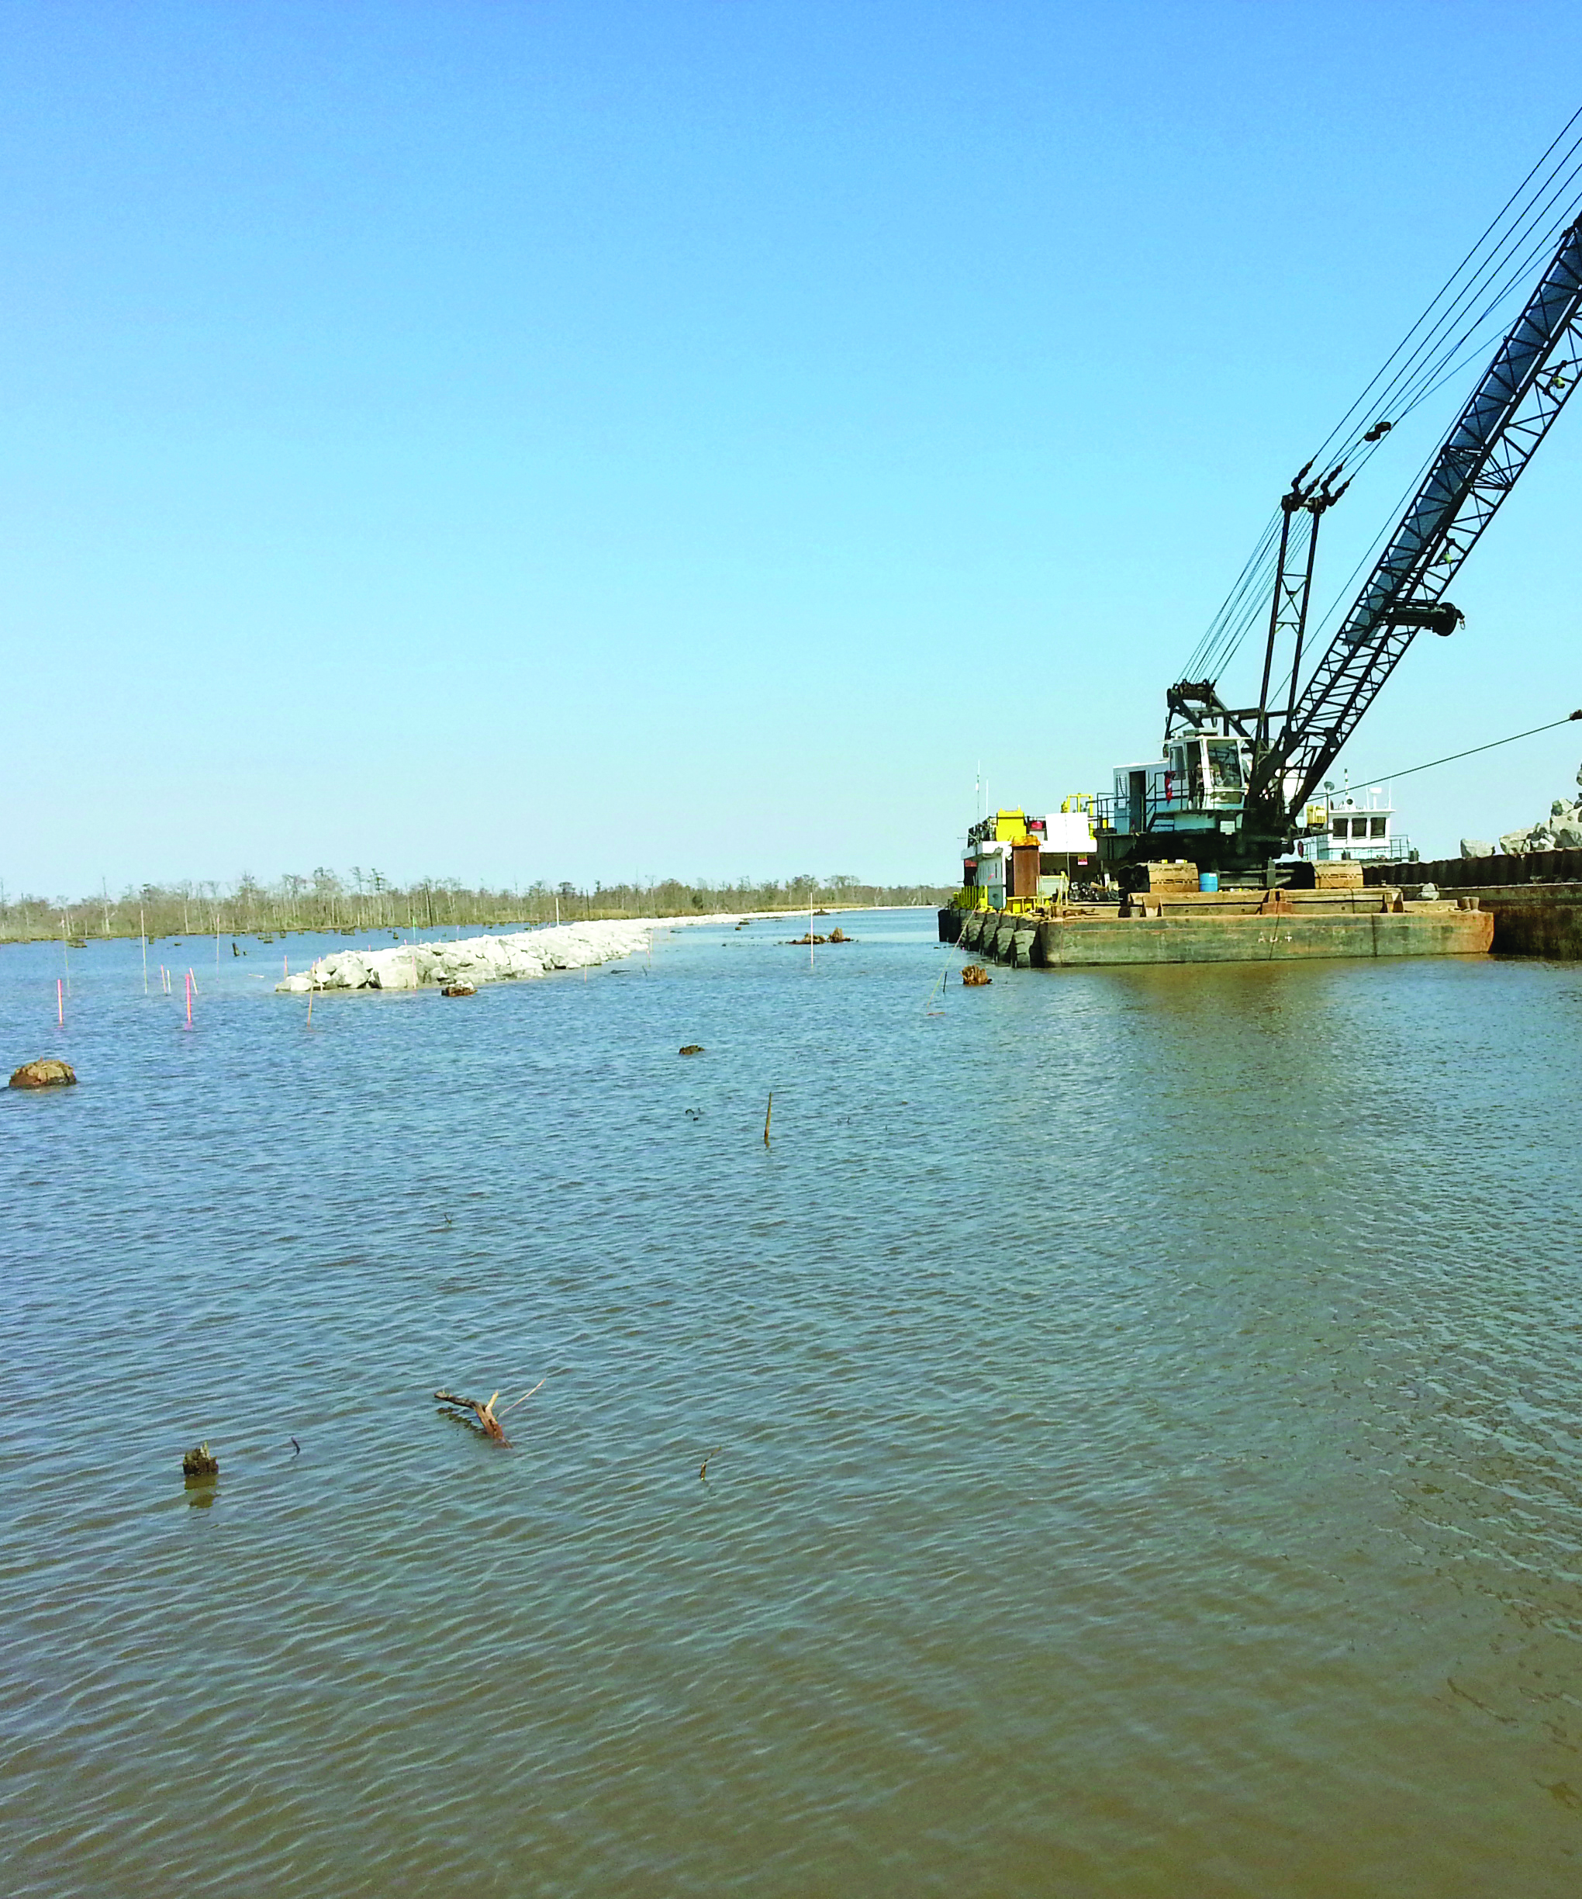
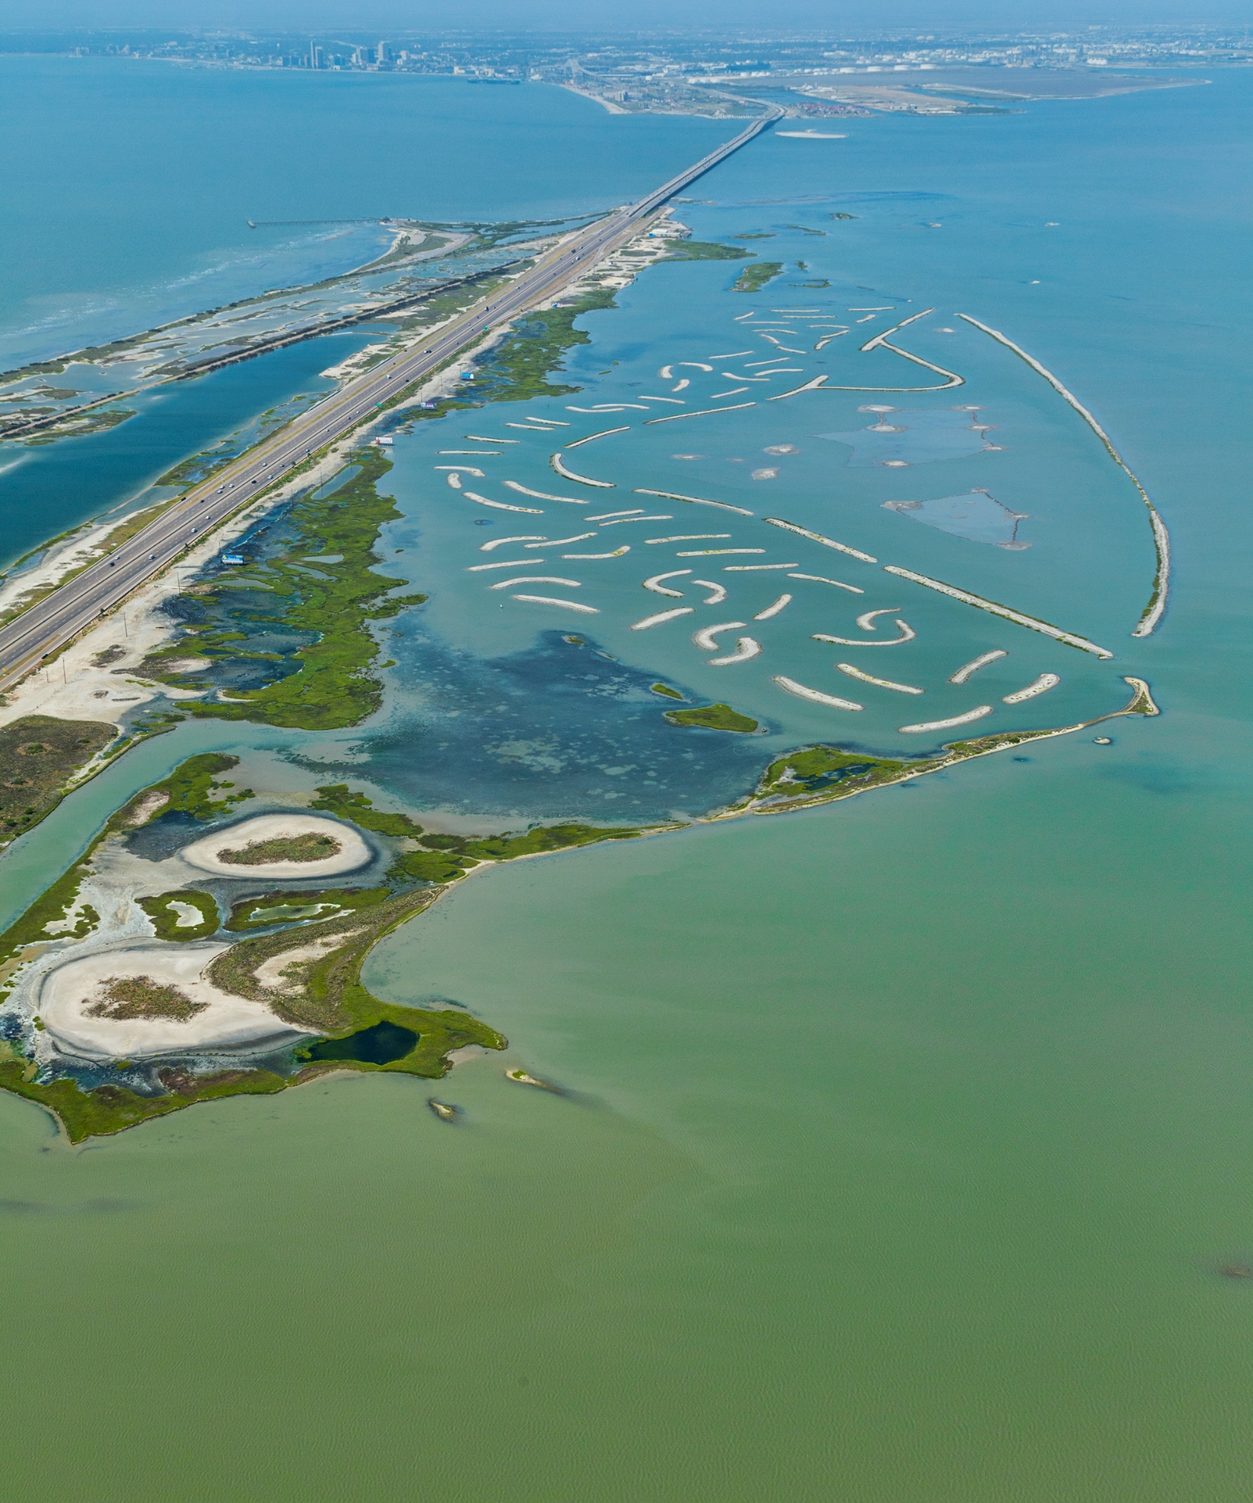
Potential Responses to Threats
Portland Causeway Marsh Restoration
Hard solutions:
  Seawalls, revetments, breakwaters, levees
Soft solutions:
  Beach nourishment, marsh restoration, reef restoration
Non-structural solutions:
  Elevating structures, relocating structures, flood proofing, land use regulations, managed retreat
Lake Pontchartrain Shoreline Protection

Slide 7
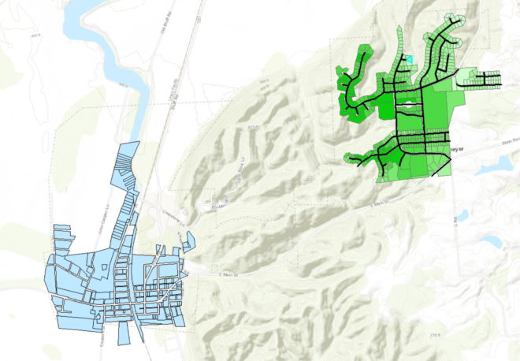
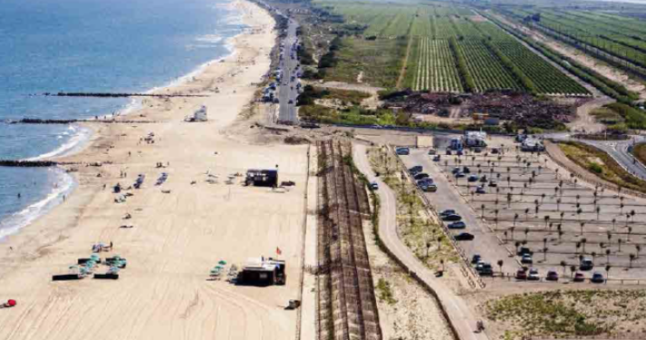
Non-structural solutions aka planning solutions
Managed retreat
  The long-term plan for a community to move when economic viability cannot be maintained or restored
  Retreating from the coast/hazard area
  Large scale buyouts/migration
    Valmeyer, IL
    Princeville NC
“Strategic realignment”
  The short- and mid-term plan for a community to absorb and resist climate threats while remaining economically viable
  Relocating structures
  Land use regulations
  Redrawing our waterlines
Notes:
Managed retreat was first used by coastal engineers in the early 1990s, but the earliest well-documented wholesale flood relocation occurred in Nebraska in 1881

Slide 8
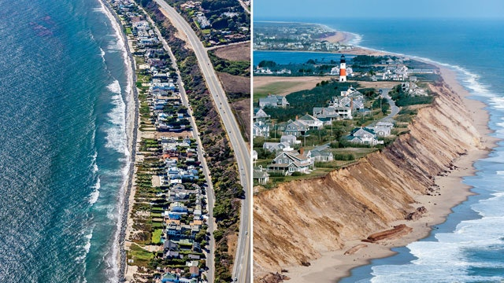
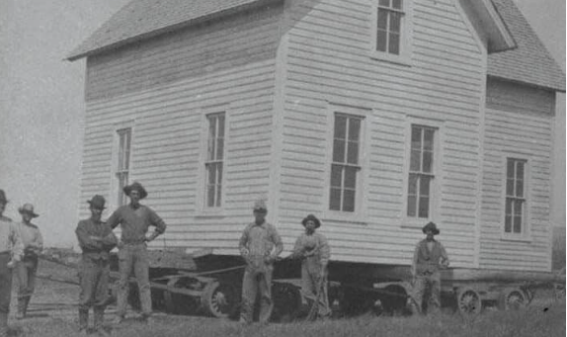
Managed retreat
Term first used by coastal engineers in 1990s, however has been practiced for decades
The earliest well-documented wholesale flood relocation occurred in Nebraska in 1881-82.
Recognized by IPCC as a solution to global SLR
However, often
  has a negative connotation
  is politically charged
History Nebraska

Slide 9
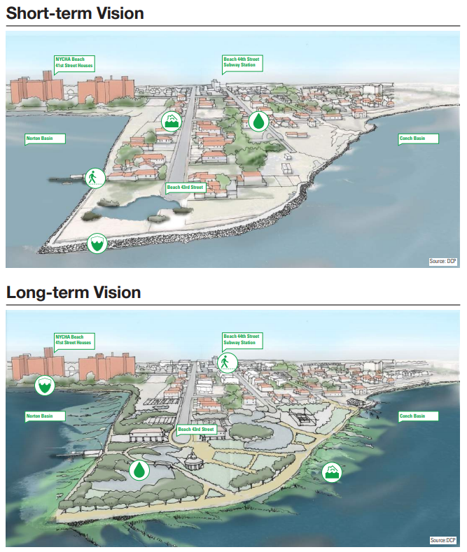
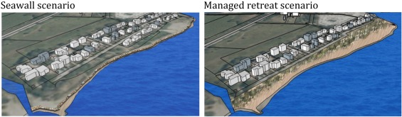
“Rebranding”…
Strategic realignment
Described as a method of planned shoreline change to maintain a community's presence
  Less drastic and sudden
  Focuses on maintaining the culture and community present
Allows for a new line of defenses with more space for threat or impact dissipation
Less costly than structural stabilization
Georgetown Climate Center
Current shoreline Long-term shoreline
Adapted from Rulleau and Rey-Valette, 2017
Notes:
Managed realignment
Adaptive relocation
Resilient relocation
Transformational adaptation

Slide 10
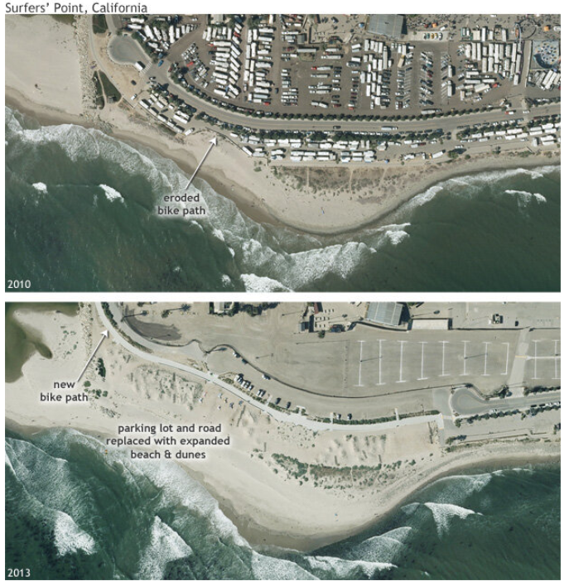
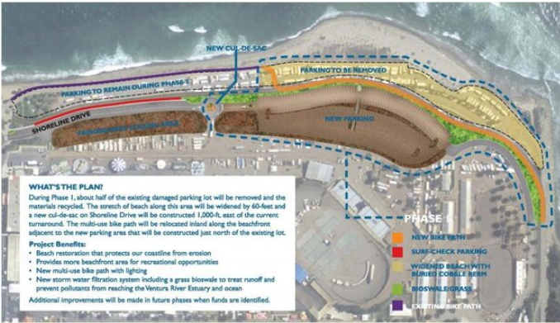
Strategic Realignment
NOAA
Case Study: Pacifica State Beach
Long battle with chronic erosion and flooding of oceanfront homes and shops
After planning, it was determined that armoring was not the ideal solution
A decision was made to realign the shoreline to allow for natural processes to occur
Since removal of developed area, erosion is no longer a threat to infrastructure inland

Slide 11
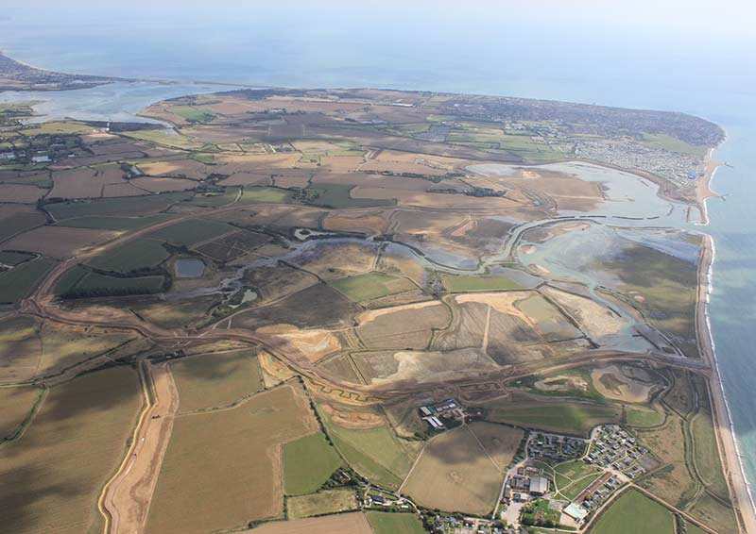

Strategic Realignment
Case Study: Sussex, UK
“Managed realignment” was employed to provide flood protection to the region which experienced flood hazards
Previous protection was a 2-mile bank that was frequently breached and required maintenance seasonally
Actively used land was restored to tidal marsh and flood plains, reducing flooding
Estimated $90M direct economic benefit is expected from the project
England Environmental Agency

Slide 12
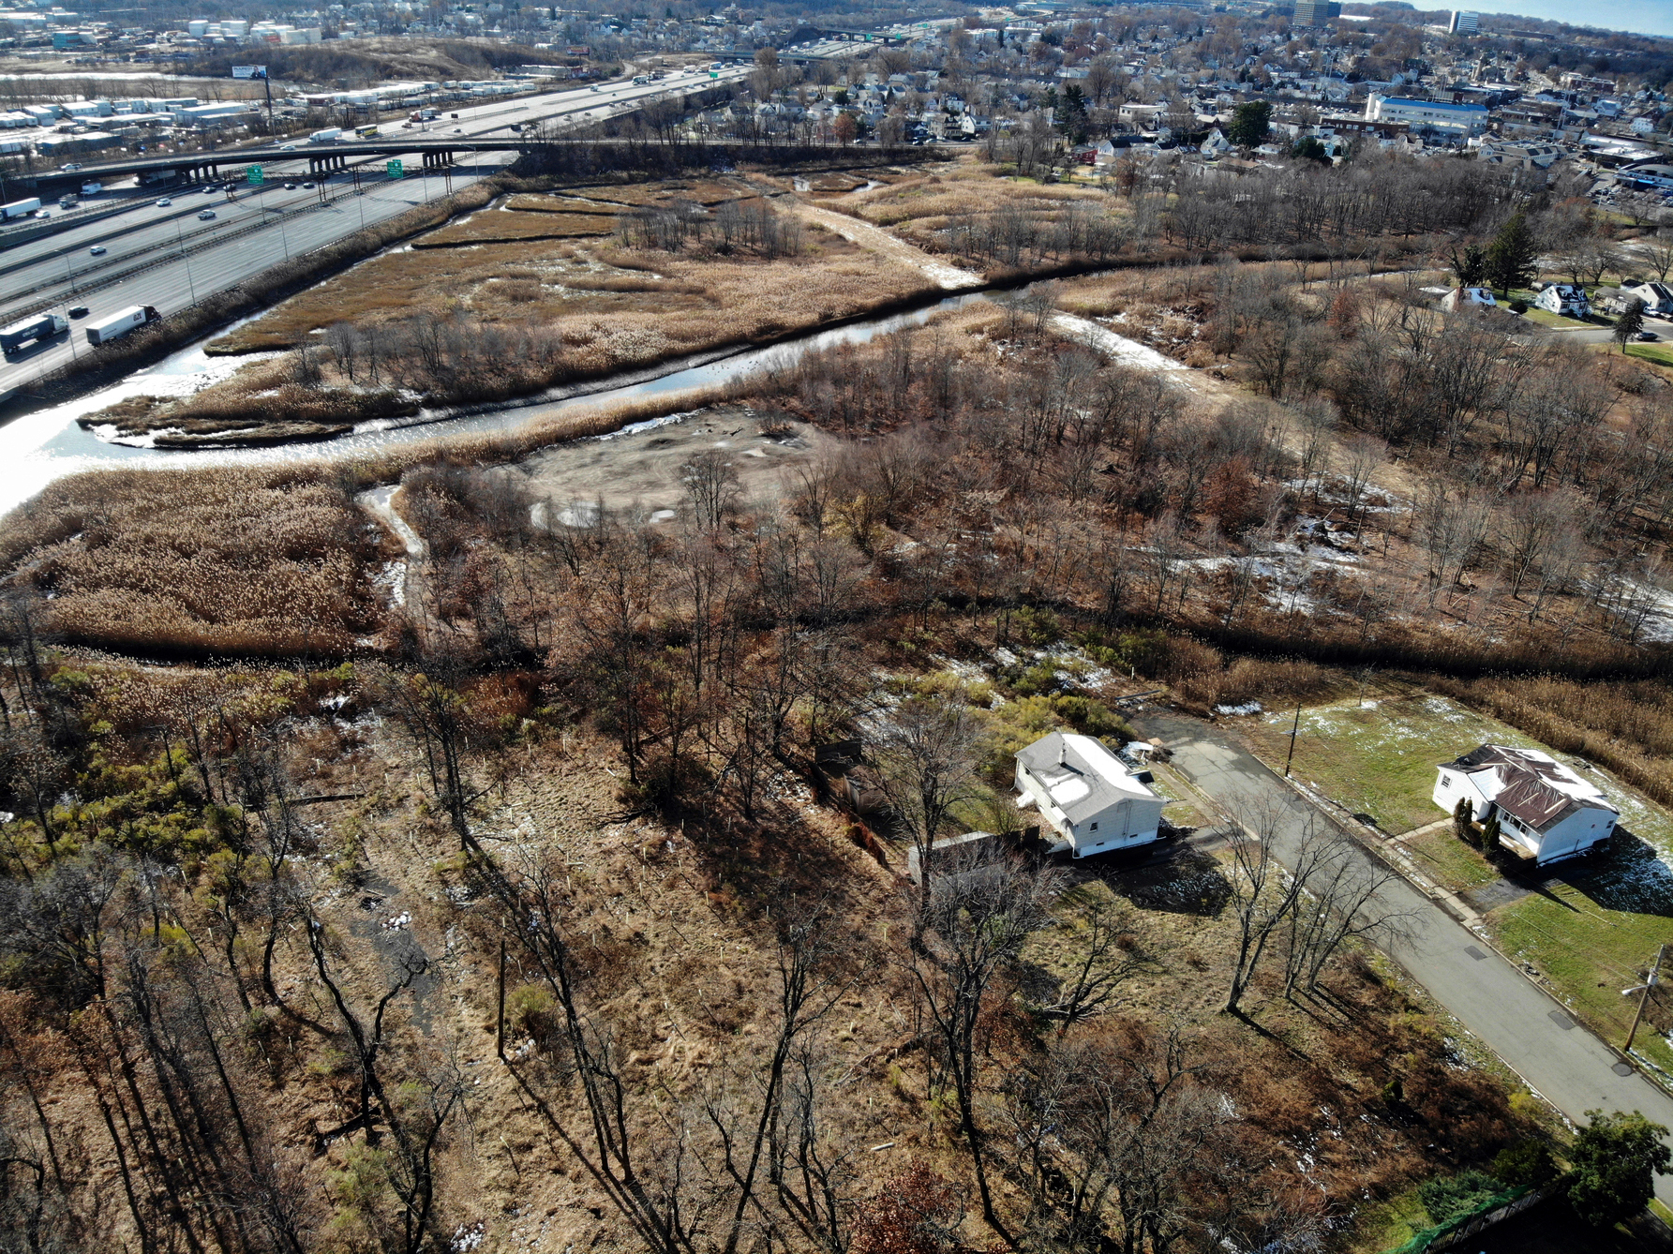
Managed Retreat
Case Study: Woodbridge, NJ
Goal: to remove people and property from the danger of future floods and allow flood plains to act as they naturally should
NJ officials worked with community members through the Blue Acres program
165 homes were purchased and removed
AP Photo

Slide 13

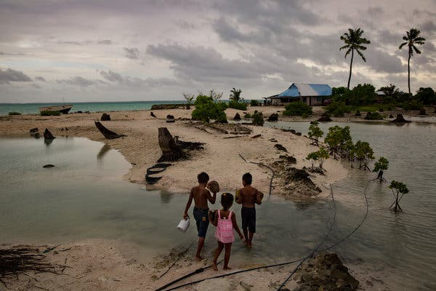
Managed Retreat
Case Study: Kiribati
Small island in the Pacific Ocean and is disappearing as sea level rises.
In 2014, leaders of Kiribati purchased 5,000 acres in Fiji
  Initially for agricultural, long-term to resettle on.
  “Migration with Dignity”
Some islands in the country are already uninhabitable
Current leaders do not want to leave and plan to adapt and defend for as long as possible
NY Times

Slide 14
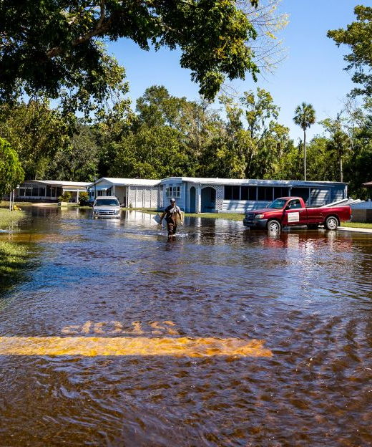
Social Impacts of Migration
Loss of community
  Missing sense of place/self identity
Health impacts
  Physiological stressors
Cultural heritage
  Landmarks, stories, cultural expressions
Resistance
  People enjoy close access to the water/coast
  Government distrust
Can further marginalize communities
CNN

Slide 15
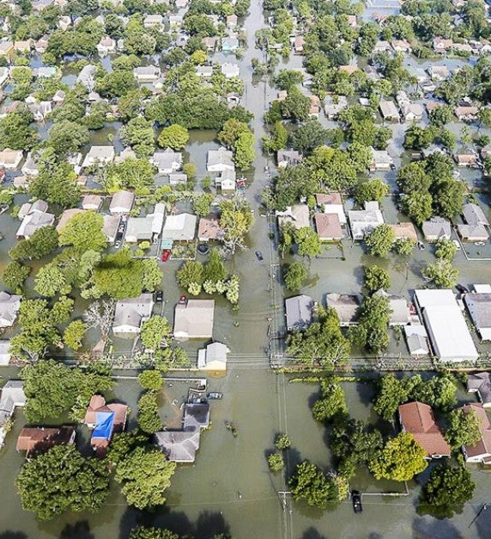
Social Justice Implications of Migration
Decisions are often based on Cost-Benefit Analysis
  Disproportionate effect on low-income communities
  Exacerbates historic inequalities unless concerted efforts are made to address inequality
Conversely, communities with funding and more representation are often favored in relocation, leaving vulnerable communities in the floodplain.
Miami Herald

Slide 16


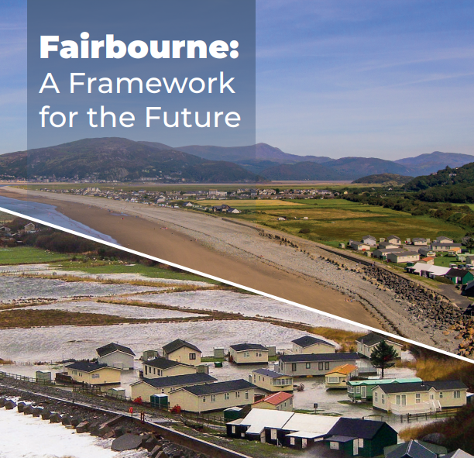
Importance of Planning
Short-, Mid-, and Long-term planning is critical to a community’s success
  Preservation of lives, livelihoods, and lifestyles
  Capital planning
Planning with the community is critical to buy-in and participation
Engaging professional planners and community specialists can increase the likelihood for success

Slide 17





Conclusions
Strategic realignment and managed retreat are valuable tools in the toolbox.
Plan now.
Decisions are generally made by CBA, however, the social aspect is critical to community health
Promoting short- and long-term adaptation and equity in floodplains requires a conscious effort to address social justice.

Slide 18
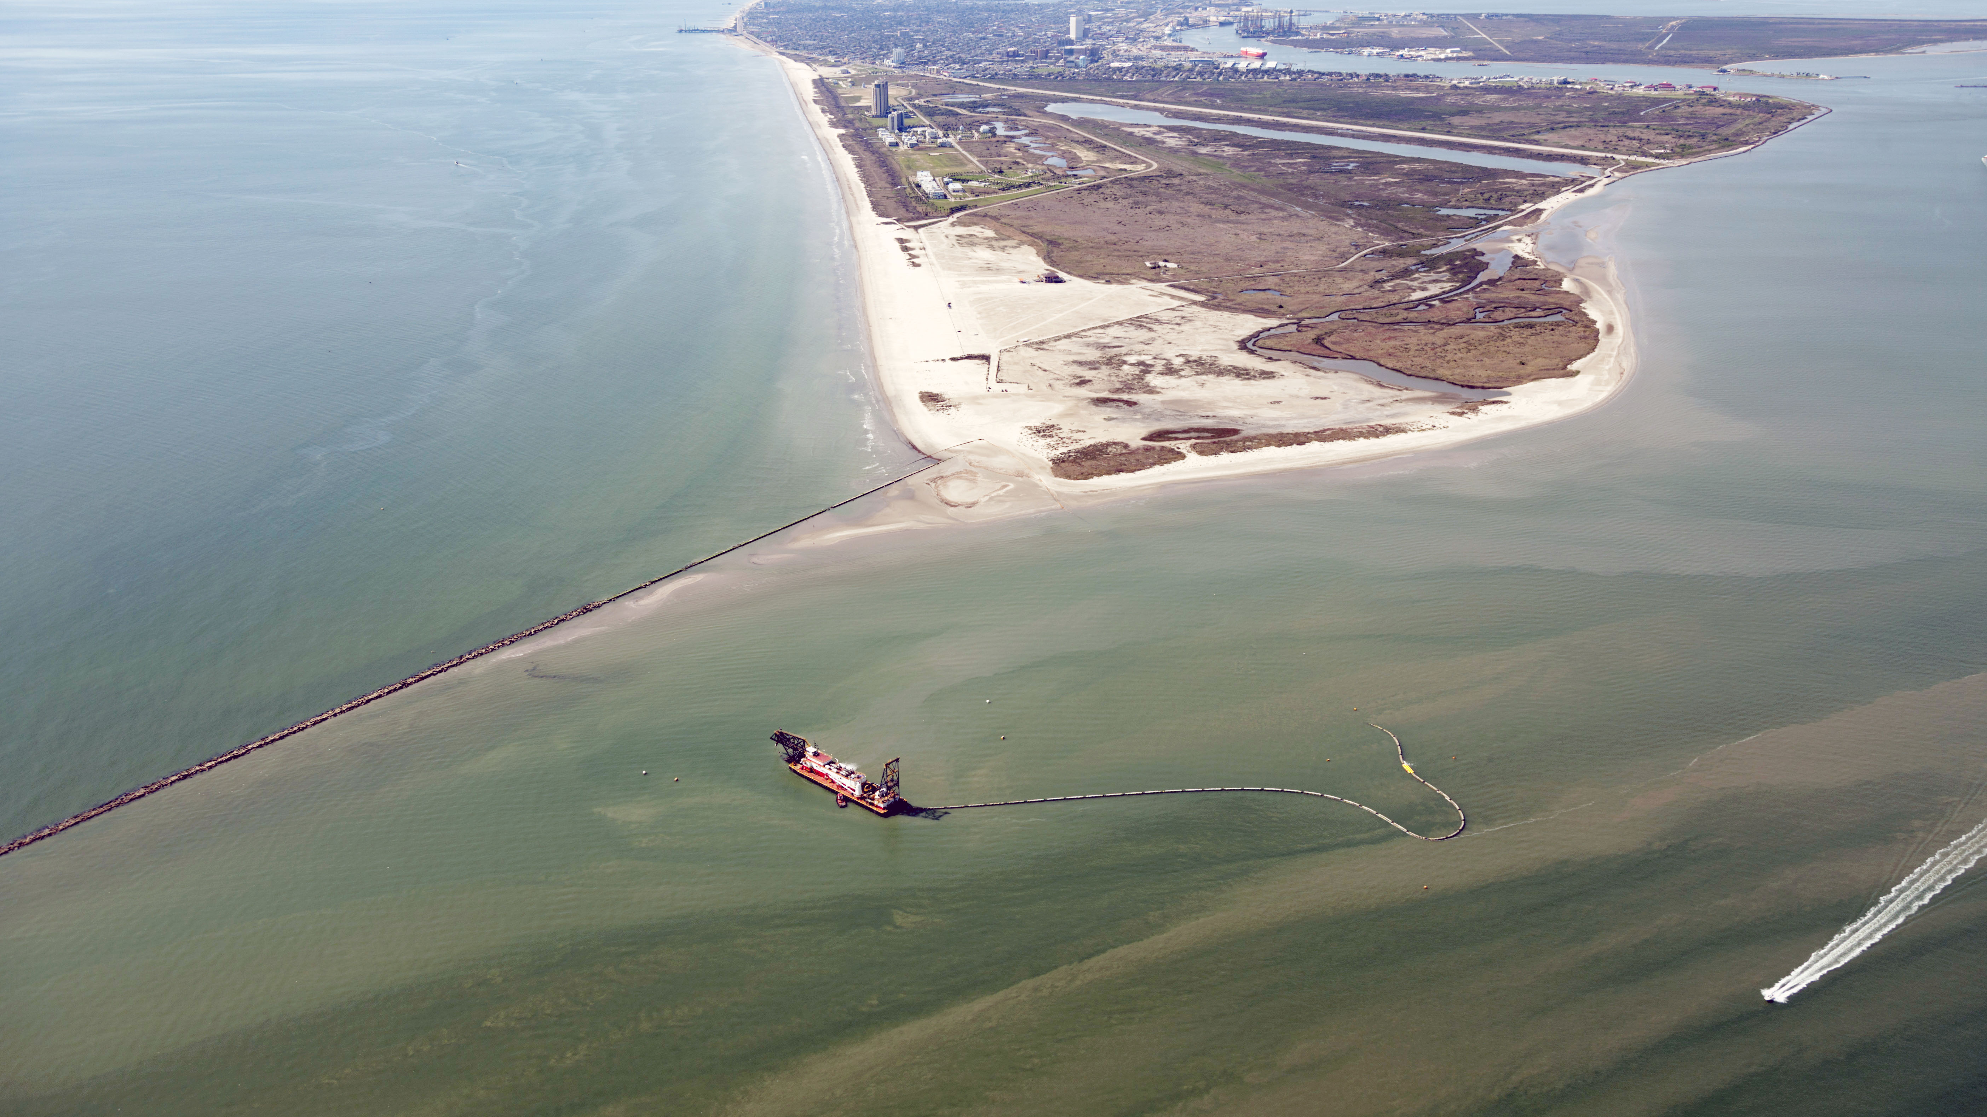
Questions?
Contact: Nick.Brown@HDRinc.com
10/23/2024

