Slide 1
NJ PACT REAL at the Local Level
March 19, 2025

Slide 2
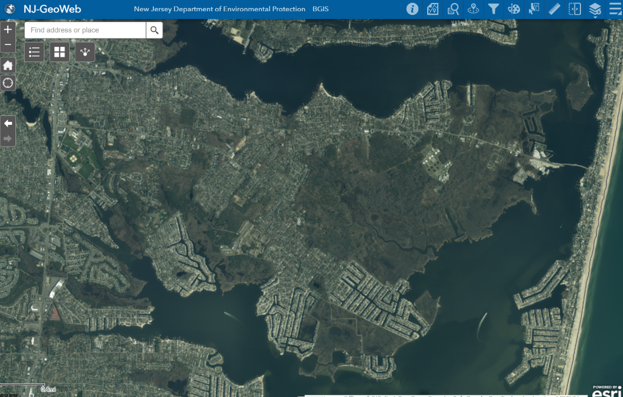
The 08723
NJ PACT REAL at the Local Level
October 24, 2024
Notes:
Brick is a large community. 32 square miles with 26 square miles of land and 6 square miles of waterfront. Floodplain management for me has largely been limited to tidally influenced flood zones, as Brick is a coastal community. We have 103 miles of waterfront at mean tide. This is one area of southern Brick (the 08723), but is fairly representative of our flood zones. I tried to keep the area the same in all of the slides for this part.

Slide 3
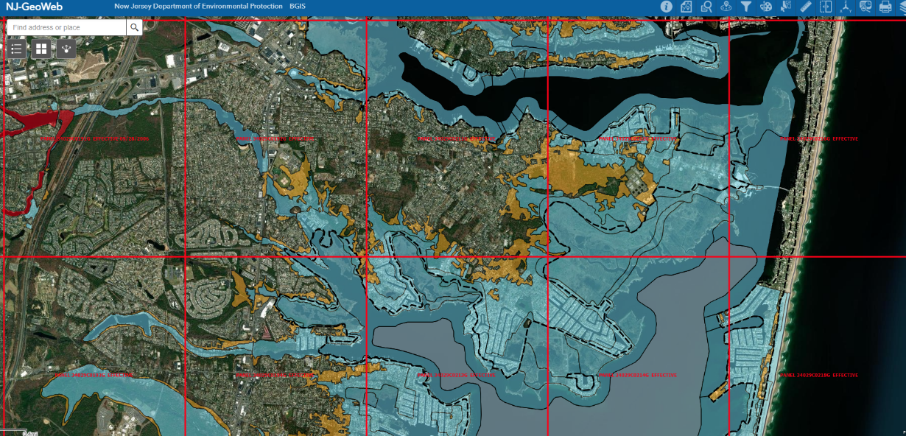
Notes:
While we do have some riverine flood hazard areas: however, since Sandy, the majority of our redevelopment has been in the NFIP’s tidally influenced special flood hazard area. Everything that you see here in blue is flood zone and is regulated by the National Flood Insurance Program. FEMA flood elevations generally are delineated by topography. For example if the lowest flood elevation in this area is “7”, so then the flood zone generally stops where the ground elevation is 7.
We have a very diverse group of professionals here and I don’t want to either overwhelm or bore anyone with the weeds and specifics of the requirements for construction in the flood zone, but let’s just say there are special permitting and construction requirements inside the blue line, that you wouldn’t have to do outside of the blue line.

Slide 4
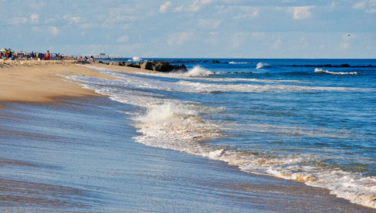
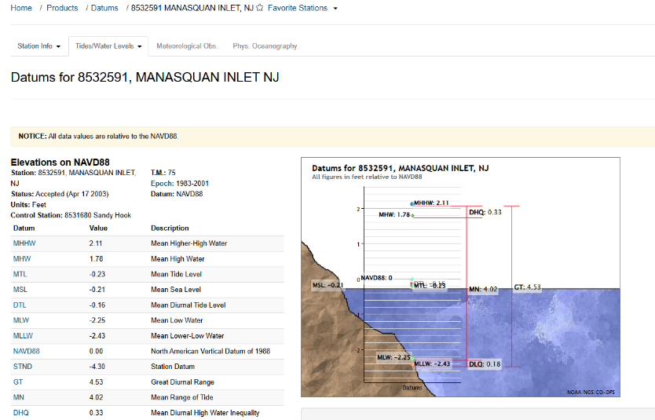
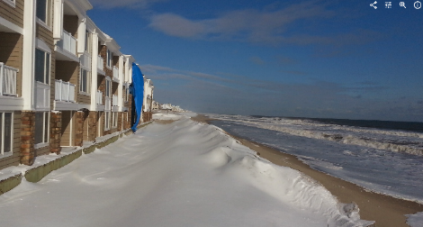
Mean High Higher Water usually the evening tide….
Notes:
The REAL PACT regulations are based upon 5-feet of sea level rise. We create the Inundation Risk Zone by anticipating the 5-feet of sea level rise. To start, we go to NOAA and look at some gage data to show our MHHW in Brick . You are actually supposed to either collect gauge data and interpolate between available gauges over a year to determine the MHHW…. For simplicity, for today we are going to say our MHHW elevation in Brick is completely uniform, and it is about elevation 2.2, everywhere. So we are adding 5-feet to the MHHW and calculating the FUTURE MHHW is roughly elevation 7.2.
And in Brick, for today, for simplicity, we are calling it a uniform elevation of 7.2 – Everywhere.

Slide 5
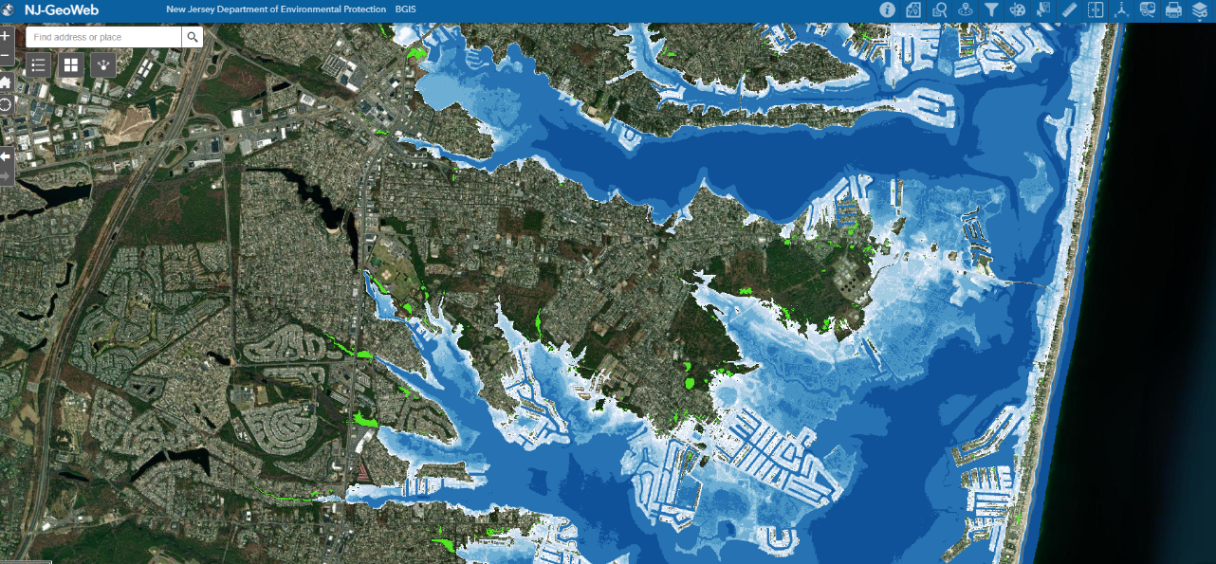
NJ PACT REAL at the Local Level
October 24, 2024
Notes:
We are calling all of the land underneath of it the INNUNDATION RISK ZONE. IRZ. So, it is an elevation and it’s a zone. The
MHHW + 5 feet = IRZ
So you can’t actually see the IRZ on a map yet. The DEP has indicated that a map will provided, but for now, I am using the mapping layer of Sea Level + 5-feet from the NJ GeoWeb to estimate the IRZ.

Slide 6
Notes:
If we overlap the IRZ onto the Preliminary Flood Maps that we enforce today, the areas are almost congruent. (which really makes sense, because our lowest flood elevation is 7 and we are assuming elevation 7.2 for the IRZ.) So if you are mapped in the special flood hazard area today, you will likely be in the IRZ under the Proposed Rules.

Slide 7
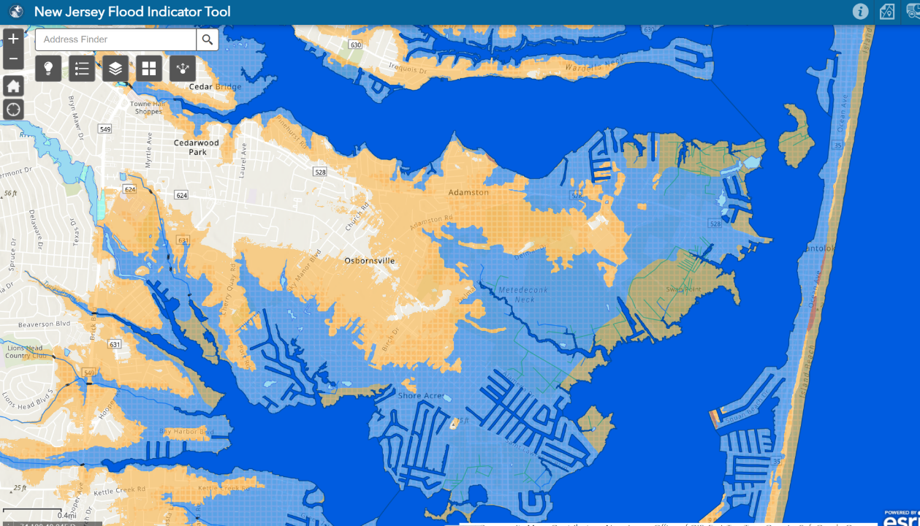
NJ PACT REAL at the Local Level
October 24, 2024
Notes:
The Climate Adjusted Flood Elevation, or CAFÉ, which will be the new special flood hazard areas, are delineated by adding 5-feet to either the (Preliminary) FEMA Base Flood Elevation or the IRZ elevation in your site. So, the CAFÉ is the also an elevation and it a zone.

Slide 8
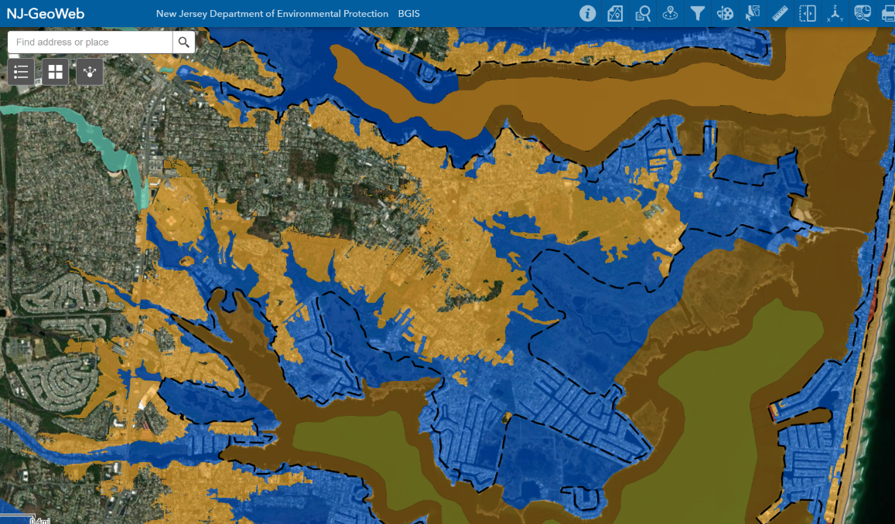
NJ PACT REAL at the Local Level
October 24, 2024
Notes:
Once you determine your elevation and plot it on a map, all of the areas underneath that elevation will be regulated as special flood hazard areas. For simplicity today, in Brick, we are using elevation 12. Everyone that exists under elevation 12 is in a CAFÉ and will be regulated as being in a special flood hazard area.
So the orange areas of this map will be the NEWLY regulated flood zones. There are a few thousand structures here, so the first thing that would change for me is the number of people that I need to regulate, and the volume of records I have to keep. Regulation of more area requires more resources. Bu that is ok, because that’s my job.
Next I want to get into some areas that I have specific concerns about the Proposal .

Slide 9
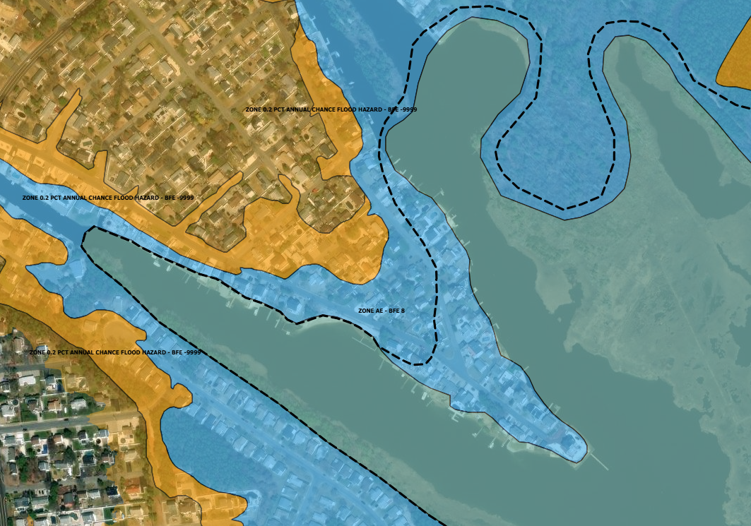
CAFE = MHHW + 5-Feet + Feet
CAFÉ = ?????
CAFE = FEMA Base Flood + 5-feet
CAFE = 13-feet
Notes:
The DEP is NOT providing a new Flood Map with elevations, just a general location of the CAFÉ Area. So, If you are located in an area that is Mapped as a Special Flood Hazard Area now, I can calculate you what your CAFÉ Elevation will be and advise you on how to proceed with your application. If you are newly mapped into the flood zone as a result of incorporation of the CAFÉ, you have to calculate your own. You have to have a professional interpret the MHHW Elevation at your location and you’ll have to submit to the DEP for a verification of your CAFÉ .
If you establish your climate adjusted flood elevation through verification, you will not qualify for permits by registration or general permits by certification.
Anything that is regulated with a verification of flood zone elevation, must get a general permit or an individual permit, depending on the activity.
[Here (point to blue) I can take your base flood elevation of 8 and add 5-feet. Easy peesy. There (point to Orange) you are on your own to calculate the CAFÉ and have it verified.]

Slide 10
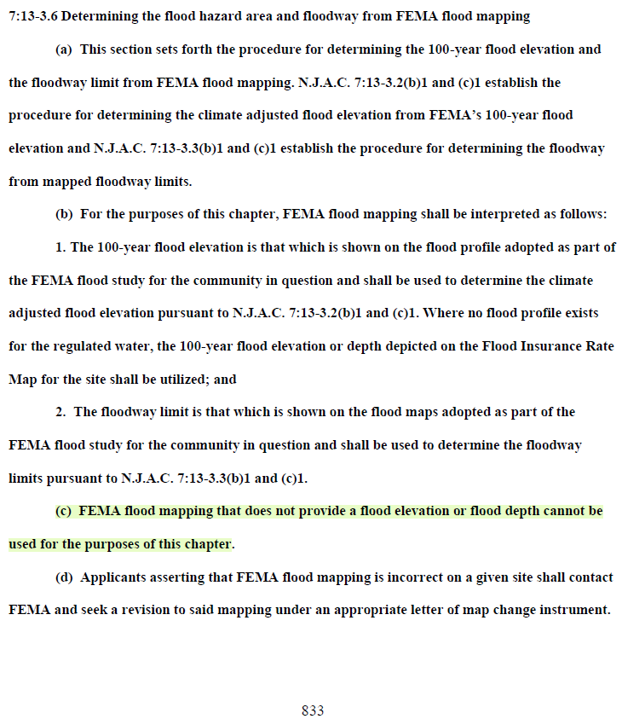
CAFE = MHHW + 5-Feet + Feet
CAFÉ = ?????
CAFE = FEMA Base Flood + 5-feet
CAFE = 13-feet
Notes:
Don’t believe me? The DEP didn’t either. Until I pointed it out to them…the rules specifically state that you cannot use FEMA mapping if an elevation is not provided for your project site ….
This does not make sense to me....

Slide 11
CAFE = MHHW + 5-Feet + Feet
CAFÉ = ?????
Permits by Registration
Gazebos
Pavilions
Sheds
Fences
Pools
Demolition & Home Reconstruction
Home Additions
Adding a generator
Adding Air Conditioning
CAFE = FEMA Base Flood + 5-feet
CAFE = 13-feet
Notes:
Things like fences, sheds and pools will now require a permit by registration. If you bought a house right on the water, you can just register for a flood hazard area approval, but if you are located hundreds of feet from the water, they you are to apply to DEP for a CAFÉ elevation verification and then apply for a general permit. Permit by registration is FREE! General Permits and CAFÉ verifications come with associated application fees in the thousands of dollars, plus, you have to pay a professional to prepare your application.
[This guy (point to house at tip) can demolish and reconstruct his home in a new footprint and add additional square footage just by registering online. That guy (point to Orange) needs a verification and a general permit to install a new AC condenser and gets hit with permit application fees and the cost of preparing an application by a professional.]
These are my people. They not only pay my salary but they shape my community. I care about these people. They are the residents of Brick Township and I want to keep them all safe, but this arrangement does not sit well with me.

Slide 12
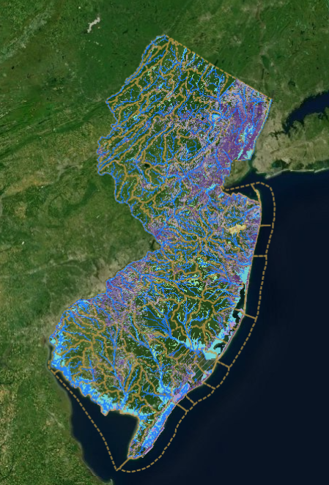
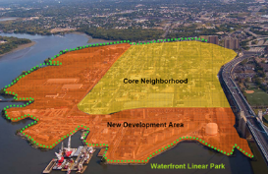
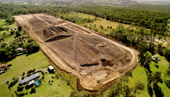
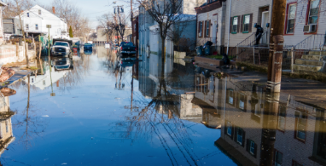
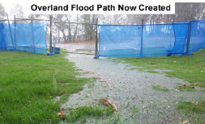
Notes:
This regulation of unmapped areas isn’t terribly new, but, we as a State ,are really failing on mapping and flood studies.
The state does not invest in mapping our water courses or studying of our rivers and stream corridors. We rely on developers to study our floodplains and those studies are often compiled with the focus of one particular piece of property within a watershed. There is potential for the data and the resulting study to be skewed.
Once the data is compiled, reviewed by the state and accepted for development permitting, it doesn’t get incorporated into any state mapping that other citizens in the watershed can benefit from.

Slide 13
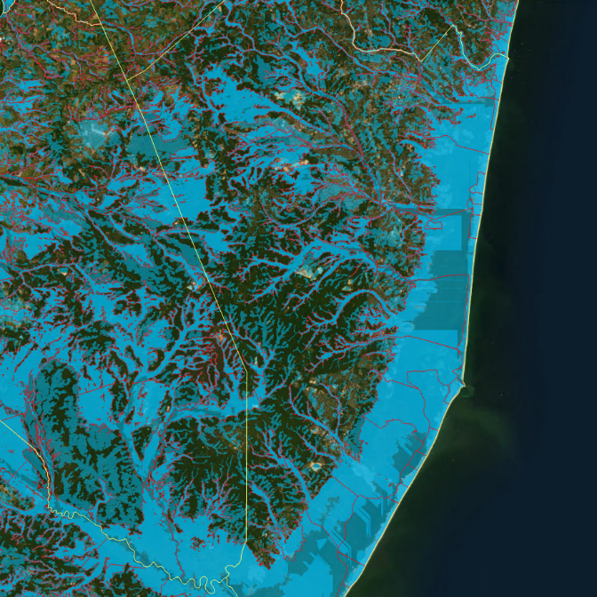
Regulated Waters under the NJ Flood Hazard Area Control Act
7:13
Ocean County, New Jersey
Base Level Engineering
Notes:
Why can’t the State of New Jersey invest in stream studies and mapping. If we want to keep or residents safe, if our communities are worthy of regulating, they are worth the investment of mapping.
NJAFM estimates that almost 48% of the state is regulated under 7:13 The Flood Hazard Control Act Rules. (This Base Level Engineering Map was made by Mr. Chris Crane, the current NJAFM chair, and it uses the approximation method.)
The areas outlined in red represent the FEMA and State Studies with the addition of 2 or 3 feet to represent the NJFHADFE (New Jersey Flood Hazard Area Design Flood Elevation) for fluvial flooding. This layer was prepared by Rutgers University.
The remaining blue areas represent unstudied streams with drainage areas of 50 acres or larger. These streams are not studied and the floodplain has been approximated based on the Approximation Method outlined in NJAC7:13.
This clip is just Ocean County, but Mr. Crane mapped the entire state. NJ is roughly 7,425 square miles of land area, 30.4% is within a mapped floodplain based on the Rutgers layer. In actuality the DEP regulates around 47.8% of the state when accounting for 50 acre drainage areas using approximation. That is approximately 57% more flood hazard area than is currently mapped. Homeowners, developers, investors, municipalities, and even the state would benefit from knowing if they are potentially in a regulated area.
Our communities are worthy of the mapping investment.

Slide 14
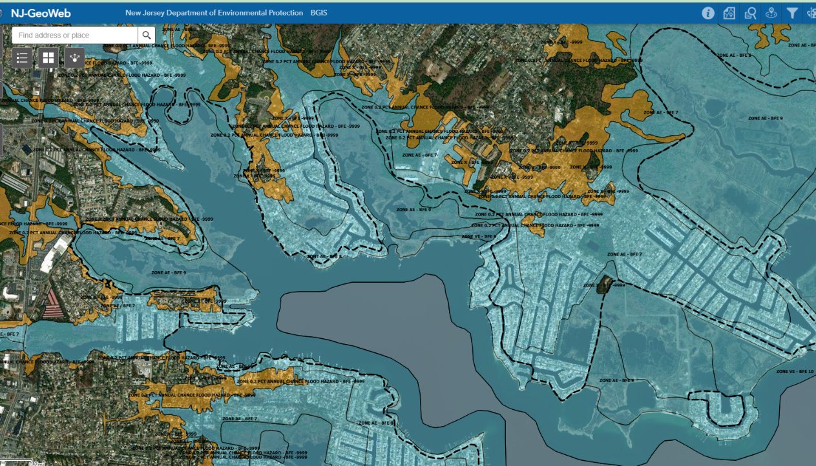
NJ PACT REAL at the Local Level
October 24, 2024
Notes:
Another concern I have in the regulations is the lack of action with respect to the limit of wave action. The heavy dashed line on this FEMA flood map is the limit of moderate wave action. If your building is on the waterward side of the heavy dashed black line, you are to construct your structure on piles to protect it from wave action and prevent building collapse. So let’s just call the heavy dashed line, the piling line.

Slide 15
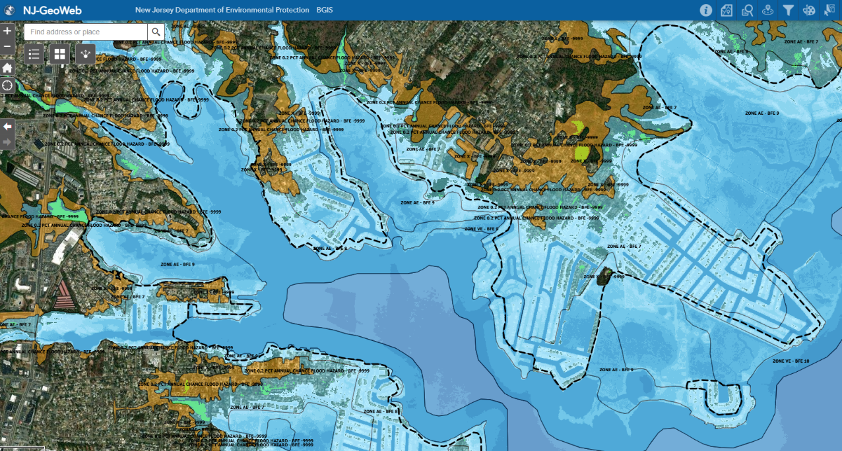
NJ PACT REAL at the Local Level
October 24, 2024
Notes:
When you overlay the IRZ onto the same area, you see the areas that these regulations anticipate The IRZ, our entire flood zone being inundated with 0-5 feet of water, at least twice a day everyday. The anticipated daily high tide, absent of a storm, extends well beyond the current piling line. I am thinking that the entire IRZ should anticipate some wave action. Yet, there is nothing in the proposal to extend the requirements for piles into the IRZ.

Slide 16
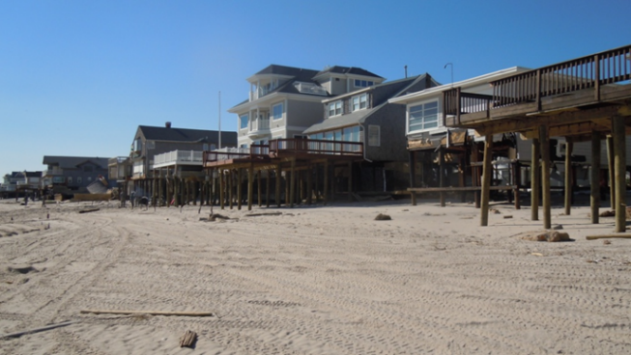
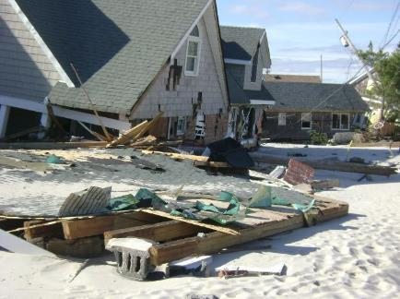
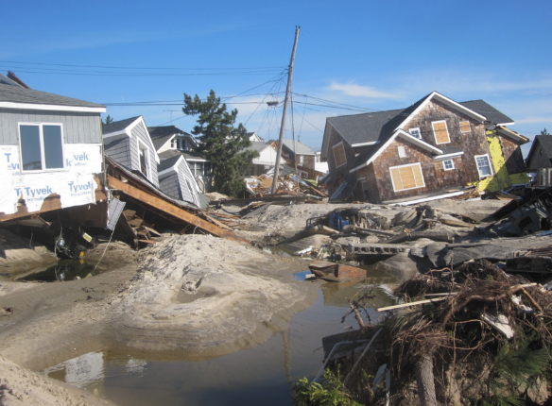
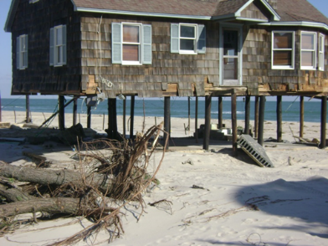
Notes:
We know pilings work well in wave action zones. but they will not be required.
Buildings will be higher, but they can still be on blocks. It's a higher, harder fall in the event of building collapse. So how safe are we keeping everyone?
This does not make sense. To be fair, in order to adjust the piling line, I am told that the Department would have to do a study…and they don’t want to that, as they are not funded to do it.

Slide 17
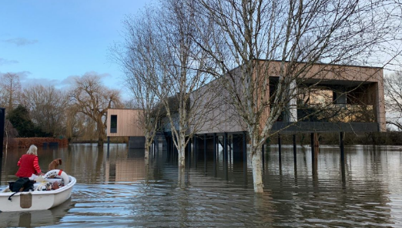
REAL proposal on Dry Floodproofing
7:13-12.5 (t) 2.
s)](t) The Department shall issue an individual permit to dry flood-proof a building under [(r)1](s) above only if the following requirements are satisfied:
The building is designed and constructed to meet the dry flood-proofing requirements of the Uniform Construction Code, N.J.A.C. 5:23, so as to prevent floodwaters from entering the building up to a flood depth of at least one foot above the [flood hazard area design]climate adjusted flood elevation;[.]
2. The building is not located within a flood hazard area where the flood velocity during the flood producing the climate adjusted flood elevation is greater than five feet per second or unknown, or in an inundation risk zone, Coastal A zone, V zone, or VE zone;
Elevation of a structure is dry floodproofing!
Notes:
But then again, I have a lot of questions about the IRZ. There is a section in the proposal that reads the Department will NOT issue a permit to dry floodproof in the IRZ, Coast A or V Zones.
Elevation is dry floodproofing.
Elevating, the only option available to floodproof a dwelling, and it is still considered dry flood proofing.
I questioned the DEP on this restriction of dry-floodproofing in the IRZ, and they indicated that it only will apply to “watertight” dry floodproofing, only; NOT elevation…But that is not what the proposal reads, so if not addressed or corrected in the proposal, it will be up to the interpretation of the reviewing agent.
At worst, this condition could be used to deny any application for a structure (other than parking, storage or marine garages) in the IRZ.
At best, it limits the development within these area to residential construction only.

Slide 18
NJ PACT REAL at the Local Level
October 24, 2024
Notes:
Section 7:13-12.5 S and T speak about what you can do to dry flood proof a building through watertight construction…. However; it is not permitted in the IRZ…
So NO water-tight construction. So no new commercial or multifamily development in the IRZ.
So what are we allowed to build there, if anything? Strict interpretation of these rules would allow only garage, storage and limited marine structures with a variance in the IRZ…
Keep in mind, the IRZ is almost concurrent with our existing flood zones.
The authors of these regulations probably had very specific scenarios in mind when drafting these regs, but those folks will not be at the Department forever and the next generation of reviewing agents can interpret this to enforce “no build zones.”

Slide 19
NJ PACT REAL at the Local Level
October 24, 2024
Notes:
The IRZ is also a new “Special Area” under the CAFRA regs (7:7-9.50) - You need an individual permit from CAFRA to do any new build in this area unless you are a non-critical building and not a residential structure. There is an extensive list of requirements and proofs that you need to provide in order to get that IP, and additions to single-family homes are not excluded.
Also, as a special area, any new development within the special areas of IRZ (and the CAFE will be limited to 3% impervious cover. If you have an existing development, you can keep the impervious cover that you have, but new development would be capped at the 3%.

Slide 20
Impervious Cover
To the maximum extent practicable, the special areas regulated under N.J.A.C. 7:7- 9 listed at i-xvi below shall be excluded from, or shall be designated as a critical environmental site(s) within, Coastal Metropolitan Planning Areas, Coastal Suburban Planning Areas, CAFRA centers, CAFRA cores, or CAFRA nodes:
i. Dunes at N.J.A.C. 7:7-9.16;
ii. Overwash areas at N.J.A.C. 7:7-9.17;
iii. Coastal high hazard areas at N.J.A.C. 7:7-9.18;
iv. Bay islands at N.J.A.C. 7:7-9.21
v. Beaches at N.J.A.C. 7:7-9.22;
vi. Existing lagoon edges at N.J.A.C. 7:7-9.24;
viii. Flood hazard areas at N.J.A.C. 7:7-9.25;
ix. Riparian zones at N.J.A.C. 7:7-9.26;
x. Wetlands at N.J.A.C. 7:7-9.27;
xi. Coastal bluffs at N.J.A.C. 7:7-9.29;
xiii. Endangered or threatened wildlife or plant species habitats at N.J.A.C. 7:7-9.36;
xiii. Critical wildlife habitat at N.J.A.C. 7:7-9.37;
xiv. Special hazard areas at N.J.A.C. 7:7-9.39;
xv. Excluded Federal lands at N.J.A.C. 7:7-9.40; and
xvi. Inundation risk zones at N.J.A.C. 7:7-9.50;
Notes:
In fact anything in the flood hazard area, anything in the CAFÉ Area will be identified as a CRITICAL ENVIRONMENTAL SITE

Slide 21
Impervious Cover
To the maximum extent practicable, the special areas regulated under N.J.A.C. 7:7- 9 listed at i-xvi below shall be excluded from, or shall be designated as a critical environmental site(s) within, Coastal Metropolitan Planning Areas, Coastal Suburban Planning Areas, CAFRA centers, CAFRA cores, or CAFRA nodes:
i. Dunes at N.J.A.C. 7:7-9.16;
ii. Overwash areas at N.J.A.C. 7:7-9.17;
iii. Coastal high hazard areas at N.J.A.C. 7:7-9.18;
iv. Bay islands at N.J.A.C. 7:7-9.21
v. Beaches at N.J.A.C. 7:7-9.22;
vi. Existing lagoon edges at N.J.A.C. 7:7-9.24;
viii. Flood hazard areas at N.J.A.C. 7:7-9.25;
ix. Riparian zones at N.J.A.C. 7:7-9.26;
x. Wetlands at N.J.A.C. 7:7-9.27;
xi. Coastal bluffs at N.J.A.C. 7:7-9.29;
xiii. Endangered or threatened wildlife or plant species habitats at N.J.A.C. 7:7-9.36;
xiii. Critical wildlife habitat at N.J.A.C. 7:7-9.37;
xiv. Special hazard areas at N.J.A.C. 7:7-9.39;
xv. Excluded Federal lands at N.J.A.C. 7:7-9.40; and
xvi. Inundation risk zones at N.J.A.C. 7:7-9.50;
TABLE H
Percentages For Calculating Impervious Cover
Limits Under N.J.A.C. 7:7-13.17 Site Location Impervious Cover Percentage
CAFRA urban center 90 percent
CAFRA regional center 80 percent
[Coastal regional center]
CAFRA core
CAFRA node
CAFRA town
[Coastal town] 70 percent
Military installation
CAFRA village 60 percent
[Coastal village]
CAFRA hamlet 50 percent
[Coastal hamlet] Coastal Metropolitan Planning Area 80 percent
Coastal Suburban Planning Area, within a sewer service area 30 percent
Coastal Suburban Planning Area, outside a sewer service area 5 percent
Coastal Fringe Planning Area 5 percent
Coastal Rural Planning Area 3 percent
Coastal Environmentally Sensitive Planning Area
CAFRA critical environmental site 3 percent
Notes:
If you are a municipality regulated under the Coastal Area Facilities Review Act, The incorporation of flood zones and the IRZ, into the new critical areas will result in 3% maximum limitation on Impervious Cover…
So what can you build there? Maybe the answer is nothing much. Maybe that’s a good thing. Best way to keep people safe is to keep them out.

Slide 22
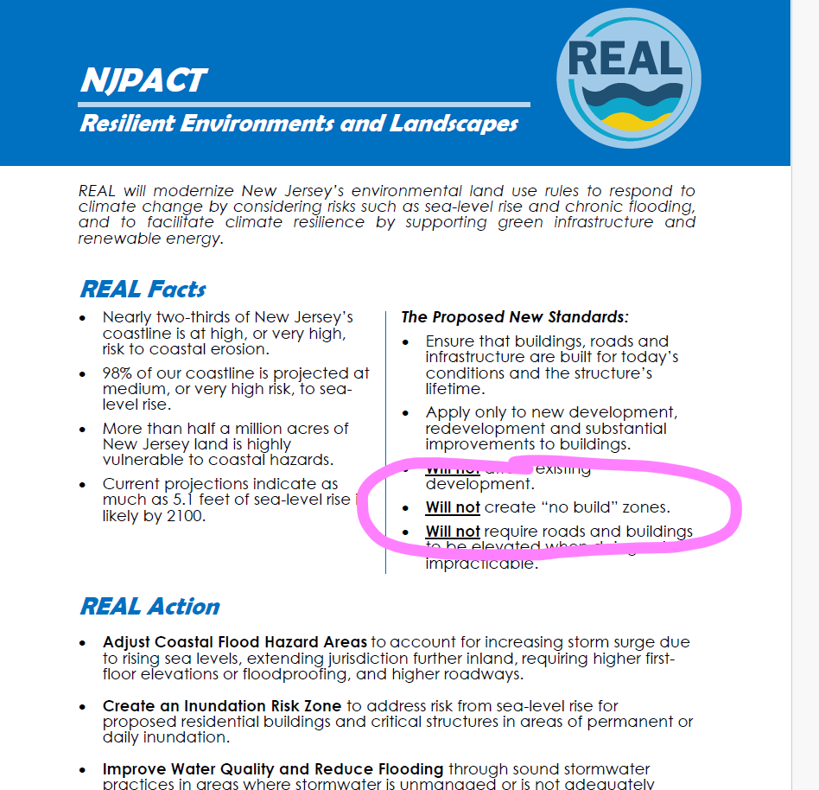
No Build Zones for Impervious Cover
To the maximum extent practicable, the special areas regulated under N.J.A.C. 7:7- 9 listed at i-xvi below shall be excluded from, or shall be designated as a critical environmental site(s) within, Coastal Metropolitan Planning Areas, Coastal Suburban Planning Areas, CAFRA centers, CAFRA cores, or CAFRA nodes:
i. Dunes at N.J.A.C. 7:7-9.16;
ii. Overwash areas at N.J.A.C. 7:7-9.17;
iii. Coastal high hazard areas at N.J.A.C. 7:7-9.18;
iv. Bay islands at N.J.A.C. 7:7-9.21
v. Beaches at N.J.A.C. 7:7-9.22;
vi. Existing lagoon edges at N.J.A.C. 7:7-9.24;
viii. Flood hazard areas at N.J.A.C. 7:7-9.25;
ix. Riparian zones at N.J.A.C. 7:7-9.26;
x. Wetlands at N.J.A.C. 7:7-9.27;
xi. Coastal bluffs at N.J.A.C. 7:7-9.29;
xiii. Endangered or threatened wildlife or plant species habitats at N.J.A.C. 7:7-9.36;
xiii. Critical wildlife habitat at N.J.A.C. 7:7-9.37;
xiv. Special hazard areas at N.J.A.C. 7:7-9.39;
xv. Excluded Federal lands at N.J.A.C. 7:7-9.40; and
xvi. Inundation risk zones at N.J.A.C. 7:7-9.50;
TABLE H
Percentages For Calculating Impervious Cover
Limits Under N.J.A.C. 7:7-13.17 Site Location Impervious Cover Percentage
CAFRA urban center 90 percent
CAFRA regional center 80 percent
[Coastal regional center]
CAFRA core
CAFRA node
CAFRA town
[Coastal town] 70 percent
Military installation
CAFRA village 60 percent
[Coastal village]
CAFRA hamlet 50 percent
[Coastal hamlet] Coastal Metropolitan Planning Area 80 percent
Coastal Suburban Planning Area, within a sewer service area 30 percent
Coastal Suburban Planning Area, outside a sewer service area 5 percent
Coastal Fringe Planning Area 5 percent
Coastal Rural Planning Area 3 percent
Coastal Environmentally Sensitive Planning Area
CAFRA critical environmental site 3 percent
Notes:
So why not be honest about the creation of “No Build Zones”… Work with municipalities and let them plan for it.
Instead of having to pay your consultants or the nerd that sits in the basement of town hall to carefully comb through and cross reference 1,000 plus pages of rule to find all of these nuances, tell them the REAL effects of the REAL Rules up front.
Last week the commissioner of the DEP told the Ocean County Mayors to embrace change and plan on modifying their zoning ordinances to allow for greater building heights. (Didn’t go over great.) But it was honest!
Be honest about it. Let communities plan. Allow them to allocate resources to address these things now, as opposed to reacting to restrictions later.
This is why Mayors, council and committees across the coastal area are so upset. They are being mislead. There is a lot of distrust.

Slide 23
Changing the Utility of the Lands in the CAFÉ Area
Notes:
Why would you not let them prepare for the potential tax appeals from the loss in utility of these area, particularly in the IRZ and CAFÉ Area, where property owners may or may not have an idea what is about to happen to their development potential. But the tax base will shift and the municipalities will need resources to manage that.

Slide 24
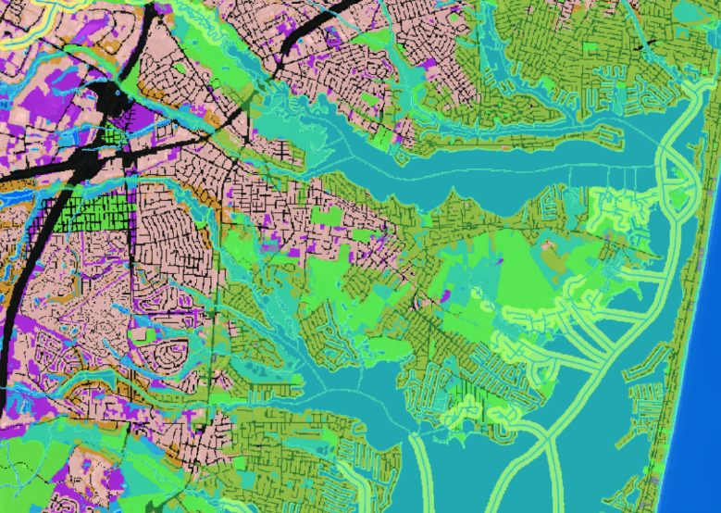
Changing the Utility of the Lands in the CAFÉ Area
Notes:
Allow them the opportunity to use this information to reexamine their Affordable Housing opportunities and obligations.
Resilient communities plan… so give them the information they need to let them plan accordingly. It’s disingenuous to make a municipality plan for affordable housing in a place where it can never be developed.
Does the DEP work with HUD to remove the areas they have designated as environmentally critical or sensitive from the developable potential of communities? NO.
The DCA says we need 360 units – based upon several factors, but predicated on the “vacant land analysis” we say our obligation is 29…
We already have 3 lawsuits filed against us for builders remedy for the NEXT of affordable housing…. So we are going to have to fight the DCA and 3 lawsuits…. The state agencies create competing regulations and impose them upon Municipalities. We are always in a reactive position…
If the state agencies could work together on things like this….it would free up a lot of municipal resources that we could allocate proactively towards greater resilience.

Slide 25
Building Height
Show pictures of elevated buildings & get rid of dynamic logo
Notes:
Speaking of Building heights, we have some concerns for how high is too high…Not just for the building character of our housing stock, We don’t have ladder trucks that can reach these heights in the event of a fire. Will there be grants for new, bigger fire trucks?
But above a certain height, you have to jump to an higher construction level in the International Residential Code. You have to adhere to a higher fire rating of 5A construction, which also increases construction costs. In addition to the soft costs associated with engineering, planning, surveying and permitting. So there will be an affect to the affordability of housing in the costal communities. It won’t stop the development, just result in residents with deeper pockets.

Slide 26
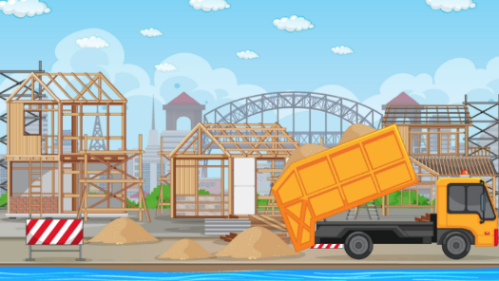
Enforcement
Notes:
Who do you think is enforcing all of these DEP rules and requirements…
The DEP doesn’t have inspectors that periodically check all of these developments?
Nothing in this proposal means a thing if structures are not constructed properly. Without eyes on the construction, all of this is just a waste of time and money

Slide 27
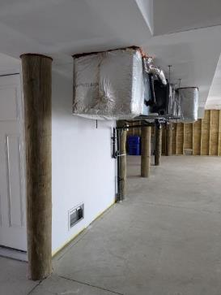
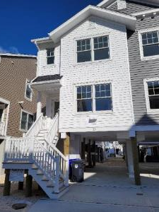
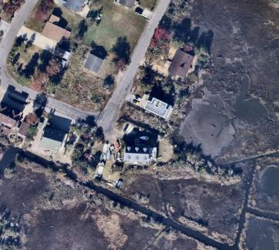
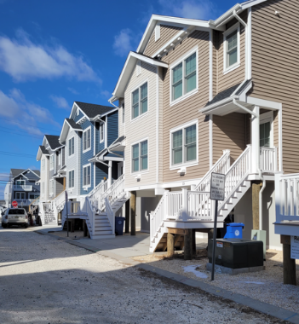
Notes:
You know who is making certain that things are built correctly? Who is verifying that all the structure elevations are correct. That all of the DEP permit conditions are complied with? It isn’t the Construction Official. It is not the DEP.
It’s the LOCAL FLOODPLAIN MANAGER that makes certain all the requirements of the special flood hazard area are complied with.
That the clearing limits are respected.
The building foundations are anchored and balanced.
That the living spaces and attendant utilities are at the proper elevation.
That the deed notices area filed.
That properties and the structures on them are insurable.
That people are protected

Slide 28
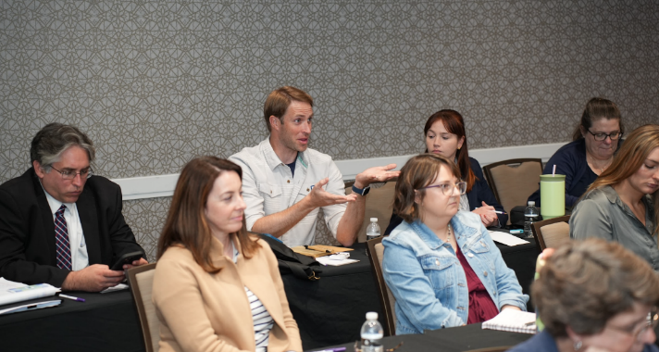
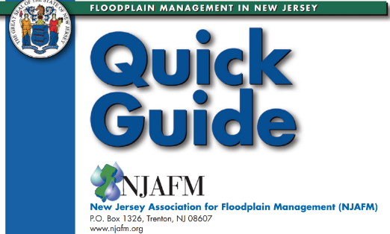
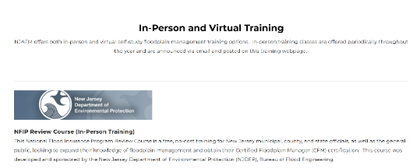
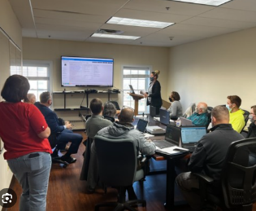
Notes:
The State of NJ requires no training for the local floodplain manager. They should. I cannot stress enough the need for a minimum Base Level training requirement for the local floodplain manager.
Start Small. Start with getting a written acknowledgement from the floodplain manager in each community that they understand that they are the floodplain manager and they have responsibilities associated with that. You would be surprised that Many municipalities in NJ do not even know who their floodplain managers are, so that that would be a great start.
The training is available and often free!
[Please don’t act like it is too complicated…. If the DEP can require Stormwater Training for planning board and board of adjustment members and reviewing engineers, why can’t they require minimum training for floodplain management. Yet they require nothing for the local floodplain managers… If flooding is this paramount and keeping people and property safe is warrants regulating for 2100 conditions in 2025, doesn’t it warrant having qualified people enforcing these regulations?]

Slide 29
THANK YOU!
Elissa C. Commins, PE, CFM Township Engineer & Floodplain Manager Township of Brick, Ocean County NJAFM, Past Chair ecommins@twp.brick.nj.us
Notes:
I am a local floodplain manager. We are NJAFM. The New Jersey Association for Floodplain Management, and we are here to help.
We are not just floodplain managers, but scientists, planners, engineers, regulators, GIS specialists, vendors, Insurance Agents, Real Estate Brokers, Architects, Administrators and elected officials. We exist to inform and heighten awareness about flood risk, to better protect public safety, property, the economy and the environment. And We would be honored to be a resource you.
Thank you for your time today. – Hope I didn’t go over time.

