Slide 1

Lessons Learned using City Simulator to evaluate climate Vulnerabilities

Slide 2
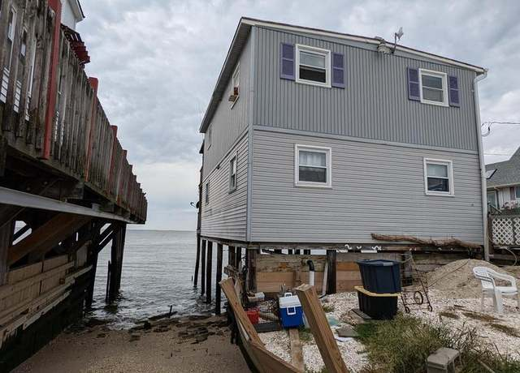
What is Vulnerability?
A vulnerable system is defined as:
  the degree to which a system, or part of it, may react adversely during the occurrence of a hazardous event.
  Acute (short term) – Storm
  Chronic (long term) – background erosion
  Climate Vulnerabilities can also be thought of as Disruptors
Notes:
This concept of vulnerability implies a measure of risk associated with the physical, social and economic aspects and implications resulting from the system’s ability to cope with the resulting event.

Slide 3





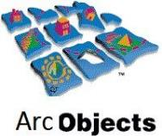

City Simulator Defined
“A map-based decision support tool that helps communities understand their vulnerabilities to future disasters and find the most effective mitigation and adaptation actions.”
V 1.0 (desktop)
V 2.0 (online)
Esri ArcMap Extension
Asp.net Single Page Application
SQL Server/ C# / HTML5, CSS, JavaScript
Microsoft Visual Studio 2019 C#, Vb.net
Open-source plug-ins for mapping, charting
Cloud-based, wide access

Slide 4
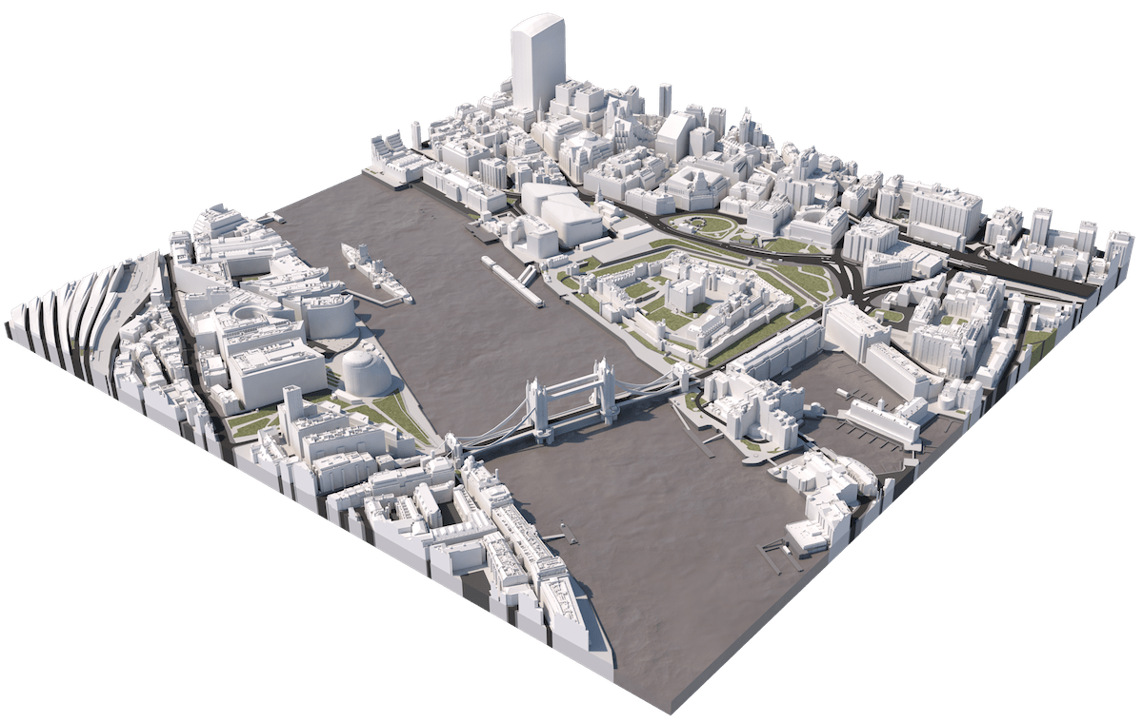
How City Simulator works
Digital Twin
Simulate
2020-2100
Measure
Economy
Productivity
Storm damage
Energy Consumed
People
Trips disrupted
Freight disrupted
Heat days disrupted
Environment
Carbon Footprint
Water Quality
Annual
New Business
New Buildings
New Infrastructure
Natural System Impacts
Carbon Footprint
Climate Hazards
Impacts
Recovery
Travel
Commerce
Daily
System Users
System Infrastructure
System Control

Slide 5
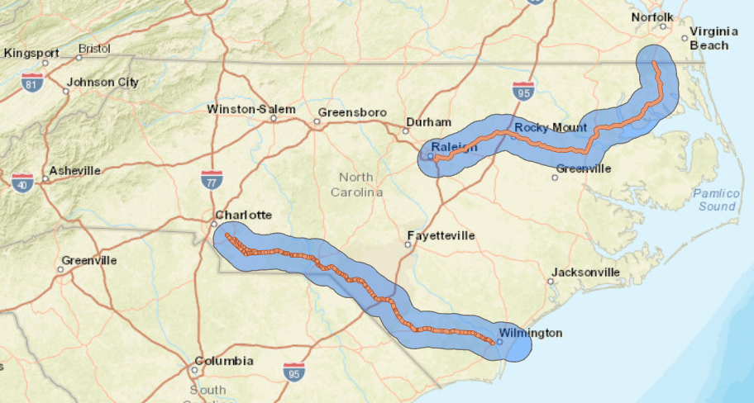
NCDOT US74
I-87
?
Climate change impact on traffic
?
Where is disruption
?
Which assets are critical for people and freight
?
Cost to operate
?
Cost of climate change
?
Impacts to disadvan-taged population
US-74

Slide 6
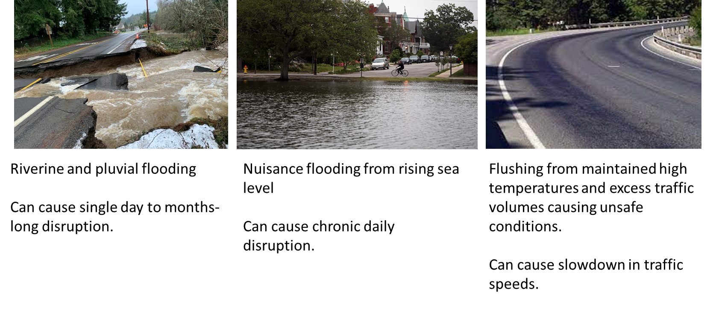
US74 Corridor Case Study
Defining Disruption
Notes:
Pluvial = flash floods or surface water

Slide 7
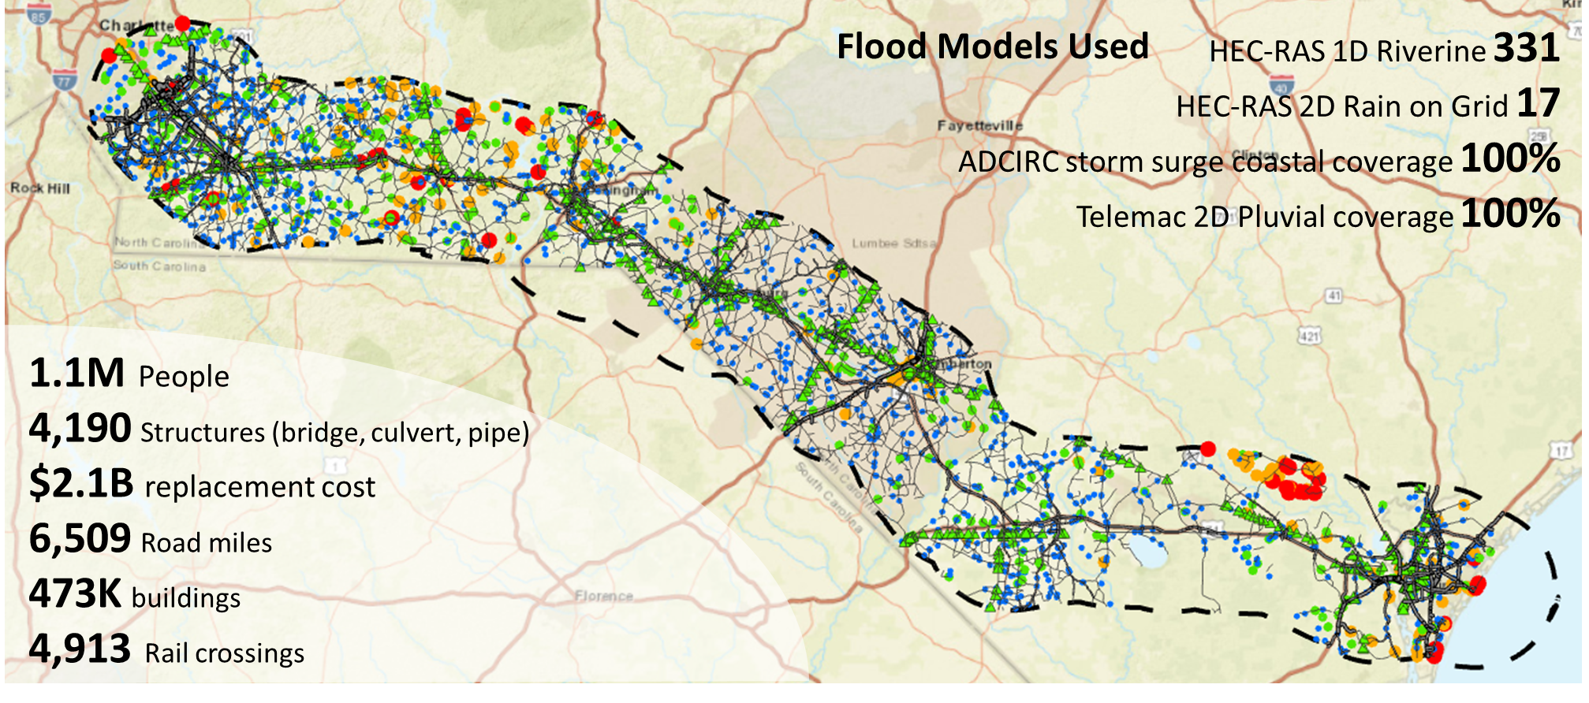
US74 Corridor Case Study
U.S. 74 Digital Twin

Slide 8
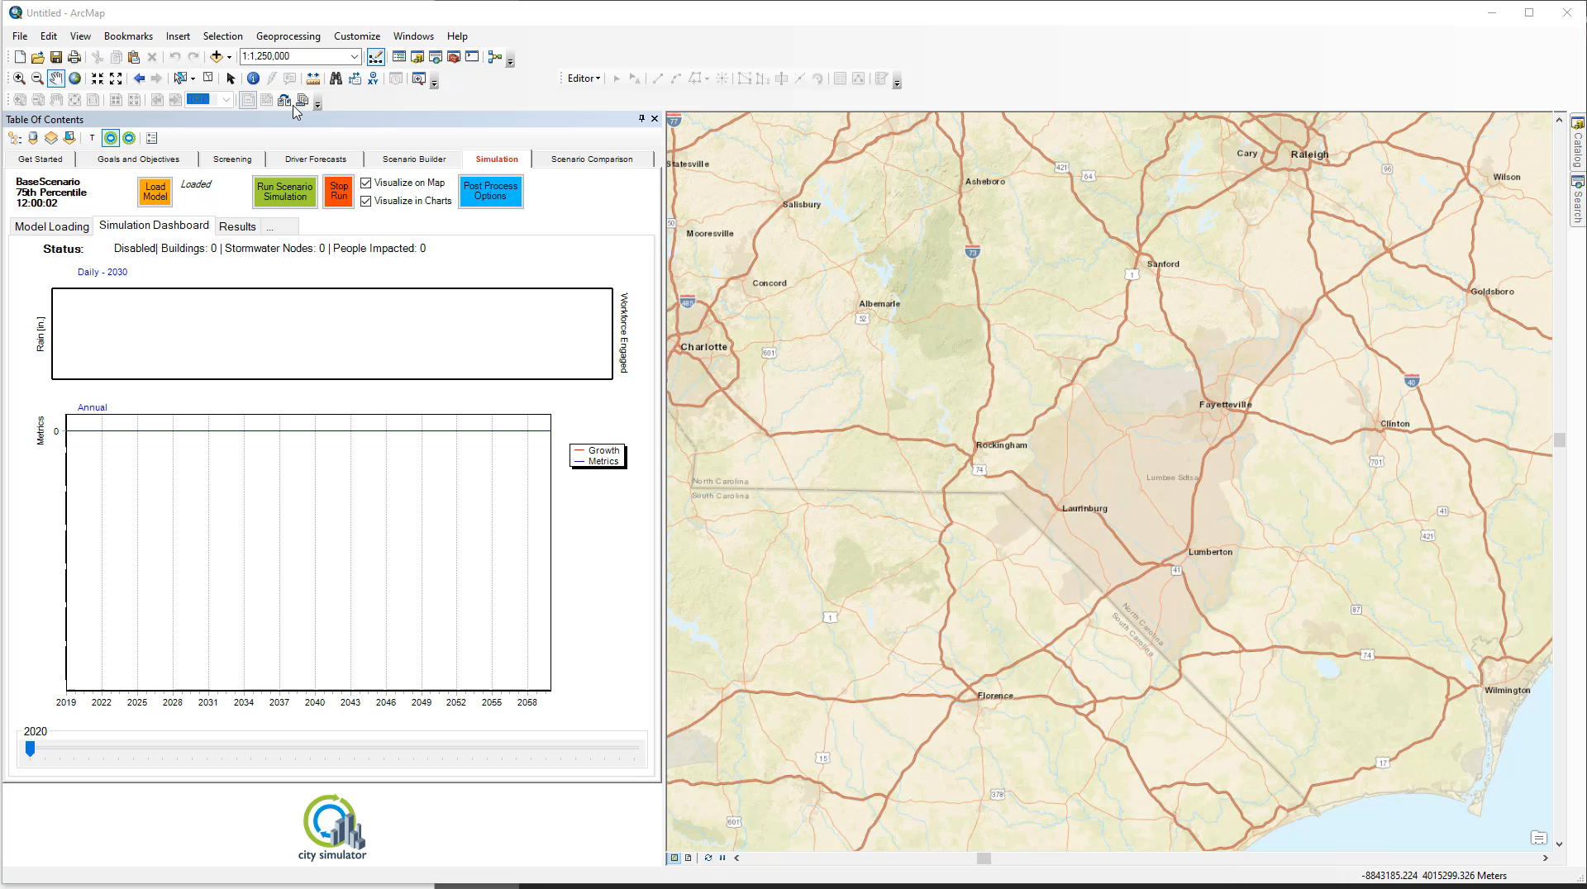
NCDOT US74

Slide 9
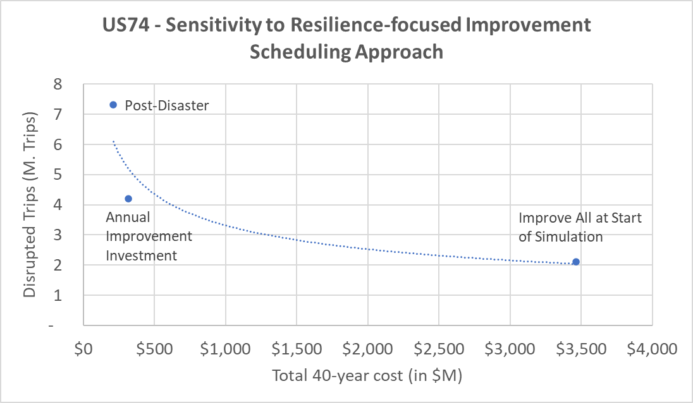
US74 Corridor Case Study
Select Findings: Adapting/Mitigating
Varying timing of resiliency investment
All at start: Highest reduction in disruption but unattainable cost.
Post-disaster: Least effective, Highest disruption.
Annual improvement: pro-active, resulting in substantial reduction in disruption with moderate increase in cost.

Slide 10
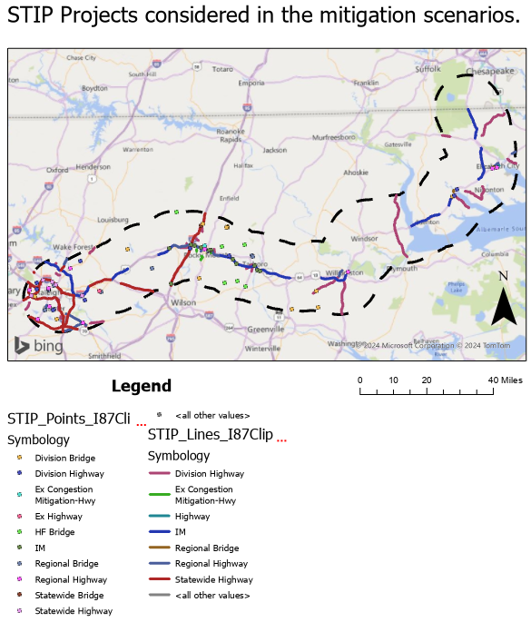
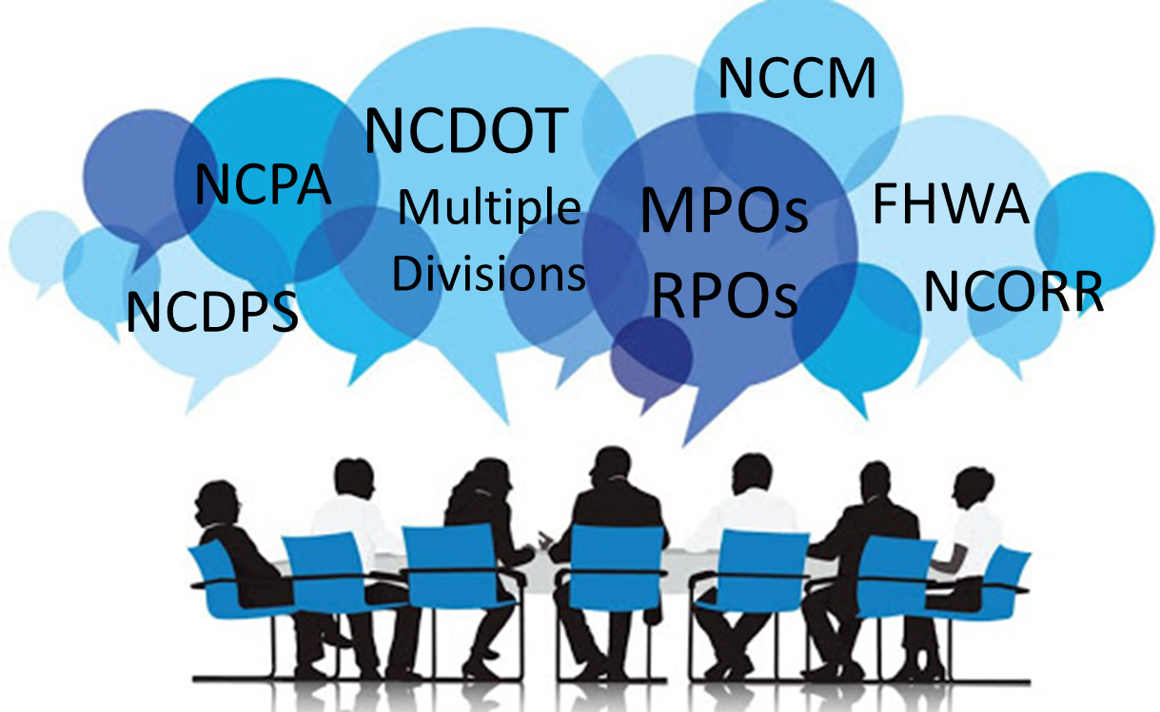
NCDOT US74
PROTECT Grant
Planning
Grant
DOT $
Maximized Grant ROI
Shared Vision Planning
Aligned with Master Plans

Slide 11
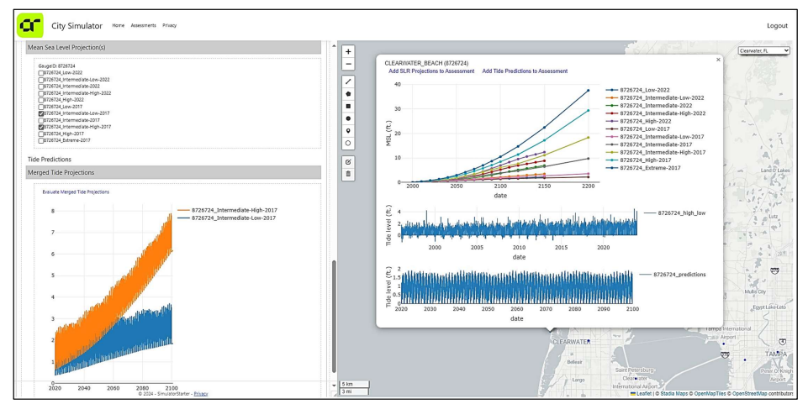
FDEP Resilient Florida Grant Program
Vulnerability Assessment
Aligned to Grant Requirements
Larger Assessment expands beyond Flood
Clearwater, FL

Slide 12
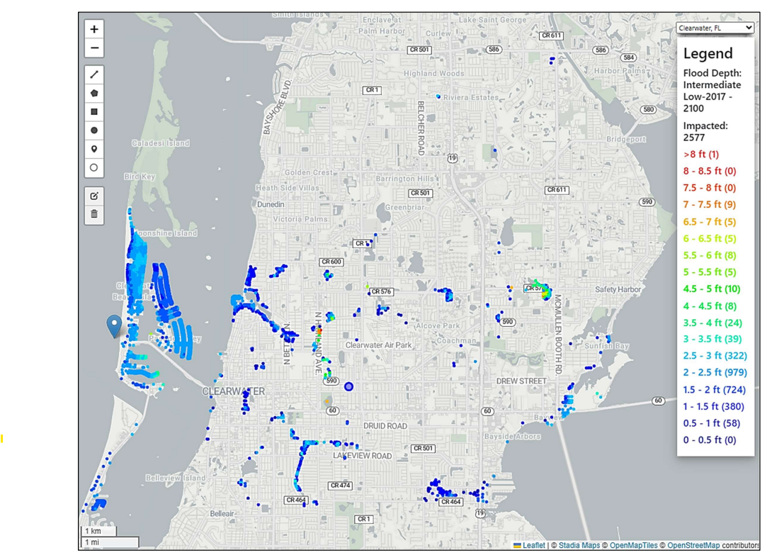
Clearwater, FL
Critical Facilities
All Buildings
Disruptors
Acute Flooding
  Riverine
  Pluvial
  Surge
Chronic Flooding
  Sea Level Rise Sunny Day Flood

Slide 13
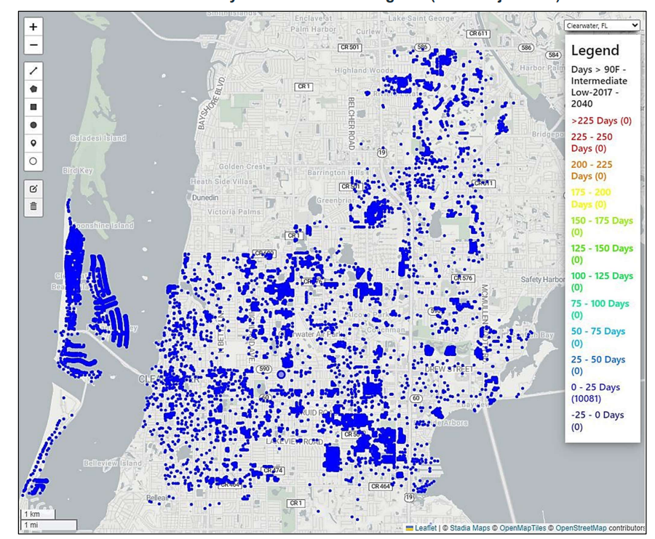
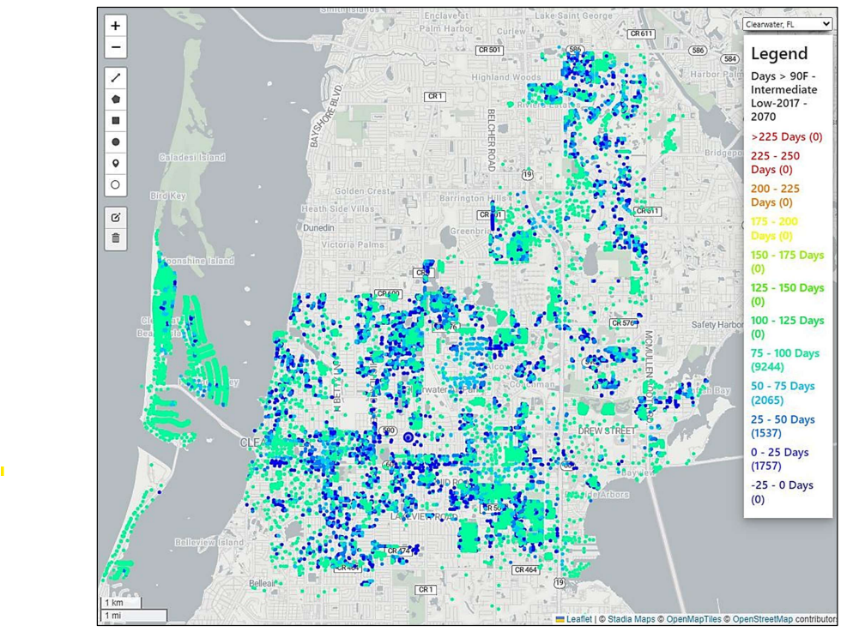
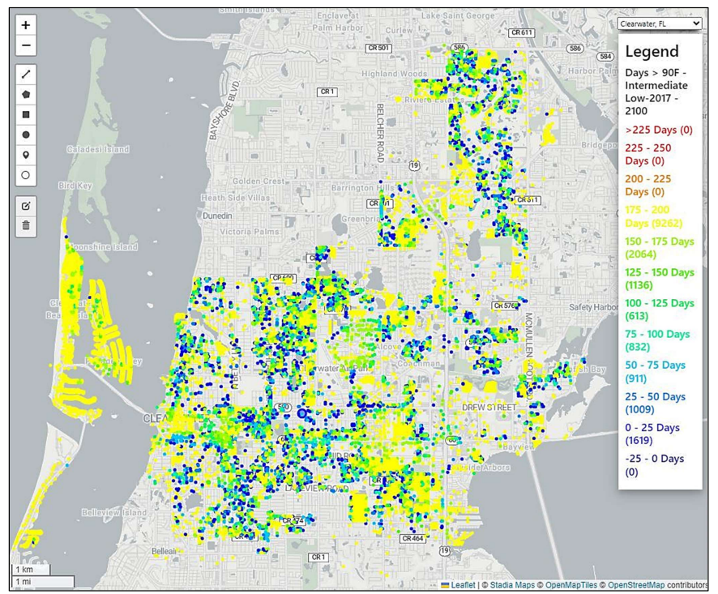
Clearwater, FL – Heat Impacts
2040
2070
2100
Buildings with Days > 90F

Slide 14
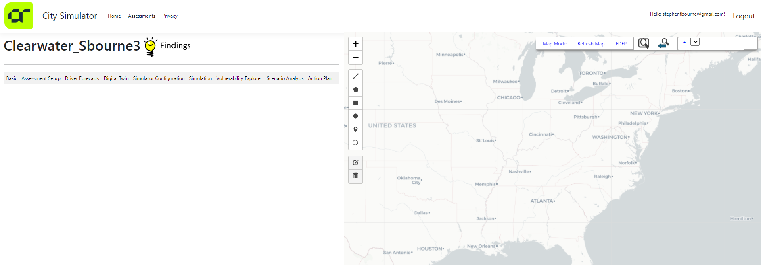
What is City Simulator?
City Simulator Online
Basic | Assessment Setup | Driver Forecasts | Digital Twin | Simulation Configuration | Simulation | Vulnerability Explorer | Scenario Analysis | Action Plan
Specify Analysis domain Includes GIS layer of every county, river basin, and community in the country – any can act as an analysis domain. | Integrates popular resilience frameworks (e.g. ENVISION, PIEVC), and client master plans as themes. Integrates grant programs (BRIC, Resilient Florida). Allows for specifying metrics to be measures in simulation – linking back to themes and grants. Allows for specifying toolbox of adaptation actions. | Weather (rain, temp) Pulls input data from NOAA/USGS APIs Uses custom cache systems Integrates proprietary Stormcaster algorithm Sea Level Rise Integrates proprietary City Sim SLR algorithm Pulls data from NOAA water levels API (historical tide, tide predictions, SLR projections) and USACE SACS study. | The digital twin is: GIS layers - parcels, buildings, roads, stormwater system, etc. Tables – agents, commute paths, etc. Flood models, Travel models, Tree percentage DCIA, and others. Loads data from City Simulator geodatabase created in ArcMap extension. Allows for building digital twin directly in online tool. E.g. Loading demo data from US Census through their API. Exporter of data to Esri tools. | No-code configuration of simulation, allows for specifying which modules are included in the daily-simulation loop. | Tools to run the simulation and produce results. Simulates: Acute (storms, surge) Flooding Chronic (sea level) flooding Urbanization Energy usage Heat exposure to assets Heat exposure to people Exporter of data to Esri tools. | Tools to visualize the simulation base run results. Buildings at risk. Critical Facilities at risk. High trip disruption locations on the road system. | Tools to create scenarios with adaptation/mitigation actions Many options Used Seawall, tree planting, elevating homes, buyout program, elevating roads and bridges in Clearwater project. New method of optimizing. Finds best(highest ROI) projects given a range of total budgets. | Creates MS Word doc with summary of findings and selected adaptation scenario.

Slide 15
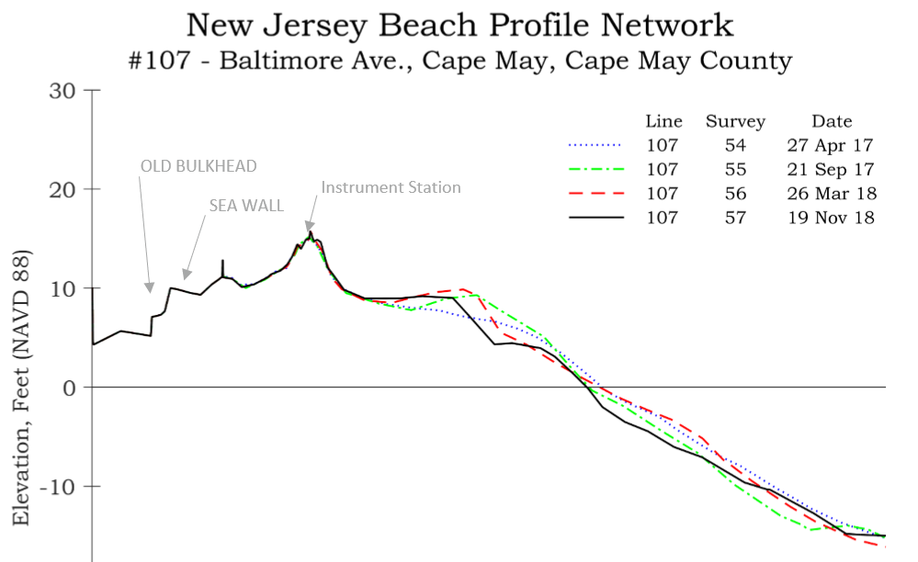
A resilient system is one that:
Reduces failure probability
  Robust
  Naturally resilient
  Built-in features
Reduces consequences of failure
  Redundancy
  Smart development
Reduces time of recovery
  Pre-planning
  Easier replacement/repair
DUNE
Timber Bulkhead
Stone Seawall
Dunes
Periodic Beachfill
Notes:
Concepts of resilience take two broad forms, namely (1) Hard resilience : the direct strength of structures or institutions when placed under pressure. In the disaster context, resilience is often treated as the simple inverse of fragility. Engineers, for example, often refer to increasing the resilience of a structure through specific strengthening measures to reduce their probability of collapse with respect, for example, to earthquake intensities, wind loading or other physical stresses. As resilience increases, the degree of damage for a given intensity hazard decreases. (2) Soft resilience : the ability of systems to absorb and recover from the impact of disruptive events without fundamental changes in function or structure.

Slide 16
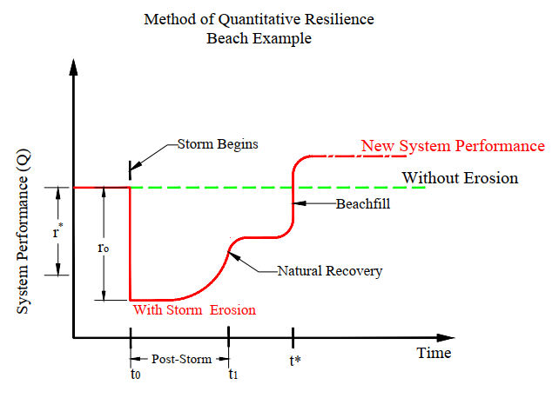


Slide 17
Another way to look at it:
Natural Disaster
Resilient City
Community Health/Prosperity
Business as usual
Resilient City Prospers
Un-Resilient City
Larger Impact
Slower Recovery
2020 2030 2040 2050 2060

Slide 18
Lessons Learned
Creating a digital twin using software such as City Simulator can help assess vulnerabilities and disruptors
Assessing the vulnerabilities can help prioritize expenditure of resources to increase resilience
Initiating projects (adaptation) before the disruption event early, will effectively minimize post-event disruptions (increase resilience).
A more resilient community will have a faster recovery

