Slide 1
WaterWorks OnDemand:
Advancing Coastal Engineering and Hazard Analysis through Cloud-Based Workflows
Alireza Gharagozlou, PhD
2025 Coastal Flooding Technical Workshop
NJCRC
March 19, 2025

Slide 2
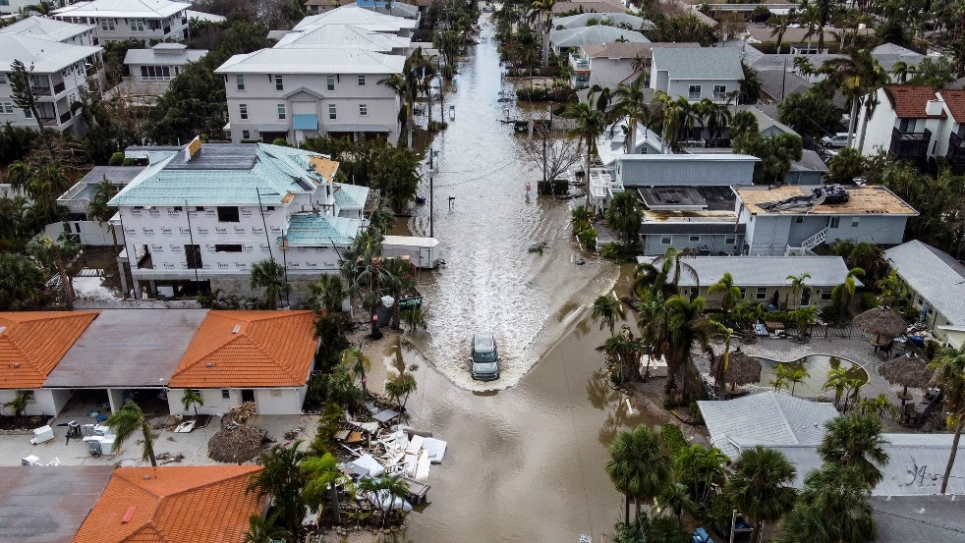
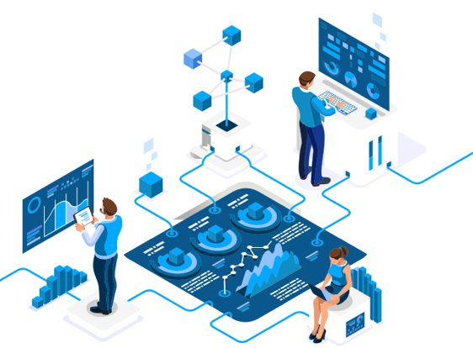
Background
Increase in coastal vulnerabilities:
Storms and sea level rise
Increasing frequency and intensity of events
Enhancements in modeling capabilities:
Improve model integration
enhance data infrastructure
Hurricane Milton, Siesta Key, Florida

Slide 3
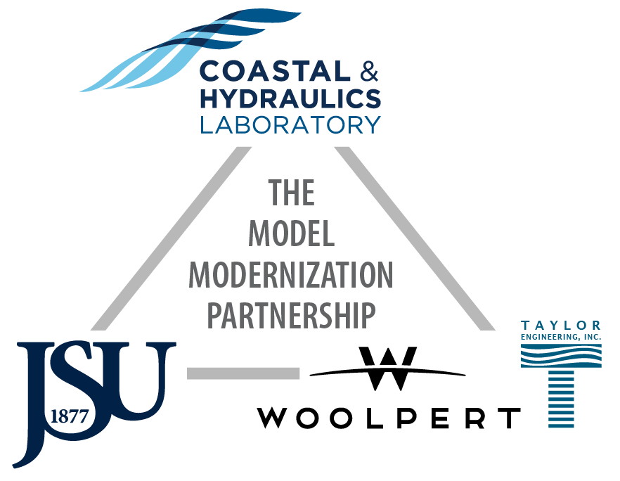
Numerical Technology Modernization Strategy
Initiated by U.S. Army Corps of Engineers' Coastal Hydraulics Laboratory.
Modernize tools for coastal and hydraulic analysis.
Enhance modeling and data integration infrastructure.
Improve accessibility of data and numerical tools.
Foster collaboration across ERDC, agencies, and academia.
Leverage shared resources for innovation and efficiency.

Slide 4


WaterWorks OnDemand
Cloud-based platform for coastal hazard modeling and analysis
Key features:
Added Functionalities, Seamless Model Setup
Improved Computational Resource, Easier Access
Faster Result Generation, Automated Visualization
Increased Collaboration

Slide 5
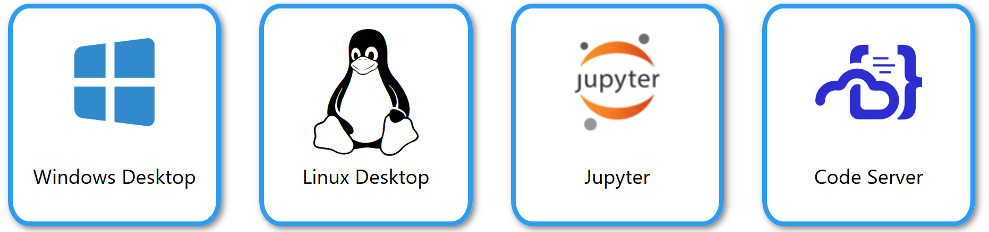
Cloud Architecture and Models
Numerical models and tools:
Azure
HPC User
ADCIRC
CSHORE
PTM
OnDemand
Authentication
STWAVE
SMS
AdH
FUNWAVE
CMS
HPC Scheduler
HPC Compute Node
Shared File System
GSSHA
WMS

Slide 6
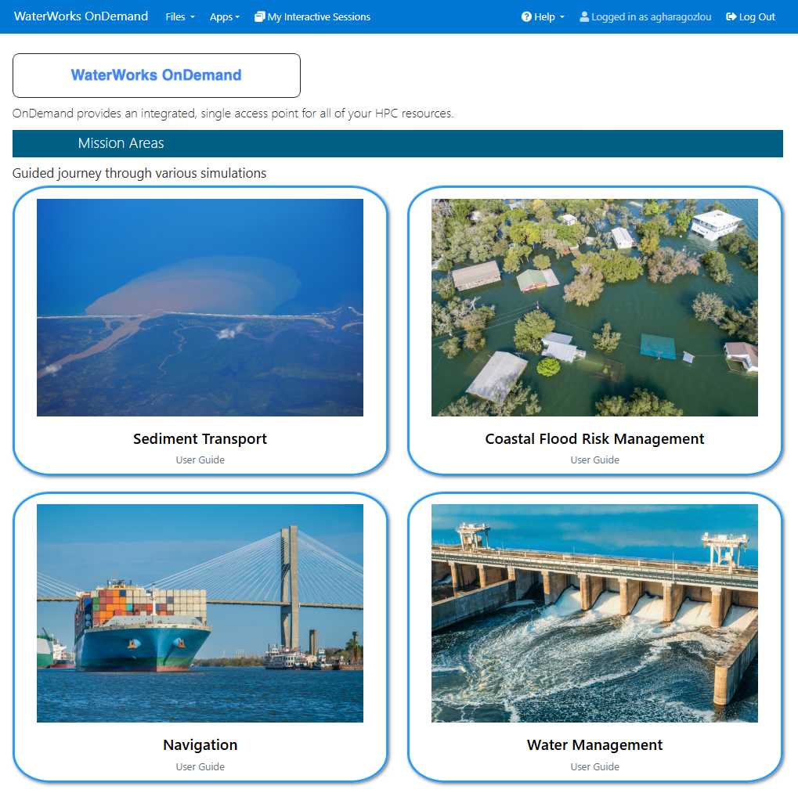
Models and Use Cases
Homepage and features:

Slide 7
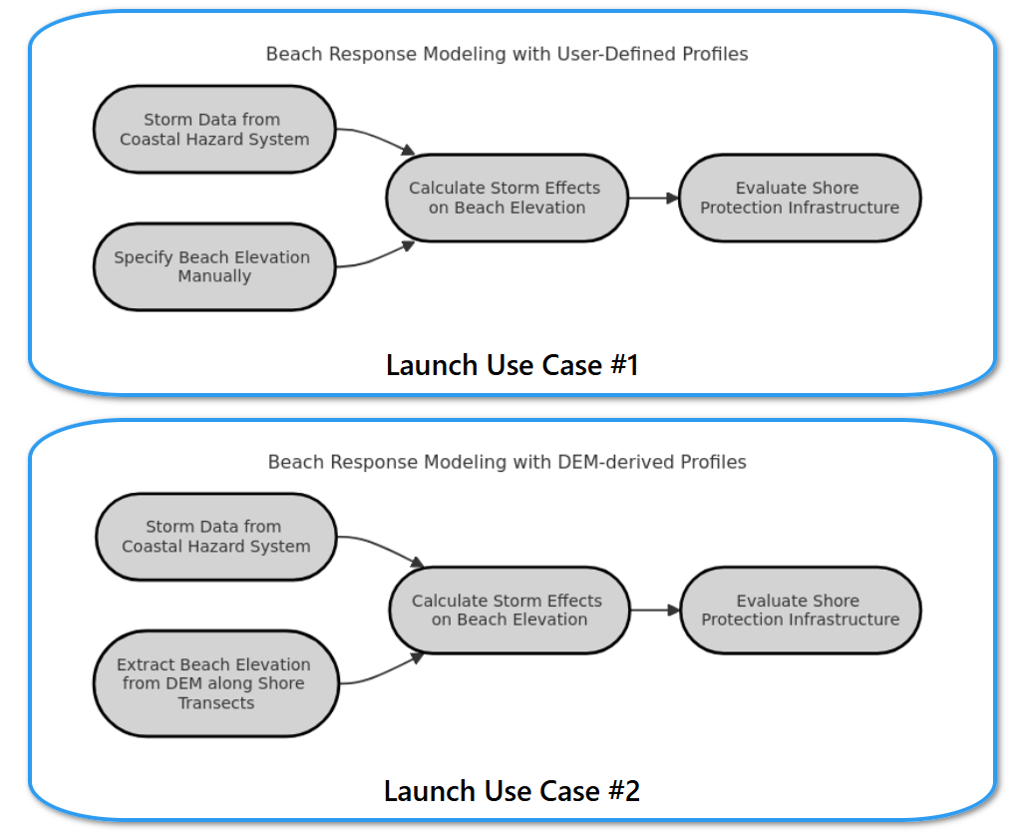
Models and Use Cases
Homepage and features:

Slide 8
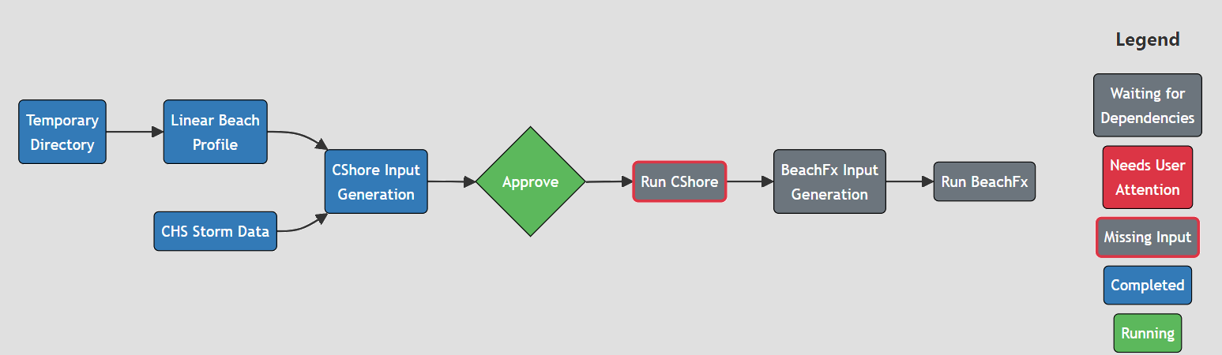
Models and Use Cases
Step-by-step model setup workflow:

Slide 9
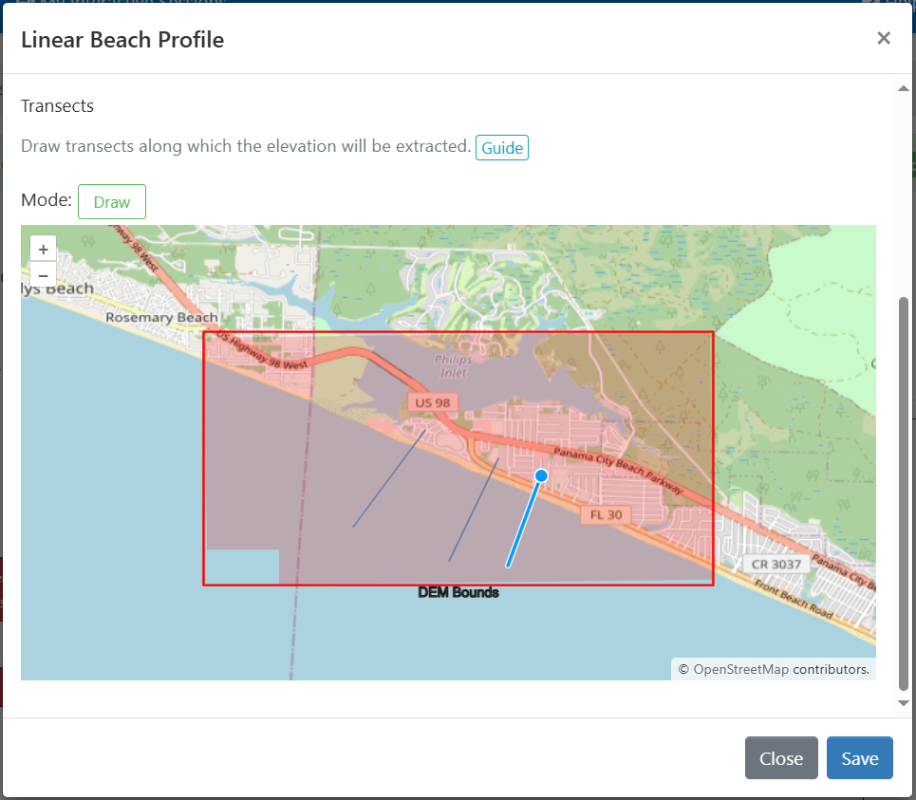
Models and Use Cases
Step-by-step model setup workflow:

Slide 10
Models and Use Cases
Step-by-step model setup workflow:

Slide 11
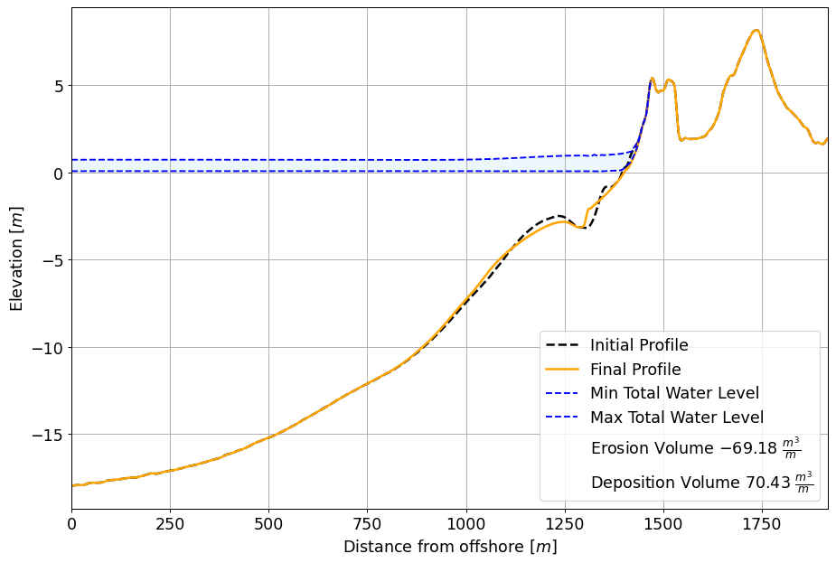
Models and Use Cases
Step-by-step model setup workflow:

Slide 12




Ongoing Work
Collaborate with universities
Expand models available
Improve the automation of result
Implement Verification, Validation and Uncertainty Quantification

