Slide 1
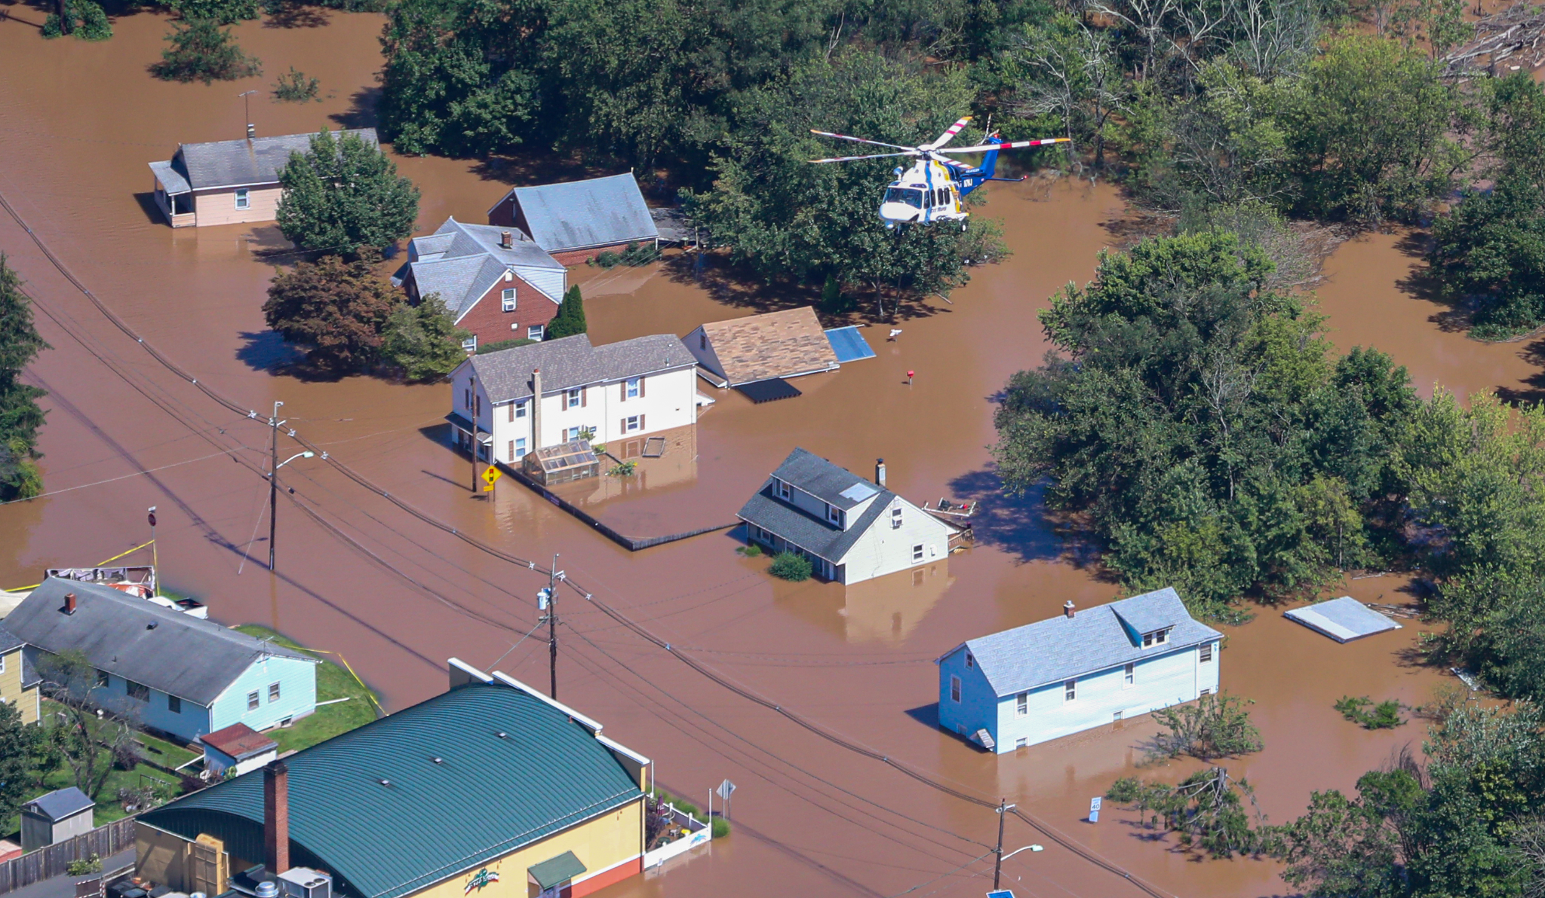

Enhancing Flood Damage Predictions Using NFIP and LIDAR Data
03.19.25
A Case Study Assessing HAZUS Accuracy During Hurricane Ida in Manville, NJ
Holly Josephs, Avin Laali, Fahed Chickh-Alchabab
Advisor: Dr. Jie Gong

Slide 2
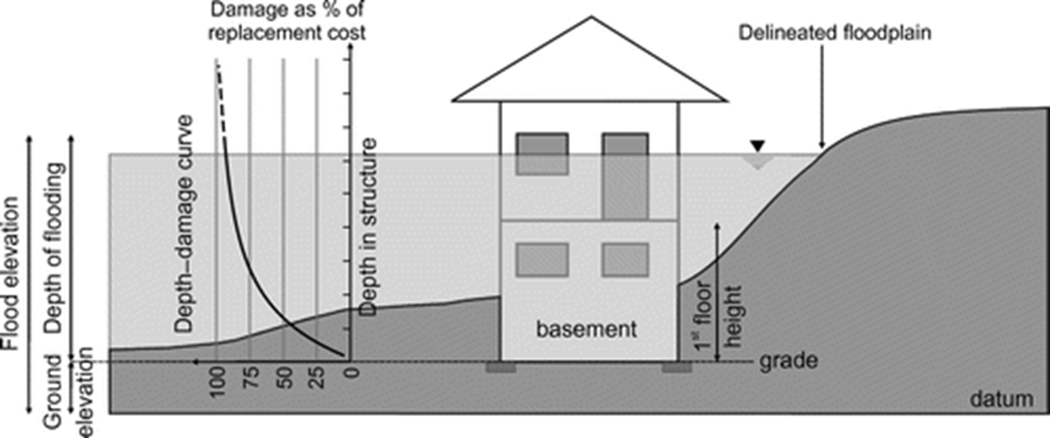
Sources of Uncertainty in Predicting Flood Damages
•Flood Depth: modeled or reported with inconsistencies
•First Floor Elevation: extraction imperfections, sparse data
•Depth Damage Curves: do not consider other factors, non-localized defaults

Slide 3
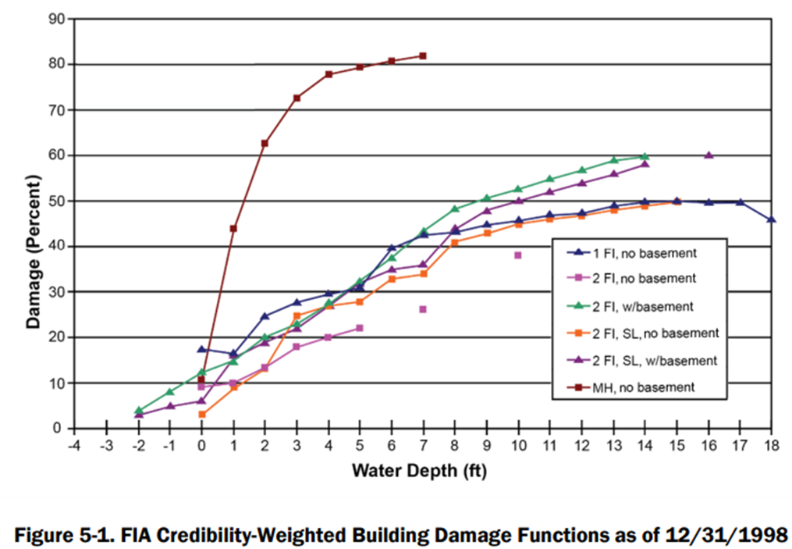
Background - HAZUS
HAZUS: FEMA tool to estimate damages from natural disasters
Allows for varying levels of specificity of disaster and building data
For flood scenarios: Utilizes generalized depth-damage curves to estimate damages

Slide 4
Methodology
Actual damage percentages and building attributes from 189 National Flood Insurance Claims in Manville, NJ from Hurricane Ida
Associate claims with First Floor Elevations extracted from LiDAR scans
Associate claims with modeled maximum flood depth experienced during Hurricane Ida
Run HAZUS analyses with varying levels of specificity to compare modeled building damages with actual damages

Slide 5
OpenFEMA NFIP Claims
Building damage and attribute information
Requires private data set to join with location
+
HECRAS Modeled Floods
Maximum water depths from Hurricane Ida in Manville, NJ
+
First Floor Elevations
Extracted from LiDAR Scans, used to obtain in-home flood depths
Localized Depths and Actual Damages
=
Localized Depths and Estimated Damages
HECRAS Modeled Floods
Maximum water depths from Hurricane Ida in Manville, NJ
+
First Floor Elevations
Extracted from LiDAR Scans, used to obtain in-home flood depths
→
HAZUS

Slide 6
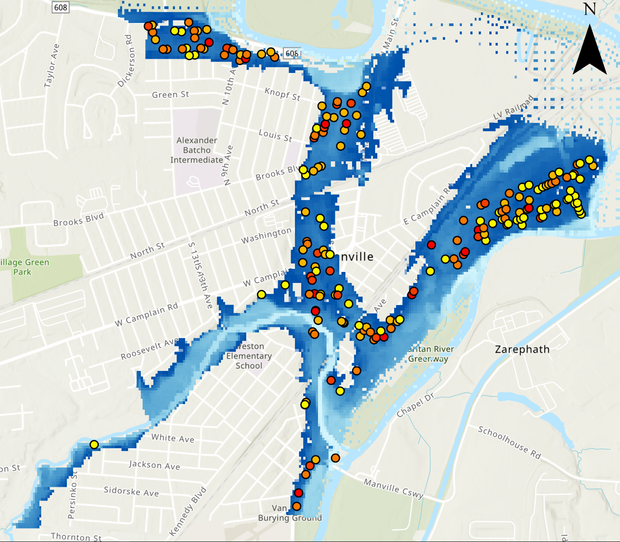

Comparing with HAZUS Predictions for Manville
Actual Damage Percentages from NFIP Claims
Mean = 35.6%
Modeled Damage Percentages from HAZUS Level 3 Analysis
Mean = 23.6%

Slide 7
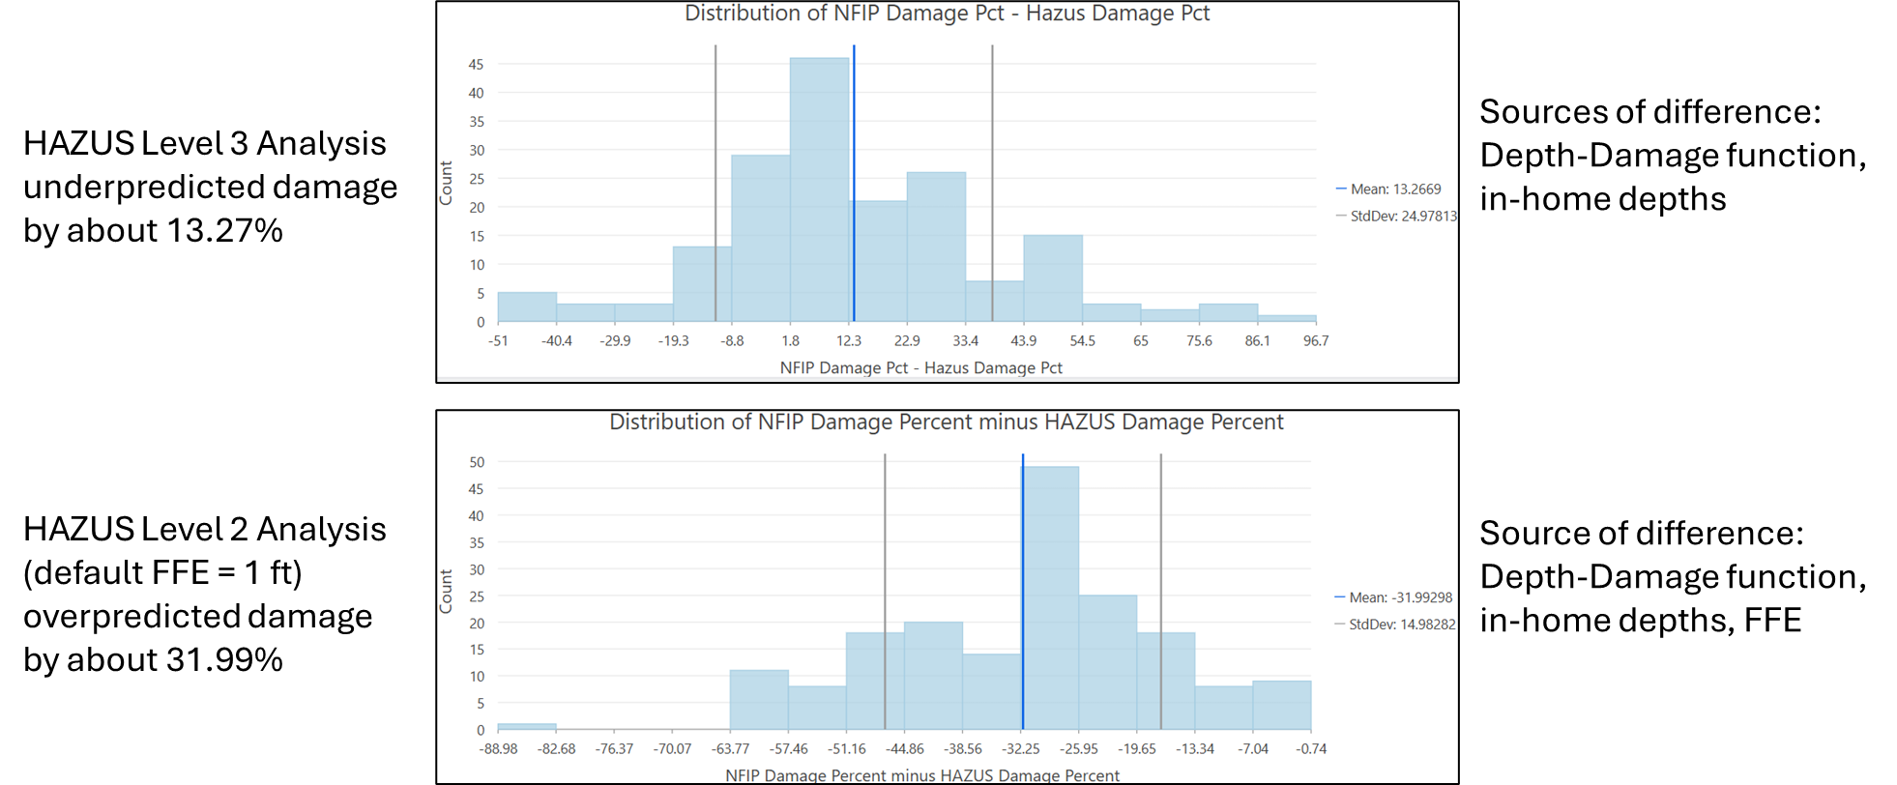
Comparing with HAZUS Predictions for Manville

Slide 8
What’s Next?
Improve foundation type specificity in HAZUS scenario
More case studies to localize depth-damage curves
Move towards machine learning for predicting damages to include factors other than in-home water depth and foundation type

Slide 9
Thank you! Questions?

