Slide 1
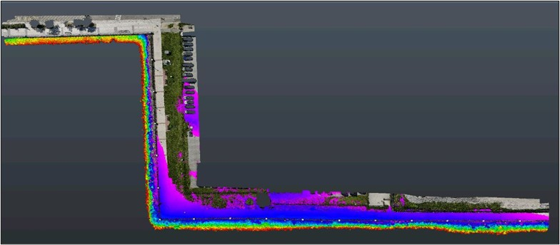

Utilizing Drone Photogrammetry to Simply Visualize Coastal Flood Risk
Benjamin Komita, EIT
03/19/2025

Slide 2
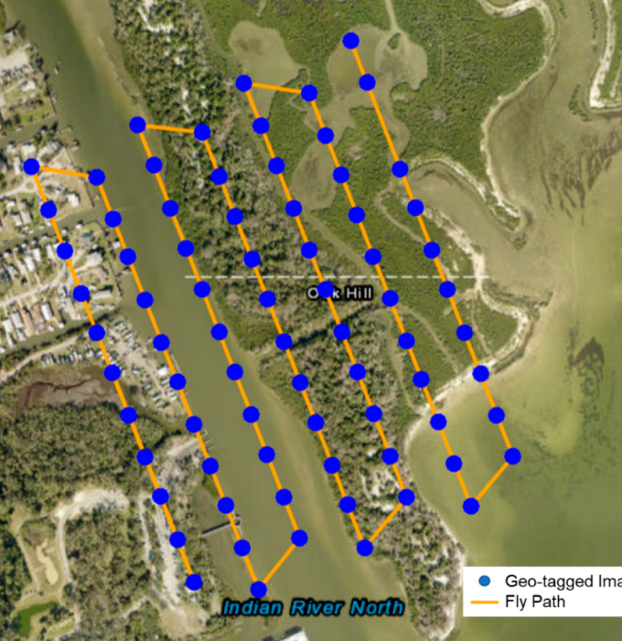
Basics of Drone Photogrammetry
Aerial based highly detailed photography
  Requires ground control points (GCP)
  Overlapping photos along flight path
Process photos using software
  Manually align GCP with images
Retrieve point cloud
Congrats! You have a detailed aerial map with elevations (3D)
Yang, B., Hawthorne, T. L., Torres, H., & Feinman, M. (2019). Using Object-Oriented Classification for Coastal Management in the East Central Coast of Florida: A Quantitative Comparison between UAV, Satellite, and Aerial Data. Drones, 3(3), 60. https://doi.org/10.3390/drones3030060

Slide 3
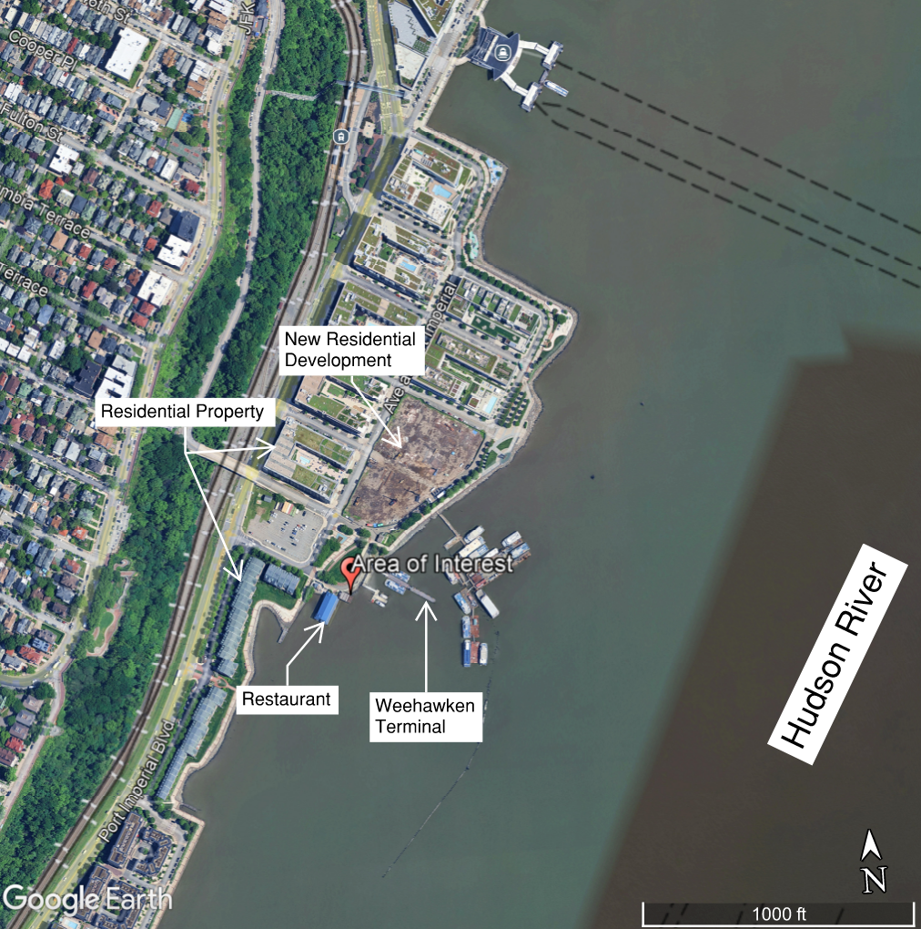
How can we use it?
Conventional topo survey combined with imagery
Point cloud > desktop “site visits”
Interactive investigation of areas of interest
  Identify low terrain
  Assess site vulnerability to flooding
  Highlight impact of coastal flooding
Example: Port Imperial/ Weehawken Waterfront
Yang, B., Hawthorne, T. L., Torres, H., & Feinman, M. (2019). Using Object-Oriented Classification for Coastal Management in the East Central Coast of Florida: A Quantitative Comparison between UAV, Satellite, and Aerial Data. Drones, 3(3), 60. https://doi.org/10.3390/drones3030060

Slide 4
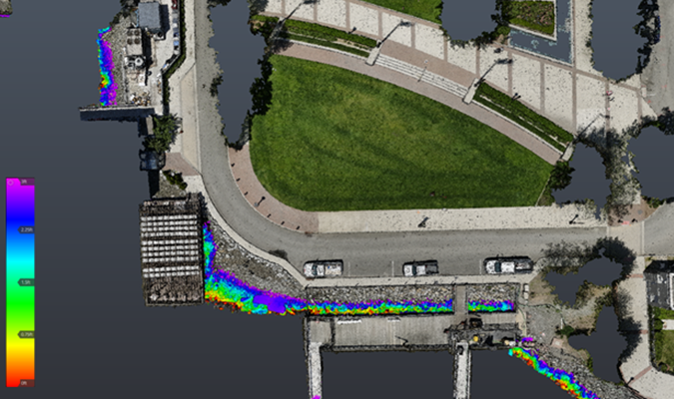
Investigate Normal MHHW Tide Levels
Set baseline water level conditions (or whatever tidal elevation is appropriate)
Look at potential daily tide interactions with terrain
MHHW
Trees/tall vegetation blocking aerial drone view of ground
Imagery notes all areas above water or above MHHW elevations
Rainbow colors note all areas underwater or below MHHW during daily tide conditions

Slide 5
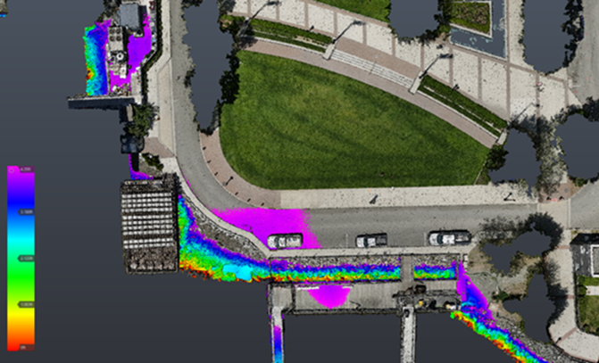
Investigate Extreme/King Tide Levels
Set site specific measured (or predicted) monthly highest high tide level
Look at potential monthly tide interactions with terrain
MHHW +2.5’
Lowest point of upland site = first to feel coastal flooding and runoff accumulation
“Pinch point” in the riprap (matches erosion hotspot and undermining of the sidewalk)
Dock/walkway overtopping BEFORE we consider waves

Slide 6
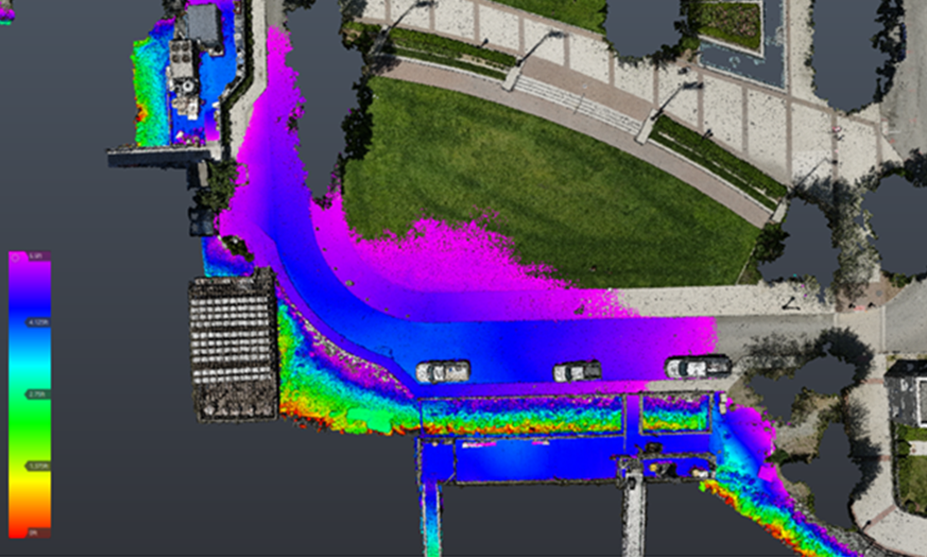
Investigate Storm Water Levels
Set storm event water level conditions (1-yr, 5-yr, 100-yr, etc.)
Look at potential yearly tide interactions with terrain
MHHW +3.75’
Upland site inundation from only SWL (no waves or runoff)
Prepare for emergency response! Road covered = restricted site access
What infrastructure is at risk during storm conditions and how can we protect it prior?

Slide 7
Importance of Visualizing Coastal Flood Risk
How can we maximize it?
SLR leading to increase in sunny day flooding events
Accessibility/understanding for clients/stakeholders/owners
  Topo and contour survey VS visuals (both include elevation data)
  Tailored to the project goals
Similar cost while faster
Help to direct and optimize design solutions
  E.g. maybe the site is susceptible to flooding at only one location or from a different flooding source
Basic introduction to client on severity of their problems (even photos only!)
Visually observe progression of erosion from flood events
Adapt visualization strategies based on environment or client

Slide 8
Questions?

