Slide 1
Reduction in insurance premiums attributable to Nature-Based solutions
Placeholder for optional client logo
New Jersey Coastal Resilience Collaborative Coastal Flooding Technical Workshop
March 19, 2025
Laura (Lemke) Verderame, PhD (Laura.Verderame@guycarp.com)
Roberto Guidotti, PhD (Roberto.Guidotti@guycarp.com)
Guillermo Franco, Ph.D., A.Re. (Guillermo.E.Franco@guycarp.com)

Slide 2
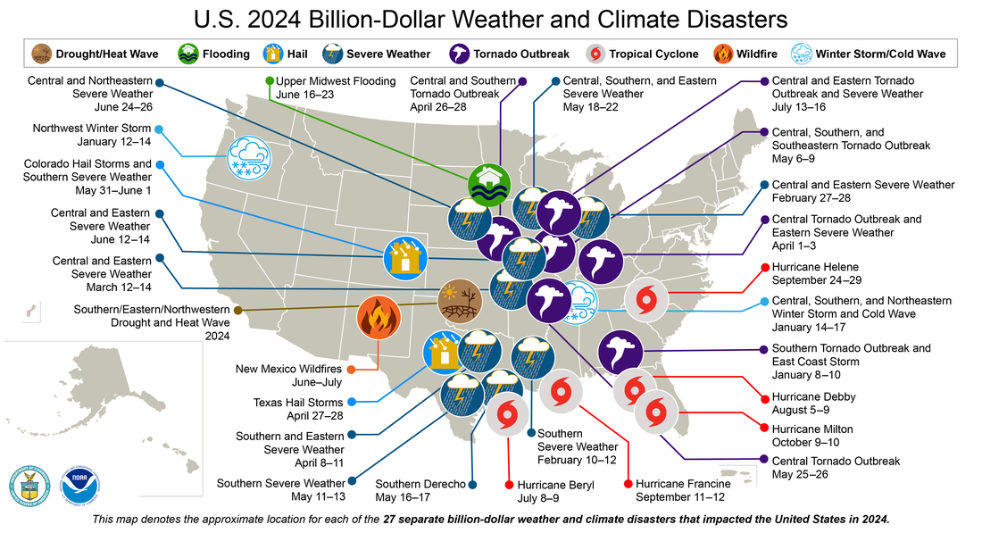
As these events continue, we need to think about how to control risk
https://www.climate.gov/news-features/blogs/beyond-data/2024-active-year-us-billion-dollar-weather-and-climate-disasters
Notes:
Some comment on increasing coastal risks – climate change, urban development

Slide 3
Controlling Risk: Physical Control
Mangroves
Wetlands
Coral Reefs
Beach and Dunes
“Properties [in Ocean County, NJ] behind a marsh, on average, save 16% in flood losses every year compared to properties where marshes have been lost.”
  There is a strong interest in investing in nature-based solutions
  This involves conservation of existing ecosystems that perform valuable services and implementation of new ones
Narayan et al (2017) “The Value of Coastal Wetlands for Flood Damage Reduction in the Northeastern USA”
“Without mangroves, 39% more people globally would be flooded each year and flood damages would increase by more than 16%”
Losada et al (2018) “Global Value of Mangroves”
3

Slide 4
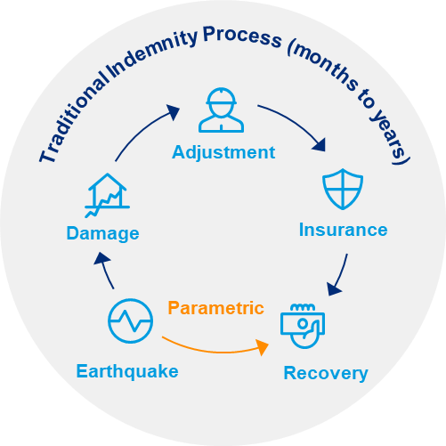
Controlling Risk: Financial Control
Parametric insurance policies pay as a function of the characteristics (parameters) of an event and independently from the actual sustained loss
Payouts are FAST because parametric insurance does not require a loss adjustment process and the parameters needed are often available in real time
Payouts are TRANSPARENT because they are based on objective measurements provided by a respected third party (like NOAA, NASA or the USGS)
Payouts are VERSATILE, not tied to any specific piece of property and can be used as required to support emergency operations, purchases, repairs, financial impacts, business interruption, etc.
Event
4

Slide 5
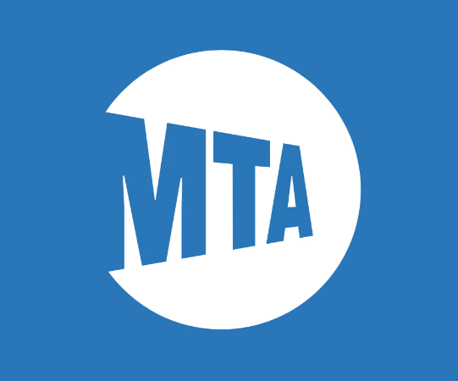

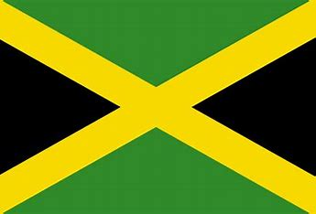



Examples of Parametric Risk Transfer
New York MTA
After Hurricane Sandy, the MTA placed a cat bond called MetroCat to protect its infrastructure from storm surge impact based on NOAA tidal gauges around New York
New York City Neighborhoods
A community-based catastrophe insurance program was designed to expand coverage to lower-to-middle income households in NYC through a parametric flood cover
https://www.artemis.bm/deal-directory/metrocat-re-ltd-series-2023-1/
https://www.artemis.bm/news/swiss-re-guy-carpenter-iceye-deliver-nyc-parametric-flood-insurance/
Government of Jamaica
The Government of Jamaica obtained named storm insurance protection through a cat bond triggering based on the storm location and minimum central pressure reported by the NHC
Government of Mexico
Mexico has used parametric insurance solutions since 2007, obtaining coverage via cat bonds for emergency response and governmental assets after major earthquakes and tropical cyclones
https://www.artemis.bm/deal-directory/ibrd-car-jamaica-2024/
https://www.artemis.bm/deal-directory/ibrd-car-mexico-2024/
Caribbean Catastrophe Risk Facility
The Caribbean Catastrophe Risk Facility was the first multinational pool to use parametric solutions to compensate its member countries via parametric policies
Pacific Alliance
The Pacific Alliance transaction was the biggest parametric transaction ever, reaching $1.4b of protection against earthquakes and covering the countries of Peru, Colombia, Chile and Mexico
https://www.ccrif.org/
https://www.artemis.bm/news/pacific-alliance-cat-bond-to-settle-at-1-36bn-priced-below-guidance/

Slide 6
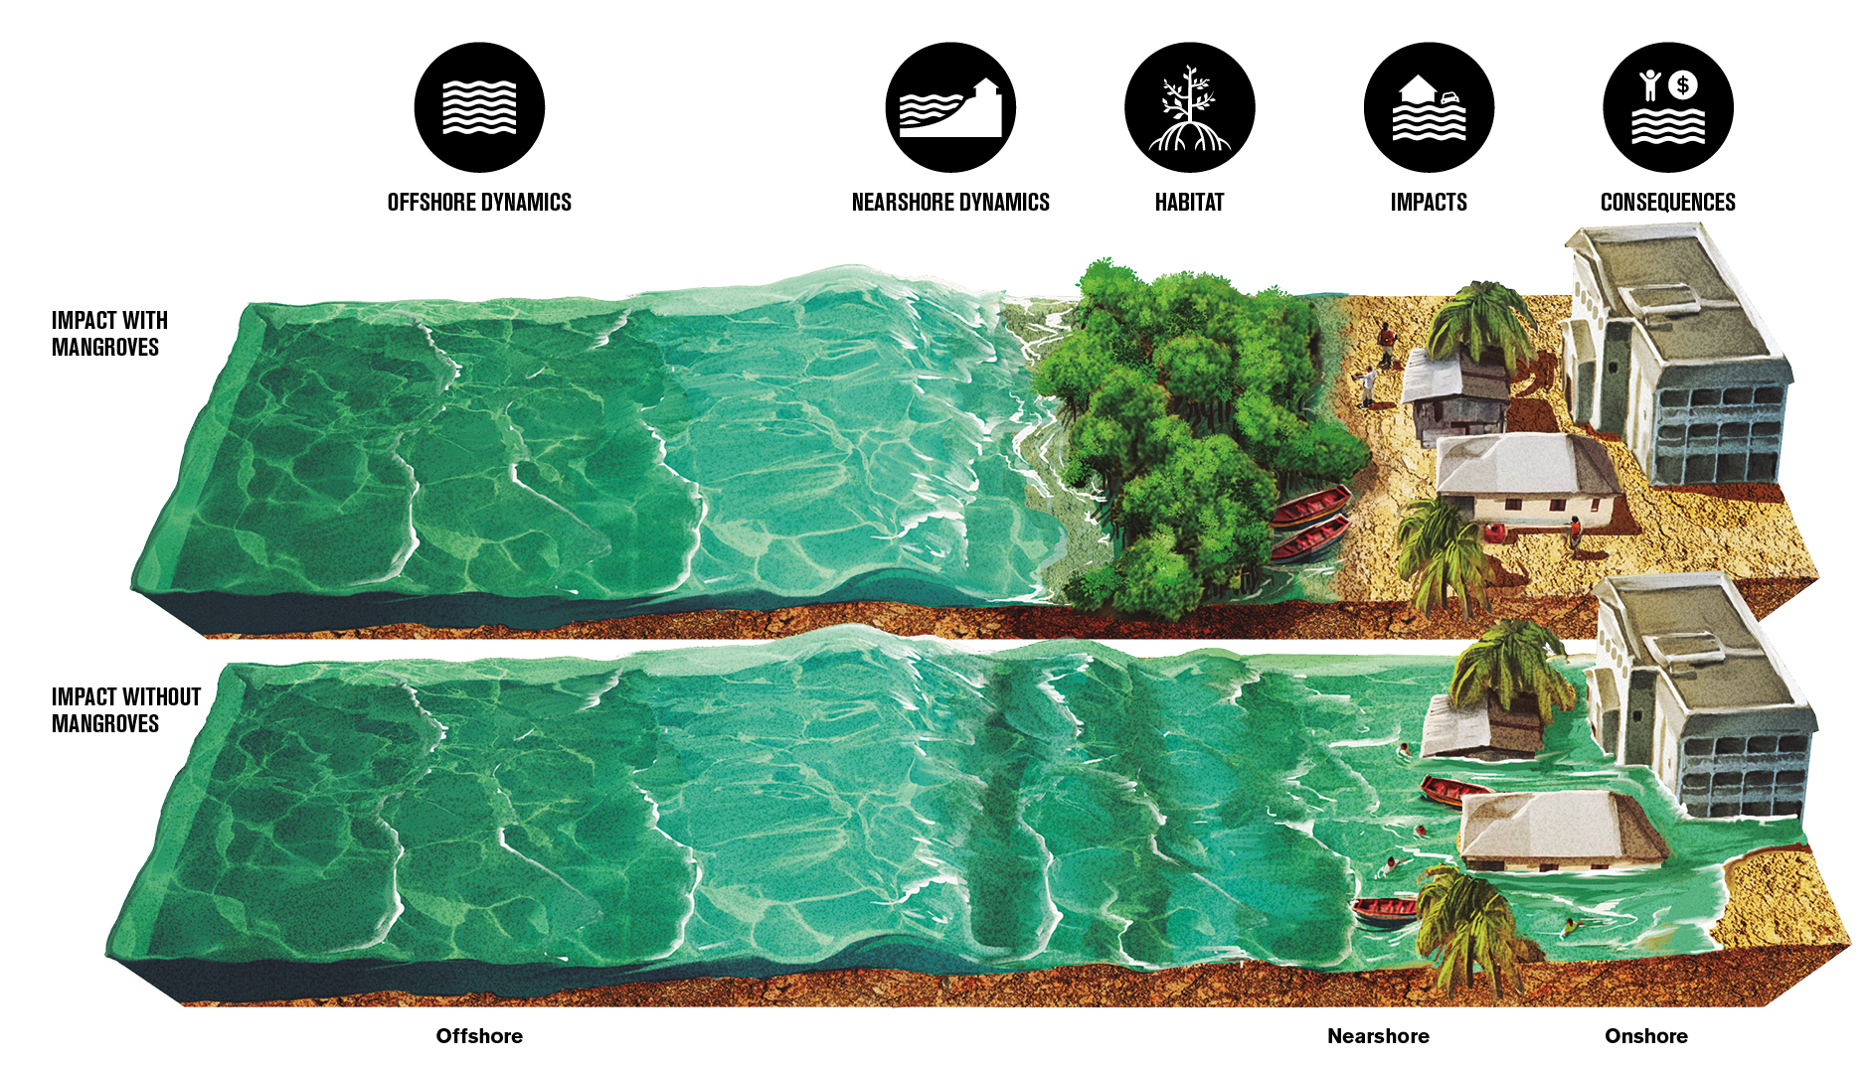
Intersection of Insurance & Nature
  When communities invest in nature-based solutions, they reduce their risk to coastal hazards
  Through this investment, we anticipate communities may see their insurance premium reduced to reflect the risk reduction attributed to NBS
Adapted from World Bank, Forces of Nature.
6
Notes:
Potentially draw comparison to incentives to harden homes

Slide 7
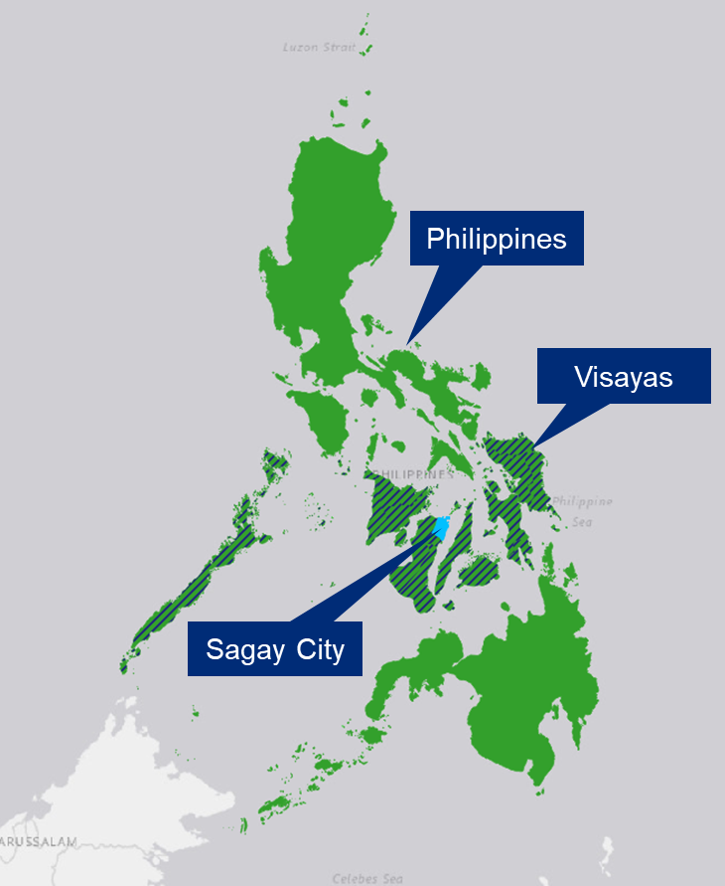


Case Study
Mangrove Forests in the Philippines
Baseline Scenario
Mangroves Removed
Calculate baseline losses to the study area using a catastrophe model
Adjust the baseline losses by applying “risk reduction factors”
Construct parametric product prototypes for both Scenarios
Obtain pricing for both parametric product prototypes
  We design and price parametric insurance structures considering both the presence and loss of mangroves for three progressively smaller geographic regions
Compare prices of parametric product prototypes to evaluate potential savings in premium with mangroves

Slide 8
Differences in Modeled Losses
Losses are estimated to three progressively smaller regions of the Philippines using a catastrophe model & existing data sources
The presence of mangroves results in less damage during topical cyclones; we expect a corresponding reduction in insurance premiums
Difference in Modeled Loss (as a %) between Baseline and Mangroves Removed Scenarios at varying return periods
The largest differences are observed for Sagay City
Difference (%)

Slide 9
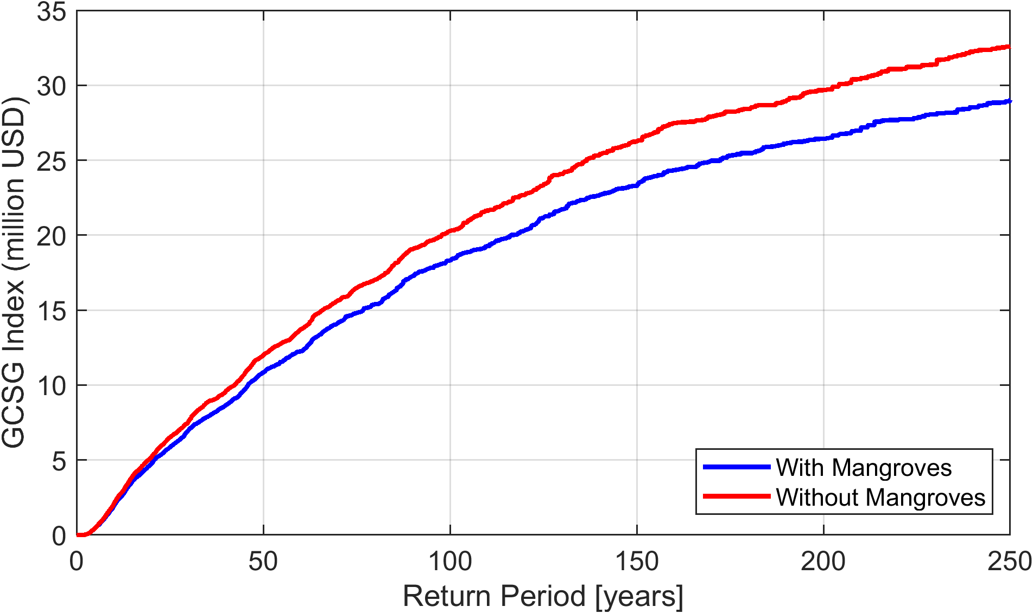
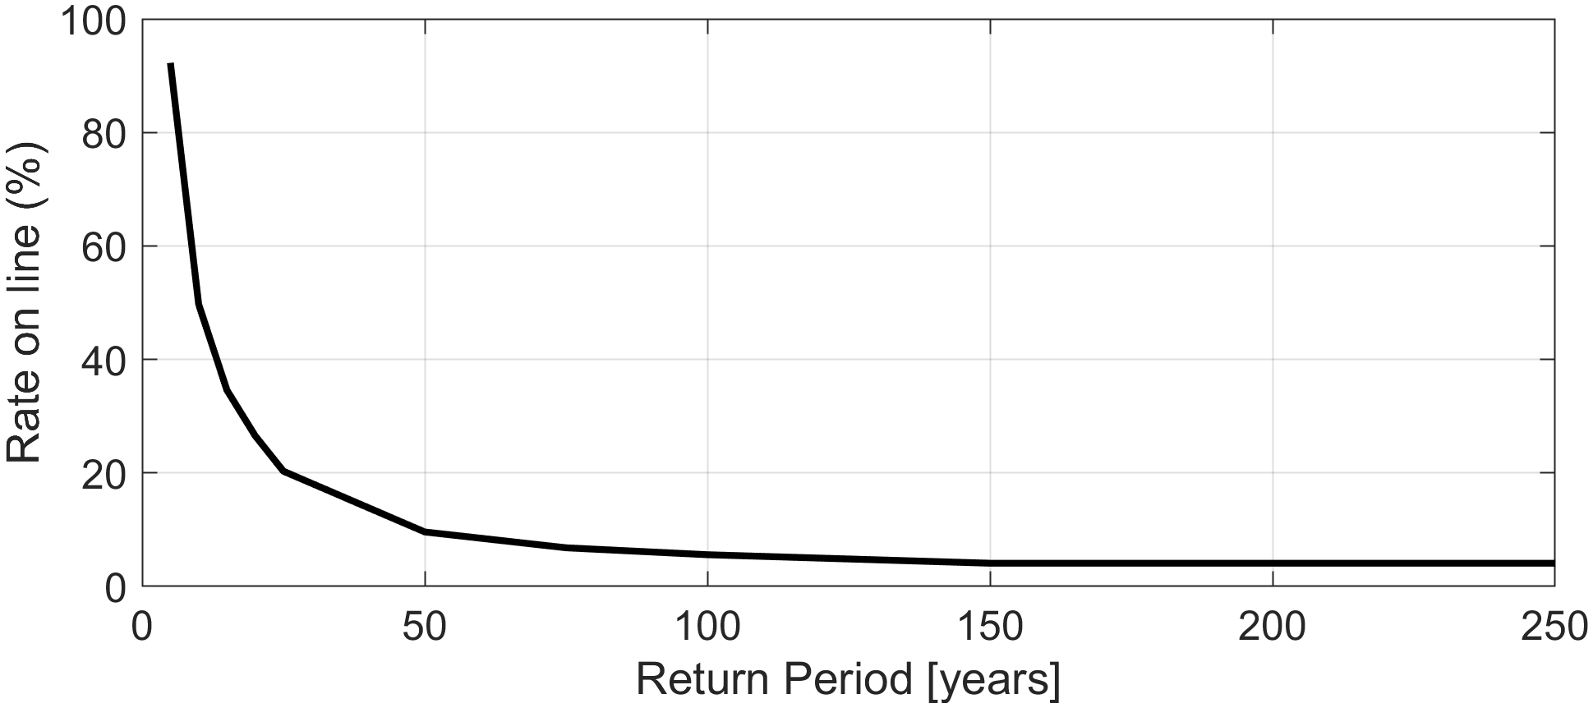
Example Insurance Layer
Parametric solutions are built to transfer the risk for each geographic region under Baseline & Mangroves Removed Scenarios
For illustration, we define a parametric insurance structure and show the price difference at the attachment & exhaustion points
Exhaustion
Insurance Layer
Attachment
Price with mangroves is lower than the price without mangroves
Price
9

Slide 10
Reduction in Insurance Premiums
Price Reduction for Insurance Structures across Three Geographic Regions
Prices are estimated for a series of parametric insurance structures and compared for the two Scenarios
We observe variations in price reduction across geographies and structures
The largest price reduction is observed for moderate events at local level
Structures Targeting Frequent Events
Structures Targeting Rare Events
Notes:
Layer 1 – 7.1% (10-20 RP for mangroves removed)
Layer 11 – 0.87% (110-120 RP for mangroves removed)

Slide 11
Takeaways & Next Steps
  Related Publications:
  “Reduction in Insurance Premiums Attributable to Mangrove Systems
  in the Philippines.” Lemke-Verderame et. al., in preparation.
  Triggering Change: Parametric Solutions for Climate Resilience (https://www.marshmclennan.com/insights/publications/2023/april/triggering-change-parametric-solutions.html)
With increasing coastal risks, communities may consider both solutions that mitigate the risk (e.g. NBS) and those that transfer the risk (e.g. insurance)
Investment in nature-based solutions has the potential to offer savings in risk transfer solutions
In a case study for the Philippines, we observe the greatest premium reductions (up to ~12%) for insurance structures targeting moderate events at a local level
We expect these results to further encourage investment in NBS and motivate similar studies in other geographies
11

Slide 12


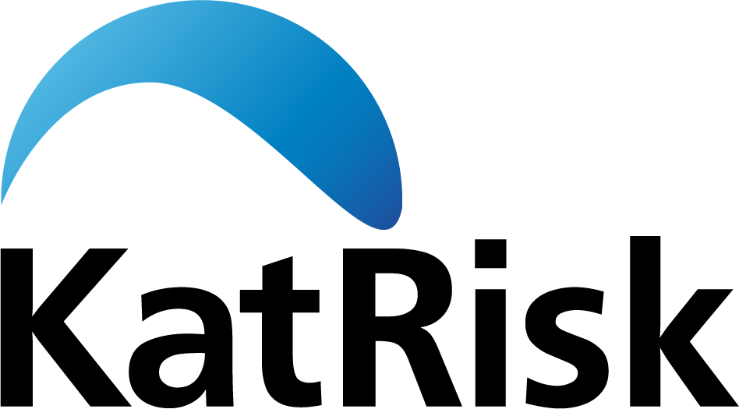


  Related Publications:
  “Reduction in Insurance Premiums Attributable to Mangrove Systems
  in the Philippines.” Lemke-Verderame et. al., in preparation.
  Triggering Change: Parametric Solutions for Climate Resilience (https://www.marshmclennan.com/insights/publications/2023/april/triggering-change-parametric-solutions.html)
Reduction in insurance premiums attributable to Nature-Based solutions
New Jersey Coastal Resilience Collaborative Coastal Flooding Technical Workshop
March 19, 2025
Laura (Lemke) Verderame, PhD (Laura.Verderame@guycarp.com)
Roberto Guidotti, PhD (Roberto.Guidotti@guycarp.com)
Guillermo Franco, Ph.D., A.Re. (Guillermo.E.Franco@guycarp.com)
Philippines Case Study prepared in collaboration with:
A business of Marsh McLennan

Slide 14
Important Disclosure
Guy Carpenter & Company, LLC provides this report for general information only. The information and data contained herein is based on sources we believe reliable, but we do not guarantee its accuracy, and it should be understood to be general insurance/reinsurance information only. Guy Carpenter & Company, LLC makes no representations or warranties, express or implied. The information is not intended to be taken as advice with respect to any individual situation and cannot be relied upon as such. Please consult your insurance/reinsurance advisors with respect to individual coverage issues.
Readers are cautioned not to place undue reliance on any calculation or forward-looking statements. Guy Carpenter & Company, LLC undertakes no obligation to update or revise publicly any data, or current or forward-looking statements, whether as a result of new information, research, future events or otherwise.
Statements concerning tax, accounting, regulatory or legal matters should be understood to be general observations based solely on our experience as reinsurance brokers and risk consultants and may not be relied upon as tax, accounting, regulatory or legal advice, which we are not authorized to provide. All such matters should be reviewed with your own qualified advisors in these areas.
This document or any portion of the information it contains may not be copied or reproduced in any form without the permission of Guy Carpenter & Company, LLC, except that clients of Guy Carpenter & Company, LLC need not obtain such permission when using this report for their internal purposes.
The trademarks and service marks contained herein are the property of their respective owners.
© 2025 Guy Carpenter & Company, LLC
All Rights Reserved

