Slide 1


New Jersey’s Regulatory Response to a changing climate
NJPACT REAL
NJ Protecting Against Climate Threats
Resilient Environments and Landscapes
19 March 2025
Vincent J. Mazzei, Jr., P.E.
NJ State Floodplain Administrator

Slide 2

FLOOD RISK ASSESSMENT
New Jersey’s colonial settlements were along the coast and navigable waterways.
As a result, many of the State’s population centers are located within flood hazard areas today.
Older development was often built without regard for potential flood risk.

Slide 3

FLOOD RISK ASSESSMENT
Flood risk is generally measured by what has happened in the past.
Based on data collected over the past 50+ years, as shown on FEMA flood insurance rate maps.
Not an accurate predictor of today’s flood risk.
Not a sound methodology for predicting flood risk due to climate change.

Slide 4
FLOOD RISK ASSESSMENT
People need to be aware of flood risks when buying, renting, occupying or developing property.
  Mapping is a good starting point to assess risk but flooding often exceeds mapped floodplain limits.
Floods don’t stop at a line on a map.

Slide 5
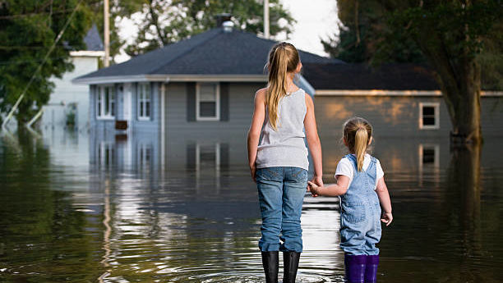
Socioeconomic Implications
Superstorm Sandy alone:
Two million households in the state lost power
346,000 homes were damaged or destroyed
Economic losses to businesses of over $30 billion
37 people in NJ were killed
Primary, secondary, and tertiary impacts felt for years

Slide 6
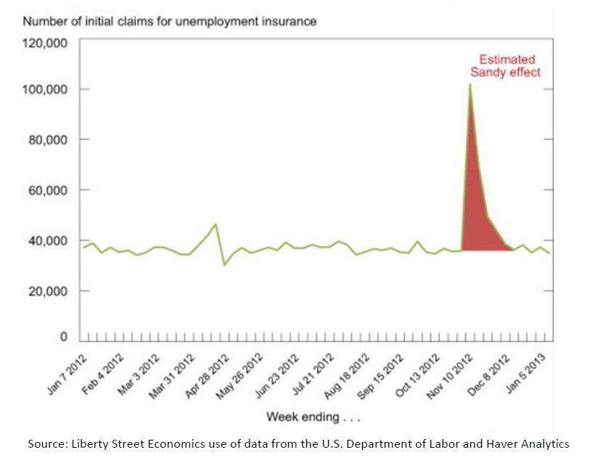


Slide 7
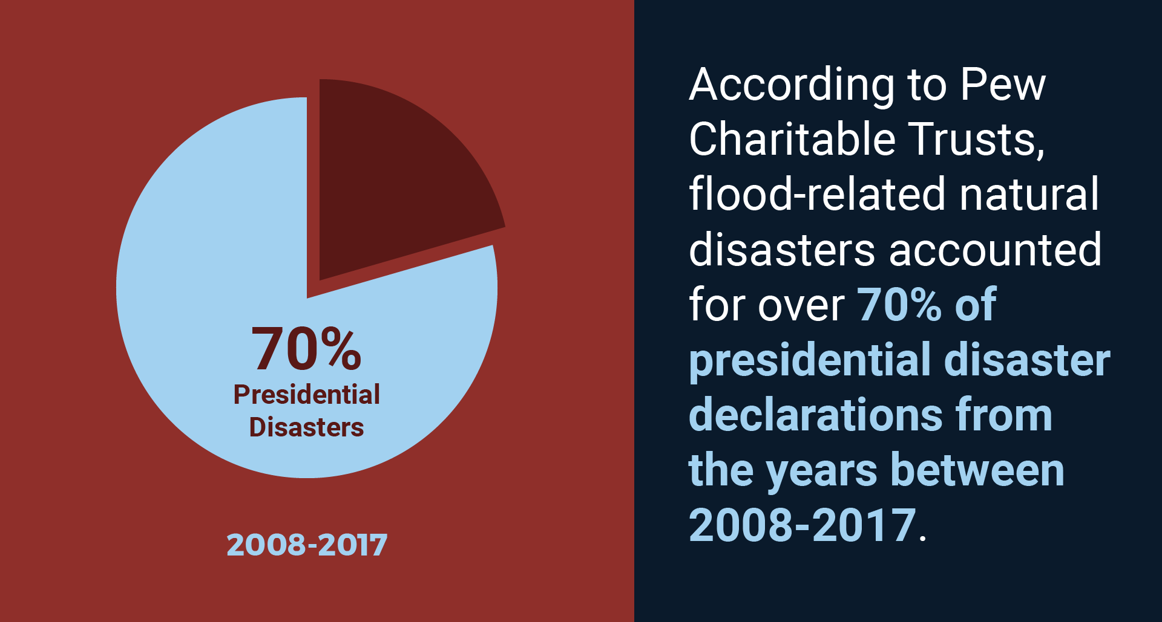

Slide 8
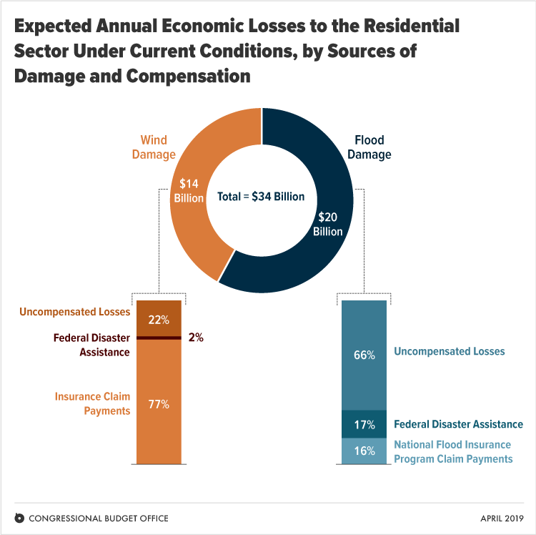

Slide 9
Socioeconomic Implications
Most densely populated state
Chronic flooding issues
Large areas of state subject to flooding
Enormous development pressure
Development can increase flooding
Climate change
Unsustainable Condition

Slide 10
“Flooding is New Jersey’s
#1 Natural Hazard”
FEMA, August 4, 2004

Slide 11


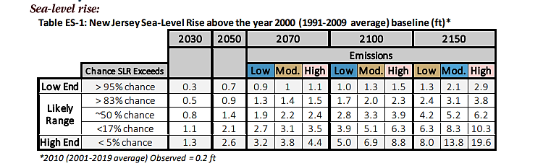
Coastal Inundation & Flood Damage
Rutgers University’s Science and Technical Advisory Panel (STAP) Report indicates a 50% probability that sea level rise will exceed 3.3 feet and a 17% probability that sea level rise will exceed 5.1 feet by 2100 assuming moderate emissions.
For general discussion purposes only. Information provided is pre-decisional and does not constitute a final agency decision or action.
https://njclimateresourcecenter.rutgers.edu/resources/nj-sea-level-rise-reports/

Slide 12
Coastal Inundation & Flood Damage
Rutgers University’s Science and Technical Advisory Panel (STAP) Report indicates a 50% probability that sea level rise will exceed 3.3 feet and a 17% probability that sea level rise will exceed 5.1 feet by 2100 assuming moderate emissions.
For general discussion purposes only. Information provided is pre-decisional and does not constitute a final agency decision or action.
https://njclimateresourcecenter.rutgers.edu/resources/nj-sea-level-rise-reports/

Slide 13
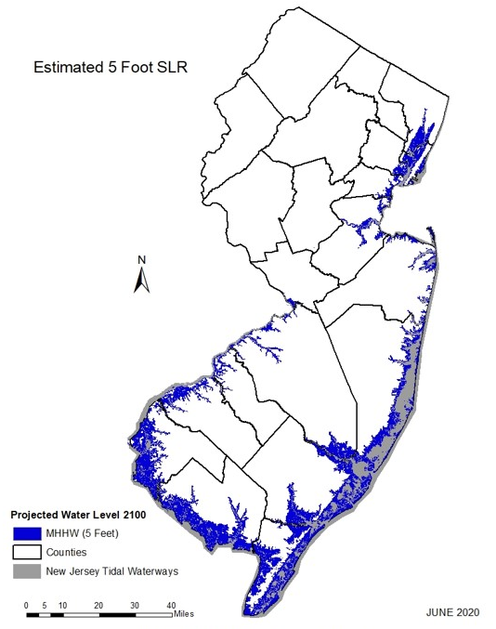
Fixing Data Gaps to Protect Coastal Investments
Sea Level Rise = More land regularly or permanently inundated
More Inundation =
Higher flood elevations
Higher Elevations =
More recurring flood damage
Existing flood standards are based on outdated historical trends that do not account for sea-level rise and attendant storm surge.
Many roads and buildings built today are likely to be serviceable by 2100.
  Reliance on incomplete and inaccurate data leads to inadequate risk assessment and substandard design criteria for buildings and infrastructure.
For general discussion purposes only. Information provided is pre-decisional and does not constitute a final agency decision or action.

Slide 14
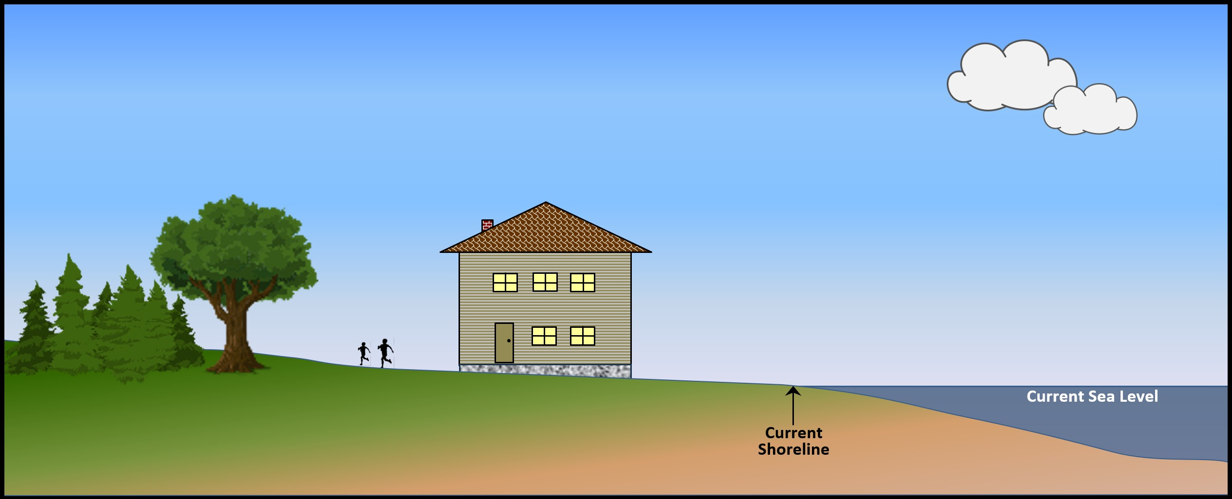
Inundation Risk Zone

Slide 15
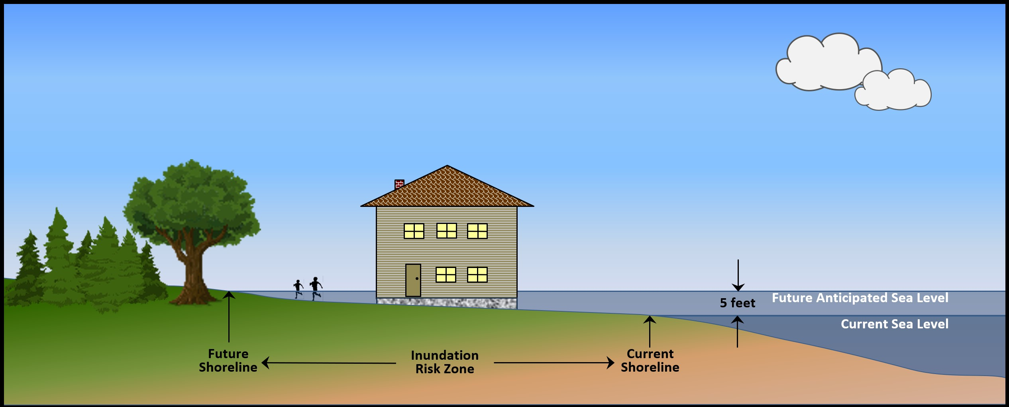
Inundation Risk Zone

Slide 16
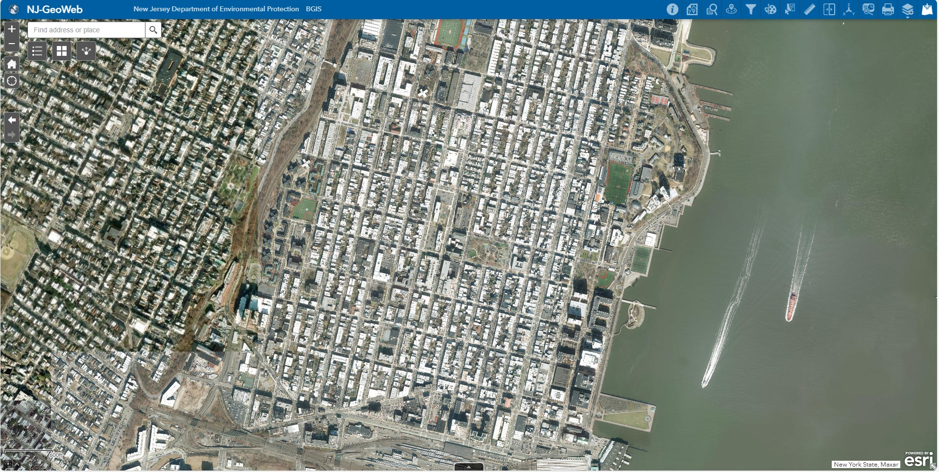

Slide 17
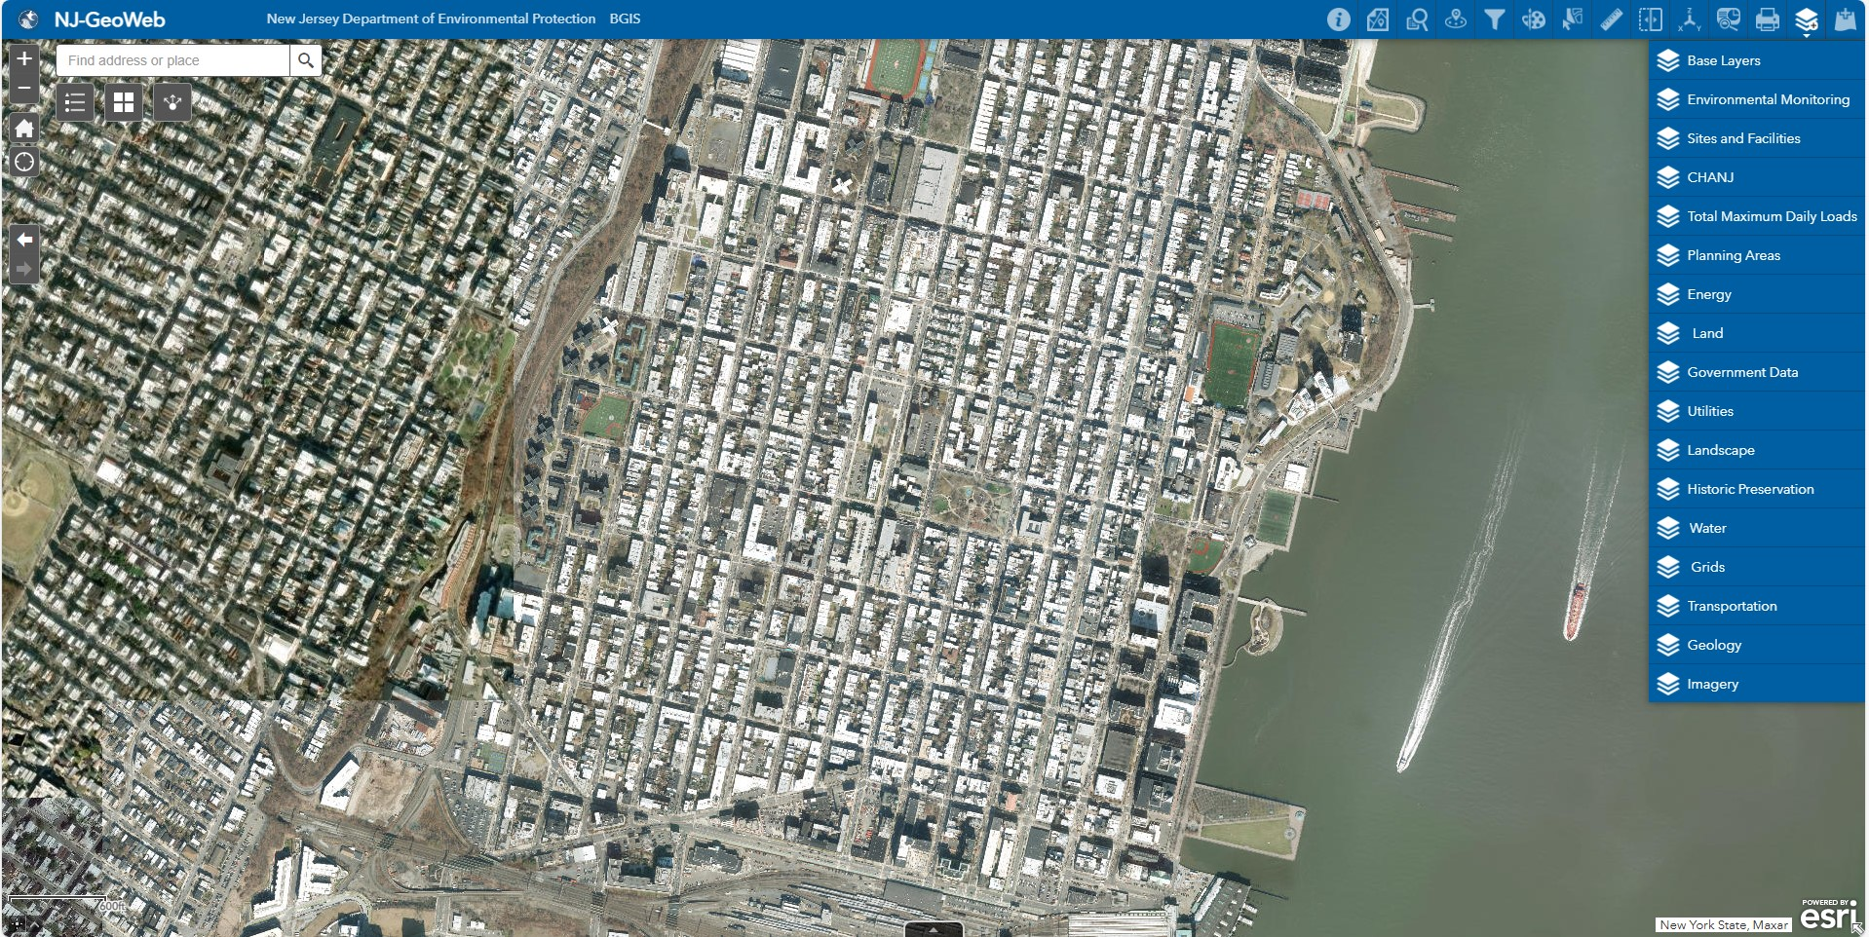

Slide 18
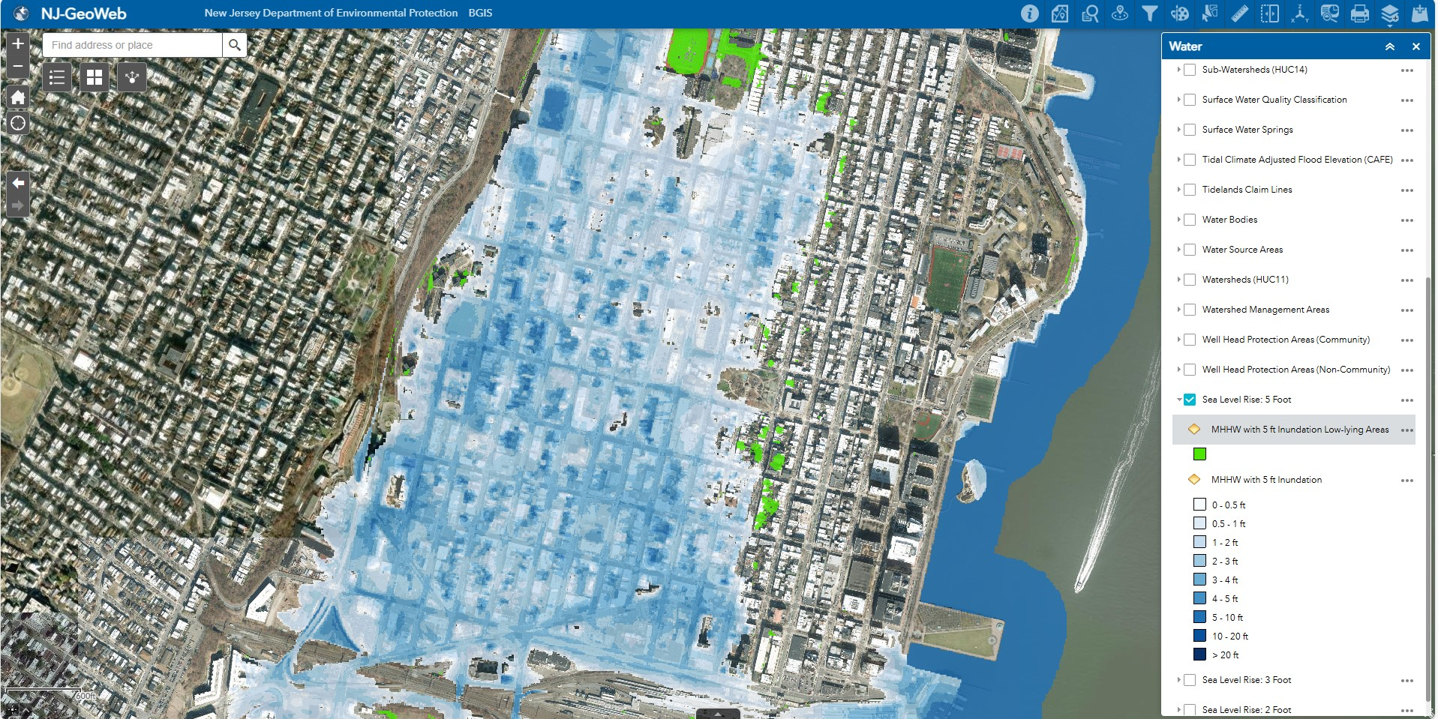

Slide 19
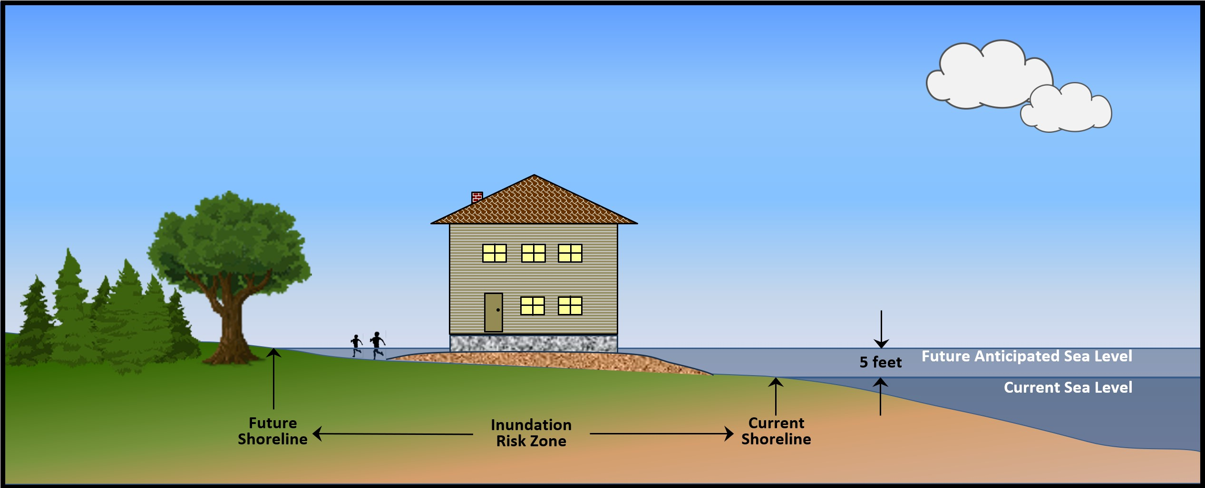
Inundation Risk Zone

Slide 20
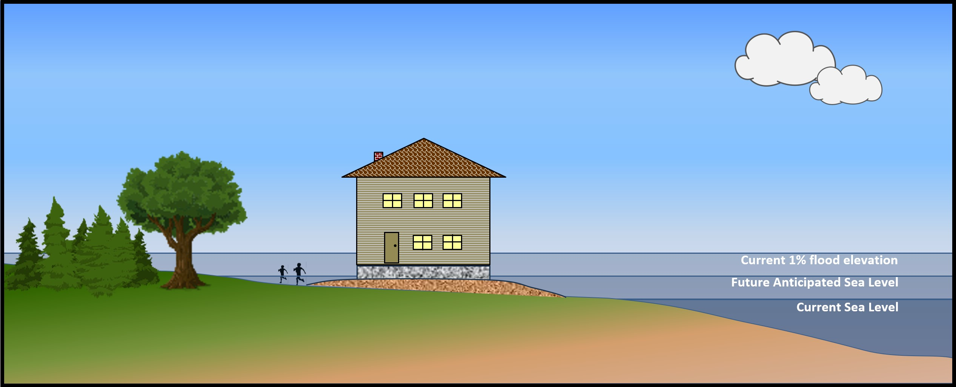
Inundation Risk Zone and Future Flood Elevation

Slide 21
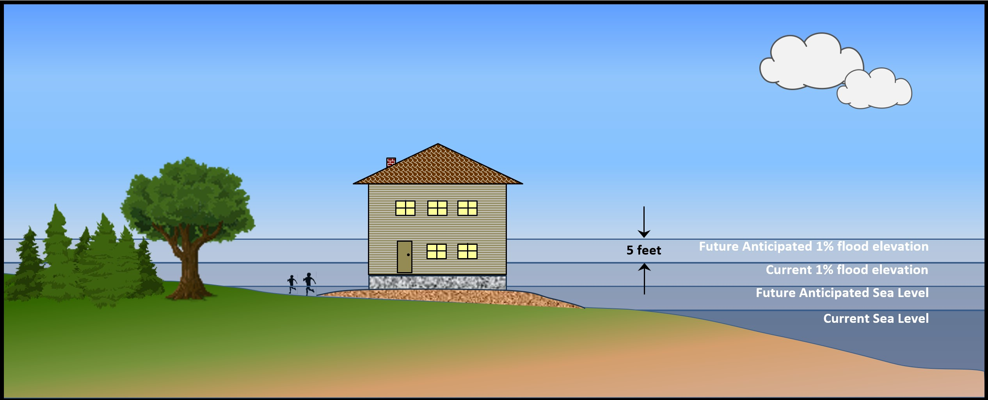
Inundation Risk Zone and Future Flood Elevation
CLIMATE ADJUSTED FLOOD ELEVATION

Slide 22
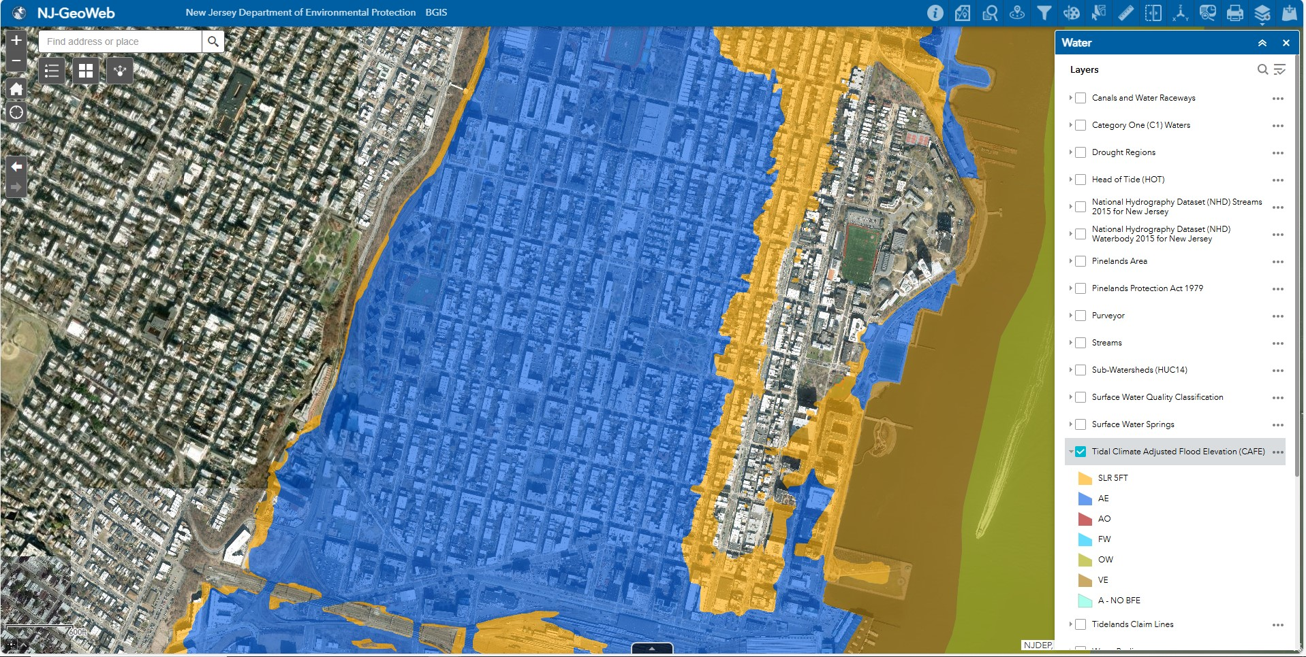

Slide 23
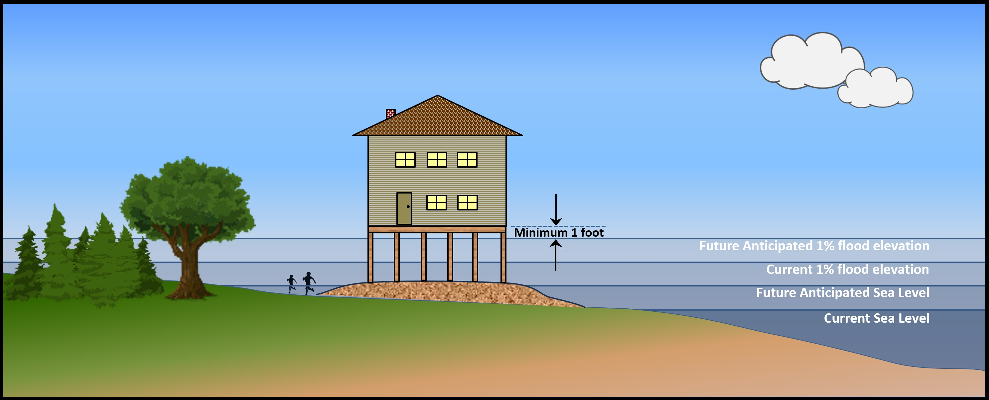
Inundation Risk Zone and Future Flood Elevation
CLIMATE ADJUSTED FLOOD ELEVATION
Fill

Slide 24
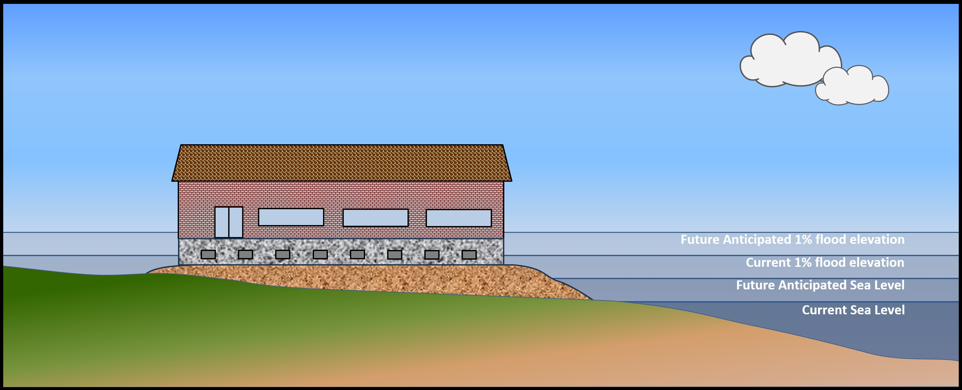
Inundation Risk Zone and Future Flood Elevation
CLIMATE ADJUSTED FLOOD ELEVATION
Fill

Slide 25
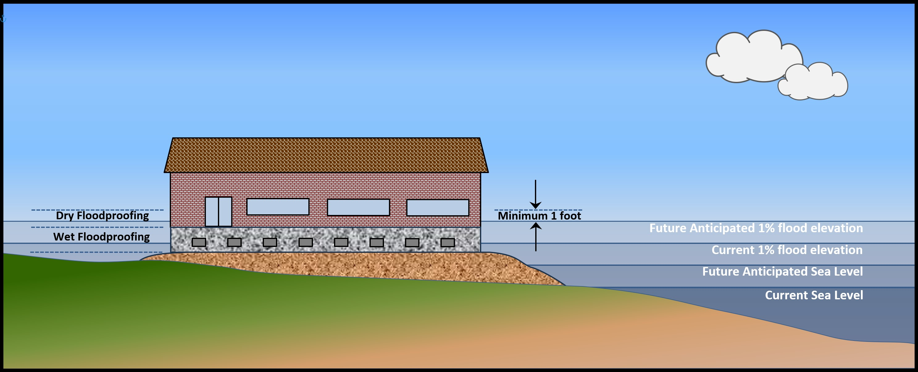
Inundation Risk Zone and Future Flood Elevation
CLIMATE ADJUSTED FLOOD ELEVATION
Fill

Slide 26
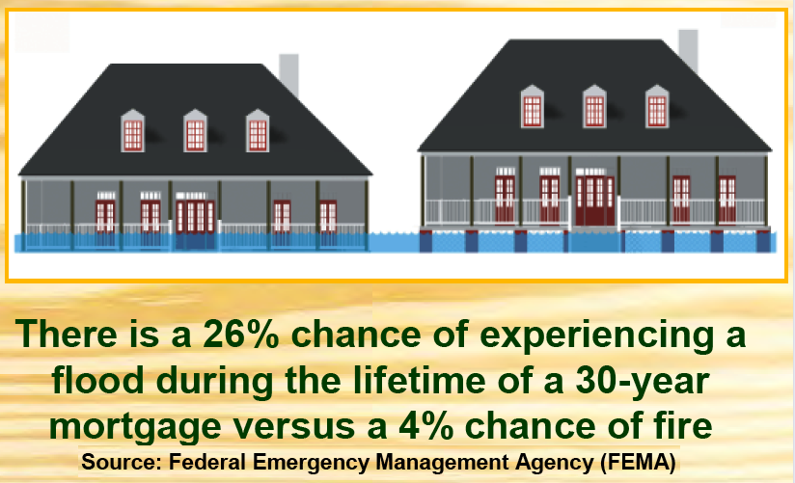

Slide 27
For more information see REAL website: https://dep.nj.gov/njreal email: vincent.mazzei@dep.nj.gov
z

