Slide 1

FLOOD RISK AND BASEMENT HOUSING IN NEW YORK CITY: The Impact of Extreme Weather on Vulnerable Housing Stock
Ambika Nair
Claire Kramer Mills
The views here are those of the authors and do not necessarily represent those of the Federal Reserve Bank of New York or the Federal Reserve System.
March 2025

Slide 2

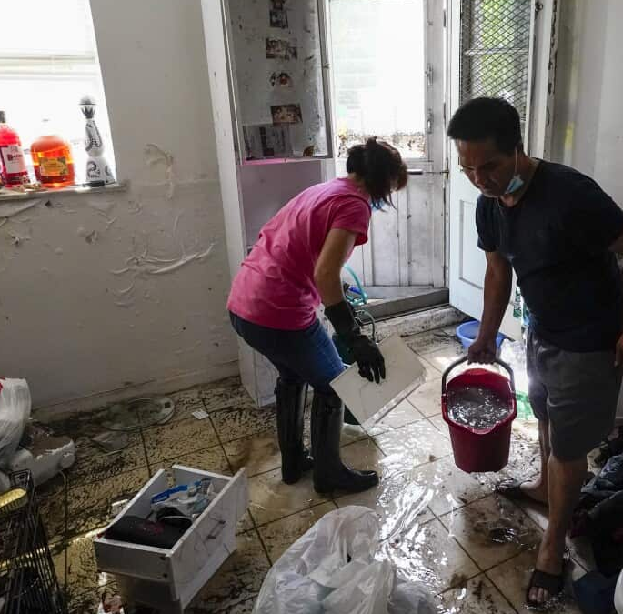
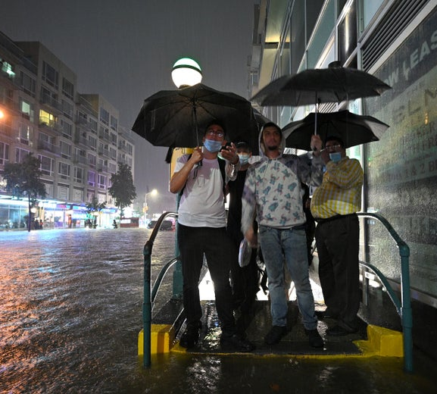
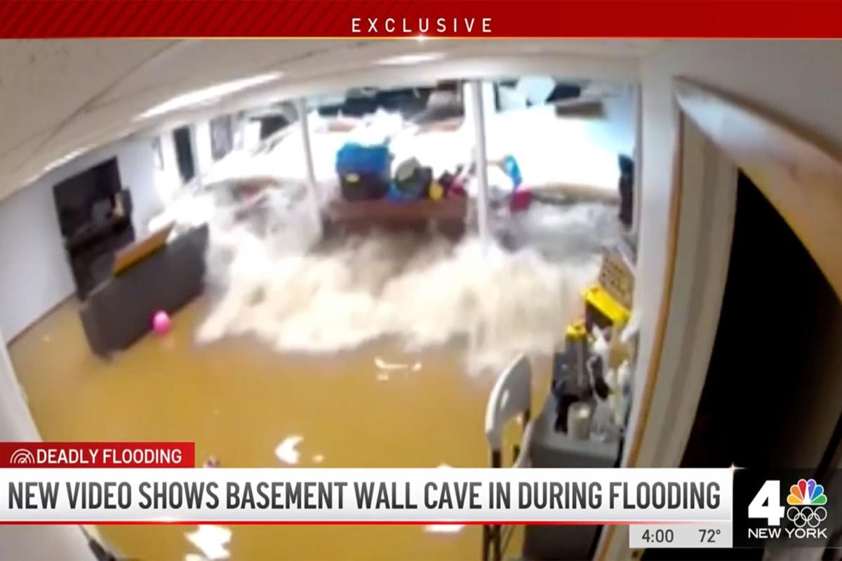
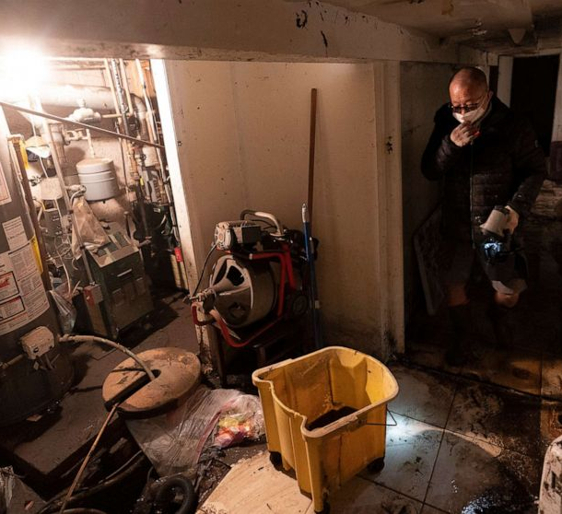
Hurricane Ida and Flood-Prone Basement Housing in NYC
Hurricane Ida, which struck New York in early September 2021, exposed the region’s vulnerability to extreme rainfall and inland flooding.
The storm caused $7.5 billion in damage to homes and vital infrastructure in New York state. It was responsible for the deaths of eleven people in their basement homes, highlighting specific risks to inhabitants of low-lying units.
Severe rainstorm events like Ida are becoming more intense and more likely to overwhelm existing infrastructure and threaten low-lying housing stock.
The intersection of natural hazards, severe housing shortages, and public safety raises the importance of identifying which neighborhoods contain the highest shares of flood-prone dwellings.

Slide 3
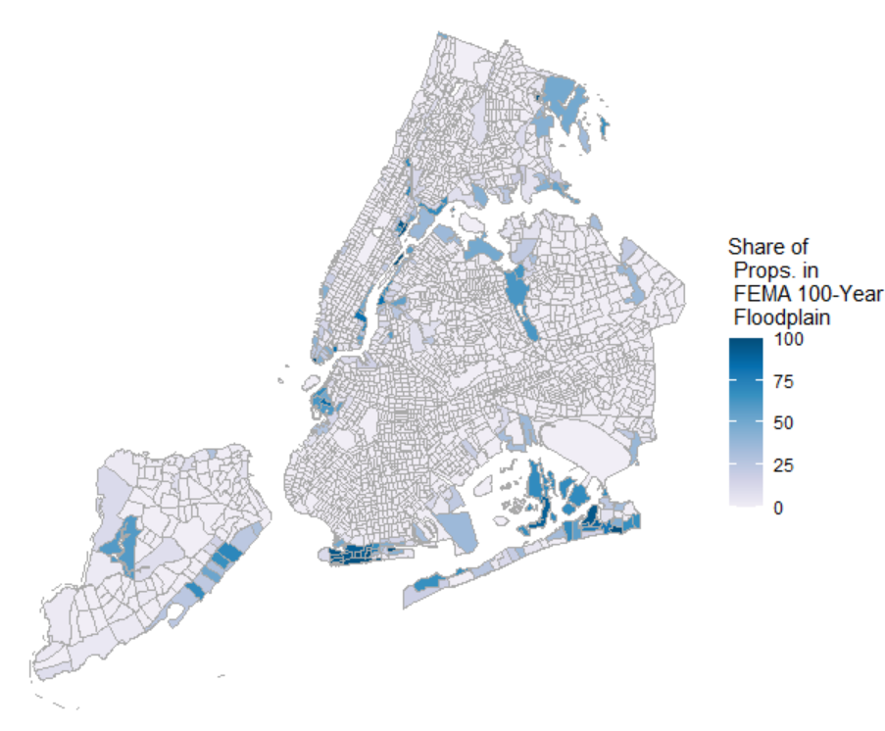
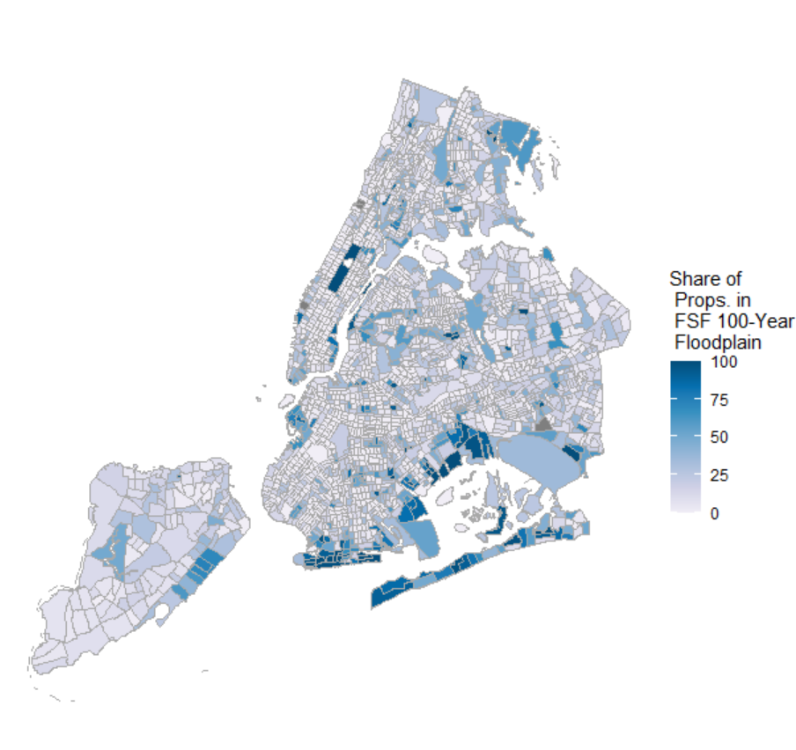
Flood Risk in New York City: 100-year Flood Plain
Combined FEMA and First Street Foundation flood risk metrics to create a holistic picture of coastal, riverine, and rainfall-driven flooding.
  Hurricane Ida (2021) saw severe and deadly basement flooding in inland areas of Brooklyn and Queens, in areas more prone to rainfall-driven flooding not consistently captured by the FEMA 100-year floodplain.
FEMA 100-Year Floodplain
First Street Foundation 100-Year Floodplain
Data: First Street Foundation (2021); FEMA
Note: The 100-year floodplain using First Street Foundation data was found by calculating the share of properties experiencing greater than zero inches of flooding in the 100-year return period.
Data: First Street Foundation (2021); FEMA

Slide 4
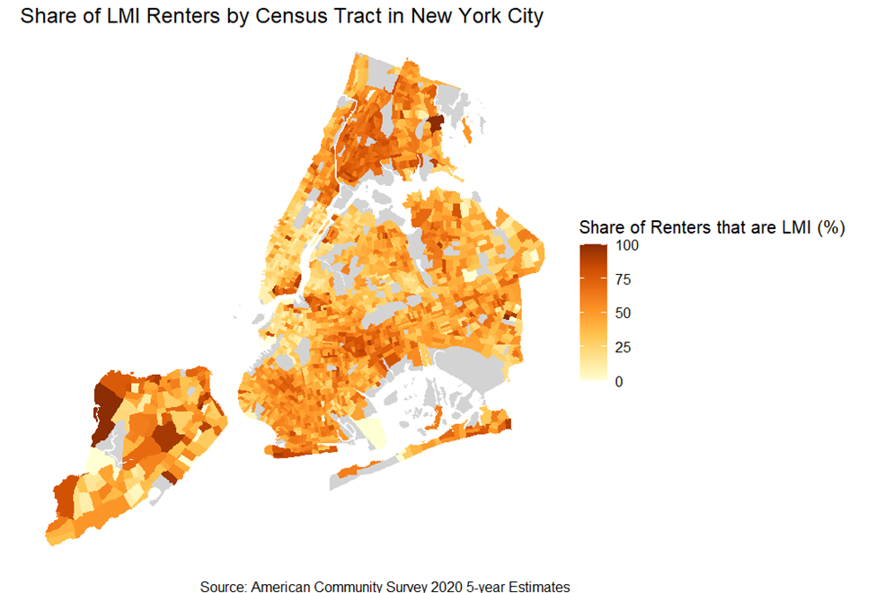
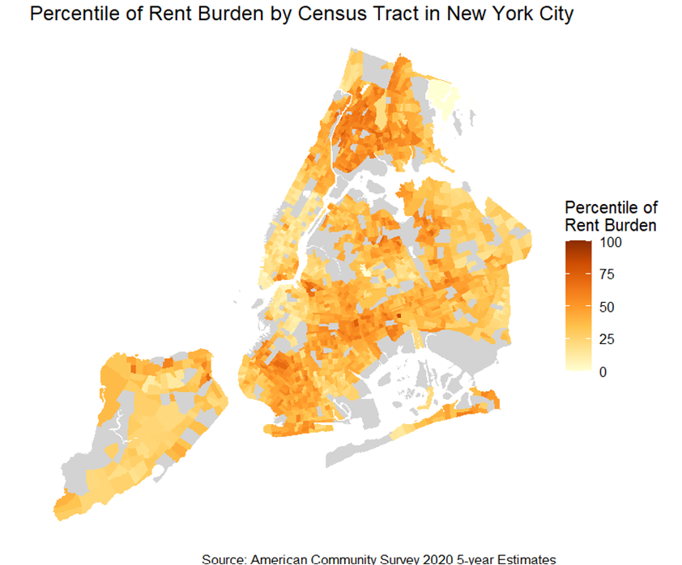
Low-and-Moderate Income Renter Populations & Rent Burden in New York City

Slide 5
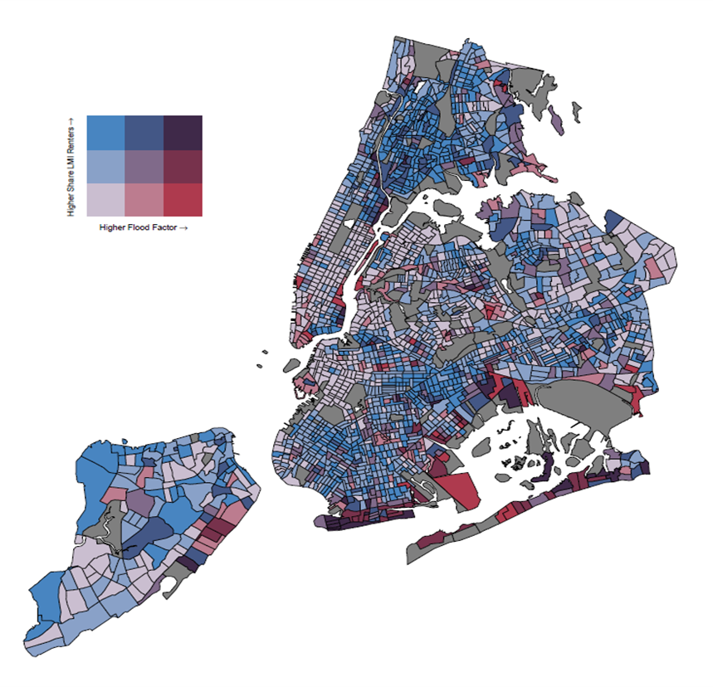
Flood Exposure to Low-and-Moderate Income Renter Populations
Tracts with the highest flood risk for low-income renters include East Bronx, East Harlem, the East Coast of Staten Island, Southern and Eastern Brooklyn, the Lower East Side of Manhattan, and Southern Queens.
Over 50 percent of LMI households and approximately 40 percent of racial minorities and immigrants largely live in areas that are at high flood risk.
Data: American Community Survey (5-year, 2017-2021); First Street Foundation (2021)
Note: Dark gray census tracts indicate data are not available. The numeric buckets for the share of LMI renters axis are 0-31 percent, 31-64 percent, and 64-100 percent.

Slide 6
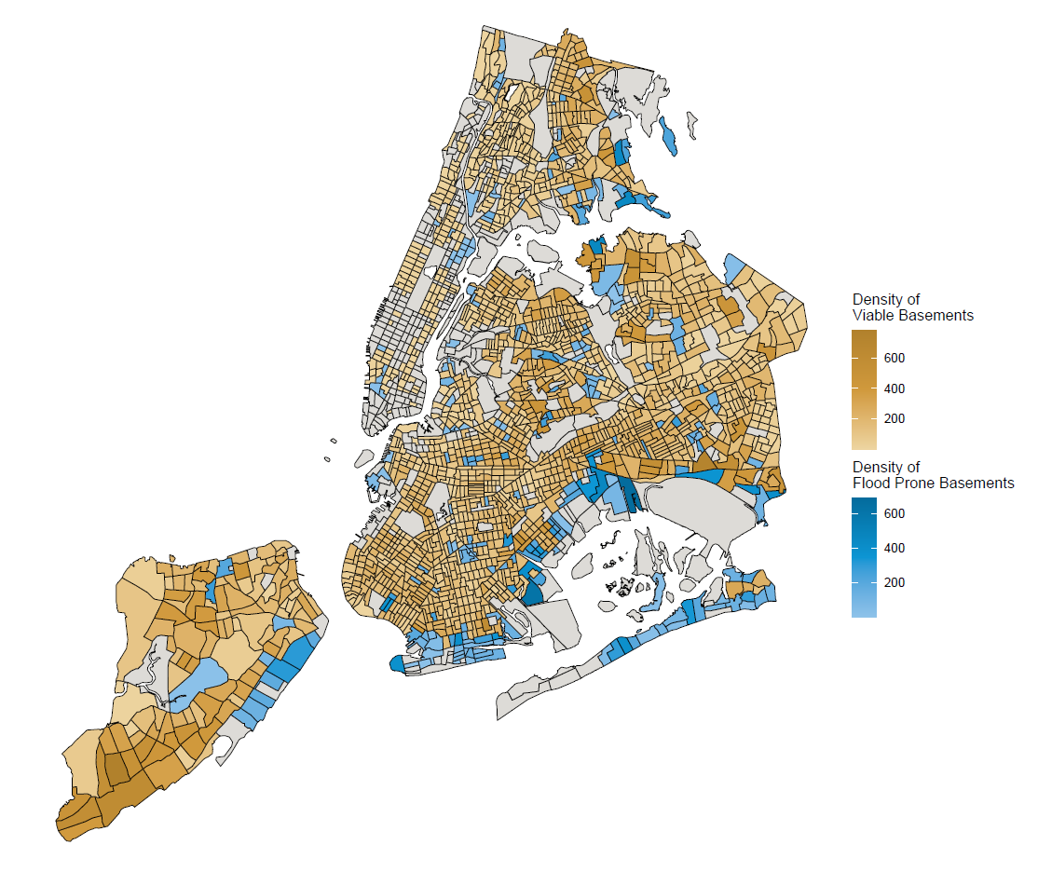
Flood-Prone Basement Housing and Resident Characteristics
Basement Type | LMI | Immigrants | Racial/ethnic minorities | Monthly Median Rent ($)
Census Tracts with Flood-Prone Basements | 9% | 9% | 10% | $1,494
Census Tracts with Coastal Flood-Prone Basements | 4% | 5% | 4% | $1,325
Census Tracts with Pluvial Flood-Prone Basements | 5% | 4% | 6% | $1,510
Approximately 10 percent of low-income and immigrant New Yorkers live in census tracts with high concentrations of basement apartments at high risk of flooding.
Our estimates of the viable versus flood-prone housing stock suggest that adjacent and nearby neighborhoods that are affordable and less vulnerable to storms could be developed as future sites of safe dwellings.
Data: PLUTO NYC Database version 23.1; First Street Foundation (2021); FEMA
Note: Dark gray areas indicate that there are no identifiable potential basement dwellings in the census tract, given the data-filtering process used here.

Slide 7


FRBNY Community Development:
Research on Flood Risk in LMI Communities
Flood Risk and Basement Housing in New York City: The Impact of Extreme Weather on Vulnerable Housing Stock
Ambika Nair
Claire Kramer Mills
Flooding Impacts on Household Finances: Insights from Focus Groups in New York City
Dyvonne Body
Contact:
  Ambika Nair
  ambika.nair@ny.frb.org

