Slide 1

Tools for Assessing, Communicating, and Responding to Sea Level Rise and Coastal Flood Risk
March 19, 2025
Notes:
First of regular monthly business meetings - both FV/Biz-Dev
Looking forward to your feedback, input, and guidance as we lay out our next steps, and make decisions.
We aim to manage costs within the tight budget without compromising FloodVision's revenue potential or mission goals.

Slide 2
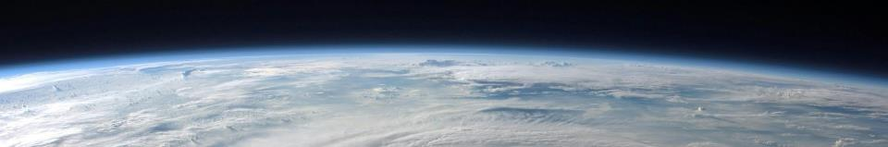
A Little About Climate Central
We use science, big data, and technology to generate thousands of local storylines and compelling visuals that make climate change personal and show what can be done about it
We are non-profit, non-partisan, non-advocacy
We provide localized and evidence-based information on climate science, impacts, & solutions
Notes:
I’m Dan Rizza and I lead the Program on Sea Level Rise at Climate Central. First I’ll tell you a bit about Climate Central. We are a somewhat eclectic group of climate scientists, meteorologists, journalists and television producers, graphic artists, software programmers, policy wonks, and data nerds. But the heart of what we do is to try and translate complicated science into storytelling, graphics, and tools that help explain the risks and impacts of climate change at the local level and point people toward the solutions.

Slide 3
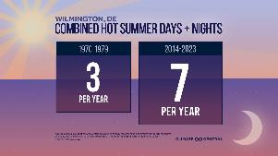
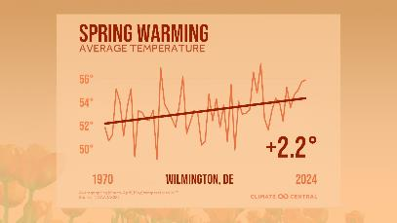
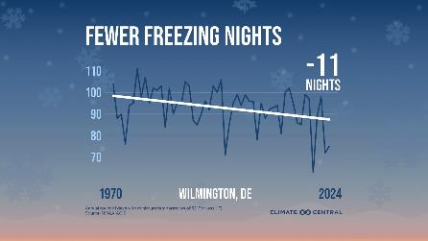
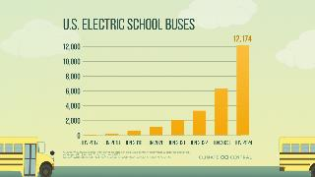
Climate Matters Program
Notes:
And our Climate Matters team produces free weekly climate reporting materials in English and Spanish, localized for 245+ U.S. cities and media markets. Each week, we provide data analysis, localized graphics, science explainers, and other reporting resources on timely topics.
Many of you in the resilience world are not just dealing with flooding, but also with wildfires, heat events and other extreme weather. You can sign up for a weekly newsletter, at https://www.climatecentral.org/climate-matters

Slide 4
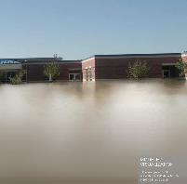
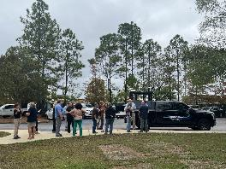
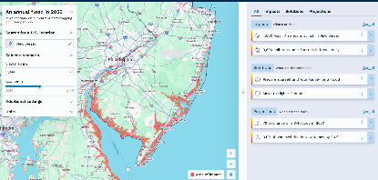
Sea Level Rise Program
FloodVision®
Coastal Risk Finder
Notes:
Some of you may have used our free tools in the past. The Coastal Risk Screening Tool is an interactive map showing areas threatened by sea level rise and coastal flooding. This allows you to enter an address (almost anywhere in the world) and find what sea level rise and flood risk is for decades going forward, or by water level, or by global temperature increases. We also have maps that show affordable housing at risk, and wetlands at risk. Set to premiere in April, is our re-launch of our Coastal Risk Finder Tool, which will allow you to visit any U.S. coastal location and find out what’s at risk, looking at populations and demographics using Census data, as well as miles of road, infrastructure, and other important information to help with resilience grant proposals

Slide 5
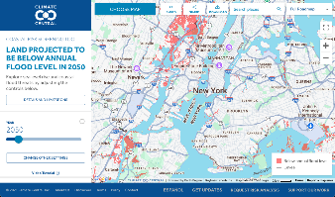
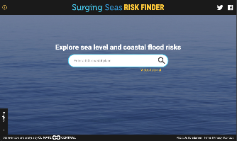
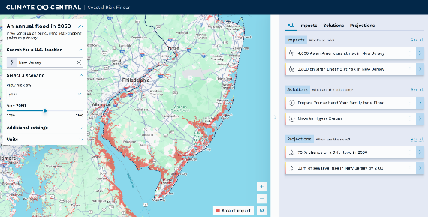
+
Notes:
I think you recall that we spoke with over 100 end users a couple of years ago to understand their needs. This led us to merge our high-traffic mapping interface with our risk analysis tool, Risk Finder, creating a single platform that helps users quickly find places they care about and key takeaways they can bring to their communities and work.
So far, we've only shared it with Queen Quet’s Sustainability Think Tank and a few select users at the Tools Café at Coastal GeoTools—and are in process of reaching out to many from CREWs – response has been overwhelmingly positive.
We have set our release date to April to give us enough time to ensure we incorporate the most impactful features and meet end-user needs.

Slide 6
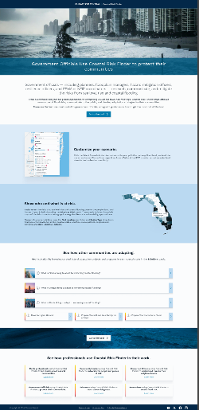
Notes:
CSO feedback - all surrounding what we’d provide in these pages

Slide 7
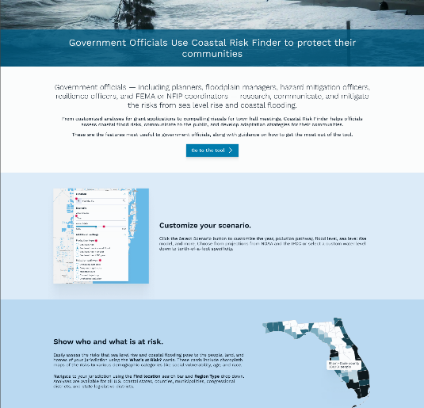
Notes:
Community leaders
Media professionals
Researchers
Concerned citizens
Educators
Gov officials

Slide 8
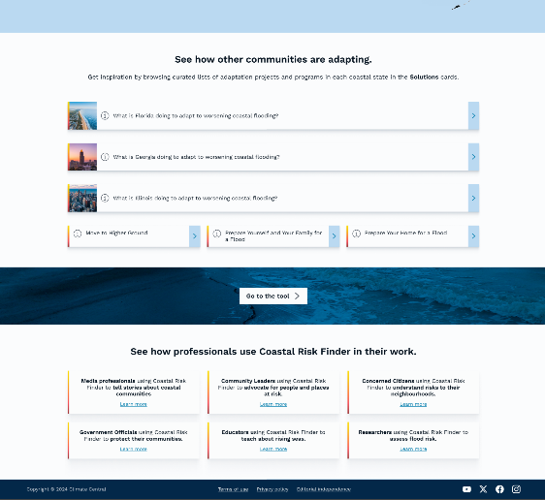

Slide 9
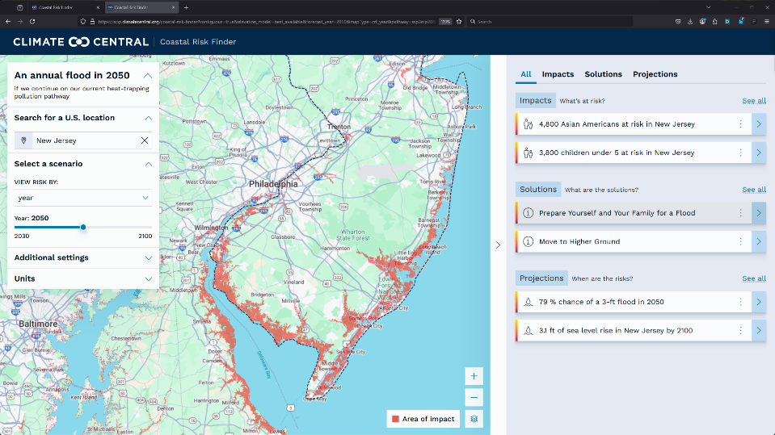

Slide 10
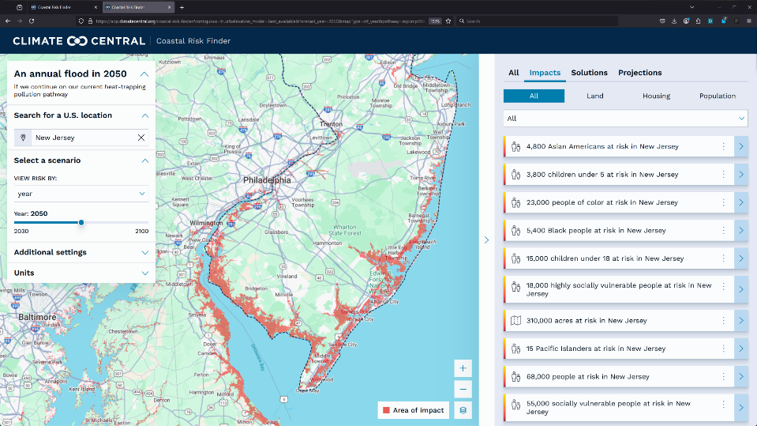

Slide 11
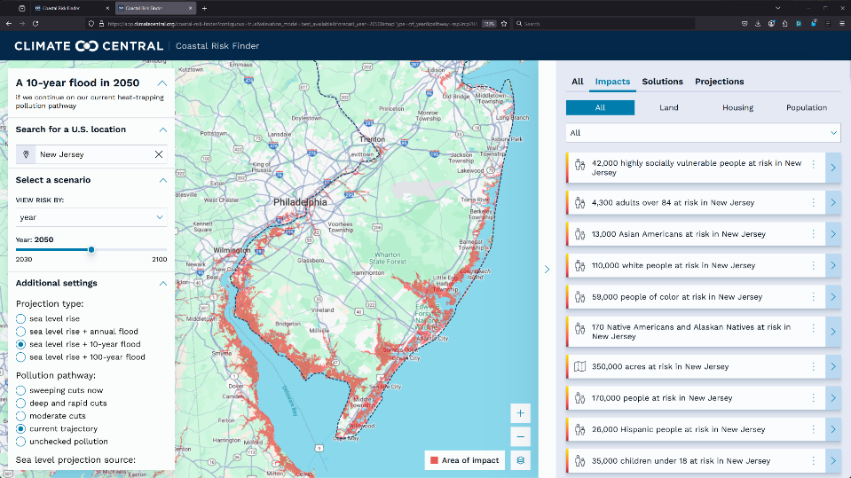

Slide 12
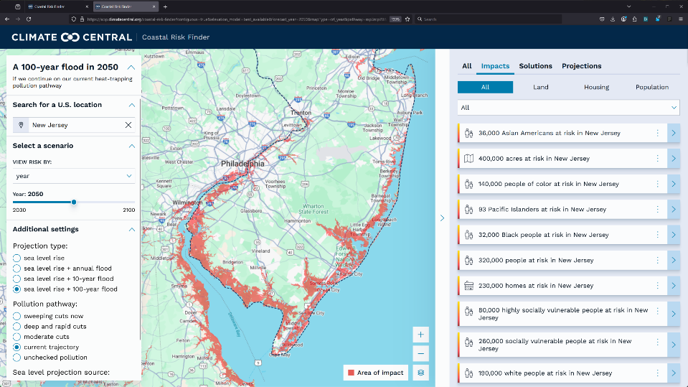

Slide 13
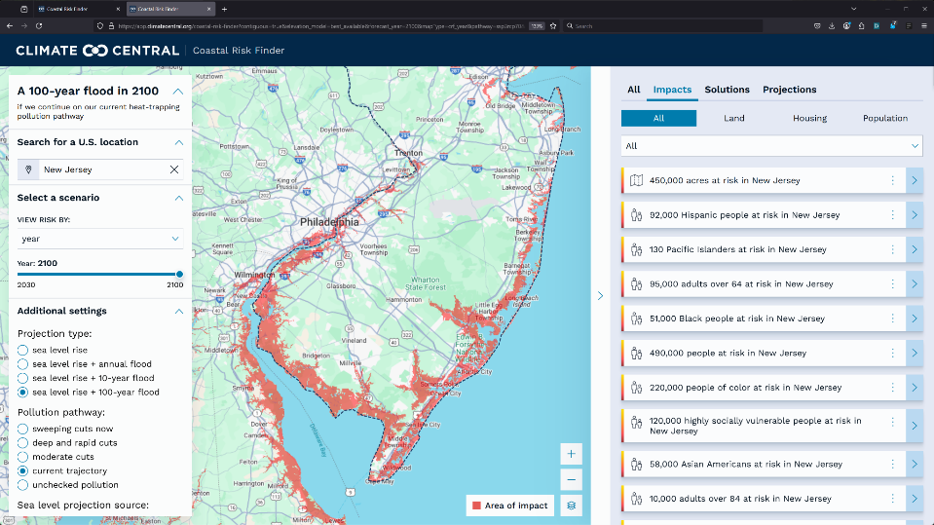

Slide 14
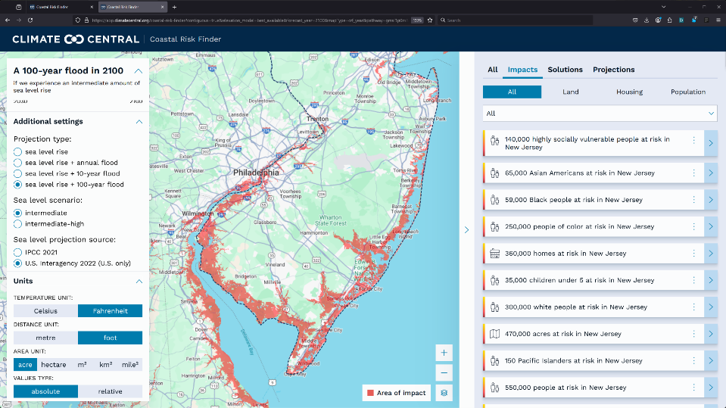

Slide 15
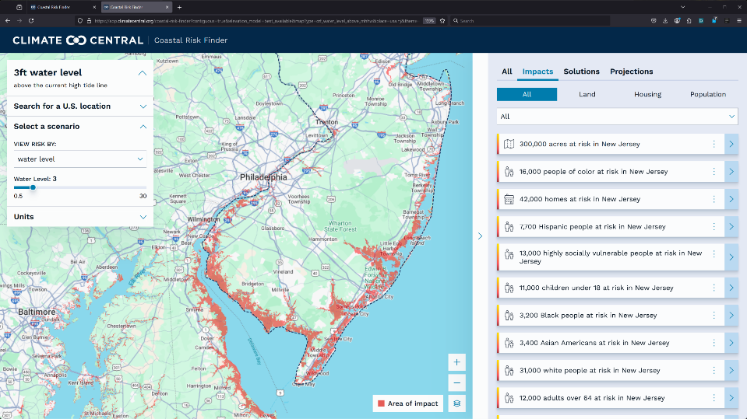

Slide 16
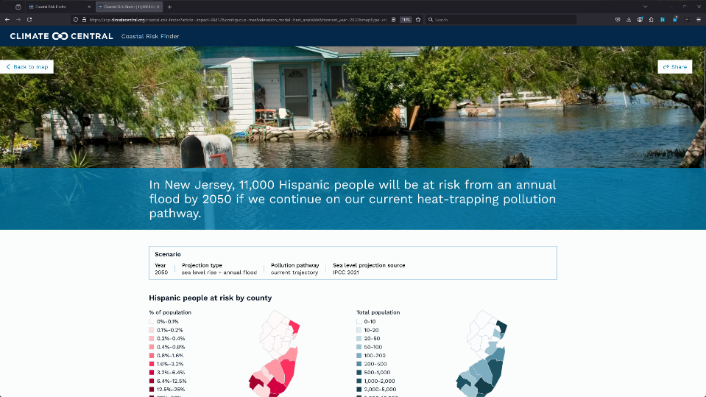

Slide 17
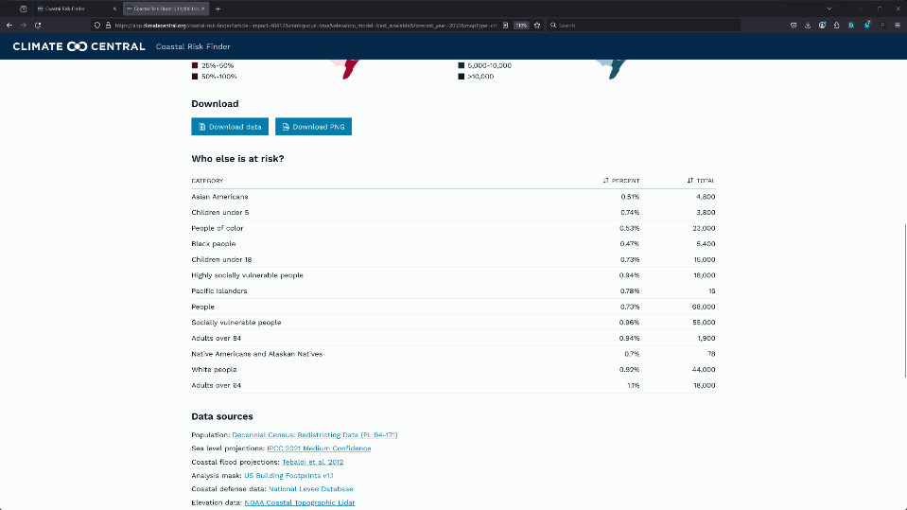

Slide 18
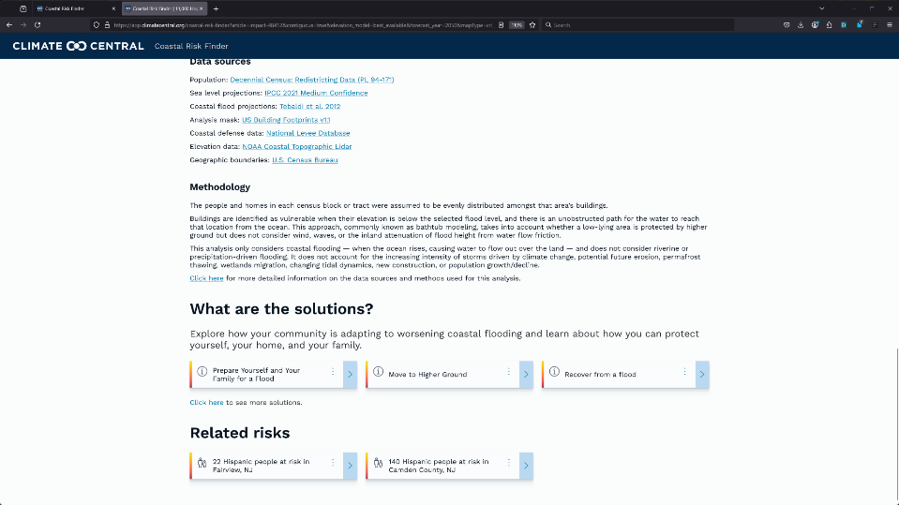

Slide 19
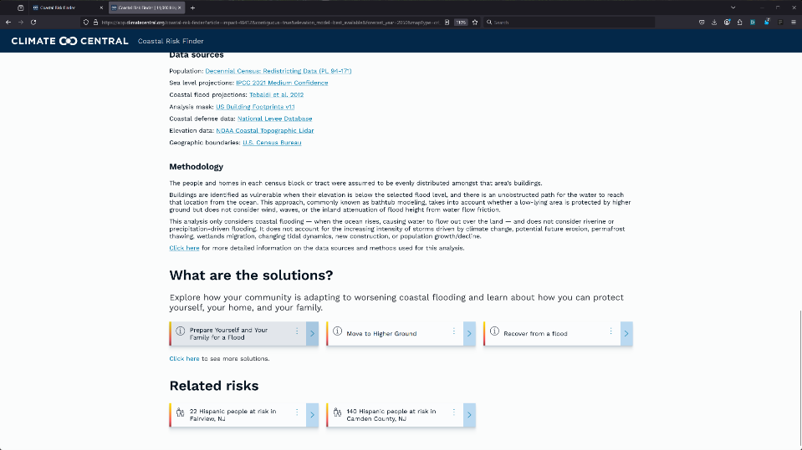

Slide 20
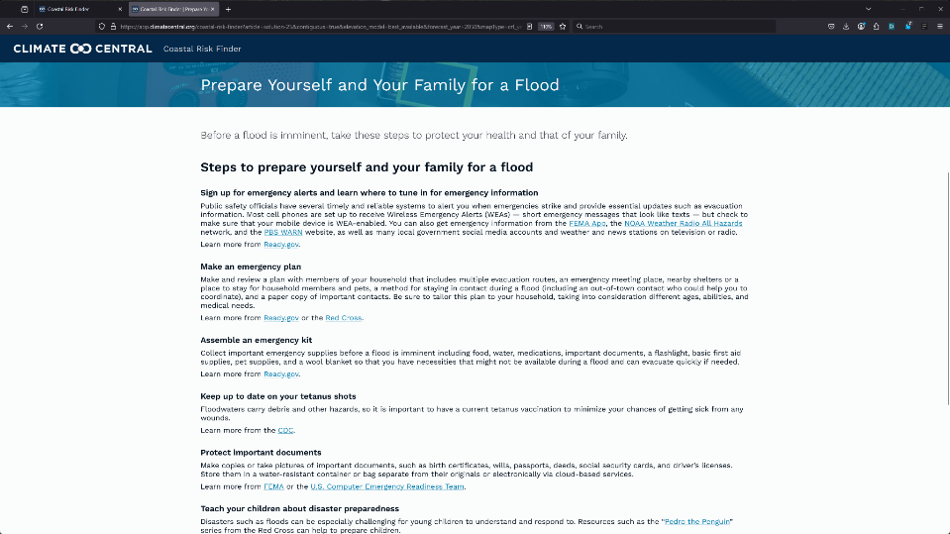

Slide 21
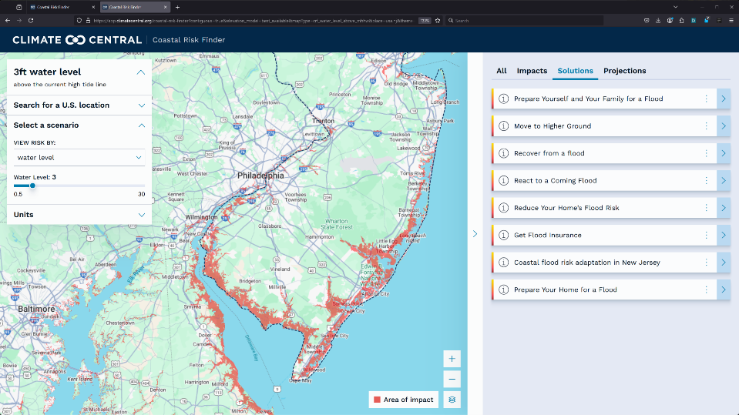

Slide 22
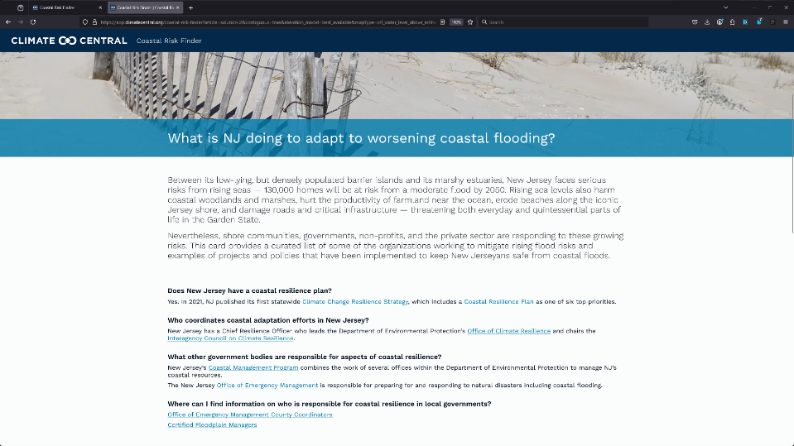

Slide 23
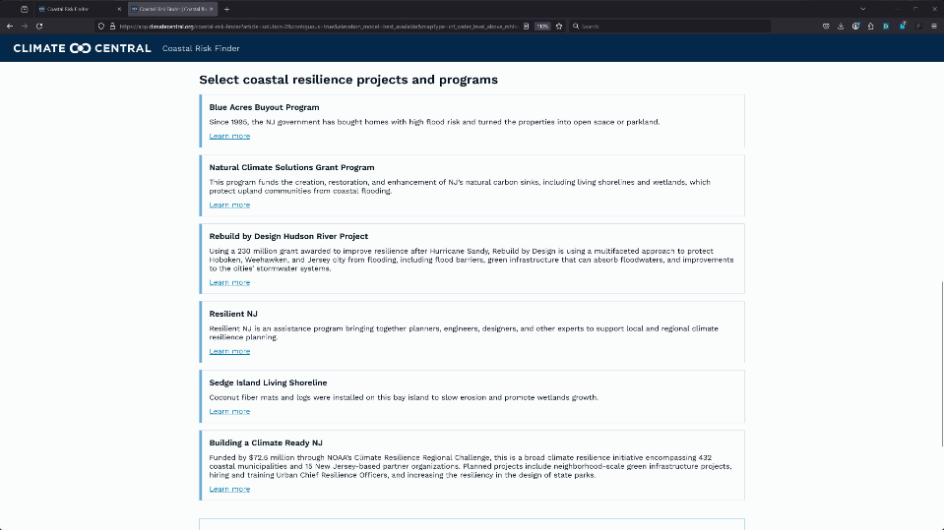

Slide 24
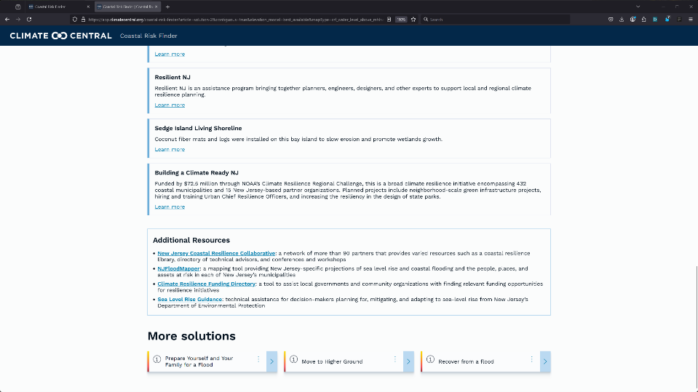

Slide 25
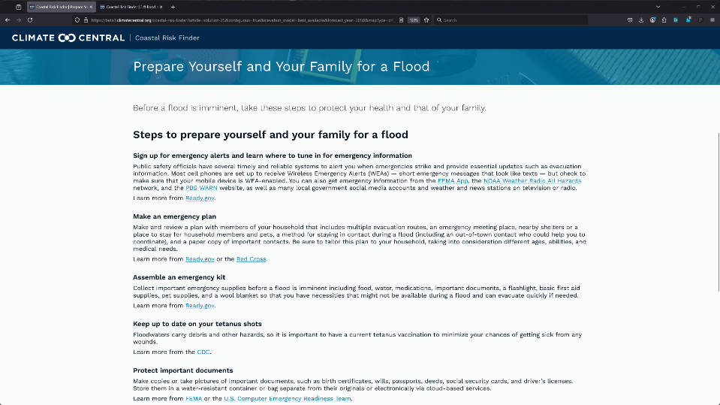

Slide 26
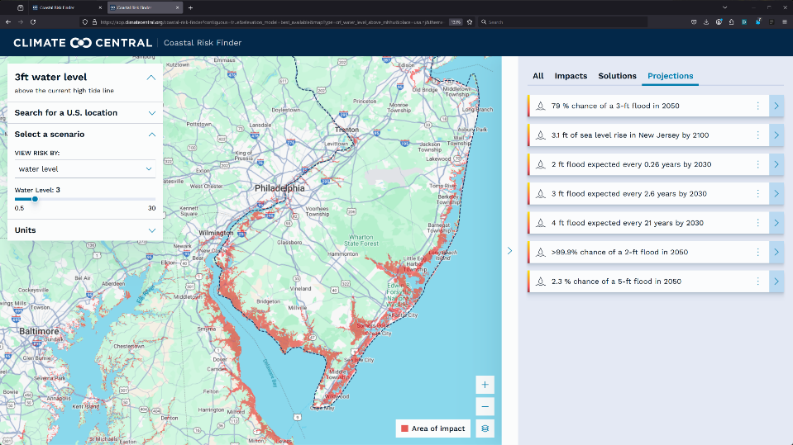

Slide 27
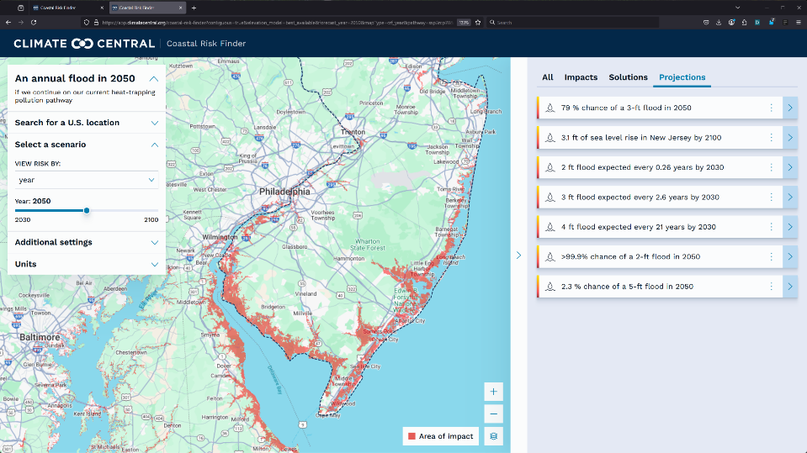

Slide 28
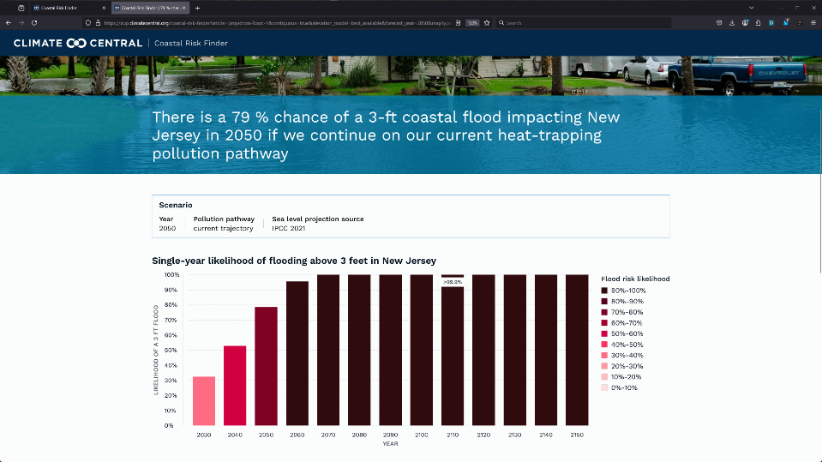

Slide 29
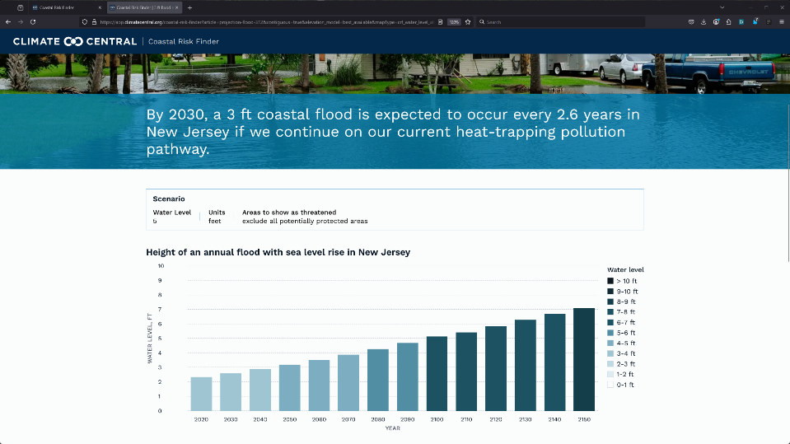

Slide 30

If you can see the future, you can shape the future
Notes:
First of regular monthly business meetings - both FV/Biz-Dev
Looking forward to your feedback, input, and guidance as we lay out our next steps, and make decisions.
We aim to manage costs within the tight budget without compromising FloodVision's revenue potential or mission goals.

Slide 31
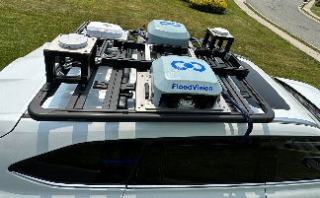
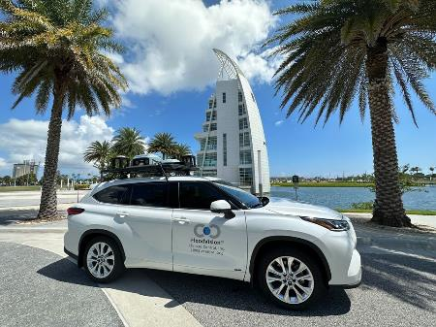
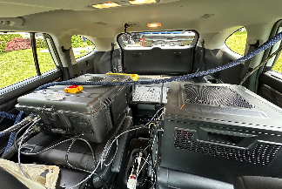
FloodVisionⓇ
Notes:
FloodVision. Climate Central has developed an innovative tool that makes the impact of climate change visible before the next disaster strikes. Think of it as Google Street View, but for flooding. Here’s FloodRover 1 - we have installed 4 professional quality cameras, or 2 sets of stereoscopic cameras on top of our vehicles, Each set of cameras has it’s own lidar, and we use a very accurate mobile GPS unit with two raised antenna. The LiDAR transceivers paint laser images over the steroscopic data precisely measured distances to each point and object in the field of view.

Slide 32

Notes:
The GPS is overlaid on top of the visuals allowing us to know the elevation on any of the pixels in the visuals we are collecting. This is a GPS layer from a data collection route in Ocean City NJ.

Slide 33
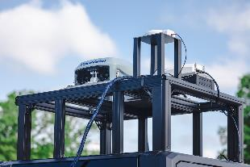
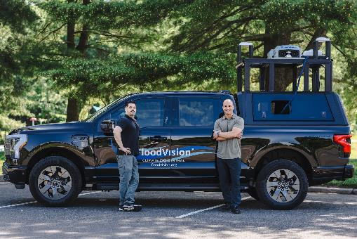
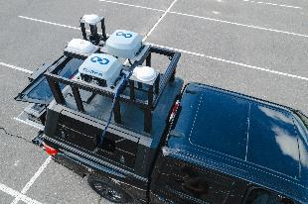
FloodVisionⓇ
Notes:
This is our FloodRover 2 - a fully electric Ford F150 Lightning.

Slide 34
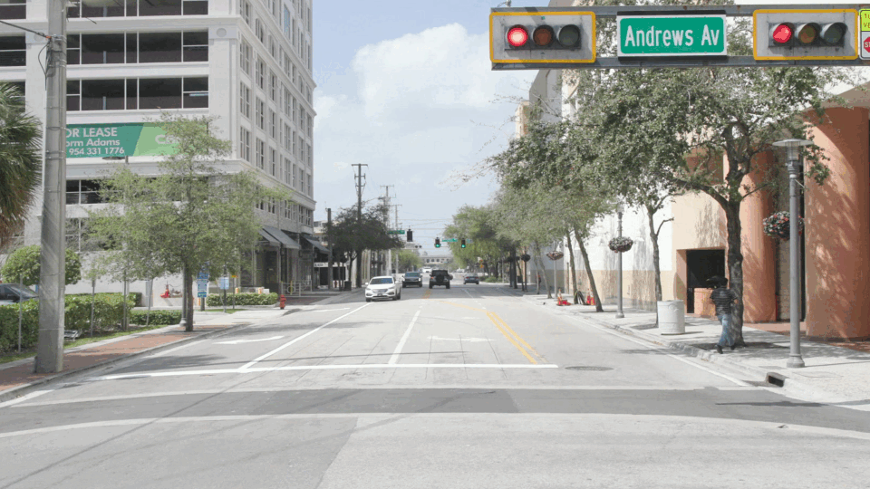
FloodVisionⓇ
High quality entry-floor elevation data for quantitative flood risk assessments
Photorealistic flood visualizations for effective risk communication
Notes:
As we drive the Flood Vision® vehicles ("FloodRovers") through coastal communities, we scan the streets to collect video, laser, and elevation data. Then, using AI, we can generate photorealistic flood and sea level rise visualizations with precision. We believe that FloodVision presents an important opportunity to drive action on coastal resiliency at a time when climate change is posing an increasing threat to people around the country.

Slide 35
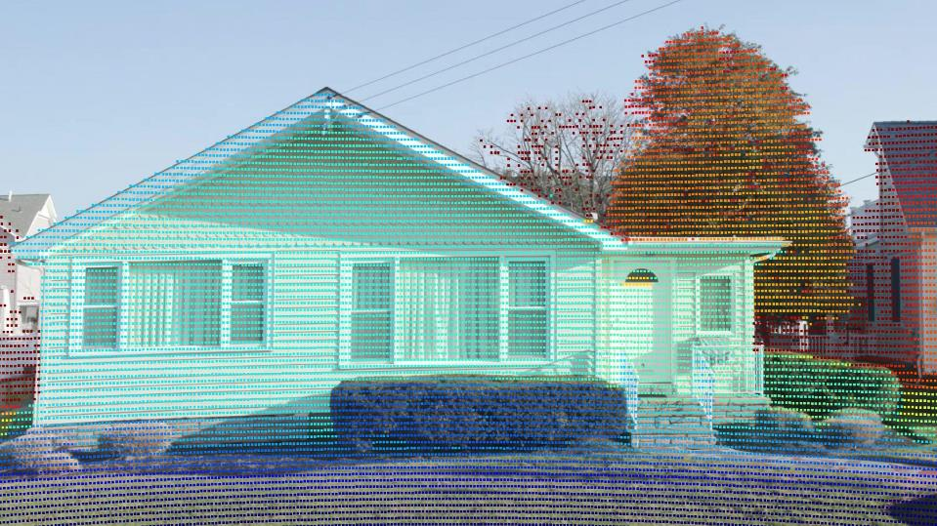
Notes:
We are able to calculate the approximate location of every pixel in a data frame in 3D. This allows us to precisely estimate entry floor elevations of buildings and structures.
These elevations can be useful for pricing of flood risk, activities within the NFIP, informing building codes, and more.

Slide 36
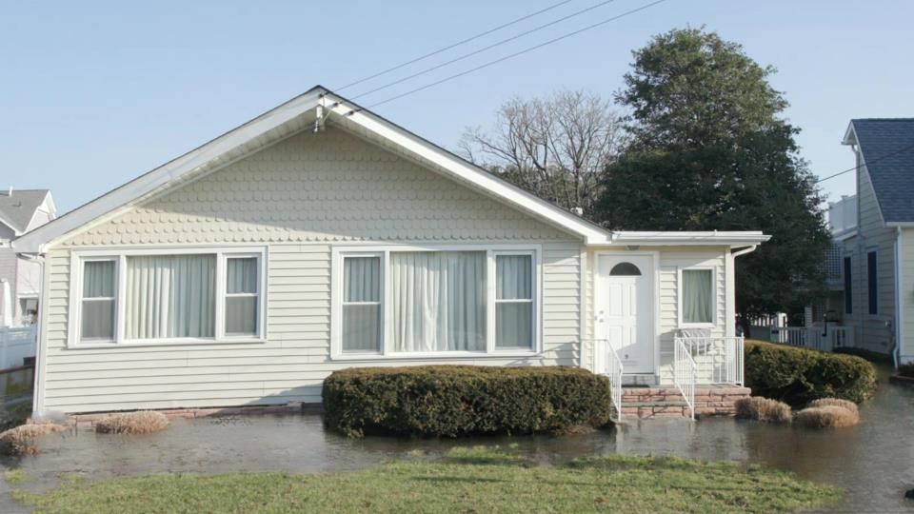
SIMULATION
Notes:
We also are able to generate photorealistic flood and sea level visualizations with precision. We can produce visualizations of any water level, as long as it’s science based - for example, we can show an expected storm surge from an incoming hurricane, or a historic water level from a past storm, to projected future sea levels.

Slide 37
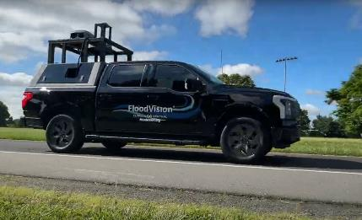
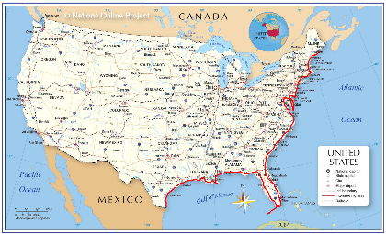
Edge of America (EOA) Tour:
Groundbreaking Expedition from Maine to Texas
Notes:
Now my colleague, Dan Krueger, will tell you about our work related to our FloodVision Edge of America Tour.
We drove an electric truck, the FloodRover II, from Maine to Texas over the course of June 2024 to January 2025. Along the way we collected data and produced visualizations of flood risk.
We focused on locations of interest - recognizable locations, cultural sites, critical infrastructure like bridges and roads, evacuation routes, transportation hubs. Places that people use everyday that might be underwater in the next big storm.
So when you have a truck and you are on a tour, what do you do? You tailgate!!

Slide 38
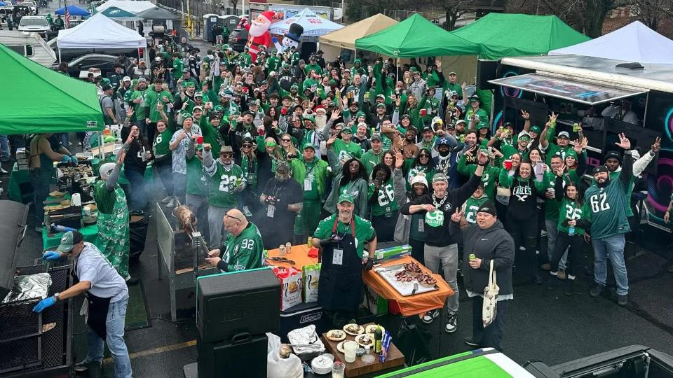
Notes:
No, not that kind of tailgate….

Slide 39
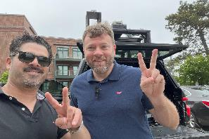
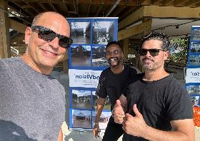
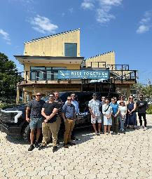

EOA Tour: What We Learned Along the Way
Land use decisions in the U.S. are made at the local level
State and local government officials, NGOs, and concerned community members need accessible visualizations to communicate flood risk
The FloodRover vehicle itself is a powerful communications tool
Notes:
A Resilience Tailgate!. Along our Edge of America tour we met with local resilience folks - elected officials, climate scientists, community leaders, folks working in aquaculture, fishermen, lobster men, lots of folks from the Sea Grant institutions and non-profits along the way. These were very powerful meetups – and very positive. We had food and we shared stories of what was working, what were the challenges, and what our hopes and fears were for the future.

Slide 40






Notes:
Some of our meetups…. Resilient tailgates.

Slide 41

FloodRover in Hoboken
Notes:
While on the Edge of America tour, we were able to capture some data in Hoboken. Good news - The Stevens Institute of Technology is NOT at risk of sea level rise flooding.

Slide 42

Notes:
But here is an area that could be at risk.

Slide 43

Notes:
This is a modeled visualization showing what it could look like in 2070 with an annual flood. This is 1’ 10” above the road level.

Slide 44

Notes:
This is a modeled visualization showing what it could look like in 2070 with a 10% annual chance flood. This is 3’ 2” above the road level - 5’ 7” above the local high tide line.

Slide 45

Notes:
Here is another local area that could be at risk.

Slide 46

Notes:
This is a modeled visualization showing what it could look like in 2070 with an annual flood. This is 1’ 6” above the road level and 4’ 3” above the local high tide line.

Slide 47

Notes:
This is a modeled visualization showing what it could look like in 2070 with a 10% annual chance flood. This is 2 ‘10” above the road level - 5’ 7” above the local high tide line.

Slide 48

Notes:
This modeled visualization shows what it could look like in 2070 with a 1% annual chance flood. This is 5’ above the road level - 7’ 9” above the local high tide line.

Slide 49


Thank you!
Links and Contact Info:
https://go.climatecentral.org/floodvision
Notes:
That concludes our presentation. We’d welcome hearing from you. You can scan this QR code to get to a landing page with links to all the tools we talked about and our contact information.
Thanks to all of you for your time.

