Slide 1
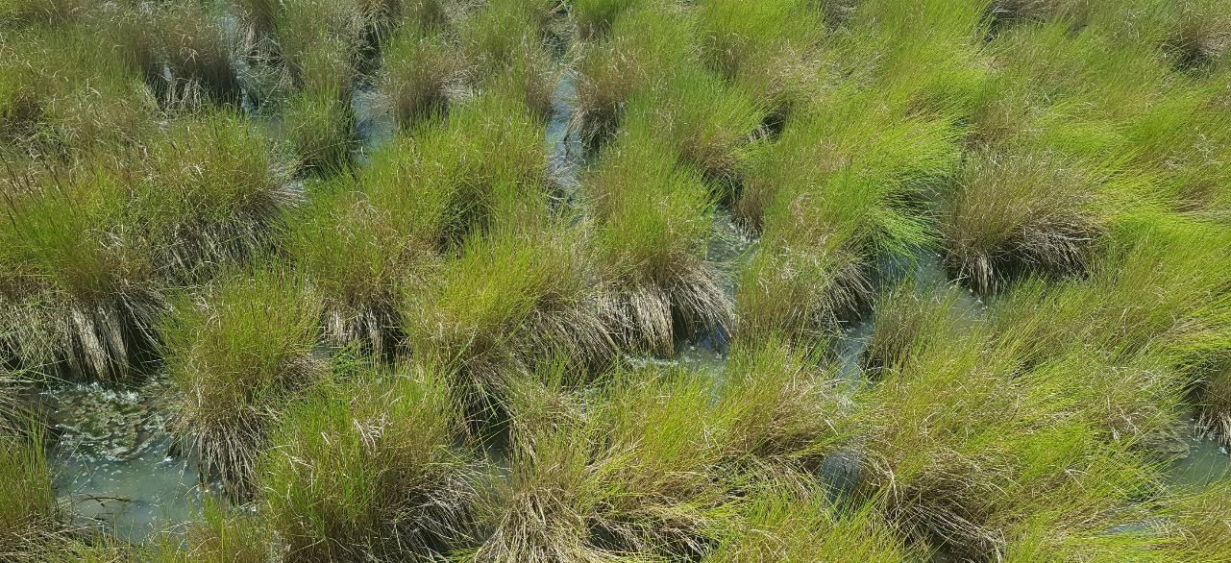



FIREPLACE NECK
Tidal Wetland Restoration through Small Scale
Hydrologic Changes
March 19th, 2025
© HDR 2025, All Rights Reserved
Notes:
Pilot program

Slide 2
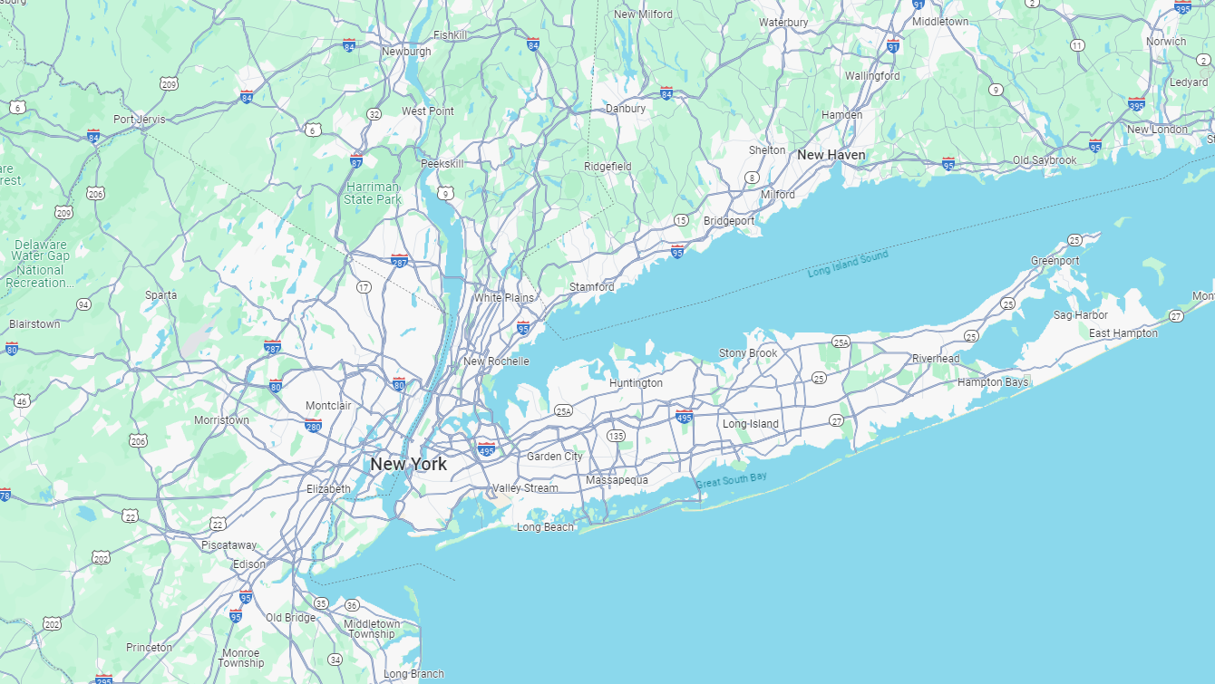
Notes:
South Shore Long Island

Slide 3
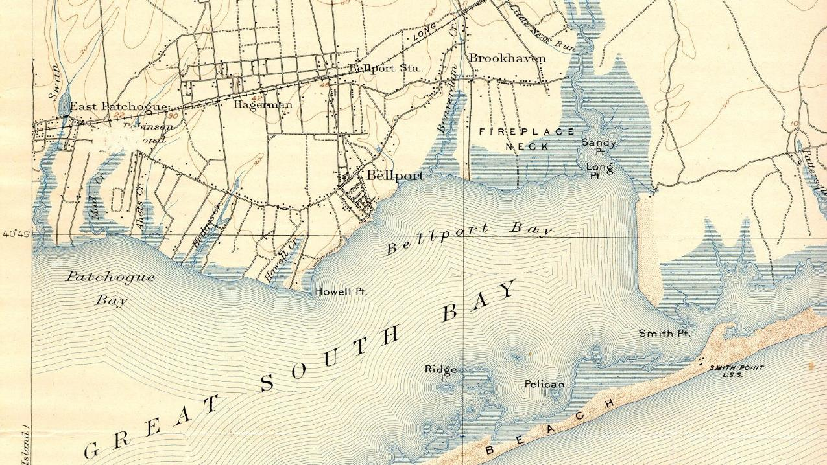
Wertheim National Wildlife Refuge
FIRE ISLAND
Notes:
In Bellport Bay adjacent to Wertheim

Slide 4
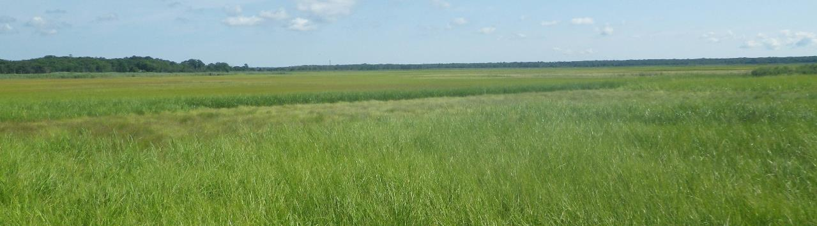
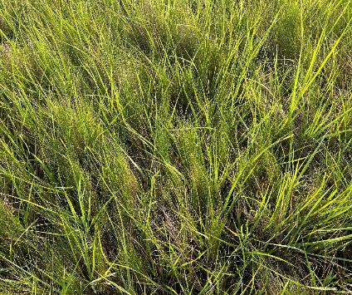
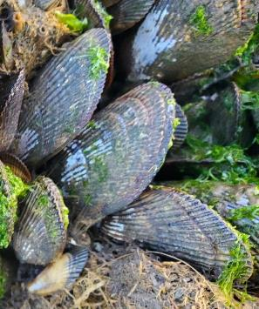
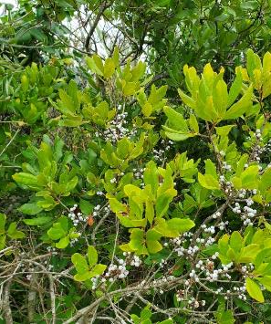
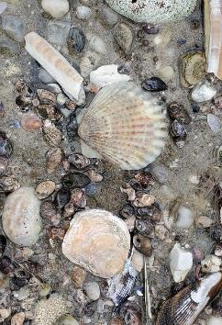
Notes:
Looks good, until you look closer

Slide 5
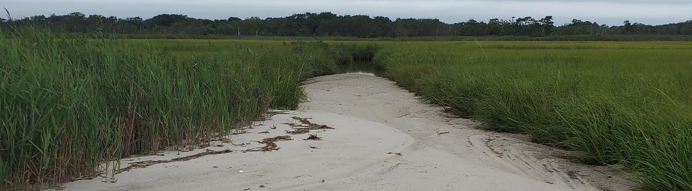
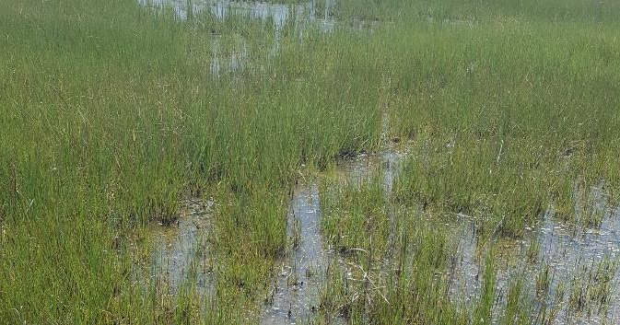
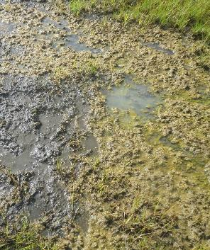
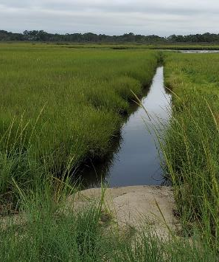
Notes:
a marsh in decline

Slide 6
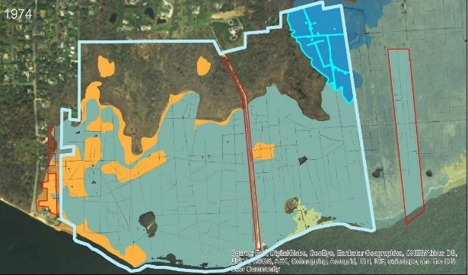
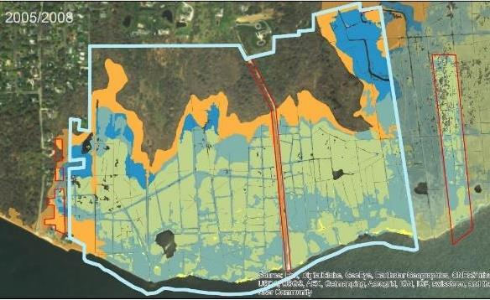
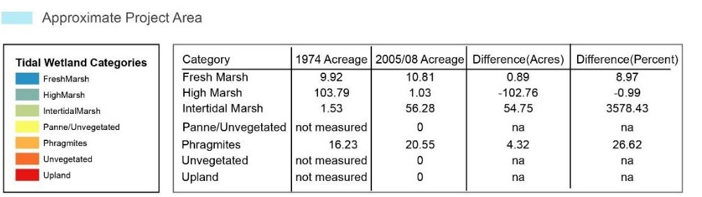

Notes:
Historically a high marsh system that supported salt hay farming. Dramatic loss of high marsh over 30 years

Slide 7
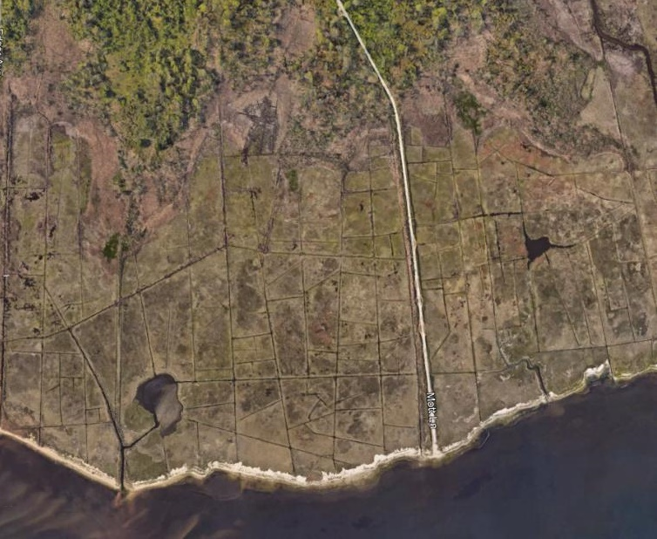
Degradation of marsh from high marsh dominated system, to low marsh and salt panne.
High Marsh
102.8 Acres Lost
Intertidal Marsh
54.8 Acres Gained

Slide 8
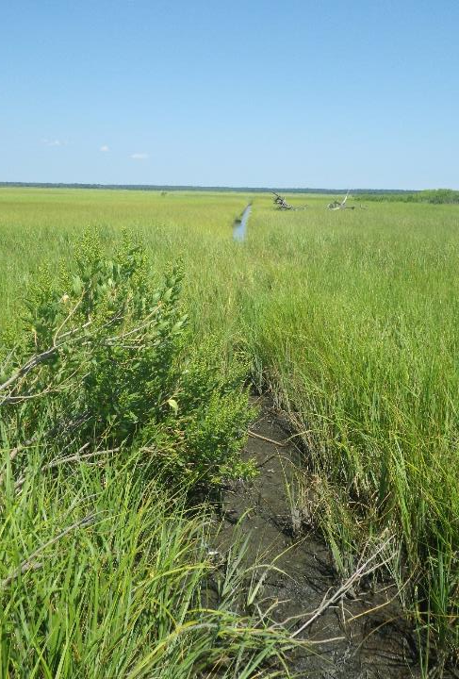
PROJECT GOALS
Limit further degradation by minimizing additional mudflat and open water formation;
Encourage tidal hydrology more typical of a Long Island Tidal Marsh;
Maintain existing ecological functions and possibly increase habitat values;
Enable the marsh to sustain the same level of protection and resiliency from large storm events; and
Support the tidal marsh’s ability to adapt to sea-level rise.

Slide 9
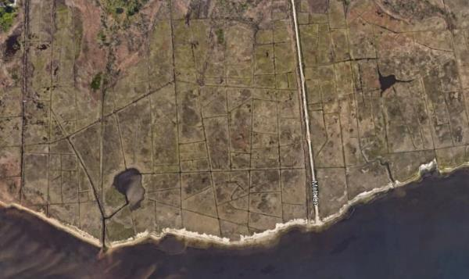
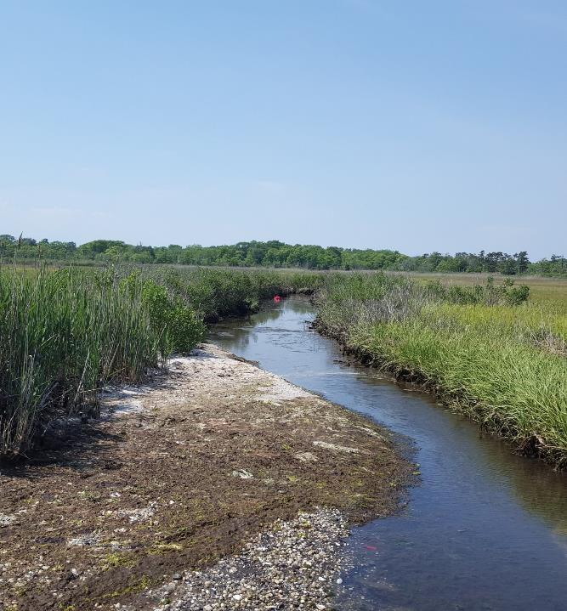
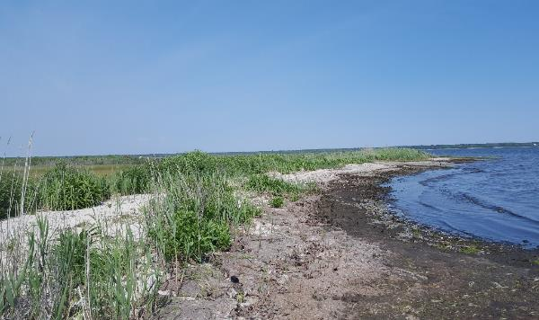
Notes:
Shallow basin with a dune at the water’s edge and almost flat marsh rising to the upland.
Review of aerials showed significant loss of shoreline, and sediment filling narrow openings.
Tidal amplitude of site is 1 foot or less. Site was dominated by short spartina alterniflora, telling us that there was a soil salinity issue

Slide 10
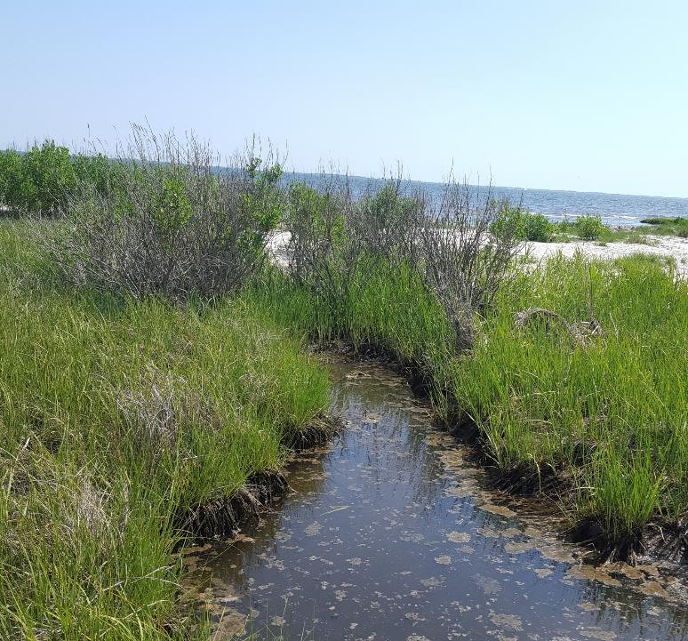
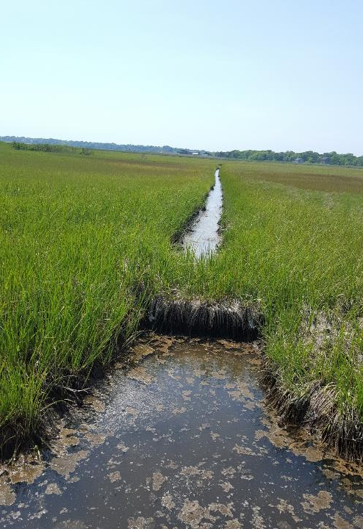
Notes:
Water becomes trapped in the marsh resulting in low dissolved oxygen and salinity higher (26-33ppt) than the bay (25 ppt). Ditch plugs were installed in the 80s to fill in some of the ditches however this is a low sediment system and the ditches have not closed.
Discuss buildup of

Slide 11
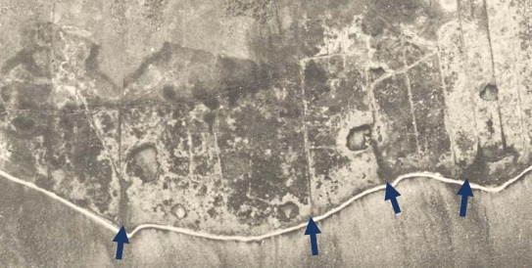
Aerial Photograph 1928-1930 with outlets identified (Suffolk County Government 1928-1930)
Notes:
Historically 4 channels within the marsh

Slide 12
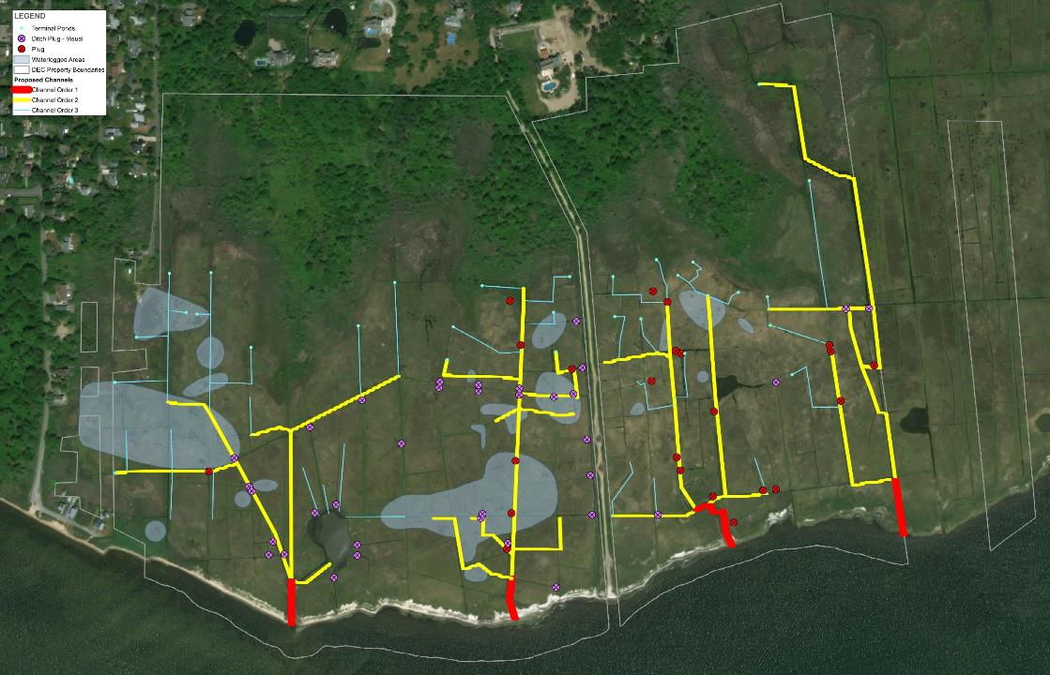
Notes:
With mott lane acting as a levee the site was subdivided into four drainage areas.

Slide 13
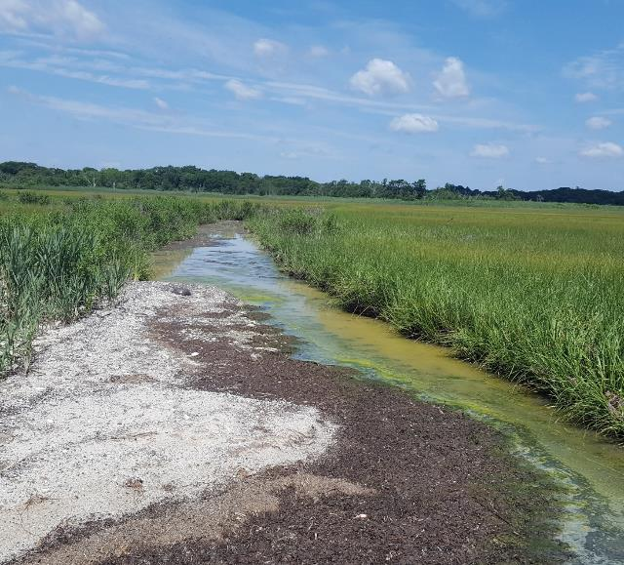
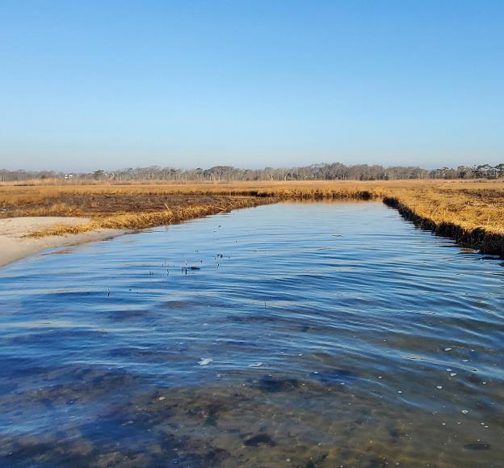
Channel Widening
Notes:
Channels historically 120-150 feet wide

Slide 14
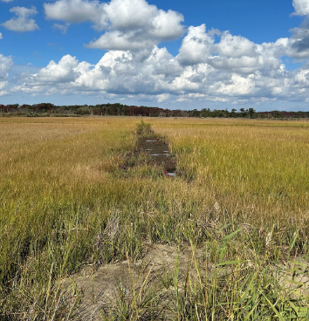
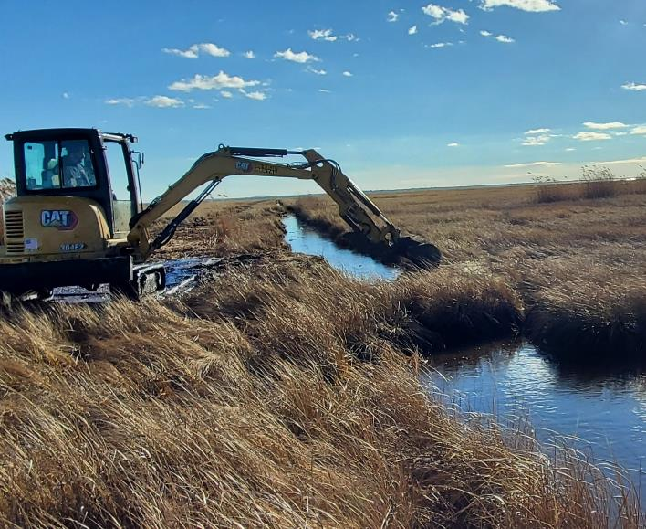
Ditch Filling, Plugging, and Unplugging

Slide 15
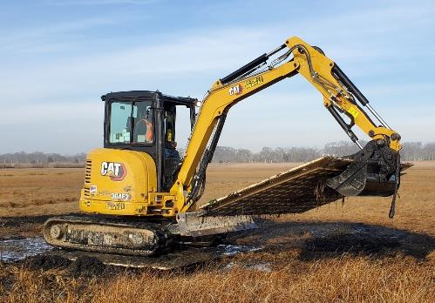
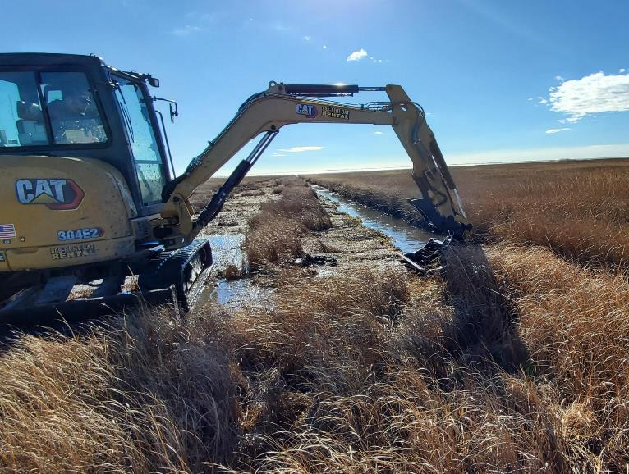
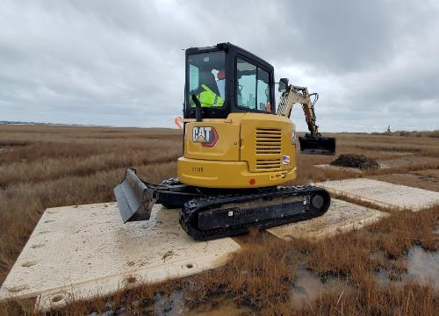
Leveling of Sidecasting

Slide 16
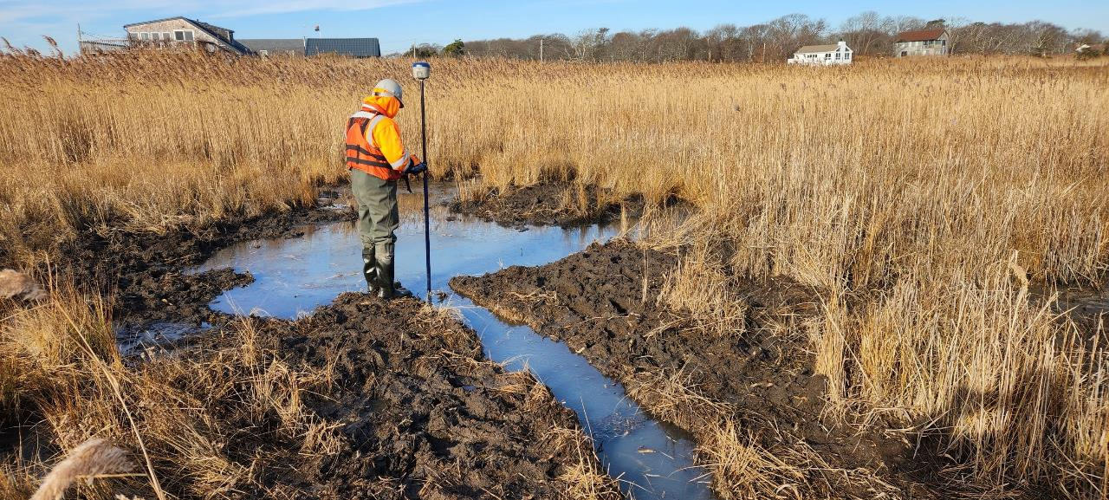
Micropools

Slide 17
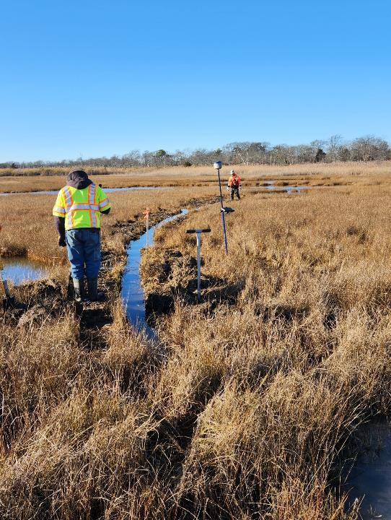
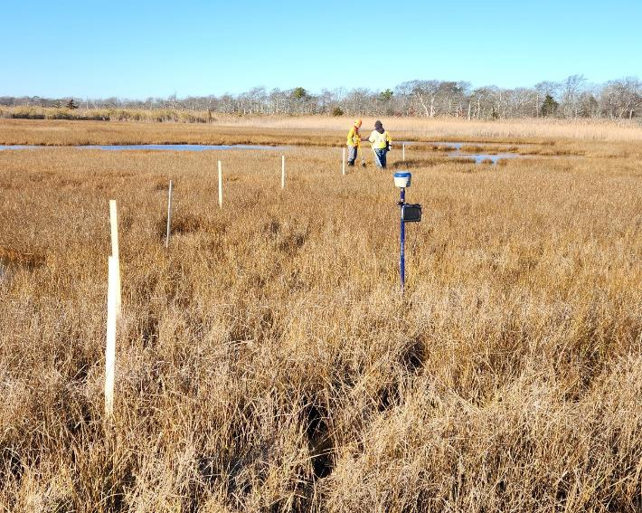
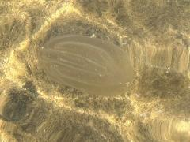
Runnels
Notes:
Box Jellyfish seen in micropools

Slide 18
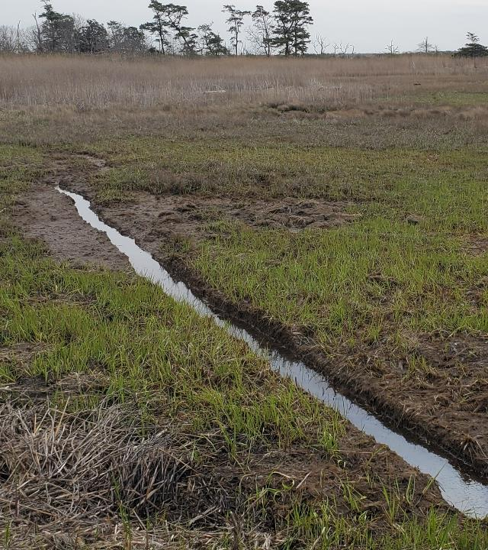
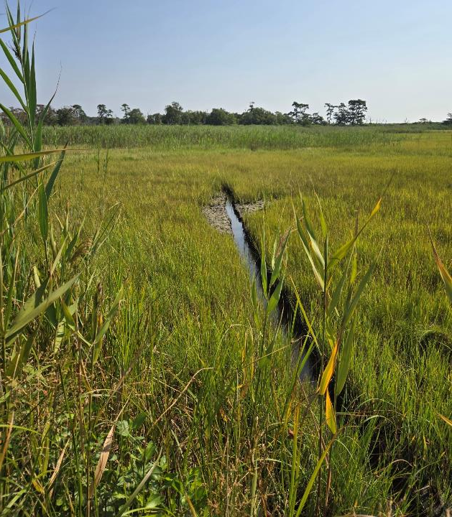
Notes:
Early signs are pointing towards success with areas revegetating and taller flowering spartina. With that we will stop there

Slide 19
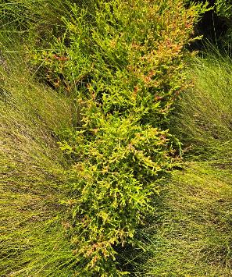
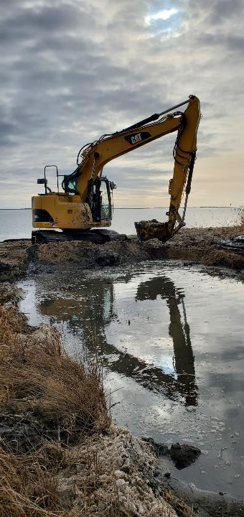
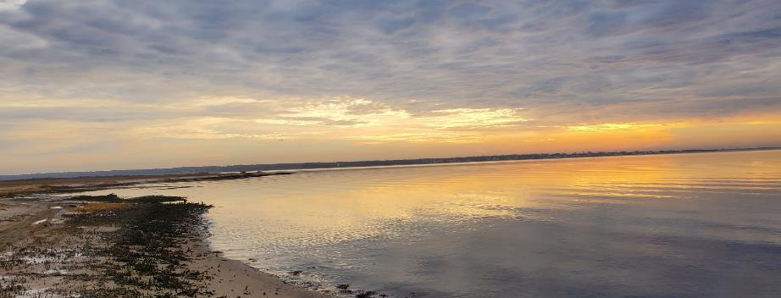
Thank You!
MICHAEL.SPINA@HDRINC.COM

