Slide 1
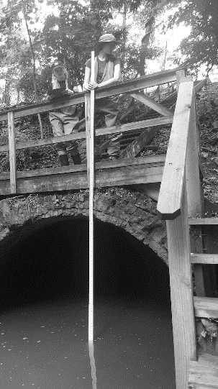
Aquatic Connectivity Through Climate-Ready Infrastructure
NJCRC 2025 Coastal Flooding Technical Workshop 3/19/25
Isabelle Stinnette
NY-NJ Harbor & Estuary Program
Hudson Rive Foundation
Notes:
Update on this project that was initiated 6 years ago

Slide 2
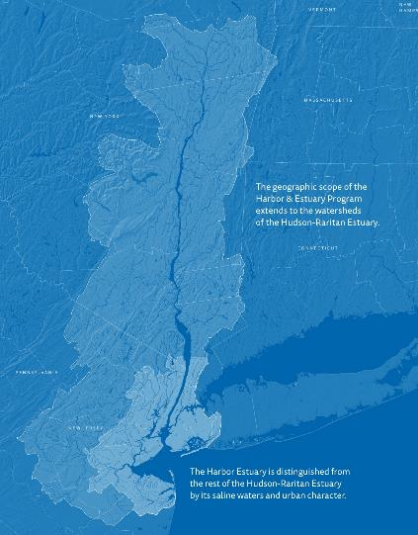
New York-New Jersey Harbor & Estuary Program
One of the Nation’s 28 National Estuary Programs
Created by the EPA at the request of the governors of NY and NJ in 1988 under the Clean Water Act
Managed in partnership with the Hudson River Foundation

Slide 3

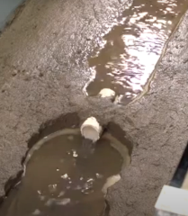
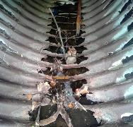
Assessing Bridges and Culverts Through Three Lenses:
Aquatic Connectivity
Hydraulic Capacity
Structure Condition
Notes:
NAACC created a standard protocol that’s being used widely across the Northeast. They’ve developed a rigorous training system and a publicly accessible database. The NAACC protocol tries to get at what to fish like. And scores each crossing structure depending upon data taken in the field including substrate, velocity, outlet drops, water depth and structure length.
The Cornel culvert capacity model a GIS based model that is set up to work directly with the NAACC results. You then add in precipitation and elevation data. And the output is the maximum storm event that the crossing can accommodate without causing road flooding and erosion.
Storm events = probability in a given year
100 year = 1% chance
50 year = 2% chance
25 year = 4% chance
10 year = 10% chance
Use both of these datasets plus a simple visual assessment of culvert condition to make a prioritization for stakeholders of which crossing structures to upgrade.

Slide 4
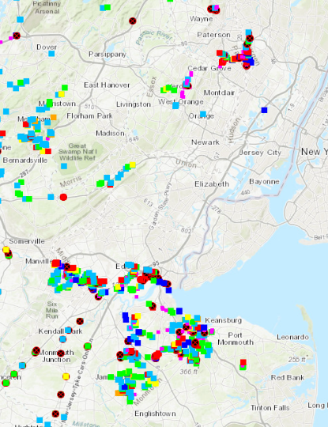
Assessments
Assessed over 750 crossings in 15 subwatersheds
Partnered with 7 Universities/NGOs
Funded in part by Rutgers University, EPA and Restore America’s Estuaries
Notes:
We have been running this project for 6 years in coastal NJ – the NJ focus is because the HREP has a great similar program in NY
In 2020 HEP was awarded a big coastal watershed grant from EPA and administered by RAE, which allowed us to get a big chunk of this work done.

Slide 5
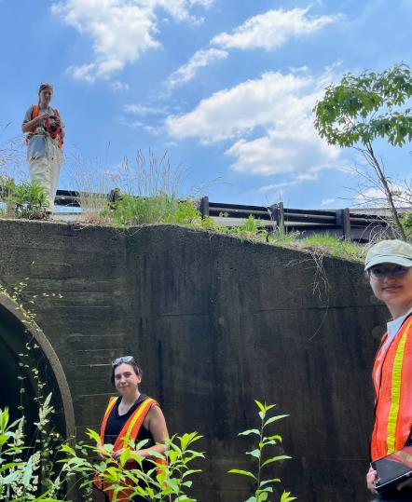
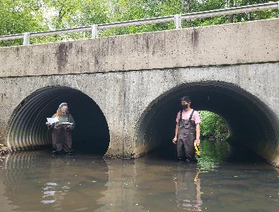
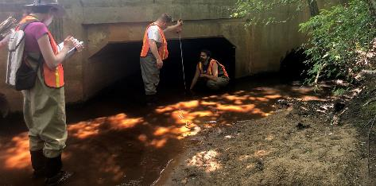
Notes:
These assessments are no gis analysis - real, in the mud fieldwork. Leads to a really good confidence about our data.
Team on the left are from Save Coastal Wildlife a non-profit from the Raritan Bayshore who have conducted our most recent assessments.

Slide 6
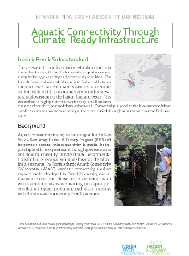
Fact Sheets
Notes:
I created a fact sheet for each subwatershed detailing the character of the streams in that watershed as well as the highest priority projects. Available on our website.

Slide 7
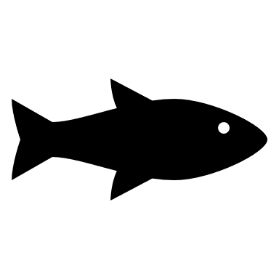
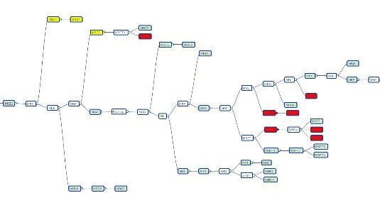
Dendritic Connectivity Index
DCI Score = Passability x Length of stream until the next barrier, summed up for the whole watershed
Notes:
Allows you to compare the overall connectivity from watershed to watershed. And see which barrier makes the most sense to remove to improve the connectivity of the watershed as whole.

Slide 8
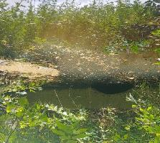
Results
~ 40 % Undersized for Current Precipitation
17 % in Poor Condition
Notes:
High level results.
Our stream infrastructure needs some work, particularly when it comes to rightsizing undersized culverts to prepare them for increased precipitation

Slide 9
All Hydrologic Model Data
Maximum return period is the storm event designation that a crossing can accommodate without flooding overtopping the road or causing erosion (> 50 is considered adequate for a roadway).
Notes:
These are the total results from the Cornell Hydrologic Model.
The maximum storm interval represents the storm event for which anything larger fills up the culvert capacity causing flooded roads and erosion. For example, a capacity for a 100 year storm event has a 1% chance of occurring every year and a 0-year storm event flood has a 100% chance of flooding every year and probably floods with each rainstorm. It gets slightly worse with future precipitation scenarios.
Take home here is most of the crossings are right sized but there are still about 40% that are undersized in these watersheds. Field observers noticed many instances of eroded banks, which will only get worse with the heavier precipitation predicted.

Slide 10
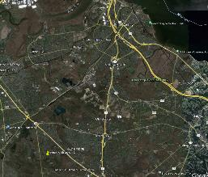
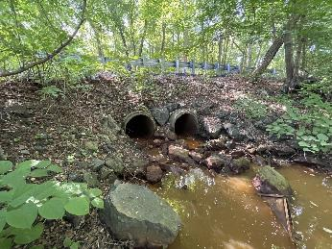
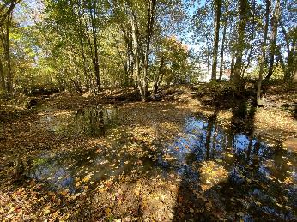
Iresick Brook (IB5)
Existing Conditions
Downstream Face
Downstream Scour Pool
Notes:
With an advisory committee, we chose an undersized crossing to proceed with towards restoration. Worked with Princeton Hydro on a 30% design.
Runs into Duhernal Lake which is part of the South River
Deeply undersized, huge scour pool, eroding road edges
Very close to the major pasta dumping incident a few years ago

Slide 11
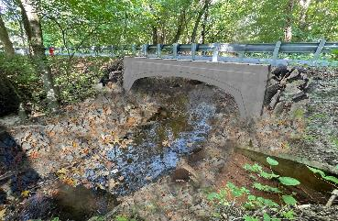
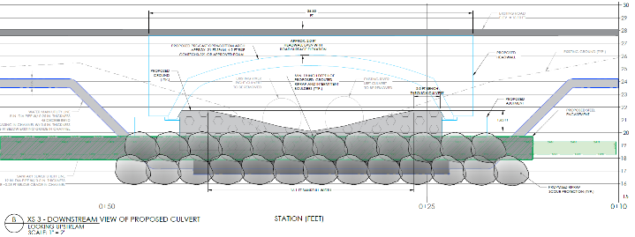

Proposed Design 30% by Princeton Hydro

Slide 12
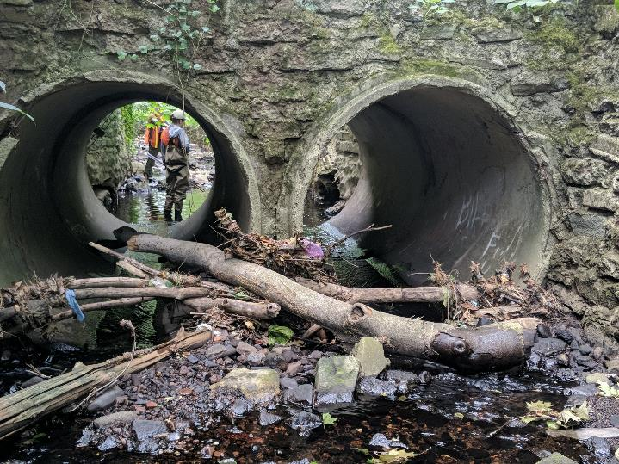
Culverts Toolkit
Objectives:
Leverage low-cost data
Compare a handful of potential projects
Two parts of toolkit:
Prioritization Matrix – Feasibility & project complexity
Solutions Matrix – Compare complexity (and cost) of solution
Notes:
The toolkit Effort to make this data meaningful and useful to our municipalities.
- Data that’s already been collected, can collect in field observations, or the NAACC data – no engineers necessary
The prioritization matrix takes my fact sheet info and does a better job of really grounding the information in the real world. Are the gas or sewer lines that run under the culvert, is it near wetlands, is it a major traffic artery.
The solutions matrix suggests restoration options and offers an order of magnitude cost estimate

Slide 13
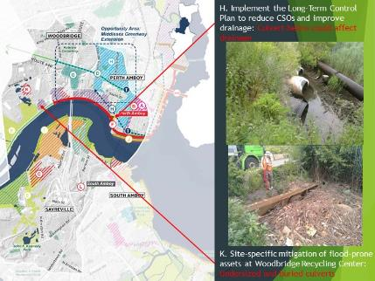
Outreach and Next Steps
Notes:
I have been doing a lot of outreach to stakeholders in New Jersey. There are opportunities for improvement in every watershed we’ve assessed. This is an example of a slide I made for the Resilient NJ project showing them where their recommendations and mine overlap.
We’re still looking for municipalities and other stakeholders to adopt the toolkit and we have some funding to encourage this use. I am having some discussions with partners but if nothing comes of those, I plan to put out an RFP shortly for municipalities on the use of the toolkit to encourage restoration on these culverts.

Slide 14
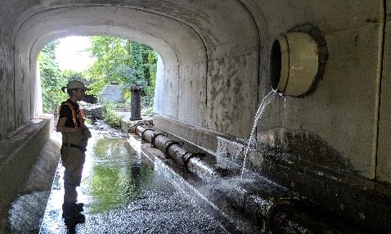

Questions and Thanks
Isabelle Stinnette
Istinnette@hudsonriver.org
Notes:
To close – this is such a wonderful project in terms of co-benefits. Some people only care about flooding concerns, some only transportation safety, some only fish migration but the solution to all of these is the same.

