Slide 1
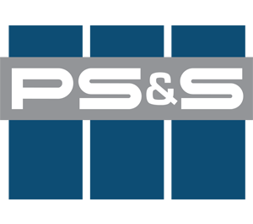

BICC Site Sediment Cover System in the Hudson River Coastal Flood Plain
Janos M. Szeman, P.E. and
James Boyer, P.E.
Notes:
Welcome
Thank You NJCRC
The next 15 minutes will highlight a multi year design permitting then construction project

Slide 2
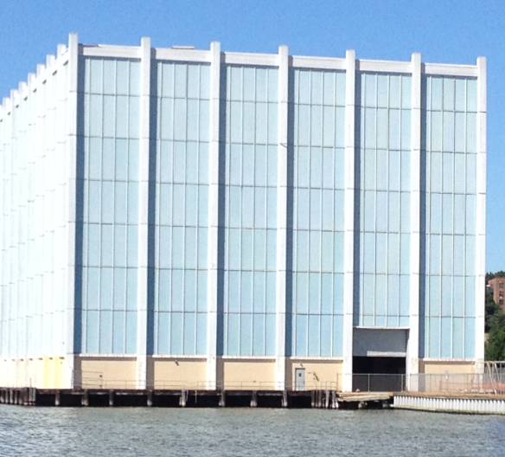
Agenda
BICC Site History/ Impact
Hudson River Sediment Remediation
Coastal Flooding Events & Required Resistance
WECV Study
Multi Layer SCS
Remote Sensing System
Site Redevelopment

Slide 3
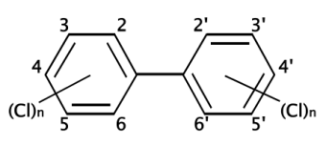

Why were PCBs used at the BICC Site?
S.S. Hepworth & Company
    Sugar machinery and tools manufacturer 1886 to 1890.
  India Rubber Percha Insulating Company
      Wire and cable manufacturer 1890 to 1915
  Habirshaw Wire Company
      Fabricated paper-insulated, lead-jacketed cables, rubber-insulated and jacketed cables, and armored submarine cable 1915 to 1930.
  Phelps Dodge
      Fabricated paper-insulated, lead-jacketed cables, rubber-insulated and jacketed cables, and armored submarine cable 1930-1960’s
      Polyethylene and ethylene propylene rubber cables 1960’s to 1984
      Source of PCB Contamination
  Cablec/BICC Cables Corporation
      Manufactured same products as Phelps Dodge 1984 to 1996
      Site closure in 1996
Notes:
1.BICC site History and Impact
2. Polychlorinated Biphenyls (PCBs)
PCBs – Organic Chlorine Compound
USEPA Persistent Organic Pollutants (POPs)
Present in the Dielectric Fluid for BICC High Voltage Cables
Hydrophobic
Resistant to Temperature Change, Acids, Bases, Oxidation, Hydrolysis

Slide 4
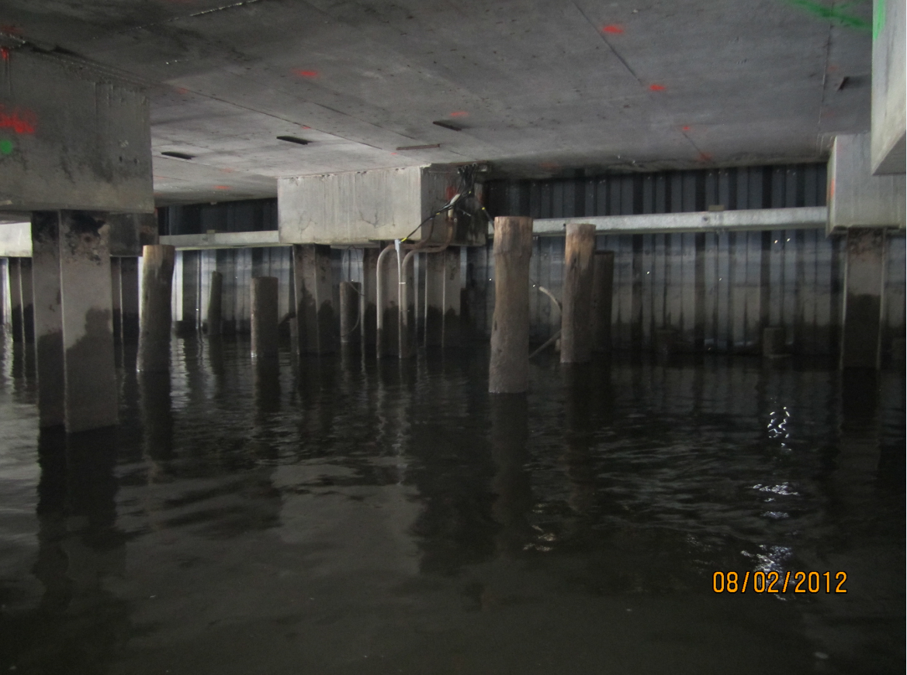
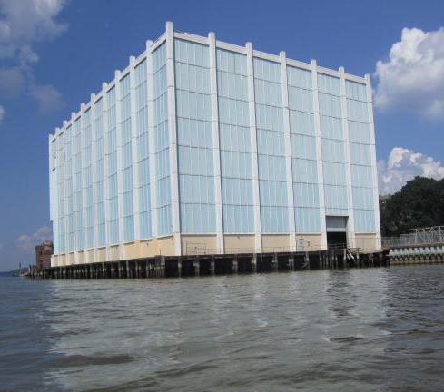
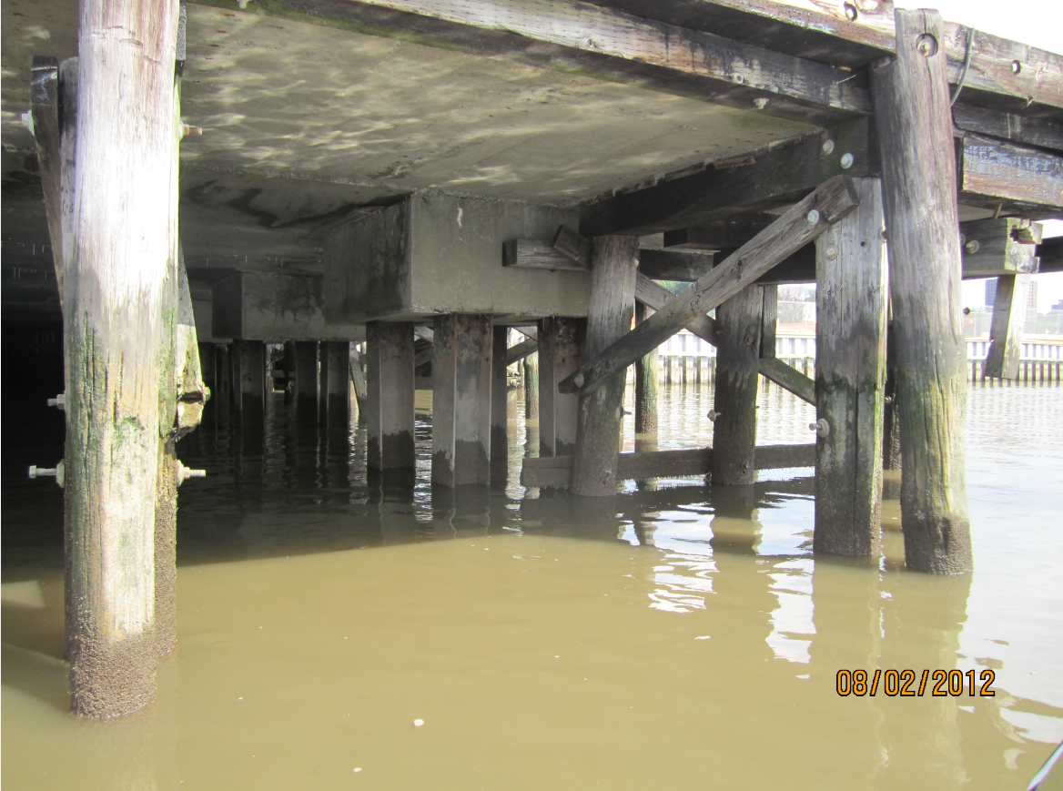
Hudson River Sediment Remediation
Operable Unit # 1
Operable Unit # 2
Dredge Certification Units (DCU)
  DCU Areas I, II, IV, and V
  DCU Area II (2A, 2B, & 2C)
Under Building Area, OU-2
Open Water Areas, OU-1
Notes:
1. NYSDEC consent order to investigate then remediate land and Hudson river sediment
2 NYSDEC records of decision (RODS) for BICC site
Successful open water dredge and clean fill sand caps
6 unsuccessful dredge attempts abort criterial with NYSDEC & USACE
Multi-layer sediment cap under the EPRI building( aka Blue Cube

Slide 5
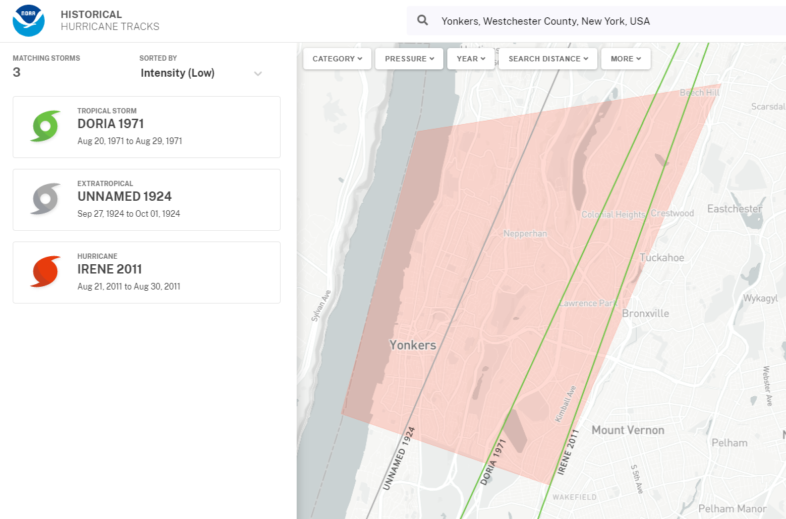
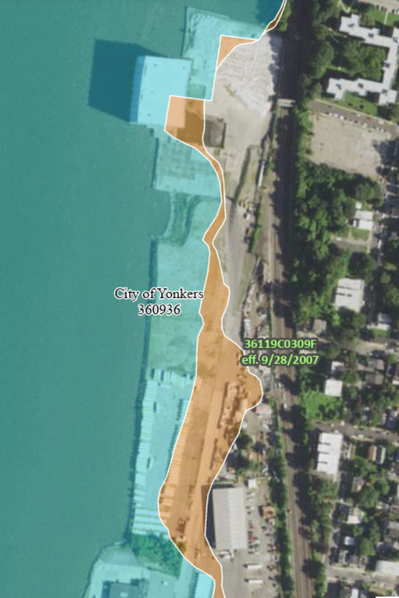
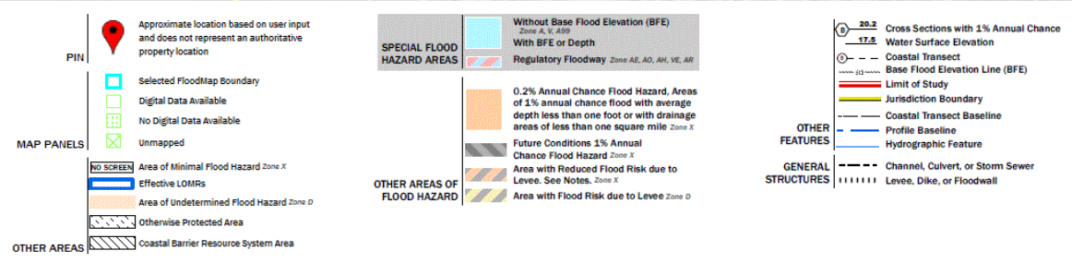
NOAA – Historical Hurricane Tracks
Tidal Costal Flooding Resistance
FEMA – Yonkers, NY
“ArcGIS Web Application.” 2025. Arcgis.com. 2025. https://hazards- fema.maps.arcgis.com/apps/webappviewer/index.html?id=8b0adb51996444d48793 38b5529aa9cd&extent=-74.27732388537049.
Notes:
October 2021 superstorm, 3 ft of storm surge inundate upland remediation site
Deposited impacted sediment and destroyed interim remedial measures
The EC Sediment Cap was designed, permitted and constructed based on super storm Sandy costal Flood elevation observations
The SCS provides a redundant EC to withstand the Hudson River velocities, wave energy and tidal flooding events.

Slide 6
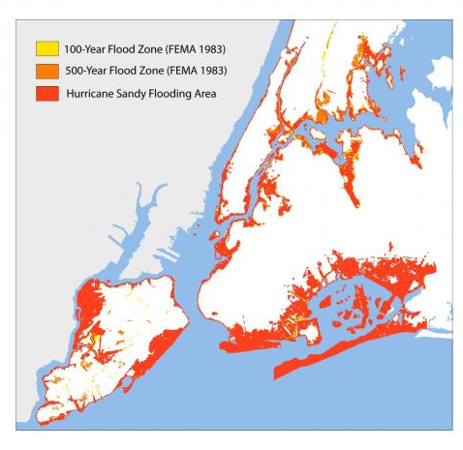
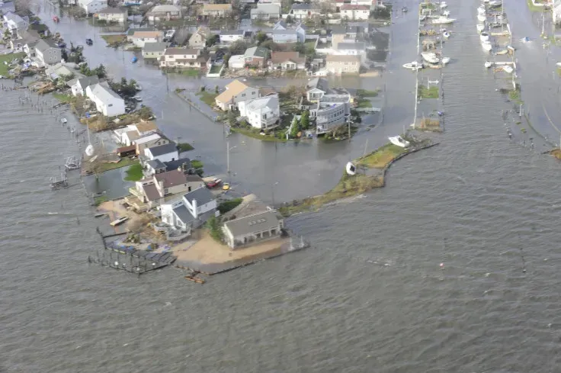
2012 Superstorm Sandy Flood Zone
Notes:
Sea Level Rise Mapper – allows you to map sea level rise projections

Slide 7
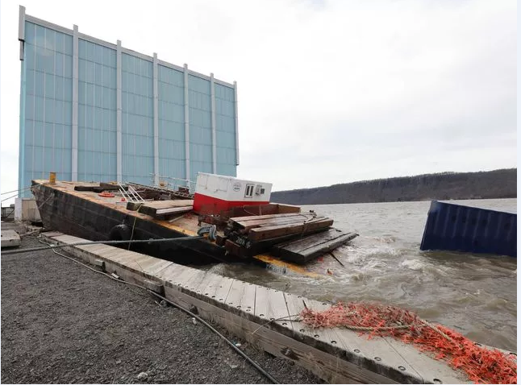
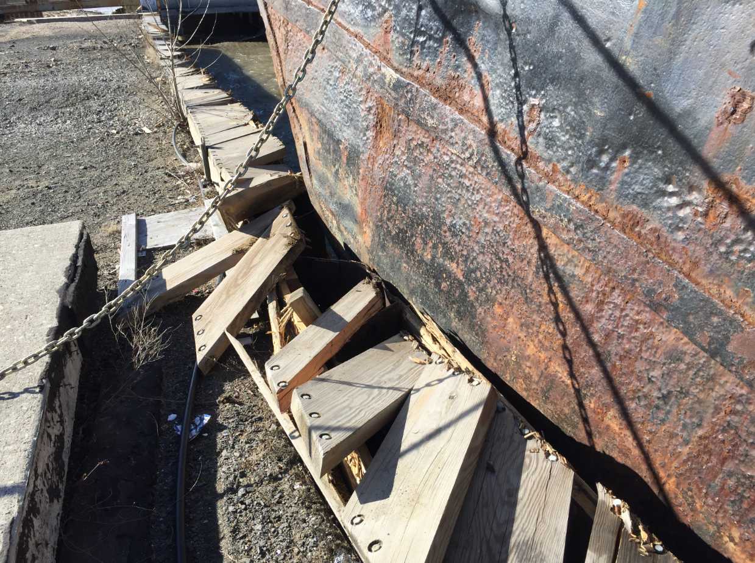
March 2018, Nor'easter Storm Event
Runaway Barge
Damage to Steel Bulkhead Timber Walkway
No Damage to the Sediment Cap
Notes:
1. observed 4-foot storm surge
6 foot to 8-foot waves
Wind driven waves on top of sediment cap

Slide 8
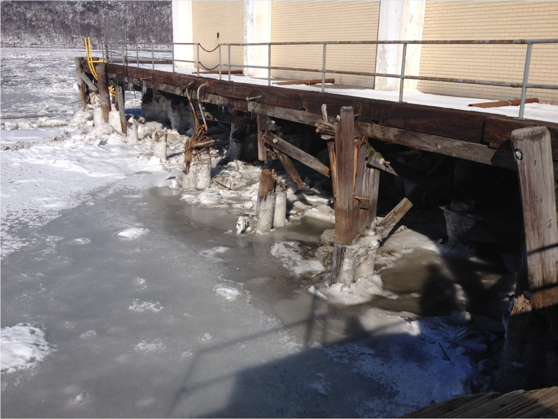
Hudson
River
Ice Flows
Notes:
Polar vortex- winter 2012
01/02/2025 winter ice flows
3. bulkhead and sediment cap “engineering Controls” Address ice
Ice buildup on eastern shoreline and BICC site

Slide 9
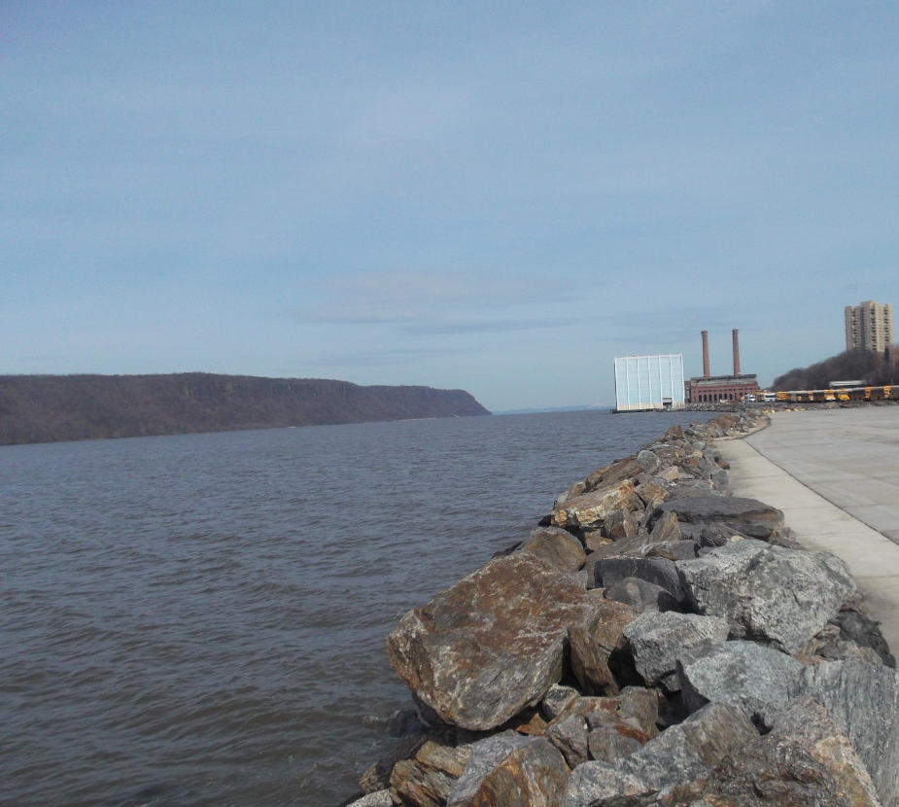
Hydraulic Model
A hydrologic model was developed
      Hudson River velocities
        Sediment Cap Armoring Technology
        B. Compliance with Regulatory Requirements
Notes:
1. PS&S built hydraulic Model to design sediment cap under the blue cube

Slide 10
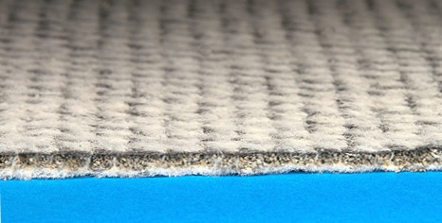
Active Treatment and Containment Layer
CETCO Organoclay Reactive Core Mat: 0.8 lb/ft² of Organoclay between two geotextiles
CETCO Granular Activated Carbon Reactive Core Mat: 0.4 lb/ft² of GAC between two geotextiles
Geotextiles provide:
  Separation – no intermixing and reduced bio-intrusion
  Reinforcement – tensile strength
Continuous and Overlapping Active Treatment and Sediment Cap:
  Successful Installations under Bridges/Piers and around Piles
Notes:
ROD Design Requirements
150 % (1.5 Safety Factor)
Major Events
SCS Integrity
Wave Energy
Current Velocity
Access Constraints under EPRI Building
Post-Remediation Monitoring Program

Slide 11
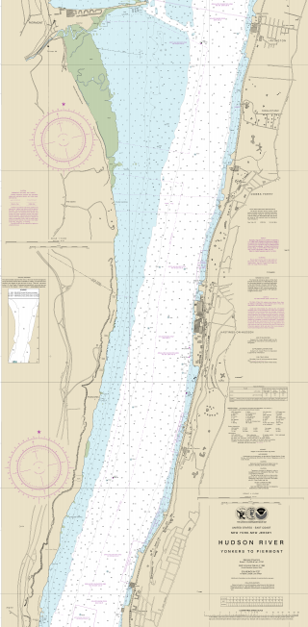
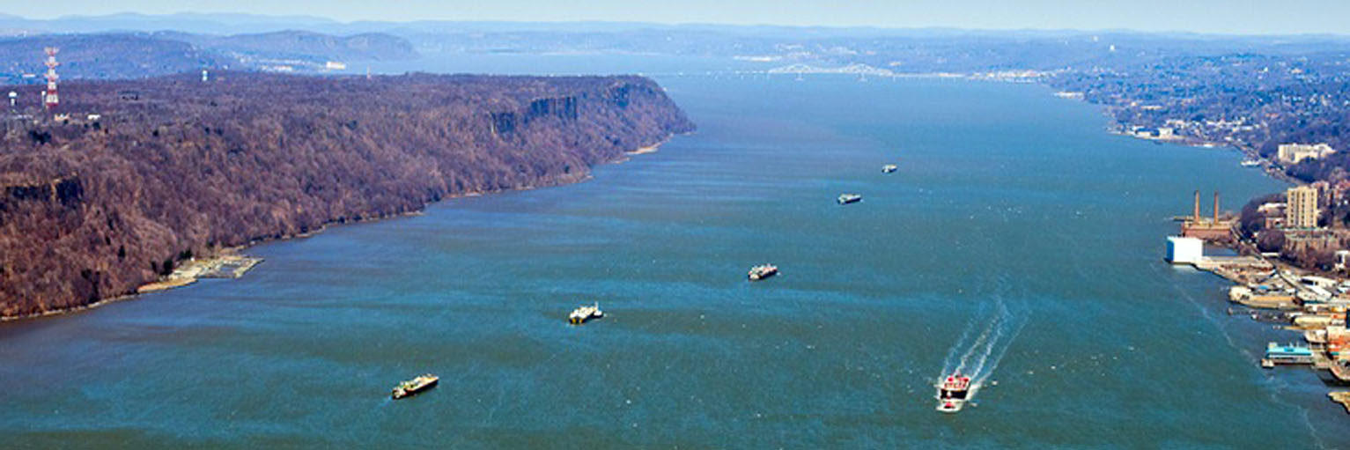
Wave Energy & Current Velocity (WECV) Study– SCS Armor
Protection Layer
A. Current Velocity
  SCS Scour Protection Layer
  TenCate GT500 Geotubes
B. Wave Energy
  Zone I SCS Armor Protection Layer
  Zone II SCS Armor Protection Layer
Notes:
OU-2 ROD Requirement
Zone I SCS Armor Protection Layer 48” D50 Stone
Zone II SCS Armor Protection Layer 24” D50 stone
HEC-RAS Model Multi-Layer SCS Integrity/Stability Review
SCS Settlement
Constructability
Conclusions
a. Current Velocity SCS Scour Protection Layer with TenCate GT500 Geotubes
b. Wave Energy class V rip rap

Slide 12
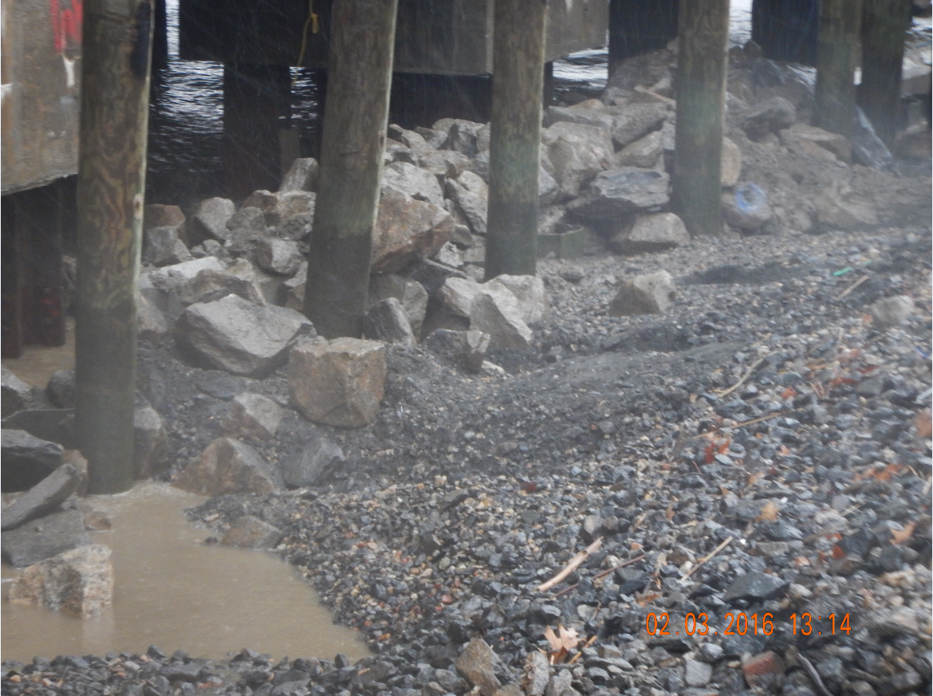
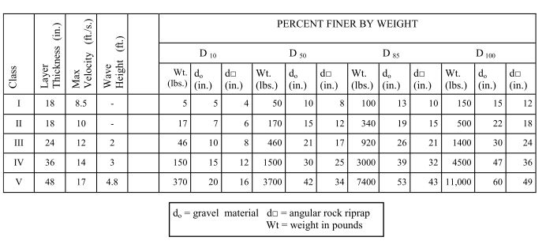
WECV Study – SCS Armor Protection Layer
Class V Rip Rap
24-Inch-Long ConTech A-Jacks
Zone 1
(Shallow),
Less than
5 Feet of Water:
D₅₀ = 48 Inches
Notes:
Five Key Components:
Cushion Sand Layer
Active Treatment and Containment Layer
SCS Ballast Protection Layer
SCS Armor Protection Layer
Habitat Mitigation Layer

Slide 13
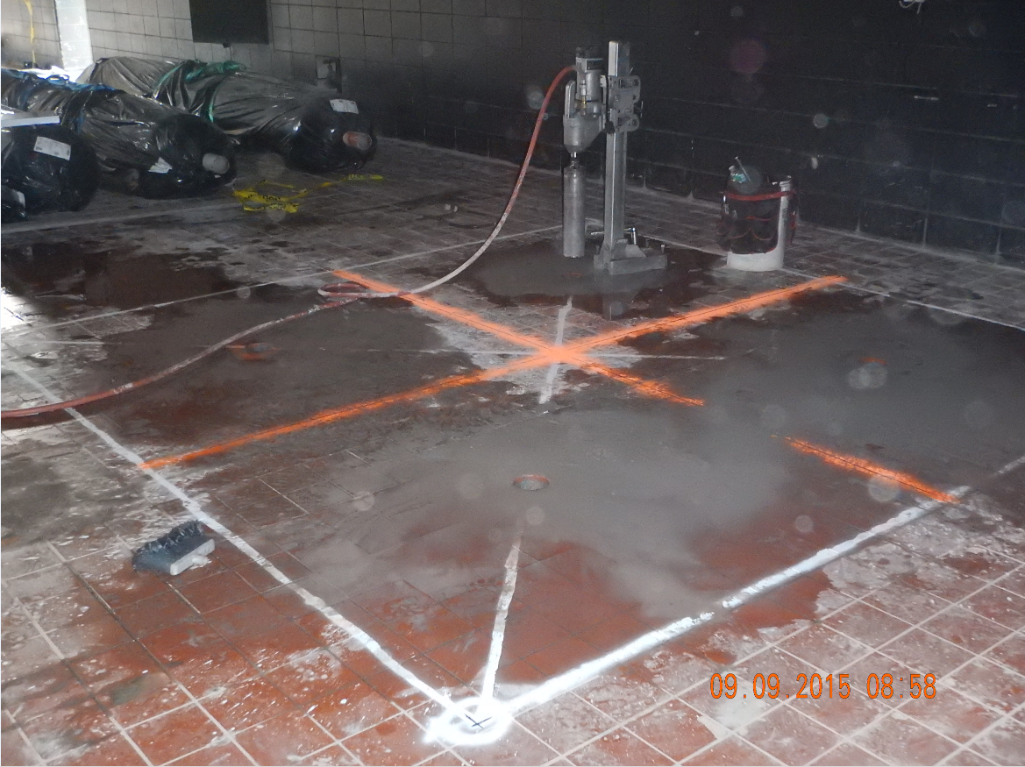
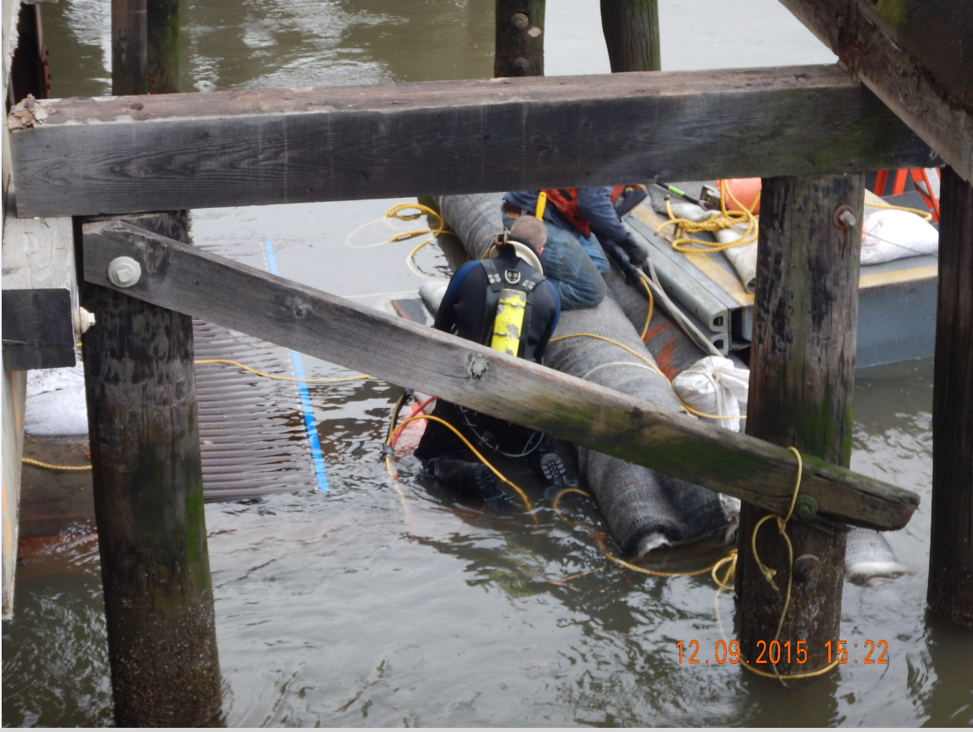

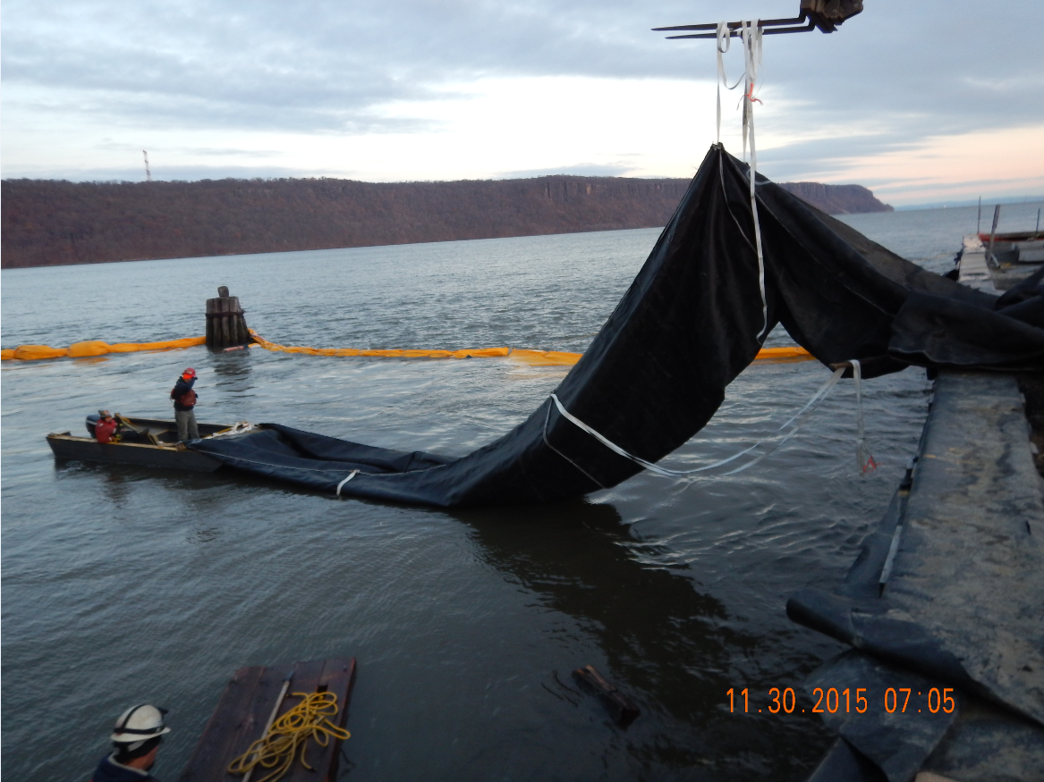
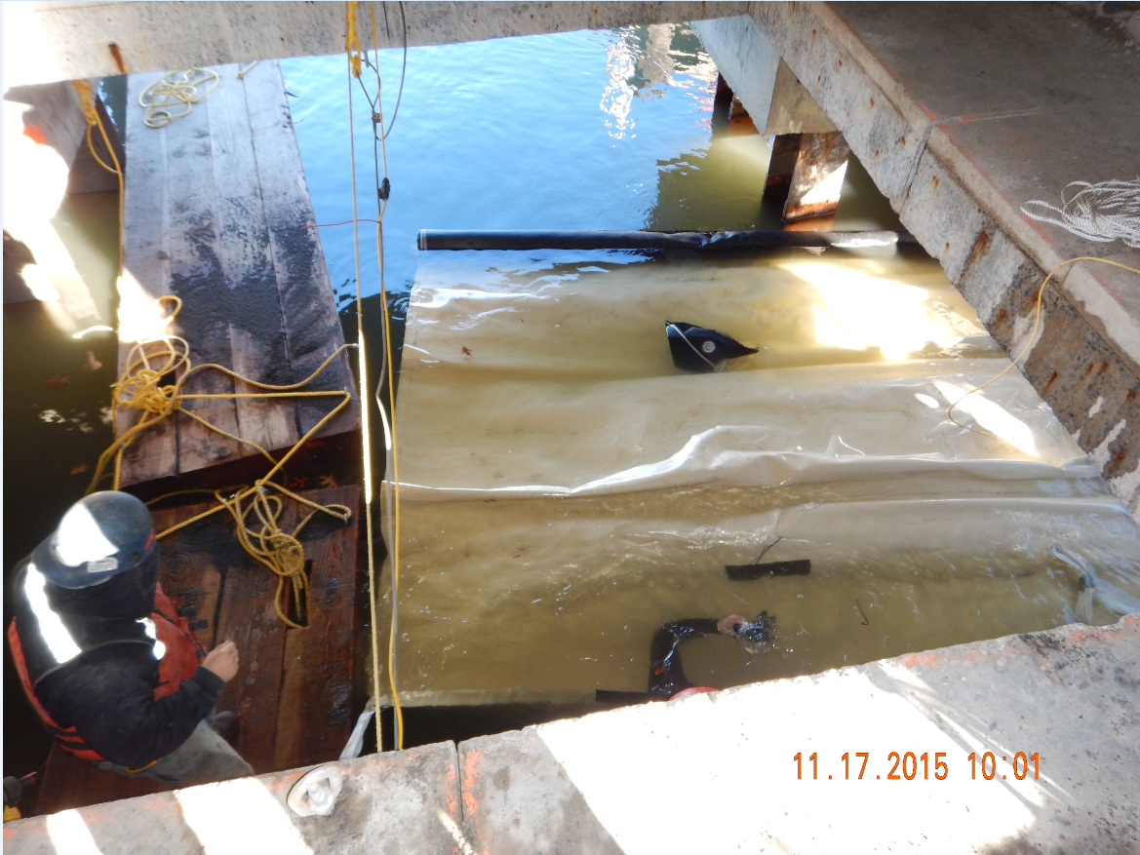
Multi-Layer SCS Construction:
Notes:
Marine Contractor
Engineer
Third Party Engineer
Periodic Regulator Site Visits
Over 15,000 Hours Worked Safely
0 First Aids
0 OSHA Recordables
Multi-Layer SCS Construction
Marine Contractor
Engineer
Third Party Engineer
Periodic Regulator Site Visits
Over 15,000 Hours Worked Safely
0 First Aids
0 OSHA Recordables

Slide 14
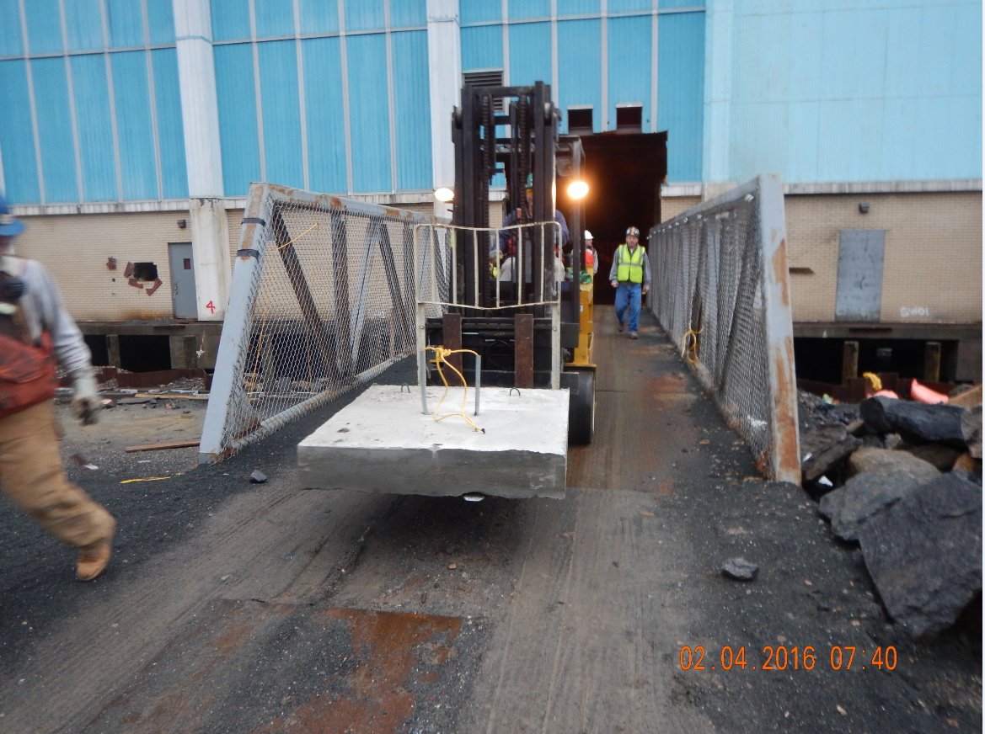
SCS Annual Review & Remote Sensing System
SCS – Fiber Optic Cable Monitoring and Reporting System.
Annual SCS Measurements with Engineering Certification to NYSDEC and USEPA
Post-Remediation Care allowed for Site Redevelopment.
Notes:
The fiber optics distributed sensor system relies on using a known and reproducible method by which the temperature and strain can interact with the light travelling within the fiber.
Precise Measurements are compared to previous data sets to identify variance that Indicate excessive settlement or potential EC Breach
The SCS Remote Sensing System observations in conjunction with the bathymetric survey measurements allow for the long-term integrity monitoring of the SCS.

Slide 15
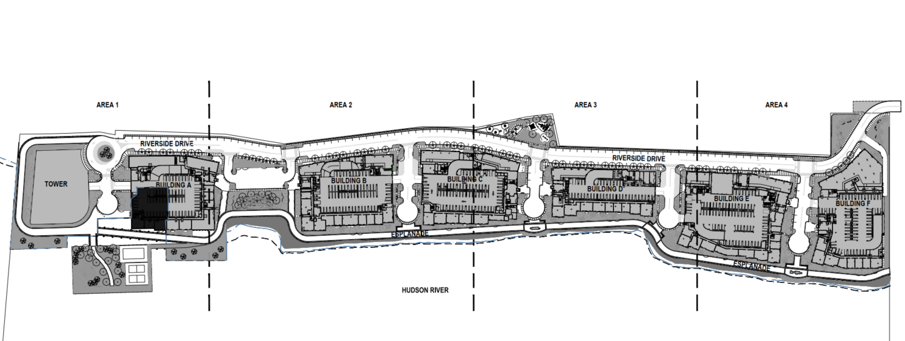
Site Redevelopment
Notes:
1,800 Residential Units
Redevelopment Plan required substantial imported fill material (1.5 Million Tons) to raise the Site Grades above the NEW FEMA Flood Plan of Elevation + 11 Feet (Raise Site Grades by ~ 5 Feet to 7 Feet)
Brownfield Redevelopment Plan required a NEW Bulkhead to support and protect new buildings and support structures, Waterfront Esplanade, and New Final Site Grades

Slide 16
Thank You NJCRC
Contact Information:
Janos M. Szeman, jmszeman@psands.com
James Boyer, jboyer@psands.com
Questions?

Slide 17
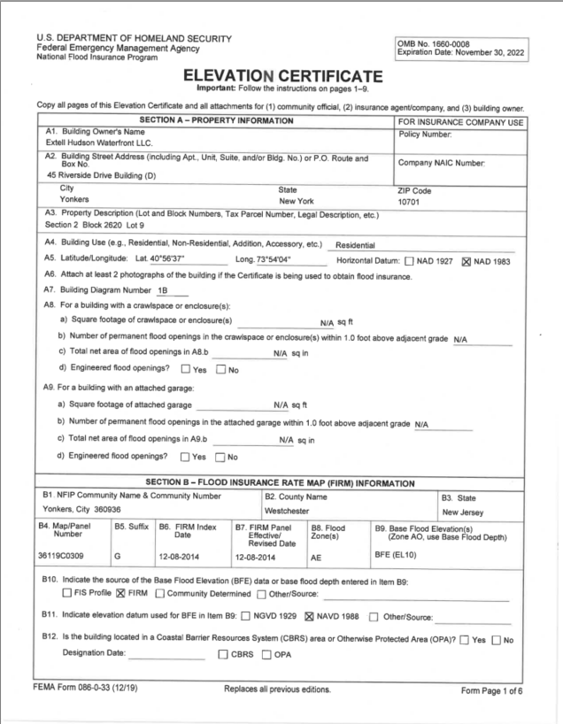
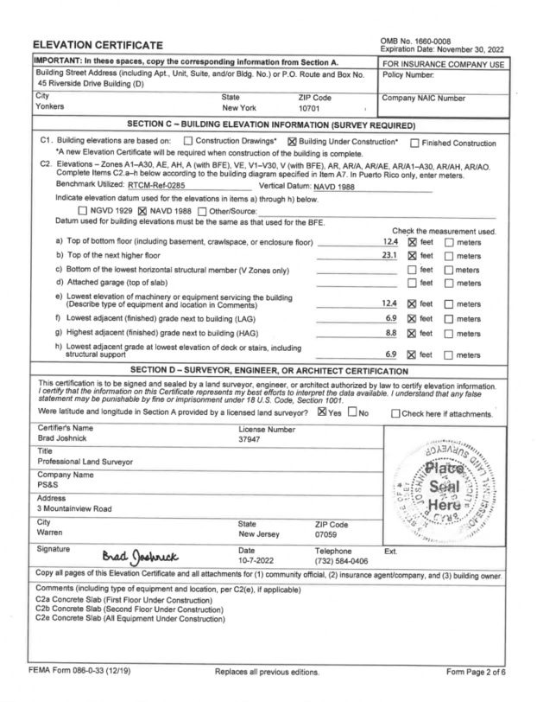
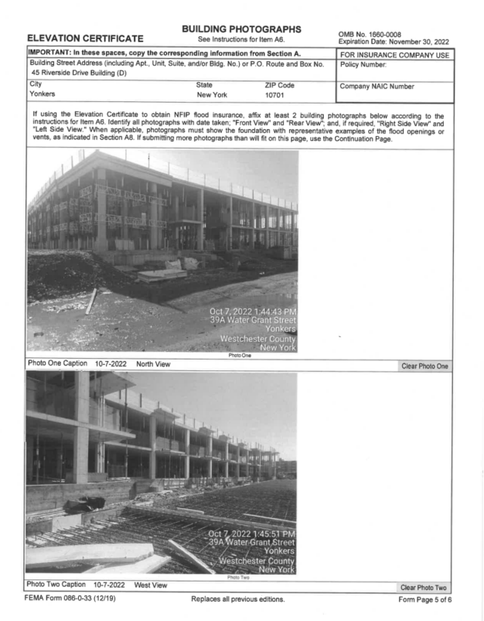

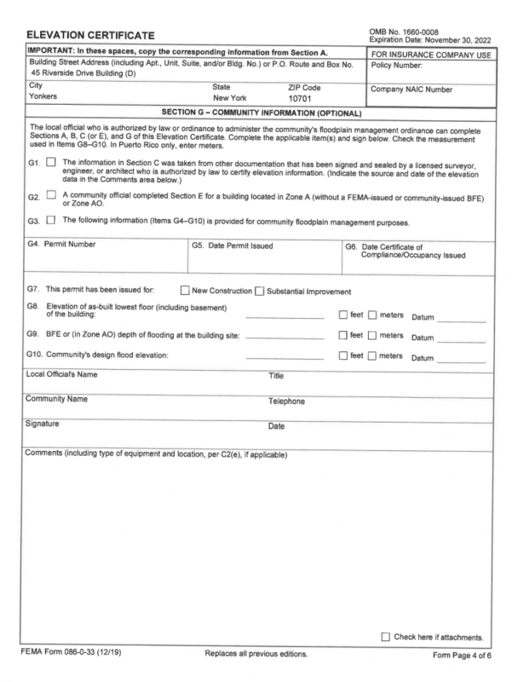
Elevation Certificate Example:
Notes:
1,800 residential units
Minimum use elevation at 12 feet NEV88 1 foot above revised flood elevation
About 1.5 million tons of structural fill imported to raised site grades above regulator
New higher bulkhead or higher hardened revetment stone shoreline

