Slide 1

Seaside Heights
Flood Mitigation
Developing Solutions
Bayside Terrace
&
Hiering Avenue
NJCRC
Flood Mitigation Workshop
March 19, 2025
Notes:
Hi everyone and thank you for having me
Today I’m presenting on a current project that is in progress
And it’s a project with real community implications because

Slide 2
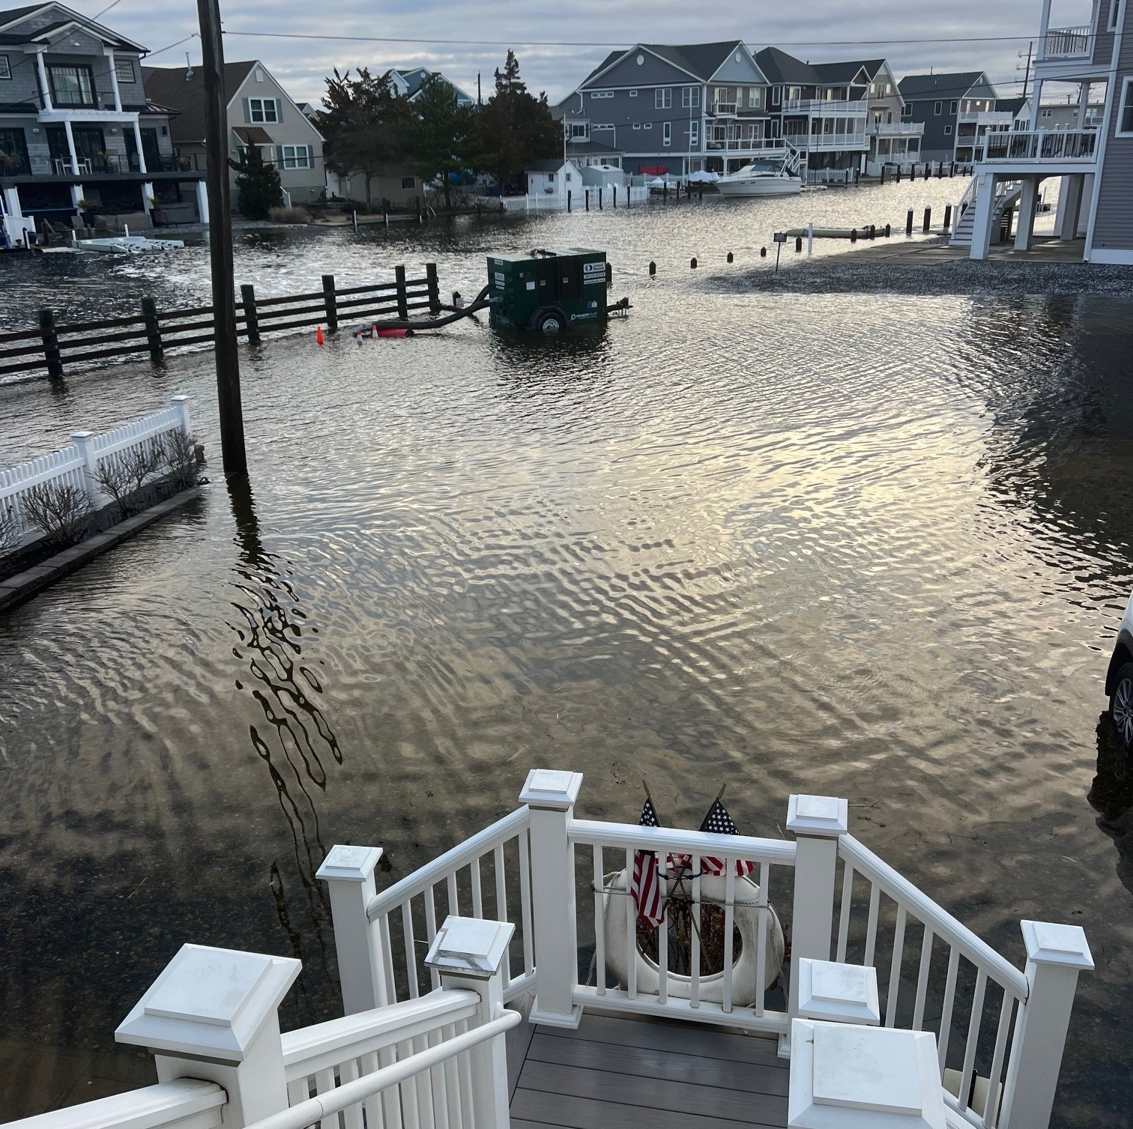
April 4, 2024
ENOUGH IS ENOUGH
Flooding after every heavy rain or a back-to-back rainy days.
Drainage system doesn’t drain.
Marginal success with auxiliary pump.
Action is needed.
ACT Engineers
Notes:
Enough is Enough
After years of flooding due to rain, due to storm surge, or both, and trying to use an auxiliary pump (pictured) to reduce water levels, we have been contracted by the Seaside Heights to design appropriate solutions to limit flooding like this in the future

Slide 3
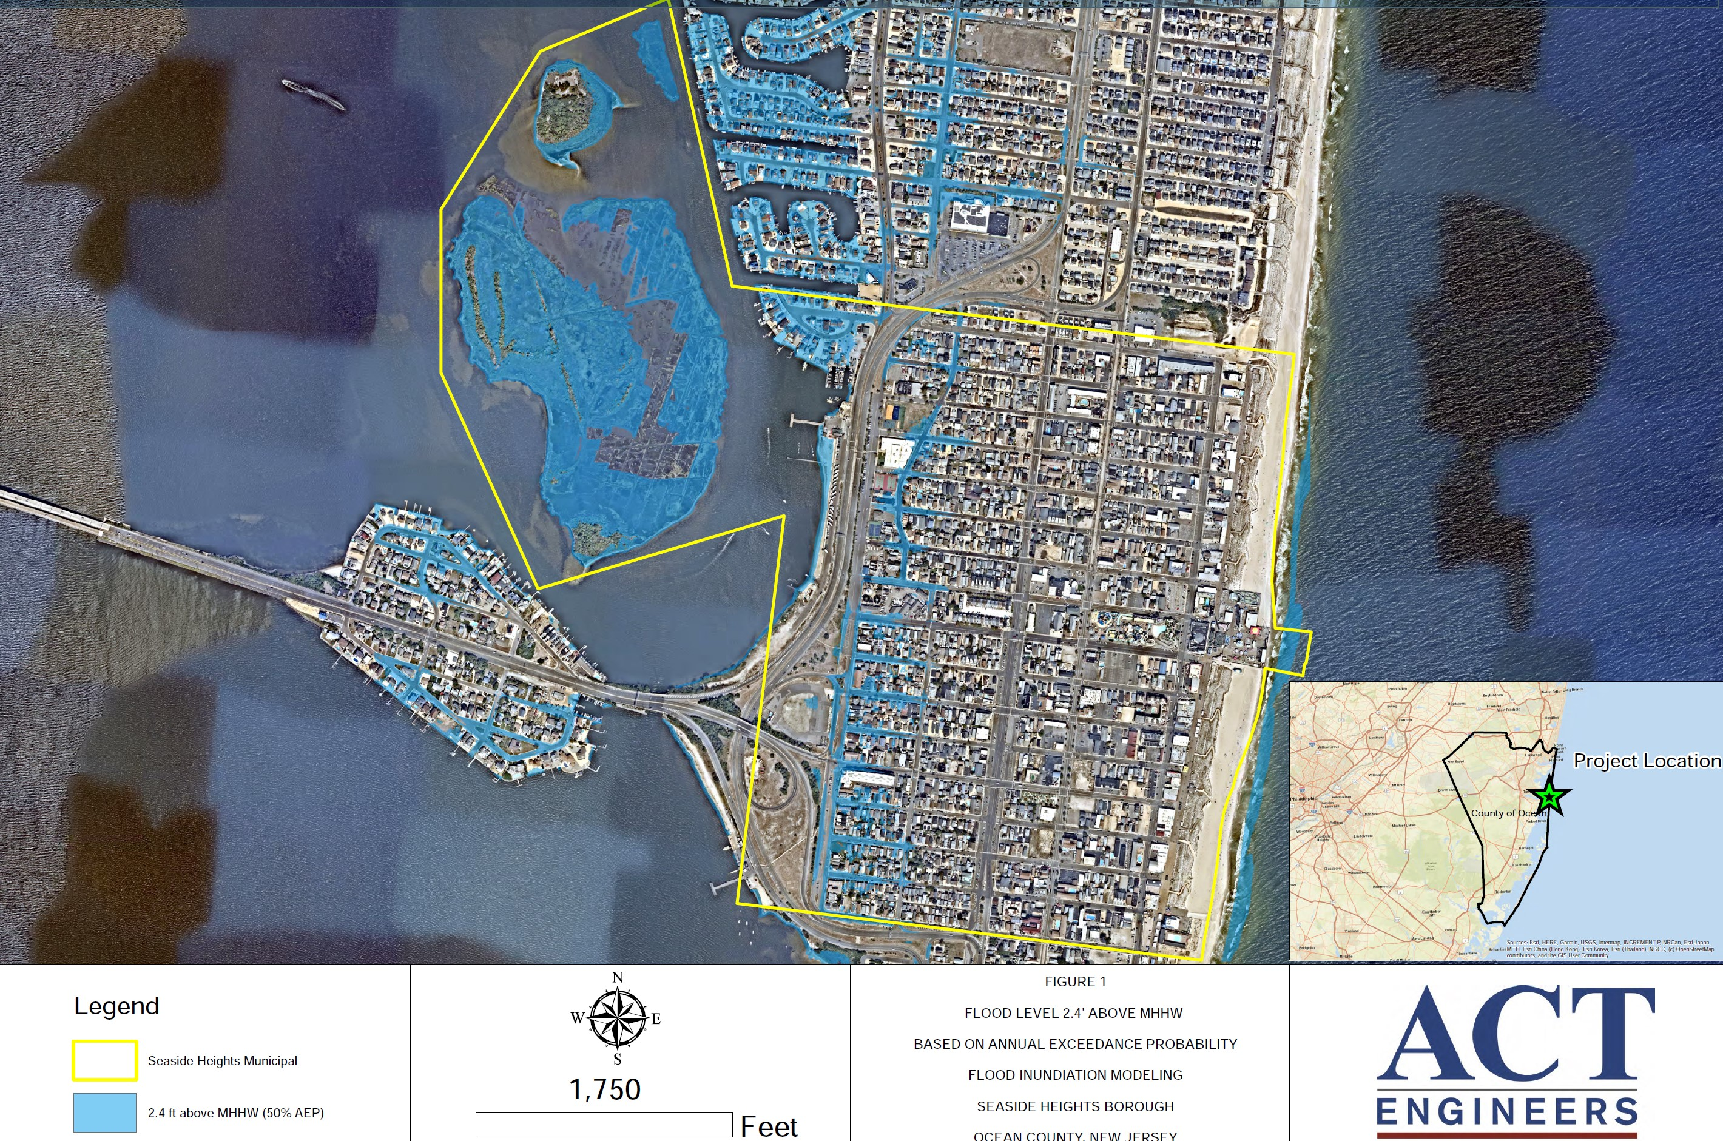
Rt. 37
ACT Engineers
Notes:
Located on the barrier island of Ocean County,
With
Dover Beaches and Lavalette to the North
Seaside Park to the South

Slide 4
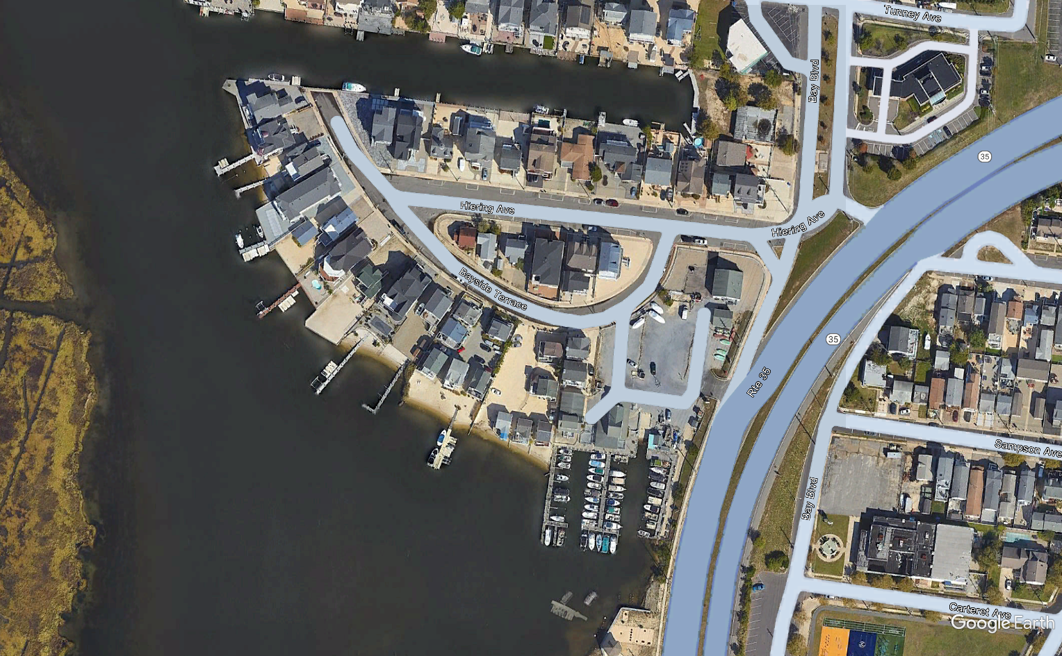
Project Location
ACT Engineers
Notes:
The specific neighborhood we’re working on is located on the Bay at the bend in Rt. 35
For a landmark – this building here is Sunsets

Slide 5
ACT Engineers’ Initial Scope of Work
Data Collection
Review existing data, as well as previous & ongoing studies.
Survey the area and map in high detail.
  Aerial LiDAR
  Bathymetry
Model flood scenarios, determine sea level rise trends, and model rainfall events.
Present potential solutions based on model results.
Get Feedback from Seaside Heights Council and residents.
Design conceptual plan based on feedback for approval.
Generate final design plans and specifications, apply for permits, and prepare the project for public bid.
Modeling & Assessments
Informed Design
Final Design
ACT Engineers
Notes:
Our initial SOW can be broken down into 4 basic phases
I’ll begin by briefly going over part of our data collection and the modeling analysis
We are currently in the informed design stage of the project

Slide 6
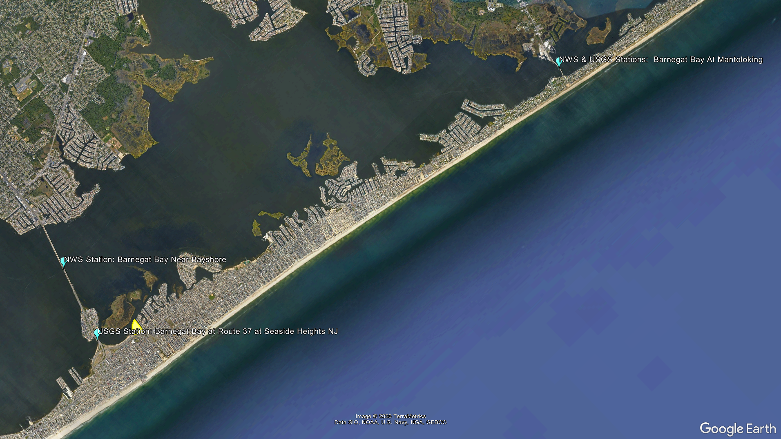
Monitoring Station Locations
Notes:
Our climate and water level data is coming predominately from 3 nearby stations
Although farthest from the neighborhood, the joint station at Mantoloking has over 20 years of recorded data, making it suitable for use in projecting long term trends
The closer stations may be more accurate for current conditions, but don’t have a long term data set

Slide 7
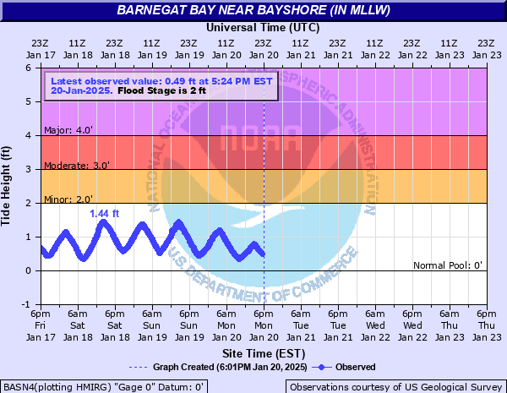
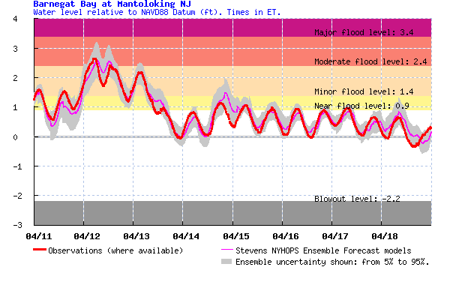
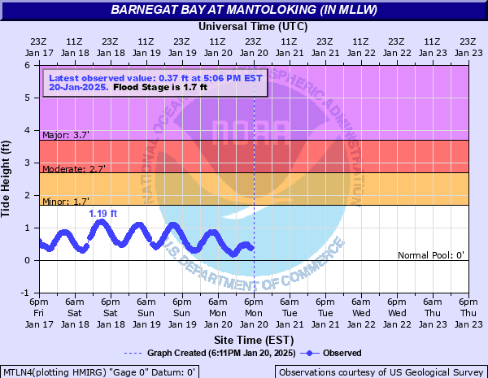
Existing Flood Level Determinations
Stevens Flood Advisory System
NWS Eastern Region Coastal Flood Page
ACT Engineers
Notes:
Existing flood forecasting services
these tools are useful to predict severity of flooding in a general area help us when it comes time to talk design heights

Slide 8
Survey Data Mapping
Notes:
The bathymetry, LiDAR, property information, and utility plans are imported into CAD software – and all referencing the NAVD88 zero line
From which we can generate contours, determine flow patterns, and discern sub catchment areas that will later inform how much water is entering the common flooding areas

Slide 9
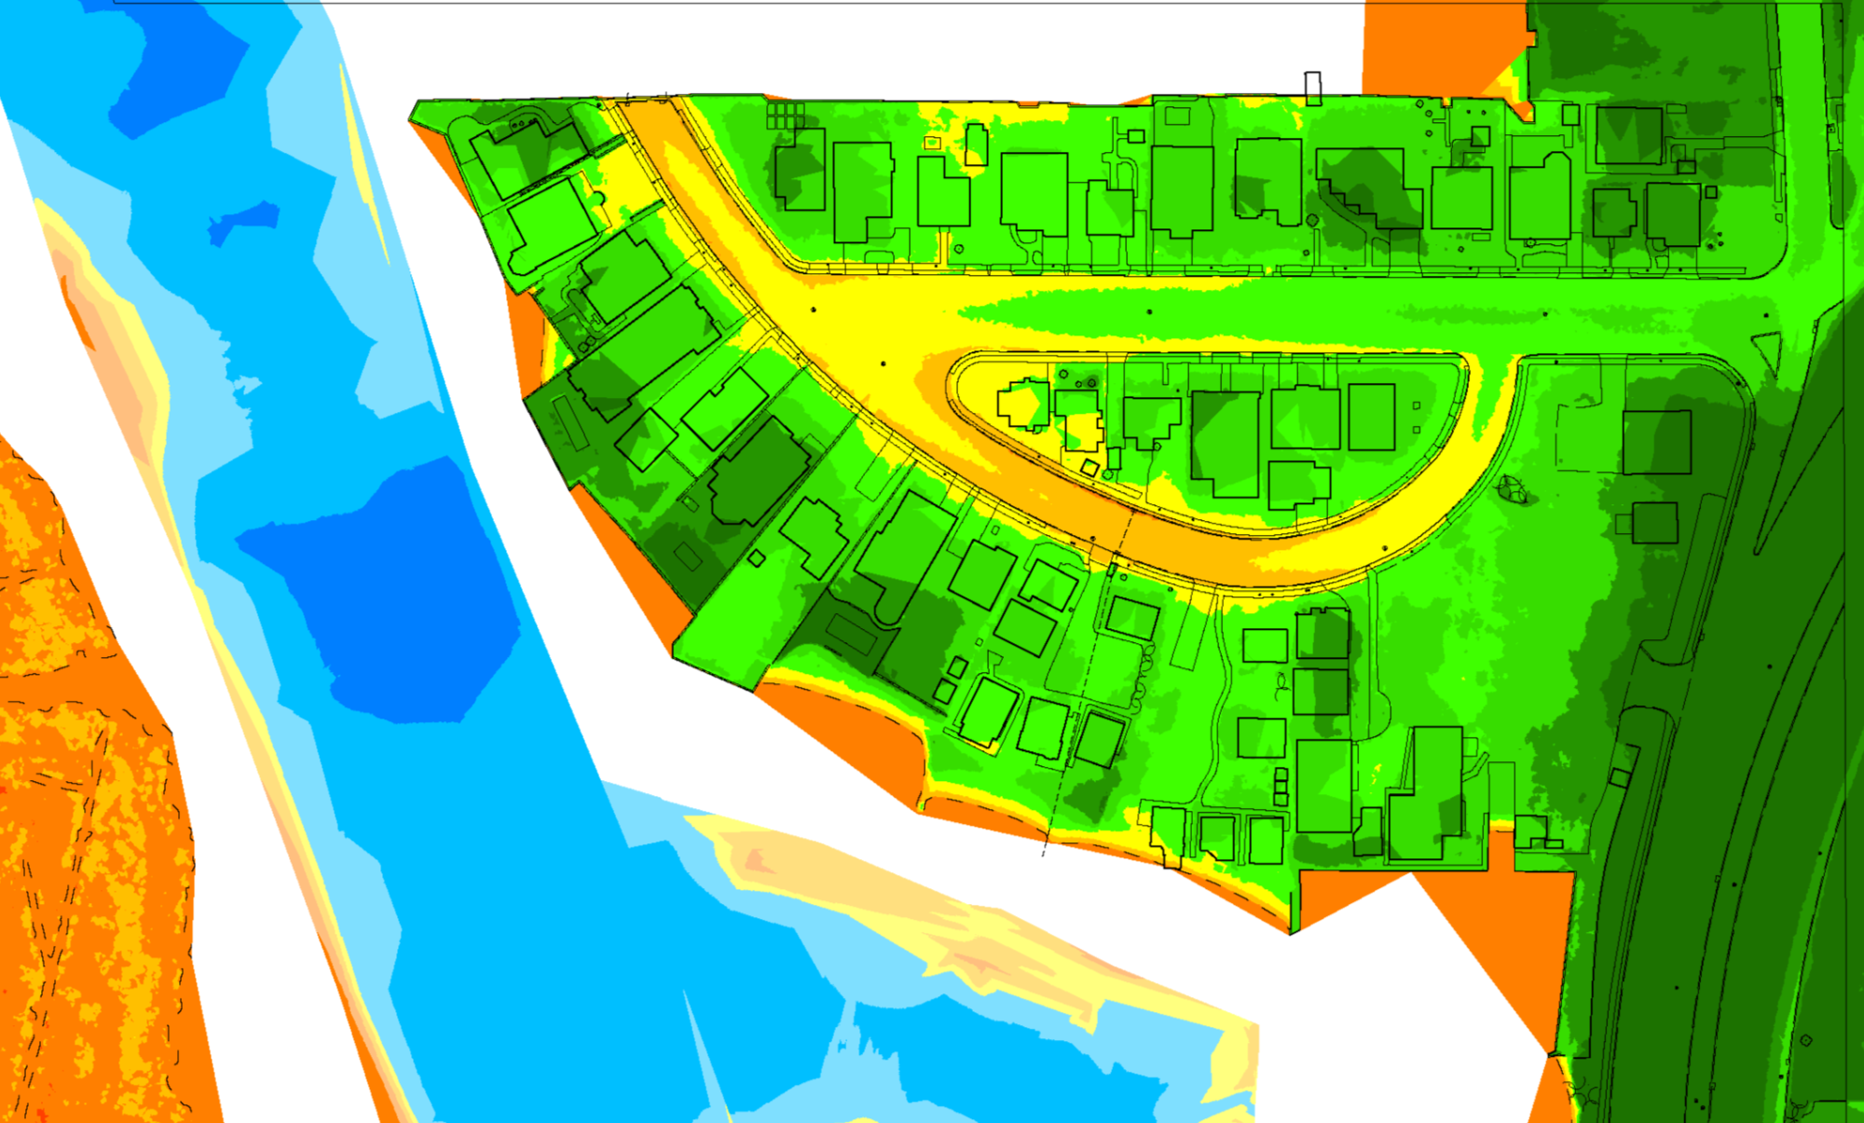
Digging Deeper
Bowl shaped topography
→ Once the water gets in, it stays in.
Higher at the highway
→ Collects runoff from broader area.
ACT Engineers
Notes:
You can probably pick out the bowl shape of the area
higher at water edge, lower in the middle
And it accumulates runoff from the broader area – it’s not just the rain falling directly into the street causing problems
From here, we can also very easily identify the main pooling areas, and calculate the areas that are going to drain into them

Slide 10
Digging Deeper
Bowl shaped topography
→ Once the water gets in, it stays in.
Higher at the highway
→ Collects runoff from broader area.
ACT Engineers
Notes:
And when we say “Bypass the Bulkhead”, we are referring to this area here where currently no bulkhead exists
The bulkhead height & water tightness varies by property, and in some places may be overtopped, but for the purposes of this presentation we mean the highpoint of the ground surface here, which is approximately 2.5ft
Note – this isn’t a continuous hill – the water finds its way through low spots

Slide 11
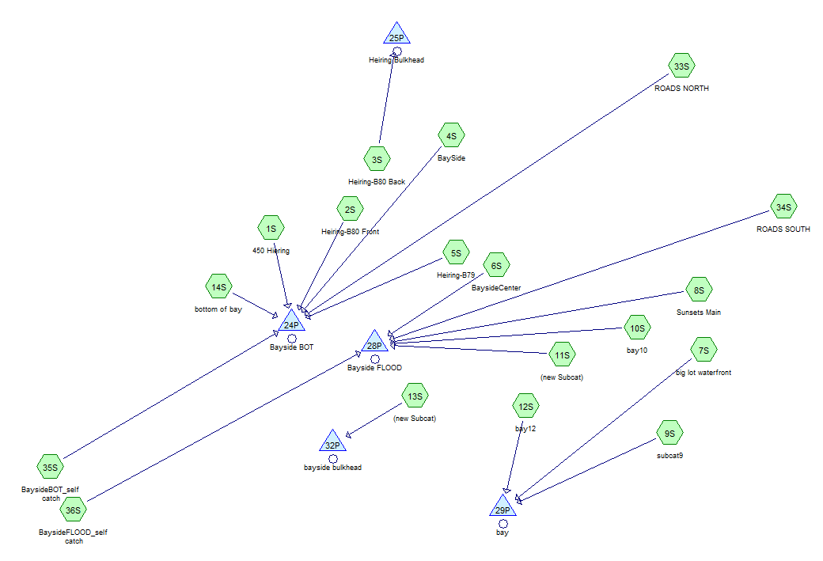

Flood Source: Rainwater
On average, rainfall exceeds 1.5” in a single day 2-3x per year.
ACT Engineers
Notes:
Using the survey mapping, weather history data, and specialized software, we can determine how much rainwater is accumulating in the low spots
The results from this step tell us how much water from rain alone we need to deal with and will be used to determine the pump capacity needed to recover after a storm
But this is only half the story – we still have the whole bay to contend with

Slide 12
Flooding Source: Rising Tides
ACT Engineers
Notes:
This shows HIGH TIDE at Mantoloking – the long-term gauge we can use to assess climate trends
The daily data is compared to the Stevens’ flood prediction designations and the water level trend was calculated for the period of record
If this trend continues at the same rate, it equates to an increase of approximately 1ft in the next 50 years – or by 2075

Slide 13
Water Levels – SLR Adjusted
ACT Engineers
Notes:
To adjust for sea level rise, the data was detrended, so that we can apply the 50-year SLR amount and view the history as if it were occurring in the future
This allows for better planning to ensure that protections we install today will continue to work in the years to come
Once adjusted, you can see that the water level can regularly bypass the bulkhead at hightide

Slide 14
Hydrodynamic Model
The model ties in what we’ve observed through local stations and survey data, and generates a flood map projecting 27 potential flood scenarios:
0 to 8ft SLR
50, 100, 500 - year storm events
Thank you,
Hydroclimte Risk Consulting, LLC
ACT Engineers
Notes:
A hydrodynamic model is a tool used to anticipate future impacts of storms or sea level rise
They used available climatological, tide, and survey data to generate the model base and ran the model for 27 different flood scenarios using SLR ranges from 0 to 8 feet for 3 differ storm intensities

Slide 15
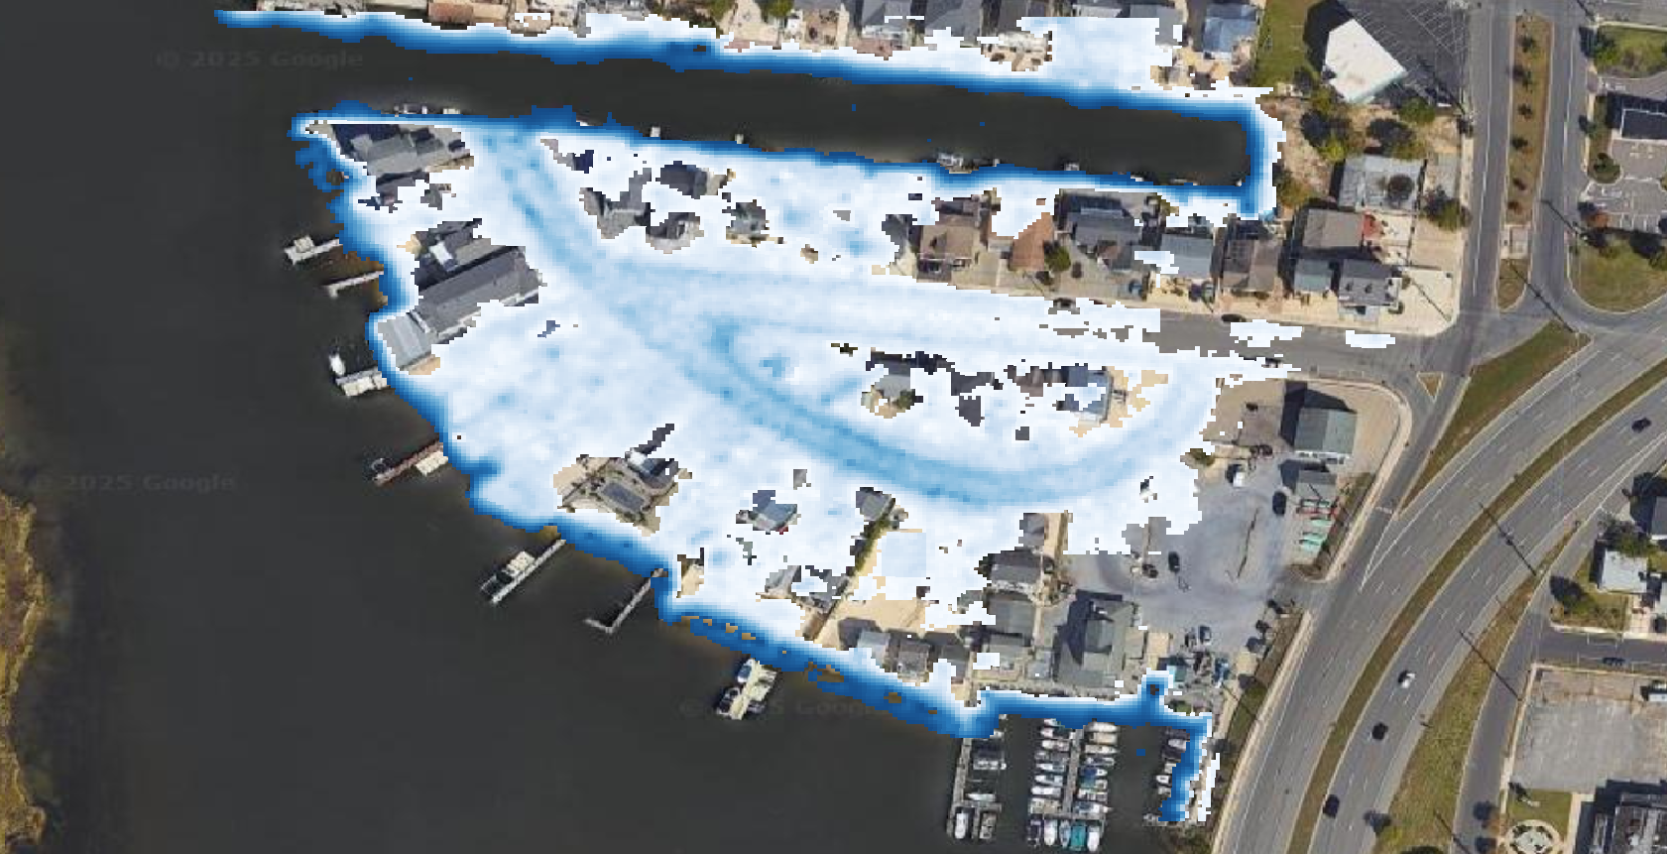
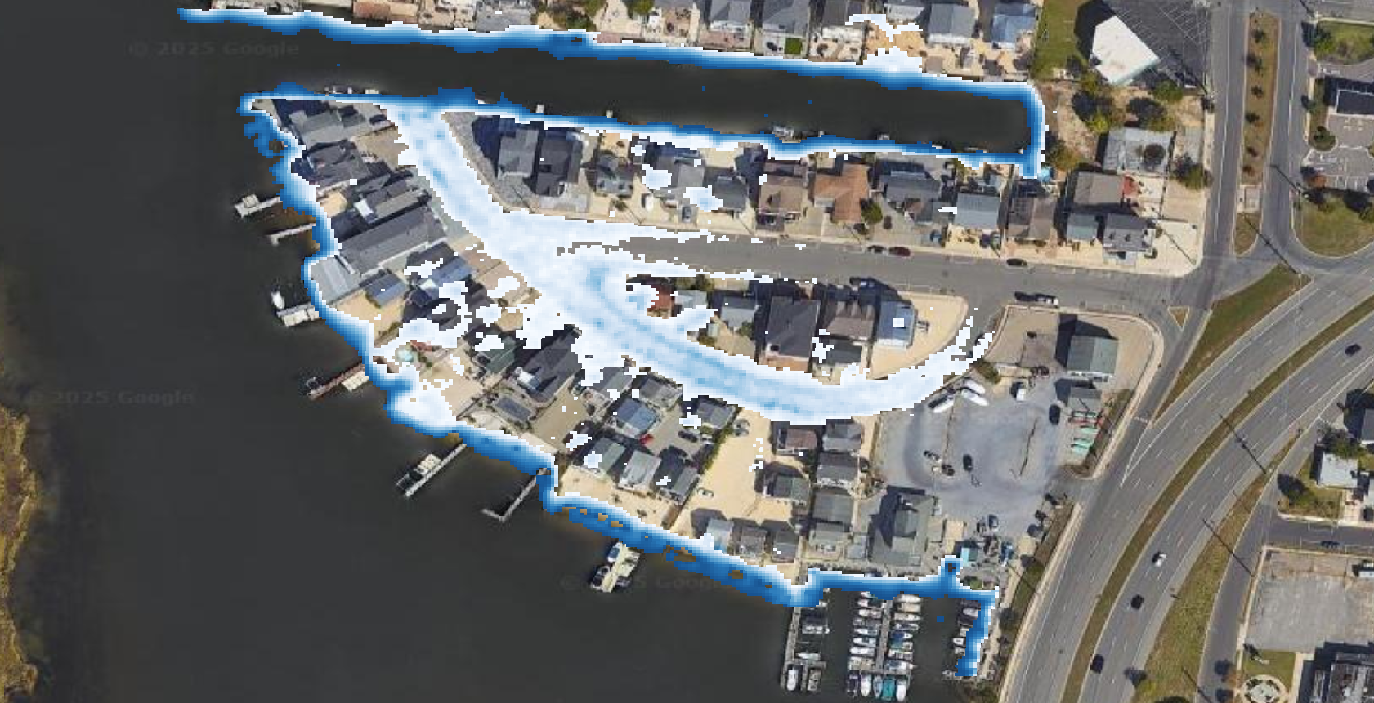
Model Results – Dec 2023 Storm
Hydroclimate Risk Consulting LLC
Hydroclimate Risk Consulting LLC
6 inches
3 feet
1 foot
3 feet
ACT Engineers
Notes:
The storm event that occurred in December 2023 was used to calibrate the model
The calibration matches closely to what was observed, and gives us a really good idea of the most vulnerable areas of the neighborhood
Changing the intensity of the flood scale further aids in identifying trouble areas

Slide 16
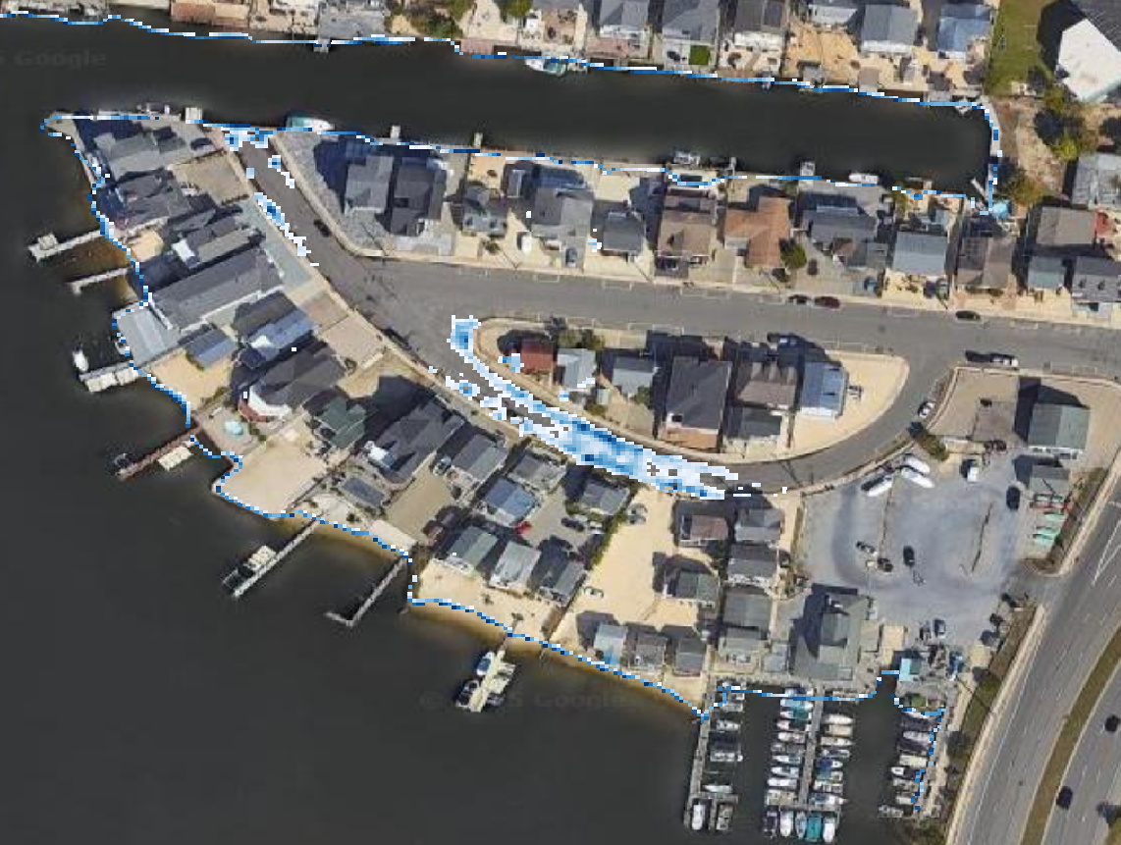
Confirm Main Pooling Locations
ACT Engineers
Notes:
This information tells us where the drainage most needs improvement and where a stormwater collection system will be most useful

Slide 17
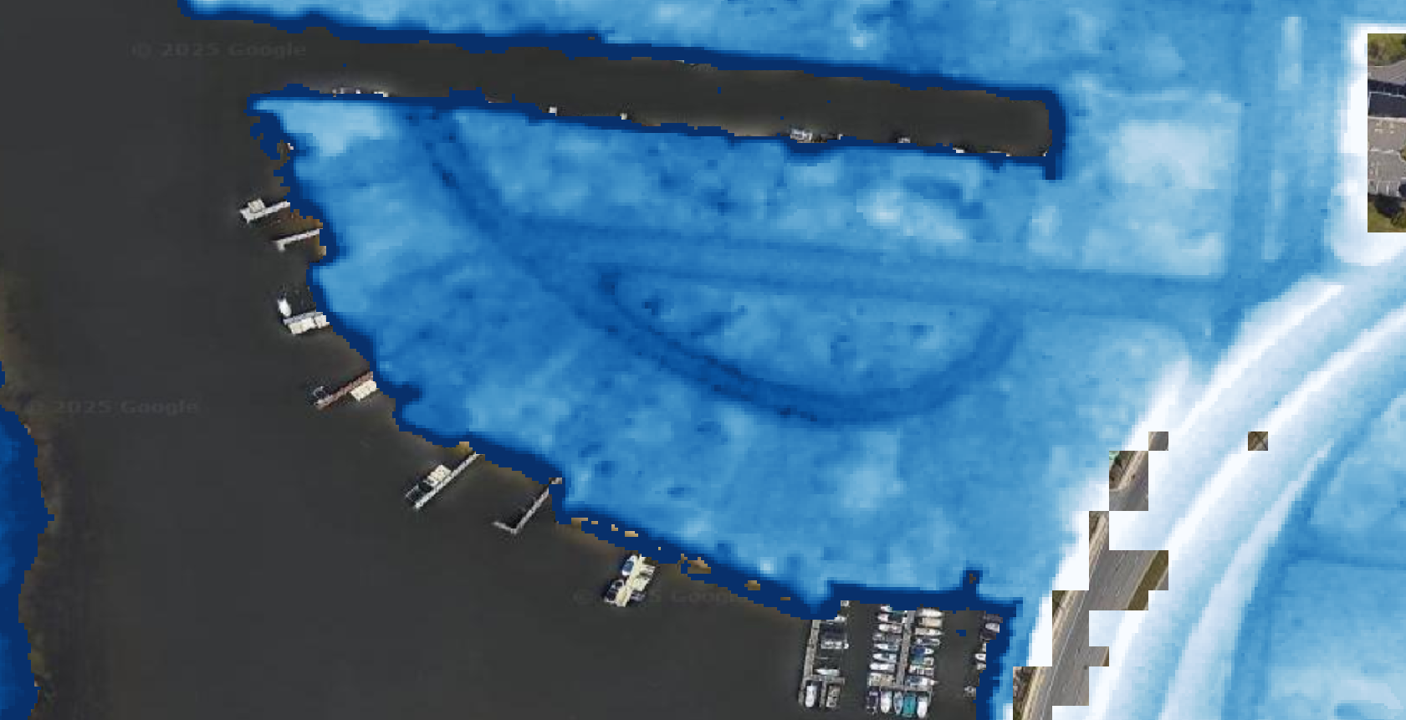
The
Current
50-yr Storm
Hydroclimate Risk Consulting LLC
0 feet
5+ feet
No sea level rise or wave action added to this scenario.
ACT Engineers
Notes:
This is the least severe storm condition modeled, aside from the December 2023 storm used for model calibration
Additional water level from waves is not included in the model
HOWEVER – the neighborhood is protected from large waves by the surrounding marsh islands that will prevent wave attack during typical storms
It would take a hurricane with sustained 80mph winds could produce 5ft waves on top of the surge (assume 2mi fetch and 5ft depth limitation after the marsh floods)

Slide 18
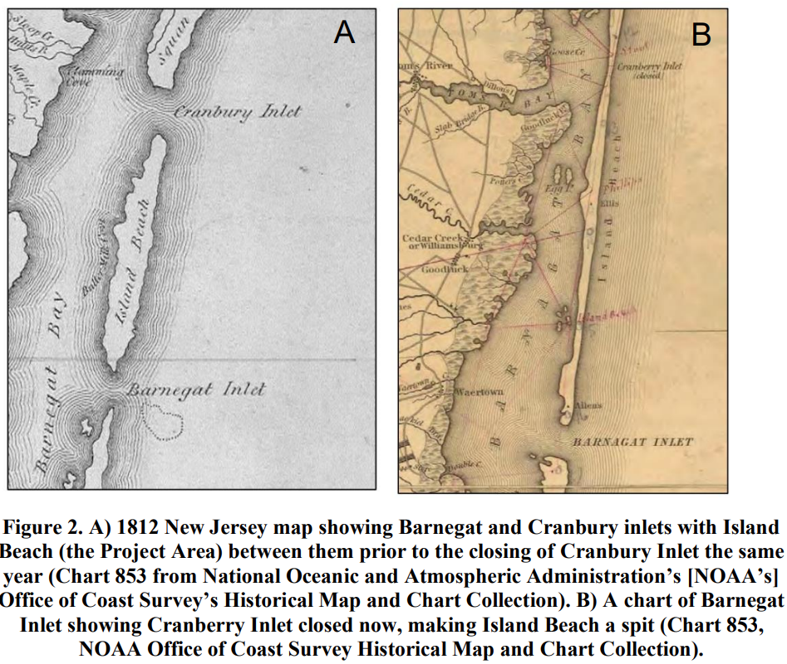
Not just over but through
Hydraulic conductivity of soils: TBD
“The water seems to come up through the ground.”
“I’ve rarely seen water coming over the bulkhead.”
“The street just seems to fill up.”
Kulynych, Anna & Buynevich, Ilya. (2023)
ACT Engineers
Notes:
New Jersey formerly had several inlets along the coast that have long since been filled in and built on
Today, many are erosional hotspots
This piece requires the flood mitigation structure/bulkhead to be watertight to slow the transgression of rising tide via the ground
Again, we call it this bc sea wall is a scary term
Also calls for all properties needing to accept adding a bulkhead (hard sell for 2 lots) but it offers a compromise with lower overall heights

Slide 19
Conceptual Mitigation Design Approaches
Short-Term Approach:
These options can be applied within the next year and do not require extensive permitting.
Install check valves at existing drainage (recently completed).
Use available flood forecasting tools to determine flood potential.
  Deploy sandbags or other temporary measures during surge events.
  Deploy temporary pump to mitigate precipitation events (ex: April 2024).
Long-Term Approach:
These options can be implemented in 2+ years. They require extensive permitting, engineering, and construction.
Install continuous flood mitigation structure.
Update drainage and install collection system.
Install permanent pump at street end to expel accumulated water.
Notes:
The short-term approaches don’t vary much from the current business as usual – rather it involves monitoring and planning ahead of storm impacts.
The longer term approaches will take significant engineering and construction. They include installation of a continuous bulkhead at consistent height, updating the current drainage system, and installing a permanent pump.

Slide 20

Install Check Valves
Ground Level
Inlets at Gutter
Bulkhead
W/O CHECK VALVE
Ground Level
Inlets at Gutter
Bulkhead
Check Valve
WITH CHECK VALVE
Notes:
Check valves work by only allowing water to flow in one direction – thus water can drain from the street via gutters but cannot be forced up the pipe when the tide rises

Slide 21
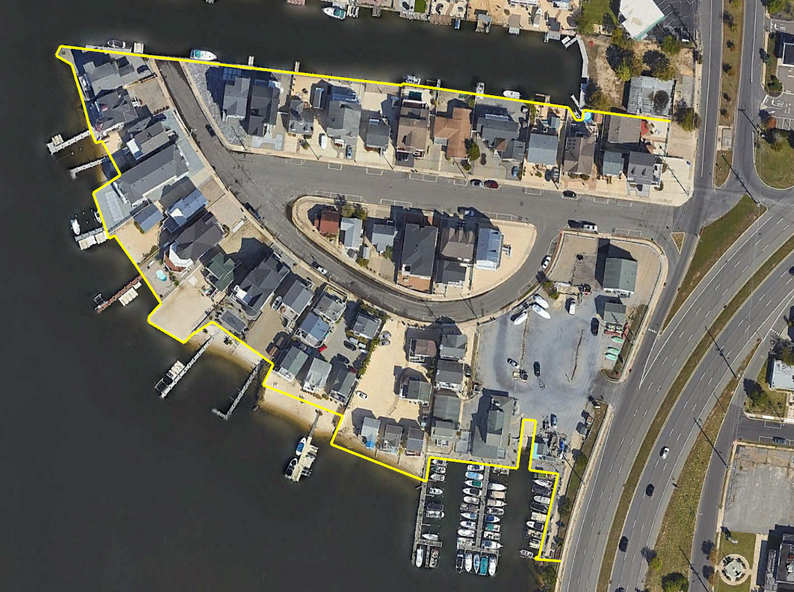
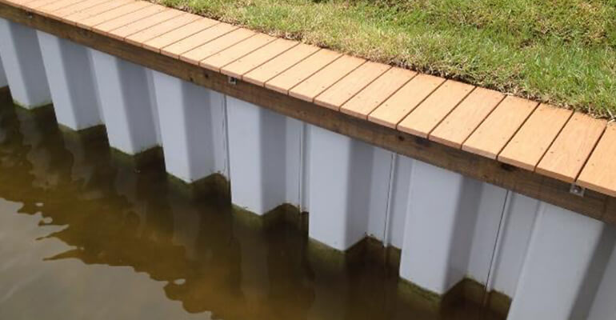
Flood Mitigation Structure
Image courtesy of:
https://www.gulfcoastdockmasters.com/marine-bulkhead-seawall-construction.html
ACT Engineers
Notes:
We propose installing a continuous structure around the entire neighborhood
Properties that do not currently have a bulkhead will have one installed, and properties with lower elevation sections will have theirs altered to match the design height
We will work with the property owners on location and potential for maintaining their beach access
Existing bulkhead sections of appropriate height will be updated to ensure water rightness
The elevation consistency is crucial during surge events – if there is a gap, the water will find it
There may be additional mitigation efforts needed at the boat launch

Slide 22
Bulkhead Design Considerations
  Consistent height at all properties.
  Tie in bulkhead height to inland contour to prevent bypassing.
  Must be watertight to delay tidal rise though soils.
  Pump will only compensate for rain & runoff – NOT the bay.
  Problem area – boat launch
xx
ACT Engineers
Notes:
Boat Launch Alternatives analysis for how to fix it:
Do nothing, flood gate, remove launch, other?

Slide 23
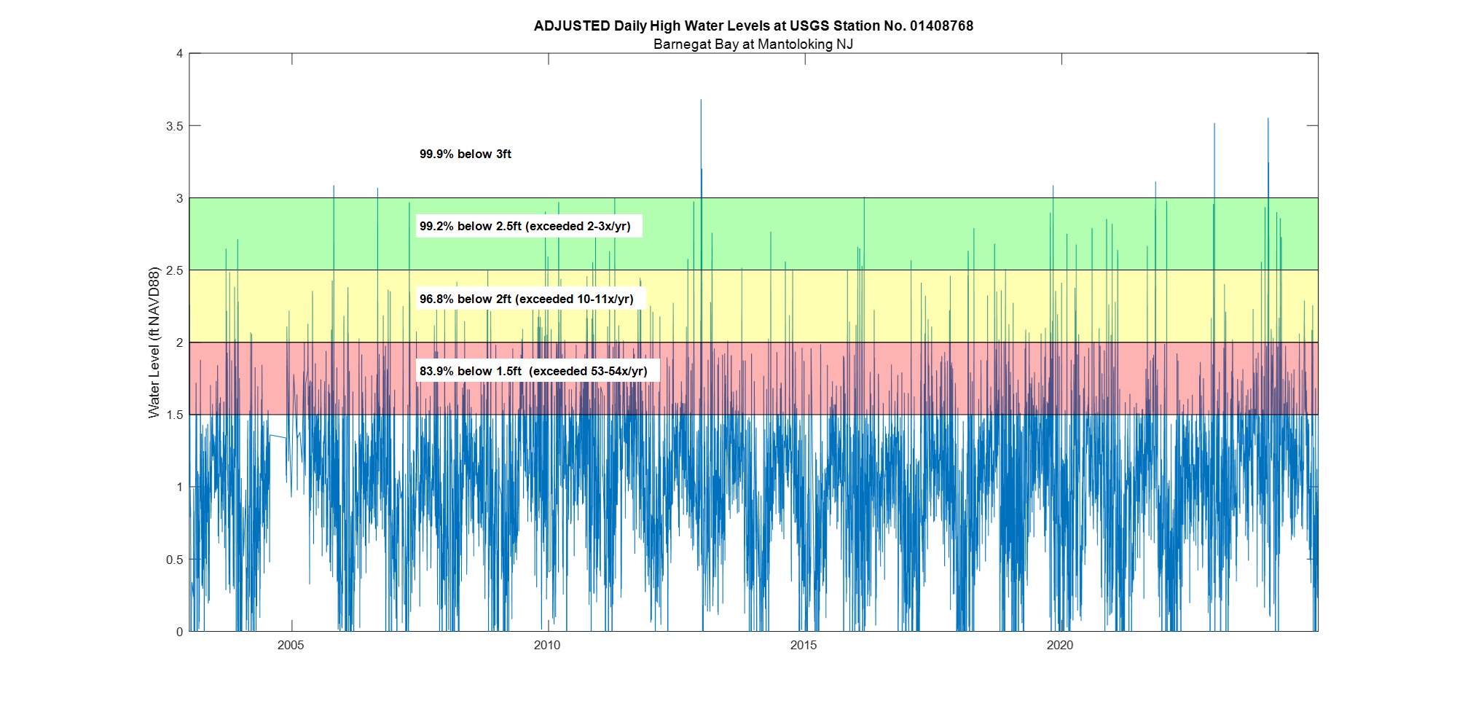
Flood Mitigation Structure Height Options
ACT Engineers
Notes:
This is the detrended high tide levels at the Mantoloking gauge
Again, these water levels do not include wave action on top of the tide – but we can determine how often certain levels are exceeded
It’s also important to note that these are for normal storms – your Sandys and other major storms exceed the capacity of these gauges so we don’t see those here
The main questions here are:
- How much protection do you want?
- What structure height can you tolerate?
We recommend no lower than 2.5 feet if 2-3 flood events are tolerable – again, this would be paired with the pump system to drain the neighborhood to recover faster.

Slide 24
Community Outreach
The design life of this project is 50 years. What level of protection do you want?
What are your expected outcomes?
What is the highest structure you can tolerate?
Does your property regularly flood? If so, how often?
Is your property raised?
  Is yes, how high?
  If no, do you plan to have it raised?
Is this your primary residence?
Do you currently have a bulkhead installed?
  If so, what is its height?
  In not, are you willing to lose beach access? Would you consider stairs or another alternative?
ACT Engineers
Notes:
Which brings us to community outreach
Using the feedback we get from Borough leadership, we are preparing a questionnaire for residents of the neighborhood.
This slide shows some example questions that may be asked
Our goal is to balance protection with perceived aesthetics/over engineering

Slide 25
Broader Scale
Long-Term Approach:
These options can be implemented in 2+ years. They require extensive permitting, engineering, and construction.
Link projects to establish a resilient township.
Work with neighboring communities to build resiliency.
Protect & enhance marsh islands.
ACT Engineers
Notes:
we’ve seen this in wildlife conservation; you can’t fix everything all at once, but you can build pieces that connect and create a web of resiliency and continuously add pieces over time at the locations most needing support
This leads into working together with neighboring communities and the State

Slide 26
Broader Scale
Long-Term Approach:
These options can be implemented in 2+ years. They require extensive permitting, engineering, and construction.
Link projects to establish a resilient township.
Work with neighboring communities to build resiliency.
Protect & enhance marsh islands.
ACT Engineers
Notes:
Many grants are competitive, and it can seem like if one town wins, another looses big. But we’ve seen success in other locations and coming together to for planning, pooling resources if able, allows for bigger projects to be realized – I’m just gonna say it – teamwork makes the dream work

Slide 27
Broader Scale
Long-Term Approach:
These options can be implemented in 2+ years. They require extensive permitting, engineering, and construction.
Link projects to establish a resilient township.
Work with neighboring communities to build resiliency.
Protect & enhance marsh islands.
ACT Engineers
Notes:
Many of the natural marshes have been severely degraded by human impacts, climate change, and sea level rise
We’ve had a lot of success in other townships combining marsh restoration and maintenance dredging, and have added this piece to an extended SOW

Slide 28
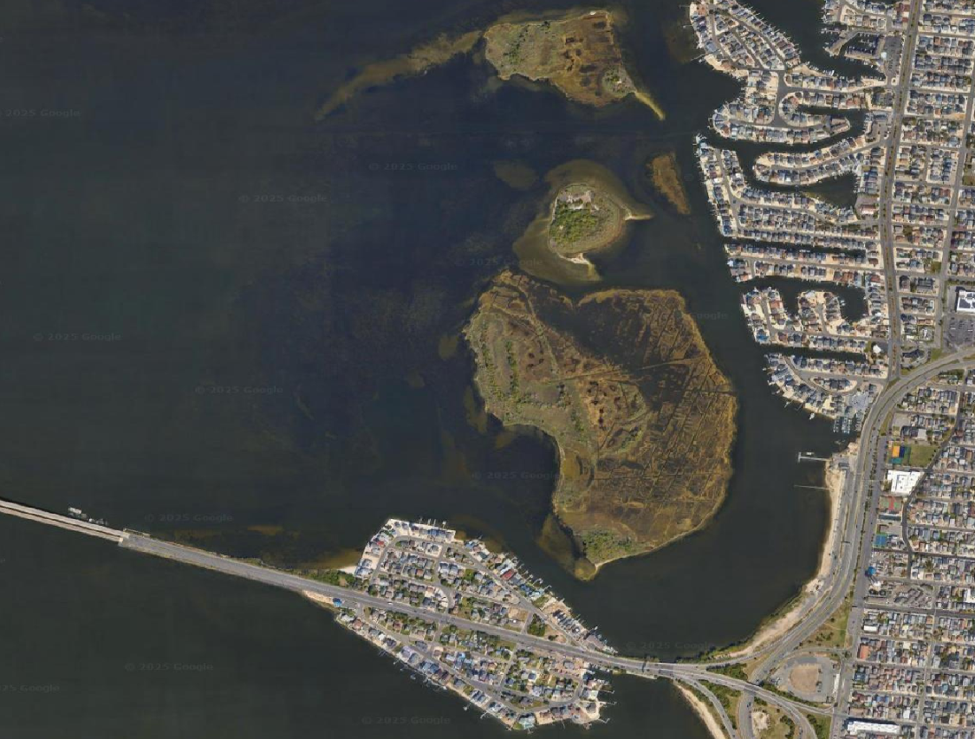

Marsh islands are more than just pretty habitat.
They’re a critical line of defense.
Notes:
Aside from the obvious habitat and ecological benefits,
Protecting and restoring these marsh islands is an integral piece of resilience for bay side communities

Slide 29
Ongoing and Next Steps
Identify and pursue funding sources (e.g., FEMA FMA grant)
  → Prepare BCA and other necessary documents
Obtain State & Federal permits.
Conduct Community survey.
Prepare conceptual designs and alternatives for Borough comment and approval.
Final design plans for permitting and bid specifications.
ACT Engineers
Notes:
Community outreach is our next big step. Feedback from the community will be used to inform our conceptual design phase.
During the design phase, costs associated with various options will be documented and presented to the Borough for approval.
The selected options will be implemented in the final design phase.

Slide 30
Data Sources
“New Jersey Department of Environmental Protection - Rainfall.” Njdep.rutgers.edu, Seaside Heights Station No. RABCH031. njdep.rutgers.edu/rainfall/#data.
“Barnegat Bay at Route 37 at Seaside Heights NJ.” Usgs.gov, 2015,USGS Station No. 01408748 . waterdata.usgs.gov/monitoring-location/01408748.
“Barnegat Bay at Mantoloking NJ.” Usgs.gov, 2015,USGS Station No. 01408168 . waterdata.usgs.gov/monitoring-location/01408168.
“Stevens Flood Advisory System.” Stevens-Tech.edu, 2025, Station Barnegat Bay at Mentoloking. hudson.dl.stevens-tech.edu/sfas/d/index.shtml?station=U222.
‌US. “Eastern Region Coastal Flood Page.” Weather.gov, 2024, www.weather.gov/erh/coastalflood?wfo=phi.
Inlet Figure:
Kulynych, Anna & Buynevich, Ilya. (2023). HISTORIC DATABASE ANALYSIS OF A FORMER WAVE-DOMINATED TIDAL INLET, CENTRAL NEW JERSEY, USA. ‌
ACT Engineers

Slide 31
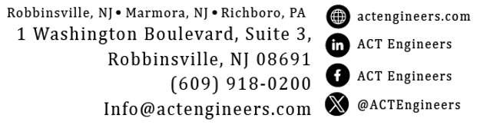
Thank you!
Questions?
nzuck@actengineers.com
ACT Engineers

Slide 32
Additional Info Slides
ACT Engineers

Slide 33
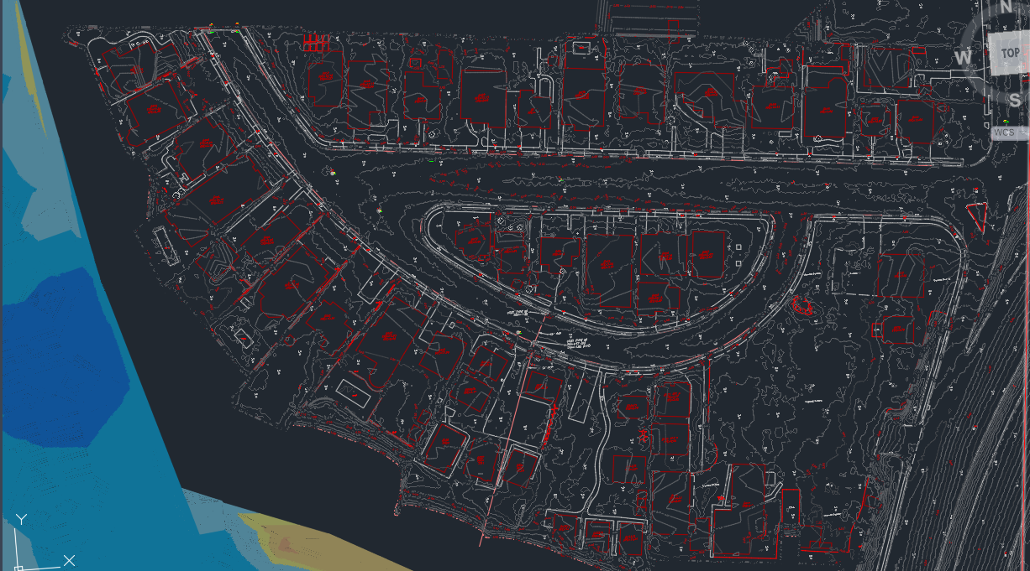
Survey Data Mapping
ACT Engineers
Notes:
The bathymetry, LiDAR, property information, and utility plans are imported into CAD software – and all referencing the NAVD88 zero line
From which we can generate contours, determine flow patterns, and discern sub catchment areas that will later inform how much water is entering the common flooding areas

Slide 34
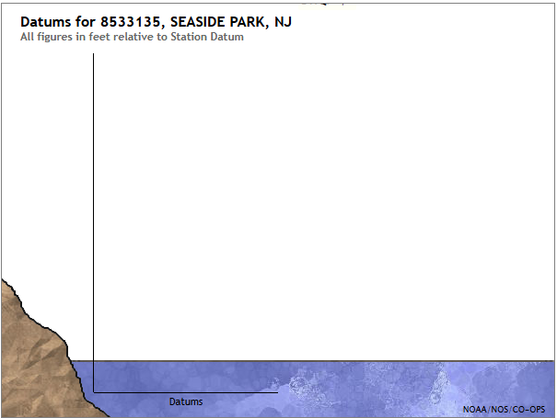
Datums
We measure from 0ft NAVD88. (yellow arrow)
If we measured from MLLW, the other measurements would be 0.014 ft higher. (green arrow)
Elevation to Bypass Bulkhead = 2.5
Lowest Street Elevation = 1.0
Mean Higher High Water = 0.775
NAVD88 = 0
Mean Lower Low Water = -.014
ACT Engineers
Notes:
To help you visualize the difference,
When water levels are reported to NAVD88 they mean the total height above this line (yellow arrow )
If we used Mean Lower Low water, the reported elevations would be slightly higher because we’re measuring from a lower line
These water levels shown here are based off the Mantoloking tidal dataset

Slide 35
Datums
Concept Design Example Elevation = 2.5 – 3.5
We measure from 0ft NAVD88.
If we measured from MLLW, the other measurements would be 0.014 ft higher.
Concept design elevation will be measured from NAVD88.
Elevation to Bypass Bulkhead = 2.5
Lowest Street Elevation = 1.0
Mean Higher High Water = 0.775
NAVD88 = 0
Mean Lower Low Water = -.014
ACT Engineers
Notes:
Everything we report to you will be measured from the NAVD88 line
There will be more on determining that elevation in the slides to come – this is just an example to show how the range will look

Slide 36
Daily Total Rainfall
ACT Engineers
Notes:
Looking at rainfall alone over the last 10 years, there are 22 instances of daily accumulation above 1.5 inches – or the level that can be mitigated with the auxiliary pump ONLY IF there is no associated storm surge
This type of one day rainfall occurs about twice a year
This graph does not include periods of rain over multiple days that can build up and overwhelm the system

Slide 37
Rainfall & Roadway Flooding
Uses daily total of 10 years of hourly data
Black line = 1.5” rainfall
22 events have rainfall exceeding that – RE – potential for flooding twice/yr on average, but I don’t need to tell you that – you’ve seen it. This is measured data to support what you’ve been living with for years.
Note that flooding can happen in less time, but models are based on 24 hour inundation that combine many factors – not just the rain
This is only one aspect of the flooding you see. Today we’ll go over the rest
SOURCE
  Seaside Heights
  RABCH031
  https://njdep.rutgers.edu/rainfall/#data
ACT Engineers
Notes:
1.95 peak Dec 10 – not even accosiated with the bigger storm Dec 17-18
Dec 18 only 1.43 inches
So theres more to it than just rainfall, but you see the puddles, you see the torrent in your street, you see the pooling – you know something needs to be done

Slide 38
Example: April 2024
ACT Engineers
Notes:
In other words –
The flooding you experienced was due to a combination of the bay by passing the bulkhead, multiple days of heavy rain, and accumulation off runoff pouring into the streets
What these figures shows us, is that during the first phase of a weeklong weather event, the surge was high, but not high enough to get in, and the pump that was brough in was able to reduce flooding from the initial ~1.5 inches of rain
However – the second phase saw accumulation starting March 31 that continued until both rain and storm surge peaked, resulting in the severe flooding seen on April 4
THIS IS NOT A SPECIAL EVENT. It does not take extreme conditions for this type of flooding to manifest in this neighborhood – a less than 2ft surge doesn’t make the news

Slide 39
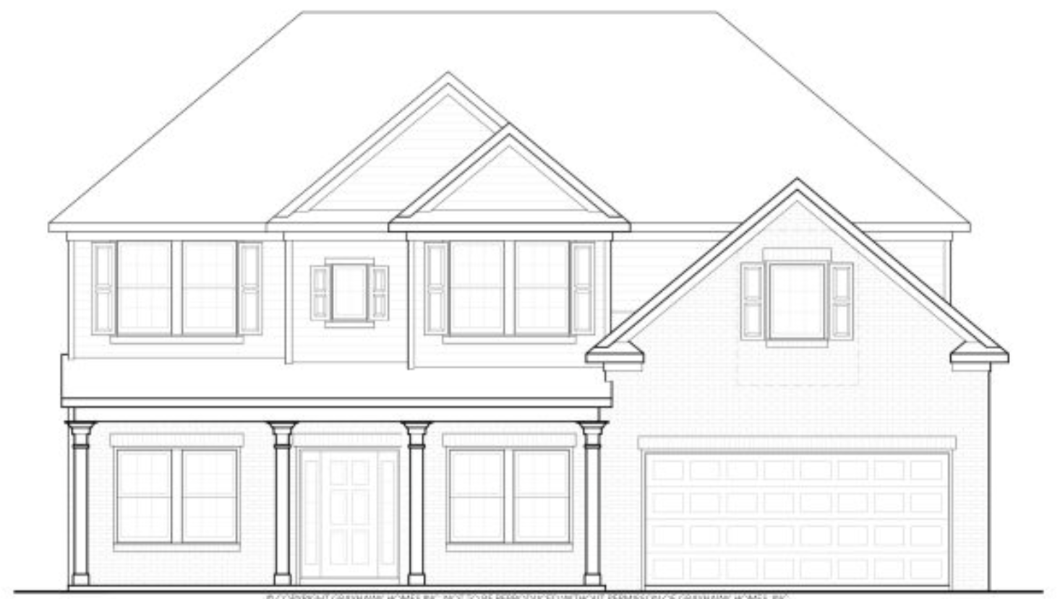
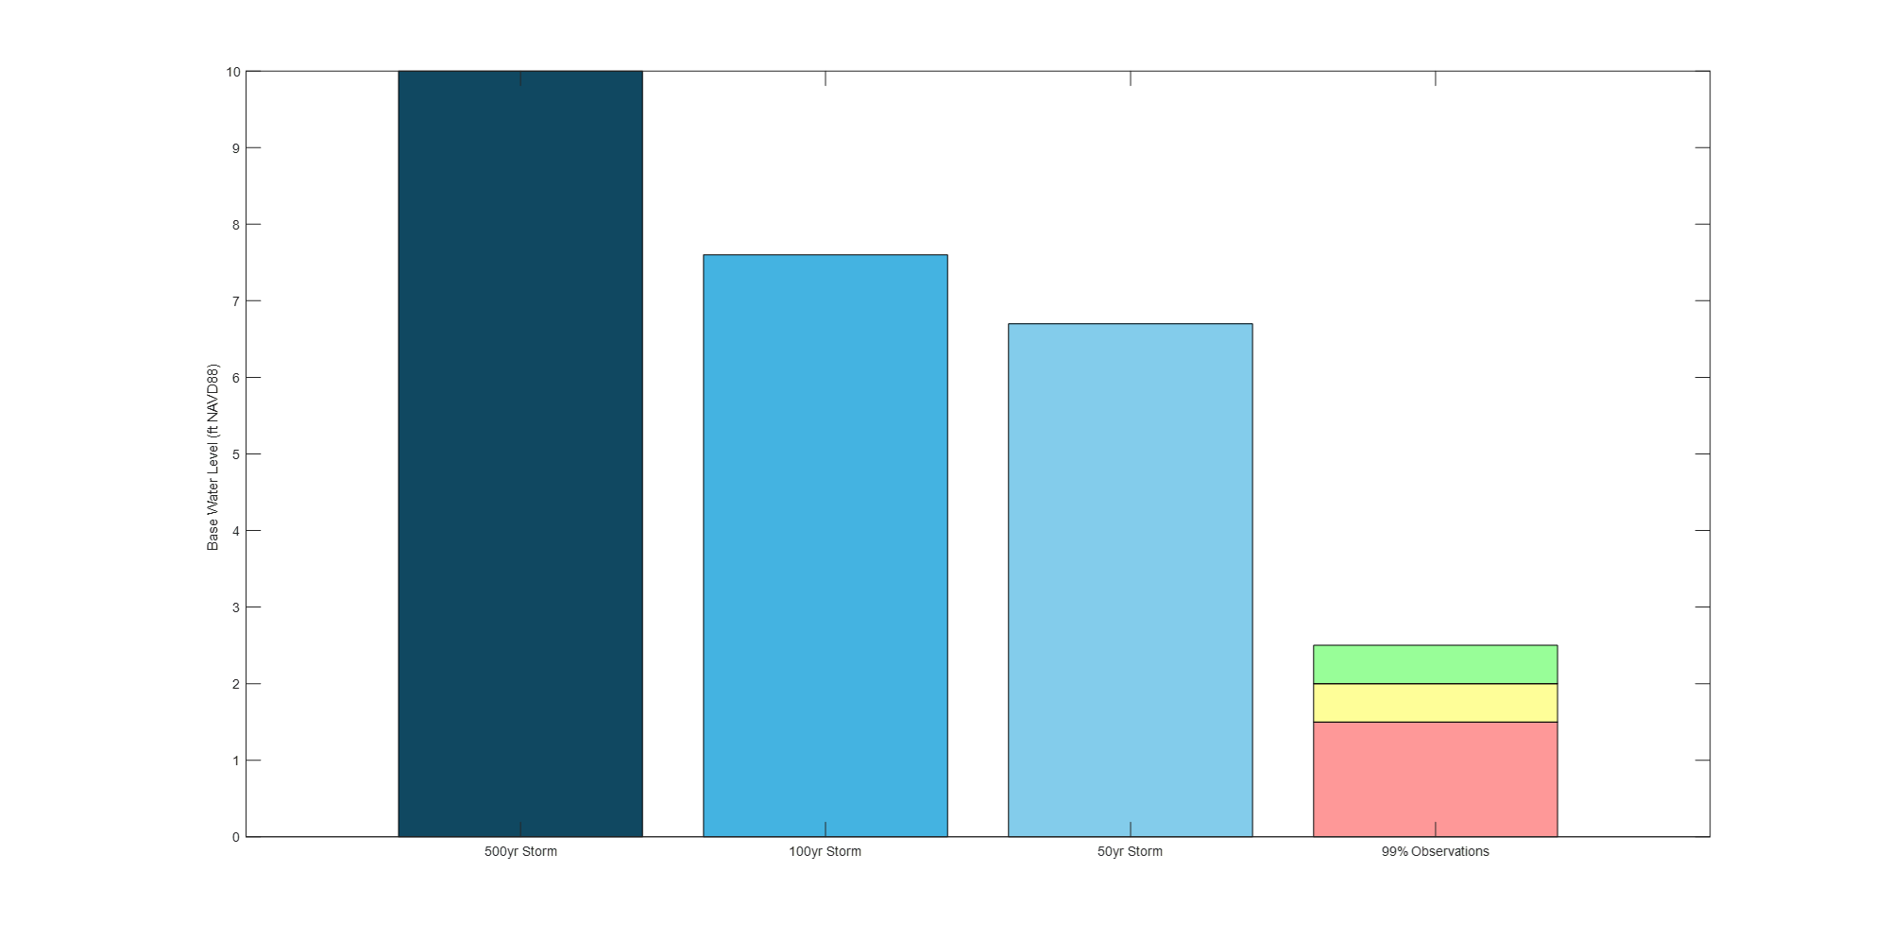
Flood Height Comparison
500-year storm
50-year storm
Exceeded
2-3x per year
Lowest street elevation
ACT Engineers
Notes:
For perspective, we can apply our model results to compare the normal conditions we just looked at to what could be expected at different storm intensities
Assuming the home isn’t raised, the base ground elevation is dry under typical conditions.

