Slide 1
Adapting to a New Funding Landscape to Continue Resilience Project Implementation
Chris Huch, CFM
Matthew R. von der Hayden
Black & Veatch Corporation
Stafford Township Administrator / Director of Water & Sewer Utility

Slide 2
Current Resilience Funding Landscape
Notes:
How do we get in front of the problem? We plan.
Development and use of a Substantial Damage Response Plan can make sure that communities are prepared and compliant.

Slide 3
FEMA Mitigation Programs – through NJOEM
Building Resilient Infrastructure and Communities (BRIC)
Terminated in April 2025
Court order blocked termination in December 2025
Remains frozen despite court order with no apparent federal action
Flood Mitigation Assistance (FMA)
Active but FY2026 appropriations have been delayed due to DHS budget disputes
Upcoming availability tied to next HMA funding cycle
Hazard Mitigation Grant Program (HMGP)
Continues to operate based on disaster declarations but distribution has drastically slowed
Take home message: FEMA mitigation funding availability and distribution is more complicated than ever before

Slide 4
State Mitigation Programs - NJDEP
Blue Acres Program
Property buyouts in flood‑prone areas
Shore Protection Program
Coastal resilience and erosion control funding
Dam Restoration & Inland Water Projects Loan Program
Hazard mitigation for dam safety
Green Acres
Acquisition and open space preservation to create natural buffers
Take home message: State programs may meet your needs but also may become more competitive

Slide 5
State Mitigation Programs - NJDEP
Green Streets & Stormwater Infrastructure Mapping Grants
Stormwater infiltration, green infrastructure
Natural Climate Solutions Grants
Funding for carbon‑sequestering ecosystems like forests and marshes.
Sewer Overflow and Stormwater Reuse Municipal Grants
Source control and stormwater mitigation
NJ Water Bank (Clean Water & Drinking Water State Revolving Funds)
Financing stormwater, sewer, climate resilience, flood reduction projects
Take home message: State programs may meet your needs but also may become more competitive

Slide 6
State Mitigation Programs
NJ DCA
Mitigation Assistance Program (Home Elevation Program) to elevate flood‑prone residential structures to reduce repetitive flood losses and lower future risk
NJ DA: Natural Climate Solutions Grants
Stormwater/Nonpoint Source Pollution‑related support
Invasive species control
New Jersey Board of Public Utilities (BPU)
Microgrid and energy resilience initiatives
Clean energy programs that support continuity of operations during disasters
Take home message: State programs may meet your needs but also may become more competitive

Slide 7
NOAA Mitigation Grant Programs
NOAA Transformational Habitat Restoration and Coastal Resilience Grants
Supports mitigation through ecological restoration that reduces risk
Coastal Habitat Restoration & Resilience Grants for Tribes and Underserved Communities (BIL)
Coastal and estuarine restoration activities that reduce community and environmental vulnerability
NOAA Climate Smart Communities Initiative
Funding planning and implementation of climate adaptation projects
Take home message: Be on the lookout for federal funding opportunities that align with your needs

Slide 8
Non-Governmental Opportunities
Non-profits
Community Groups
Philanthropic Organizations
ANJEC
Sustainable Jersey
Take home message: Think outside the box!

Slide 9


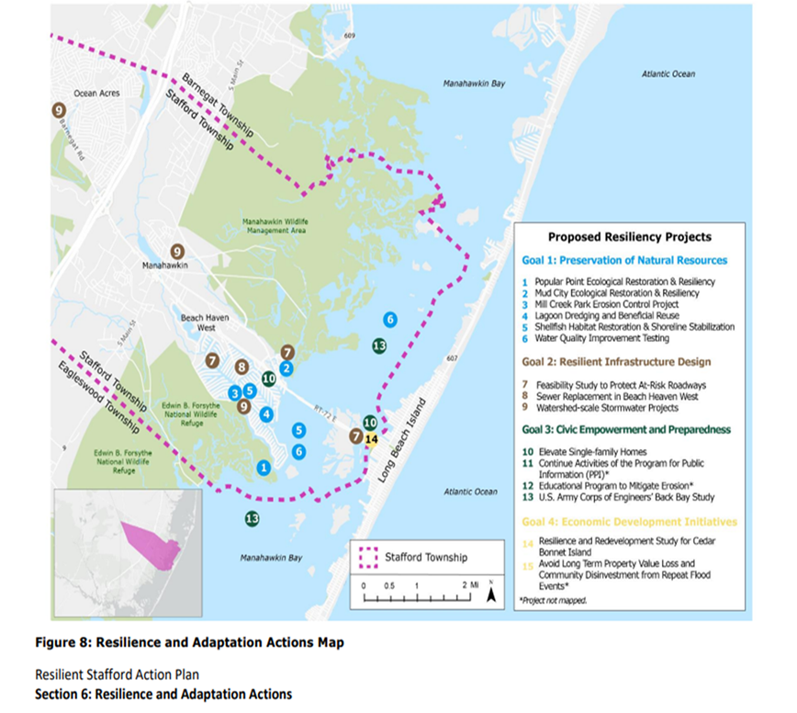
Resilience Funding Success Story: Stafford Township
Goals:
Preservation of Natural Resources
Resilient Infrastructure Design
Civic Empowerment and Preparedness
Economic Development Initiatives
** Just funded $120,000 in
Additional Planning Funding

Slide 10
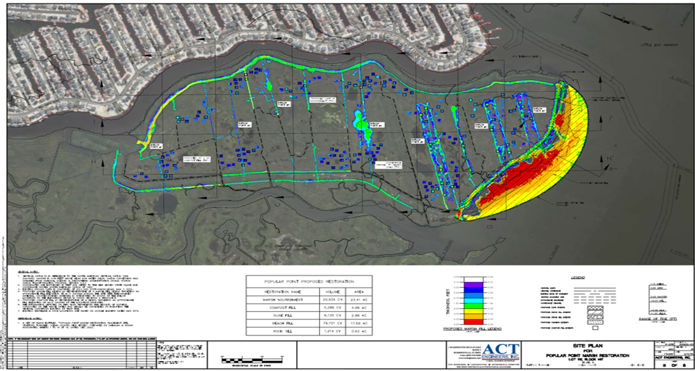
Resilience Funding Success Story: Stafford Township
Grants
NJDEP Grant: $4,998,109
Natural Climate Solutions Grant: $5,000,000
Natural Climate Solutions Grant – Rd 2

Slide 11
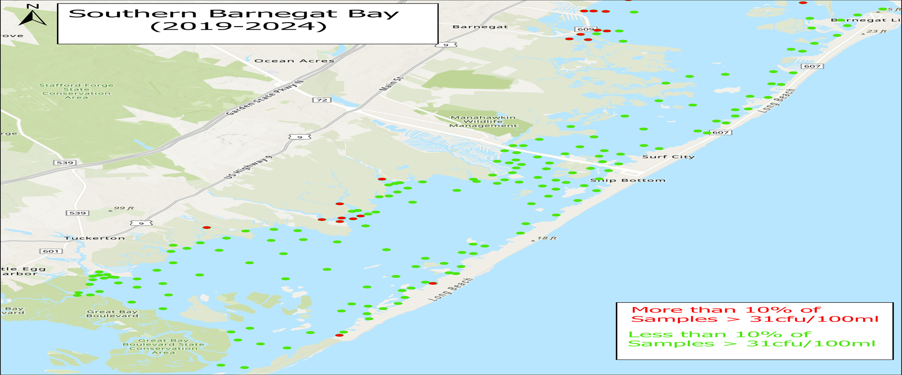
Resilience Funding Success Story: Stafford Township
Cleaning Up The Bay
186 Acres in Manahawkin Bay

Slide 12

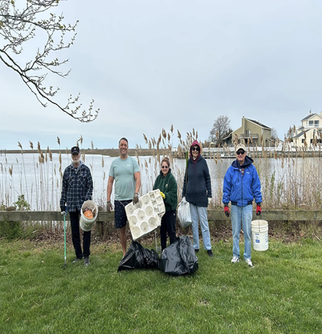
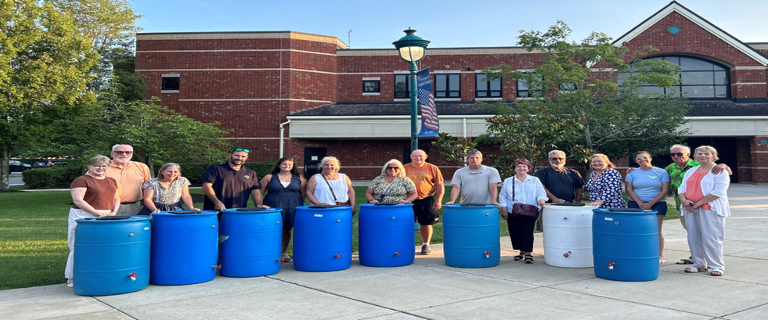
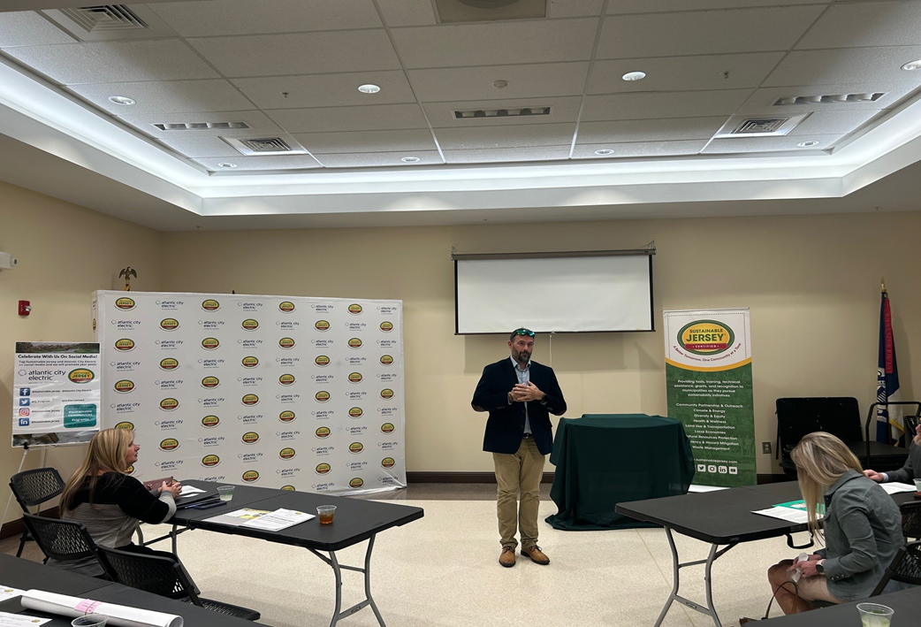
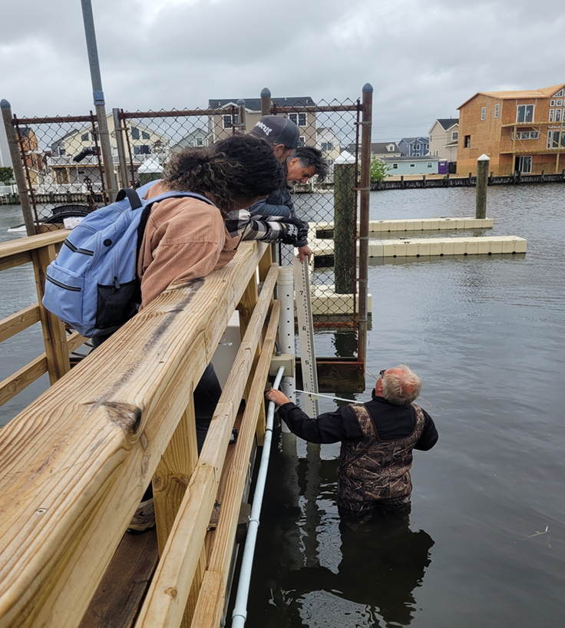
Resilience Funding Success Story: Stafford Township
Involving the Community

Slide 13
For more information contact:
Matthew R. von der Hayden
Stafford Township
Administrator / Director of Water & Sewer Utility
Township of Stafford
609-597-1000 Extension 8516
mvonderHayden@staffordnj.gov
Chris Huch
Black & Veatch Corporation
Hazard Mitigation Planning Specialist
+1 201 225 8077
HuchJrC@bv.com

