Slide 1
Measuring the Social and Economic Benefits of Flood Resilience Projects
Alison Miskiman, CFM, GISP
Black & Veatch Corporation

Slide 2

Agenda
Measuring the Social and Economic Benefits of Flood Resilience Projects
U.S. HUD Disaster Funding Overview
Statewide Disaster Context
Texas GLO Benefit Study Approach
Case Studies
Key Findings
Alison Miskiman
Resilience Planning
Black & Veatch

Slide 3
U.S. HUD CDBG-Disaster Recovery and CDBG-Mitigation
Appropriated by Congress after disasters - not permanently authorized
Funding source to meet the recovery needs of low- and moderate-income communities (LMI) caused by the disaster
Focused use of funds toward low- and moderate-income communities in the ‘most impacted and distressed’ areas
Administered by state authorized CDBG-DR and CDBG-MIT agency based upon an Action Plan.
Action Plan must be reviewed by the public and approved by HUD
This process generally takes about 18 months
CDBG-DR and CDBG-MIT may be used as local match and combined with other federal funds

Slide 4
Hurricane Harvey FEMA Unmet Needs Estimate
Assistance by Sector | Remaining Unmet Need | % of Unmet Need
Housing | $12,013,620,000 | 14%
Infrastructure | $60,753,702,000 | 71%
Economic Development | $12,515,963,000 | 15%
Source: Texas General Land Office
“Within 48 hours, enough water fell to supply the needs of a city of 8 million people for 1 year. The amount of water that fell over the 30-day period would put the state of Rhode Island under 10 feet of water, fulfill New York City’s water needs for 7 full years, or fill Lake Mead, the largest reservoir in the United States, twice over.” - Texas GLO’s 2019 State Action Plan

Slide 5
TX GLO Infrastructure Benefit Study
Purpose: Examine the effectiveness of a ground-breaking CDBG-DR and CDBG-MIT-funded flood mitigation infrastructure program to protect communities from future flood events
Task: Evaluate three Case Studies in geographically distinct areas with different infrastructure project types with differing landscapes and flood risks. Determine community resilience benefits, focusing on:
  People
  Local economy
Methodology Applied: Identify and describe benefits using the following:
    Interviews
    Analysis of project plans and event impact history
    GIS analysis of flood risk reduction benefits
    Qualitative and quantitative BCA analysis of low-to-moderate income community benefits
Risk reduction

Slide 6
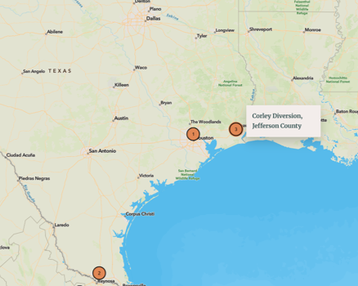
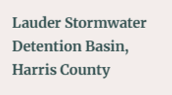

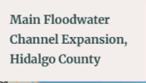
Case Studies
1
Main Floodwater Channel Expansion - Hidalgo County
2
Lauder Stormwater Detention
Basin – Harris County
2
3
Corley Diversion – Jefferson County
3
Gulf of Mexico
1

Slide 7

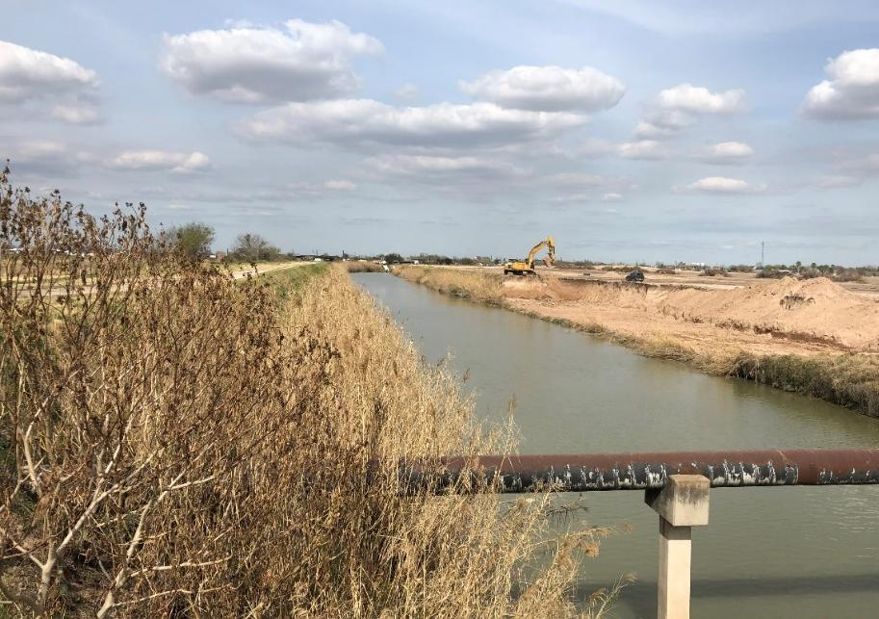
Main Floodwater Channel Expansion – Hidalgo County
1
Located on Texas-Mexico border – high poverty
Six Flood Disaster Declarations in 5 years
Stormwater drains to the Gulf of Mexico
Rapid growing population and urbanization
Significant benefits for Colonia communities, i.e. unincorporated and unregulated settlements along the United States-Mexico border
Project
  Under construction – two phases
  Improve 7 miles of channel, adding 4 million cubic yards in stormwater capacity
  Concurrent project with $200M+ drainage investments

Slide 8
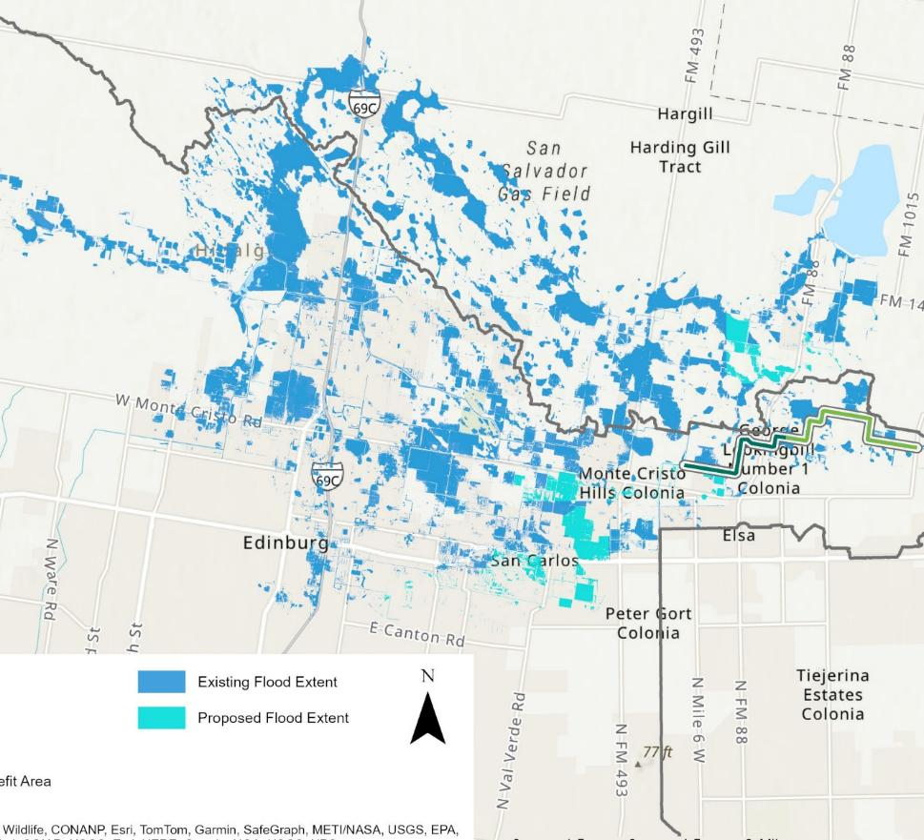
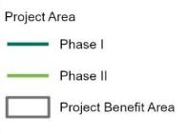
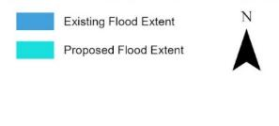
Main Floodwater Channel Expansion – Flood Risk Reduction
1
Pre-Construction Flood Impact
25,524 acres of land inundated during the modeled 1% annual chance storm
Post-Construction Flood Impact
18,133 acres removed from the modeled 1% annual chance storm event (29% reduction)
*Components of this multi-phase project are in design, so the storage volume capacity and flood depth impact are subject to change.

Slide 9
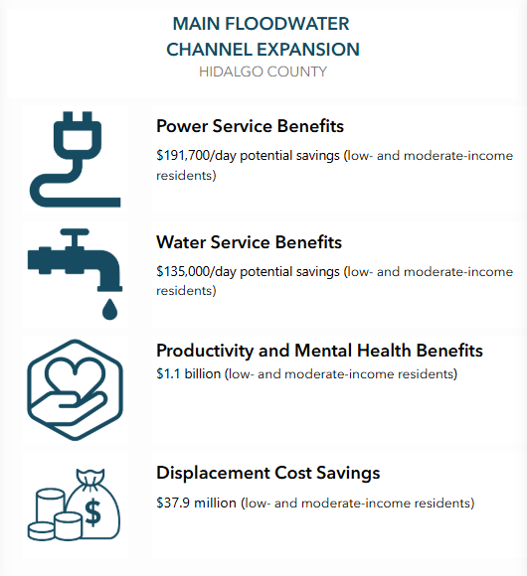
Main Floodwater Channel Expansion – Hidalgo County
1
Social
Benefit 397,800 residents (55% are LMI residents)
Reduction in displacement; productivity; mental health services
Economic
Structures – 1800 risk reduced
Critical facilities - 160 in the benefitting area
Transportation - Reduced flood depths along major roadways
Utilities – reduced number of days with power, water service interruption

Slide 10
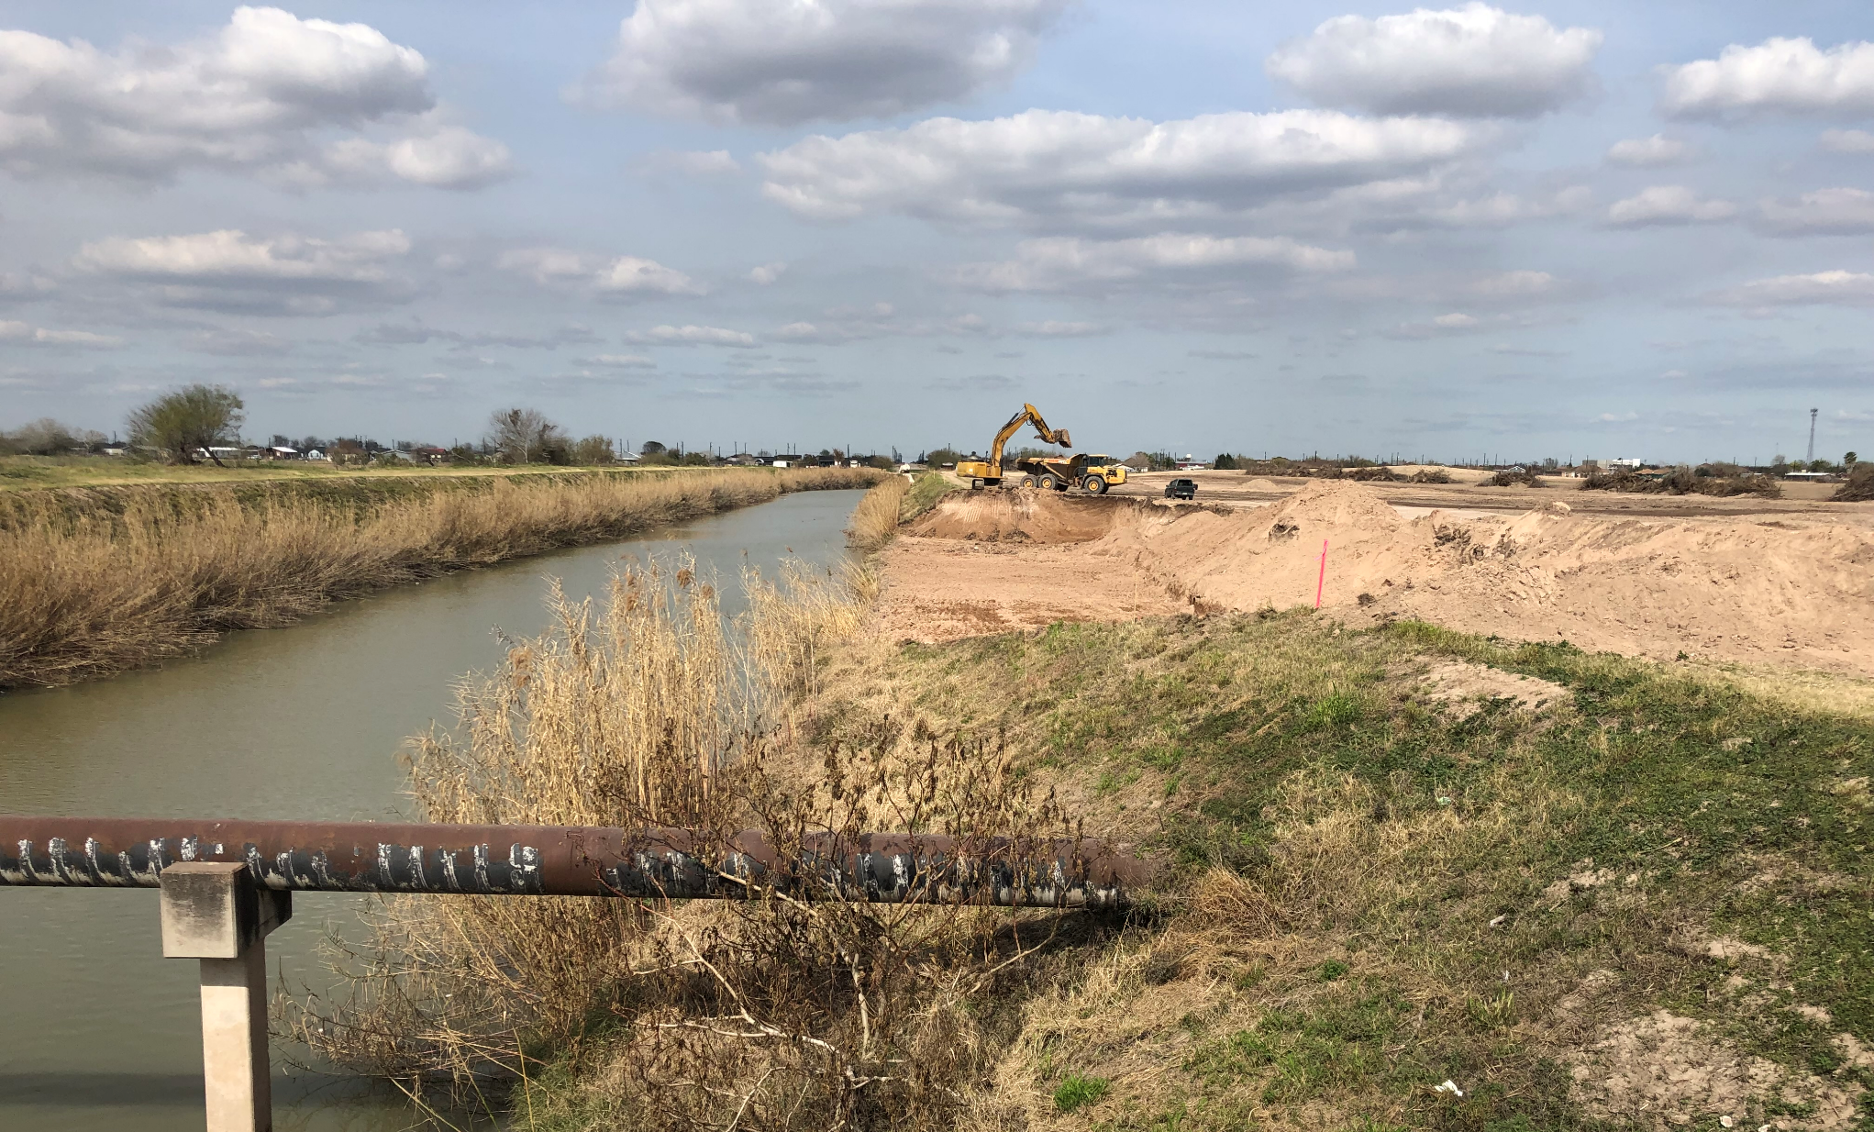
Key Findings
CDBG-DR and CDBG-MIT funding are flexible
  Help fill other program gaps
  Enables regional solutions
  Funds can be tailored to local priorities, not just federal categories
Infrastructure projects can be cost-beneficial in low-to-moderate income communities when applying a holistic benefit analysis approach
Flood infrastructure projects offer benefits beyond risk reduction – social and economic benefits. This was demonstrated across all three case studies – regardless of geography, type of flooding, or scale of infrastructure.

Slide 11
For more information contact:
Alison Miskiman
Resilience Planning Leader
+1 201-977-4432
MiskimanAM@bv.com

