Slide 1



Building Resilience for Municipalities:
Risk Methodology to Inform Future Planning
Enhancing municipal strength through strategic risk management

Slide 2


Beyond Traditional Hazard Mitigation
Comprehensive Hazard Evaluation
Evaluate present and future climate hazards across multiple planning horizons to anticipate evolving risks.
Integration of Science and Community Input
The methodology uses the best available science and community feedback to create detailed hazard profiles.
Proactive, Transformative Planning
The methodology shifts from reactive to proactive planning by linking hazard profiles with land use and development data.
Driving Resilience Investments
The approach supports resilient, fundable action plans that prioritize impactful, long-term interventions.

Slide 3
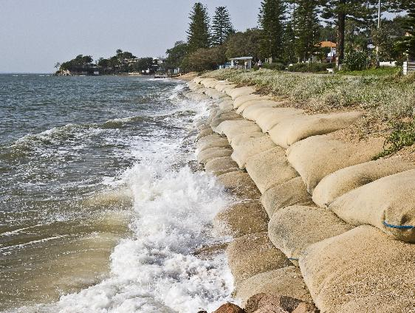
Why a Risk Methodology Matters
Importance of Clear Risk Methodology
A clear risk methodology analysis is essential for planning and securing funding for climate resilience projects.
Decision-Ready Risk Information
Provides actionable risk data that helps municipalities prioritize projects and justify funding requests.
Integration with Planning and Compliance
An extensive risk analysis can integrate with municipal master plans and legal requirements for seamless compliance and action.
Supporting Equitable Adaptation
The methodology enables transparent prioritization that supports equitable climate adaptation efforts.

Slide 4

Four Integrated Assessments
Assessment PILLAR | Purpose | Key Outputs
Hazards Identification | Catalog current and future hazards | Hazard profiles, maps, tables
Build-Out & Development | Analyze future growth and exposure | Build-out maps, zoning overlays
Vulnerability Assessment | Evaluate assets and populations at risk | Asset inventory, vulnerability scores
Risk Likelihood Assessment | Prioritize risks for action and investment | Risk matrix, prioritized asset list

Slide 5
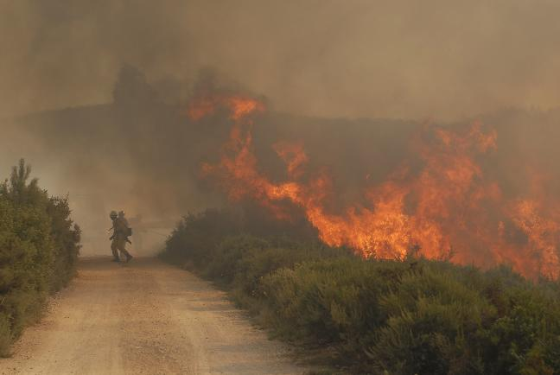
Hazard Identification Comprehensive Hazard Profiling
Spatial and Non-Spatial Hazards
The methodology assesses spatial hazards like floods and wildfires alongside non-spatial hazards such as extreme heat and drought.
Multi-Horizon Planning
Hazards are evaluated across future horizons 2050, 2075, and 2100 to anticipate evolving climate risks over time.
Detailed Sea Level Rise Scenarios
Explicit mapping of 1 to 4 feet sea level rise scenarios helps municipalities visualize incremental risks and plan accordingly.
Science-Based Hazard Profiles
Profiles use best available science, GIS data, climate projections, and community input to reflect current and future risks.

Slide 6
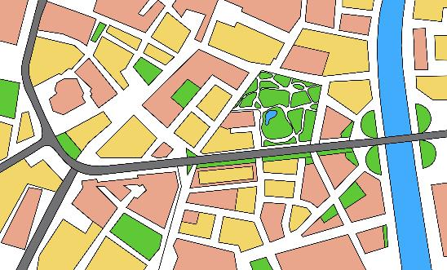
Build Out & Development Linking Land Use and Future Risk
Build-Out & Development Assessment
This assessment forecasts future land use based on current zoning and development policies using advanced GIS tools.
Overlay of Hazard Maps
Future development projections are combined with hazard maps to identify areas with increased climate risk.
Informed Municipal Planning
Municipalities use this analysis to guide zoning, infrastructure investments, and land use policies to reduce vulnerability.
Dynamic Resilience Integration
The analysis supports dynamic resilience planning by integrating risk findings into master plans and funding strategies.

Slide 7
Vulnerability Assessment Assessing Assets, People, and Adaptive Capacity
Asset Type | Exposure | Sensitivity | Adaptive Capacity
Critical Infrastructure | Flood zones, SLR, wildfire | Physical condition, redundancy | Backup power, emergency plans
Community Facilities | Heat islands, flood risk | Population served, building age | Cooling centers, outreach
Housing | Floodplain, extreme heat | Housing type, elevation | Insurance, social networks
Socially Vulnerable Populations | Proximity to hazards | Income, health, mobility | Access to resources, language

Slide 8

Risk Likelihood Assessment From Analysis to Actionable Priorities
Risk Likelihood Integration
Combines hazard probability, asset vulnerability, and development patterns to quantify risk impact on communities.
Cascading Risks Consideration
Evaluates interdependencies like power outages affecting emergency services and flooding impacting transport networks.
Prioritization and Decision-Making
Uses risk matrices and scoring to rank assets by risk, guiding investment in high-impact resilience strategies.
Adaptive Management and Transparency
Documents assumptions and uncertainties to support continuous improvement and transparent allocation of resources.

Slide 9
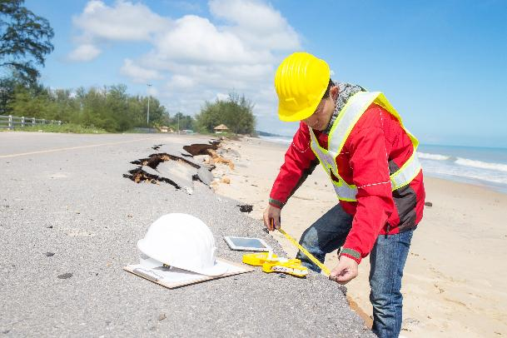
Connecting Risk Assessment to Investment
Transparent Project Prioritization
The methodology enables clear project prioritization supporting cost-benefit narratives for resilience investments.
Quantifying Costs and Benefits
Assessing direct and indirect hazard costs builds strong investment cases for municipal resilience.
Equity and Compliance Emphasis
Focusing investment on at-risk populations advances social justice and meets regulatory requirements.
Integration and Streamlined Funding
Aligning resilience plans with grants and capital plans simplifies funding and increases financing success.

Slide 10

From Methodology to Funded Projects
Scalable Risk Assessment Methodology
The methodology adapts to municipalities of all sizes, ensuring broad applicability and effective risk evaluations.
Integration with Municipal Planning
Findings integrate seamlessly into master plans and CCRHVA sections, supporting regulatory compliance and strategic planning.
Stakeholder Engagement and Transparency
Emphasizing documentation and inclusive participation, RNJ ensures accessibility for staff, officials, and the public.
Building Resilient Futures
The framework fosters continuous improvement, adaptive management, and positions communities for future funding opportunities.

Slide 11
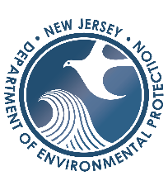
Sean Cannon, CFM
Project Manager
1700 American Blvd., 2nd Floor | Pennington, NJ 08534| 609-438-6587 (e) sean.cannon@mbakerintl.com |
T
Thank You!
Special thanks to the NJDEP team, Meghan Leavey, Matt Baumgardner, Montana Knutsen, and Barbara Woolley‑Dillon, for their collaboration, insight, and partnership throughout the development of this methodology.
I am also grateful to the Michael Baker team, Jess Jahre, Taylor Harrington, Danny Gilkeson, Jenny Gutierrez, Shibani Debnath, and many more, for coming together to shape, refine, and advance this work. Your collective expertise and commitment made this methodology possible.

