Slide 1

Making Climate Vulnerability Models Fit for Purpose: How Transportation Agencies Assess Asset Risk
By: Kevin McKeehan, Ph.D.
Sr. Geospatial Solutions Developer, Climate Resilience and Advanced Modeling
HNTB Corporation
Cleveland, Ohio
New Jersey Coastal and Climate Resilience Conference
Session: Strengthening Communities through Climate Resilience
Galloway, New Jersey
March 9, 2026

Slide 2
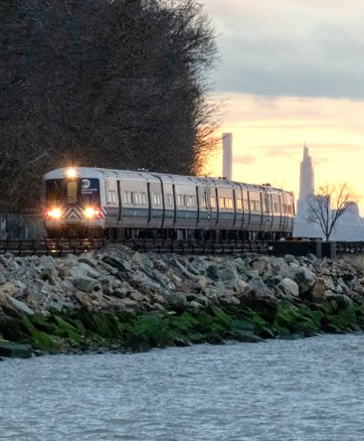
MTA Vulnerability Climate Assessment Project
Dates of Work Done:
Jan. 2023 – Mar. 2024
Project Purpose:
Project Prioritization:
Model to prioritize capital plan and sustainability goals
Asset Management:
Assess potential impacts of hazards on critical assets
Guiding principle: Science-based, flexible, and systemic

Slide 3
Fit-for-Purpose Vulnerability Model: Definition
Guiding principles of a “fit-for-purpose” model:
Science-based, flexible, and systemic
Yet, scalable to:
Client goals
Focus (interrelated)
Assets
Systems
Hazards
Geography
Assets
+ Individual?
+ Classes of assets?
Systems
+ Asset systems?
+ Networks?
Hazards
+ Modeling?
+ Specific hazard?
+ All hazards?
Geography
+ Site specific?
+ Regional scale?

Slide 4
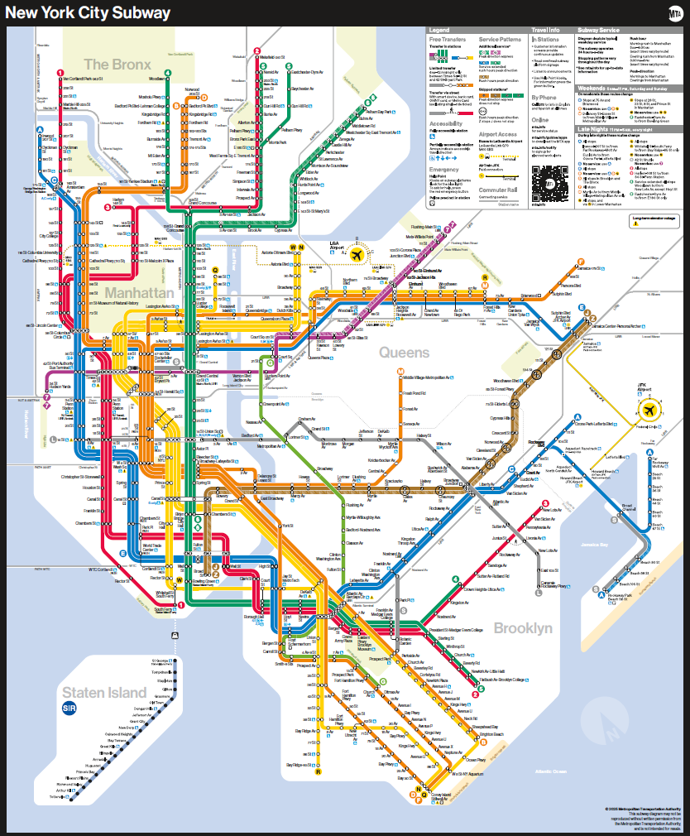
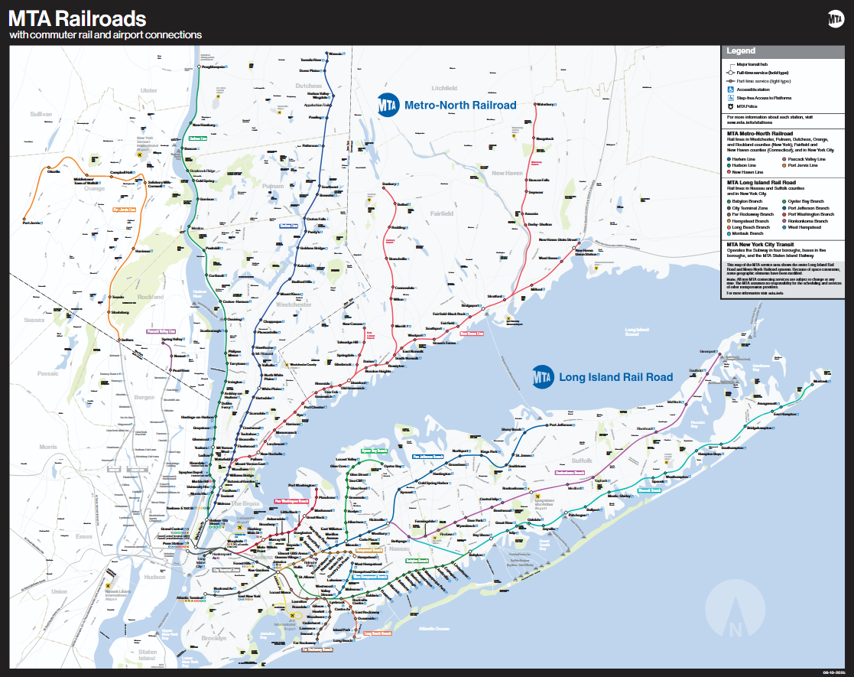
Fit-for-Purpose Vulnerability Model: In Practice
Program Development Considerations
MTA-specific objectives:
Use adaptation objective to drive Capital Program decisions
Client control of tool and ability to update data and model
Analysis by asset, asset class, subclass, and geography
Customizable, powerful, and designed for MTA’s needs
Robust standalone user guide and intuitive design

Slide 5
Fit-for-Purpose Vulnerability Model: In Practice (cont.)
Approach Tailored for MTA
Hazard Modeling & Analysis:
Traditional vulnerability assessments unsuited for MTA’s objectives
Traditional formula: Vulnerability = Exposure + Sensitivity - Adaptive Capacity
This approach suffers from limitation of scale → it’s too coarse for MTA’s needs
MTA needed:
Asset- and location-specific assessments, not broad vulnerability formulation
Exposure to 8 hazards by severity at 4 timestamps between now and 2100
Issues:
Hazard data diffused across multiple states and governmental jurisdictions
MTA conglomeration of multiple agencies, with different (or no) enterprise asset management system
Solution:
Rank asset priorities based on:
Exposure severity, exposure timeline, importance of asset, and adaptation work
Combining modeling and guidance from 10+ sources into one complex geoprocessing model
Bootstrap all-agency asset database with unique asset IDs
Geoprocessing Model for Prioritization:
Drives the model logic and geospatial analyses, and builds time-series prioritization
Client control of tool and ability to update data and model

Slide 6


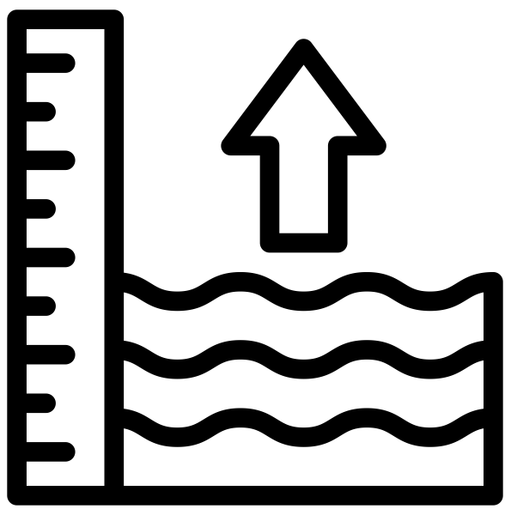





RESILIENCY PRIORITIES
Pluvial Flooding
Coastal Flooding
Sea level rise
Landslide
Extreme Heat
Extreme Cold
Wildfire
Wind

Slide 7
CLIMATE / HAZARD INPUTS
IPCC (Intergovernmental Panel on Climate Change)
National Climate Assessment
NPCC v4 / CIRCA
California’s Fourth Climate Change Assessment
Cal-Adapt
Considered 32 GCMs vetted by CMIP6
Distilled the 32 GCMs to 10 most relevant
General Circulation Models
There are hundreds of these
Each with their own methodology, focus
The Coupled Model Intercomparison Project (CMIP6) evaluates GCMs
Ex.: Canadian Earth System Model (CanESM2)
NY Stormwater model
Cal-Adapt
Downscaled the 10 GCMs, created portal to run analyses
Wildfire
Snowpack
NOAA / USACE / USGS SLR
Climate Science and Models
Models and Tools Consuming Downscaled Data
Official / Regional Assessments

Slide 8
INPUTS
ASSET
DATA
Location and details (criticality & condition) of every MTA asset
Regional and agency-specific climate risks
CLIMATE RISK
DATA
Location of MTA mitigation
and preventive projects
PAST ADAPTATION DATA
Notes:
Climate risk data:
Climate risks applying to the region and to specific areas where MTA operates
Past Adaptation data:
Locations where MTA has already made improvements addressing climate incidents and/or implementing preventive measures

Slide 9
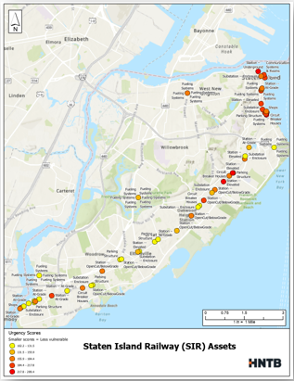

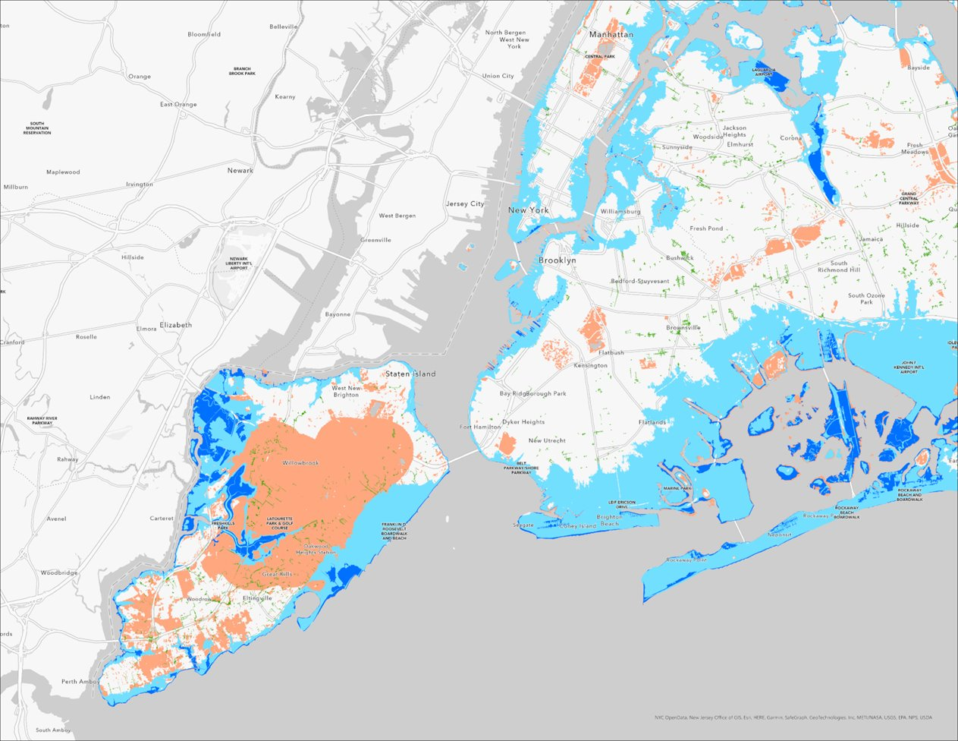
EXAMPLES OF INPUTS
FLOOD
& WILDFIRE
RISK
NEW STEP UP TO MINIMIZE STATION FLOODING
MTA ASSETS

Slide 10
Asset Inputs Example: System Impact Rating & Stakeholder Engagement
System Impact Rating Scale (adapted from FHWA guidance)​
10 - High​ | Complete Asset Failure: asset may be available for limited use after 60 days; travel disruptions, reduced access to destinations, commerce impacted​
9 - High​
8 - Med/High​
7 - Med/High​ | Temporary Operational Failure: results in minor damage and/or disruption, asset may be available for limited use within 60 days; temporary system closures, temporary interdependent system impacts (utilities)​
6 - Medium​
5 - Medium​
4 – Med/Low​
3– Med/Low​ | Reduced Capacity: results in little or negligible impact to asset, asset would be available with full use within 7 days; may include temporary closure/minimal travel disruption, alternative modes​
2 - Low​
1 – Low​
Asset​ | Asset Sub-Category ​ | System Impact Rating Scale Score​
Stations​ | Major Hub (Penn Station, Atlantic Terminal)​ | 10​
 | Underground Station​ | 9​
 | Elevated Stations​ | 3​
 | At-Grade​ | 3​
 | Open Cut/Below Grade​ | 4​
 | Parking Structures​ | 2​
Power Systems​ | Substations – Supply​ | 9​
 | Substations - Balancing​ | 8​
 | Transformers​ | 5​
 | Overhead Lines​ | 5​
Right of Way ​ | Tunnels & Portals​ | 10​
 | Elevated/Viaduct​ | 7​
 | Surface Track/OCS​ | 6​
 | Surface Track/Diesel​ | 6​
 | Bridges​ | 6​
Maintenance & Layover Facilities​ | Shops​ | 8​
 | Yards​ | 8​
Ancillary Systems​ | Radio Towers​ | 6​
 | Pump Rooms​ | 3​
 | Fan Plants​ | 2​
 | Signal Bungalows & Node Houses​ | 7​
 | Interlockings​ | 9​
Maintenance and Operations staff provided feedback on ratings
Also provided ground-truthing
Example: Where debris clogs drains
Notes:
Asset classes with the greatest anticipated impacts relative to extreme weather ​
Individual assets at the most risk​
Effects (time, travel disruptions, detours, interdependent system impacts, etc.) from the loss of a given asset​
Temporary measures (e.g., bus bridge, on-site station personnel, flagmen, temporary generators, etc.) that you would need to put in place until the asset can be fully repaired​

Slide 11
ASSESSMENT
EXPOSURE
What and when an asset will be exposed to climate hazards
Calculate a numerical
Asset-Level Urgency Score
for each climate risk
Economic impact (capital + operational); system impact; ridership intensity; social vulnerability
Measure of mitigation
MAGNITUDE OF CONSEQUENCE
ADAPTATION GAP

Slide 12



OUTPUT: URGENCY SCORE
+
MAGNITUDE OF CONSEQUENCE SCORE
+
=
ASSET-LEVEL URGENCY SCORE
EXPOSURE SCORE
ADAPTATION GAP SCORE

Slide 13
Results: Outputs
Deliverables to inform capital planning process and design:
Catalog of Asset-Level Urgency Scores
Priority list of assets based on urgency scores
ArcGIS Spatial Mapping Tool with Urgency Scores + Dashboard
Map of assets in ArcGIS
+ tailored dashboard
Exposure/Magnitude of Consequence/Adaptation Gap Standalone Scores
Catalog of component scores for individual use and tracking

Slide 14
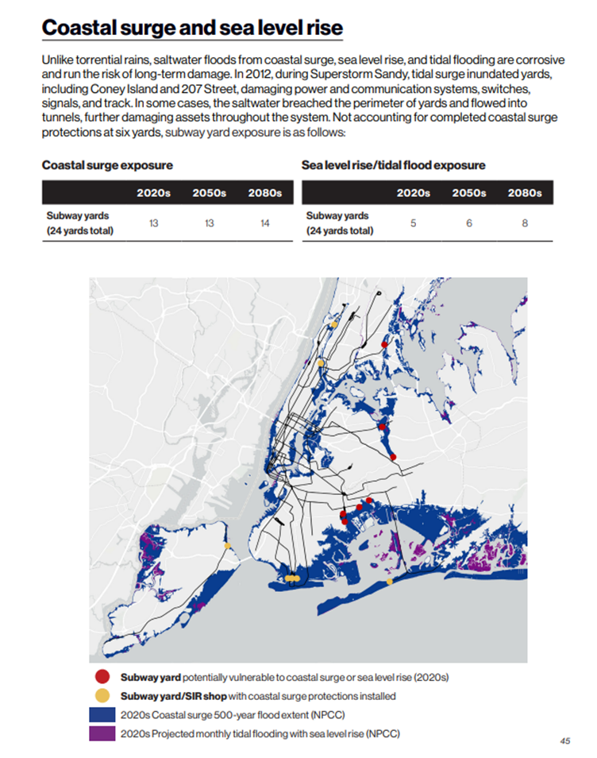
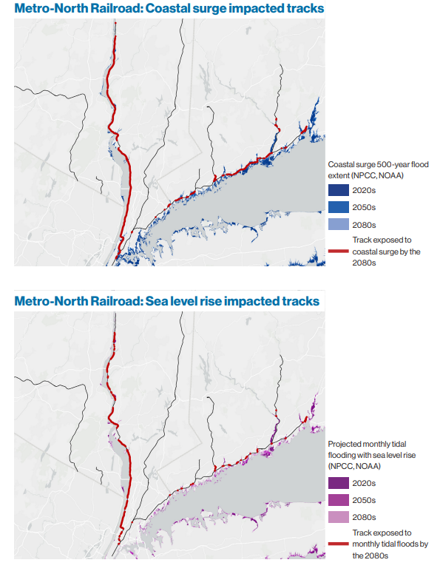
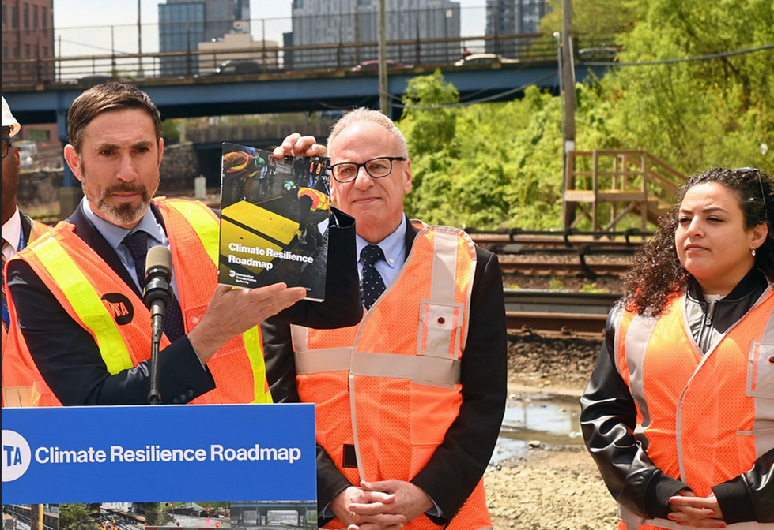
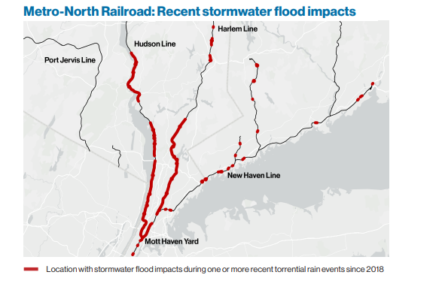
Results

Slide 15
Fit-for-Purpose Models: A Final Thought
Project scale: “This is among the most complex vulnerability assessments ever developed for a transit agency.”
Scaling Down (and in): Site-Specific Work
Key: Get even more detailed
Key: Focusing on most pressing hazard at site, most important assets at site
Key: (Where applicable) Leverage AI to fill gaps at fine scale, cut down on processing time
Scaling Up (and out): Statewide and Regional Work
Key: Use Landsystems Approach to group similar geophysical and hazard areas

Slide 16

Questions?
Thank you!
Contact:
Kevin McKeehan, PhD, GISP
HNTB Corporation
1001 Lakeside Ave., Suite 1205
Cleveland, OH 44114
kmckeehan@hntb.com

