Slide 1
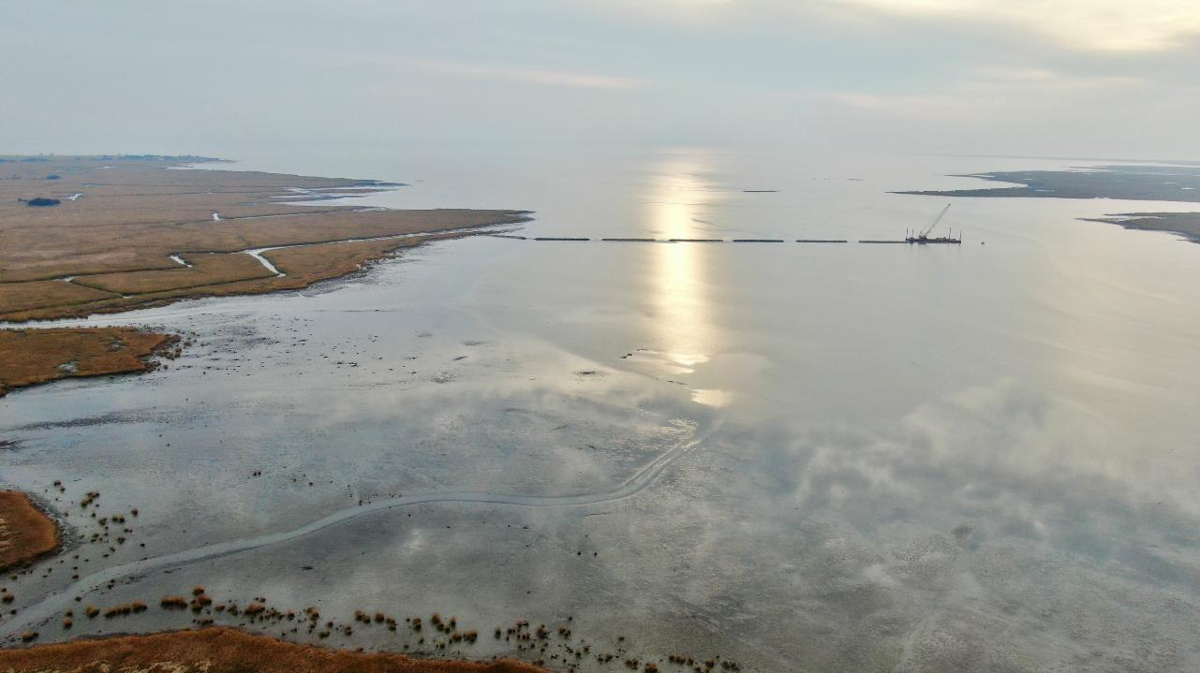
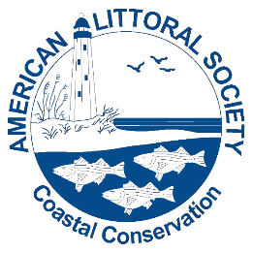

Building Resilience with Nature
The Role of Living Shorelines in NJ’s Coastal Future
Capt. Alek Modjeski
Habitat Restoration Program Director
Certified Ecological Restoration Practitioner/Coastal Ecologist
American Littoral Society
alek@littoralsociety.org
www.littoralsociety.org
Notes:
Introduce yourself
Quick Littoral Society intro – Coastal Conservation non-profit since 1961 – advocacy, education, restoration
Presentation intro -Check out our new website We care for the coast and empower others to do the same

Slide 2
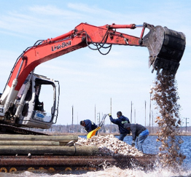
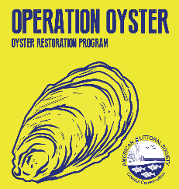
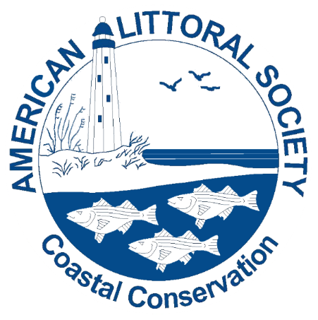
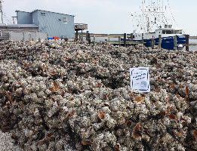
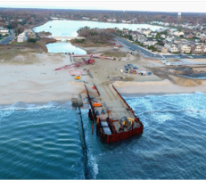
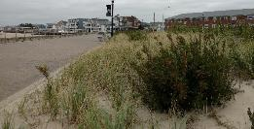
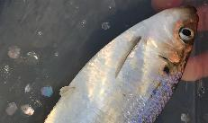
www.littoralsociety.org
Notes:
2016 – adding another beach, 4 more reefs, starting marsh restoration, and continue our monitoring efforts
If you’d like more info check out our website LittoralSociety.org or the project website restoreNJbayshore.org

Slide 3
NEW JERSEY CLIMATE CHANGE RESILIENCE STRATEGY
Priority 1: Build Resilient and Healthy Communities
Priority 2: Strengthen the Resilience of New Jersey’s Ecosystems
Priority 3: Promote Coordinated Governance
Priority 4: Invest in Information and Increase Public Understanding
Priority 5: Promote Climate-Informed Investments and Innovative Financing
Priority 6: Coastal Resilience Plan

Slide 4
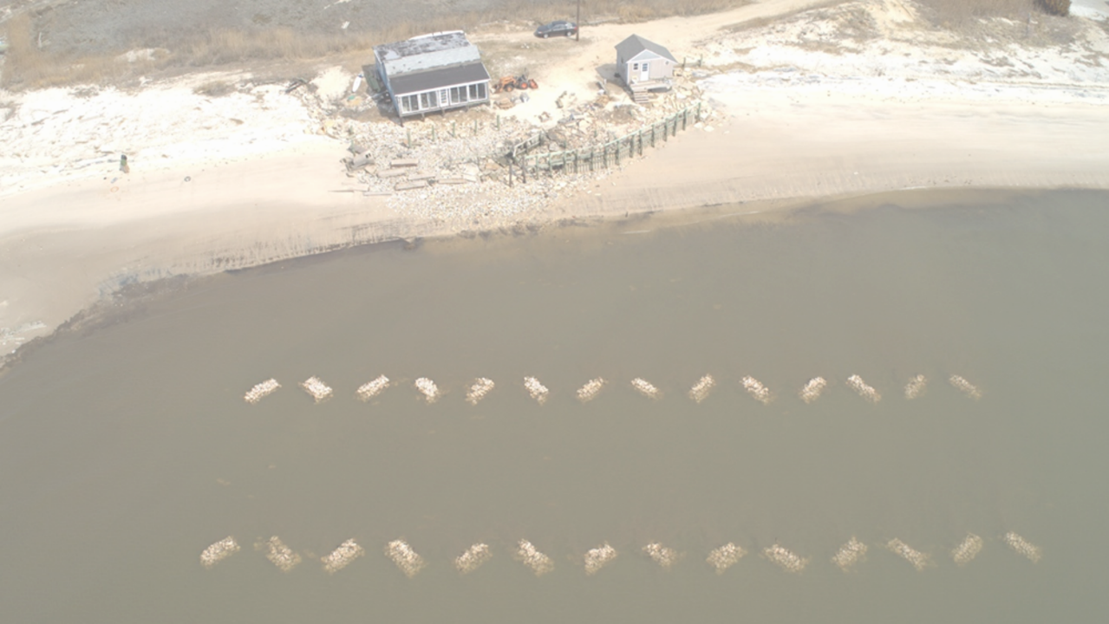
Promote and undertake restoration of habitats and creation of living shorelines
    Vegetated Berms
    Beaches
    Oyster Reefs
    Salt Marsh
Provide ecological uplift and improve community resiliency
    Flood and Storm (Climate Change)
    Water Quality and Carbon Sequestration
    Horseshoe Crab and Shorebirds
Inform, involve, and engage the public on our restoration projects
    Social Media
    Volunteers and US Veterans
    Outreach
    Engage Future Practitioners - Restoration Corps
Our Habitat Restoration Goals

Slide 5
So how do Living Shorelines and Nature-based Strategies help us:
Improve Resiliency
  Climate Impacts
  Flooding
  Sea Level Rise
  Storm
Improve Economy
Improve Stakeholder Engagement and Stewardship
Support the State’s Climate Strategy Priorities and 127 Recommendations/Climate Ready NJ
Provide Future Ecological Goods and Services

Slide 6

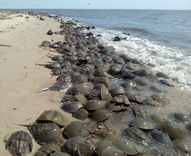
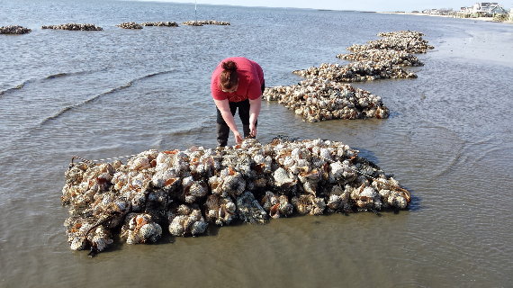
Delaware Bay Restoration Projects
6.5 Miles of Beach Restored (approx. 95+ acres)
2,051 Tons of Rubble Removed
325,000 Cubic Yards of Sand Trucked, dredged, and Placed
8 Intertidal Oyster Reefs (3,210 lf)
12 living breakwaters (more to come)
Delaware Bay Sediment Transport Analysis Tool (D.B.S.T.A.T.)
36,000 horseshoe crabs tagged
Regional 10-year permit – Programmatic Restoration
Regional State Blanket Permit – Programmatic Restoration
Mouth of the Maurice River –NW Reach
Fortescue, Pierces Point, Kimbles, Thompsons Beaches
RAE Grant – 3 more reefs on footprint – materials
13+acres of marsh (protecting 20+ acres)
Notes:
Core Partners and funders. Non Federal match includes $423K from CWF (3
years of Avian Study support, $30,000 from
NJDEP for egg density surveys, $106,216 from
volunteers through December 31, 2017. Includes
$550 from Weggel Engineering.

Slide 7
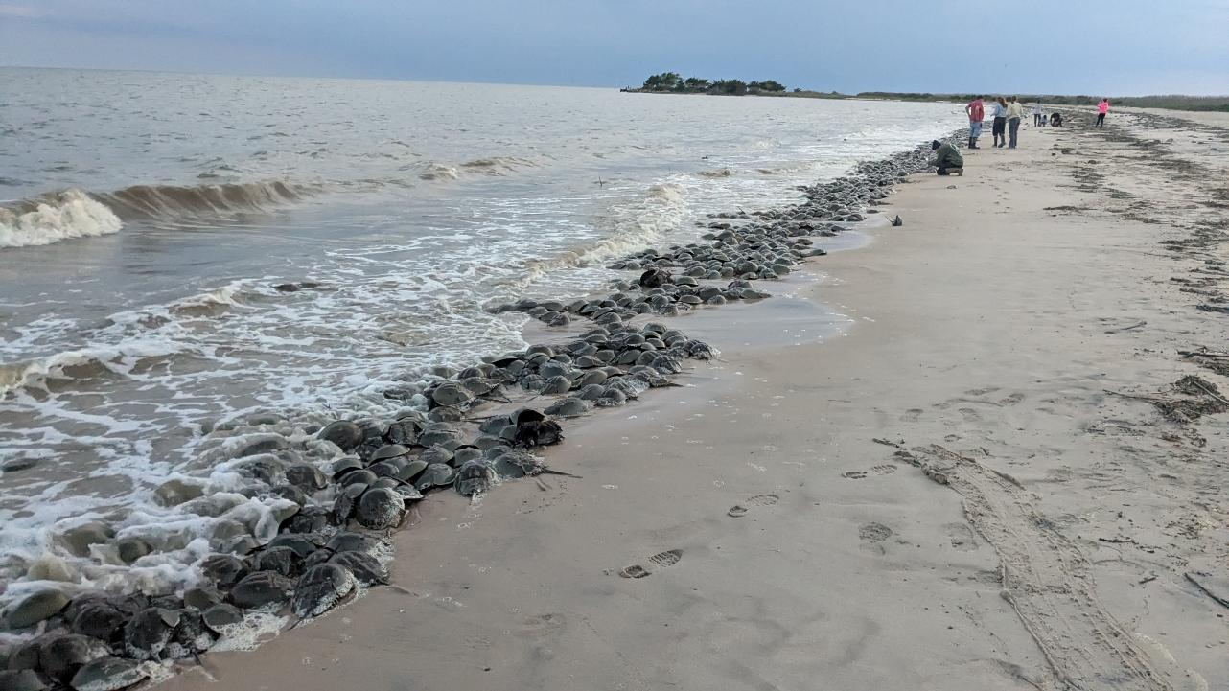
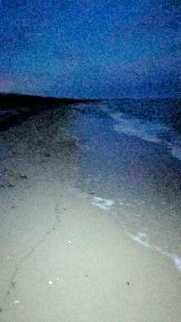
Thompsons 2025 + 40,000 tons

Slide 8
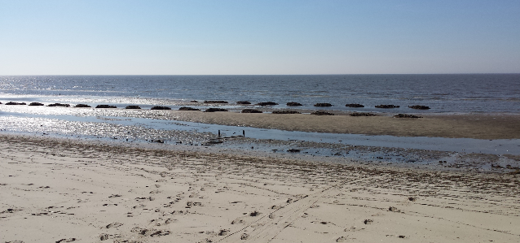
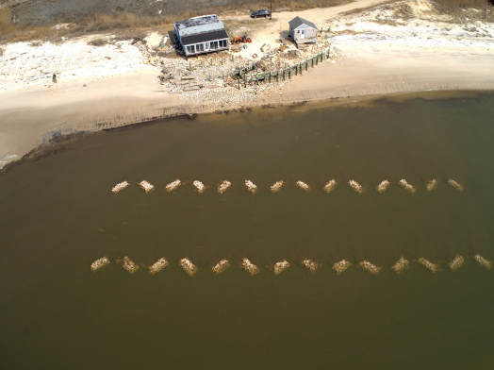
Keeping Sand on the Beach
Single Reefs (double-rowed)
100s of Volunteer
25,000 Shell Bags
Tides
Outreach/Engagement
US Veteran Monitoring
Economic

Slide 9
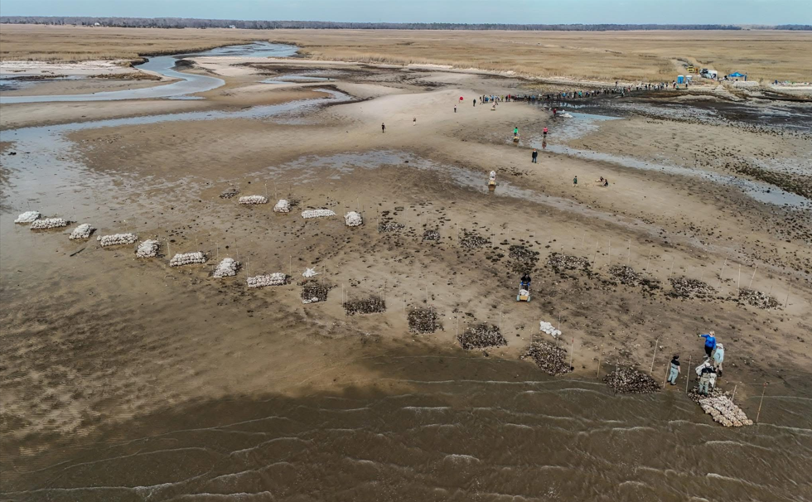
Moores Beach – 2025
120+ Volunteers
Built in a day
On footprint of past reef
170 acres of marsh vulnerable
$300k

Slide 10
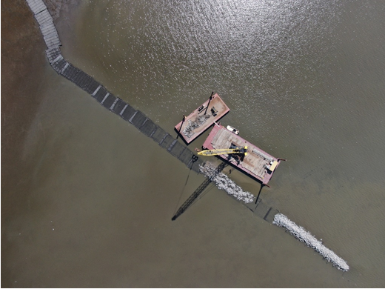
NCS Grants
Mouth of the Maurice River
Basket Flats/NW Reach
Approx $10M
400+ Acres

Slide 11
NW Reach Hybrid Breakwaters - 2025

Slide 12
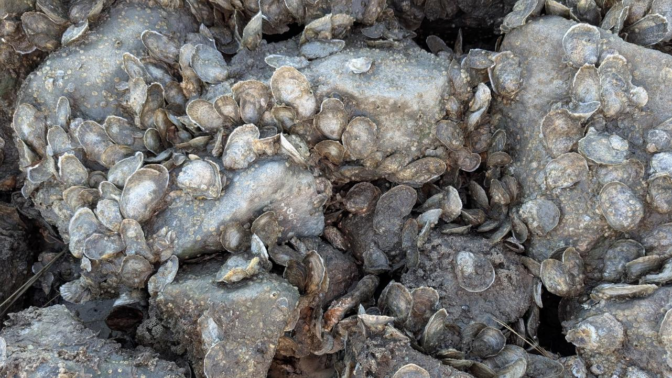
Fortescue Hybrid Breakwaters

Slide 13
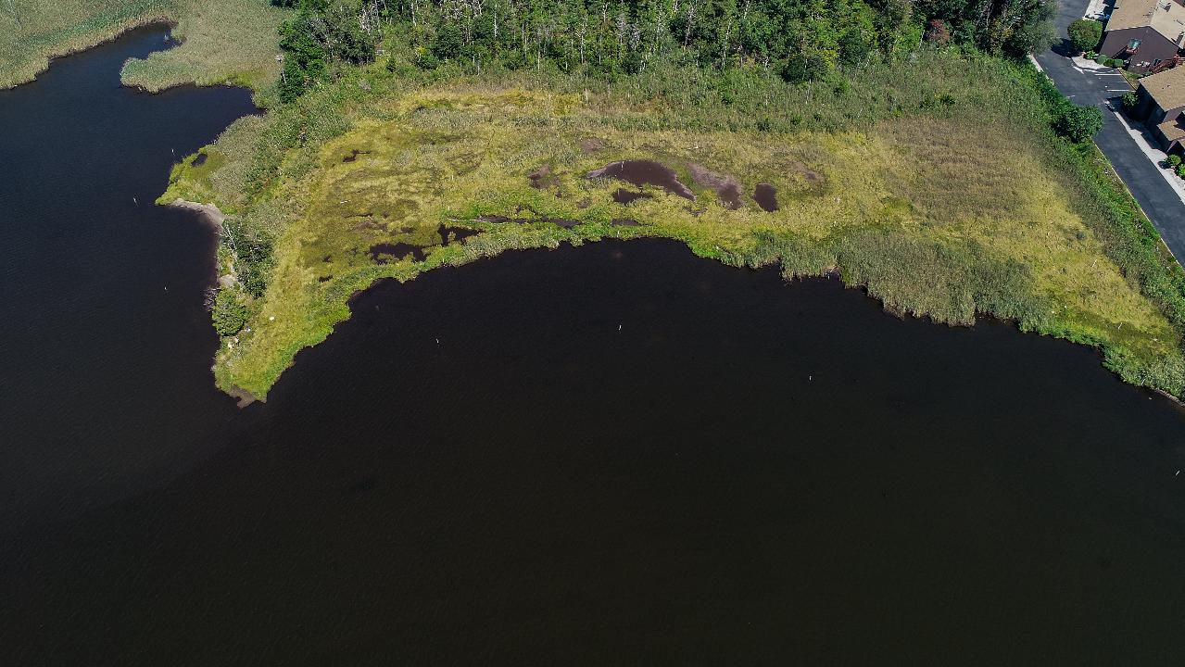
Pre- Restoration – Slade Dale Pt. Pleasant
Heavy Erosion
Saltwater Intrusion – Ghost Forest

Slide 14

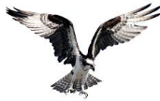
The Plan
Restore salt marsh fringe habitat
Reduce erosion
Improve sediment accretion landward of breakwater and between vanes
Re-establish vegetation into new areas of sedimentation
Modified
  Use Christmas tree branch-box breakwaters to attenuate waves
  Use Christmas tree vanes to stabilize the eroding shoreline

Slide 15
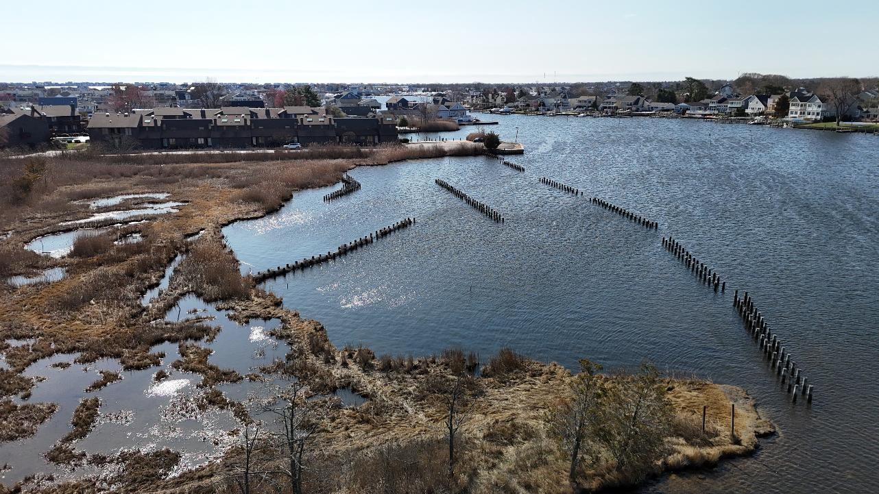
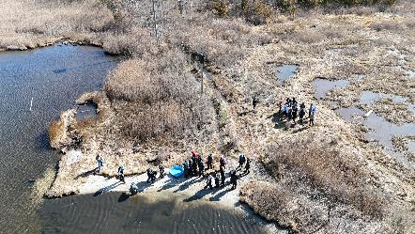
2025
Mean loss of 0.69 ± 6 (SD) cm of elevation. Most of this loss has occurred at the eastern portion of the site.
2 centimeters of elevation gain has been seen near the breakwater structures suggesting that some localized sediment accrual is occurring
Community Engagement Earth Day/Pt. Pleasant Middle School
Local Economy Stimulated

Slide 16
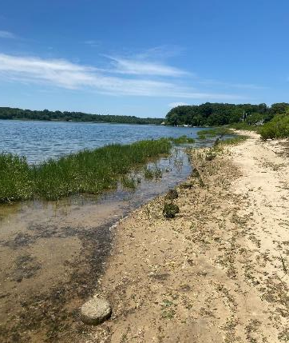
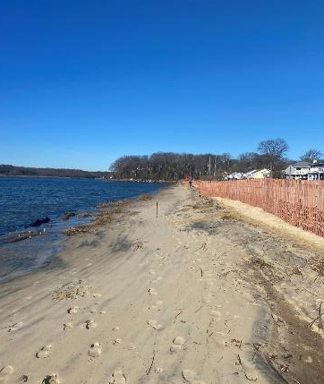
S. Riverside Drive Living Shoreline Phase 1and 2
Project – FEMA/Neptune
2,050 lf Living Shoreline in Shark River
  Sill
  Wetlands
  Beach
  Vegetated Berm
  Tide Valves and Outfall Replacement
  $1M
Horseshoe Crab Spawning Beach
Phase 2
Same concept – 900 lf
$1.5M

Slide 17
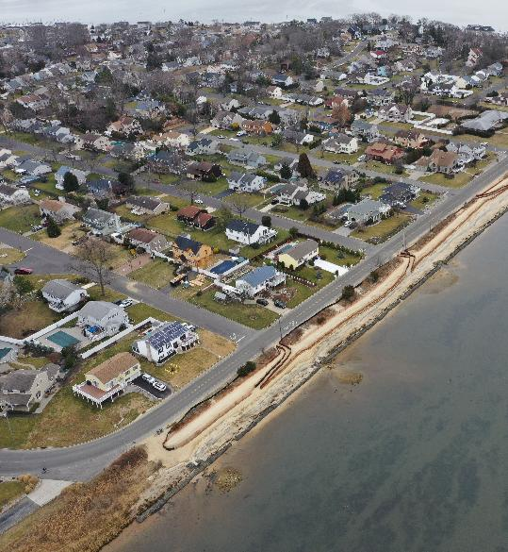
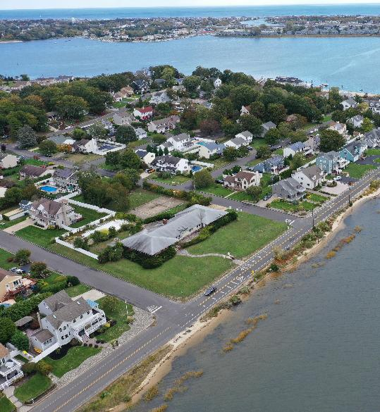
October 2022
February 2023
Photos K. Bascom
Photos K. Bascom

Slide 18
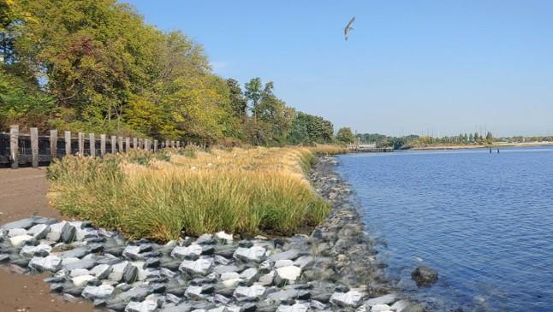
So what’s the future of Nature-Based Strategies and why?
Coincide with the state’s vision
Stimulate local economies
Improve community and ecosystem resiliency
Can be added to and be built upon
Promote community engagement and stewardwhip

Slide 19
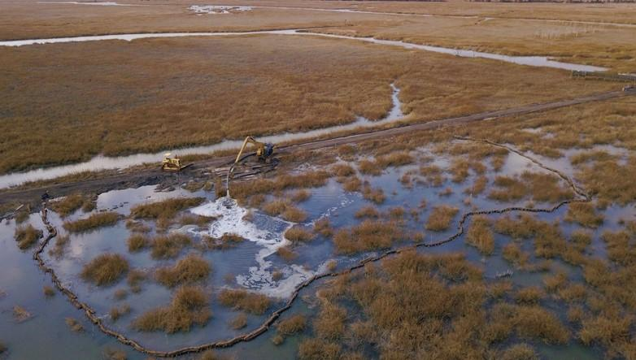

Thank You and Questions
For More Information
Capt. Alek Modjeski
Habitat Restoration Program Director
American Littoral Society
alek@littoralsociety.org
Notes:
2016 – adding another beach, 4 more reefs, starting marsh restoration, and continue our monitoring efforts
If you’d like more info check out our website LittoralSociety.org or the project website restoreNJbayshore.org

