Slide 1
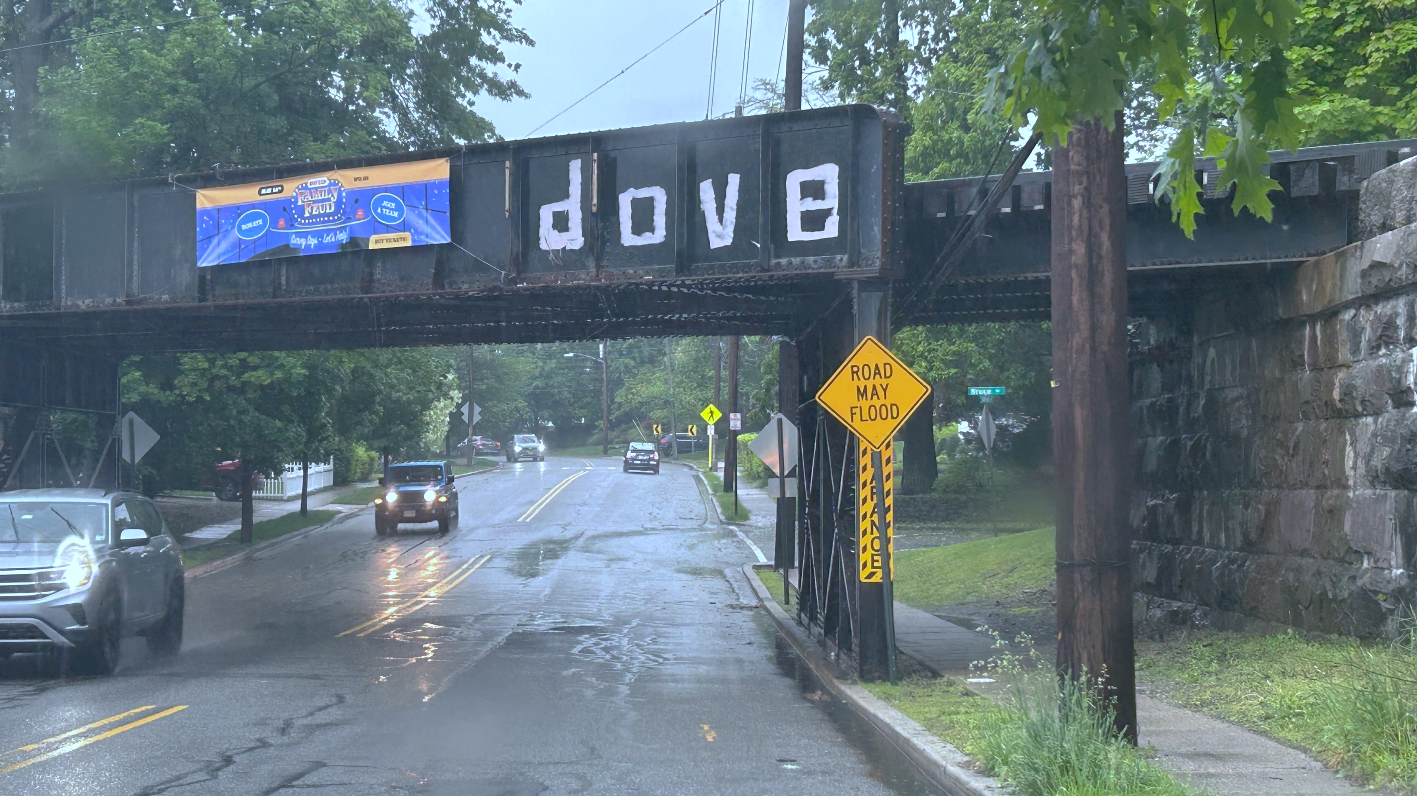
Post-Ida Resilience Planning in Montclair
2026 New Jersey Coastal and Climate Resilience Conference
March 9, 2026
Nicholas Dickerson, PP, AICP, CFM

Slide 2
Montclair, In Brief
Introduction
Montclair is an inland community in Essex County
It’s dense, historic, and largely built‑out, with very little open land remaining
The town is well connected regionally, but much of the infrastructure is aging
That leaves limited room for stormwater when heavy rain hits

Slide 3
What Could Possibly Go Wrong?
Montclair sits along the Watchung ridgeline, so water moves downhill fast
Runoff reaches low points quicker than systems were designed for
Much of the drainage network is legacy infrastructure that was not comprehensively planned when it was installed
When rainfall intensifies, problems stack up downstream

Slide 4
Hurricane Ida (2021)
Wake Up Call
Ida delivered an extreme amount of rain in a short window
Stormwater systems were quickly overwhelmed
Streets flooded, properties were damaged, and services were disrupted

Slide 5
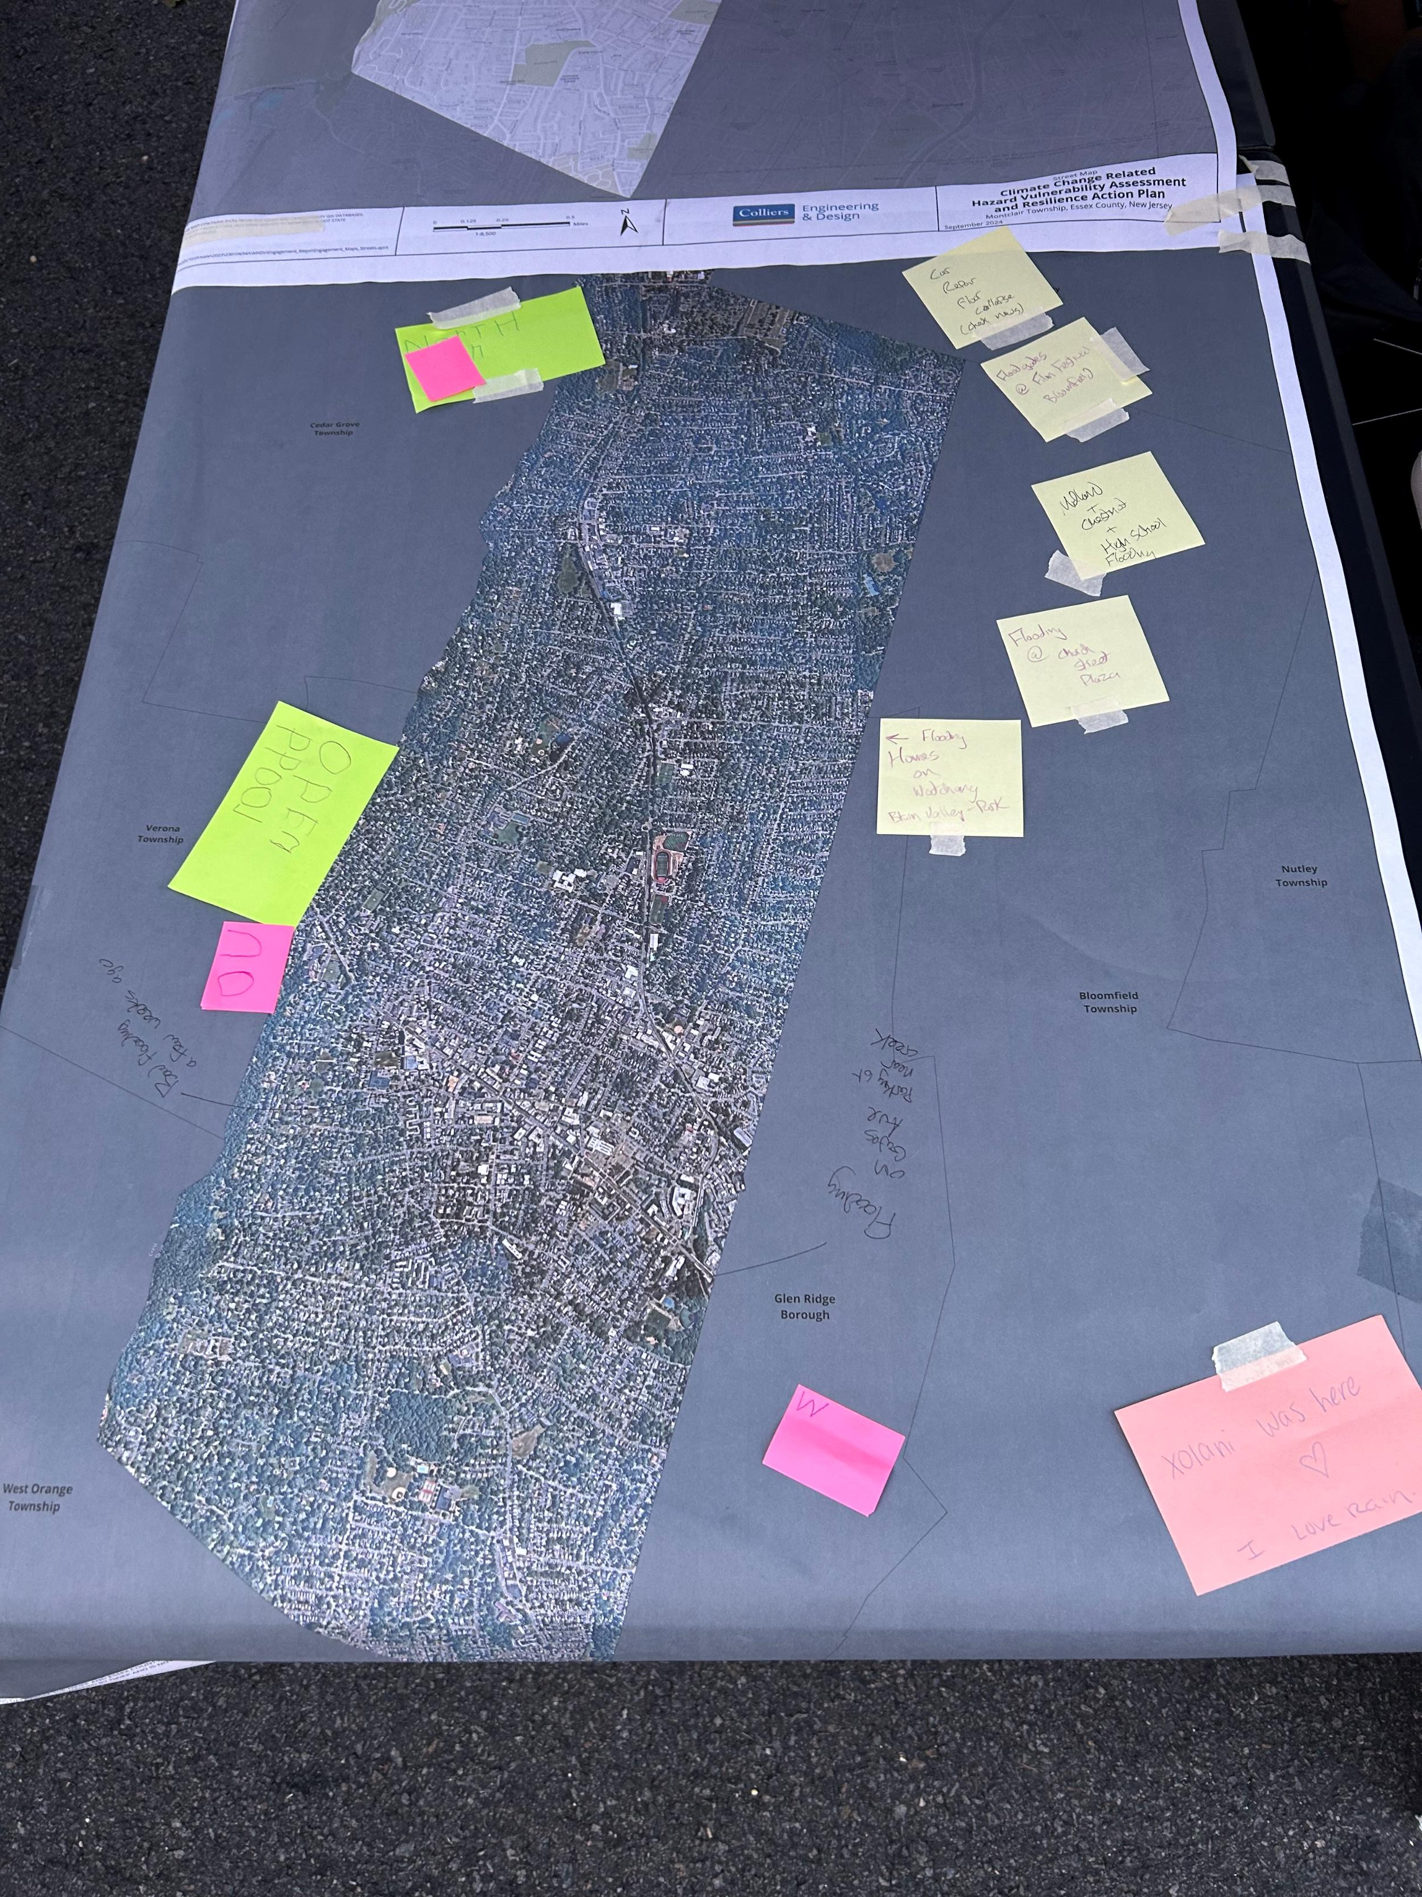
Our Role in Montclair
Our firm was brought in through an NJDEP‑sponsored Resilient NJ MAP grant
The goal was to build on Montclair’s post‑Ida planning work
Update and expand the Township’s Climate Change‑Related Hazard Vulnerability Assessment
Prepare a Resilience Action Plan focused on implementation

Slide 6
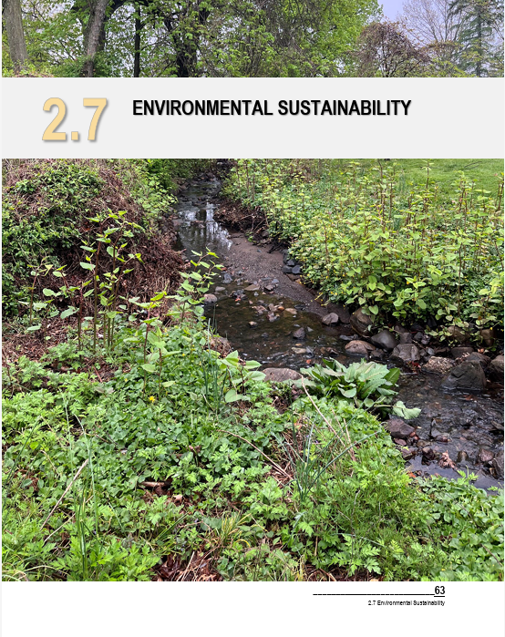
The Original CCRHVA
Starting Point
Montclair’s original CCRHVA was completed after Ida, in 2023
It focused almost entirely on flooding, with a secondary emphasis on heat and tree canopy
That made sense given the impacts the community had just experienced

Slide 7
How We Expanded The Conversation
NJDEP encouraged us to look beyond flooding and heat
We expanded the assessment to include additional climate‑related risks
Wildfire risk became especially relevant after the Greenwood Lake fire in 2024
We also evaluated landslide risk, given Montclair’s topography

Slide 8
From Ida to Action
Ida gave the Township a shared understanding of risk
The next step was deciding what that meant for planning
Looking at each risk helped point us toward specific actions that could strengthen local resilience.

Slide 9
Scale of Flood Risk
About 2,150 parcels in town are exposed to flooding
That represents more than $1.37 billion in assessed property value
Roughly $45 million in annual municipal tax revenue is tied to those areas
Flooding isn’t just a safety issue — it’s also a fiscal issue

Slide 10
It’s not just flooding
Flooding is the main hazard, but it doesn’t act alone
It interacts with other climate stressors across the community
Extreme heat puts added strain on people and infrastructure
These risks tend to compound, not happen one at a time

Slide 11
Who is Most Vulnerable?
Flood risk doesn’t affect everyone the same way
Overburdened Communities are often hit first and recover last
Seniors, renters, and people with limited mobility face added challenges
Several critical facilities are also located in flood‑prone areas

Slide 12
Sustainability & Resilience Amendments to the Master Plan
2025
This amendment defines what needs to change in local planning
It brings climate risk directly into land use decisions
Recommends actions and policies to reflect new realities
Planning better aligns with state resilience goals

Slide 13
Resilience Action Plan
The Action Plan focuses on implementing resilience
It sets priorities and helps sequence actions over time
Responsibilities are clearly assigned, so nothing gets lost
Actions are aligned with available funding opportunities

Slide 14
Resilience Goals
Reduce flood risk to people and property
Address extreme heat impacts
Protect critical infrastructure
Advance equity in resilience investments
Strengthen municipal systems long‑term
**Education

Slide 15
What Actually Changed after Ida
Ida created a shared point of reference for risk
Data helped, but experience drove urgency
Planning connected directly to implementation and funding
Importance of education and communication

Slide 16

Thank You!
Nicholas Dickerson, PP, AICP, CFM
Senior Associate-Project Manager
+1 732 963 7747
nicholas.dickerson@collierseng.com
What sets us apart is not what we do, but how we do it. Our people are passionate, take personal responsibility and focus on what’s right for our clients, people and communities. We attract and develop industry leaders, empowering them to think and act differently to drive exceptional results. At Colliers Engineering & Design, we accelerate success.

