Slide 1
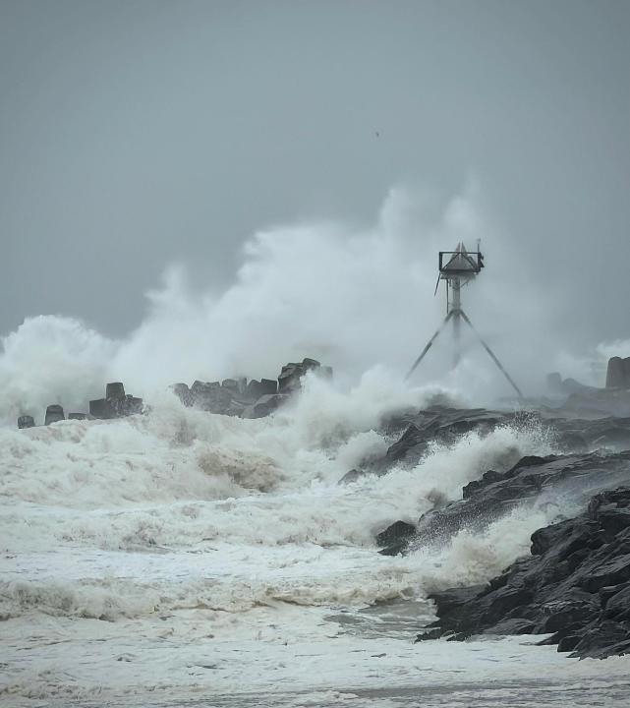

Save the Shore A COMPREHENSIVE APPROACH TO FLOOD MITIGATION IN COASTAL COMMUNITIES
Borough of Manasquan

Slide 2
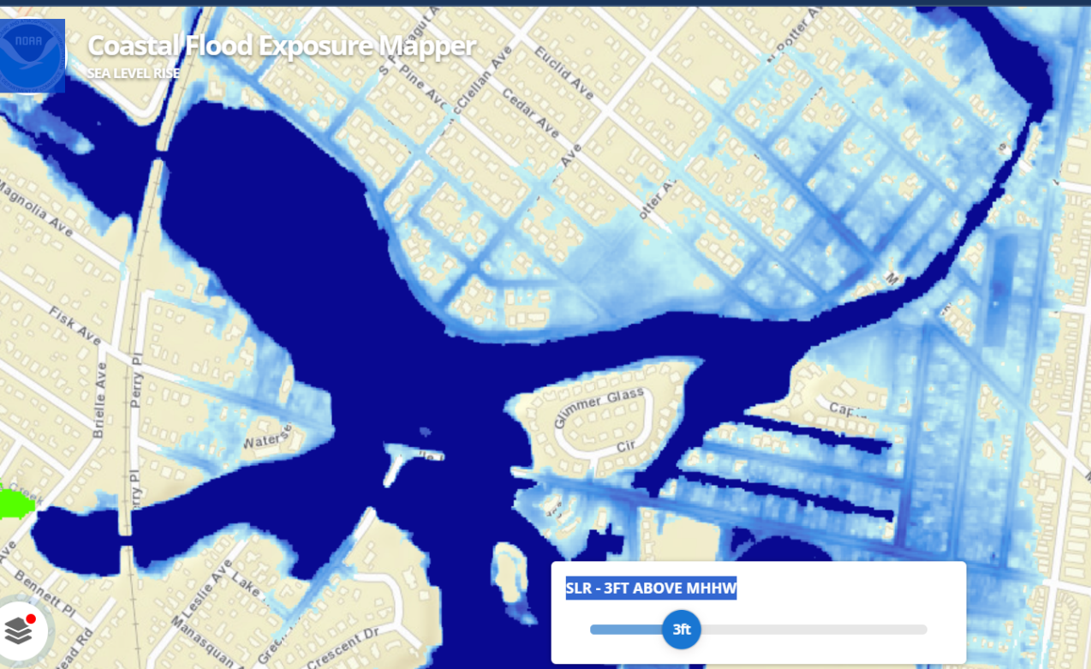

Slide 3

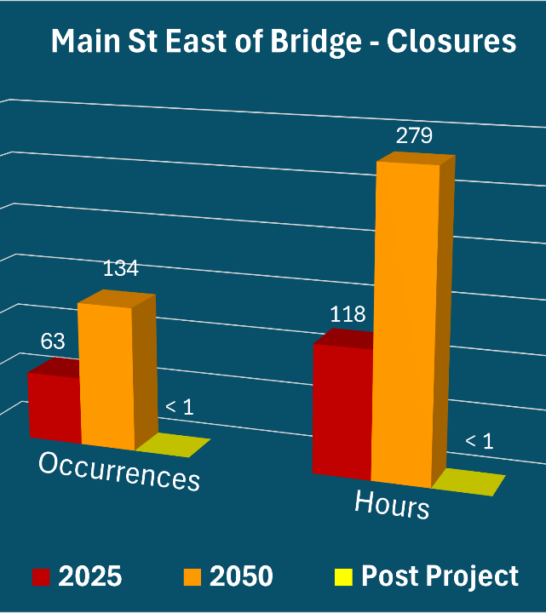
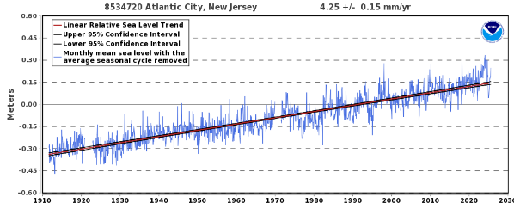
Impacts of Sea Level Rise

Slide 4
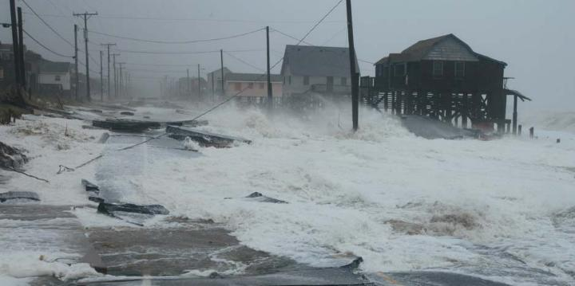
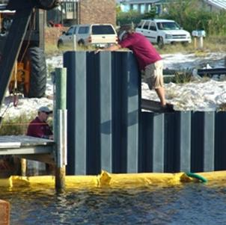
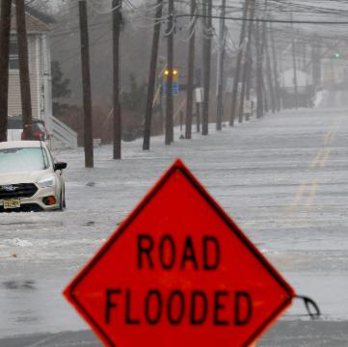
Flood Mitigation Strategies
Retreat
Surround / Walls Levees
Elevate

Slide 5
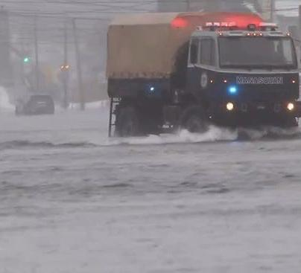
Objective
To assess the full extent of the coastal flood risk in Manasquan, accounting for sea level rise, and develop a comprehensive, scalable, and cost-effective mitigation plan that addresses flooding up to major coastal events with a phased implementation.
Enhance public safety
Protect property
Improve transportation
Strengthen the overall quality of life

Slide 6
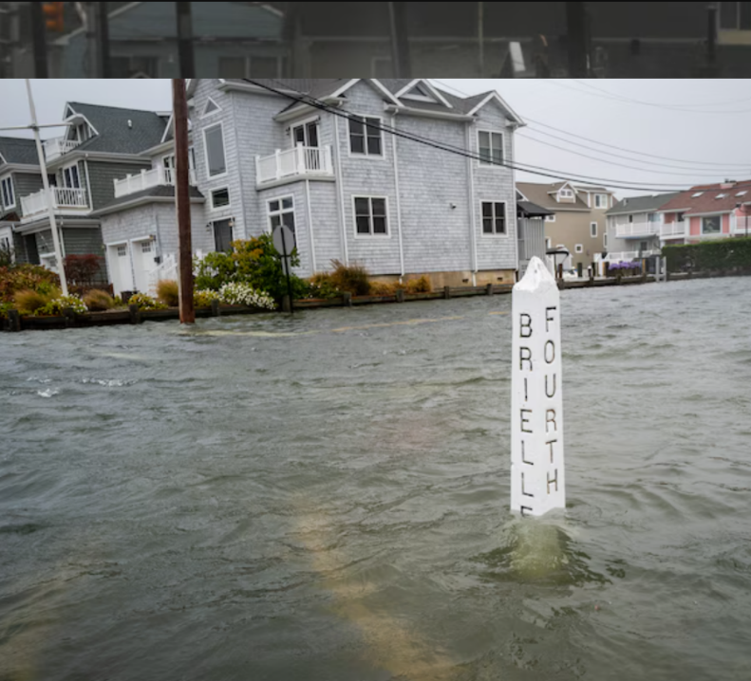
Plan Strategies
Elevate
Roads
Infrastructure
Utilities
Flood walls
Drainage upgrades
Property restoration

Slide 7
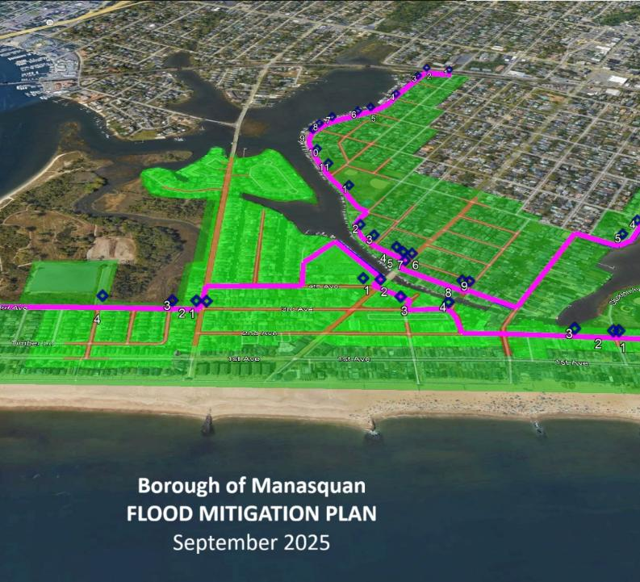
Manasquan’s Flood Mitigation Plan
9 miles of roadway elevated
3 flood walls
36 stormwater outfalls and drainage
New water & sanitary sewer throughout

Slide 8





Slide 9
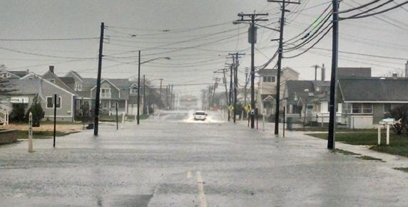
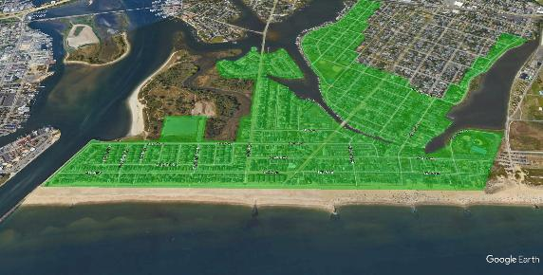
Manasquan’s Flood Mitigation Plan
1400 residences protected
9 miles of roadway elevated
Evacuation route secured – 30 yr storm
Reduces road closures townwide by 99%
Rewind the clock 140 years

Slide 10
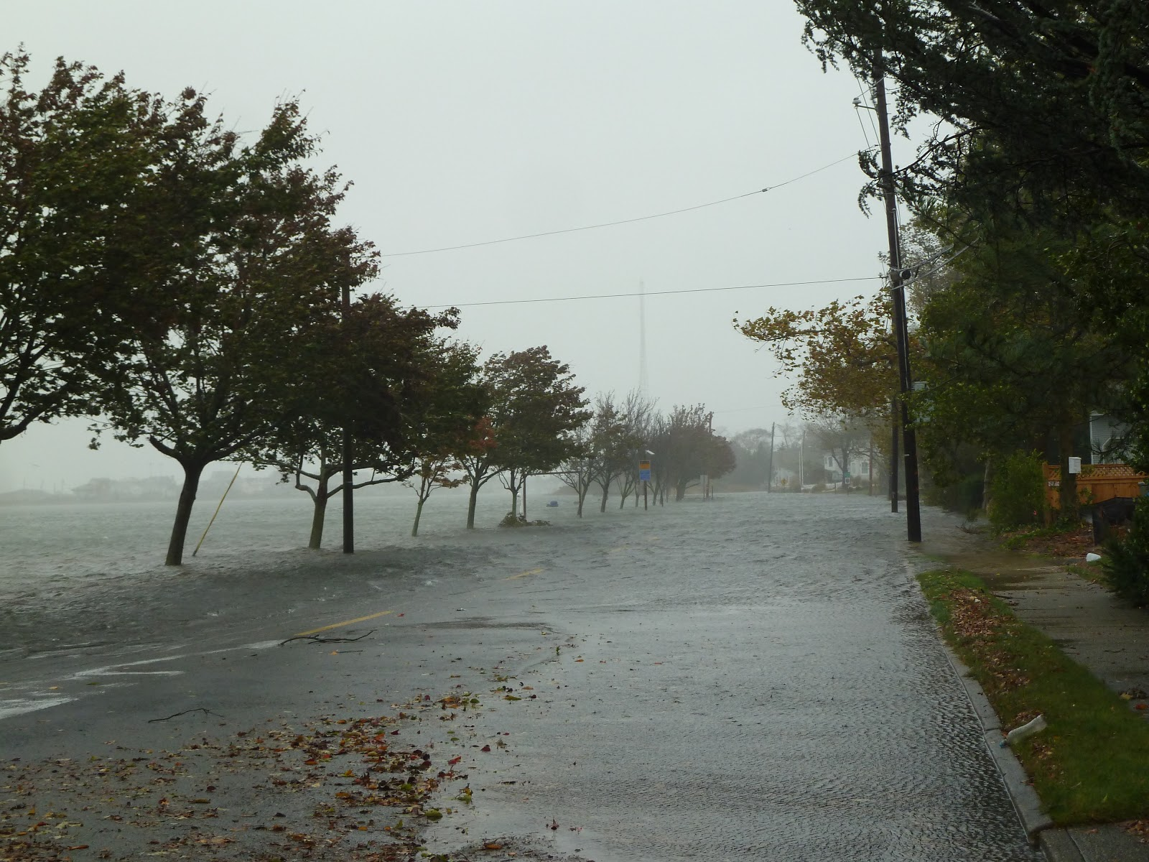
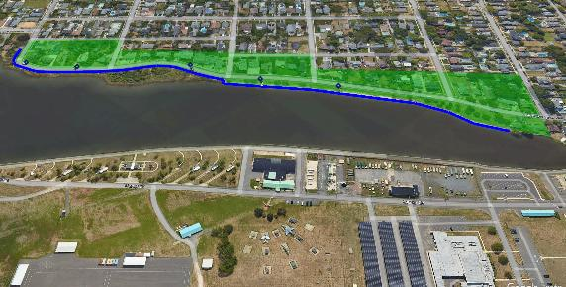
Stockton Lake Flood Wall
Details
1300 LF bulkhead
1200 LF flood wall
11 stormwater outfalls
$1.5m
Protects
40 residences
0.5 mi evacuation route
Protected thru 30-year event

Slide 11
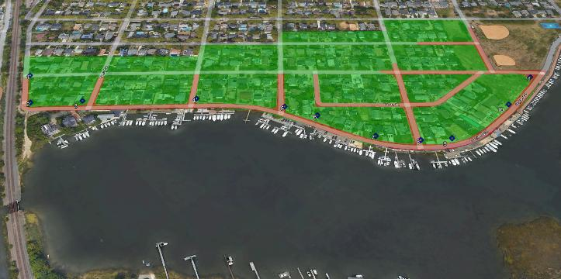
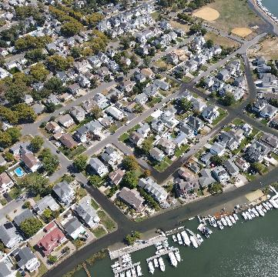
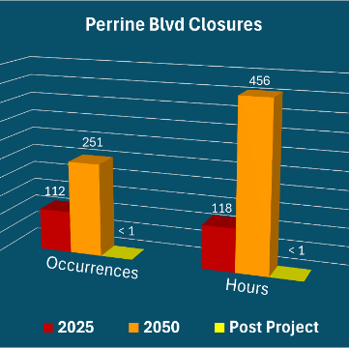
Perrine Area
Details
2.2 mi elevated roads
11 stormwater outfalls
New water & sewer
$3.8m
Protects
160 residences
2.2 mi roadways
Marinas & lift station

Slide 12
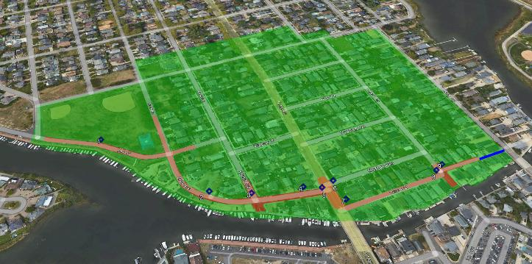
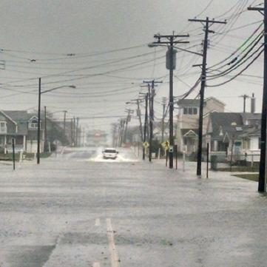
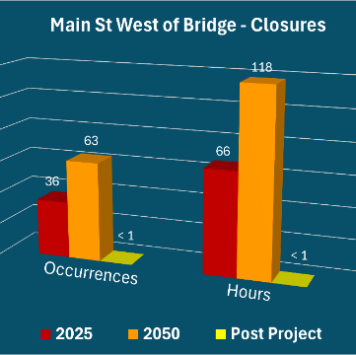
Main St West
Details
0.5 mi elevated roads
150’ flood wall
9 stormwater outfalls
New water & sewer
$3.7m
Protects
200 residences
2 mi roadways
Marinas & recreational fields

Slide 13
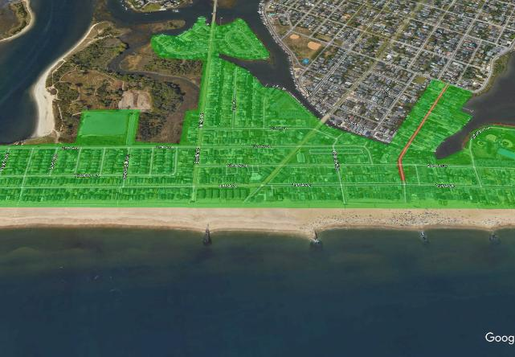
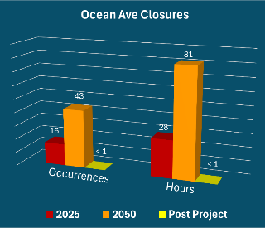
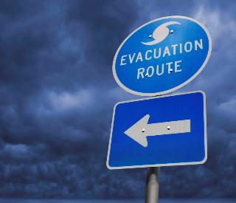
Ocean Ave Evacuation Rte
Details
0.3 mi elevated roads
New water & sewer
$2.3m
Protects
60 residences
Critical evacuation route serving over 1,000 residences and 20 businesses

Slide 14
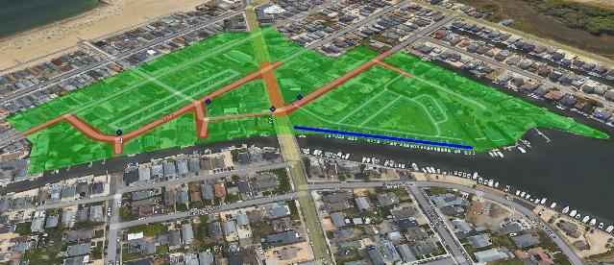
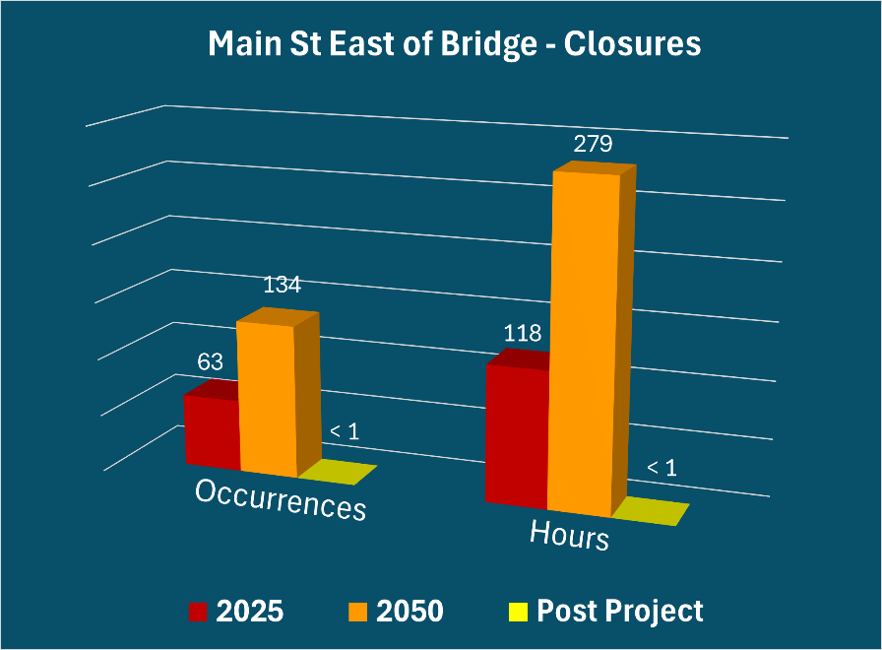
Main St East
Details
0.5 mi elevated roads
550’ flood wall
5 Stormwater outfalls
New water & sewer
$1.6m
Protects
100 residences
0.5 mi roadways
Marinas & DPW facilities

Slide 15
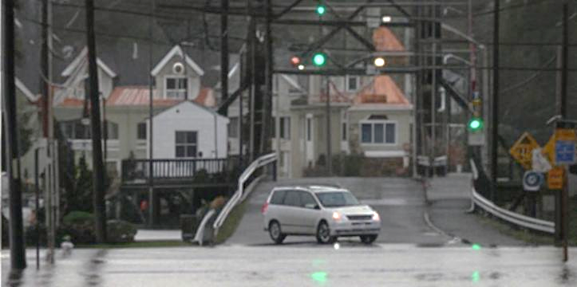
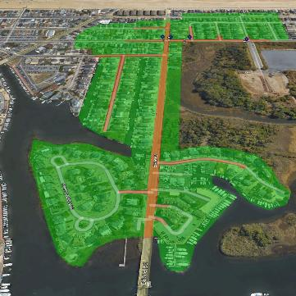
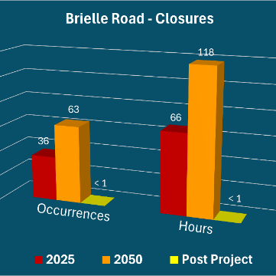
Brielle Road
Details
1.5 mi elevated roads
4 stormwater outfalls
New water & sewer
$6.7m
Protects
370 residences
1.5 mi roadways
Marinas & commercial establishments
Evacuation route

Slide 16
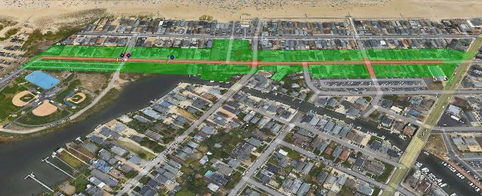
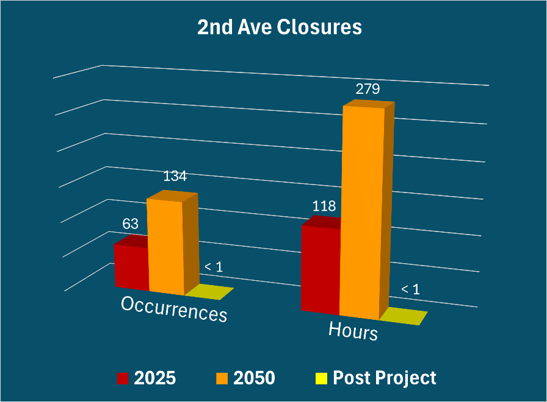
2nd Ave Area
Details
0.5 mi elevated roads
3 stormwater outfalls
New water & sewer
$2.7m
Protects
76 residences
0.5 mi roadways
DPW facilities
Recreational complex
House of worship

Slide 17
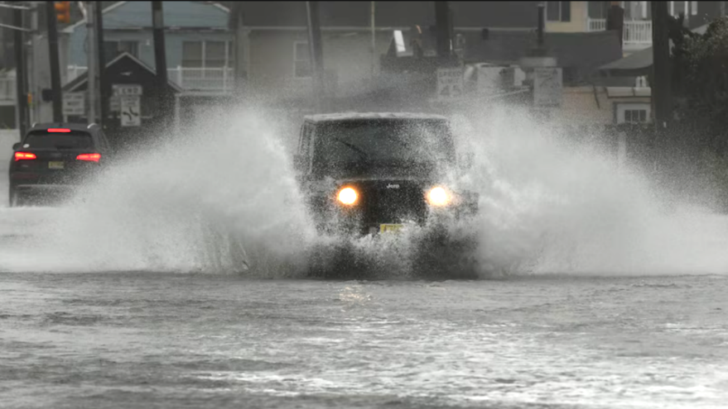
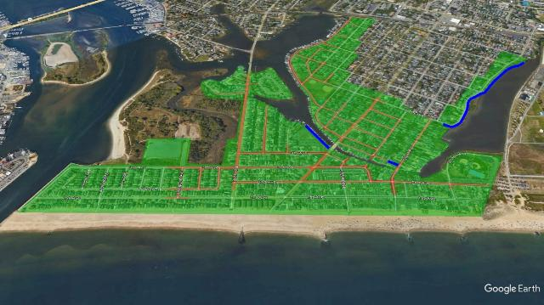
Paving Tie-In
Details
1.6 mi elevated roads
Upgraded drainage
New water & sewer
$2.5m
Protects
296 residences
1.6 mi roadways
DPW facilities
3 commercial establishments
House of worship

Slide 18
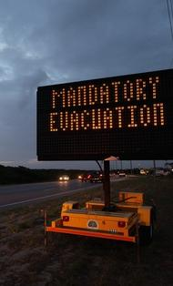
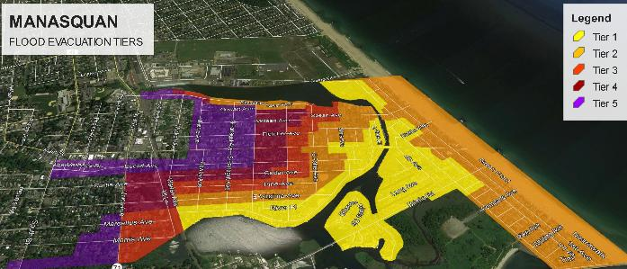
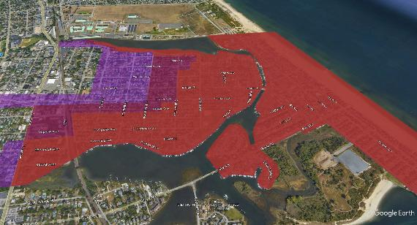
Evacuations

