Slide 1
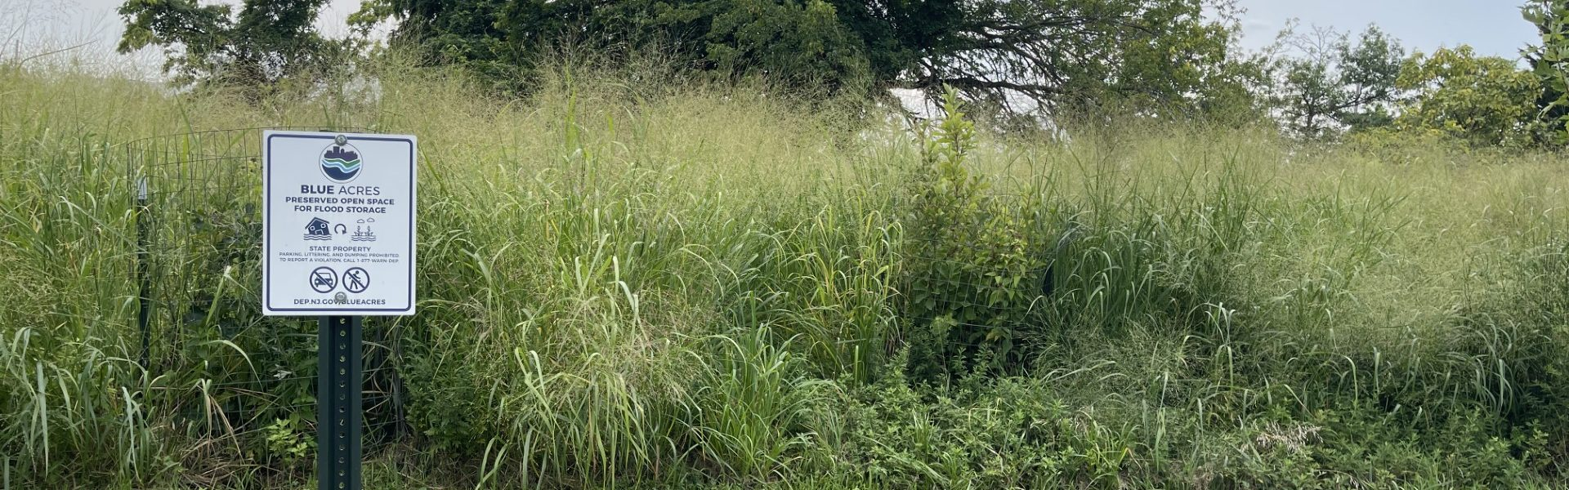

Reimagining Flood Recovery & Community Engagement: Blue Acres Buyouts Along the Orchard Brook in Cranford NJ

Slide 2
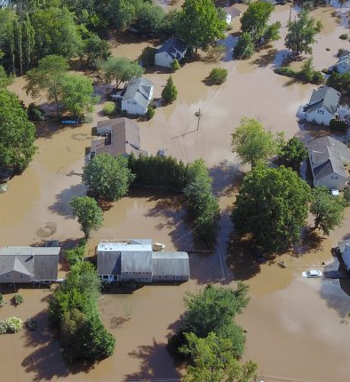

DEP Blue Acres helps New Jersey residents and communities identify and avoid risks of flooding through strategic climate resilience planning and the state-led acquisition of flood-prone property.
Core missions: Disaster recovery: Blue Acres helps New Jersey residents whose homes have been damaged in flooding events.
Disaster Preparedness: Blue Acres implements buyouts that increase community resilience by acquiring lands that are flood-prone or may buffer other lands at risk due to sea-level rise, storms, or storm-related flooding.
Notes:
Photo: New Jersey State Police (Ida)

Slide 3
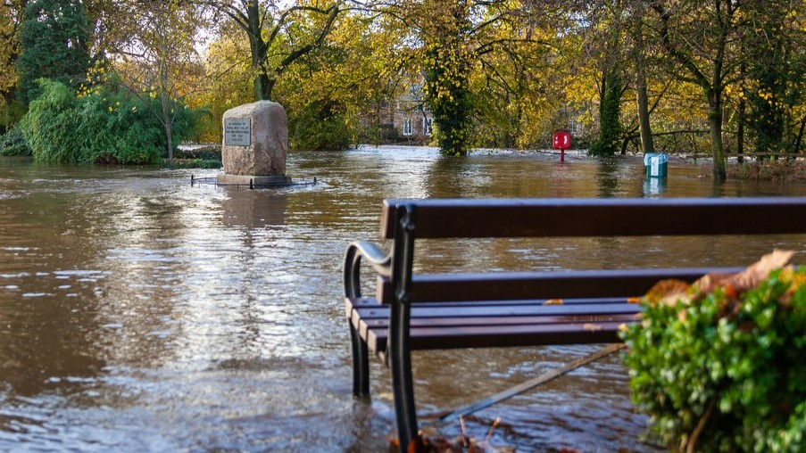

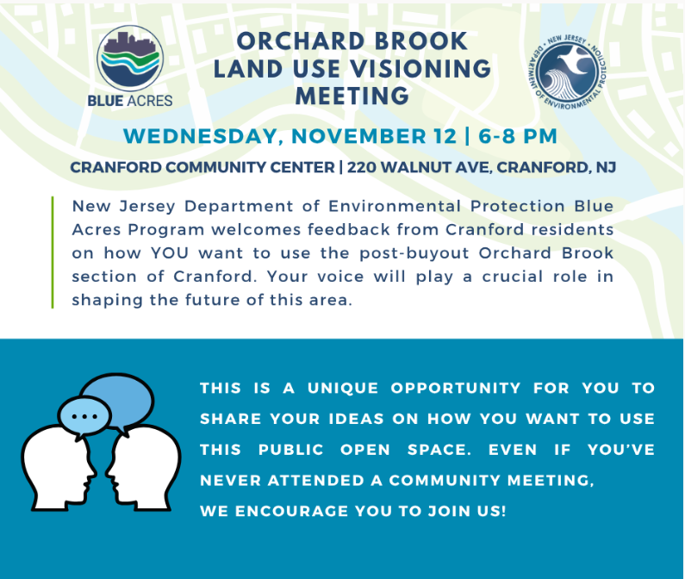
Begin with the end in mind
Emergency Watershed Protection (EWP) Program
Buyouts
Notes:
NRCS: Hilary and David
Cranford Officials:
Mayor Terrance Curran; BA Lavona Patterson; Ida Mayor and continuing advocate Kathleen Miller Prunty; Director Cranford Recreation & Parks Steve Robertazzi; Township Planner Graham Petto (Topology); Planning Board Committee members Michael Callahan, Steve Jandoli, and David Leber.
Union County Officials: Kevin Boyer from Colliers Engineering
NGOs: Hanson Conservancy; Rahway River Watershed Assoc; WMA7 Ambassador;

Slide 4
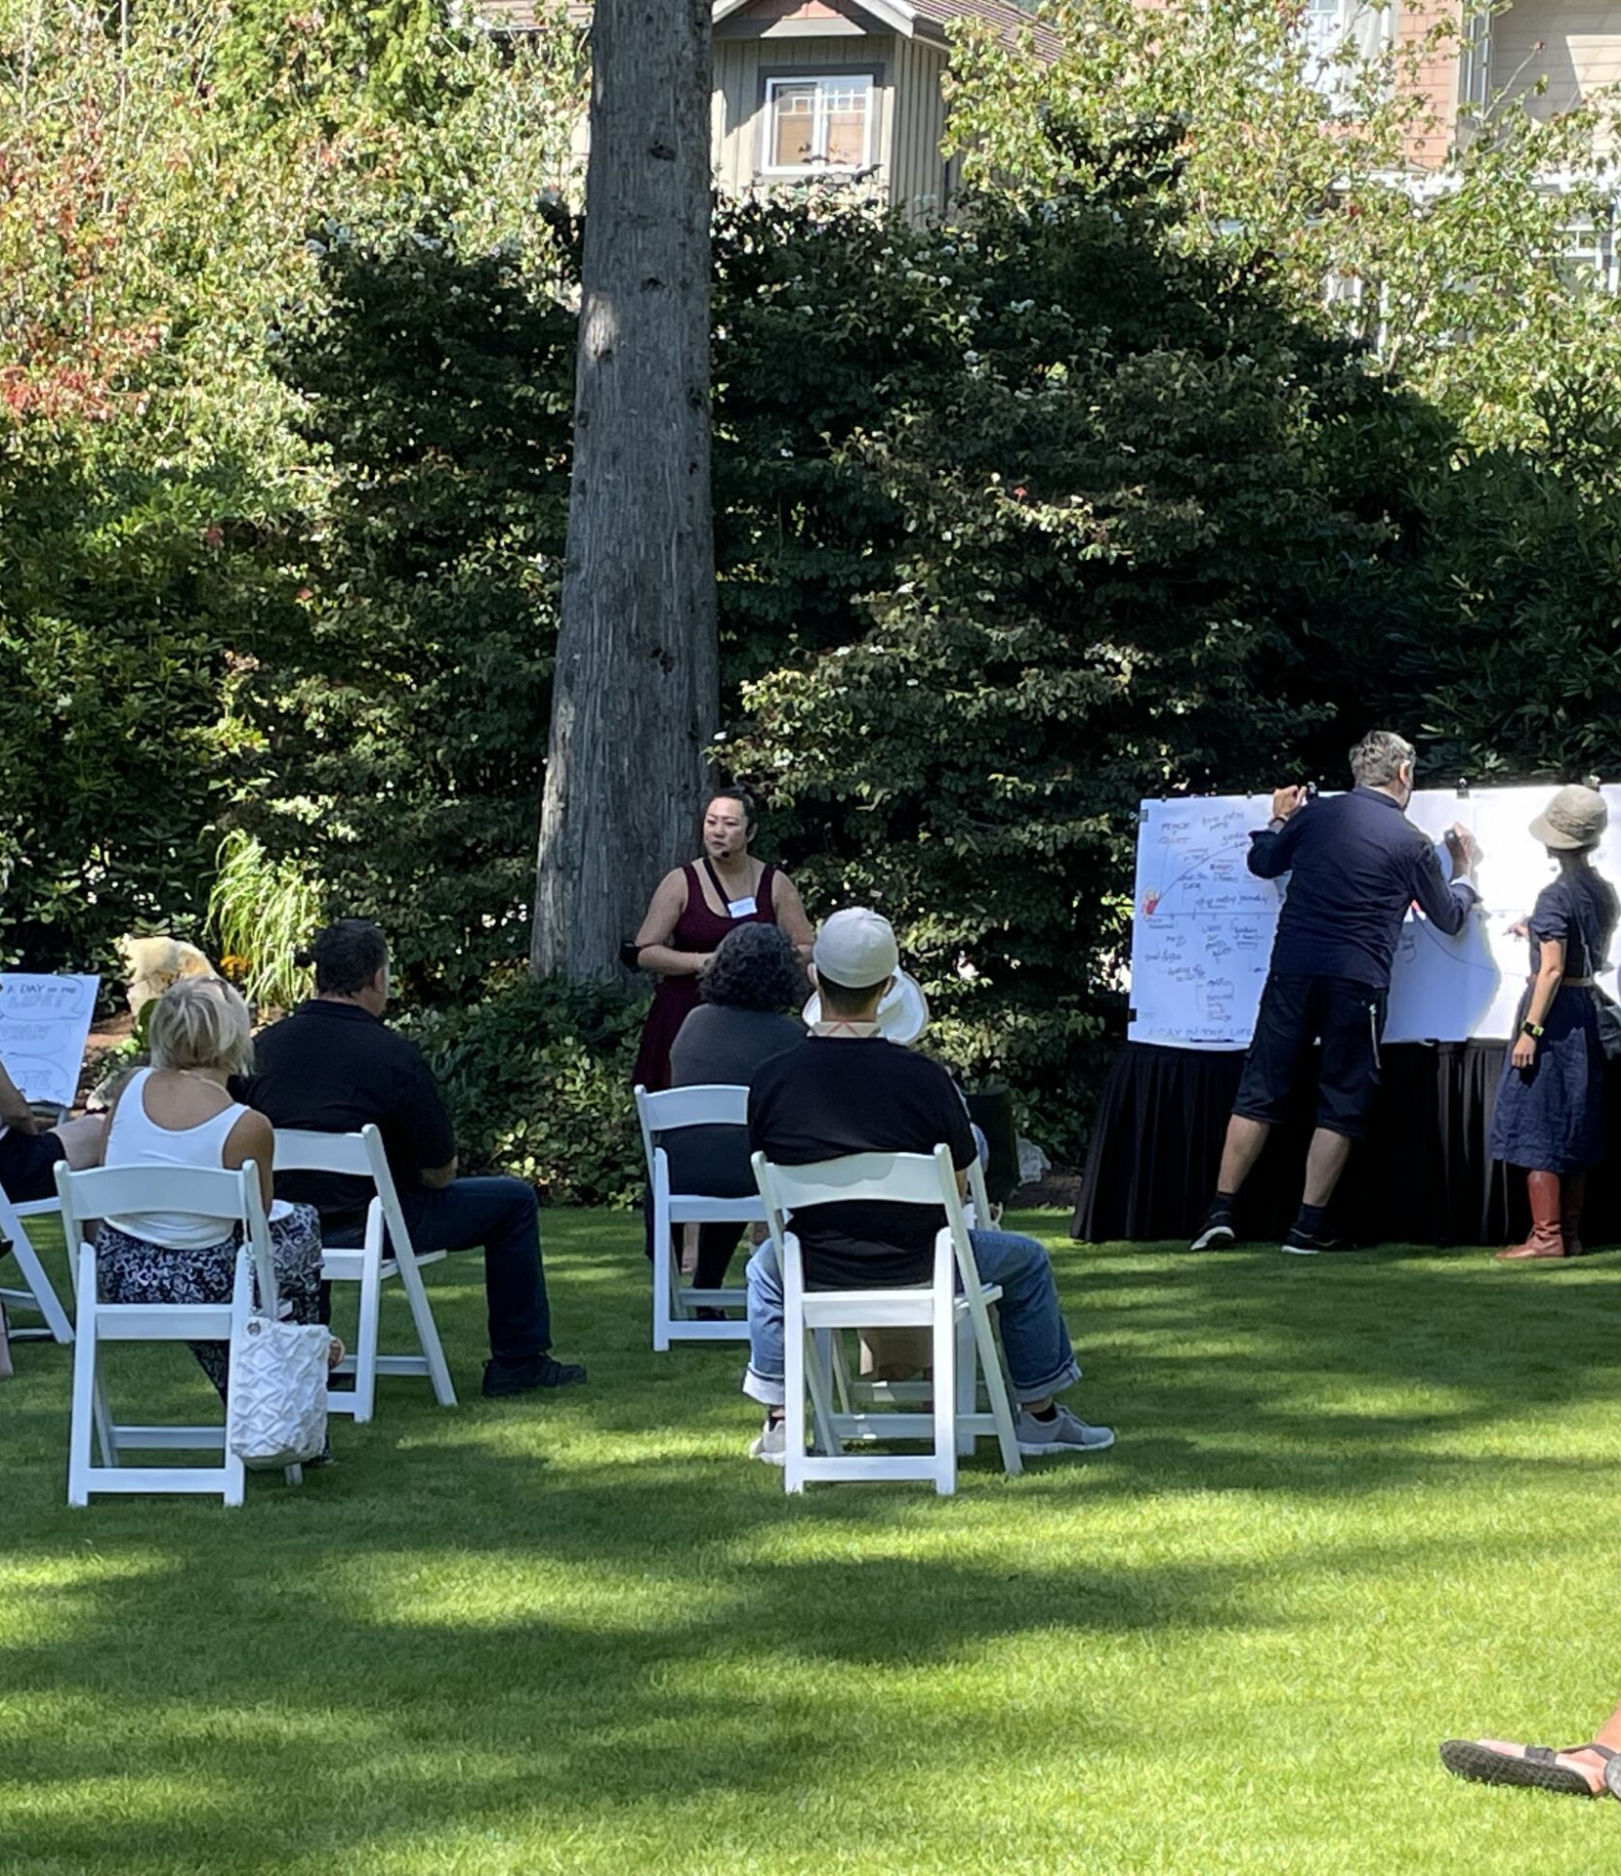
Goals for Community Engagement Visioning
Educate locals about the program, its benefits and the eligible uses of buyout land
Understand local needs and identify concerns from the community
Highlight existing and related plans, priorities and projects
Generate a spectrum of community supported ideas for future uses of the land
Notes:
Emphasize a 2-way engagement process- share info and receive info.

Slide 5
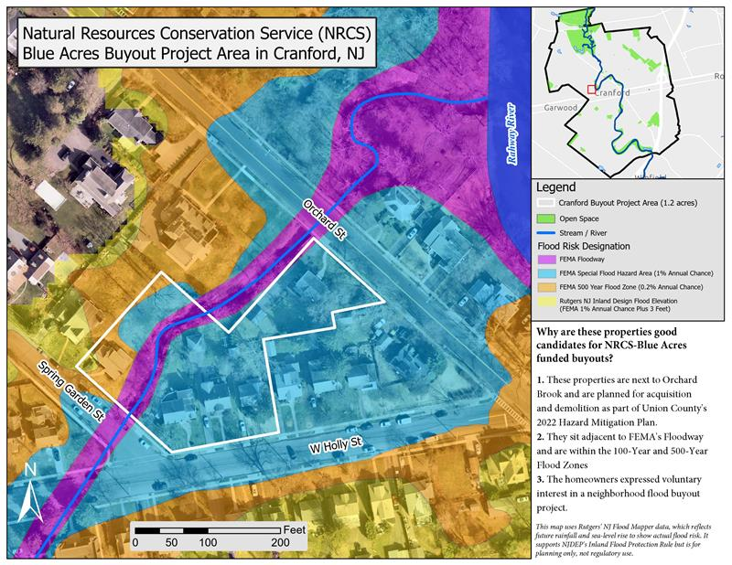
Notes:
Generalized visuals are helpful
Cranford Twp Union Co. Nearly 5 sq miles in size and a Pop = 23K residents. Famous for its canoe clubs and as a summer retreat from NYC that evolved into a full-time community
Voluntary process means final open space outcomes are subjective- demands area dialogue and a spectrum of post buyout land use ideas and options

Slide 6
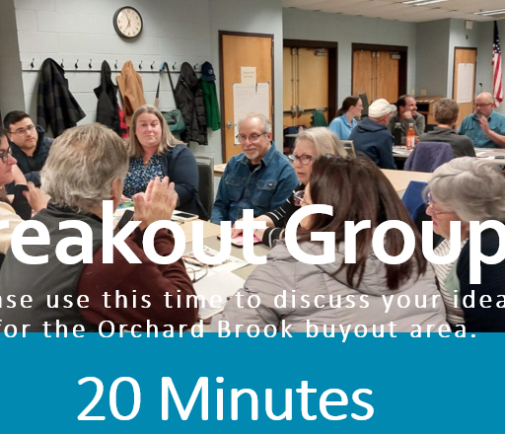
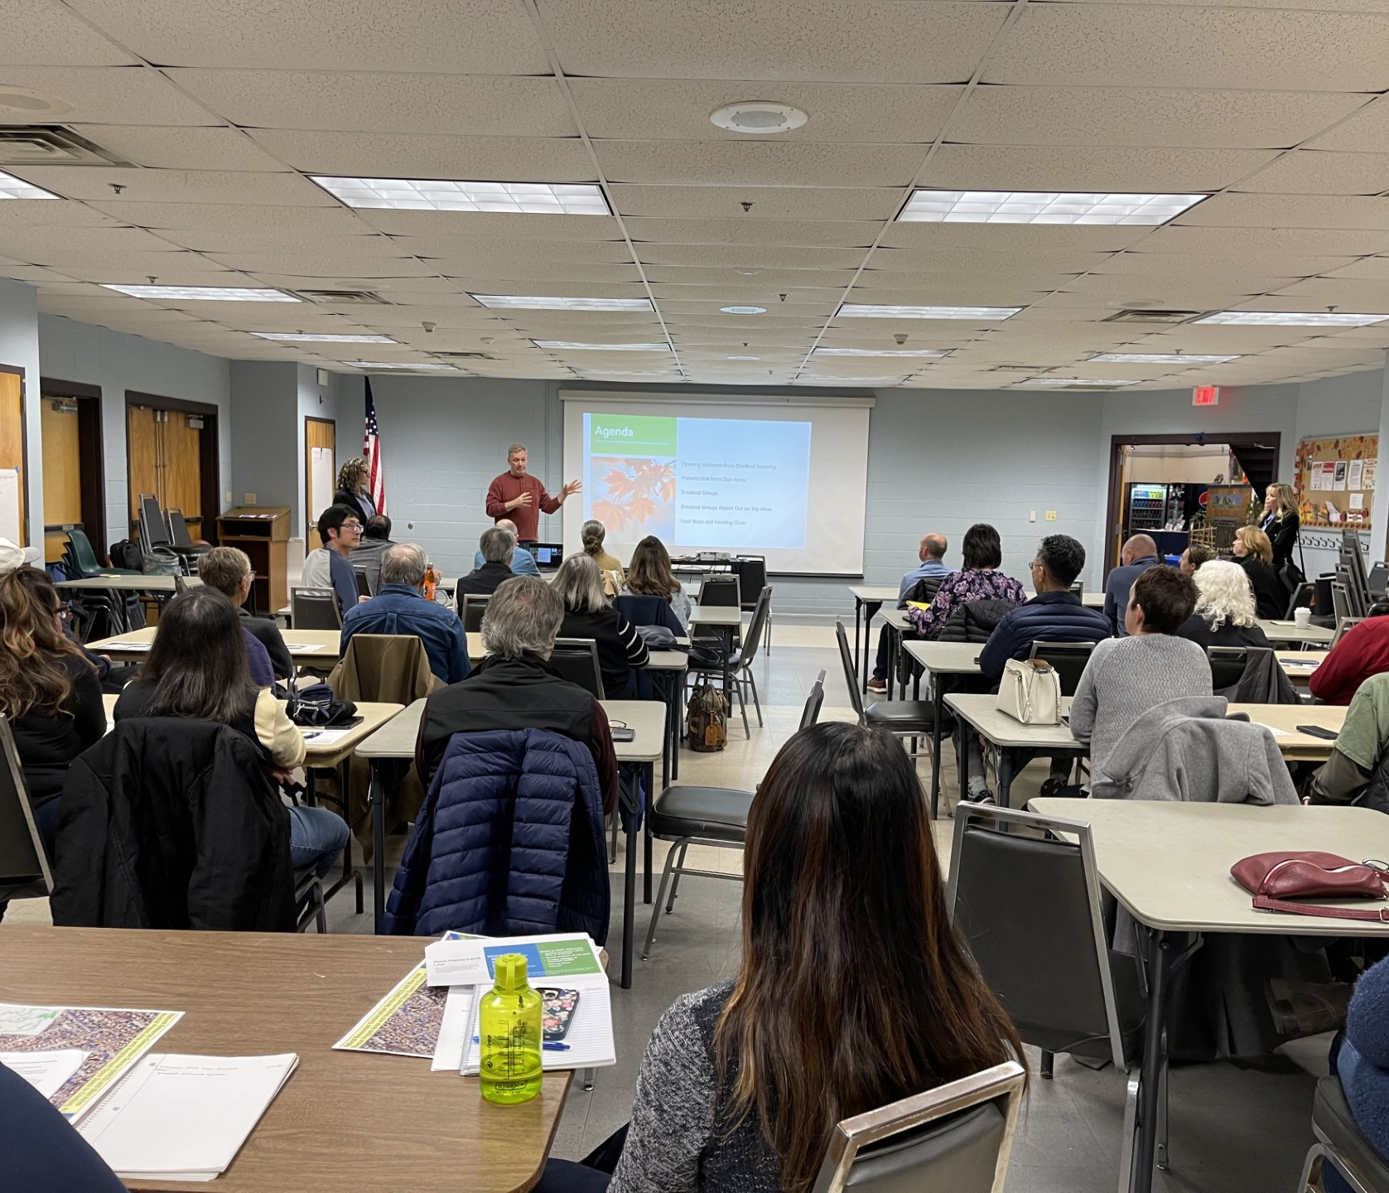
Layered Community Engagement
Notes:
Engagement should not be a 1 and done effort.
In Cranford, we have met 3 times so far.

Slide 7
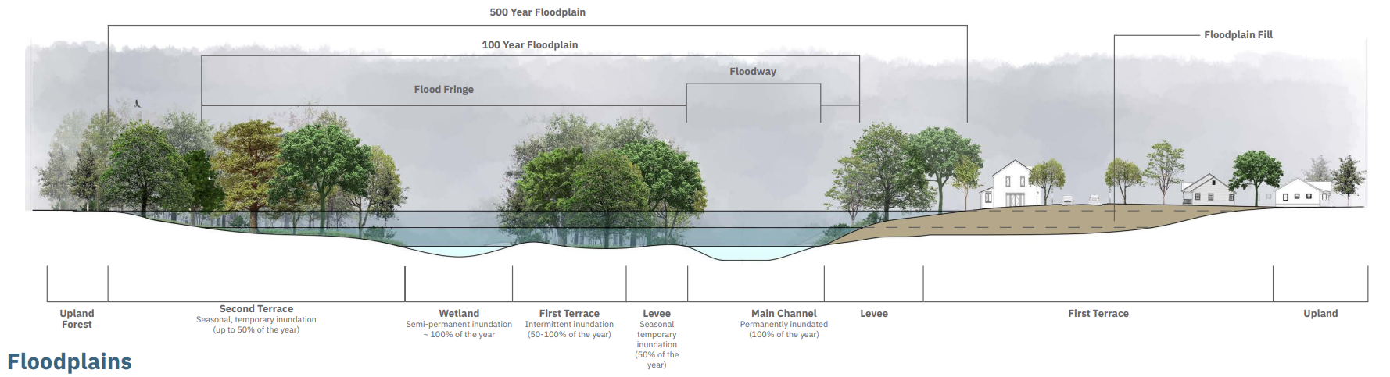
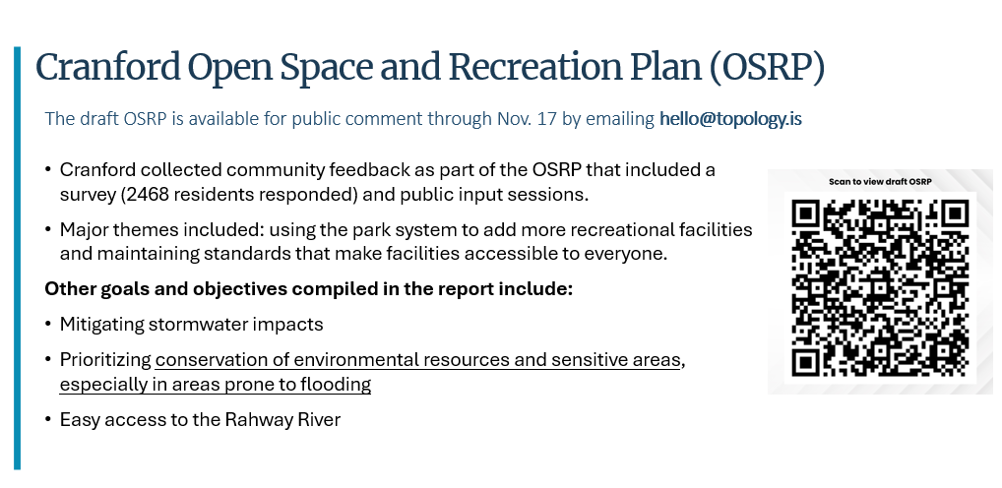
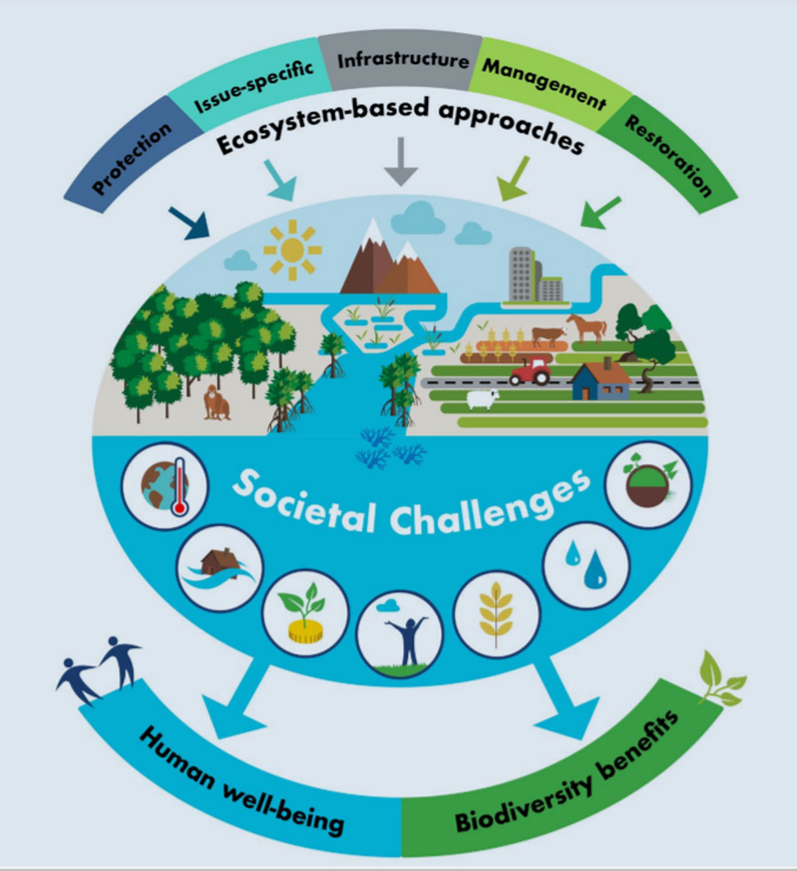


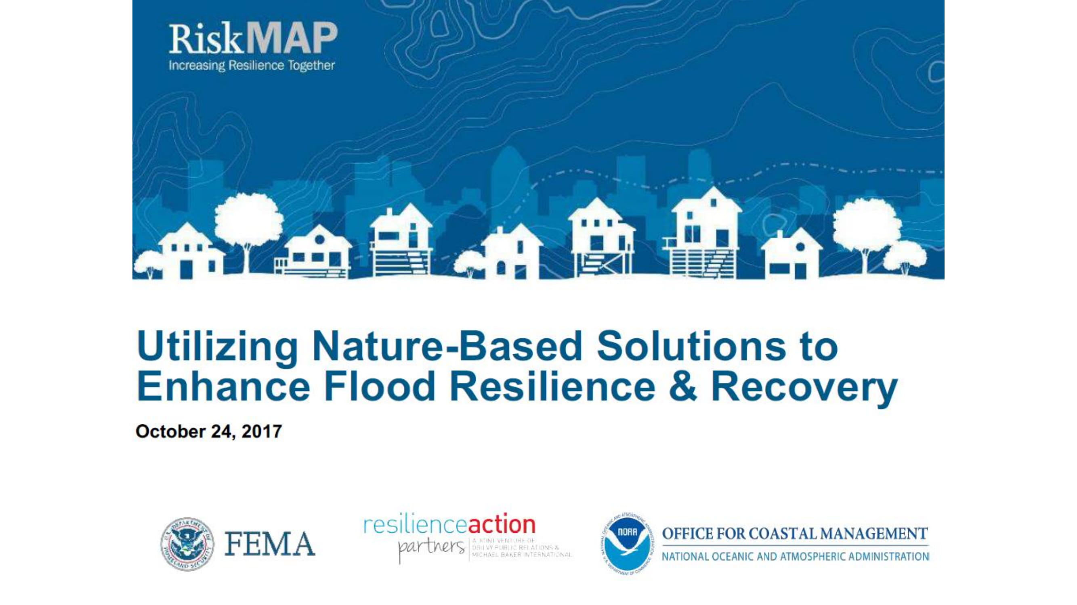

Build Relationships & Share Information
Notes:
Provide simple visuals to explain concepts and offer a variety of resources (academic, NGO, government)

Slide 8
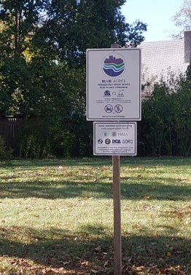
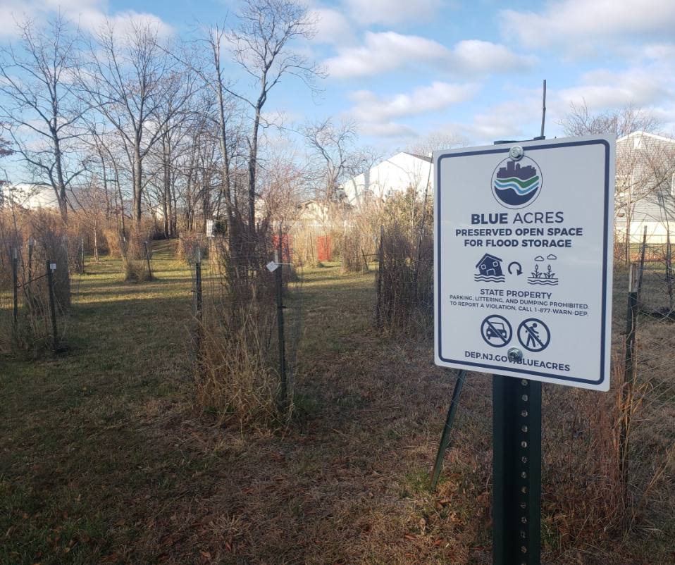
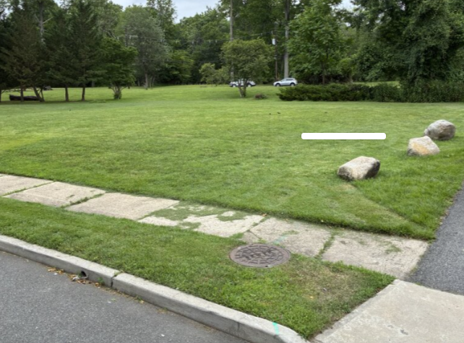
Flood Vulnerable Land Use Opportunities
Flood storage/buffers
Ecosystem restoration
Passive recreation
Uses that discourage abuses
Notes:
The deed restrictions provide guidelines that dictate what is and is not allowed on our land. The overall takeaway is that we must prioritize protecting and enhancing the natural functions of the floodplain. Any other use takes a back seat.
So, although recreation is allowed, creating recreation opportunities cannot detract from flood storage.
Things that are allowed include plants, unpaved walkways, passive recreation, restrooms, and unwalled shade structures.
Fences are both allowed and not allowed because only certain fences – those that minimize the trapping of debris and allow for the flow of floodwater – are allowed, anything that does not meet that criteria is not.
Other non-allowable things are any walled structure that's not a restroom, paved surfaces, the storage of items, and vehicle use. We don't want to compact the soil or add any impervious surfaces.
Want to avoid parking vehicles or vehicular traffic or using site as storage areas or staging areas for construction items- use of rocks to block access

Slide 9
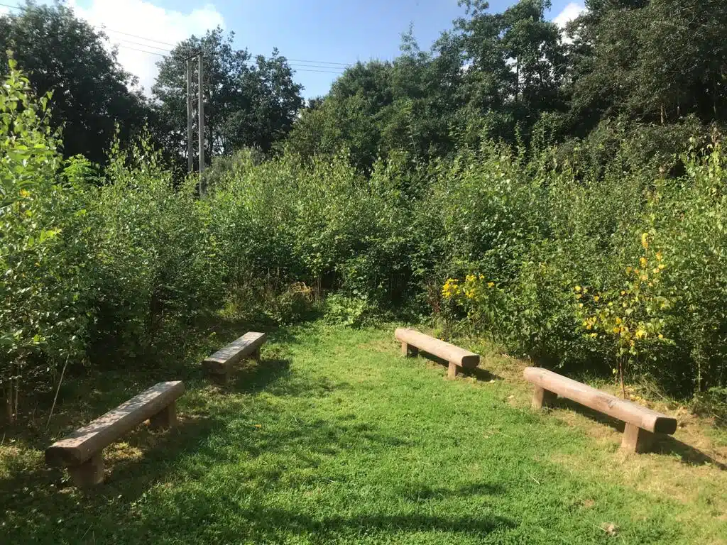
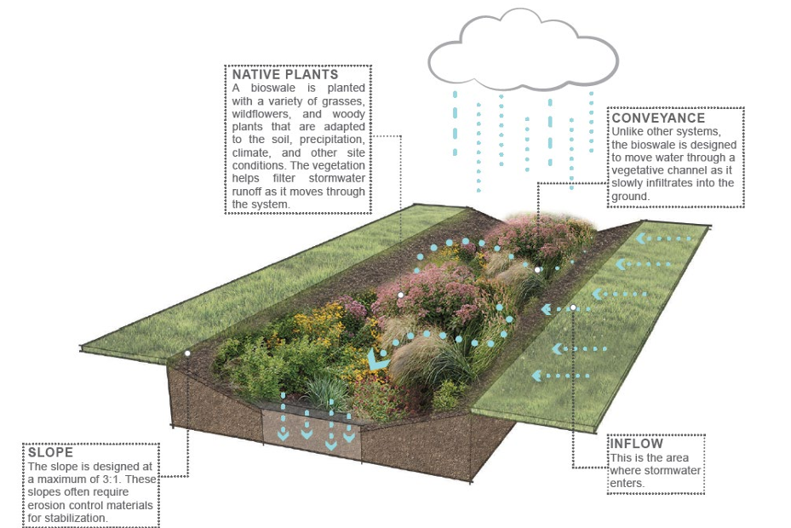
Consider: Flood Storage
Source: Rutgers Cooperative Extension
Photo by Witney Tree Keepers
Notes:
Healthy soil and vegetation is key

Slide 10
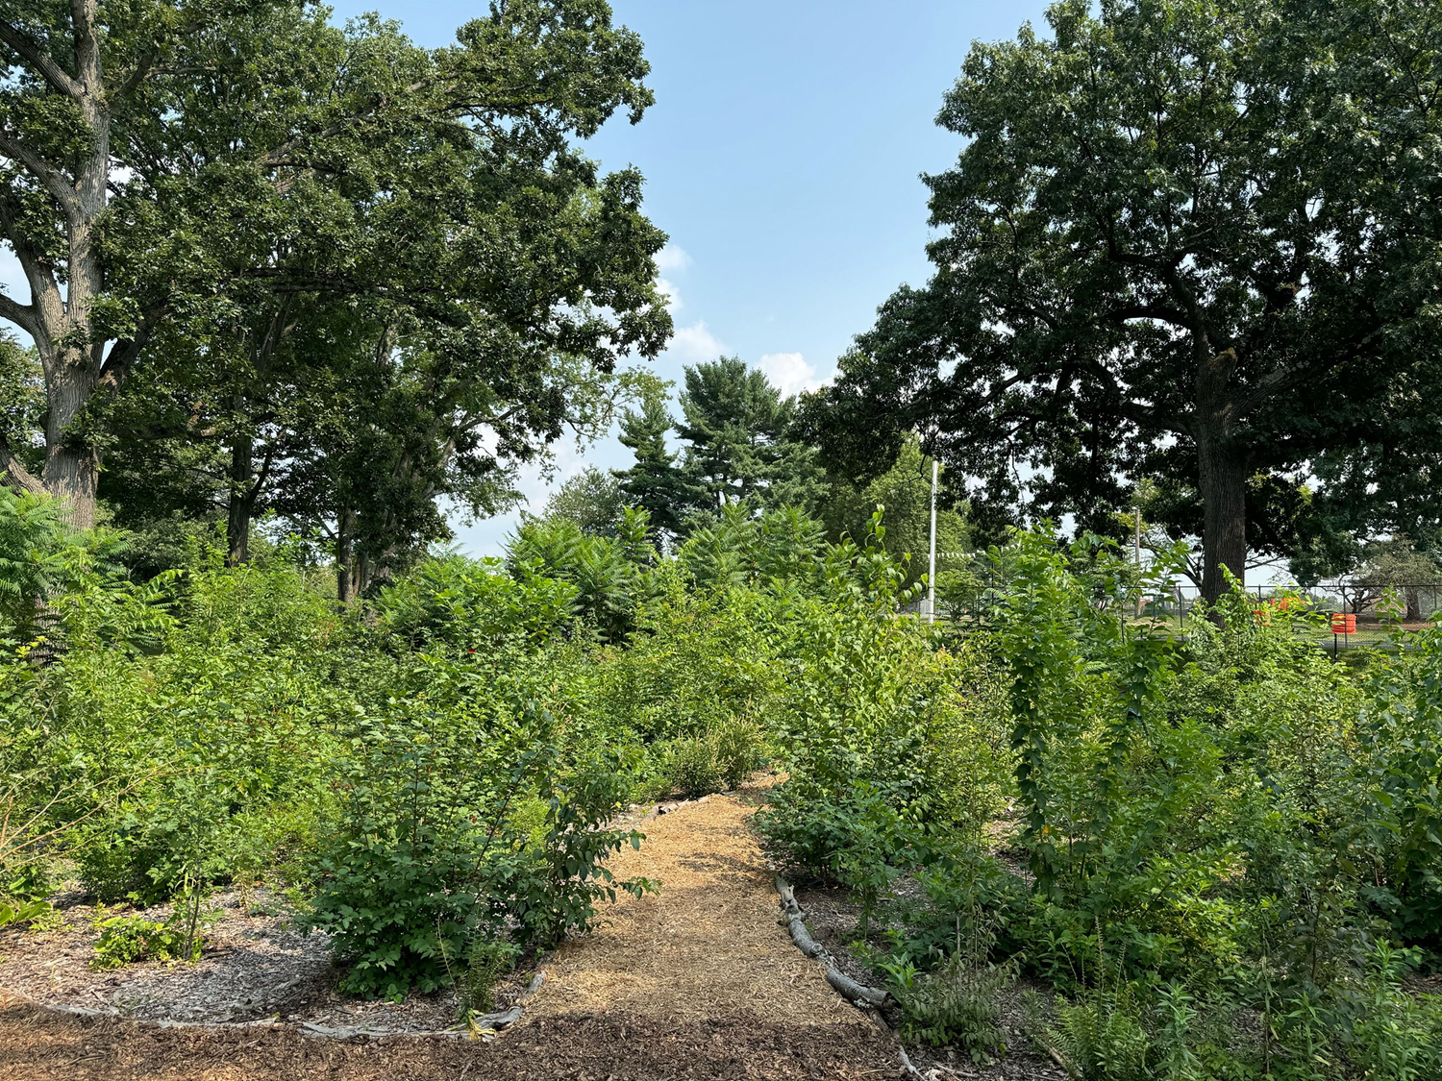
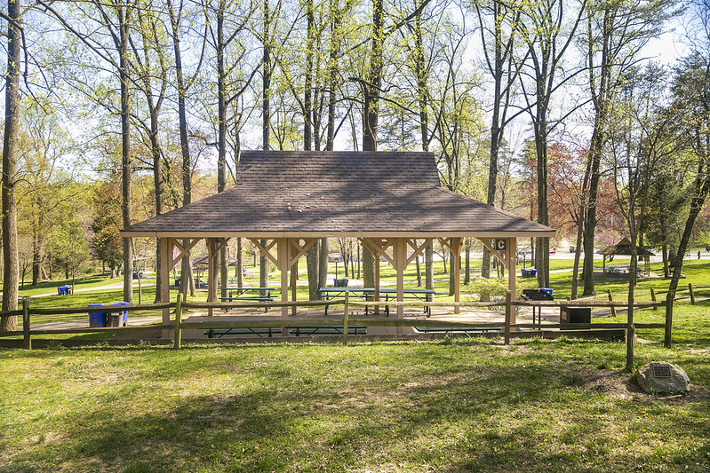
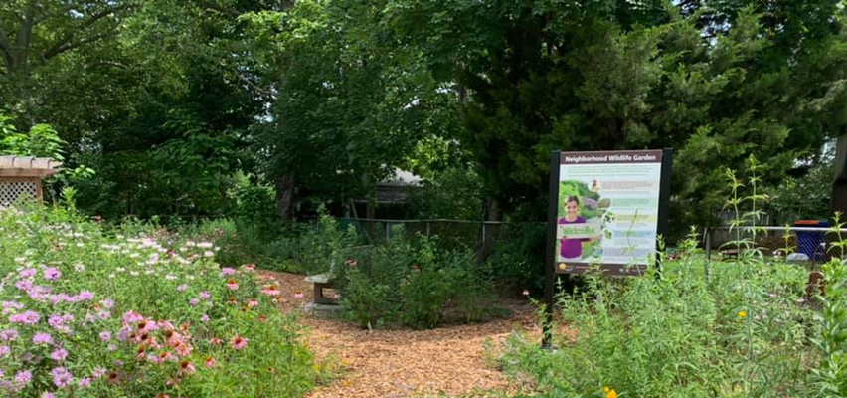
Consider: Passive Recreation
Source: Montgomery County, MD
Source: City of Summit, NJ
Photo by Pat Sutton
Notes:
Low intensive uses

Slide 11
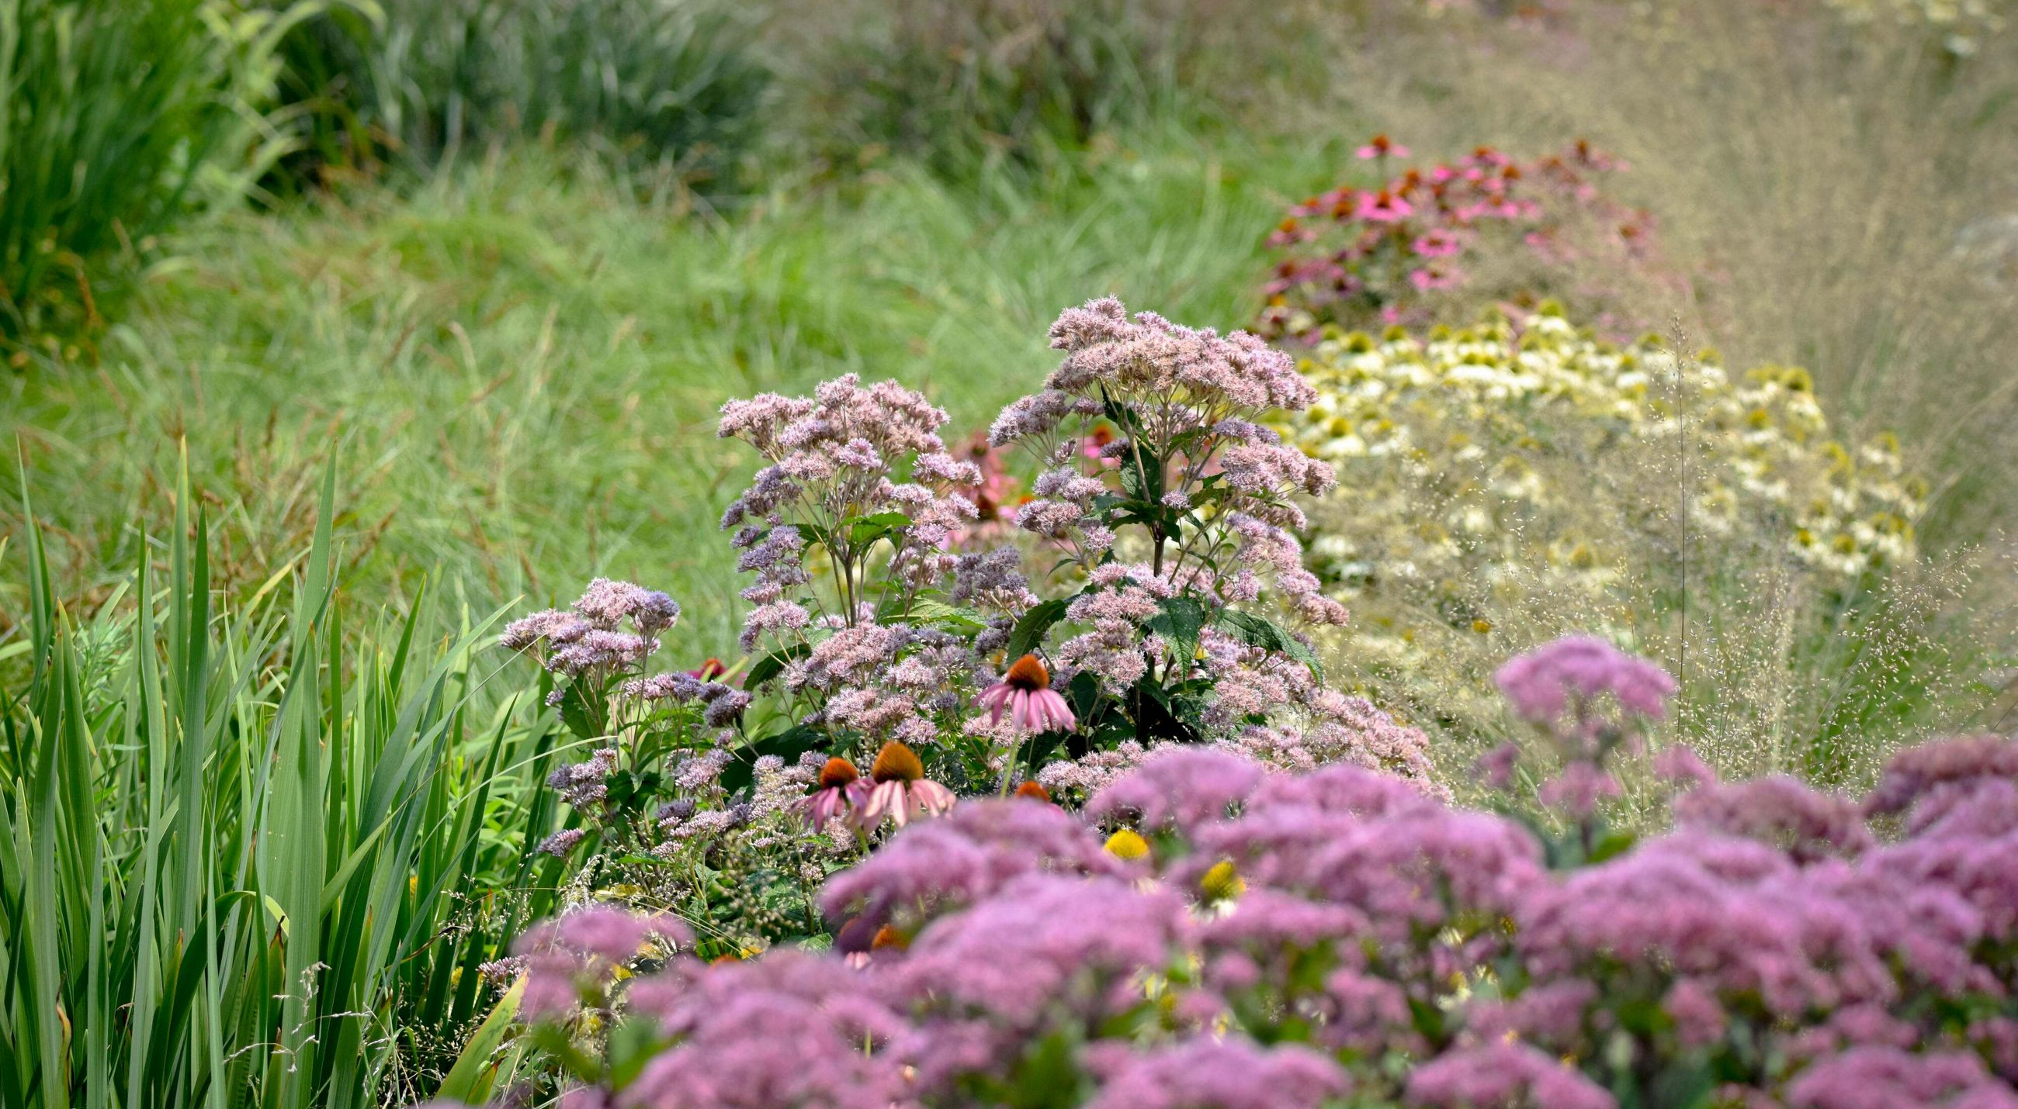
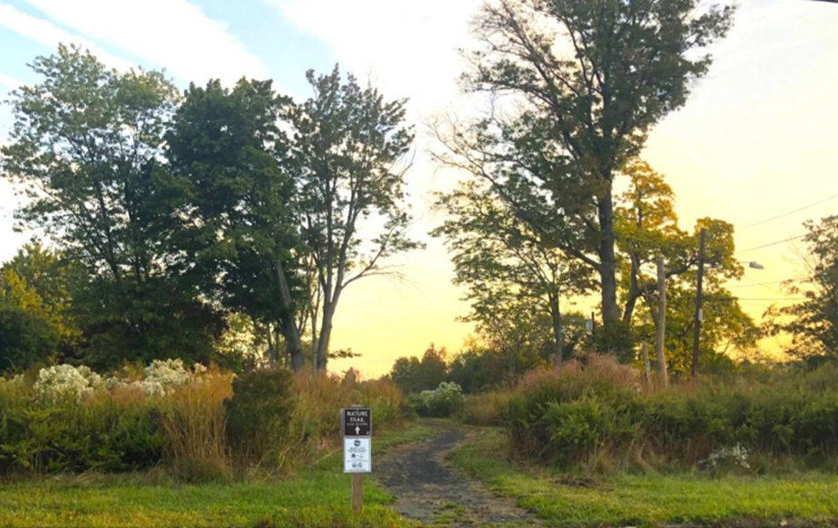
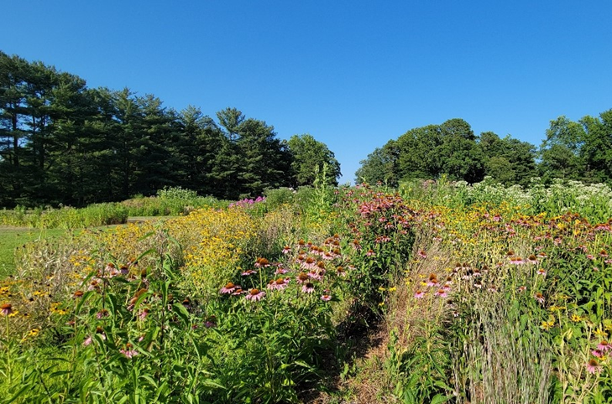
Consider: Wildlife & Biodiversity
Source: The Nature Conservancy
Photo by Pat Sutton
Blue Acres in Woodbridge Twp
Notes:
Native plants, shade cover

Slide 12
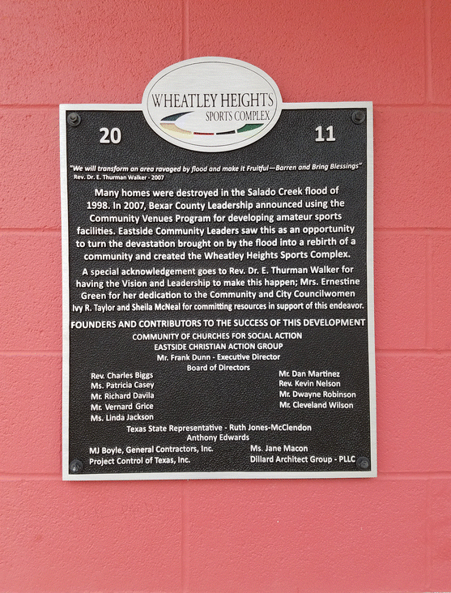
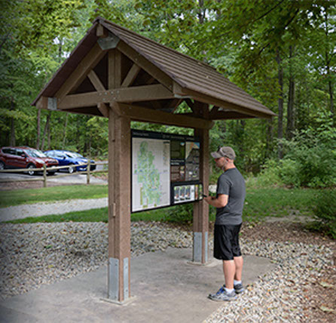
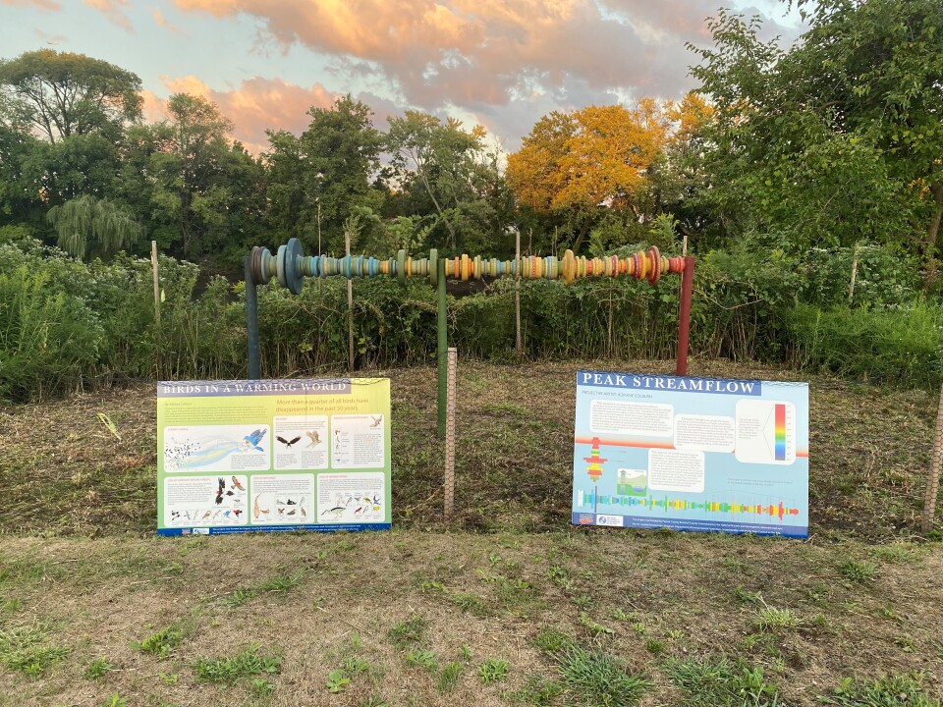
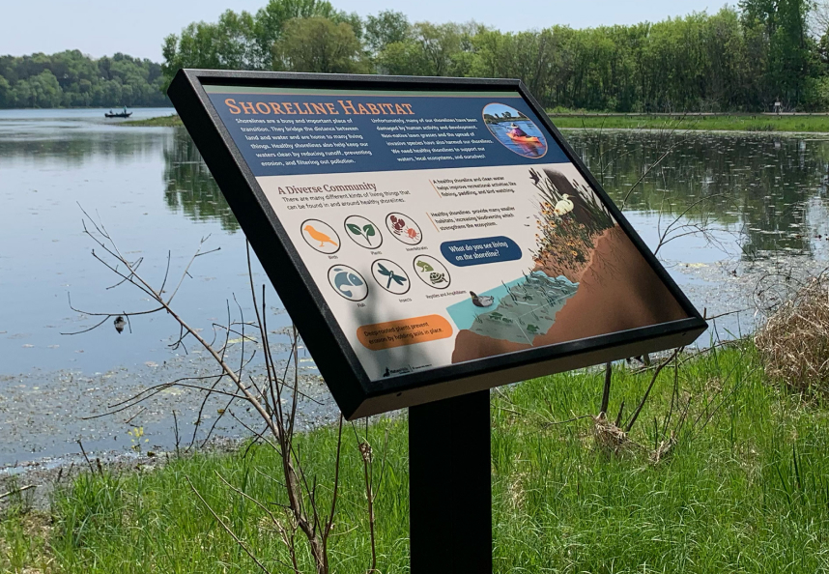
Consider: Education/Memorializing
Source: Terrabilt.com
Photo by Elyse Zavar
Source: VackerSign
NJDEP Community Arts Grant Program

Slide 13
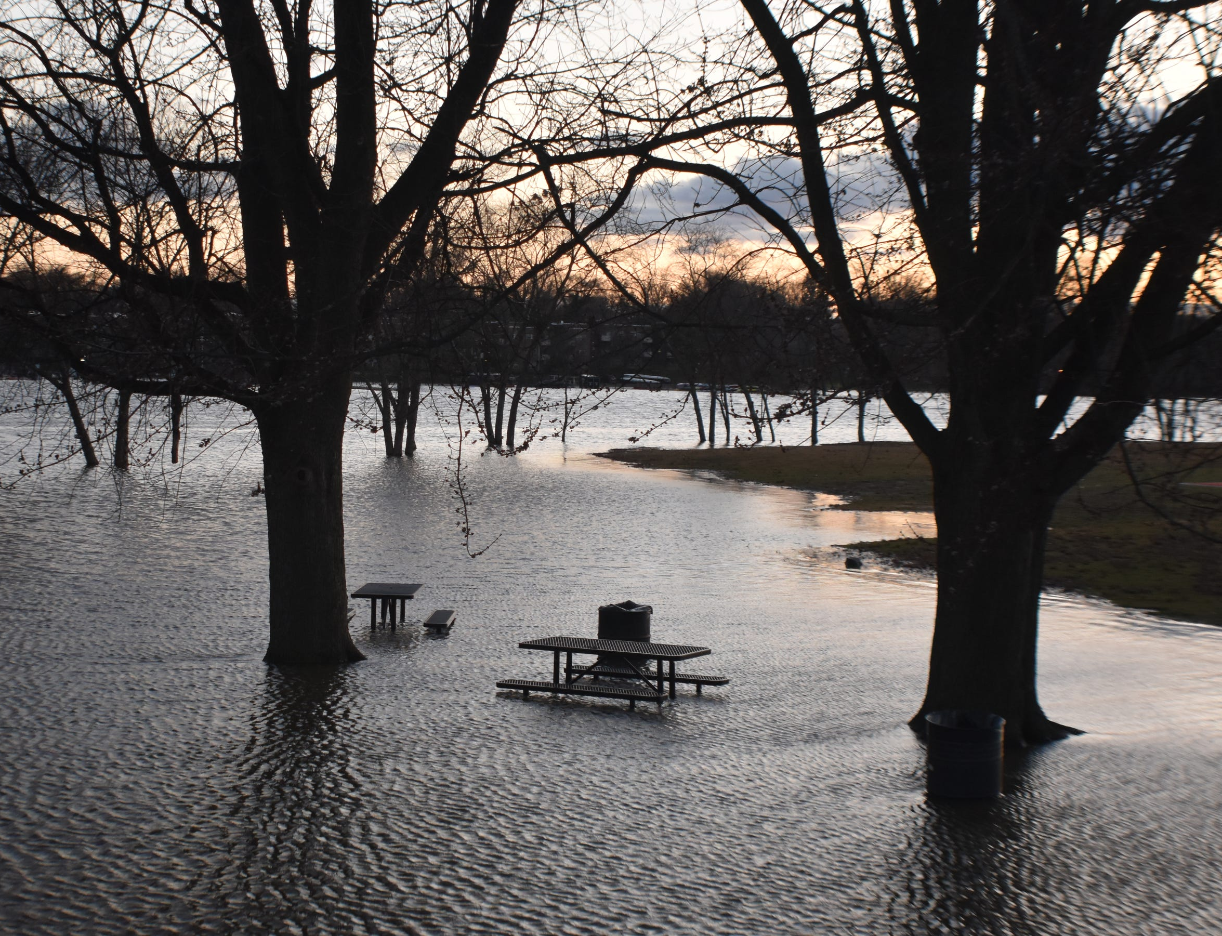
Clearly Communicate Expectations
Emphasize that local feedback informs a spectrum of possible outcomes that will influence the final restoration design.
The final restoration design must be agreed upon by project partners, and it may be adjusted based upon available funding.
Underscore that there is uncertainty involved in this process due to the nature of a voluntary buyout program.
Notes:
Buyouts not happen to but with communities and the individual families that are choosing to sell.

Slide 14





BlueAcres@dep.nj.gov
dep.nj.gov/blueacres
Office of Climate Resilience
NJ Department of Environmental Protection
609-940-4140
Like & follow us!
@newjerseydep
@nj.dep

