Slide 1


Buy Now, Save Later: Why Prompt Flood Buyouts Are Efficient Resilience Solutions
Sage Mitchell, Jennifer Tippins, Ashlynn Shanahan, Alvin Chin
NJDEP Blue Acres Program

Slide 2
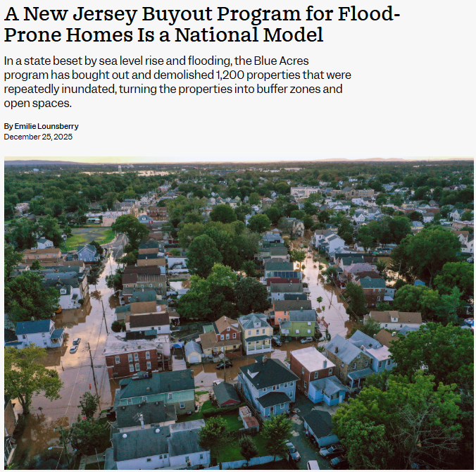
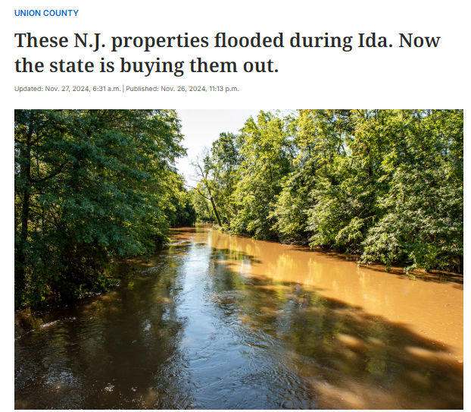

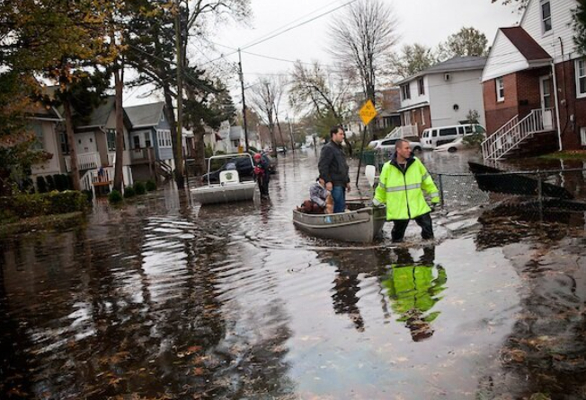
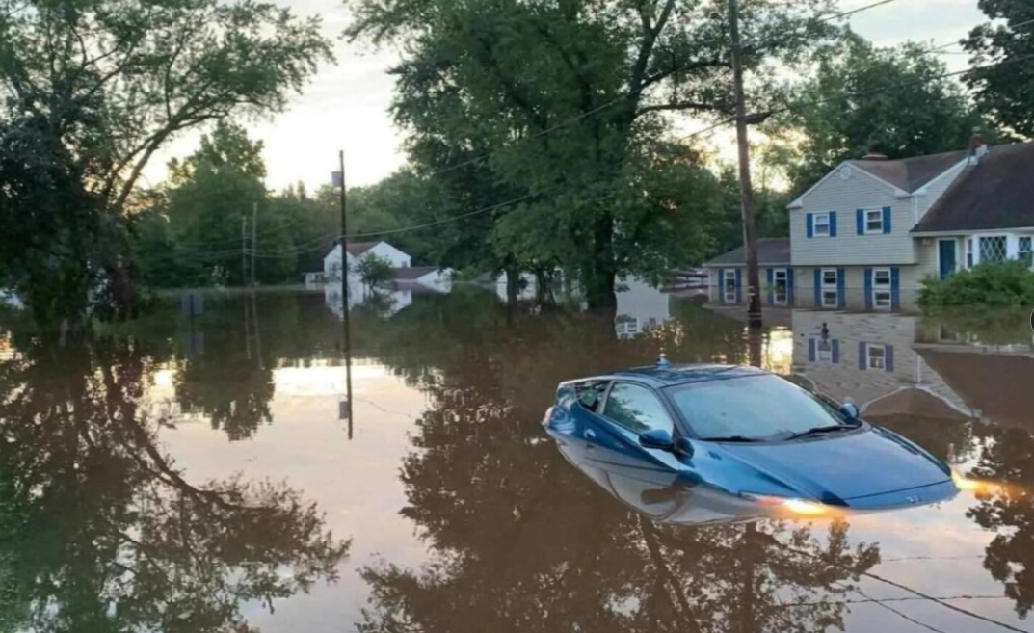
What is Blue Acres??
Voluntary State-led buyout program for flood-prone NJ properties
Complete buyouts using both State and Federal funds
Garden State Preservation Trust (GSPT)
FEMA
HUD
USDA
Over 1,200 acquisitions since its inception in 1995
Increased frequency of severe flooding events creates more demand for buyouts
Notes:
We are a Bureau within the NJDEP, operating within the NJ OFFICE of Climate Resilience
Homeowners in NJ can apply to receive a buyout offer at fair market value from the State. If they decide to accept the offer, the State purchases and demolishes the structure and the property is reverted into open green space to act as flood storage for the surrounding area. EXPAND SLIGHTLY
Regarded as a national model
THANK GSPT FOR LAST 2 YEARS IN FUNDING INCREASE
All funding partners and their grants come with various requirements, timelines, reviews, and unfortunately, uncertainly about continued availability of awarded funds.
On top of the large difference in speed of fund availability between federal and state, it’s no secret that the federal funding landscape has changed dramatically, which has made State funding a critical lifeline to help us deal with emergency buyouts and subsidize others already in progress
Our main issue remains that we continue to see increasing demand/interest in buyouts from the public at a rate outpacing the available funds. At the moment, we still have several hundred applications that have yet to receive an offer

Slide 3
The Initial Question
What is the estimated total cost (purchase and non-purchase costs) for all current active, unfunded Blue Acres applications, if they were all purchased at Current Market Value?
Notes:
while we continue to make as many buyout offers from our available funding sources as we can, there are still many applications 'left on the books’. This prompted the initial question from the previous NJDEP commissioners office, which was “what might that cost look like?”
not every submitted application is viable for a buyout. Viable means the application and property meet certain criteria to be considered for buyout funding; for purposes of this report, the “viable” property label excludes vacant lands, apartment buildings, commercial properties, properties that have never flooded or are unlikely to flood (based on FEMA flood map data), and applications with missing data that cannot be reconciled

Slide 4
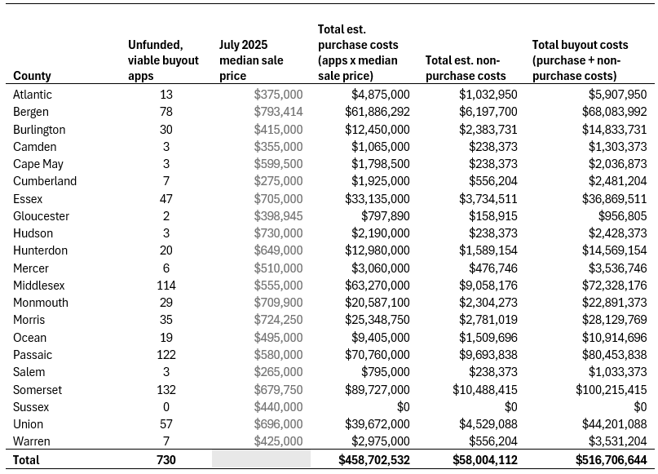
Notes:
The applications were then sorted and counted by county. We then multiplied each county's July 2025 median sale price (the most recent available data per Realtor.com & Redfin market databases) by the number of buyout applications in each county to calculate the total anticipated property purchase cost for each county by end of FY2026.
We also factored in “non purchase” costs (appraisals, surveys, etc) using cost estimates from our quarterly reports
As of July2025, there are a total of 730 active, unfunded viable buyout applications
This is out of 1,196 total Blue Acres buyout applications submitted since 2012, which is 61%
The total property purchase costs for all 730 active, unfunded Blue Acres buyout applications statewide is estimated to be approximately $458.7 million.
The total estimated buyout cost for 730 currently active, unfunded, and viable Blue Acres buyout applications is approximately $516.7 million.

Slide 5
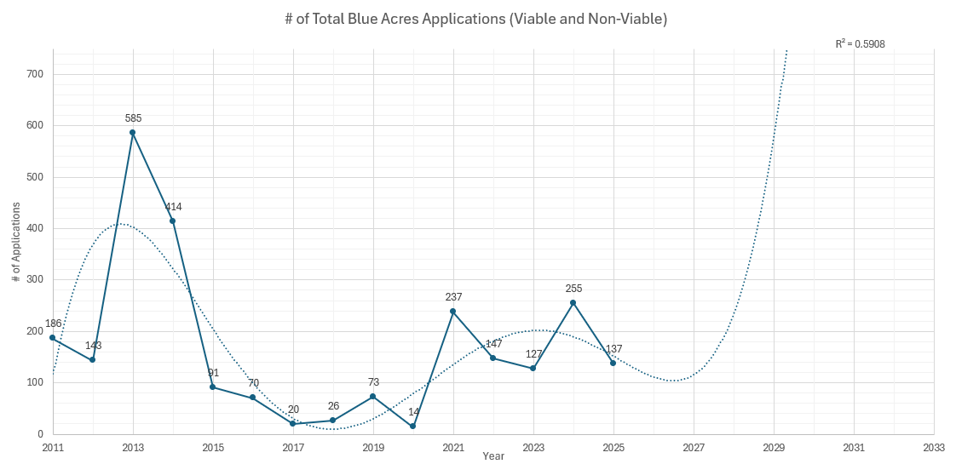
Projection of Anticipated Yearly Blue Acres Buyout Applications Through FY33
Hurricane Ida, Sep 2021
Hurricane Sandy,
Oct 2012
Over the next 7 fiscal years, Blue Acres may expect to receive nearly 1,400 new applications
Of these, Blue Acres anticipates that approximately 61% (1,094) will be viable for implementation
Notes:
Here we see a progression in total BA apps per year. To understand the full interest in the program, these are totals and include funded and “nonviable” apps
Presented on a time scale, we see that applications fluctuate along with severe/major flood events in New Jersey – more residents are interested in a potential buyout during years with harsher storm seasons.
Effects of climate change are expected to increase the frequency and severity of storm events year-to-year, forcing the overall decadal trend in buyout applications to also increase along with storm frequency and severity.
Therefore, while we might expect short-term fluctuations in applications from year to year, projections through 2032 show growing interest in voluntary buyouts over time
According to a 2025 Rutgers University research brief on current and future flood exposure to residential properties in New Jersey, there are 422,646 properties that fall within in the FEMA 1% annual flood zone, 0.2% flood hazard area, or that will be impacted by the NJ Inland Design Flood Elevation +3ft, making these properties vulnerable to climate-driven flood threats and which could become future buyout participants

Slide 6
Assessing the Financial Difference Between Immediate and Delayed Buyout Implementation
What is the difference in financial costs if the state buyout program bought all viable properties as applications came in?
Would a fully funded state program have saved money long-term versus going back to purchase older applications now?
Notes:
So now we know the heavy price tag to cover all the existing buyout apps, and we have a reasonable guess as to how many applications we should brace for in the near future. These two ideas come together to form a very steep cliff to overcome.
This prompted our team to consider the hypothetical alternative: what if we had the power to keep up with all the demand as it came in?

Slide 7
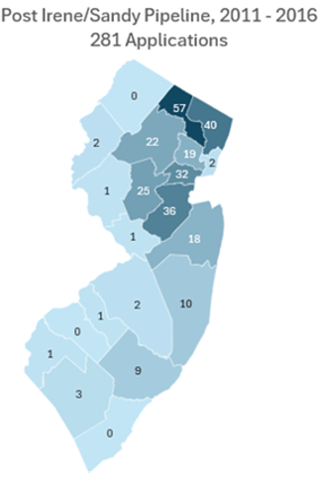
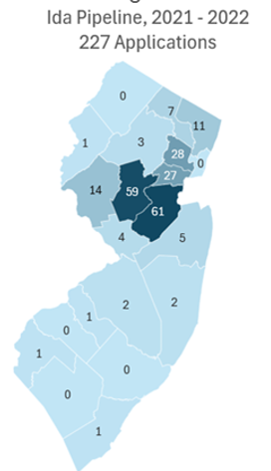
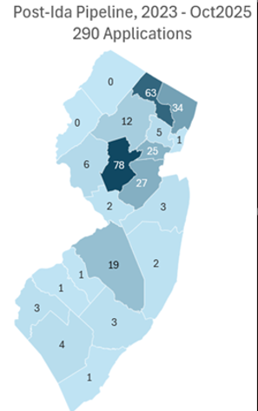
Geographic distribution of Blue Acres applications by each Storm Event Pipeline, 2011 – Oct 2025
Notes:
We first needed to determine how many viable buyout applications to consider. To do this, we first sorted viable Blue Acres applications by assigning each storm event to a “pipeline” bin of years for applications:
The “Post-Irene/Sandy pipeline ” includes applications from 2011 to 2016
The “Ida pipeline” includes applications from 2021 to 2022
The “Post-Ida pipeline” includes applications from 2023 to October 2025 (date of reporting)
This gives us a new total of 798 viable applications as of October 2025
Applications from 2017 to 2019 are not considered in this analysis, as the comparatively low number of applications were too far removed from associated storm dates to be feasibly attributed to Hurricane Irene or Hurricane Sandy
Geographically, Blue Acres application data follows a consistent year-over-year pattern of higher application density within the central and northeastern counties and fewer applications in southern and coastal counties
Somerset (162), Passaic (127), Middlesex (124) Bergen (85), and Union (84) counties had the most viable, unfunded applications
These counties are in central and northeastern New Jersey and consistently have some of the highest median home sale prices in the state (Bergen County has the highest at $846,344 in 2025)

Slide 8
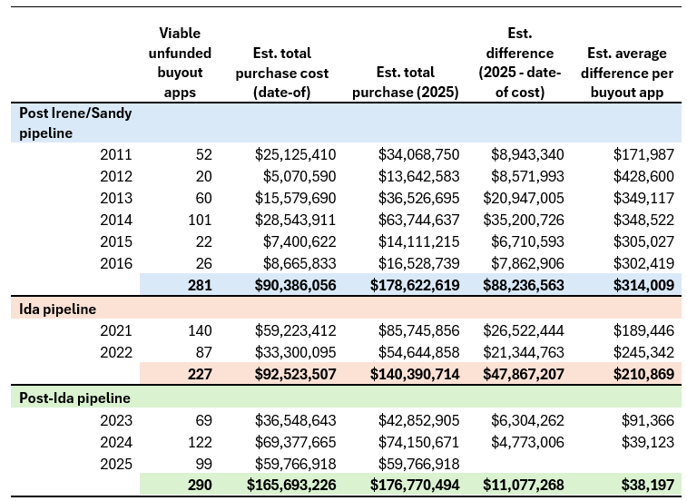
Comparison of purchase costs for viable, unfunded buyout applications using “date of” and current housing market data
Purchase costs for all 798 viable, unfunded buyout applications using “date-of” housing market data for each year total approximately $348.6 million
On average, purchase costs for unfunded applications over the multi-storm event buyout timeframe are ~14.7 million higher per year using current housing market data

Slide 9
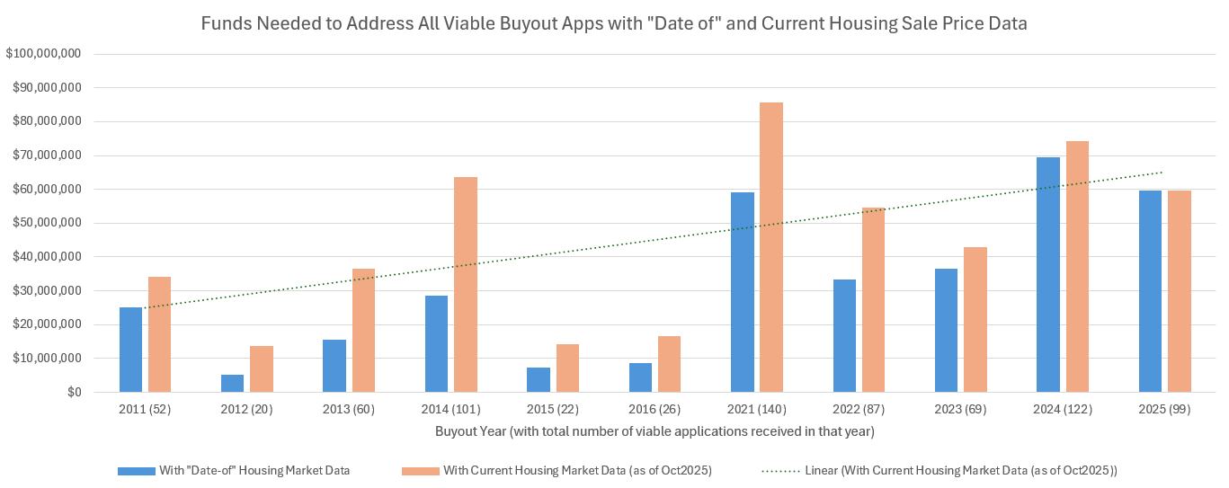
Funds Needed to Address All Viable Buyout Apps with “Date Of” and Current Housing Sale Price Data
Purchase costs for all 798 viable, unfunded buyout applications using “date-of” housing market data for each year total approximately $348.6 million
With current housing market data as of October 2025, the cost rises to approximately $495.8 million
On average, it would cost $14.7million more to address these apps currently than it would have at the time of each application
Notes:
Factoring in both date-of and current market prices for each county, we can see the large differences in cost from those original date of prices vs purchase prices now.
Funds needed to address viable buyout applications show a linear increase over time, consistent with a rising housing market.
Unfunded applications in the Post-Irene/Sandy pipeline would cost an additional $88.2 million to purchase today, and unfunded applications in the Ida pipeline would cost $47.8 million more than if purchased in the year the application was submitted.
Even Post-Ida unfunded applications now have higher costs- those that remain unfunded from just two years ago would cost an additional $11 million to purchase today.
While $14.7 million is the average per year (over the ten years listed above), the longer an application remains unfunded, the higher the cost difference it is to purchase with current funding.
Trend expressed in the 11 years reported in the identified storm event bins shows an overall steady increase in median house sale price
Time elapsed while viable unfunded applications remain un-implemented creates the risk of additional financial strain as the state housing market experiences continued inflation and uncertainty

Slide 10
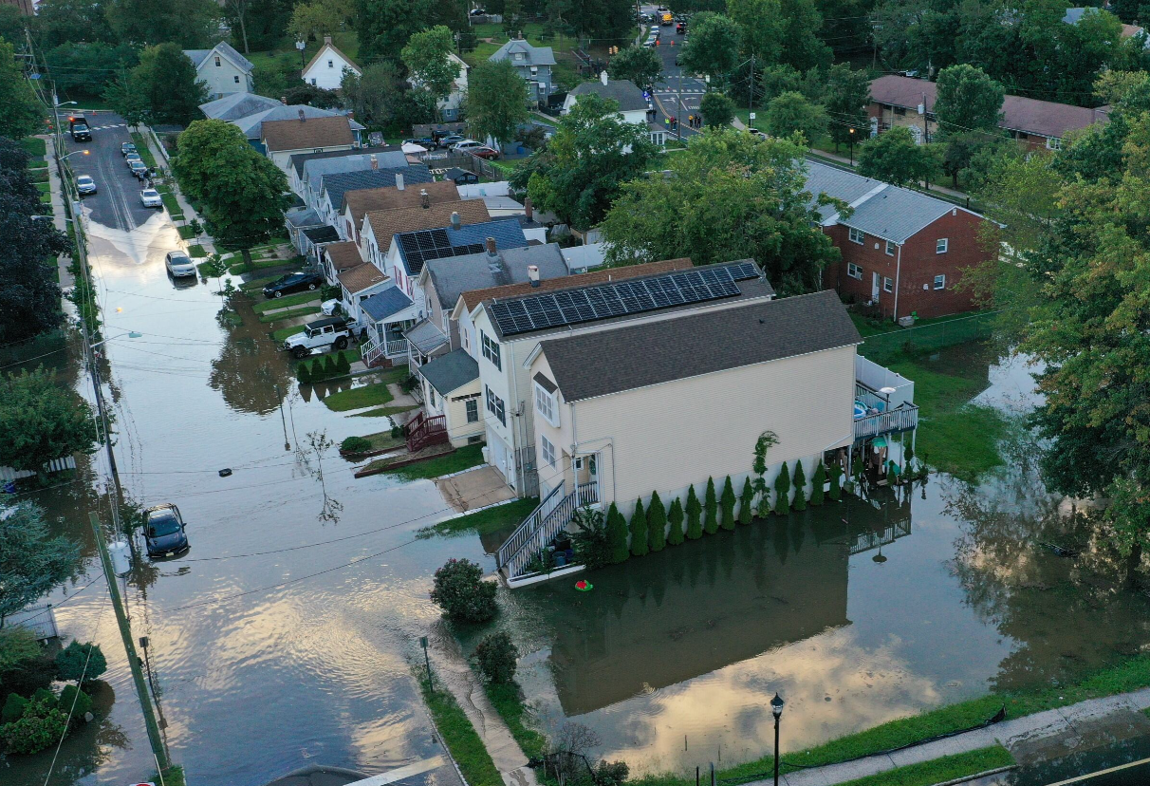
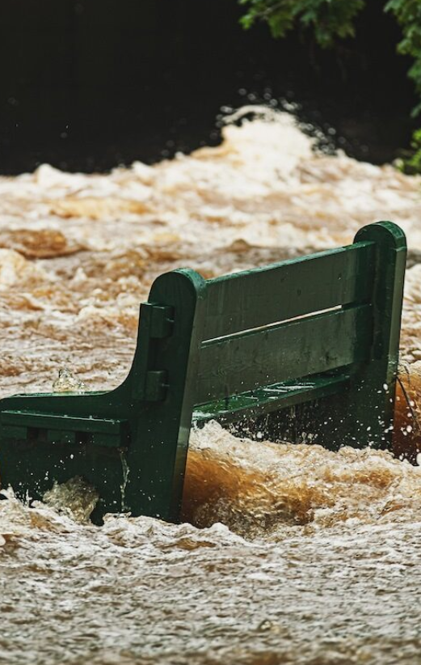
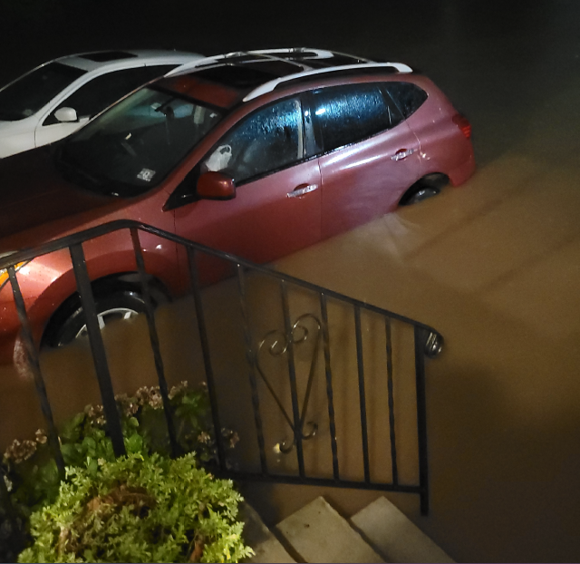
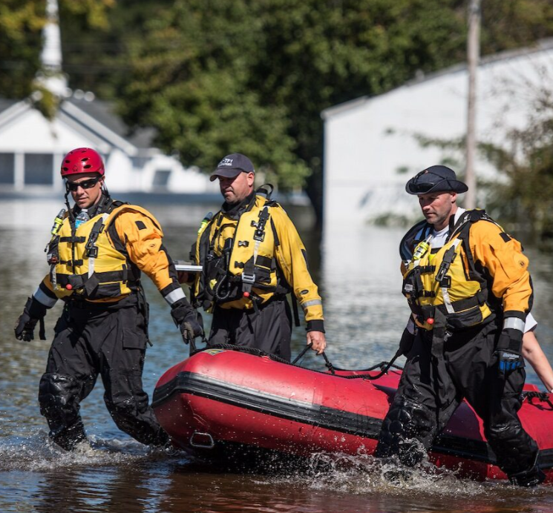
Critical Takeaways
Resilience strategies only get more expensive the longer we delay
Not only in $$, but in humanitarian loss
Robust State climate resilience funding allows for much faster implementation of buyouts and less red tape
Allows for more consideration of buyout applications for damage not tied to a Federal disaster declaration
Stable funding to compete with volatile housing market
Broader outreach to more at-risk areas in NJ
More Case Managers to work with homeowners
Notes:
We’ve seen the millions of dollars at stake here, but this problem isn’t just a matter of dollars and cents, this is also a human crisis. This is neighbors being rescued by boats out of 2nd story windows. This is folks watching homes burn to the ground because the flooding was too severe for fire trucks to get through. This is trauma and PTSD and grief for decades while we wait for others to argue over whether a storm is worth declaring as a Federal emergency to release funds.
REITERATE HUMANISM FROM INTRO
While Blue Acres cannot fully predict or influence private housing market trends, the program’s ability to implement, appraise, and purchase homes as close to application dates as possible would ensure that buyout funds are used judiciously while also offering homeowners a fair, current market value offer that they are more inclined to accept

Slide 11
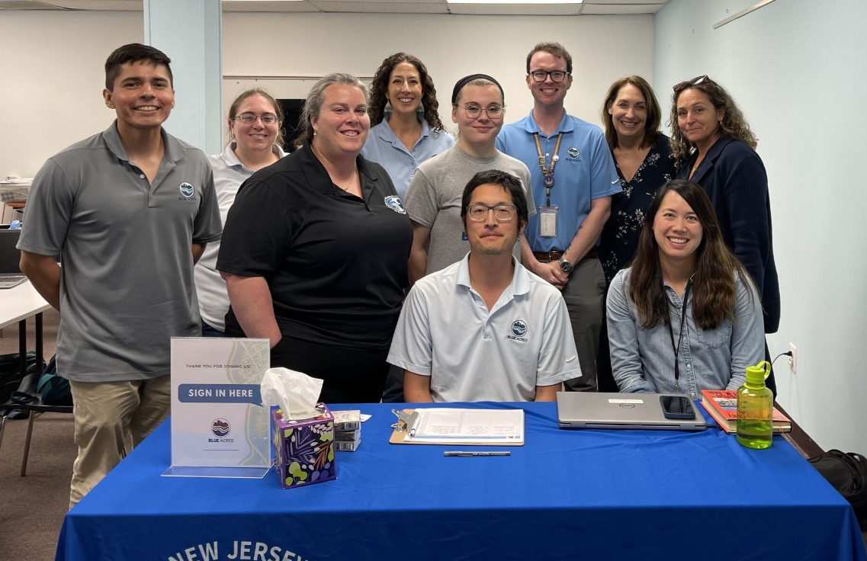
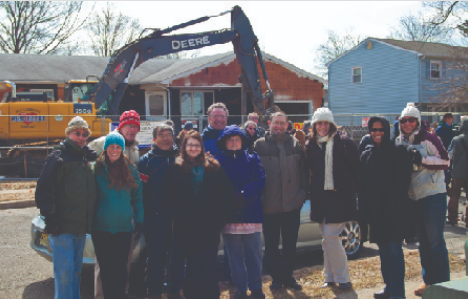
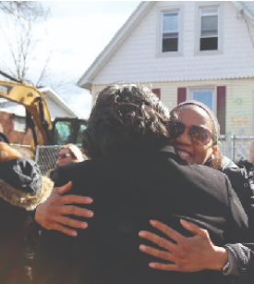
Who can help, and how?
Local/municipal officials
State officials and legislators
Groups interested in creating buyout programs
Community leaders and neighbors
Notes:
If you work for a municipal government, you can ask if your town has any applications or interest in BA. If your town already has applicants or acquired open space, you can talk to us about viable green space projects for that space so it’s more than an empty lot
If you’re here as a State legislator or representing a State official’s office… I hope the previous slides show where you can help! Again, this whole idea can work faster, smoother, and with greater effectiveness with robust State funding
If you’re here from out of state, let’s talk about what programs your State has or if it’s possible to get one started.
If you’re here as part of a NPO or other environmental group, ask us how you can get involved! There are opportunities to coordinate with towns to create more active green space projects.
Most importantly, all of us can work with this information as good neighbors and as community leaders. Get involved: make sure your town’s pantries are stocked and any disaster shelters are prepared. Check on your neighbors and make sure they’re safe and have a plan.

Slide 12


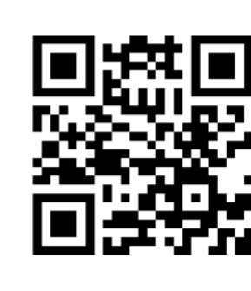


For More Information:
dep.nj.gov/blueacres
609-940-4140

