Slide 1

A Matrix-Based Approach for Assessing Watershed Resilience
Luke Hogewood – Credere Associates in collaboration with USACE ERDC
Michael Deegan – USACE IWR
Garrett Watson – USACE ERDC, Risk and Decision Science Team
Holden Keebaugh – Credere Associates in collaboration with USACE ERDC
Igor Linkov – USACE ERDC, Risk and Decision Science Team

Slide 2
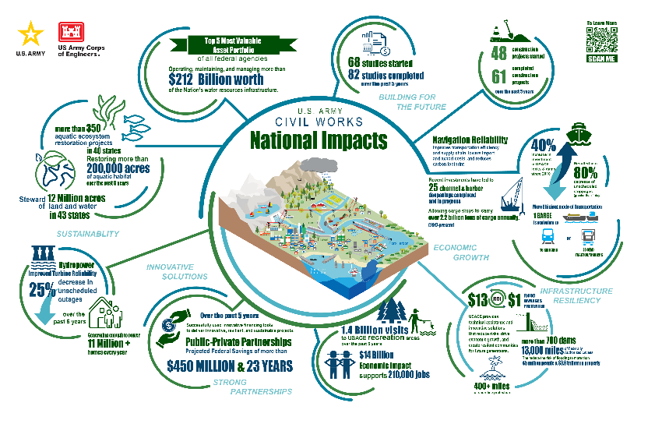
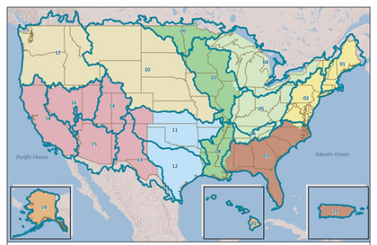
UsACe Within a watershed
Across CONUS:
700+ multi-purpose dams
7 Divisions
36 Districts
Critical Infrastructure Resilience and Protection (CIPR) Program
Dam Safety Regional Risk and Resilience Project (DSR3P)
Notes:
Images:
USACE Districts and watersheds: https://www.usace.army.mil/Missions/Infrastructure-and-Installation-Resilience/Recent_CC_HydrologyLit_Applicable_USACE_Missions/
USACE Benefits:

Slide 3
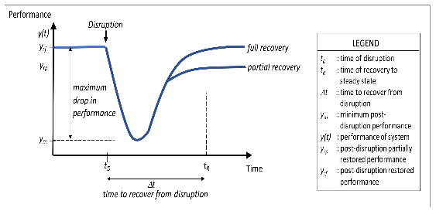
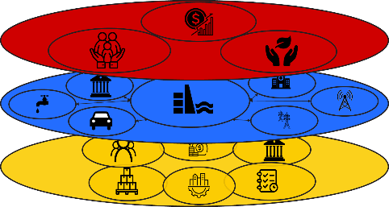
Watershed Resilience Is Critical for USACE to Successfully Deliver Its Missions
Watershed
Resilience
Many diverse stakeholders with overlapping jurisdictions
Counties, cities, states, federal agencies, infrastructure providers, private businesses, individuals
Resilience across scales and stakeholders is a process, property, and outcome
These systems are composed of physical, information/cyber, and social elements
Preventing risk is insufficient
Organizations must be able to
Absorb
Recover from
and Adapt to evolving disruptions
Resilience Outcomes
Resilient
Critical Functions
Resilience Capabilities
Notes:
We want to:
Note that problems for USACE may arise that are outside our control (i.e. based on dependencies)
Note that solutions to those problems (i.e. resilience capabilities) may also require collaboration

Slide 4
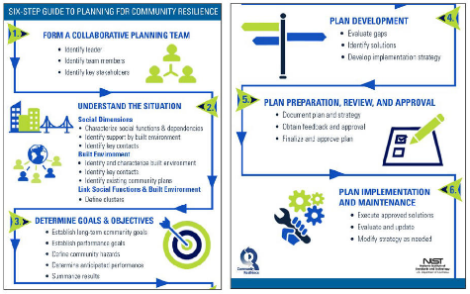

Several Frameworks exist for Building Community Resilience at Large Regional Scales
Building Resilience at a large scale (e.g. a watershed) across stakeholders is challenging
Several Federal Agency planning guides to operationalize a process for building resilience
NIST Community Resilience Planning Guide
CISA Infrastructure Resilience Planning Framework
DSR3P Process builds on these with additional goals:
Incorporate resilience assessment
Capture what is particularly relevant for dam sector resilience
1. Define Purpose & Scope
2. Define the System
3. Develop a Resilience Profile
4. ID Areas for Improvement
5. Develop & Implement COAs

Slide 5
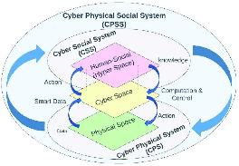
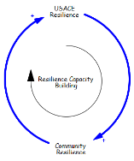
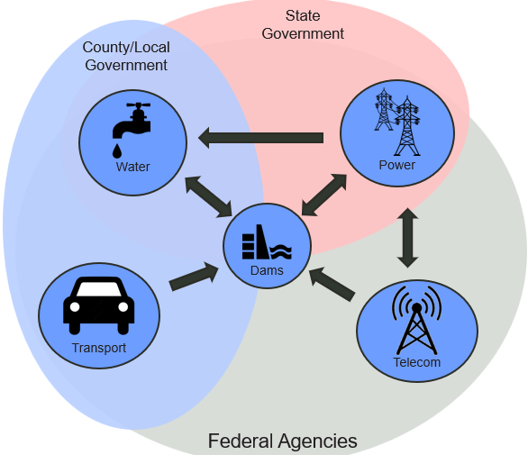
Dependencies Across Multiple Stakeholders in a region can enable and hamper resilience
Infrastructure systems and community decision-makers depend on each other and the wider communities they support
Cascading and Uncertain Threats
Extreme weather events
Deliberate attacks (e.g. cyber-attacks)
Cascading and compounding threats
Cascading Impacts across Stakeholders and jurisdictional lines
Coordination across authorities is challenging
Response and recovery may cross jurisdictional lines
Physical, Information (Cyber), Social dependencies
To effectively build watershed resilience across diverse stakeholders, we need a standardized but flexible approach to quantify resilience
Notes:
CPSS image: DOI:10.1109/ACCESS.2022.3167441

Slide 6
Finding the Overlap Between resilience Theory and Practice
NIST Review of Community Resilience Frameworks and Assessment Tools
56 frameworks
7000+ metrics
Academic papers on Resilience vs Risk
Govt policy recommendations
Theory
What can we measure? What can we improve?
What do we want to measure? What do we want to improve?
Practice
Level of detail
Level of effort
Mission requirements, govt authorizations, and jurisdictional limits
Costs/Resource constraints
Risk-based approaches

Slide 7

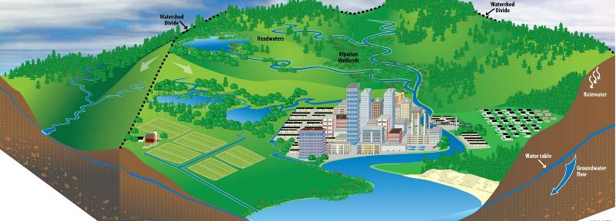



Resilience Assessment Integrating resilience Theory and Practice
5a. Implement Courses of Action
5b. Iterate and Re-assess
Recover
3. Develop a Resilience Profile
Absorb
Adapt
Physical
Information
Social
Theory
Practice
1. Define the User & Scope
4. Data Collection and Visualization
2. Define the System
Outcomes
Functions
Capabilities

Slide 8
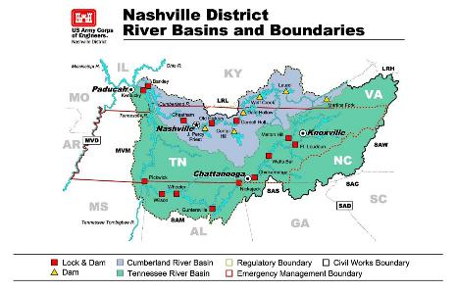
Cumberland River Watershed Pilot
Define User & Scope
Define the System
Develop a Resilience Profile
User: USACE District
Develop COAs
ID Areas of Improvement
Scope: Cumberland River Watershed
Assemble Elicitation Team (Dam PMs)
Critical Functions: Navigation Mission
Unit of Analysis: 4 Lock projects
Select Resilience Capabilities – NIST Database of CRA Metrics
Select Metrics from Metrics Library
Data Collection:
District Survey
Available Data
Data Visualization
Data Validation
Dam Resilience COA Library
USACE AARs
Academic Literature on Dam Resilience
Map 3 layers of resilience
Lock #1
Navigation Mission
Lock #3
3.40 | 3.50 | 2.67
3.17 | 4.25 | 3.27
4.04 | 3.10 | 3.70
3.65 | 2.79 | 2.50
3.21 | 3.53 | 3.02
3.70 | 3.18 | 3.05
3.60 | 3.00 | 2.33
3.33 | 3.33 | 3.15
4.29 | 3.68 | 3.05
4.60 | 2.50 | 2.00
3.17 | 3.50 | 3.00
4.15 | 3.68 | 2.95
3.00 | 1.50 | 3.00
3.17 | 3.00 | 2,67
2.31 | 1.97 | 2.50
32 elicitation metrics (Likert scale)
4 from National Inventory of Dams (NID)
3 from National Risk Index (NRI)
Lock #2
Lock #4

Slide 9
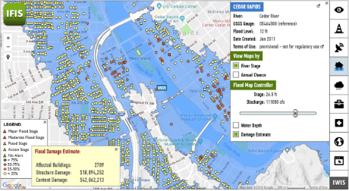
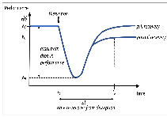

Refining USACe Resilience Assessment Process
Define User & Scope
Define the System
Develop a Resilience Profile
User: USACE District
Develop COAs
ID Areas of Improvement
Scope: Cumberland River Watershed
Assemble Elicitation Team (Dam PMs)
Critical Functions: NAV, FRM, HYD, WTR
Unit of Analysis: Any USACE projects
Select Resilience Capabilities (or Performance / Outcomes)
Select Metrics from Metrics Library
Data Collection:
District Survey
Available Data
Data Visualization
Data Validation
Dam Resilience COA Library
USACE AARs
Academic Literature on Dam Resilience
Map 3 layers + Hazard Scenarios
Prioritization of Dam Sector COAs
Models (e.g. HAZUS)
Lock #1
Watershed Missions
Lock #3
FRM
NAV
HYD
Lock #2
Potential Resilience COA
Resilience Trade-offs across Missions
Dam #1
Scenario-based Performance / Outcomes
Formalized prioritization of COAs

Slide 10
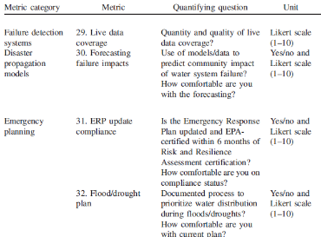
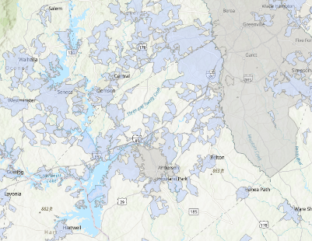
Case Study Adapting This Approach for a Water Distribution Network
Define User & Scope
Define the System
Develop a Resilience Profile
User: Regional Water Network
Develop COAs
ID Areas of Improvement
Scope: System Service Areas
Critical Functions: Water Supply
Unit of Analysis: 3 Water Distribution Systems
Select Resilience Capabilities + Performance Metrics
Select Metrics from Metrics Library
Data Collection:
Manager Survey
Available Data
Data Visualization
Data Validation
Stakeholder meeting with Joint System to discuss results and potential resilience actions
Map 3 layers of resilience
Assemble Elicitation Team (System Managers)
52 water-focused metrics using same metric categories
Examples:
Water System #1
Community Water System Service Areas
Regional Water System
Tested with partners at Clemson Engineers for Developing Communities (CEDC)
Note: Adapted from 4x4 → 3x3 Matrix since this study
6.9 | 4.6 | 7.0 | 10.0
9.1 | 6.0 | 3.0 | 9.5
5.5 | 5.5 | 1.5 | 5.8
9.5 | 10.0 | 1.0 | 1.5
6.2 | 6.1 | 7.6 | 8.3
8.4 | 8.0 | 6.0 | 7.7
6.8 | 6.3 | 3.0 | 7.4
7.8 | 9.7 | 3.0 | 3.0
Cognitive
Prepare
4.8 | 4.5 | 6.3 | 5.0
8.7 | 8.5 | 6.0 | 7.0
7.0 | 4.5 | 3.0 | 8.0
6.0 | 10.0 | 7.0 | 3.0
7.1 | 9.0 | 9.3 | 10.0
7.4 | 9.5 | 9.0 | 6.5
8.0 | 9.0 | 4.5 | 8.5
8.0 | 9.0 | 1.0 | 4.5
Water System #2
Water System #3
Hogewood, Luke, et al. "Matrix-Based Resilience Assessment of Community Water Supplies." Natural Hazards Review 26.3 (2025): 04025033.
USACE Dam

Slide 11
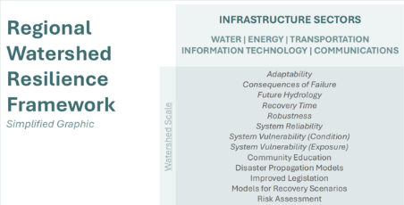
Regional Watershed Resilience Framework
Define User & Scope
Define the System
Develop a Resilience Profile
User: Any of 18 Watershed User Groups
Develop COAs
ID Areas of Improvement
Scope: Watershed
Assemble Elicitation Team (Multiple Stakeholders) – note this approach is outside USACE CIPR scope
Critical Functions: USACE missions + other critical functions
Unit of Analysis: Multiple users / functions
Select Resilience Capabilities
Select Metrics from Metrics Library
Data Collection:
Stakeholder Survey
Available Data
Data Visualization
Data Validation
Develop Collaborative Resilience COAs that can improve resilience across multiple functions / stakeholders
Map of 3 resilience layers, starting with top-down objectives
Extensive library of Target Resilience Capabilities
Developed with partners at UGA’s Institute for Resilience Infrastructure Systems (IRIS)
Target Resilience Capabilities from review of State Hazard Mitigation Plans (HMPs)
Power Provider
Water Provider
State EM Office
HYD
FRM
NAV
HYD
FRM
NAV
USACE Project 1
USACE Project 2

Slide 12
Thank You!
Thank you all for your time and attention
For more information, please feel free to contact us:
Luke Hogewood (Luke.m.Hogewood@usace.army.mil)
Michael Deegan (Michael.A.Deegan@usace.army.mil)
Holden Keebaugh (Holden.T.Keebaugh@usace.army.mil)
Garrett Watson (Garrett.W.Watson@usace.army.mil)
Igor Linkov (Igor.Linkov@usace.army.mil)

