Slide 1

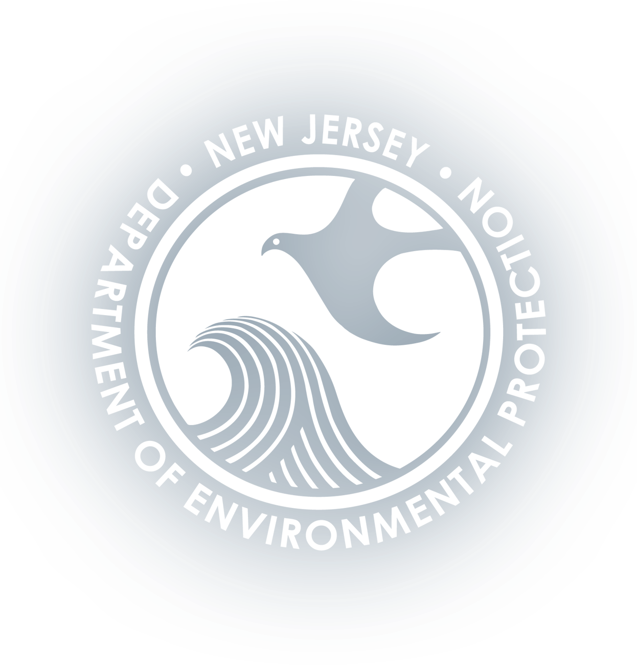

Building Wildfire Resilience in the Township of Ocean
Nickie Mitch, AICP
Arcadis
NJ Climate and Coastal Resilience Conference | March 9, 2026
Notes:
Megan

Slide 2
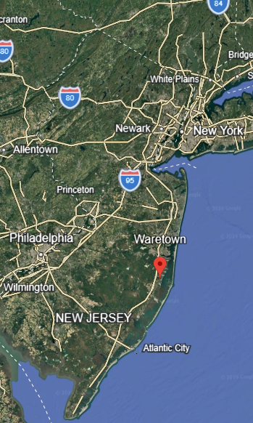
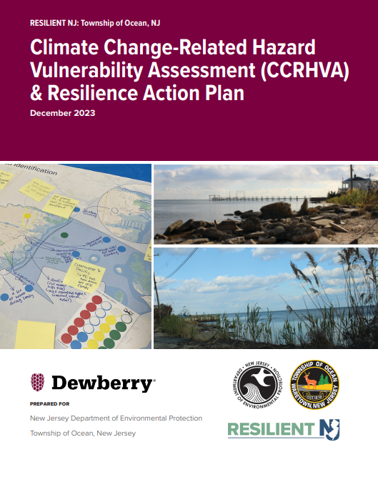
Project Overview
Part of NJDEP’s Resilient NJ Program:
Arcadis Resilient NJ Projects: | Planning | Implementation
Raritan River and Bay Communities (2021-2025) | ✓ | ✓
Northeastern NJ (2021-2025) | ✓ | ✓
Town of Harrison (2025) | ✓
Ocean Township, Ocean County (2025) |  | ✓
Focused on implementing a Resilience Action Plan released by 2022 (created by Dewberry)
Limited timeline due to federal funding constraints
Worked with Township to identify 3 priority projects:
Erosion Management Planning at Custer Drive
Minimum Bulkhead Ordinance
Wildfire Resilience Toolkit
Notes:
Nickie

Slide 3
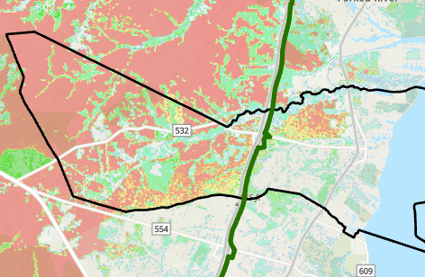
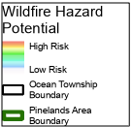
Wildfire Risk in Ocean Township
Township is among the areas of New Jersey most impacted by wildfires
Significant portion of the Township is located within the Pinelands National Preserve
Compounding hazards also increase the risk of wildfire.
Drought conditions in recent years have become more frequent.
Extended wildfire season
Increased average temperatures.
Township had a Community Wildfire Protection Plan from 2014
Aim to be updated every 5 years
Jones Road Fire
Began in April 2025 and burned for 20 days
Burned more than 15,000 acres
Exacerbated by winds and dry weather, including an ongoing drought warning that began in November 2024
Thousands of residents evacuated
Severe damage to one commercial building; no residential buildings were impacted
Approximate Location of Jones Road Fire
Township of Ocean Boundary
Wildfire Hazard Potential
Pinelands Area Boundary
Low
High
The Wildfire Hazard Potential is based on an index developed by the U.S. Forest Service that predicts the likelihood of a high intensity wildfire
Notes:
Blair

Slide 4

Our Process
Understand Existing Conditions
Identify Gaps
Develop a Toolkit of Recommended Actions
Risk Profile
Past Efforts
Best Practices
Review recent wildfire events
Review existing local plans; evaluate implementation status
Identify relevant national standards and practices
Township Updates Community Wildfire Protection Plan (CWPP)
GIS mapping using available datasets
(fire risk, critical assets, etc)
Identify additional relevant efforts/initiatives
Consider actions taken by similar communities
Notes:
Blair

Slide 5
Recommended Actions
Although significant information on wildfire risk mitigation and recovery is available, many resources were created for community and ecological contexts in the western United States that are different from those of New Jersey.
Recommended actions are organized into categories:
Landscaping Requirements and Management Plans for Hazardous Fuels Reduction: reducing wildfire risk through effective vegetation management.
Land Use & Development Regulations: reducing wildfire risk through informed planning and updated codes and regulations.
Stakeholder Identification & Coordination: ensuring the right stakeholders are identified, roles assigned, and communication protocols established to reduce wildfire risk and ensure community preparedness.
Public Outreach & Coordination: promoting community awareness of wildfire risk and preparedness opportunities.
Emergency Preparedness, Response, & Recovery: ensuring the Township is prepared to respond effectively before, during, and after a wildfire.
Notes:
Blair

Slide 6
Wildfire Resilience Toolkit
# | Action Name | Best Practice Category
1 | Develop and implement fuel reduction management plans | Landscape Management for Hazardous Fuels Reduction
2 | Adopt defensible space requirements in zoning code at the property level | Land Use and Development Regulations
3 | Adopt regulations that support wildfire resilient landscaping practices | Land Use and Development Regulations
4 | Regulate flag lots to ensure emergency vehicles can safely access properties | Land Use and Development Regulations
5 | Update subdivision site plan design standards to address wildfire resilience | Land Use and Development Regulations
6 | Adopt wildfire resistant building practices | Land Use and Development Regulations
7 | Participate in the Firewise Community program | Stakeholder Identification and Coordination
8 | Develop and distribute outreach and educational materials | Public Outreach and Education
9 | Prepare for water supply disruptions following wildfires | Emergency Preparedness, Response, & Recovery
 |  | Emergency Preparedness, Response, & Recovery
10 | Ensure Township’s response capacity
11 | Establish proactive debris management strategies
 |  | Emergency Preparedness, Response, & Recovery
12 | Develop recovery and rebuilding resources for the community
 |  | Emergency Preparedness, Response, & Recovery
Notes:
N

Slide 7
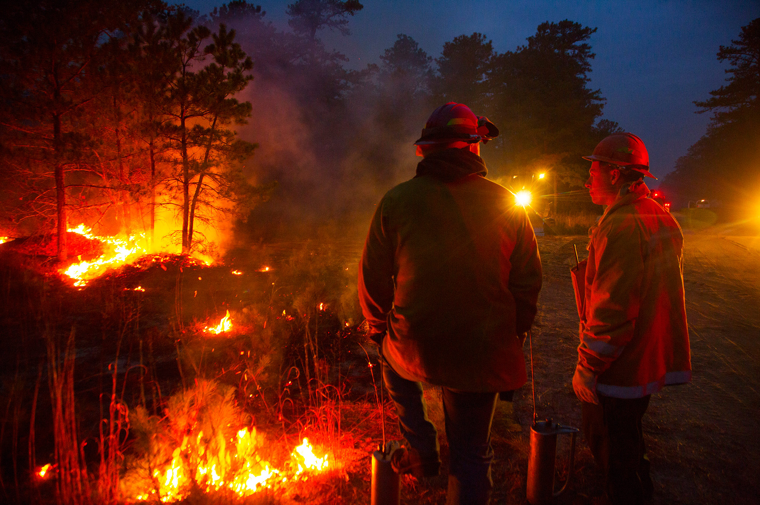
Develop and implement fuel reduction management plans
Action 1 | Landscape Management for Hazardous Fuels Reduction
7
Description The 2014 CWPP identified priority areas for the reduction of wildfire fuel hazards through prescribed burning and mechanical thinning. Fuel management practices for reducing vegetation are effective for reducing the amount and continuity of burnable vegetation that could contribute to a wildfire. The Township should review the recommended communities, structures, and areas identified for fuel hazard mitigation and incorporated updated recommendations into Community Wildfire Prevention Plan.
Implementation
A community hazard and risk assessment can be used to identify areas most at risk to wildfire and where opportunities to reduce vegetation exists. The Township can coordinate with stakeholders to identify progress since the 2014 CWPP.
Immediate Next Steps
Coordinate with community members, structure owners, and other agencies to confirm if any fuel hazard mitigation measures have been taken, per the recommendations.
Update the Community Wildfire Prevention Plan to reflect progress made and updated community risk profile, as identified in the Climate Change Related Hazards Vulnerability Assessment.
NJ Forestry Service personnel monitor a prescribed fire in the Pinelands.
Image Source: Pinelands Alliance © Jason Howell

Slide 8
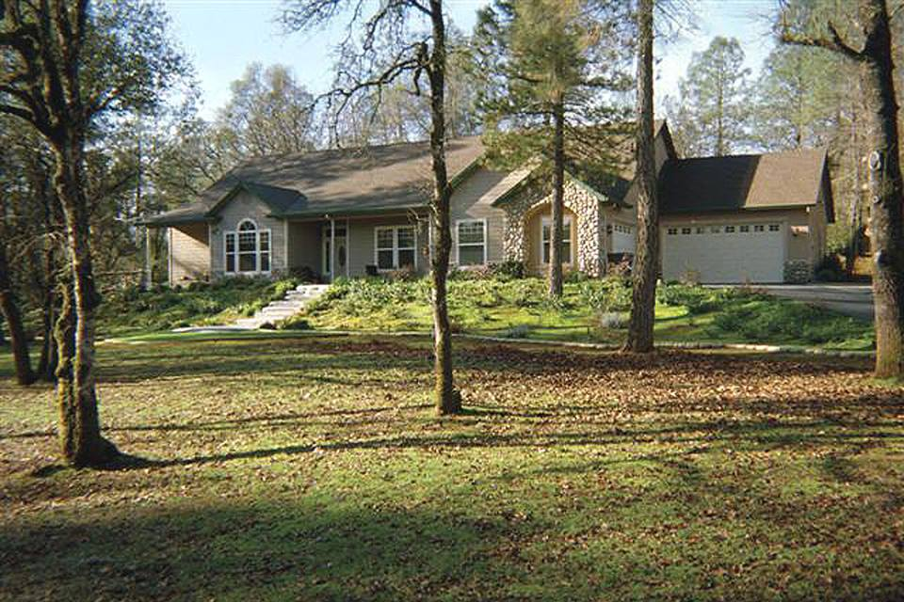

Adopt defensible space requirements in zoning code at the property level
Action 2 | Land Use and Development Regulations
8
Description Defensible space is a crucial wildfire safety measure designed to protect homes by reducing flammable materials around structures. It involves taking steps to reduce combustible materials in the vicinity of homes and other structures (see diagram at right).
Implementation To implement this recommendation, the Township can create standards to mandate the removal of vegetation and other flammable materials to slow the spread of wildfire around structures. These standards can be adopted into the zoning code and property maintenance code to facilitate implementation.
Immediate Next Steps
Update Buffers Zoning Code (Art V, § 410-44, 45, 46) to mandate defensible space practices across the Township, including in areas not subject to the Pinelands CMP (which already mandates defensible space).
Update Property Maintenance Code (Art II, §280) to set defensible space maintenance requirements for existing parcels in the Township
Example of home with defensible space.
Photo source: Oregon Department of Forestry
0-5 ft.
5-30 ft.
30-100+ ft.
Use only non-combustible landscaping and building materials.
Landscape carefully, creating gaps between fuels (such as trees) to reduce opportunity for a fire to spread. Mow grasses to 3 or less inches.
Space and prune trees and other vegetation on your property to interrupt a fire’s path.
Notes:
Reference landscaping action
Property level recommendations

Slide 9
Participate in the Firewise Community Program
Action 7 | Stakeholder Identification and Coordination
9
Description Firewise Communities are neighborhoods or municipalities that actively participate in the National Fire Protection Association’s (NFPA) Firewise USA program, which focuses on wildfire risk reduction. The program focuses on actions that can be taken by residents to address wildfire risk across property boundaries to help build resilience to wildfire. The program engages homeowners, community leaders, planners, developers, and firefighters and is focused on assessing and addressing fire risk and addressing ignition hazards, particularly those within the home ignition zone.
Implementation The Township has previously considered participation in Firewise, but progress to certification has stalled. With recent fires emphasizing the value of becoming a Firewise community, the Township should conduct outreach in the area around the Jones Road Fire Containment to identify the necessary stakeholders to participate. In New Jersey, the NJ Forest Fire Service supports communities’ participation in Firewise.
Immediate Next Steps
Prepare outreach materials to share with residents to gauge interest in forming a Firewise committee
Identify interested individuals throughout the Township to spread awareness of program.
Coordinate with interested residents to form a committee
Steps to Become a Certified Firewise Community
Required Action | Progress to Date
Complete a community wildfire risk assessment from a state forestry agency or fire department | A risk wildfire risk assessment was completed as part of the CWPP (2014) but should be updated as part of the broader CWPP update which is overdue.
Create a local action plan that prioritizes actions to reduce fire risks to homes | The CWPP (2014) includes prioritized actions to reduce fire risk but should be updated to reflect current conditions.
Hold an annual wildfire risk reduction (Firewise Day) educational event | The Township already hosts an annual clean-up event to build awareness of wildfire risk.
Identify residents and community leaders to form a committee to represent the Firewise community and plan and implement the program | The township has previously initiated efforts to form a committee but these stalled due to insufficient interest from prospective committee members.
Steps to Becoming a Firewise Community

Slide 10
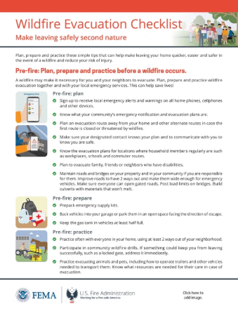
Develop and distribute outreach and educational materials on fire prevention and emergency preparedness
Action 8 | Public Outreach and Education
10
Description Successful wildfire mitigation requires community awareness of risk and responsibility. To build this awareness, outreach and education on a number of relevant topics can support resilience. These topics include:
Defensible space requirements, and fire-resistant building and landscaping practices
Evacuation strategies and other emergency preparedness considerations.
Fire risk factors, and state and local fire risk assessments
Implementation Outreach activities should focus on in-person engagement, sharing educational outreach materials that share information on the following. The Township should focus distribution of materials in areas that are most at-risk and may consider partnering with utility companies or emergency services to facilitate distribution.
Immediate Next Steps
Include state wildfire risk resources in outreach materials to help residents understand their individual level of risk
Develop and share a community survey to identify best practices for outreach and measure the efficacy of current measures
Develop an outreach campaign to prepare for following year's wildfire season with a focus on risk reduction
Example outreach material created by FEMA.
Image Source: FEMA

Slide 11
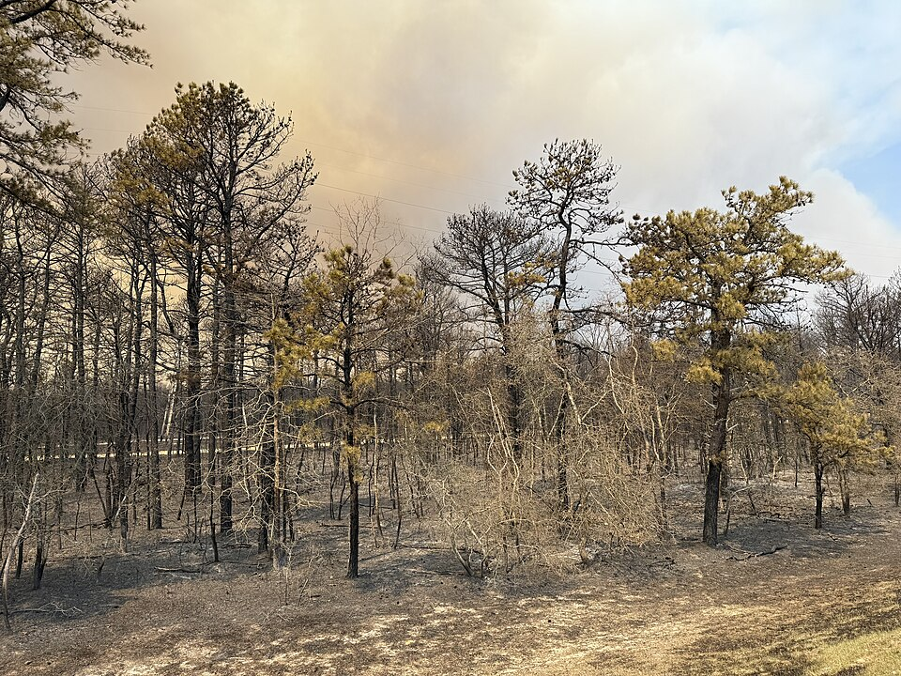
Establish proactive debris management strategies
Action 11 | Emergency Preparedness, Response, & Recovery
11
Description Debris management plans promote the safe and efficient removal of hazardous debris after a fire to protect public and environmental health. Effective debris management practices include pre-disaster planning to pre-identify landfills and other appropriate waste disposal facilities, post-disaster creation of database of properties available for debris removal, and process and workflow charts that clearly illustrate debris removal steps
Implementation The Township should work with state and local official to identify priority areas for cleanup after a wildfire and ensure compliance with environmental regulations. The Township should also consider hiring a consultant to develop standard debris management strategies (see “Additional Resources” page for an example property database.)
Immediate Next Steps
Identify Township staff to support debris management practices.
Develop and share right-of-entry form with the Township to prepare ahead of a fire
Maintain inventory of personnel protective equipment (PPE) to protect workers who may encounter hazardous materials after a fire
Ensure emergency response team is trained in proper debris management training through programs such as FEMA’s National Incident Management System
Impacted area of Ocean Township following the 2025 Jones Road Fire.
Image Source: Famartin (Creative Commons)

Slide 12


Thank you! Questions?
Stay in touch:
Nickie Mitch, AICP
Resilience Planner
Nicholas.Mitch@arcadis.com
Notes:
Distilling such a big problem into real action, need to do that quickly but comprehensively
Big region, big problem, how to go from such a big unmanageable problem to put into an implementation strategy and actually get going on it
Engagement was designed intentionally to take in direct feedback and concerns from people in these areas, developing local and regional strategies
Picture of measuring water - high level plan, meeting with people one on one, hearing their stories, impacted by flooding and the situation theyre in, take one on one level to be true to what people are experiencing and what's going to impact them in the future, and translate into plan
Urgency - fear of doing it the wrong way, balance with being true and honest with individuals

