Slide 1



Join us!

Slide 2

Advocacy, Collaboration, and Sound Policy Toward a Resilient Future for New Jersey’s Coastal Communities
Moderator: Nick Brown, Coastal and Climate Scientist, HDR
March 11, 2026

Slide 3
A Resilient Future for New Jersey’s Coastal Communities: Panel Goal
To synthesize major takeaways from the week’s sessions
To engage in a forward-looking conversation about the future of New Jersey’s coastal resilience.
To explore actionable strategies (both state and federal) for advancing coastal resilience through advocacy, collaboration, and policy,
To highlight the value of national perspectives and partnerships for New Jersey’s coastal future.

Slide 4
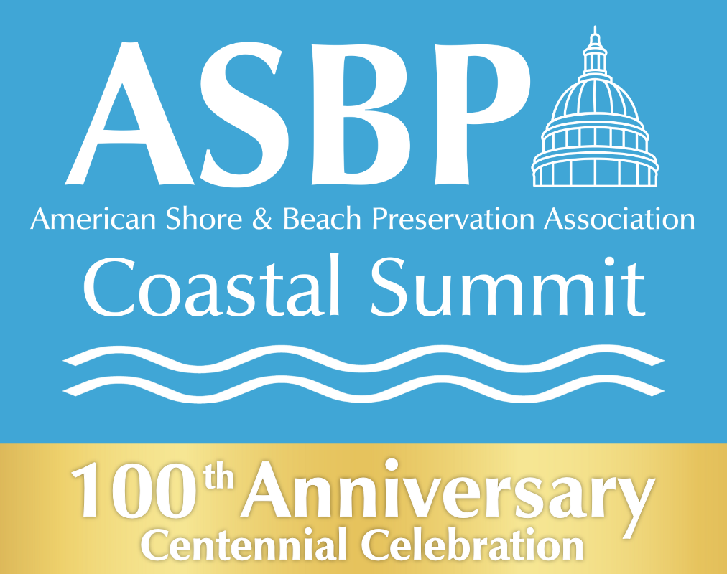
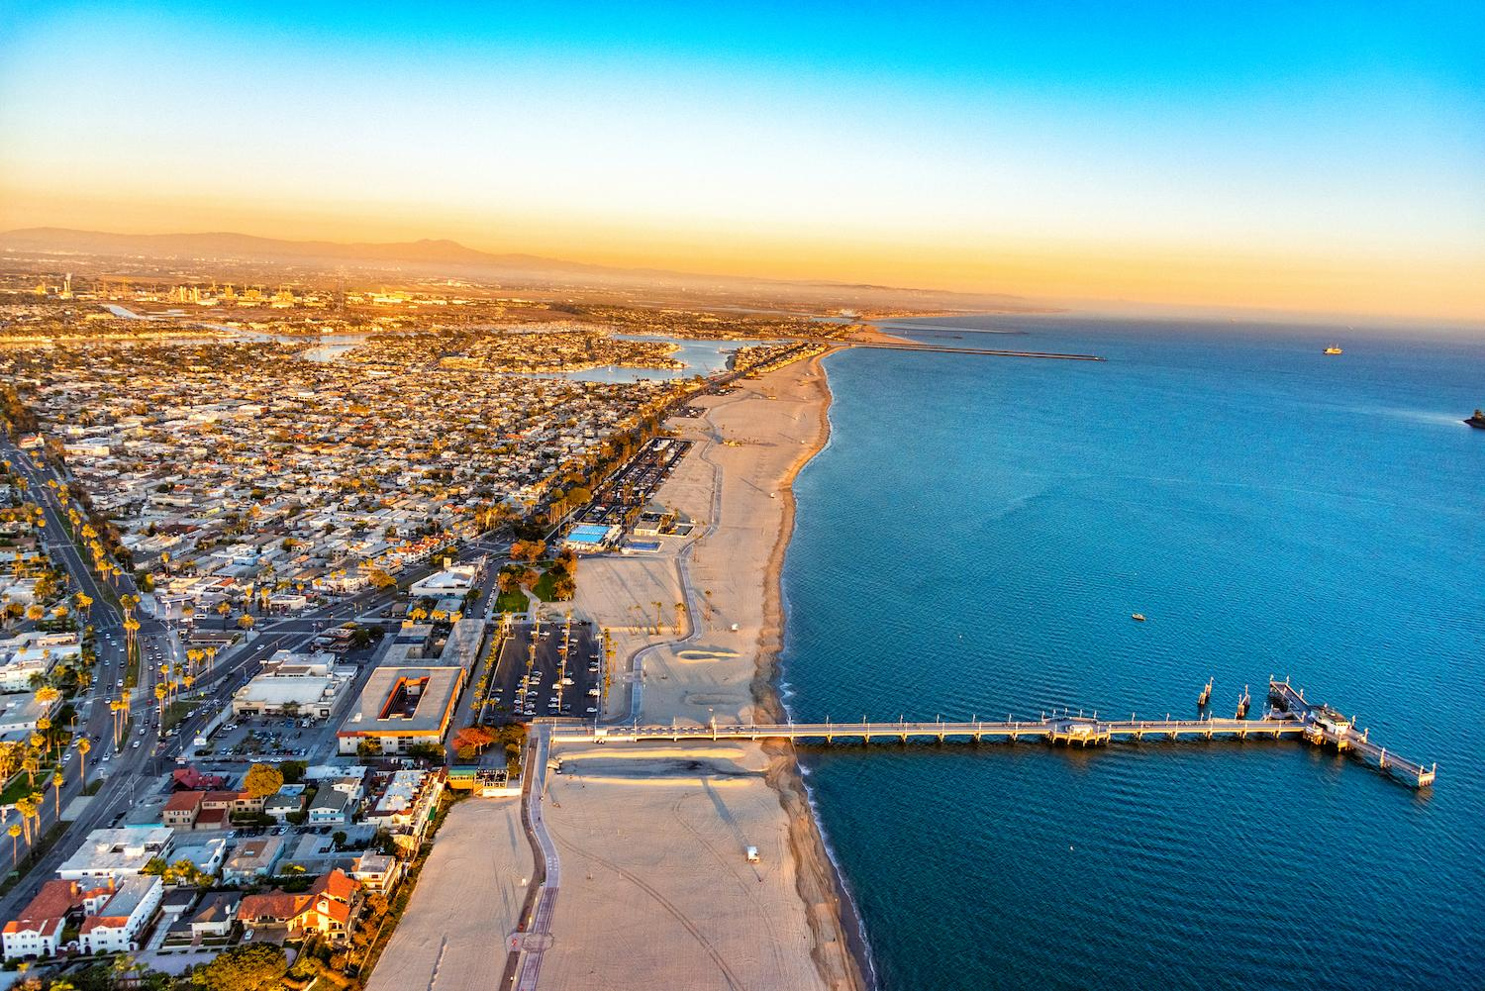
ASBPA 100th Anniversary
Coastal Conferences
Washington, DC
March 24-26, 2026
Atlantic City, NJ
October 5-8, 2026
Save the Dates
Abstracts
Due June 1st
Posters
Due August 15th

Slide 5
A Resilient Future for New Jersey’s Coastal Communities
Panelists’ Opening Statements:
Dan Barone, Rutgers; NSBPA Chapter President and Board of Directors, ASBPA
Tom Herrington, Monmouth University Urban Coast Institute, and Board of Directors, ASBPA
Grace Hanlon, Executive Director, Jersey Shore Partnership and Board of Directors, ASBPA

Slide 6
Building Community & Flood Resilience
    Advancing flood resilience, community-scale resilience, hazard risk communication, community engagement, equity, social vulnerability, and human dimensions.
Nature-Based, Hybrid & Systems Approaches
Nature-based solutions, integrated and systems-based approaches, and translating science into practice.
Data, Innovation & Decision Support
Climate data, modeling, decision support tools, regulatory and governance innovation, and evidence-based policy development.
Policy, Funding & Collaborative Capacity Building
Governance, funding and financing strategies, cross-sector and cross-jurisdictional collaboration, workforce development, education, and next-generation leadership.
Divide and Conquer!
Conference Resilience Themes

Slide 7
Driving Progress Through Advocacy, Collaboration, and Innovative Policy
An open, forward-thinking exchange on how advocacy, collaboration, and policy can drive progress on these topics in the years ahead, emphasizing the importance of national collaboration and policy innovation.

Slide 8

Audience Input: Top State and Federal Coastal Resilience Needs

Slide 9
ASBPA 100th Anniversary
Coastal Conferences
Washington, DC
March 24-26, 2026
Atlantic City, NJ
October 5-8, 2026
Save the Dates
Abstracts
Due June 1st
Posters
Due August 15th

