Slide 1
Flooding Impacts on Municipal Public Finance in NJ
Using NJ Adapt MOD IV Flood Analysis
Pritpal Bamhrah, Umer Farooq and David Listokin
Presented by – Pritpal Bamhrah
2026 New Jersey Coastal and Climate Resilience Conference – March 9, 2026

Slide 2
Contents
1. NJ Adapt and Flooding Scenarios
2. NJ Local Government Public Finance Context
3. Analysis Summary – By County
4. Limitations and Future Enhancements
Notes:
Update at the end

Slide 3
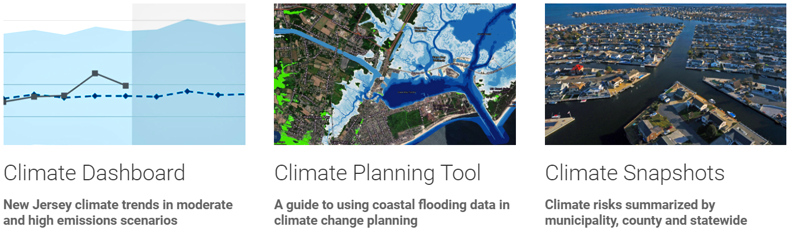

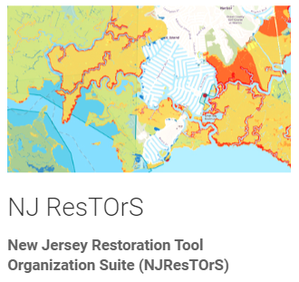
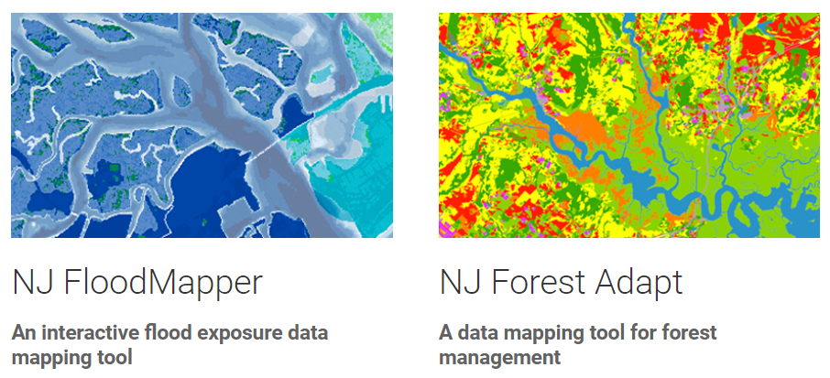
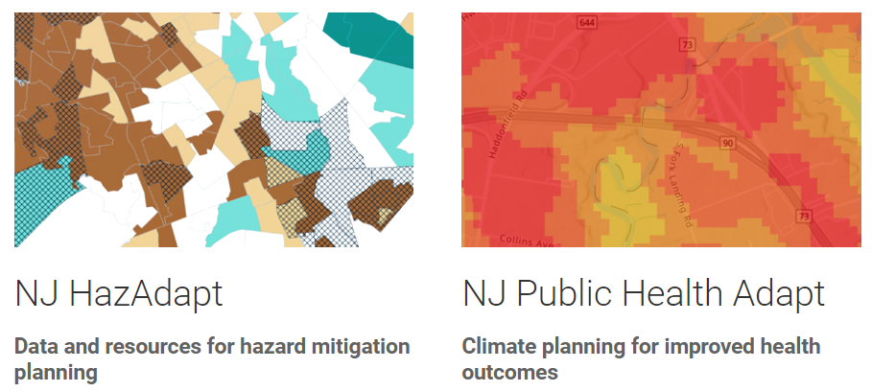

Overview of NJ Adapt
Link - https://njclimateresourcecenter.rutgers.edu/nj-adapt/
NJ Adapt is a suite of tools developed by Rutgers University for climate adaptation planning in New Jersey to assist planners, community leaders, businesses, and residents to understand and adapt to the impacts of climate change on people, assets, and communities in New Jersey.
Disclaimer
The data, maps, and information provided should be used only as a screening-level tool. As with all remotely sensed data, all features should be verified with a site visit.
These tools should be used strictly for planning reference - and not for navigation, permitting, or other legal purposes.
Tools within NJ Adapt

Slide 4
NJ Adapt MOD-IV Parcel Flood Analysis
Parcel tax data (2022)
Modeled flood impact at various scenarios
Percentage of each parcel impacted by various flood scenarios
Analysis considers both
The property assessed value (both land and improvements)
market or “equalized” property value

Slide 5
Flooding Scenarios
Coastal Flooding
2ft above MHHW
5ft above MHHW (Based on 2019 STAP report)
Inland Flooding
FEMA 1% annual chance flood
FEMA 0.2% annual chance flood
Combined Scenario
FEMA 0.2% annual chance flood and 5ft above MHHW

Slide 6
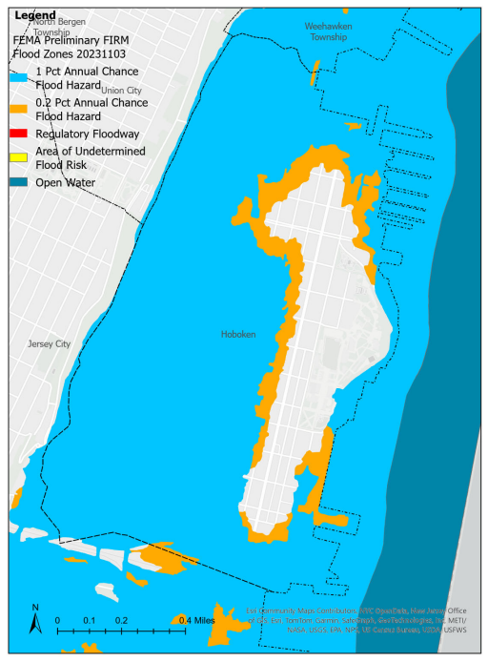
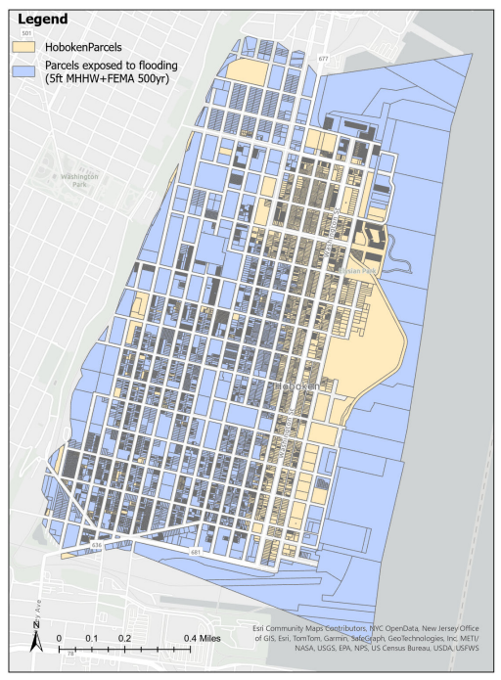
Parcel Analysis at Community Level - Hoboken
Example – Hoboken at HudsonCounty, NJ
Land Area impacted under FEMA Flood Zones
Parcels inundated more than 50% of area (FEMA 500year and 5ft above MHHW)

Slide 7
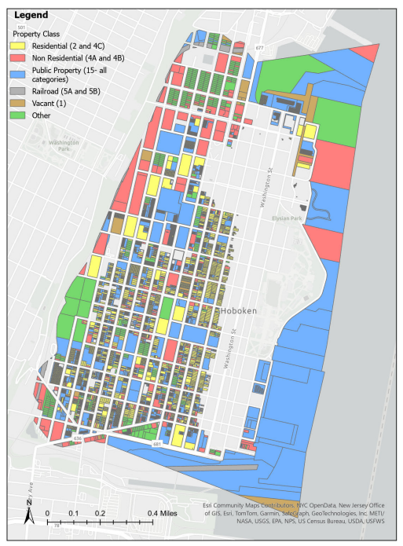
Parcel Analysis at Community Level - Hoboken
Once parcels are identified, MOD IV data helps analyze property class and assessed land and improvement values.
Property Class | No. of Parcels (%age) | Land Value | Improvement Value
Residential (2 and 4C) | 10823 (84%) | $ 2,341,668,200 | $ 3,599,542,900
Non-Residential (4A and 4B) | 495 (4%) | $ 374,701,400 | $ 614,758,000
Public Property (15 - all categories) | 937 (7%) | $ 579,366,800 | $ 1,057,256,000
Railroad (5A and 5B) | 21 (0%) | $ 6,232,900 | $ -
Vacant (1) | 68 (1%) | $ 21,806,200 | $ -
Other | 531 (4%) | $ - | $ -
Total | 12875 | $ 3,323,775,500 | $ 5,271,556,900

Slide 8
NJ Local Government Public Finance Context (2020)
High reliance on own-source revenues, especially Property Tax
 | US Local Govt. Average | New Jersey
Local general revenue A. % from intergovernmental sources (federal and state) | 34.79% | 25.29%
B. % from own source revenues | 65.3% | 74.8%
C. % from the property tax | 30.3% | 61.0%
II. Effective residential property tax rate Annual property tax ($) as a % of property market value ($) | 0.93 (median) | 2.23

Slide 9
Summary Analysis – By County
Percentage flood exposure by area (acre)
Percentage flood exposure by no. of parcels
Percentage of flood exposed market value
Flood exposed annual property tax revenue
The following slides include the detailed state and county analyses by individual parameters

Slide 10
NJ flooding Spatial exposure– Flooded percentage of Acreage by state/county and multiple flooding scenarios
The statewide flood exposed area ranges from 9% to 26% under five flooding scenarios.
Hudson County has the highest area flooded (59%) by the 5ft+500 FEMA scenario, followed by Cape May (57%) and Ocean (39%).

Slide 11
NJ flooding Spatial exposure– Flooded percentage of parcels by state/county and five flooding scenarios
The statewide flood exposed parcels range from 1% to 12% under various flooding scenarios.
Cape May has the largest percentage for 5 ft + 500 FEMA (65%), followed by Salem (33%) and both Ocean and Atlantic (29%).

Slide 12
NJ flooding financial exposure – Percentage flooded Market value by state/county and multiple flooding scenarios
The statewide flood exposed Market Value share ranges from 1% to 16% under various flooding scenarios.
Cape May County has the highest % of Market Value flooded (82%) by the 5ft+500 FEMA scenario, followed by Atlantic (48%) and Ocean (42%).

Slide 13
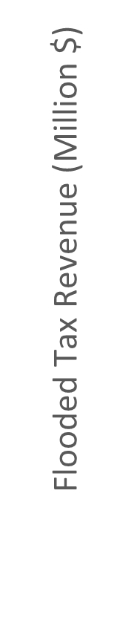


NJ flooding financial exposure – Flooded annual property tax revenue impact (M$) by state/county and multiple flooding scenarios
The statewide flood exposed Annual Property Tax Revenue Loss ranges from $ 0.24 Billion to $4 Billion under various flooding scenarios
Ocean County has the highest Tax Revenue $745M by the 5ft+500 FEMA scenario followed by Hudson with $610M.
Note - State impact in $ billions and County impact in $ millions

Slide 14
Limitations and future enhancements
Parcel MOD IV data composite – now available for 2023
New Flooding Regulations and Datasets
Inland Flood Protection Rule
Resilient Environments and Landscapes (REAL) coastal flood rule – CAFE layer
Add building footprints to understand the impact to structures vs parcels
Analyze flood challenge by community socioeconomic characteristics (e.g., race and poverty)
Analyze flood challenge by community public finance characteristics (e.g., property tax burden and municipal reliance on the property tax)

