Slide 1
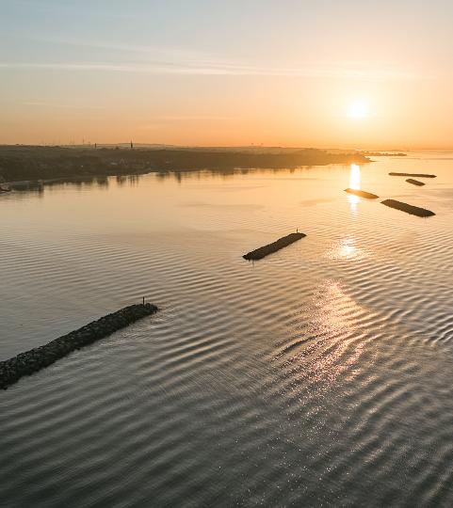
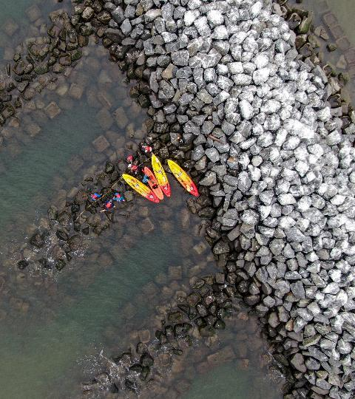
Living Breakwaters Raritan Bay / Staten Island
Pippa Brashear, RLA, WEDG
SCAPE Landscape Architecture
www.scapestudio.com

Slide 2
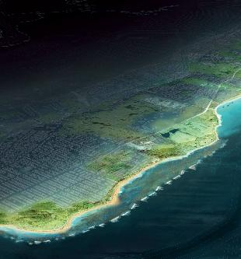
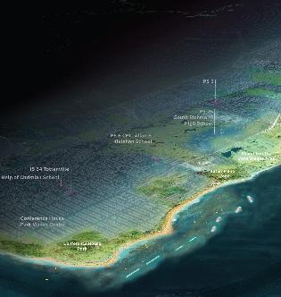
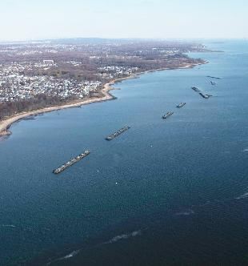
LIVING BREAKWATERS
COMPETITION VISION
DESIGN
MAKING IT A REALITY
2013-2014
2015-2019
2021-2024

Slide 3
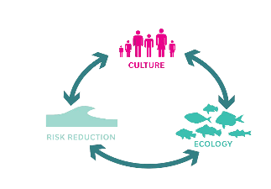
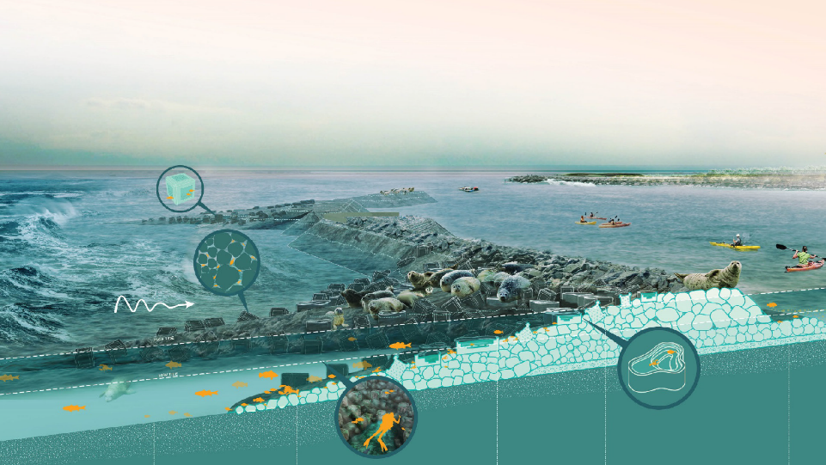

Slide 4
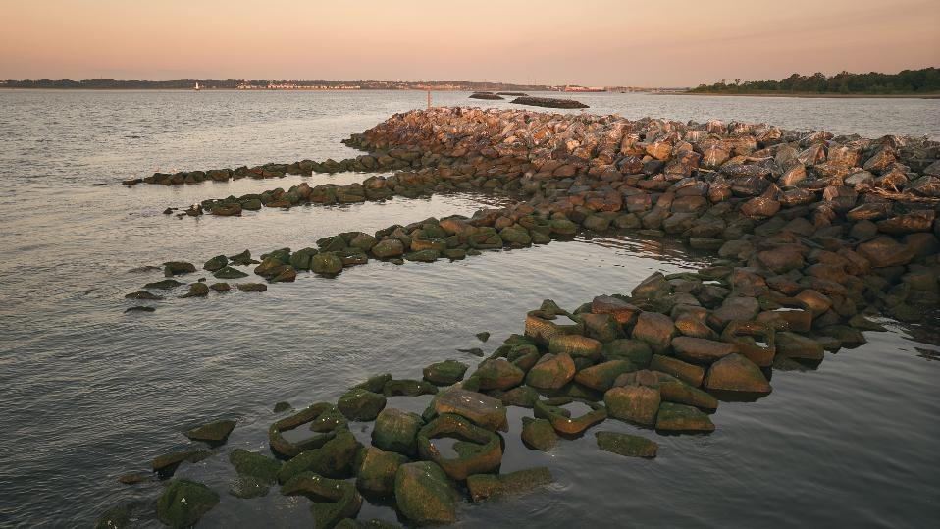
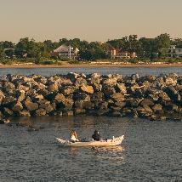
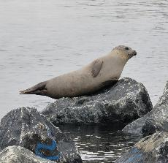

Slide 5
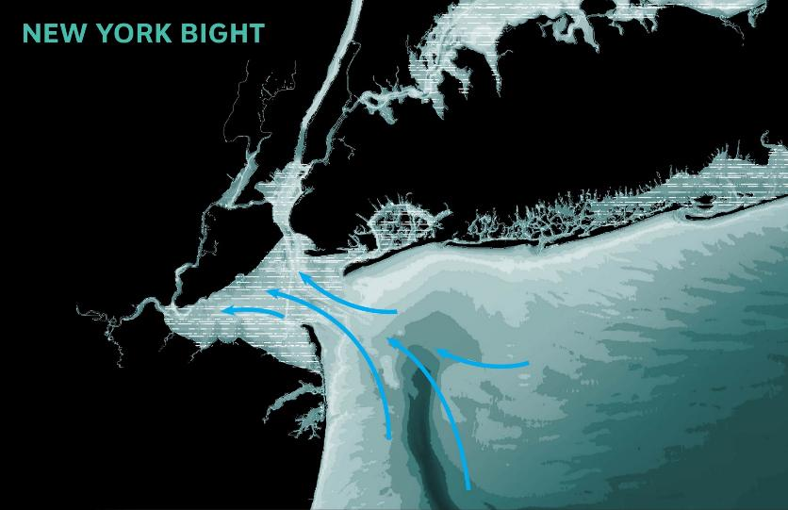
BRONX
MANHATTAN
QUEENS
TOTTELNVILLE,
STATEN ISLAND
BROOKLYN
STATEN
ISLAND

Slide 6
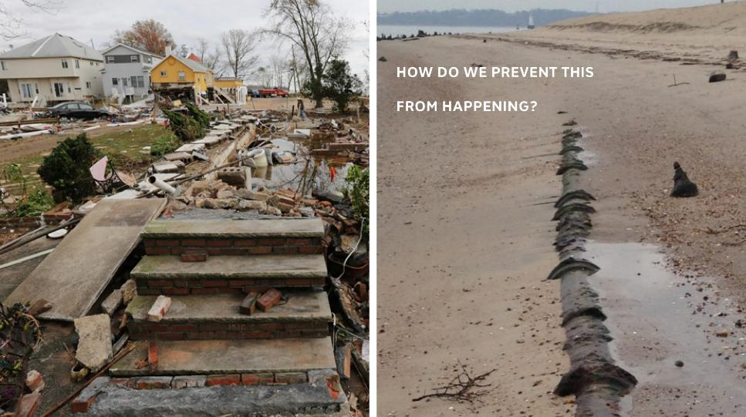
STORM WAVE DAMAGE
EROSION

Slide 7
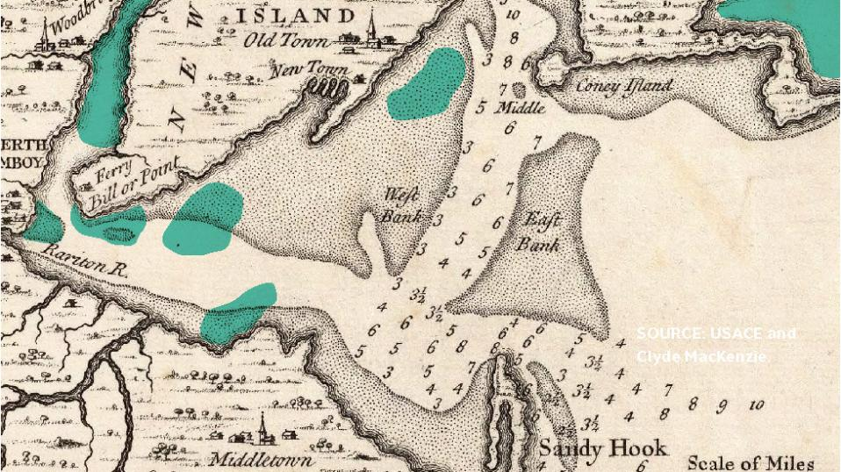
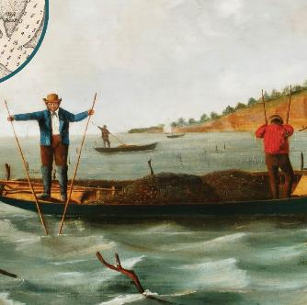
Inspired by nature

Slide 8
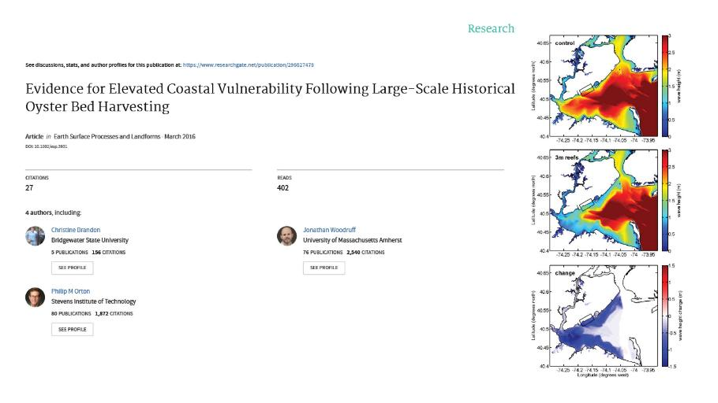
Reefs can reduce risk
Notes:
Reefs reduce risks

Slide 9
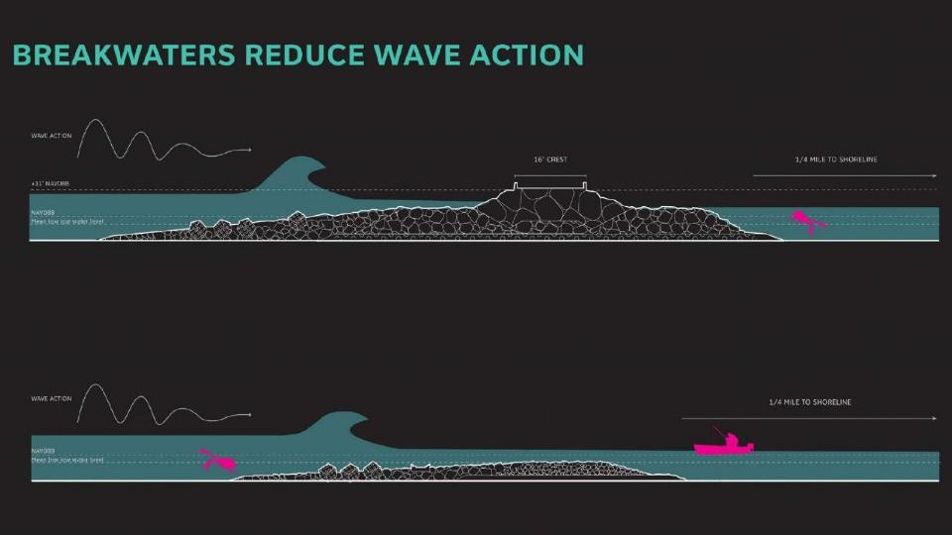

Slide 10
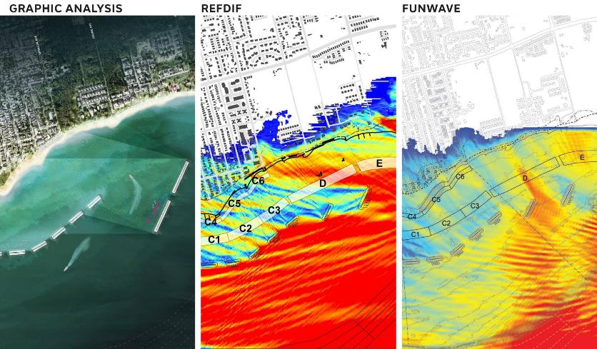
WAVE MODELING
Notes:
Which involved not just one model, but many! After understanding the wave climate (the size and direction of incoming waves over time) through modeling and calibration of that model to wave data collected in the bay, we modeled how the breakaters would attenuate large waves in storm conditions with increasing resolution as we advanced the design process.

Slide 11
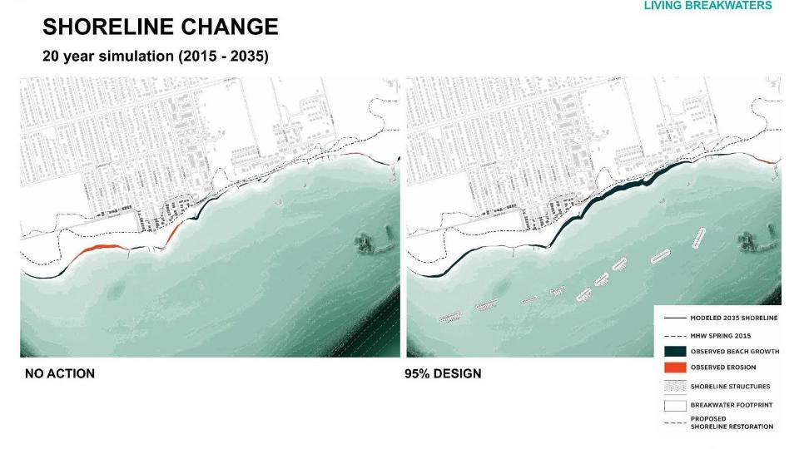
SHORELINE CHANGE MODELING
Notes:
We also modeled gradual long term shoreline change (20 year timeframes are shown here) with a different model.

Slide 12
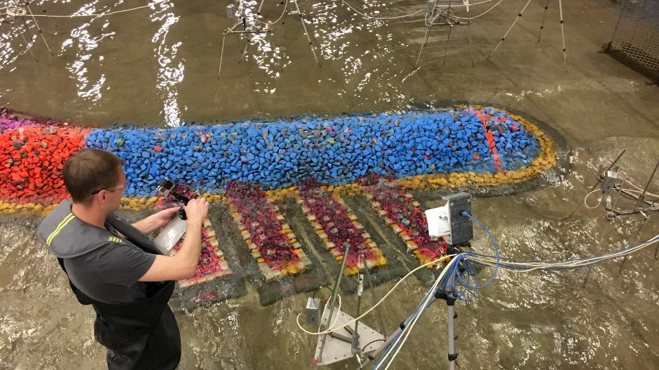
NRC, Ottowa, Canada
Notes:
And ultimately had to physically model the breakwater design

Slide 13
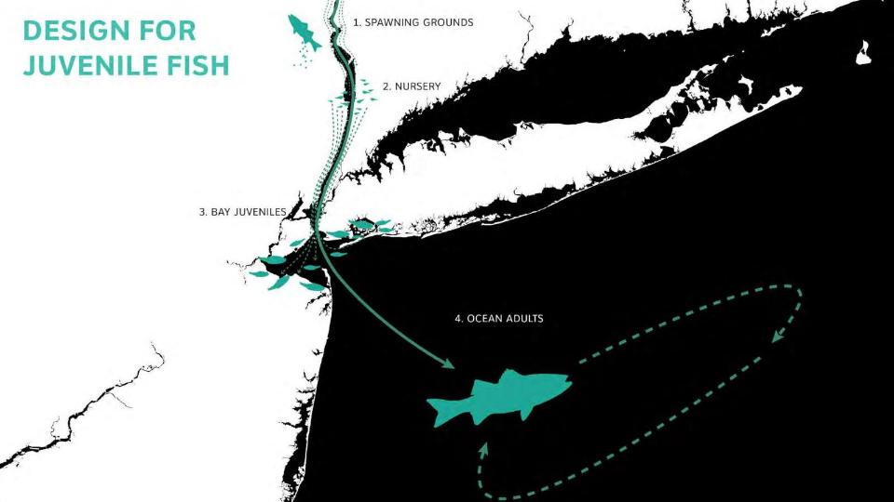
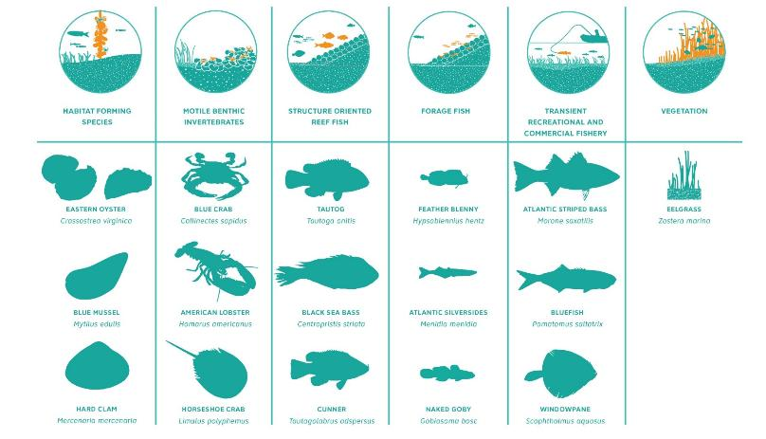
Who are we designing for?

Slide 14
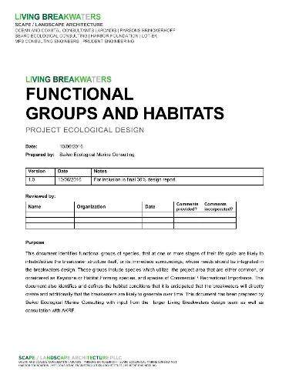
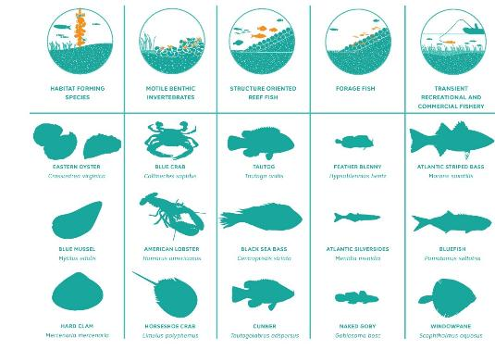
Notes:
Target species / target functional groups
SEARC

Slide 15
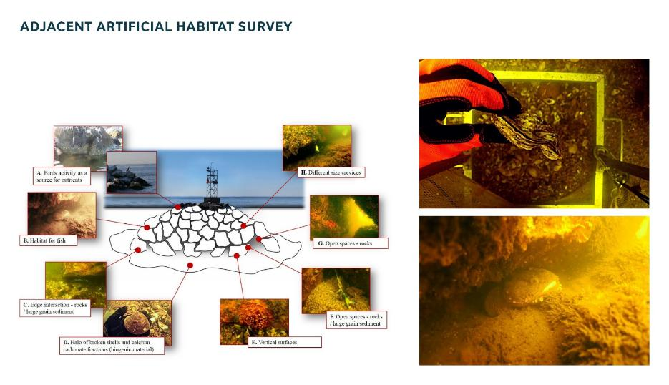

Slide 16
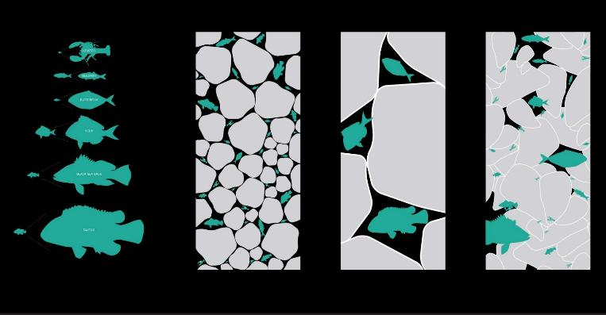
Create complexity

Slide 17
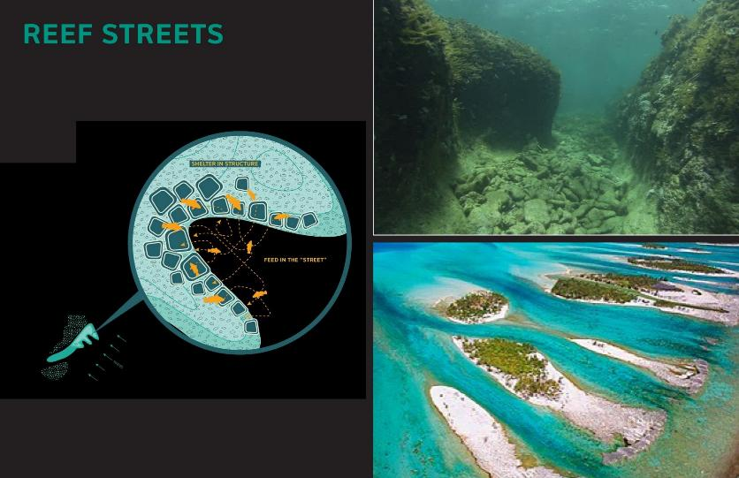
Mimic natural formations

Slide 18
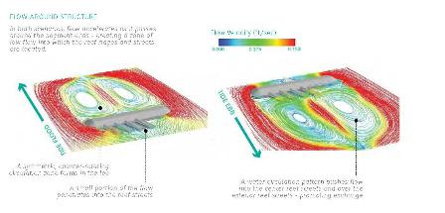
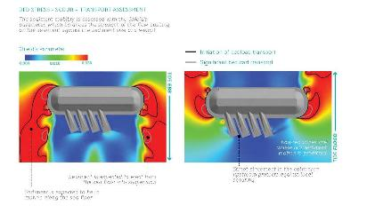
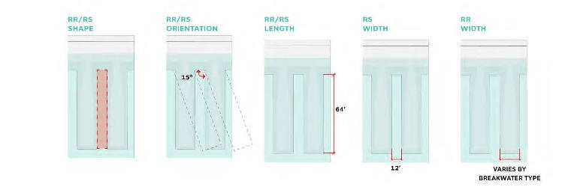

Slide 19
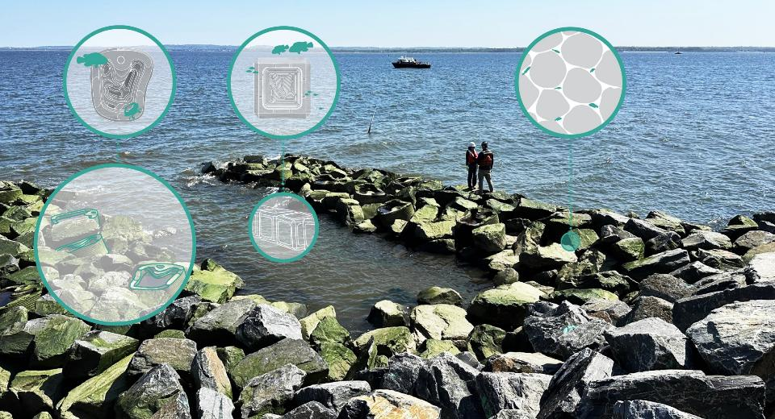

Slide 20
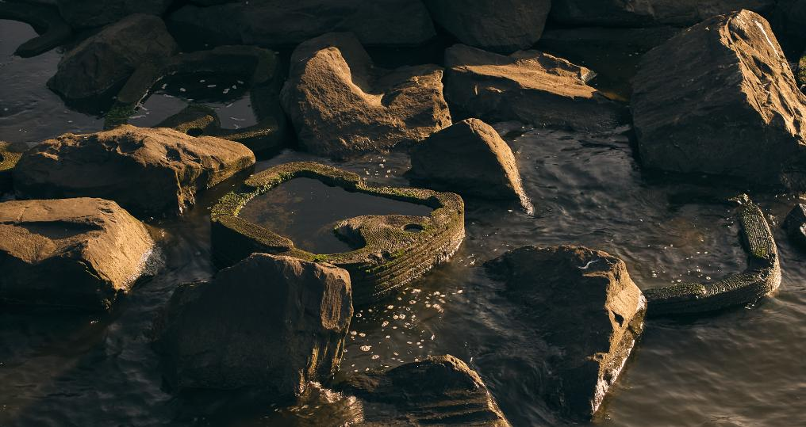

Slide 21
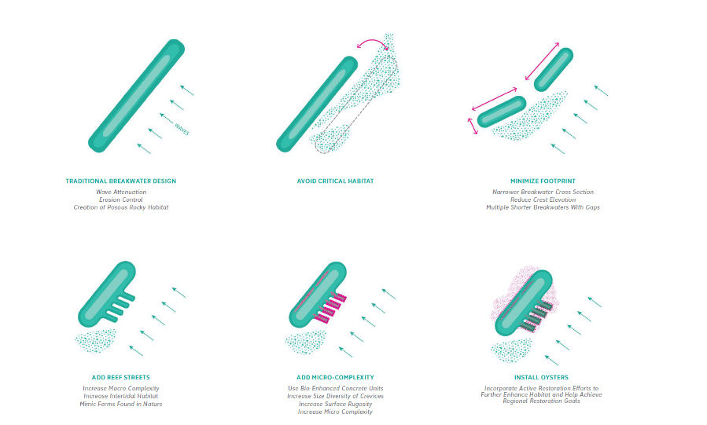

Slide 22
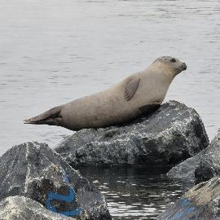
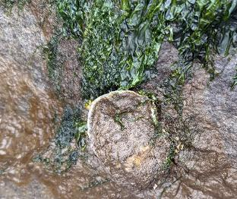
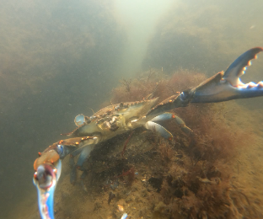
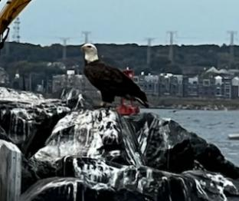
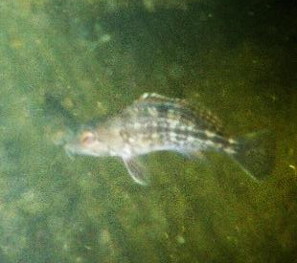
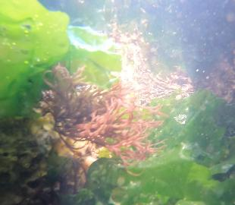
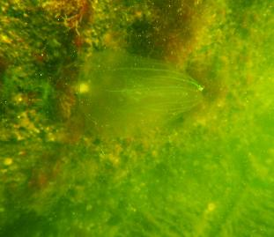

Slide 23
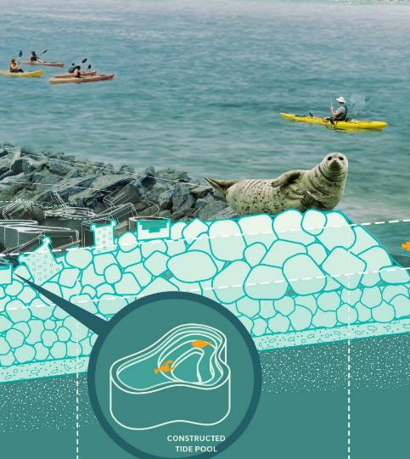
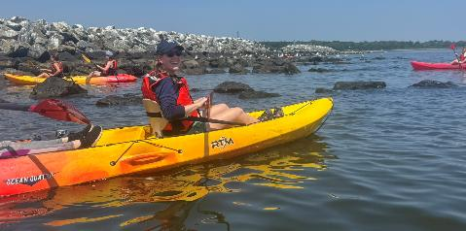
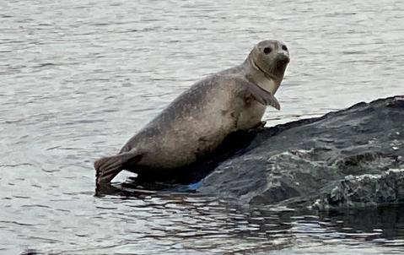

Slide 24
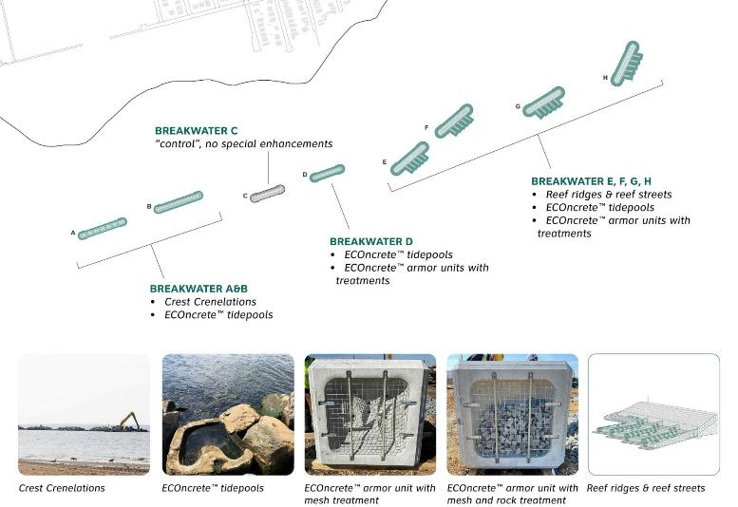

Slide 25
OYSTERS!

Slide 26
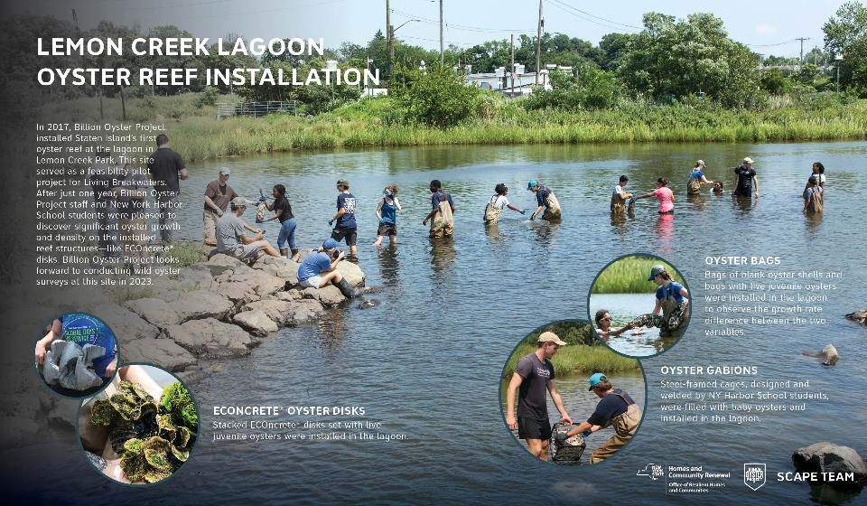
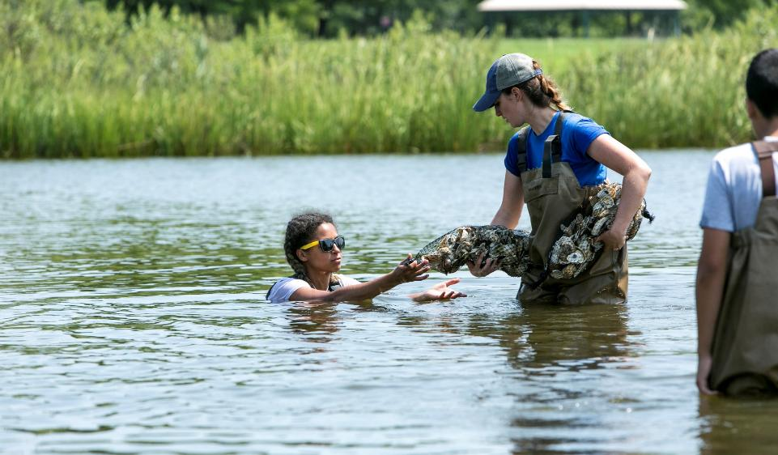
“The key to solving the challenges of climate change is changing human behavior, and humans aren’t going to change their behavior without a direct connection to the natural world.”
— Pete Malinowski, Executive Director & Co-Founder, Billion Oyster Project
Notes:
People are part of nature / we work with people

Slide 27
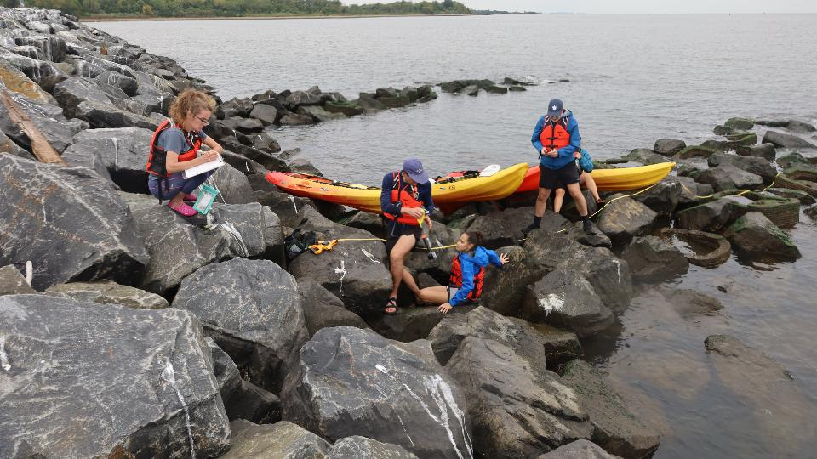
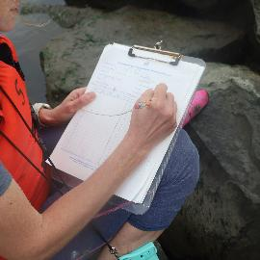
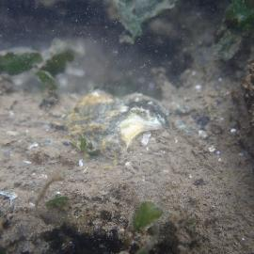

Slide 28
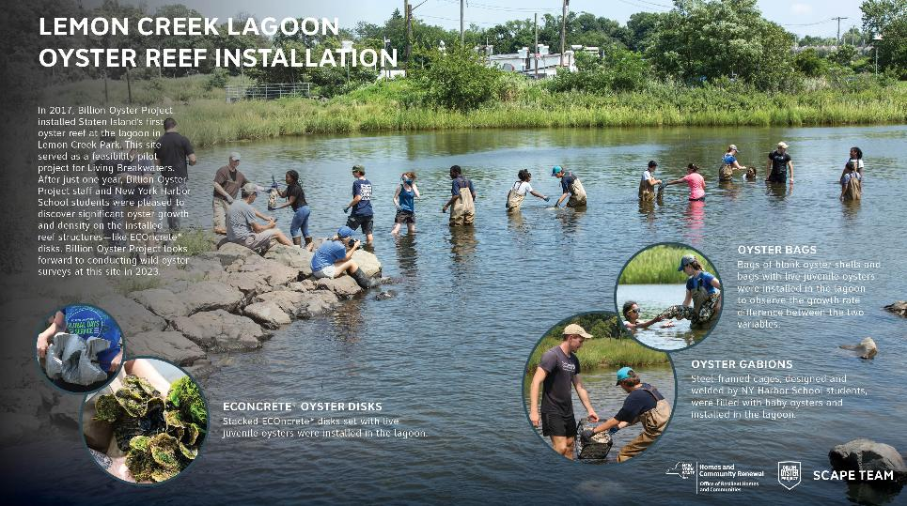
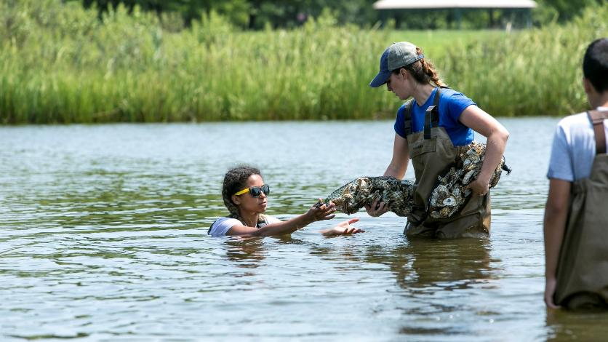

Slide 29















LIVING BREAKWATERS: DESIGN & IMPLEMENTATION TEAM
DESIGN & ENGINEERING
CONSTRUCTION MANAGEMENT
OYSTER RESTORATION & EDUCATION
CONSTRUCTION
ENVIRONMENTAL & PERMITTING

