Slide 1
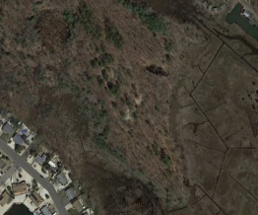
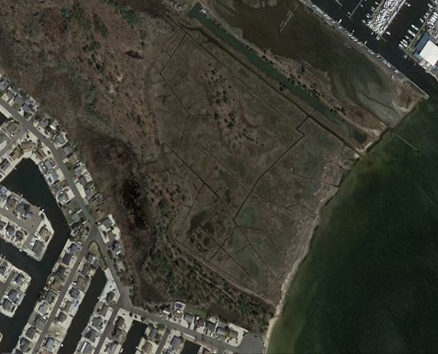
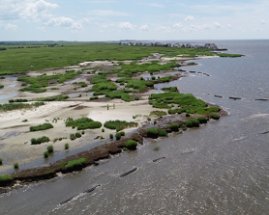
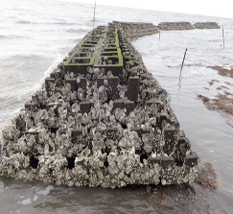
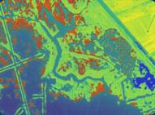
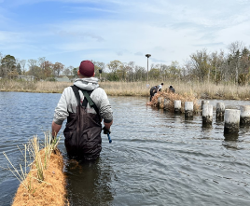
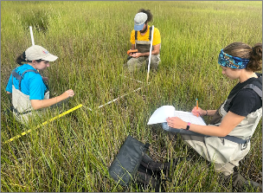
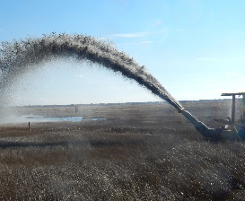
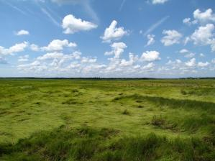



CHARRM Listening Session Results Finding Efficiencies for Ecological Restoration
Danielle McCulloch
Executive Director
American Littoral Society
Notes:
Intro

Slide 2
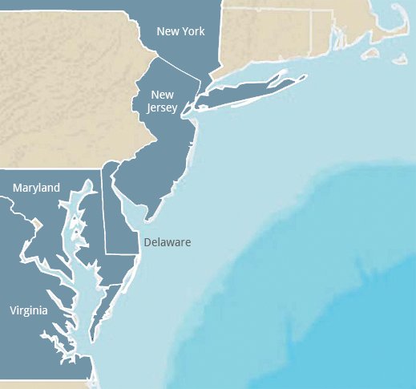








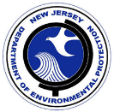






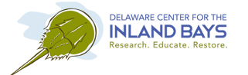



Mid-Atlantic Workgroup Summary
CHARRM: Coastal Habitat & Aquatic Resources Restoration and Management Workgroup
Regulatory Agencies / Resource Managers
Restoration Practitioners
Research Scientists
Objective: Tackle issues related to coastal resources impacted by restoration and regulations, across watersheds and organizations
Increase efficiencies among these groups
Notes:
Quick overview of CHARRM/ workgroup under NJ CRC umbrella
What is charrm: 3 stakeholder groups, Facilitate communication and collaboration, issues we tackle.
While our roots are in NJ, our geographic range is throughout the Mid-Atlantic: from New York to Virginia with members representing various different groups and agencies. Since we have started we have enlisted over 100 members from various organizations.
There are many technical working groups out there focused on particular species or habitats, but there is not a broad, interagency partnership that works beyond professional, agency, state or watershed borders. Our workgroup is a forum to transfer knowledge and expertise across sectors and states.

Slide 3
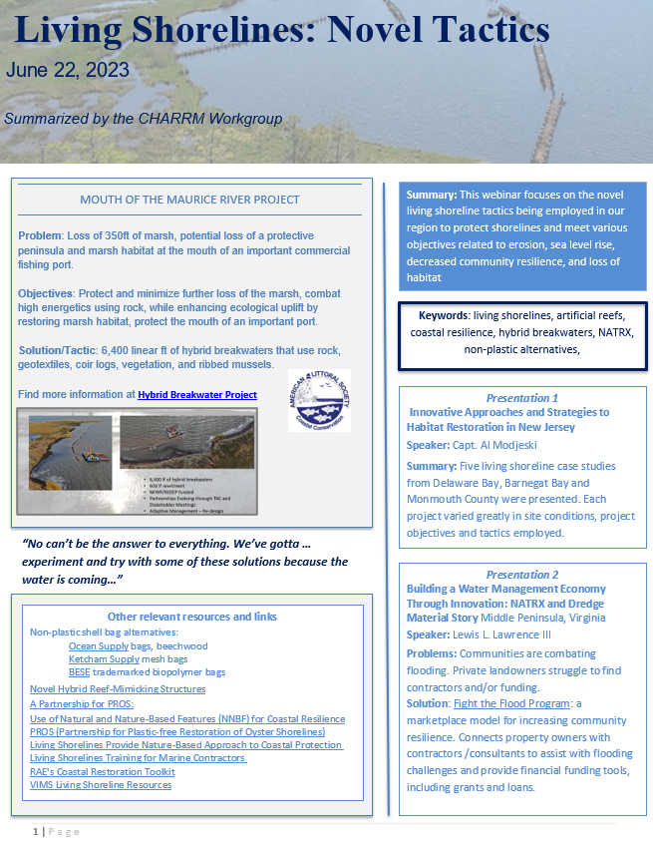
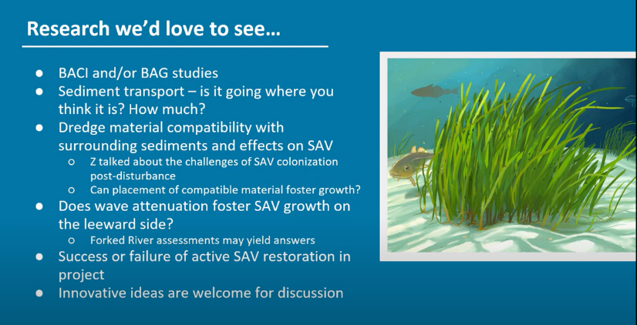
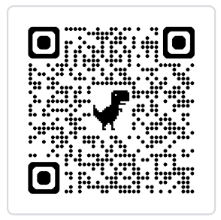
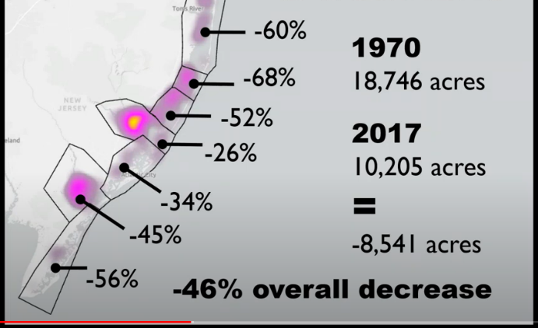
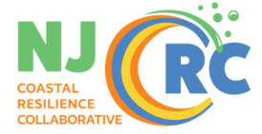
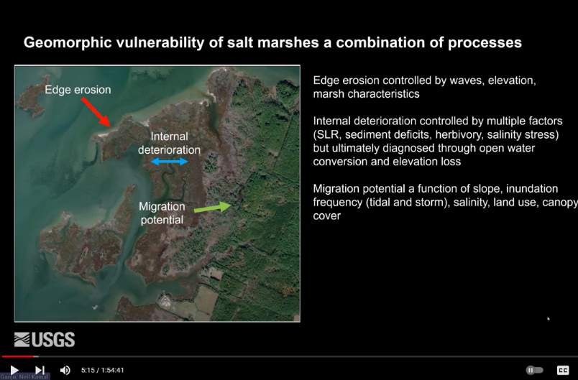
CHaRRM Learning Webinars and Topics
Seagrasses & SAV
Biology and Basics
Regulations and Mgmt
Living Shorelines
Biology and Basics
Case Studies and Lessons Learned
Novel Tactics
Mid-Atlantic Marshes
Biology, Processes, and Trends
Sediment Pancakes: Riverine Contributions to Tidal Wetland Accretion
Meetings with open forums around permitting challenges, listening sessions, information sharing, conference info, resource guides,
12+ hours of webinars!
25+ different experts!
Notes:
Restoration and coastal system science is a constantly evolving field. In an effort to share updated knowledge with our resource managers, regulators and each other, we invited experts from around the region to share their work with us. These webinars have allowed CHARRM members to stay current on research and restoration monitoring, hear about the latest tools, resources, and literature.
We have over 12 hours of learning from over 25 experts. And developed easy-to-reference fact sheets, so if you missed the webinar, you can extract just the info you need. All CHARRM info publicly available through the NJ CRC website (QR code)

Slide 4
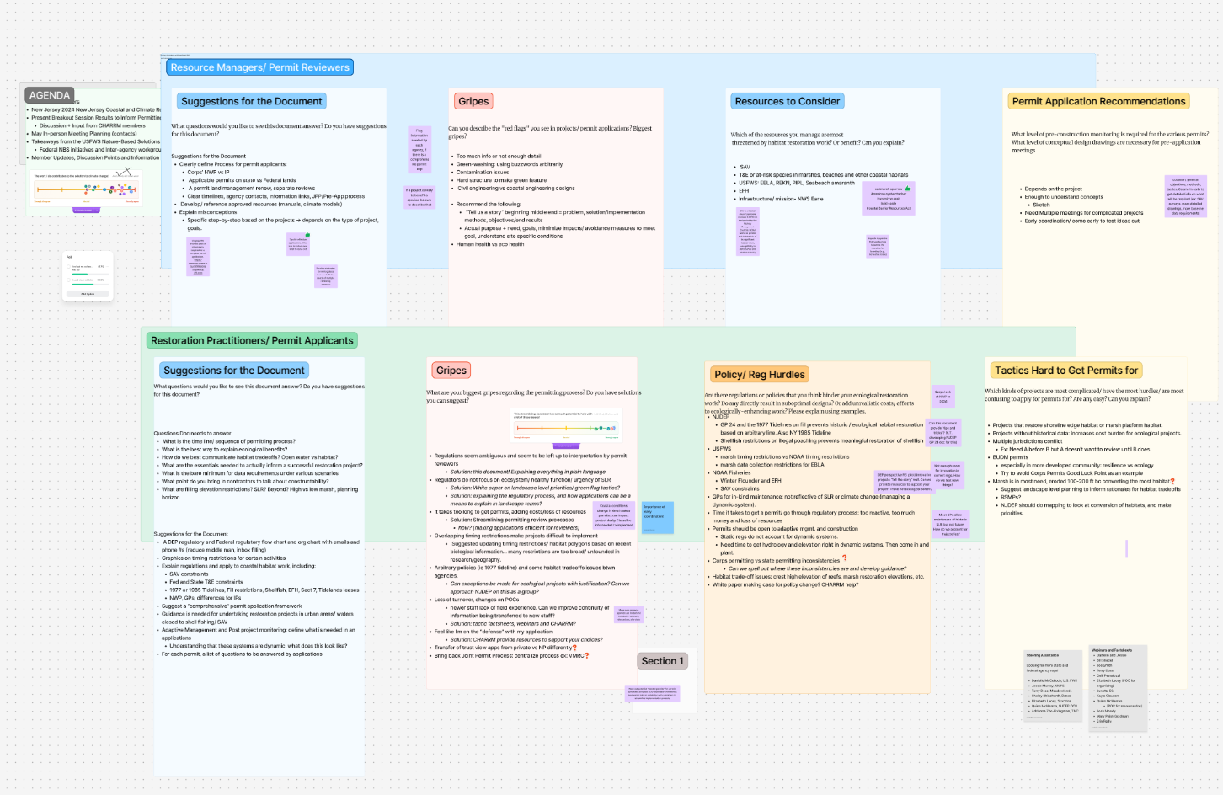
CHARRM Listening Session Results
CHARRM 2024 – FigJam
Notes:
Specific listening sessions at the last NJ CRC climate conference asking restoration community and resource managers about opportunities for efficiency in the regulatory/ permitting process. Followed up with a CHARRM meeting for input via Figma Board.
Here are the summarized results

Slide 5
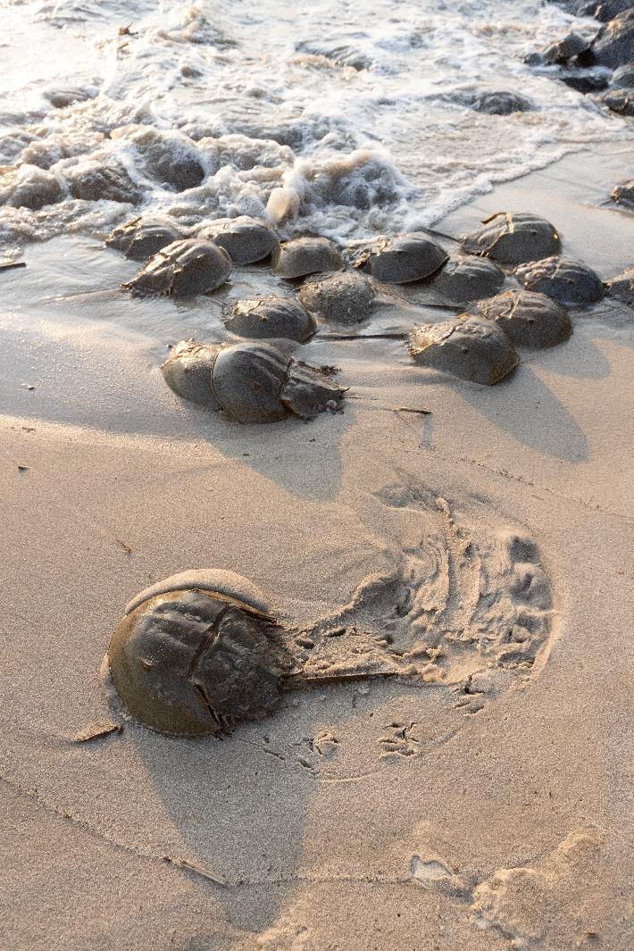
What We Heard from Restoration Practitioners
Permitting complexity/ Review times
Multiple agencies with different expectations
Sequential reviews that slow projects
Projects becoming outdated before implementation
Significant financial costs associated with regulatory delays
Regulations designed for development
Rules written for impacts rather than ecological improvement
Static regulatory frameworks for dynamic coastal systems
State vs Federal requirements = inefficient
Unclear expectations
Which data are needed vs wanted
When to engage agencies in the process
What monitoring is required for what
Innovation barriers
Difficulty permitting new restoration techniques
Limited pathways for pilot projects
Some lack of tech expertise in reviews = inability to allow innovation
Lack of understanding how to manage risk and balance for benefits
Length and Complexity of the Permitting Process
Bottom line:
Practitioners emphasized that the current process is long, difficult to navigate and not designed for restoration projects
Practitioners want predictability, clarity, and flexibility to design projects that will be successful and work in changing coastal systems.
Horseshoe Crabs in NJ. Photo by Susan Allen
Notes:
When asked about hurdles this is what practitioners told us most impact their projects related to permitting.

Slide 6
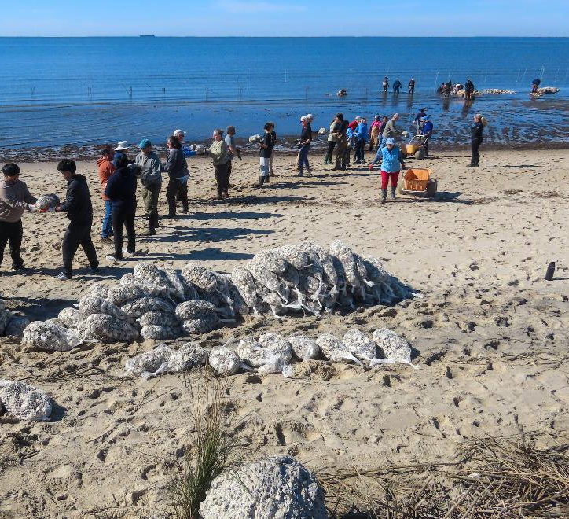
Specific Regulatory Hurdles ID’ed
Historic Regulatory Lines That Limit Restoration
1977 NJ tideline regulations (GP-24) limiting restoration on historic fill areas
Other historic polygons/ restrictions on habitat not current
Rules tied to historic conditions rather than current ecological opportunity
Conflicting or Overlapping Agency Restrictions
USFWS vs NOAA marsh or other habitat timing restrictions
Differences between state and federal permitting requirements
Corps permitting processes vs state permitting processes
Habitat Protection Rules That Limit Restoration Approaches
Shellfish restrictions related to poaching prevention
SAV (Submerged Aquatic Vegetation) constraints
Winter flounder and Essential Fish Habitat (EFH) restrictions
Habitat trade-off concerns when restoring marshes or reefs
Static Regulatory Frameworks for Dynamic Coastal Systems
Permits for in-kind maintenance that do not account for sea-level rise
Restoration design that requires time to establish hydrology and elevation before planting
Difficulty incorporating adaptive management
Mitigation required for ecological tradeoffs
Building biodegradable shell bag reefs in Delaware Bay, NJ
Notes:
Many regulatory systems were designed to evaluate environmental impacts rather than enable ecological restoration. This can create challenges when projects aim to actively restore ecosystems within dynamic coastal environments.
When asked to identify specific hurdles perceived, these were the comments we received.

Slide 7
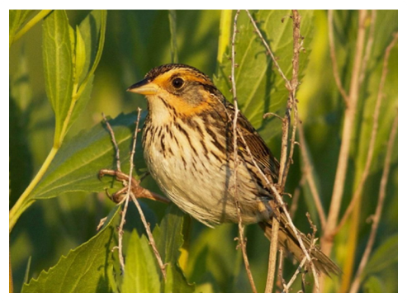
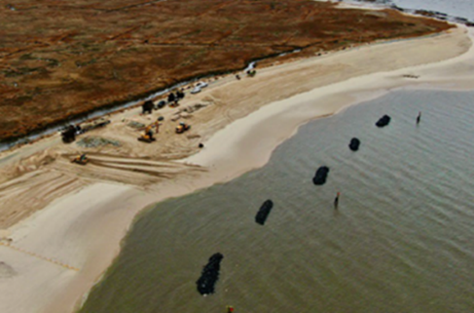
Most Difficult Projects to Permit
Shoreline edge and marsh platform restoration projects, especially where marsh loss is severe, though this where we lose the most coastal habitat.
Projects without historical data face higher costs and additional scrutiny.
Projects with habitat conversion to address process issues (tradeoffs)
Multiple jurisdictions can create conflicting review processes (i.e: one agency requiring review before another will act).
Beneficial Use of Dredged Material (BUDM) permits can be particularly complex.
Projects in highly developed areas often face tension between coastal resilience needs and ecological restoration goals.
Notes:
When asked which projects they have the most difficulty permitting, practitioners told us that

Slide 8
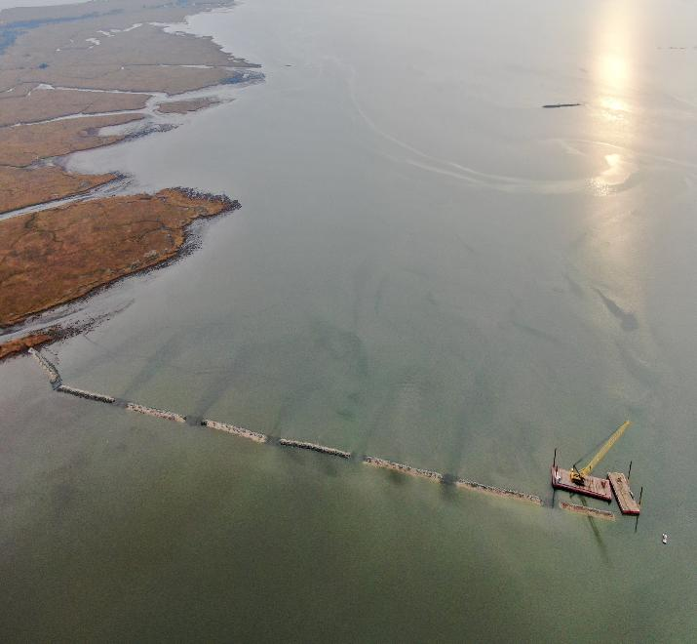
What We Heard from Resource Managers and Reviewers
Applications are often difficult to review
Missing key information or too much unnecessary information
Unclear project goals, clear need
Insufficient site characterization
Ecological tradeoffs must be evaluated, but not enough info regarding resources including
SAV habitat
shellfish resources
endangered species
essential fish habitat
etc
Capacity/ Turnover Limitations
Needs for Increased capacity and more reviewers to keep up with applications
Knowledge exchange or guidance docs from other agencies to help to overcome high turnovers and loss of expertise
Concern about “greenwashing”
Some projects framed as restoration primarily stabilize infrastructure
Need to hold restoration to same legal standards
Monitoring and accountability
Clear performance metrics needed
Monitoring data rarely shared broadly
Bottom line Reviewers want clear project narratives and monitoring frameworks that demonstrate real ecological benefit.
Resource managers emphasized the need for more resources, clearer project proposals and stronger ecological justification in applications.
Side note on everchanging regulatory landscape these days…
Maurice River Project, Drone Image by L. Niles
Notes:
We also asked resource managers and permit reviewers about what their biggest gripes are about applications they received. They stated that

Slide 9

Can you describe the "red flags" you see in projects/ permit applications?
Too much unnecessary info to wade through
Not enough detail on the right things
Green-washing: using buzzwords arbitrarily
Contamination issues
Hard structure to make green feature
Civil engineering vs coastal engineering designs
Recommend the following:
“Tell us a story” beginning middle end = problem, solution/implementation methods, objectives/end results
Come in early to get detailed info on what will be required (ex: SAV surveys, more detailed drawings, more baseline data requirements)
Actual purpose + need, goals, minimize impacts/ avoidance measures to meet goal, understand site specific conditions
Human health vs eco health arguments
Maurice River Project, Drone Image by L. Niles
Notes:
We asked reviewers what were the red flags the saw from projects.

Slide 10
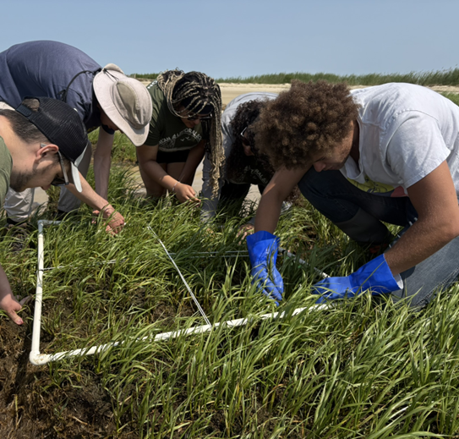
Where Both Groups Agree
Clear guidance
Clear permitting roadmap
Permitting flowcharts
Checklists and templates
Habitat or species specific guidance (as allowable)
Earlier and Frequent Coordination
Engage agencies earlier in project design
Structured pre-application pathways
knowledge sharing, overcoming hurdles helpful for outside permitting processes (CHARRM)
Increased data / results = increased opportunity for streamlining
Programmatic permits for certain tactics possible
Takes time, expertise, but could help in long run
Pathways like NWP and GP and understanding on limitations of these and opps for expansion
State and Fed coordination opps?
Better monitoring frameworks
Standardized metrics for various tactics
Expectations and adaptive management triggers clear on both sides
Shared learning
Lessons from completed projects helpful for future reviews
Better information exchange between practitioners and regulators outside of permitting allows for open exchange
Key insight
The biggest opportunities for efficiency come from improving clarity, coordination, and shared understanding.
Despite different perspectives, there was strong alignment on solutions.
Notes:
Guidance docs: tradeoffs paper, federal guidance for reviewers, CHARRM/ nj crc working on permitting gui9dance document
Some progress on these NJFO= ESA workshop annually
Corps NWP updates
Suggestions:
Create a Restoration Permitting Roadmap W clear Monitoring & Adaptive Management Frameworks
Create Pathways for Innovation (managed risk) in the regulations
Create pathways for improved interagency coordination
(State + Federal Collab on Programmatic Permits)
Build a Shared Learning Network

Slide 11
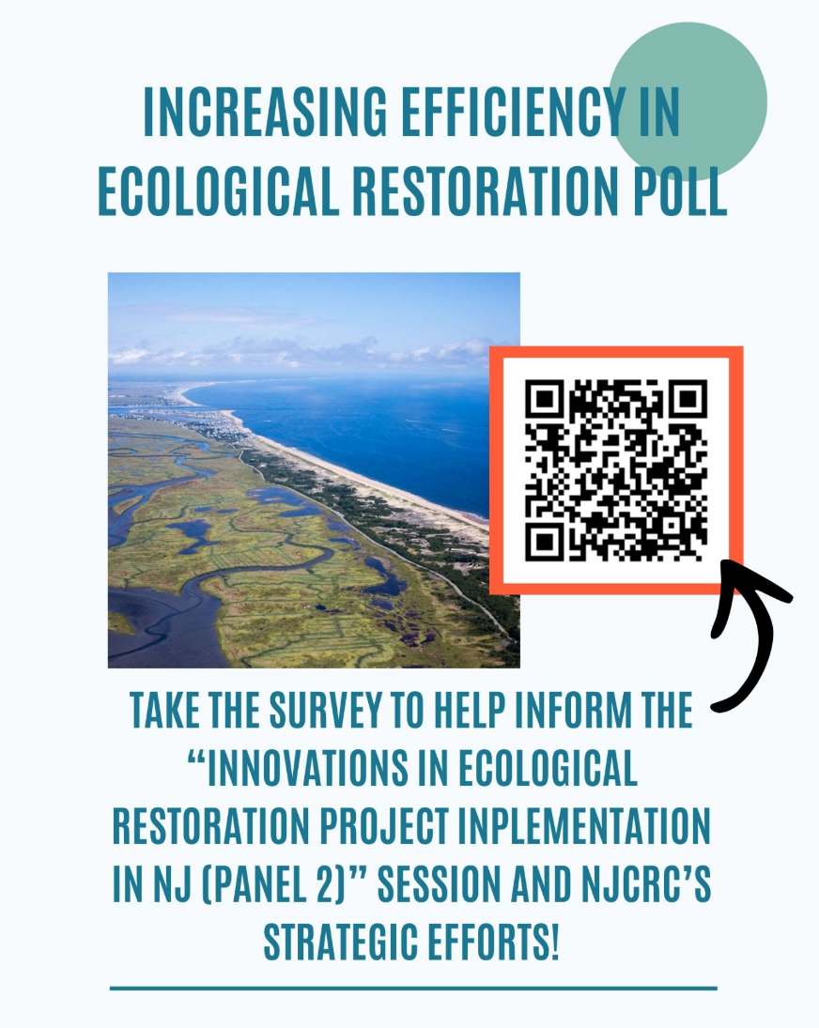

Slide 12
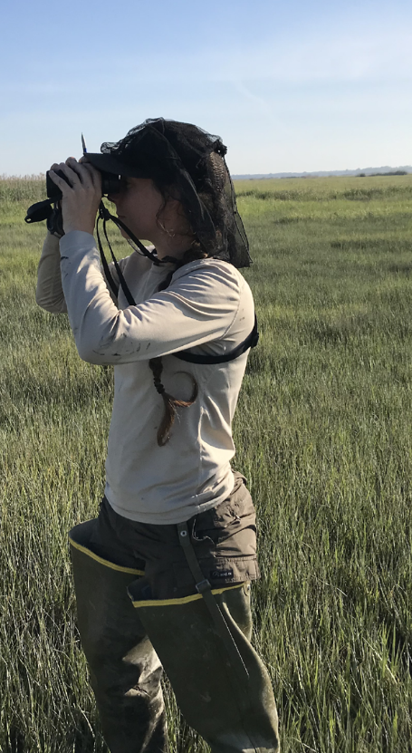
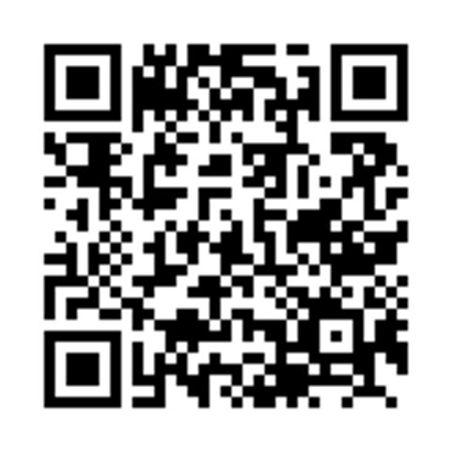
What do you think?
Please share your thoughts with us by taking this 5-minute Poll via your Phone
Instructions
Open your camera and point towards QR code
When your device scans the QR code, you'll see an icon or web address
Click the link and take the 5 min survey.

