Slide 1


Building Partnerships to Support New Jersey's Climate Literate Workforce
Panelists: Michael Acquafredda, Diana Burich, Gianna Hart, & Domingo Zapata
Moderators: Sarah Sterling, Ross Gary, & Jessica Valenti
March 10, 2026
nj.gov/education

Slide 2
Welcome! As you settle in…
Think about an experience in your childhood that inspired you to engage in your current work.
Be ready to share your story with a partner.

Slide 3
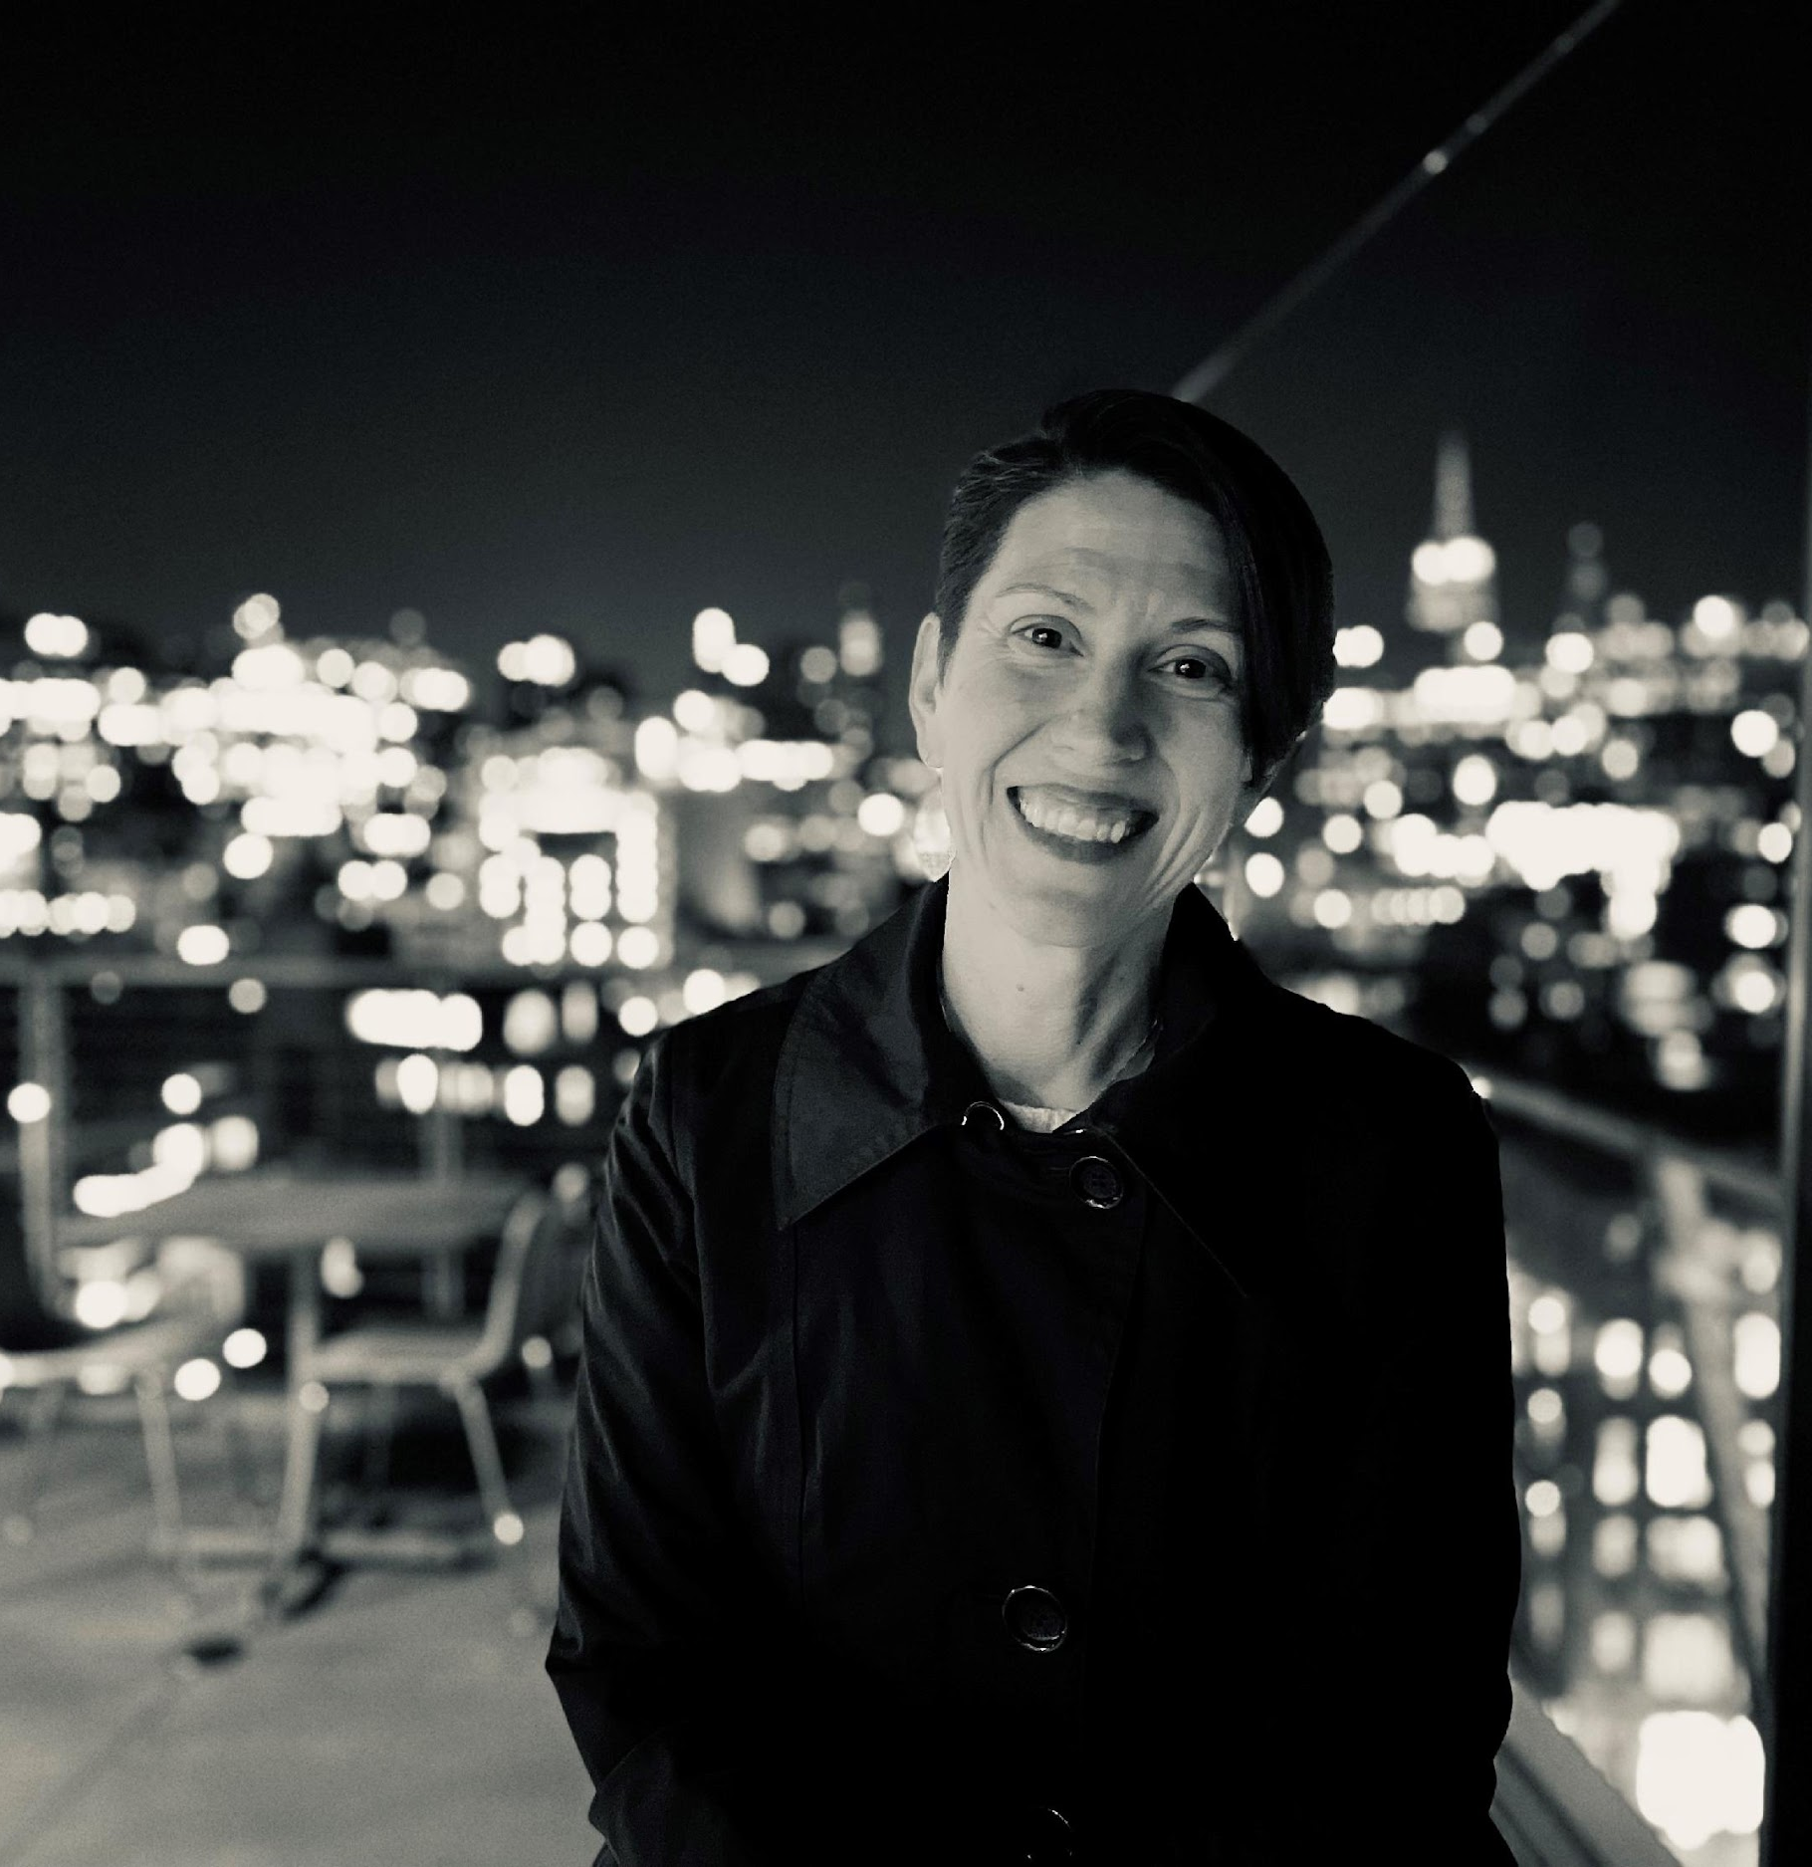
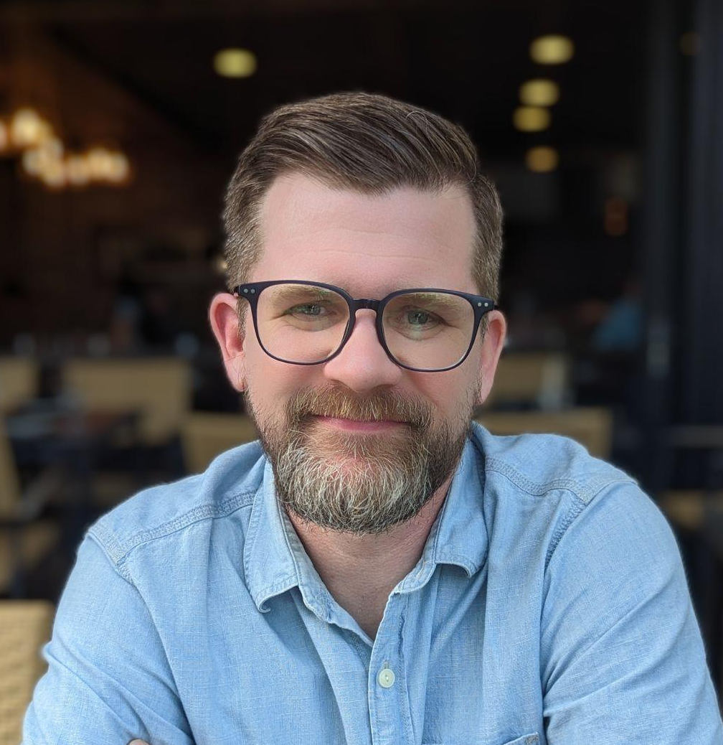
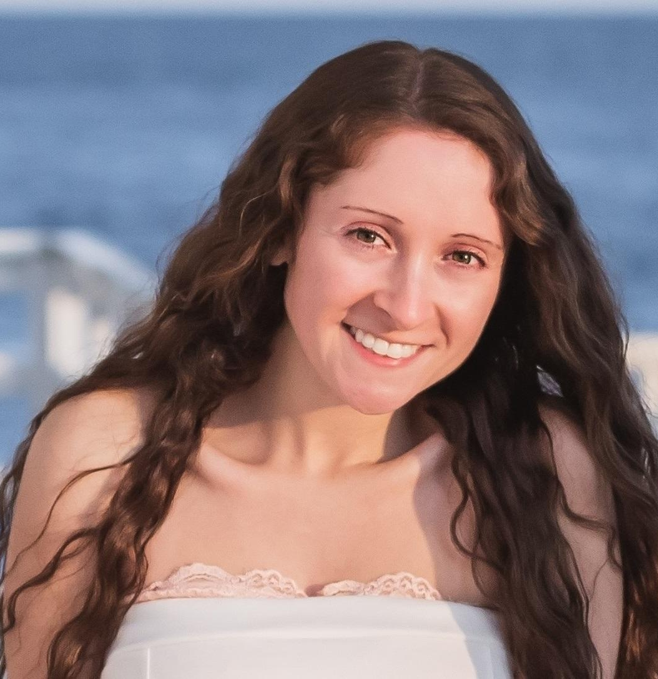
Moderator Introductions
New Jersey Department of Education
Sarah Sterling
Senior Climate Change Education Advisor
Ross Gary
Climate Change Education Specialist
Jessica Valenti, PhD
Climate Change Education Specialist

Slide 4
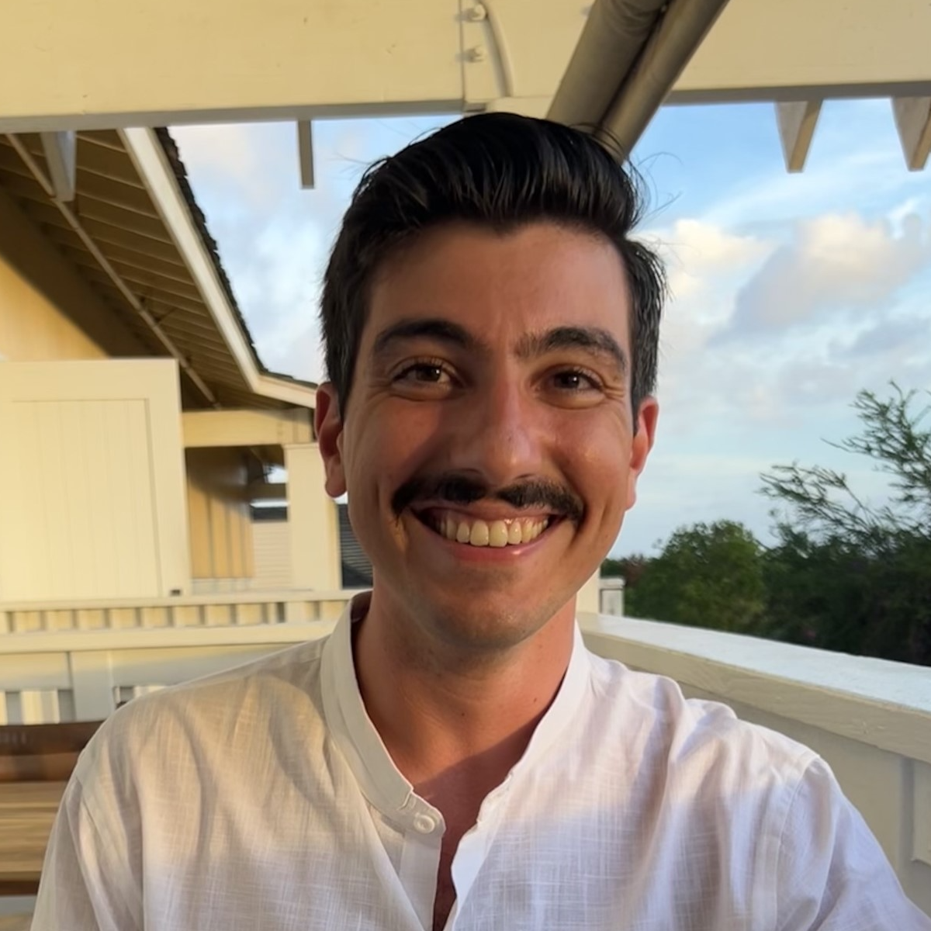
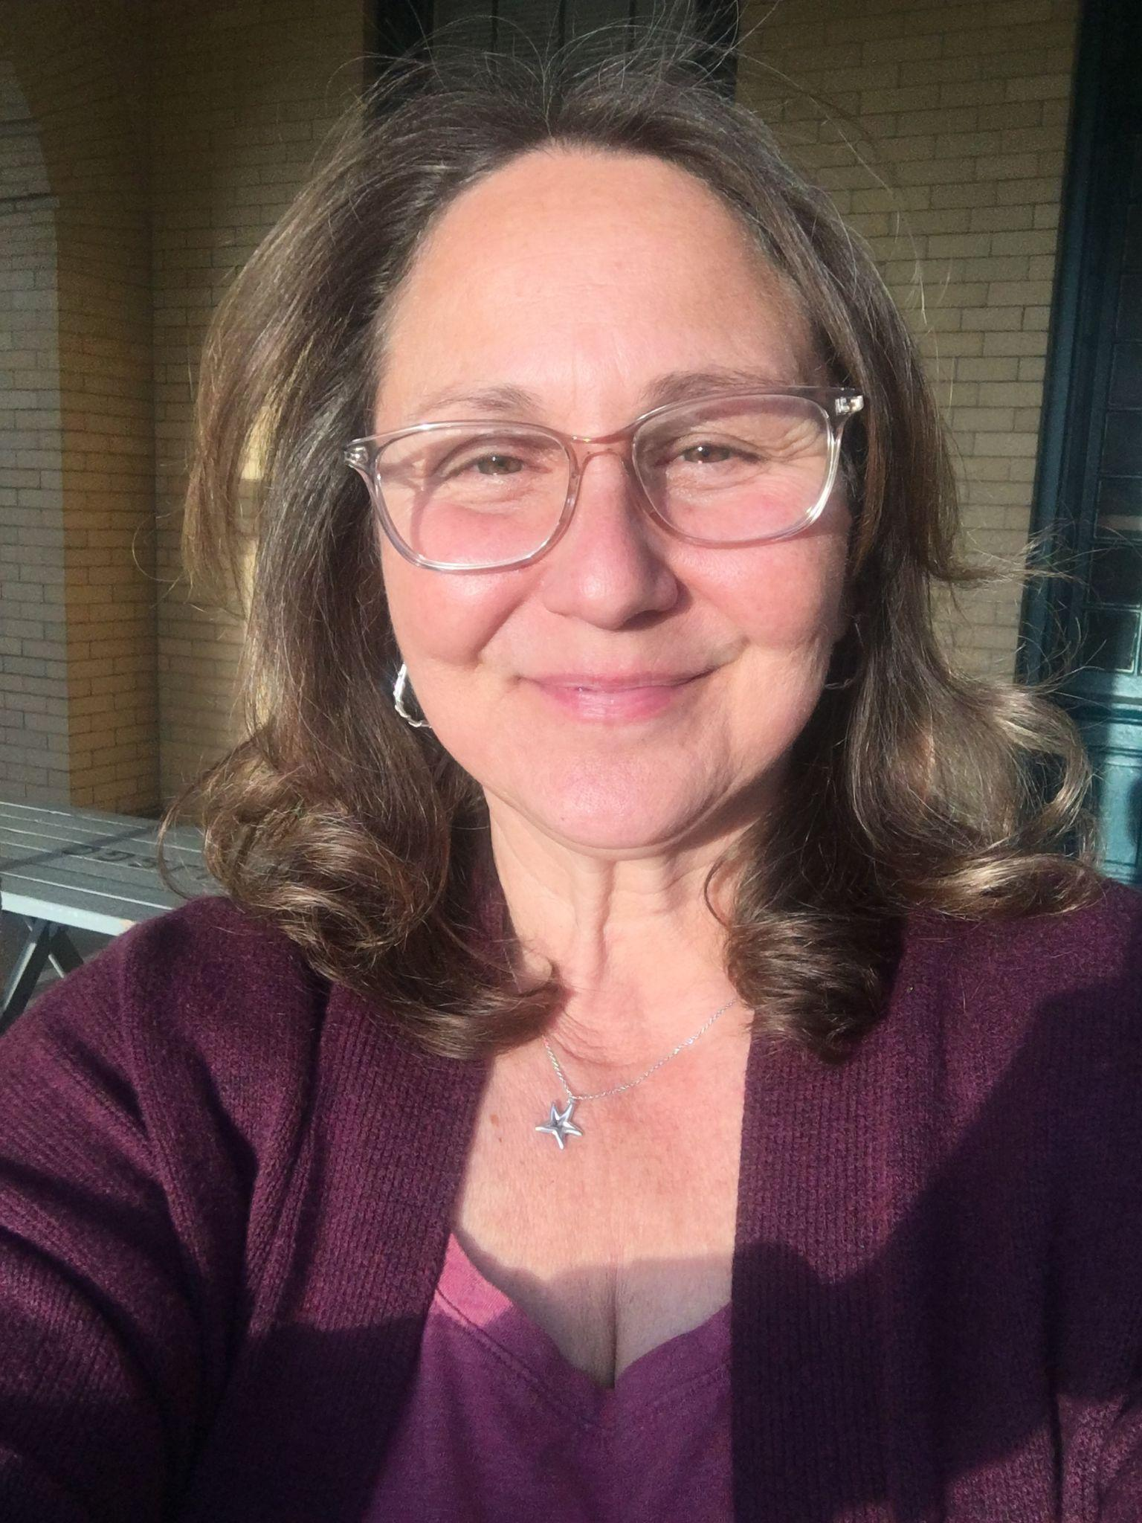
Panelist Introductions
Rutgers University | NJ Sea Grant Consortium (NJSGC)
Michael Acquafredda, PhD
Assistant Extension Specialist, Rutgers
Aquaculture Specialist, NJSGC
Diana Burich
Director of Education, NJSGC

Slide 5
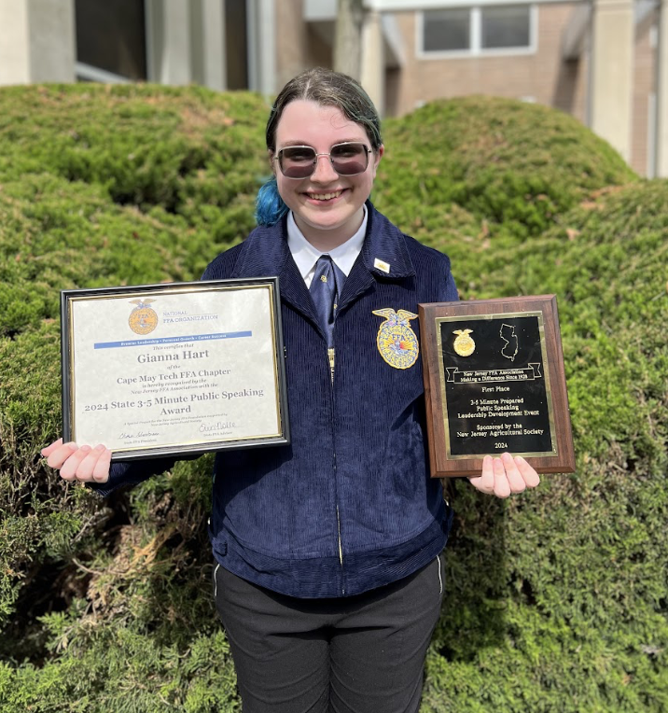
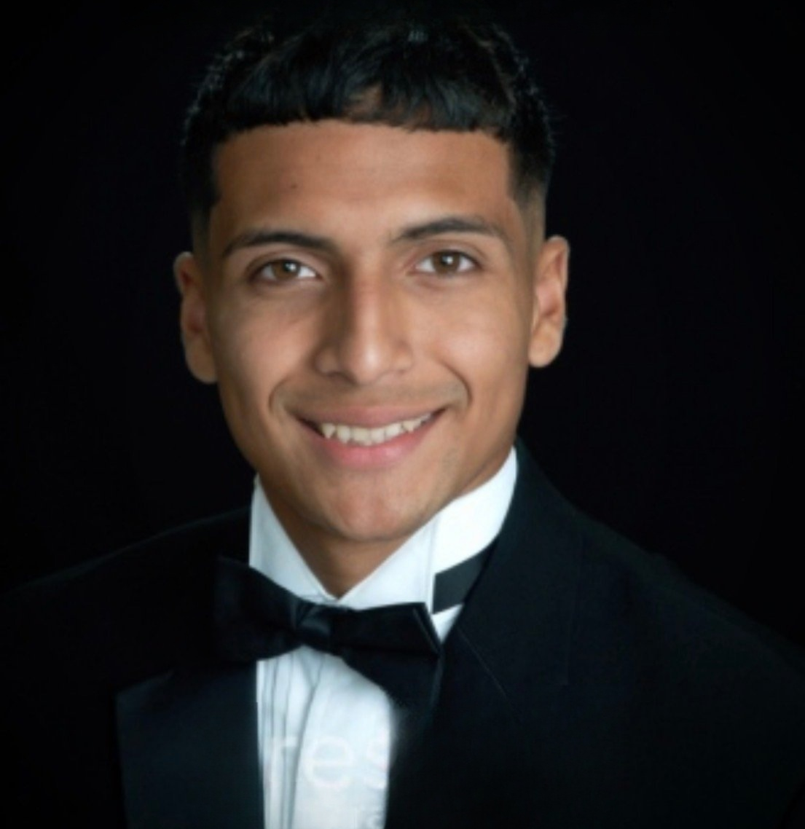
Panelist Introductions
Cape May County Technical School District
Gianna Hart
Student, Cape May County Technical High School
Domingo Zapata
Student, Cape May County Technical High School

Slide 6
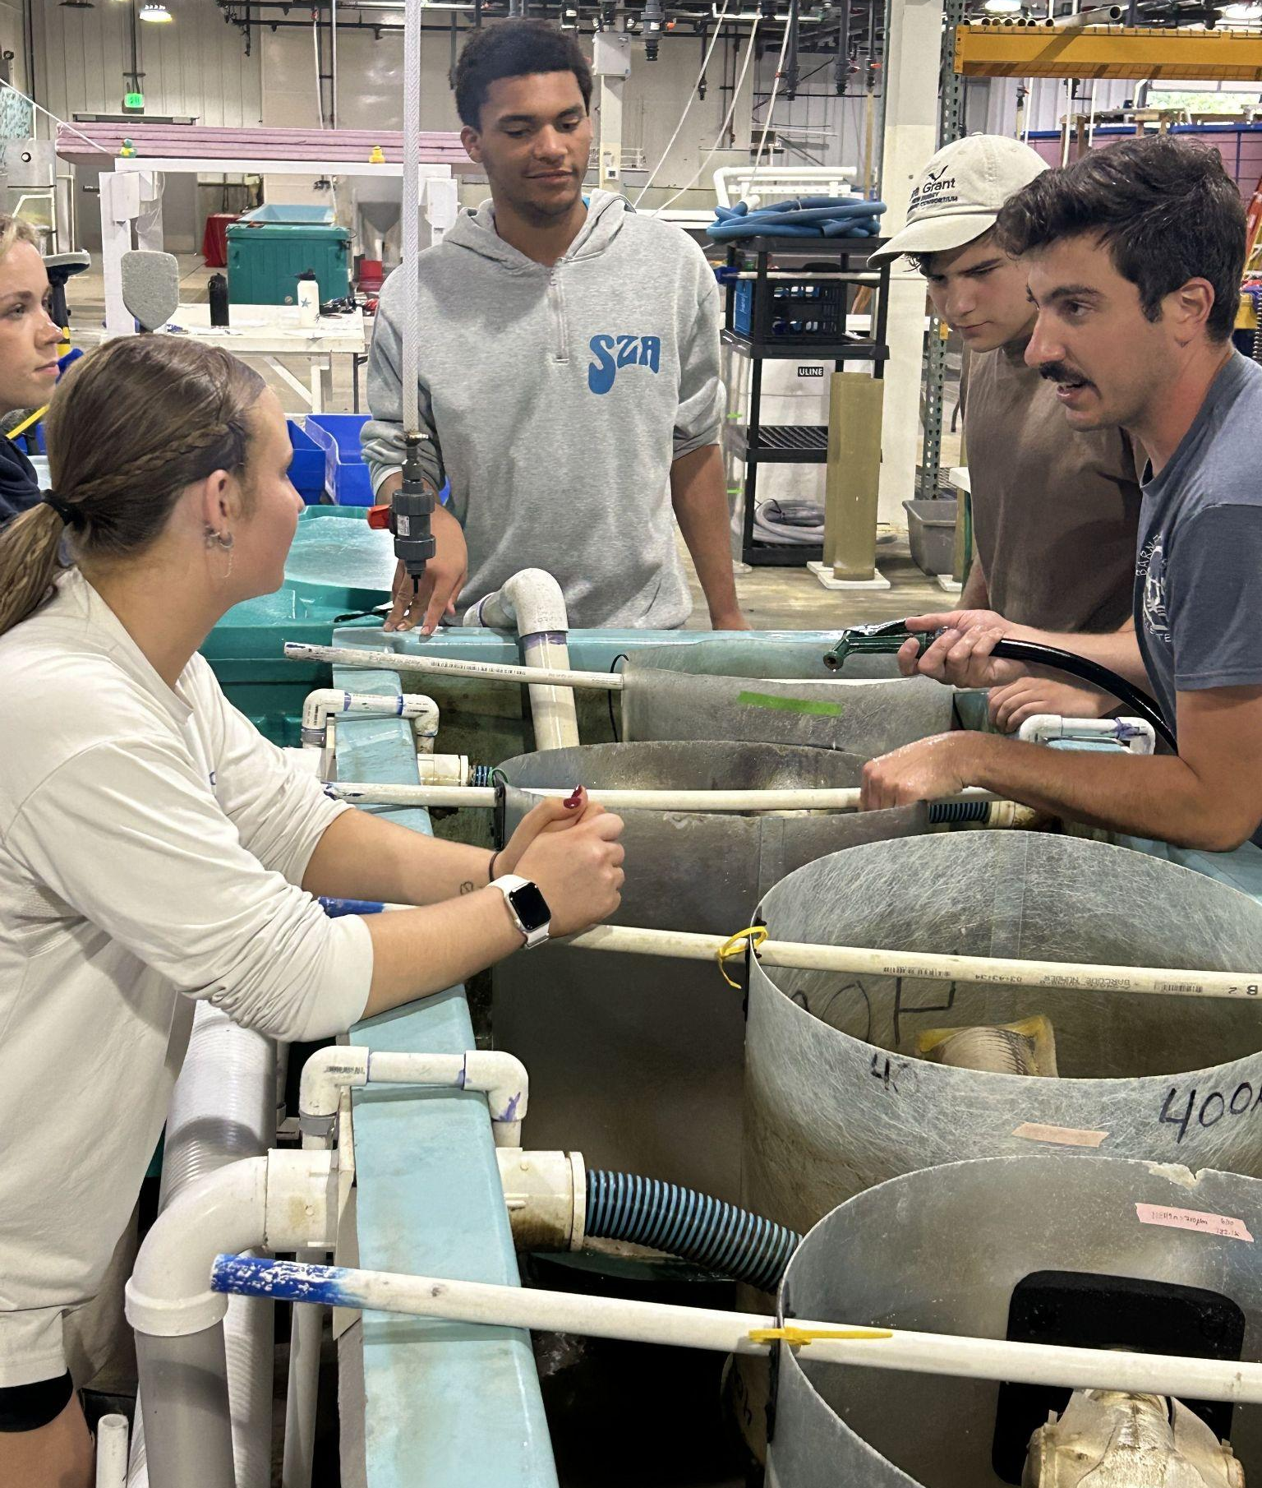
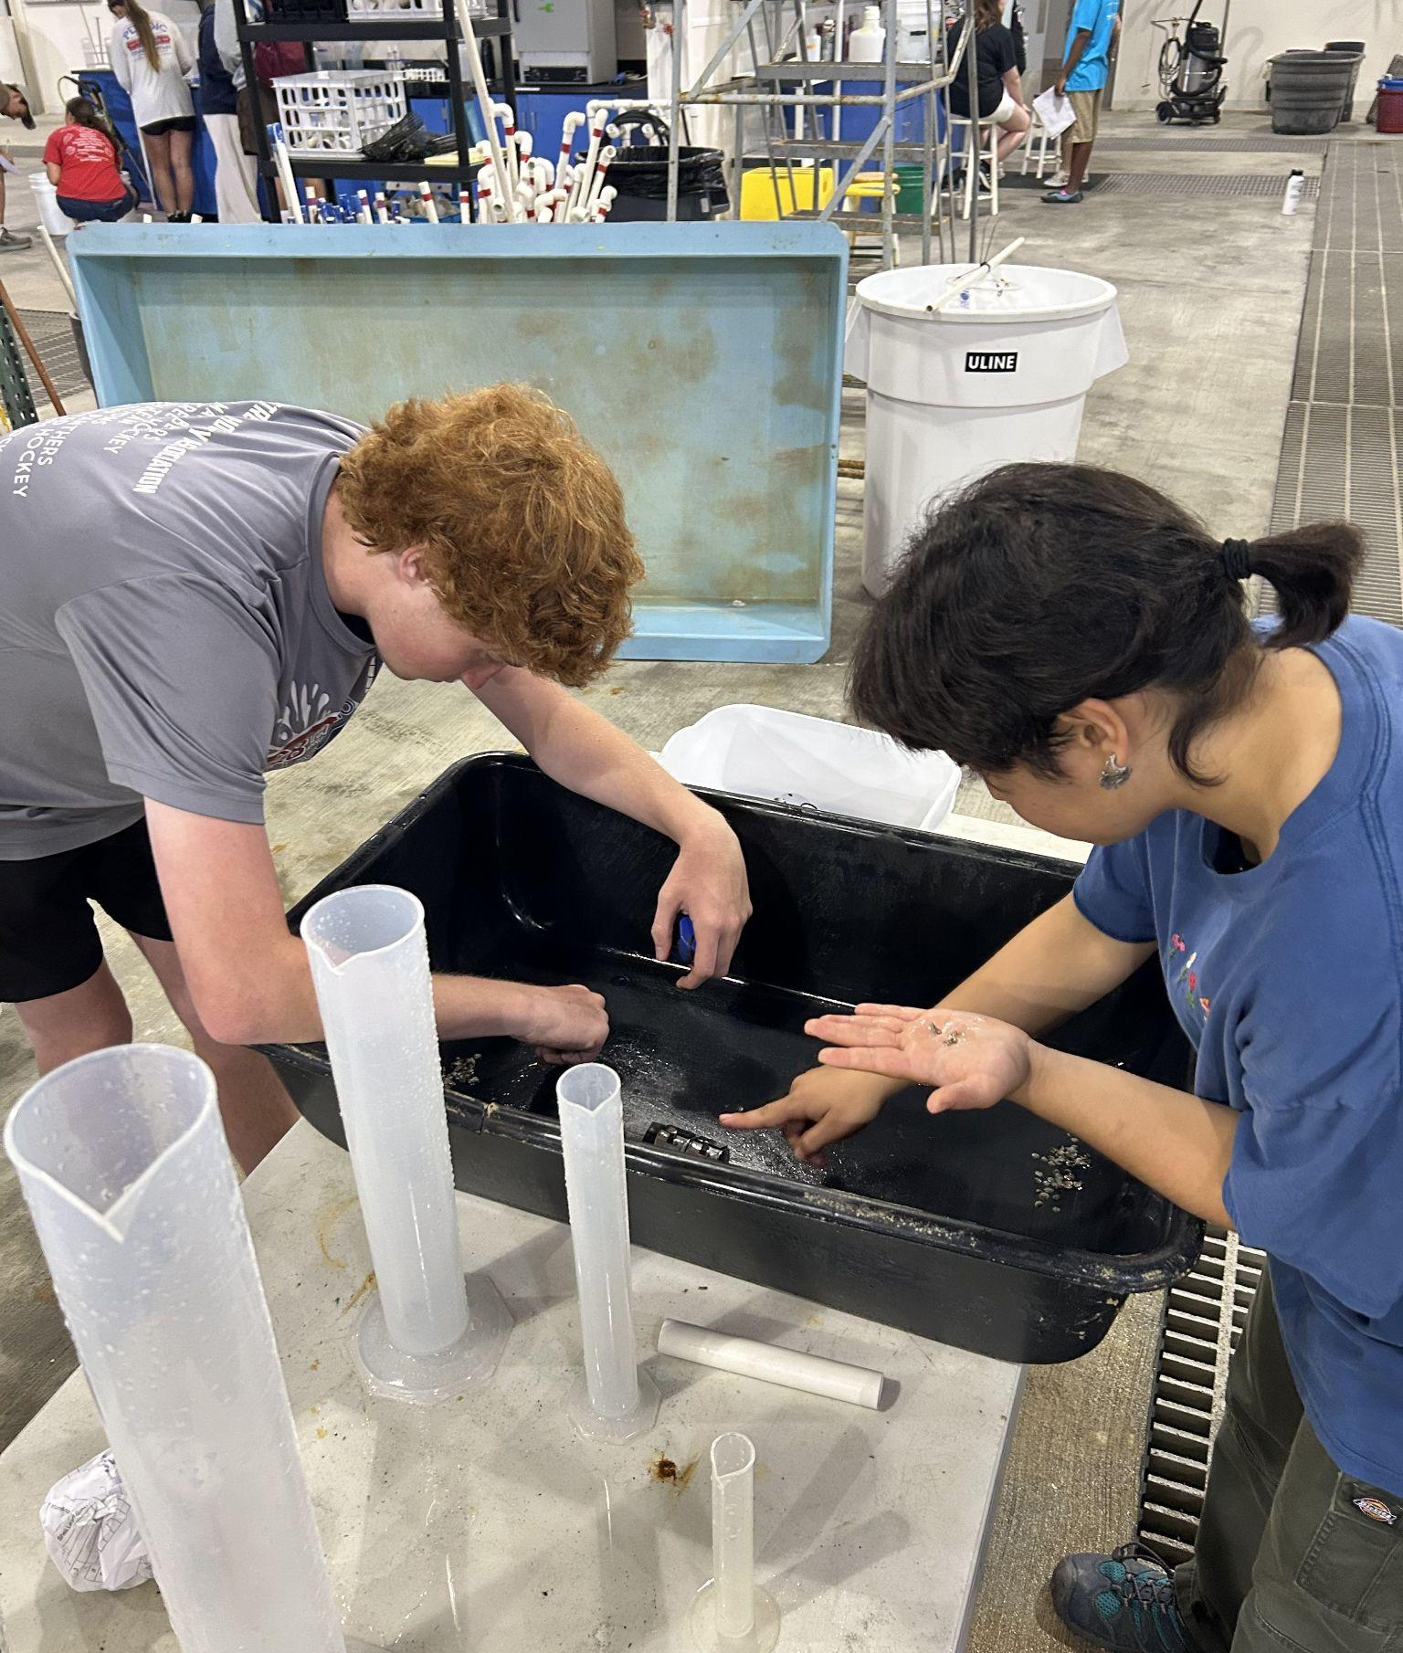
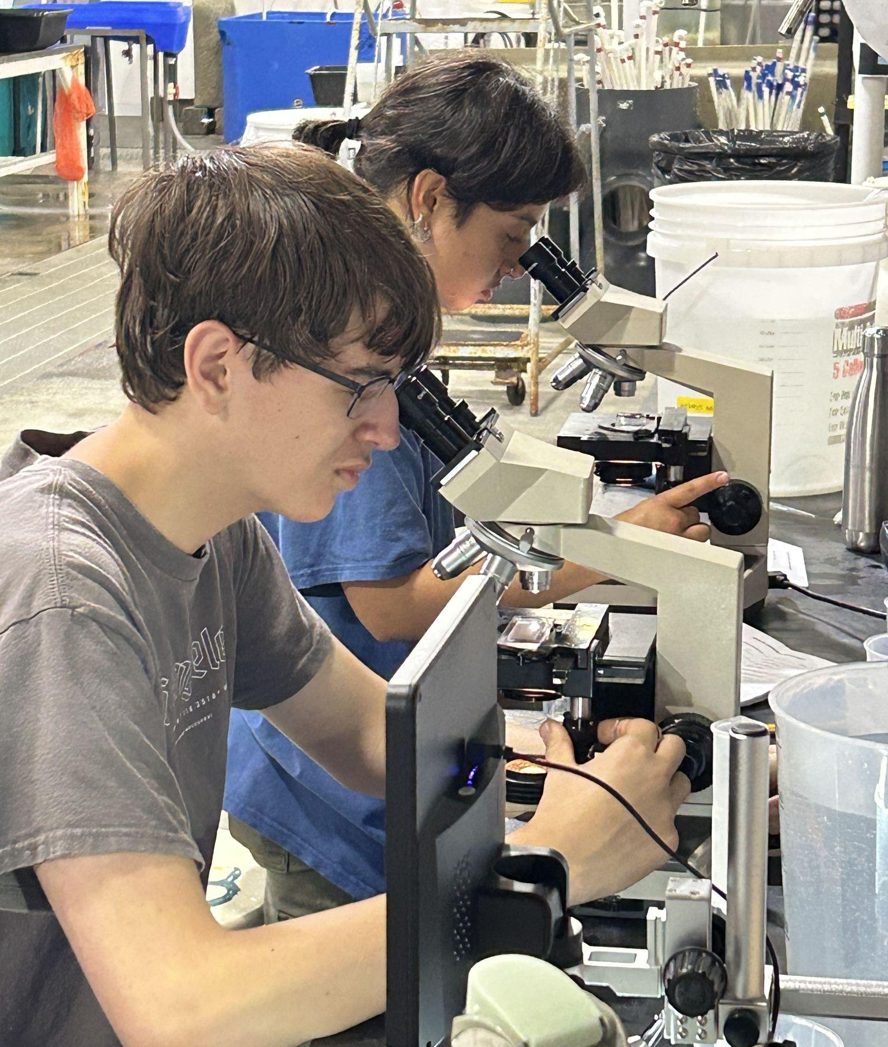
Workforce Development in High School (1 of 2)
Apprenticeship in Shellfish Aquaculture Program (ASAP)

Slide 7
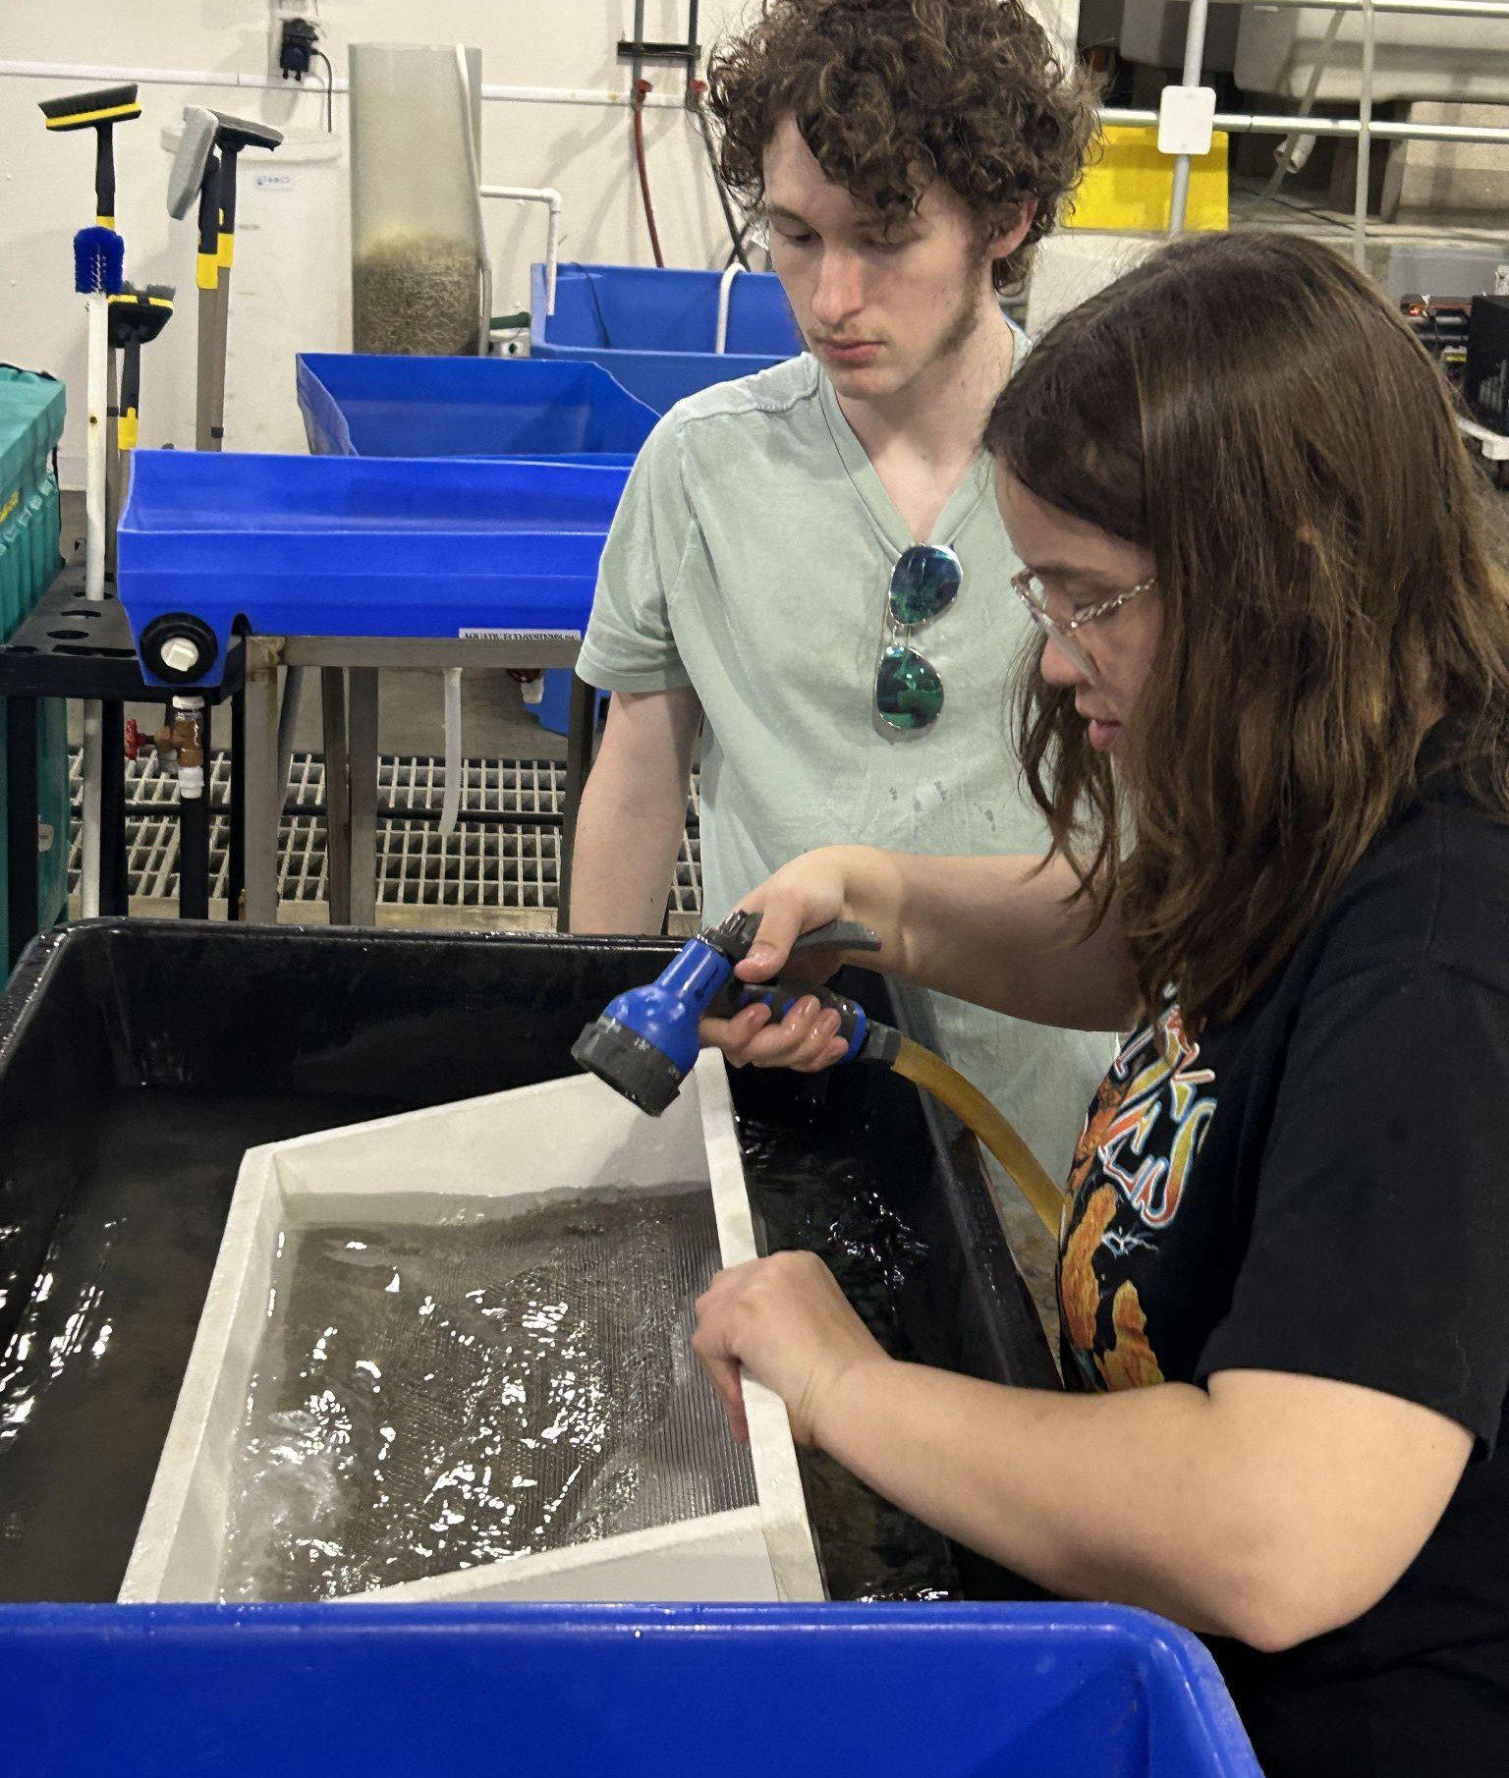
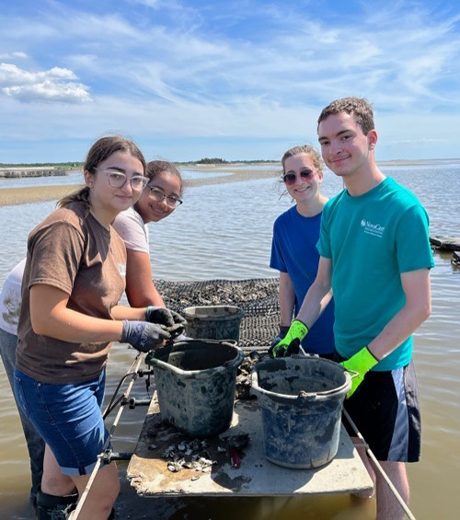
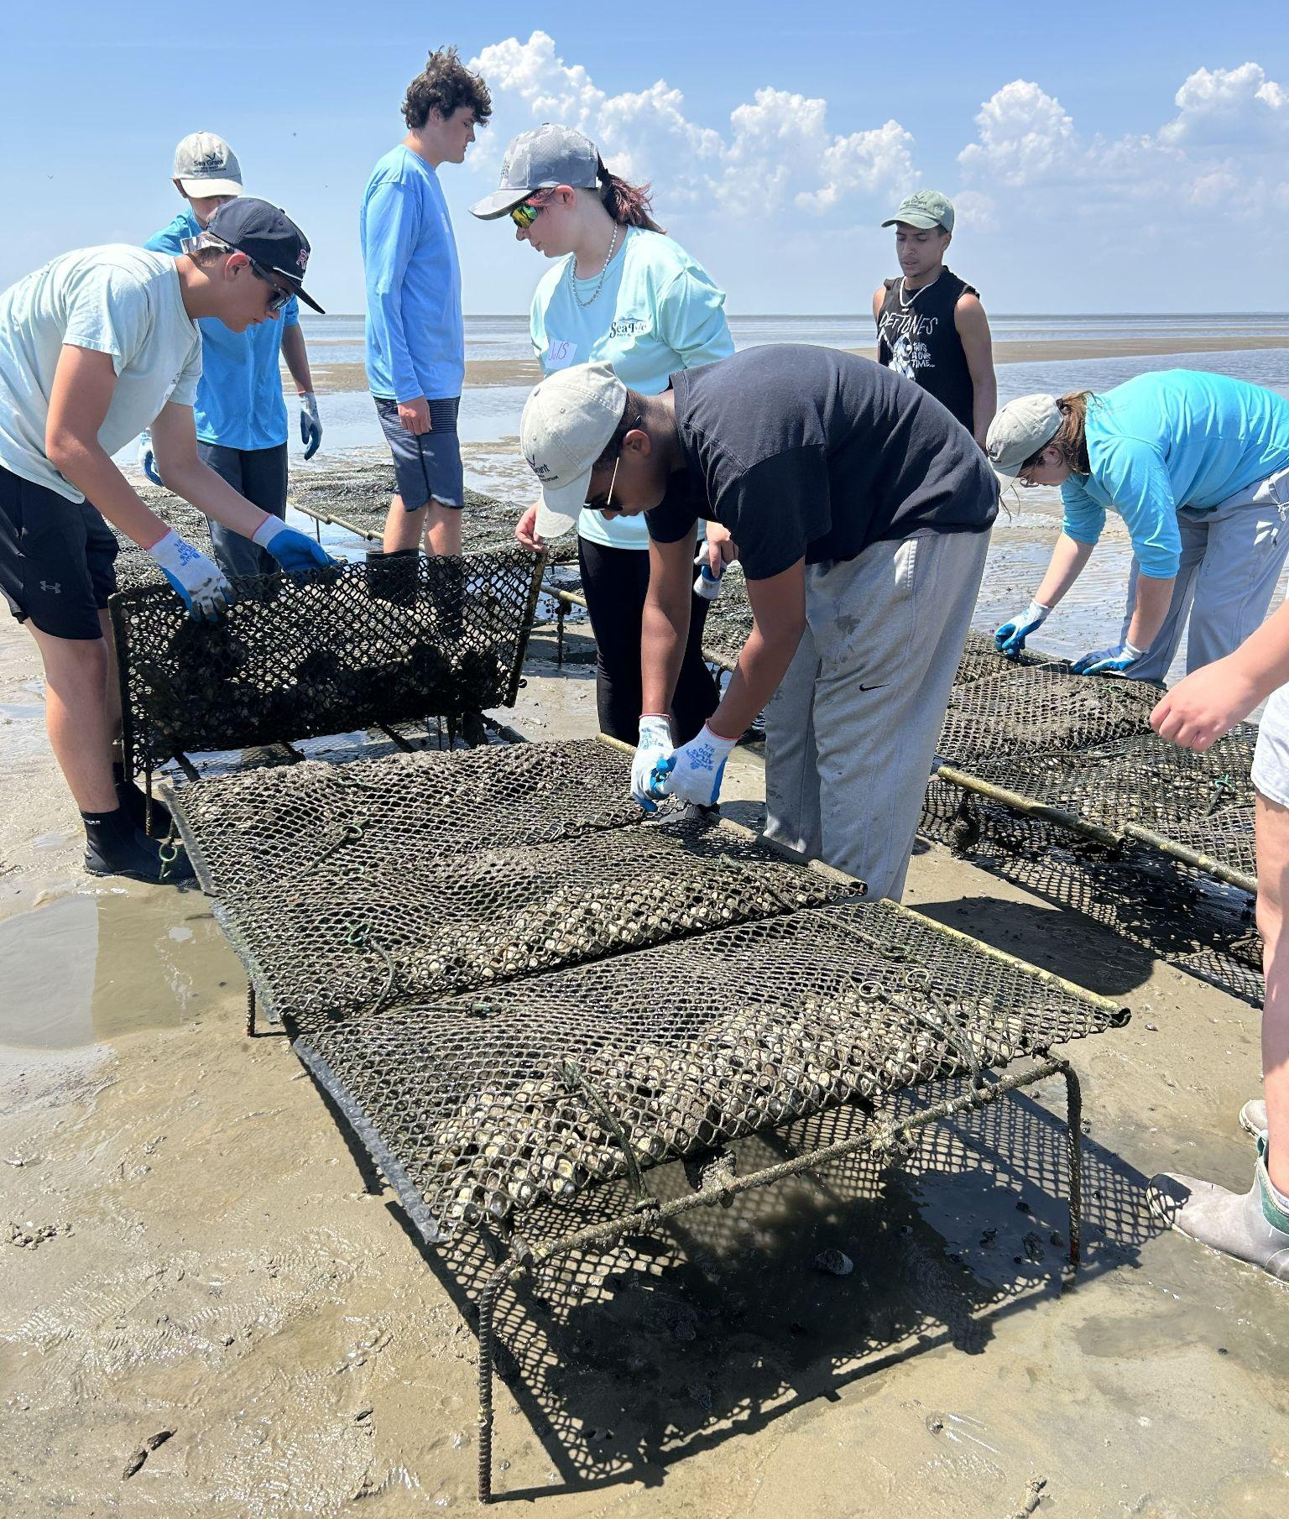
Workforce Development in High School (2 of 2)
Apprenticeship in Shellfish Aquaculture Program (ASAP)

Slide 8
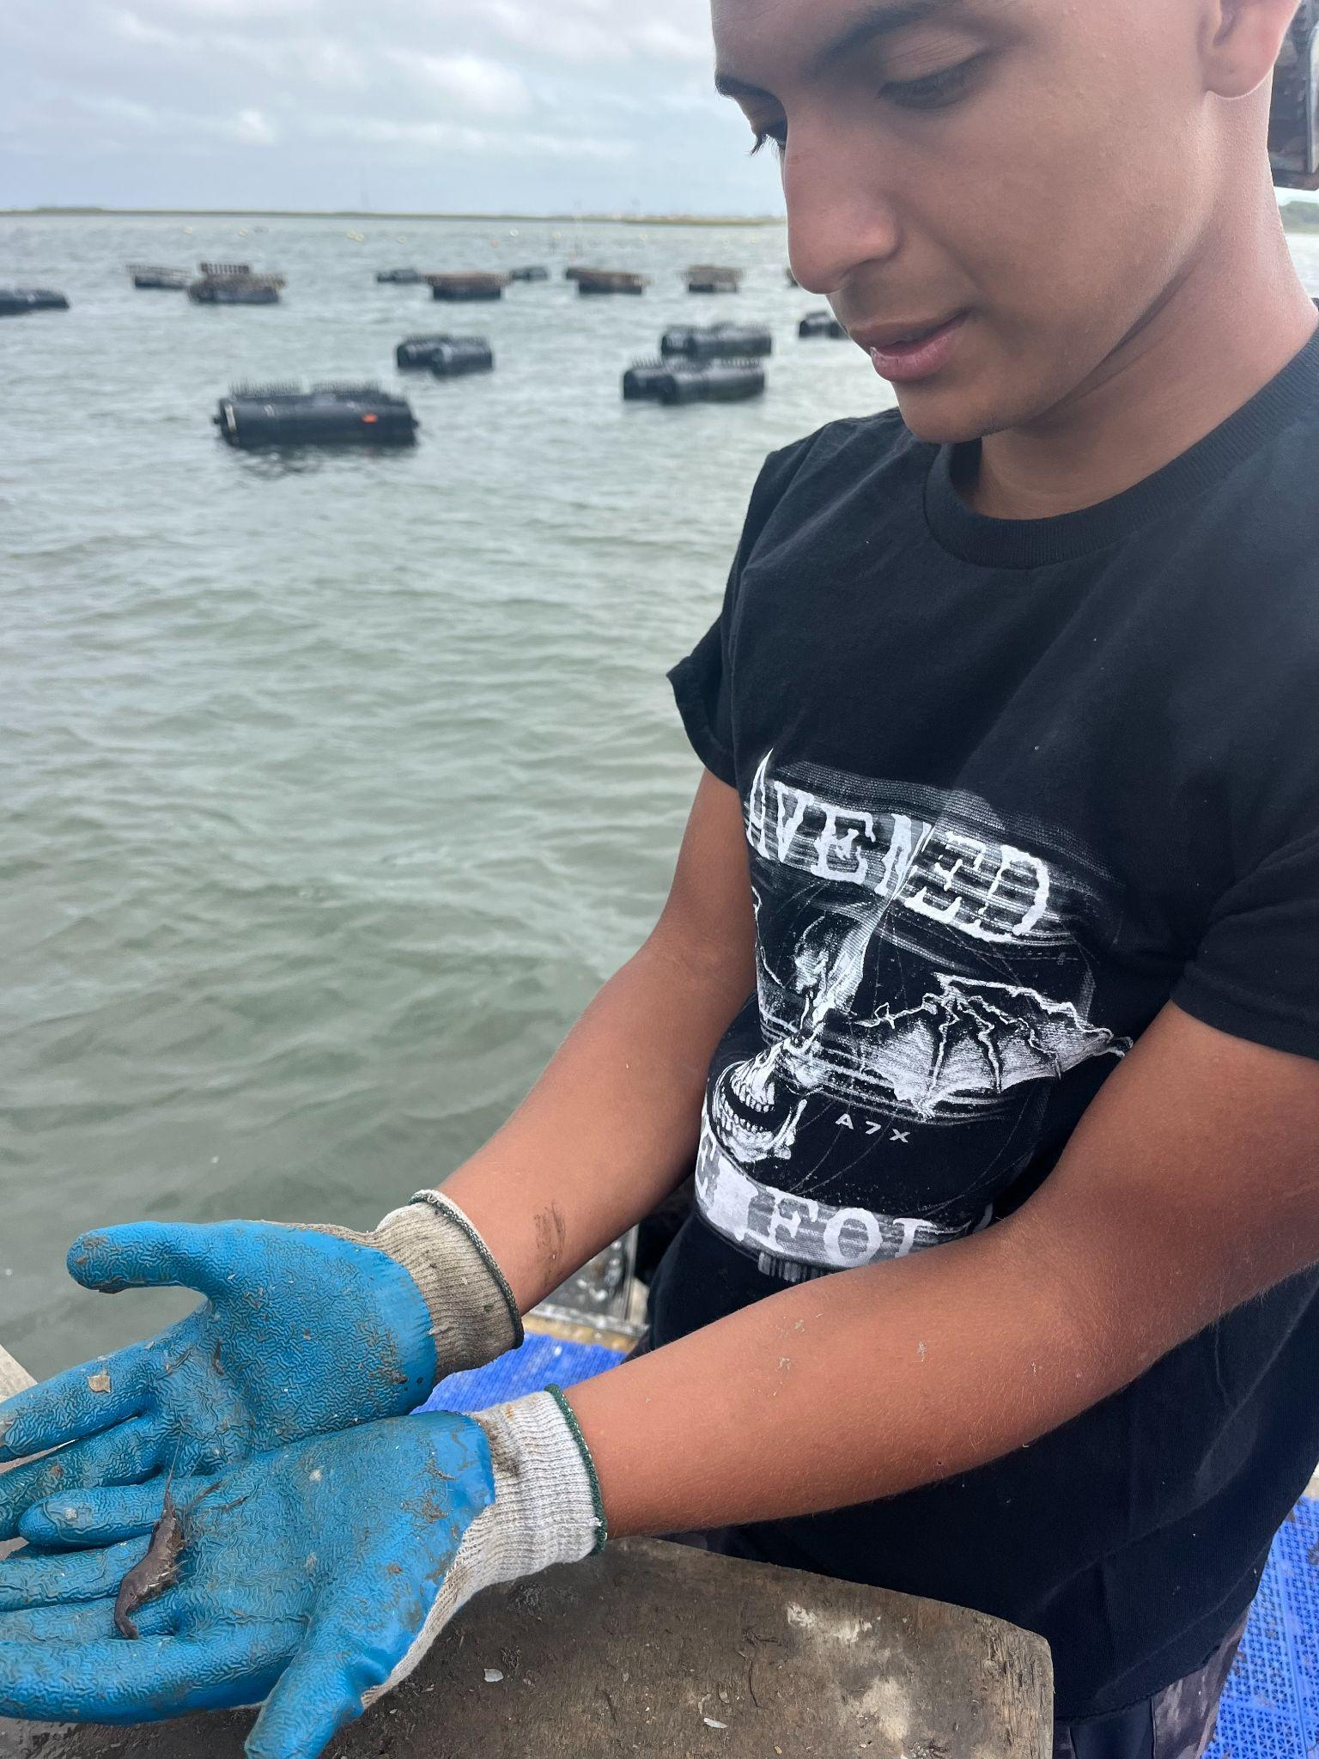
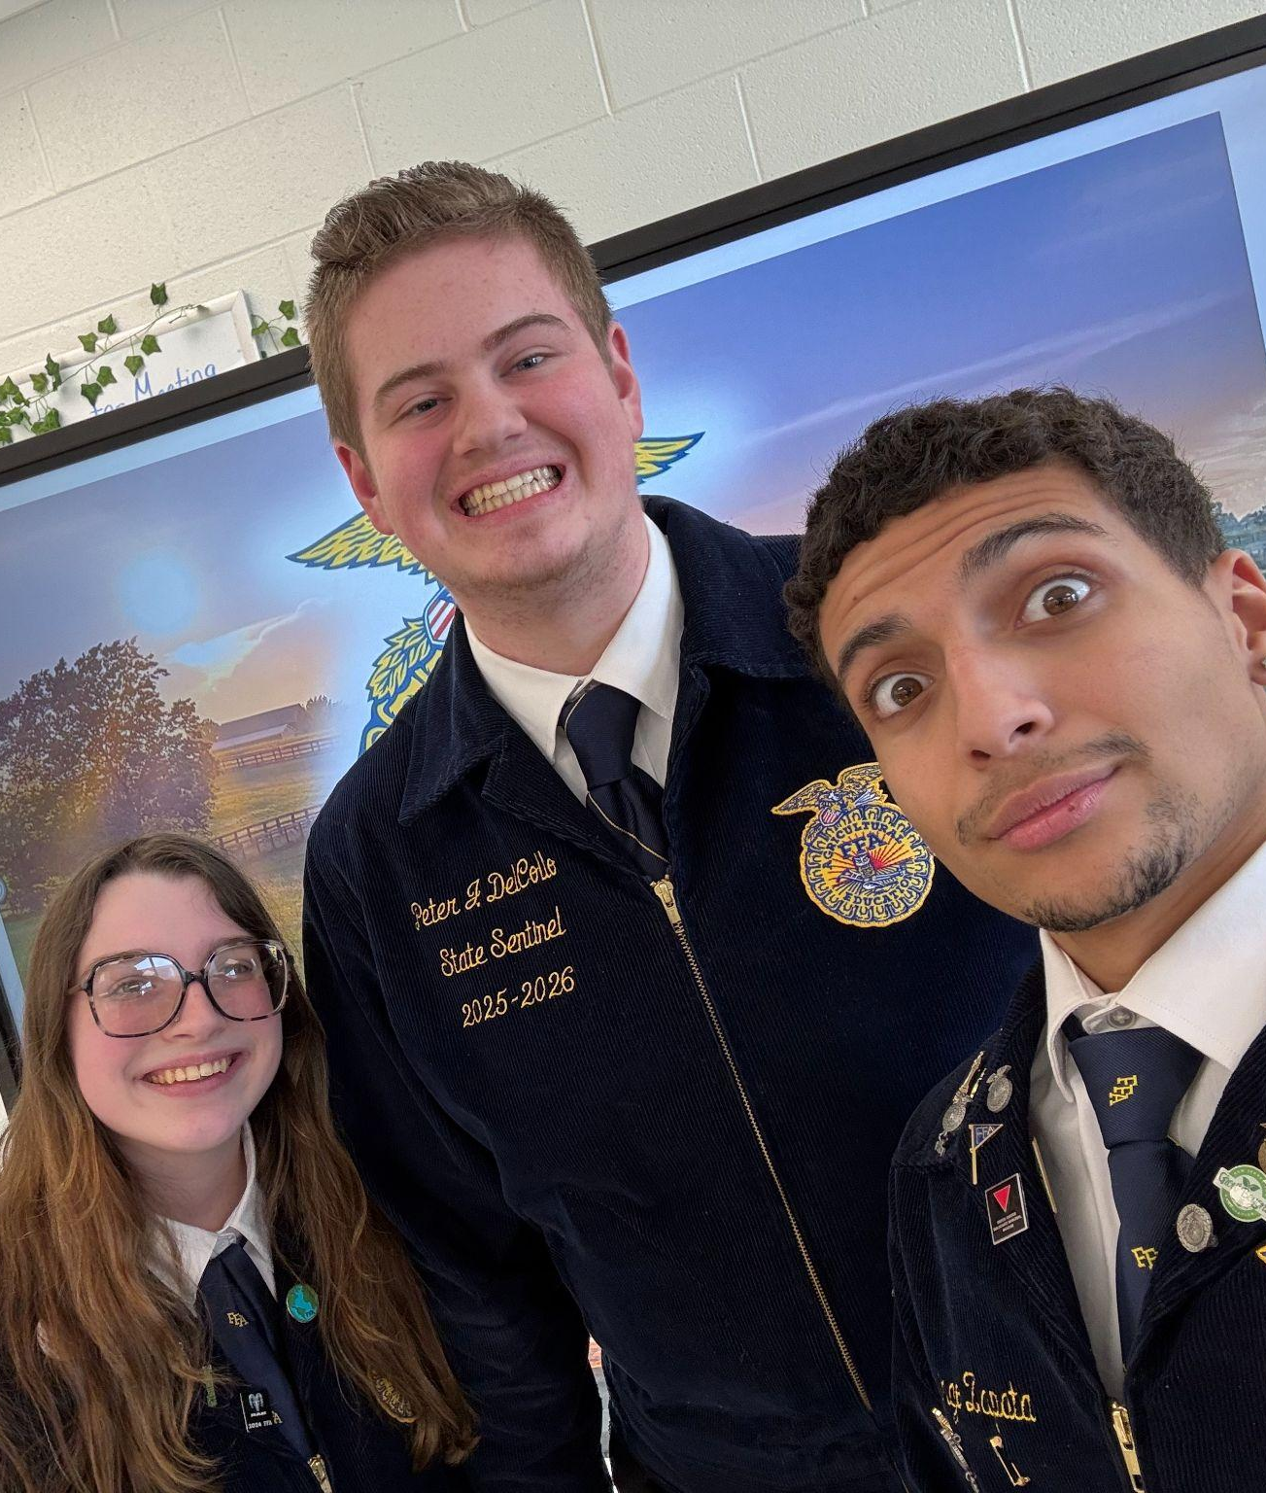
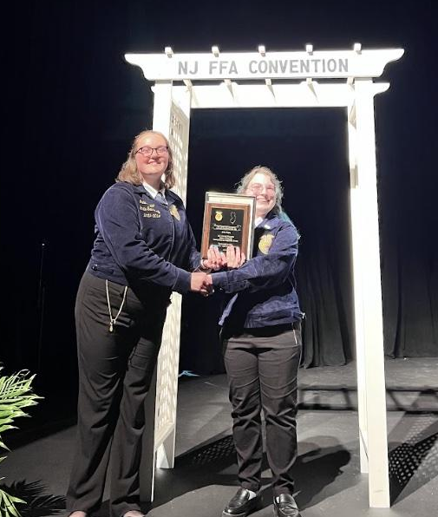
Workforce Development Experiences
Domingo and Gianna

Slide 9
Thinking about your field of work or study, what kind of opportunities could be created to provide younger learners access to your work?
How might we be able to develop a better understanding of resilience careers through innovative partnerships?

Slide 10
Questions?

Slide 11
Follow Us
Facebook @njdeptofed
X @newjerseydoe
Instagram @newjerseydoe
LinkedIn New Jersey Department of Education
nj.gov/education
Threads @newjerseydoe
YouTube @newjerseydepartmentofeduca6565

Slide 12

Thank You!
Michael Acquafredda, PhD
Assistant Extension Specialist in Aquaculture
Rutgers University
michael.acquafredda@rutgers.edu
Diana Burich
Director of Education
New Jersey Sea Grant Consortium
dburich@njseagrant.org
Kristen Schaffer
Director of Curriculum and Instruction
Cape May County Technical School District
kschaffer@capemaytech.com
Sarah Sterling
Senior Climate Change Education Advisor
New Jersey Department of Education
sarah.sterling@doe.nj.gov

