Slide 1
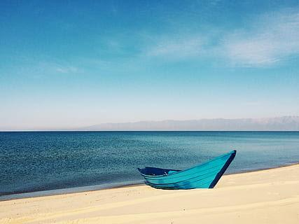
Community Creators:
Art Bridging the Gap in Coastal Hazard Communities
Presenter: Chase Jackson

Slide 2

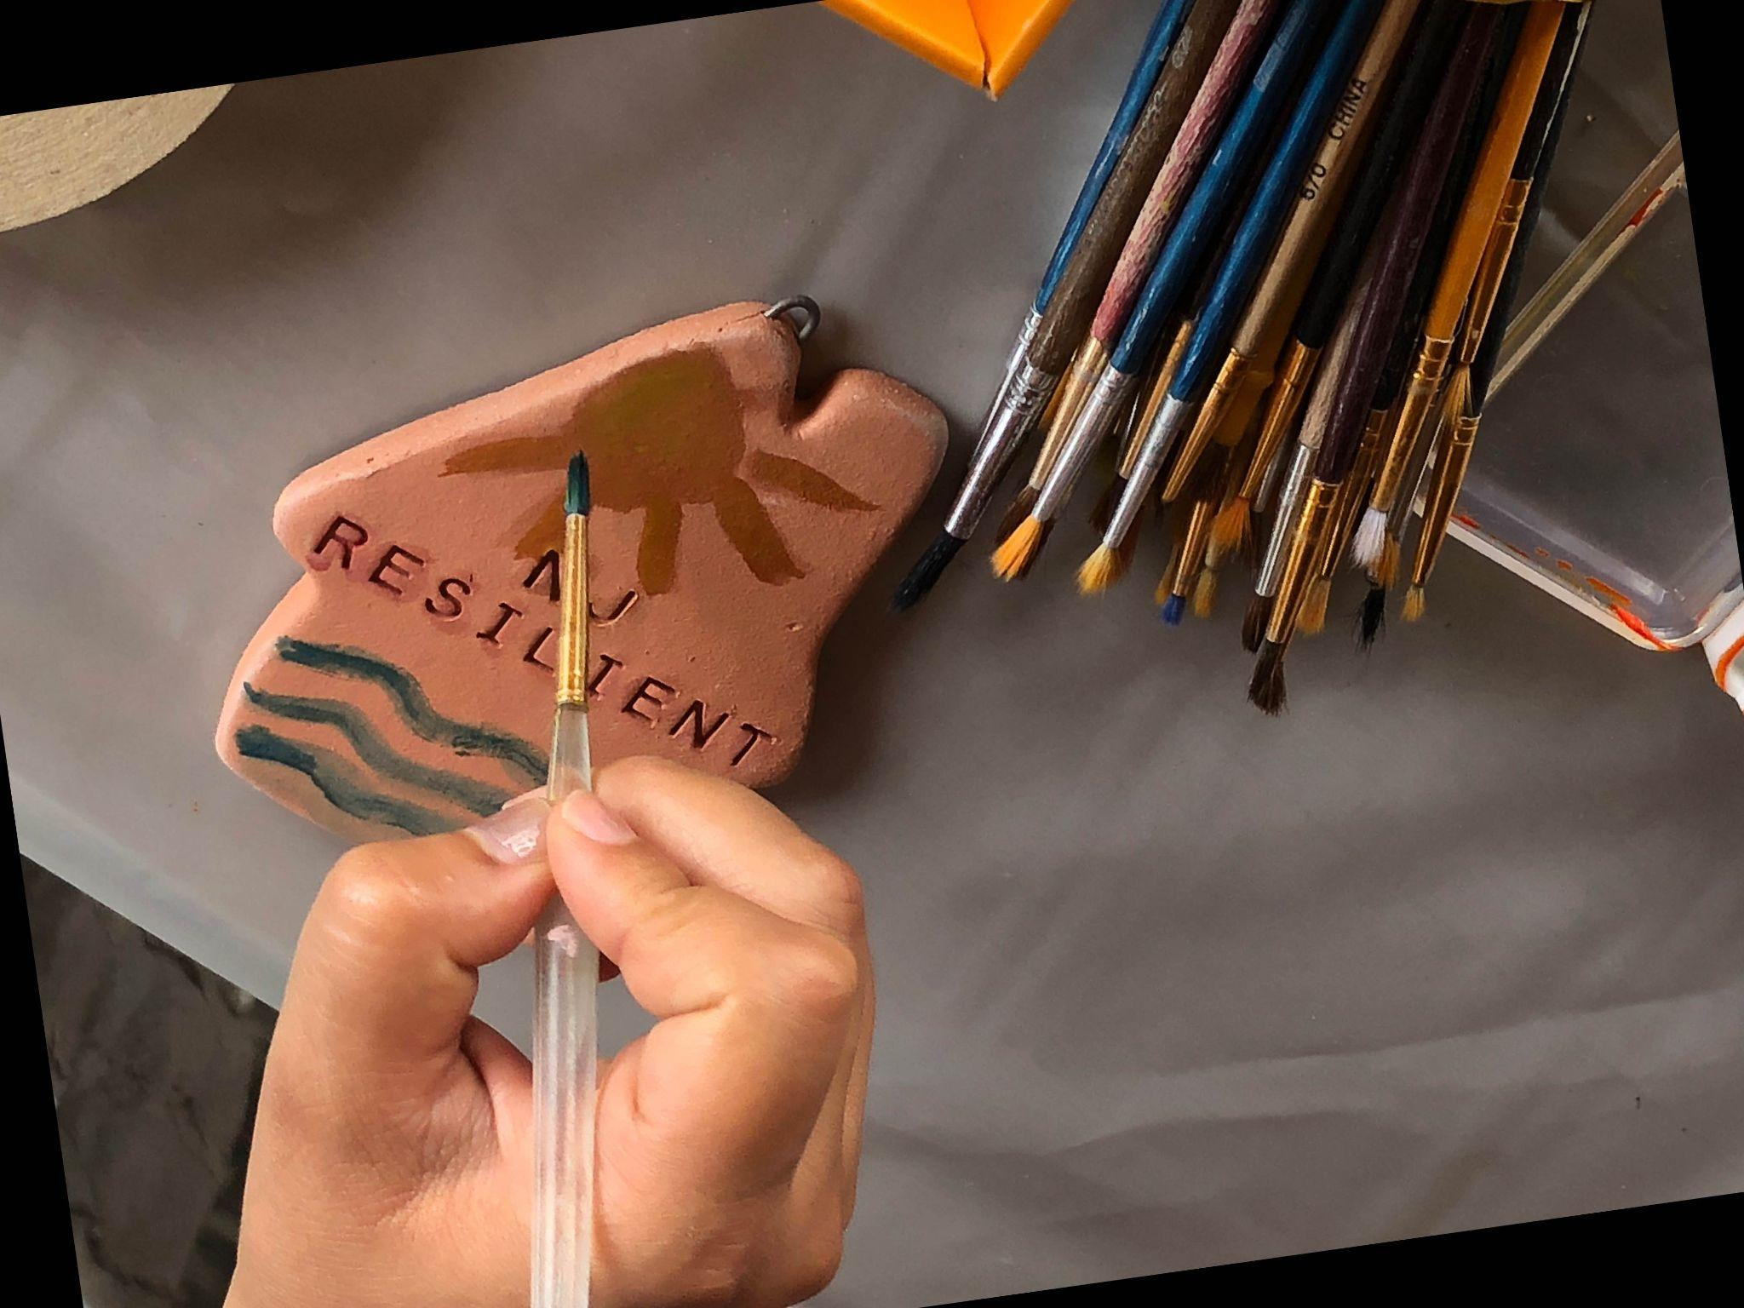

Slide 3
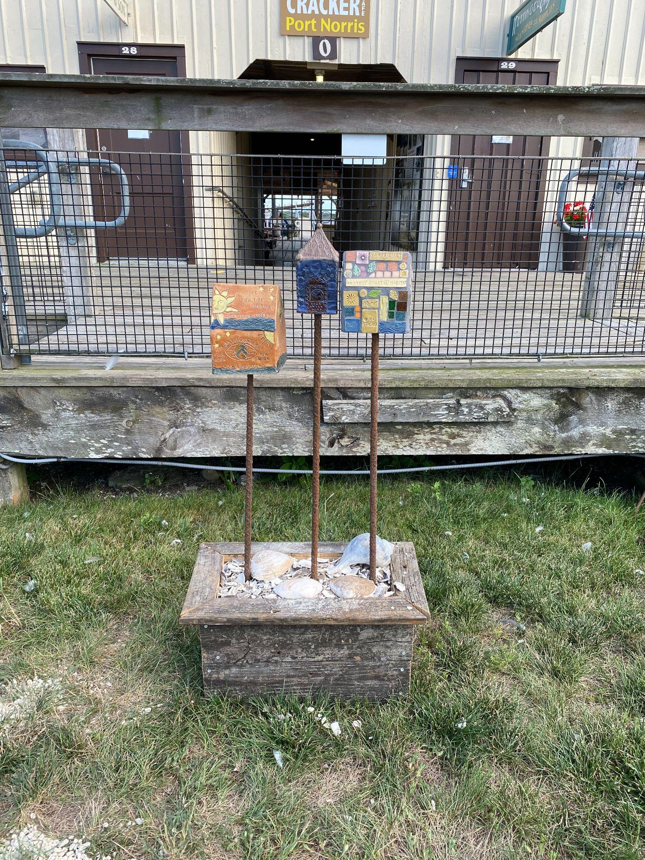
Works created at :
Bayshore Center at Bivalve,
Commercial Township, Cumberland County

Slide 4
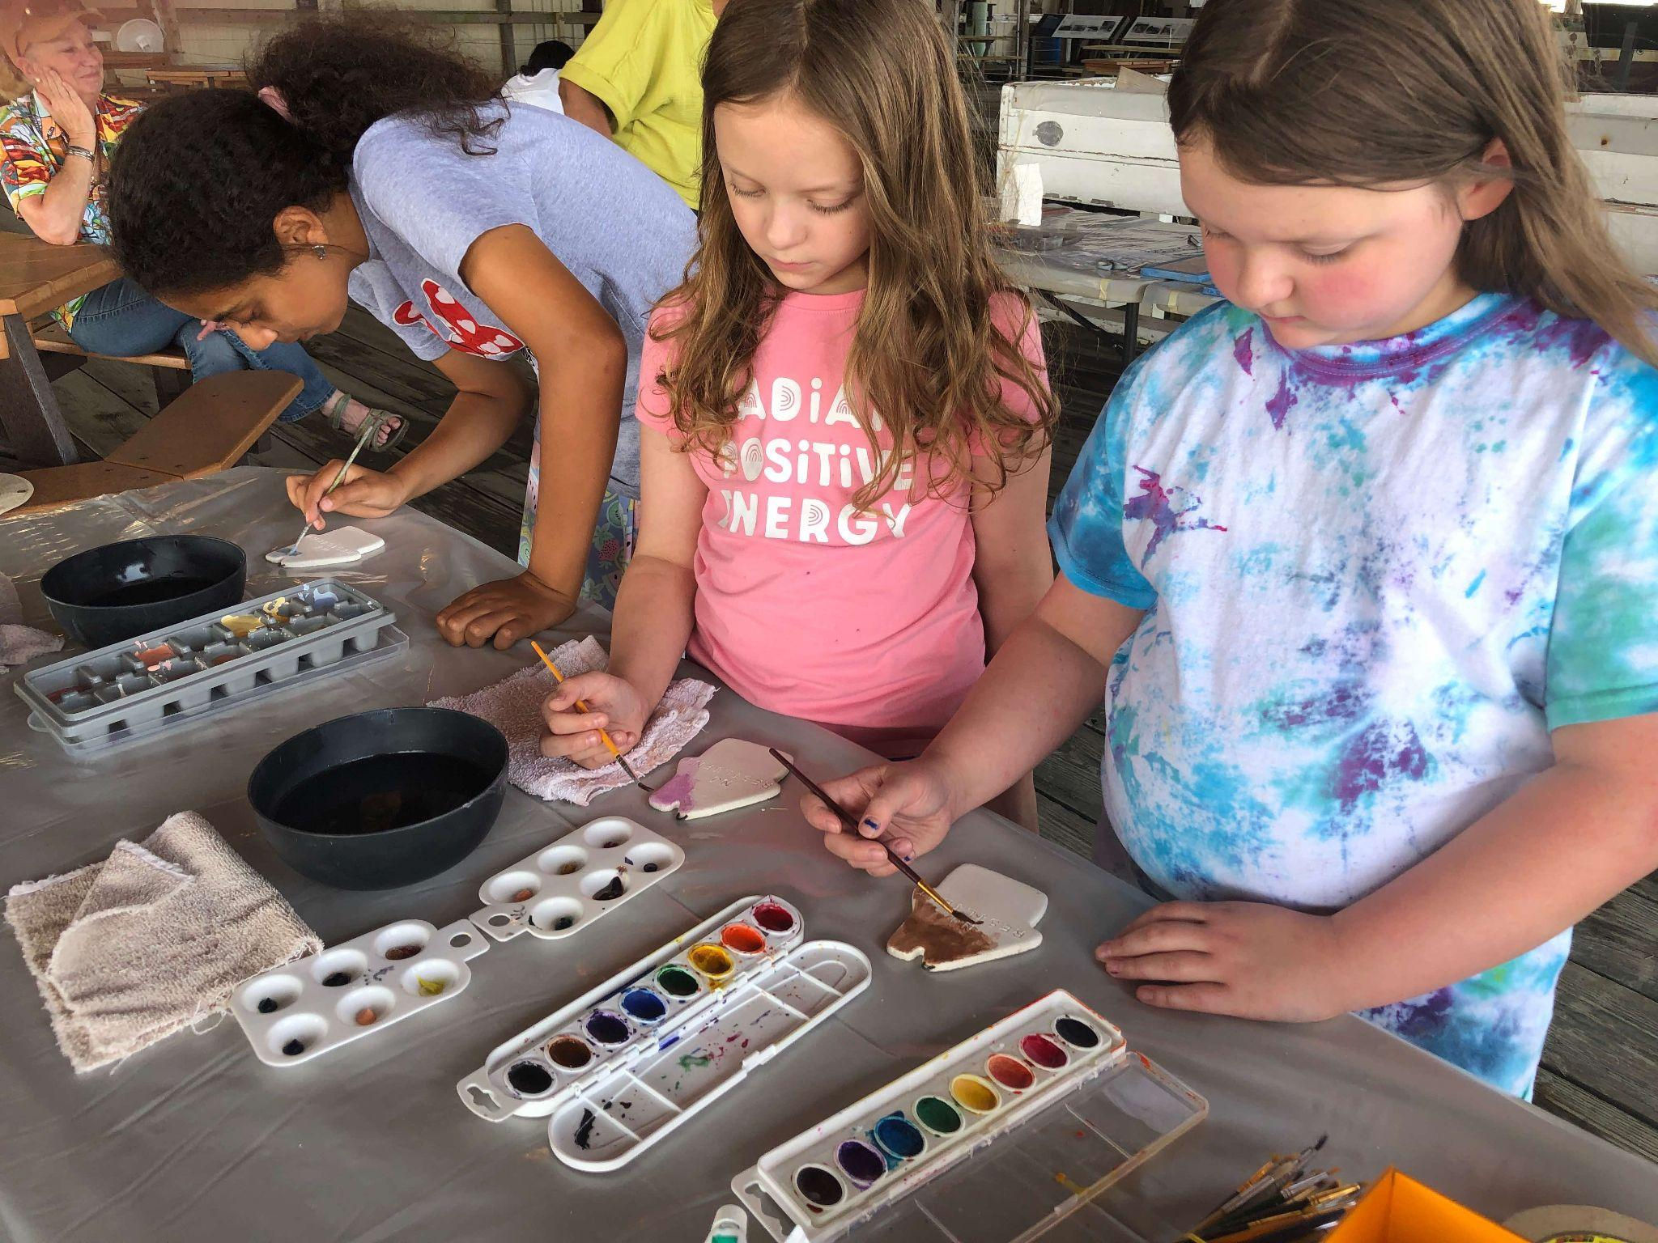

Slide 5
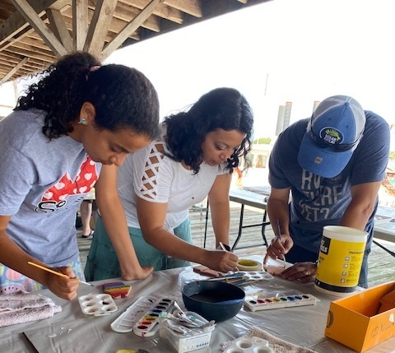

Slide 6
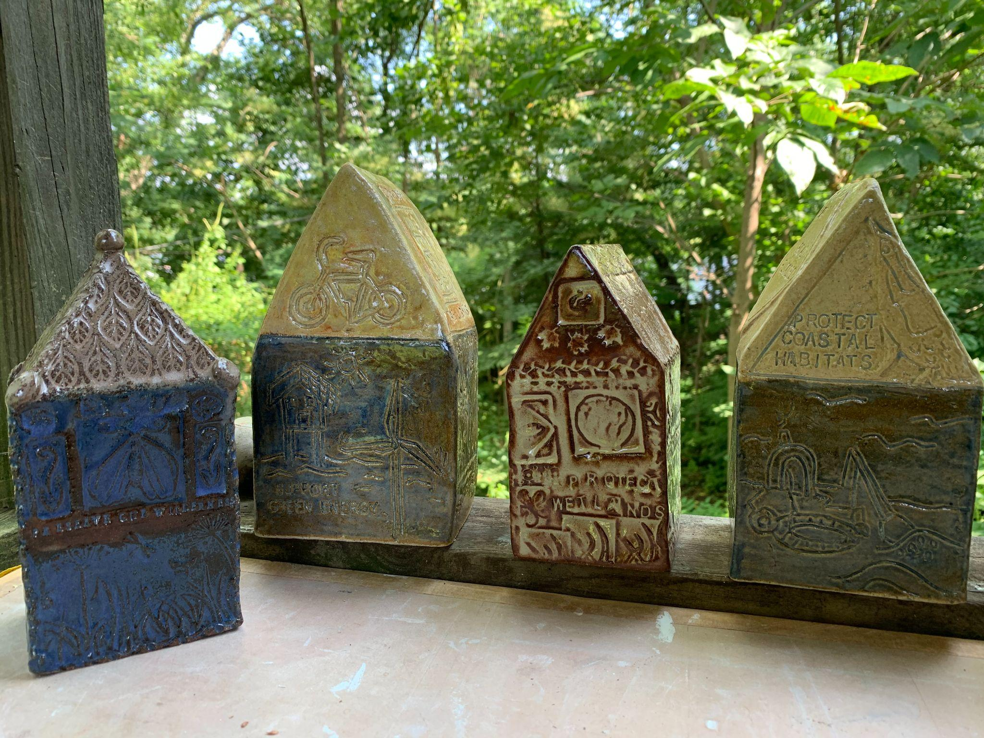

Slide 7
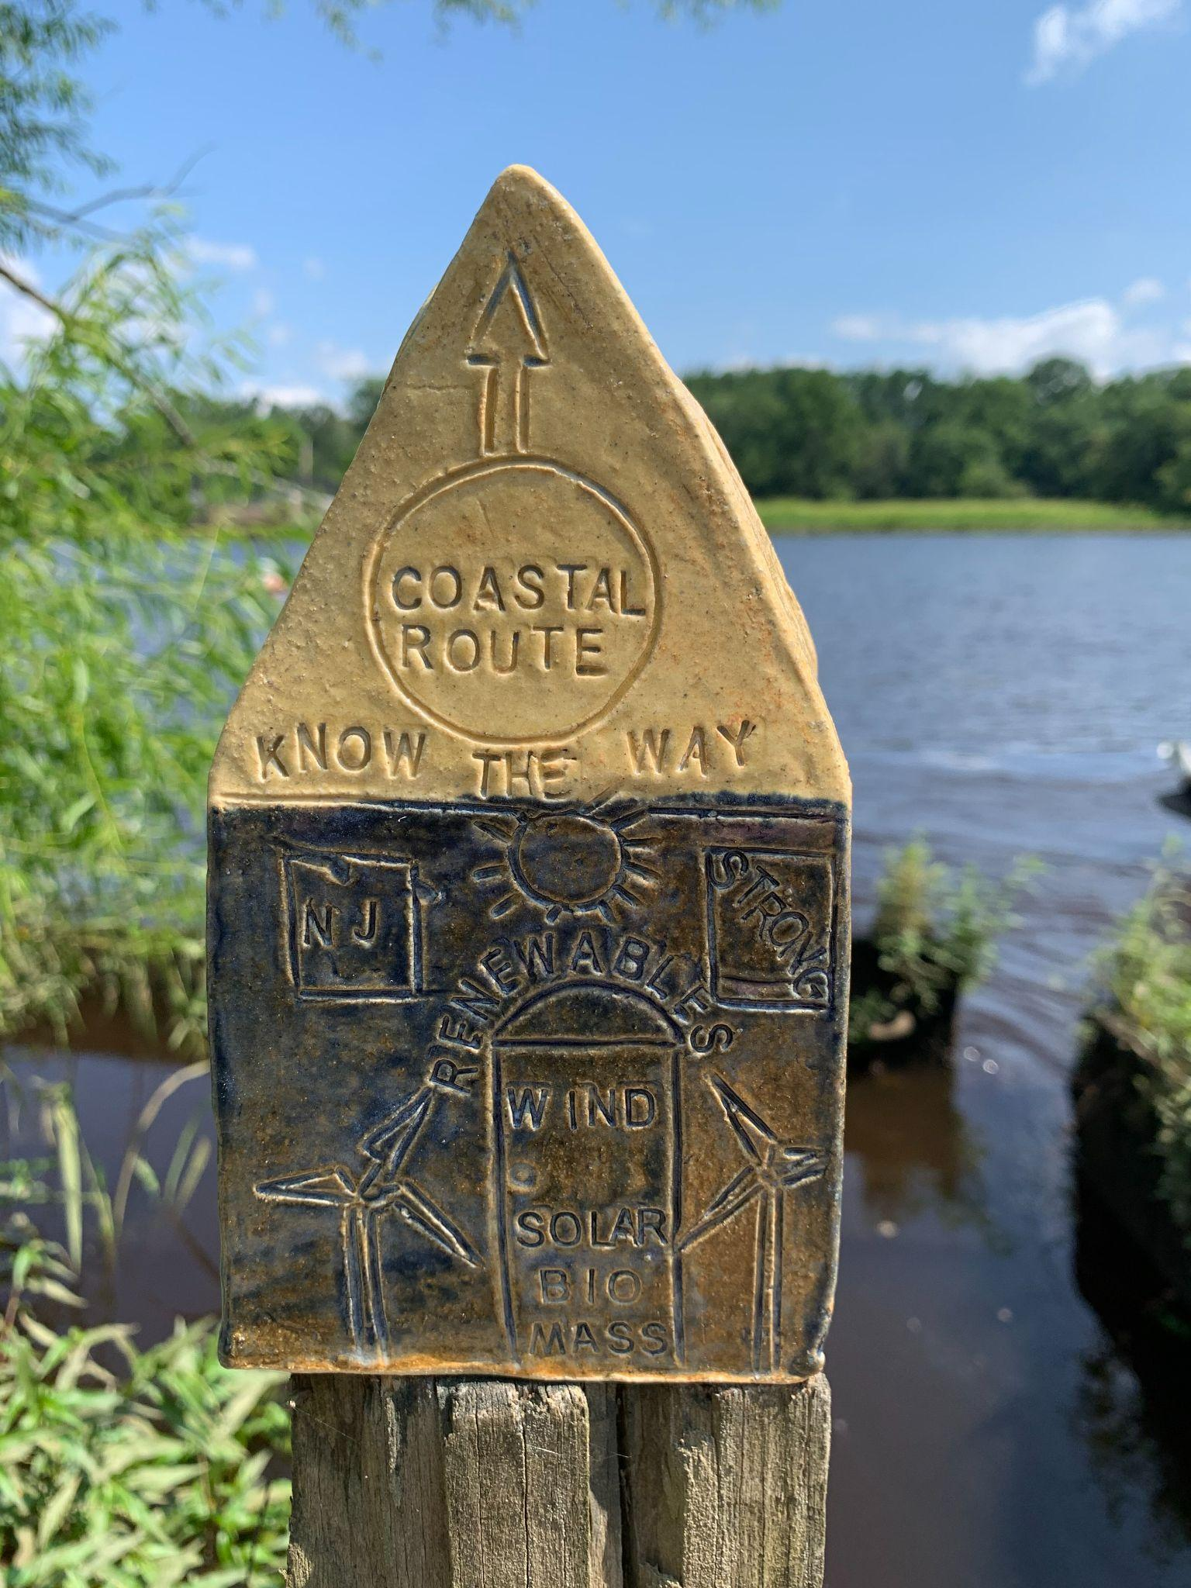

Slide 8
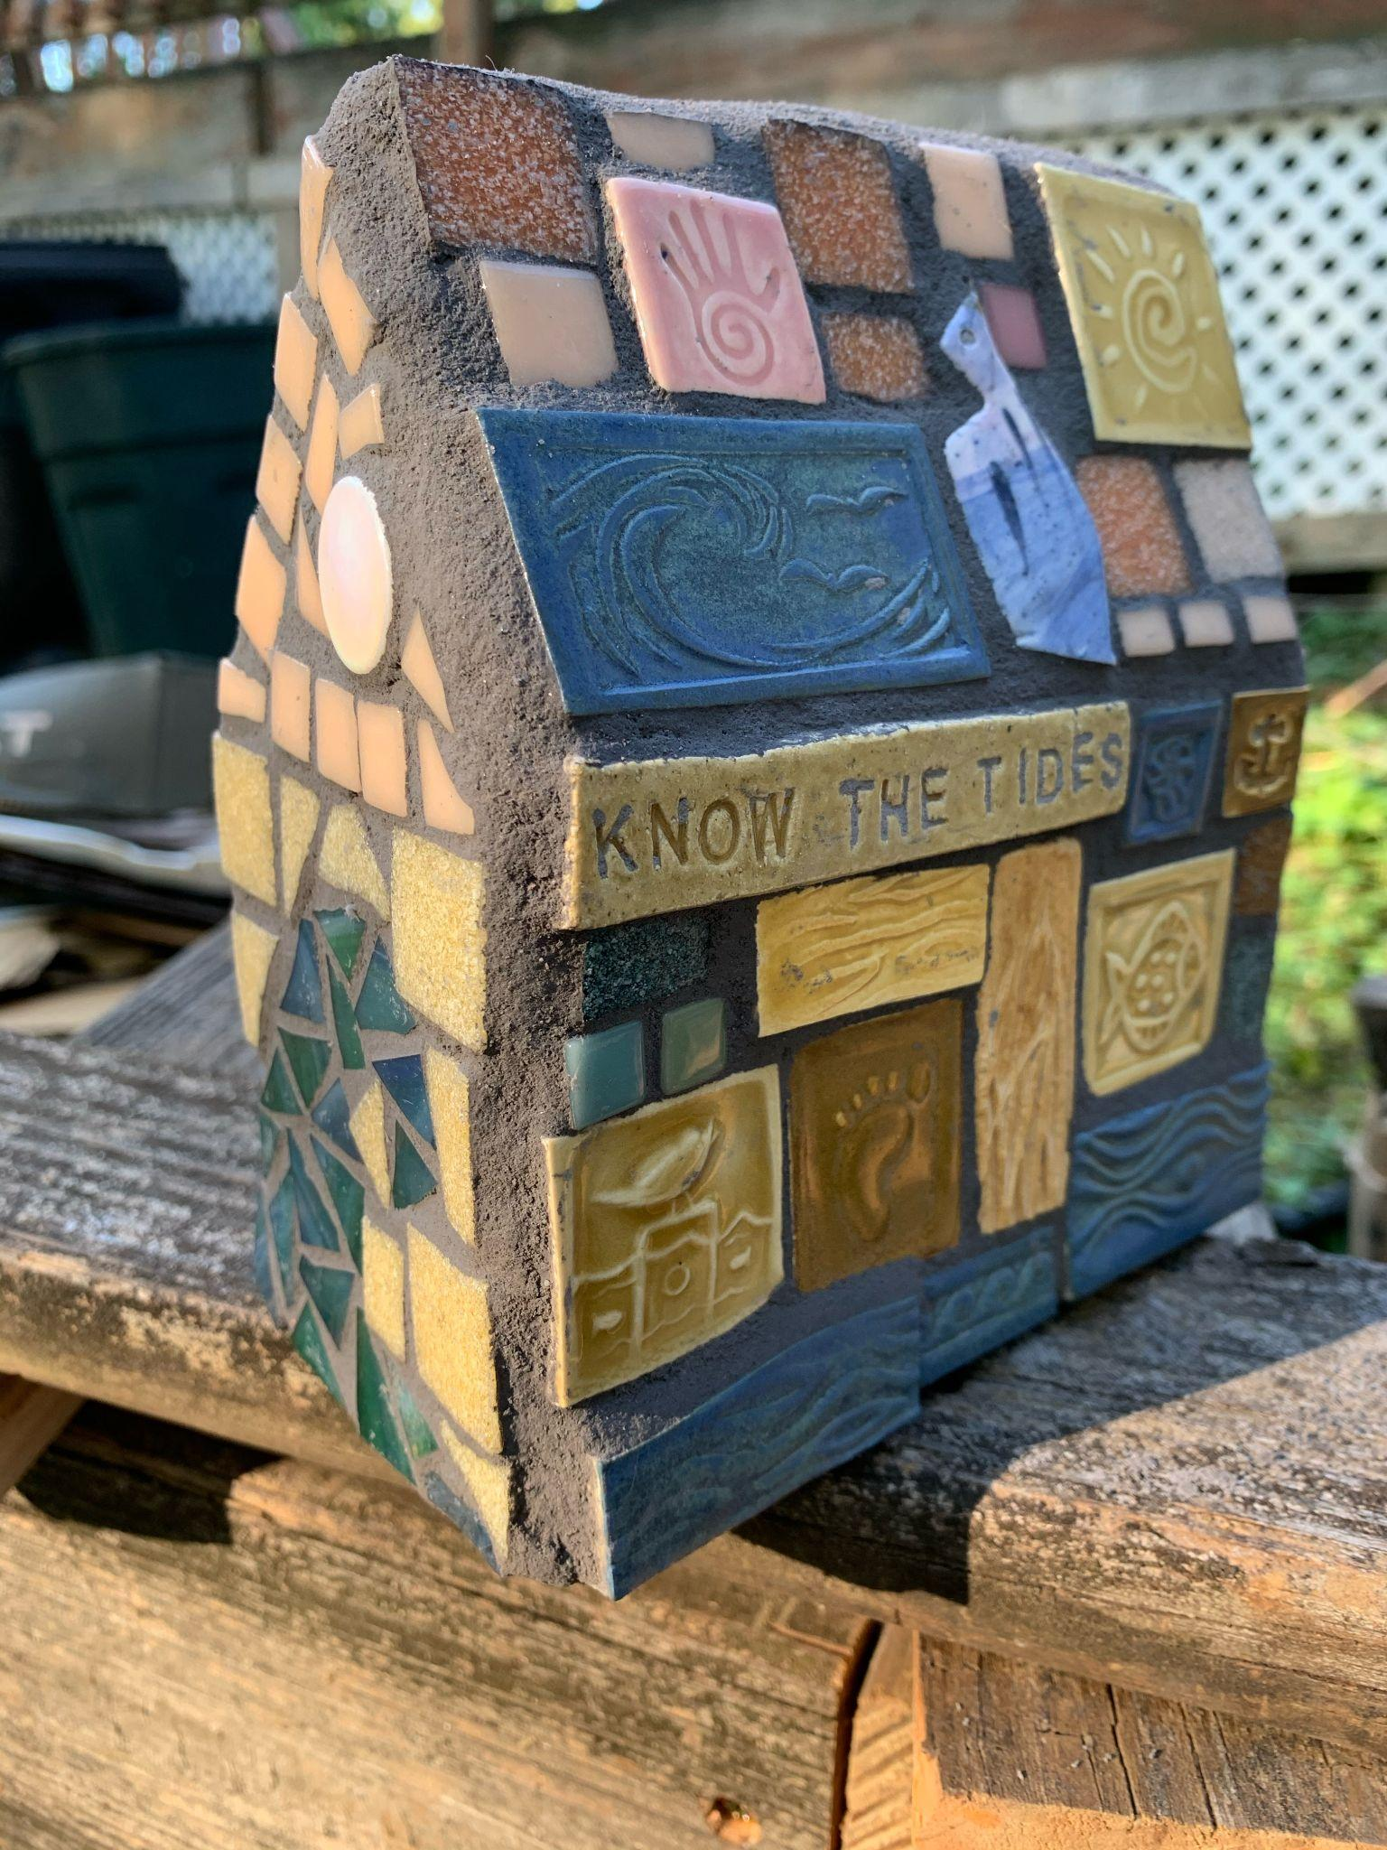

Slide 9
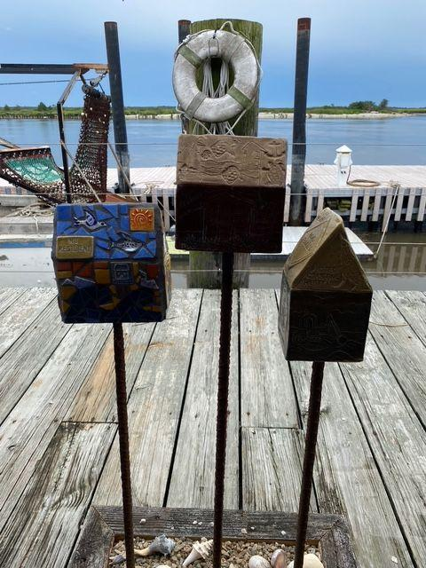

Slide 11
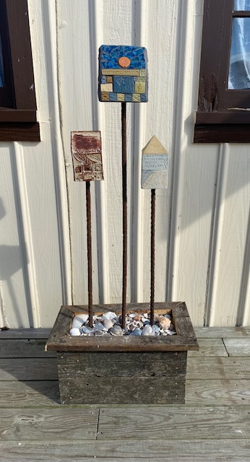

Slide 12
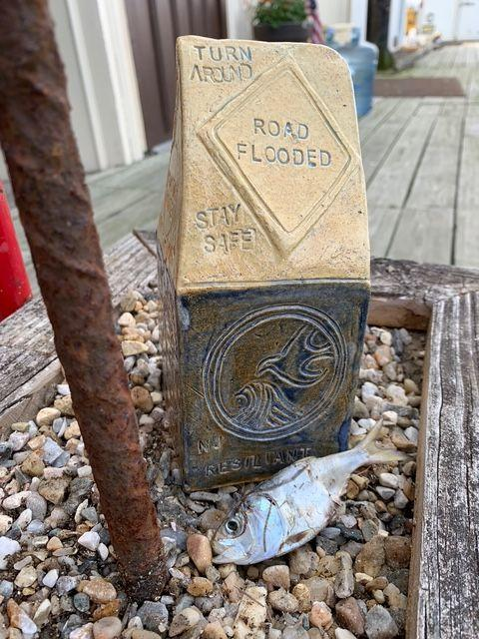

Slide 13
Works created at :
Bayshore Center at Bivalve,
Commercial Township, Cumberland County
Chase Jackson,
Executive Director of the Ocean City Arts Center

Slide 14
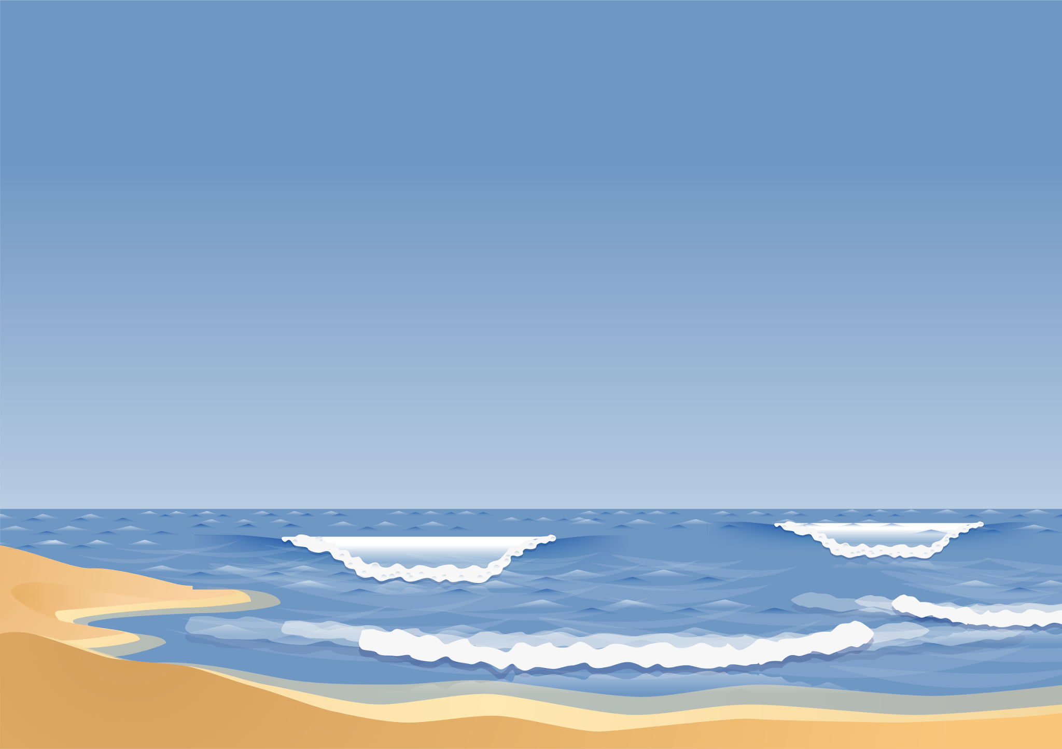
Community Creators:
Art Bridging the Gap in Coastal Hazard Communities
Presenter: Jessica Mungekar

Slide 15
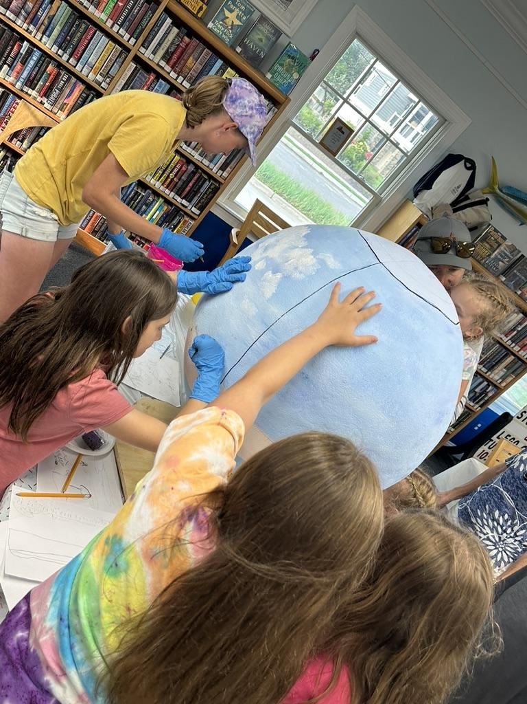
I hear, I forget;
I see, I remember;
I do, I understand.
Notes:
This saying is the bases for why Integrated community based projects are so important. I had the privilege of working with Chase on the climate resilience project in 2023 in the Barrier Island communities of Longport and Strathmere, I saw first hand as the artist how bringing Science out of the Lab and Art out of the Studio can Unitite, and educate communities in climate change and resilience,

Slide 16
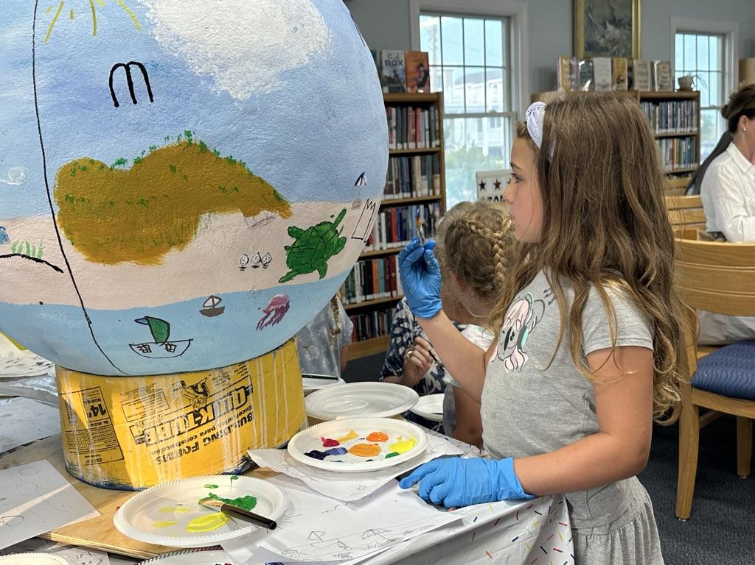
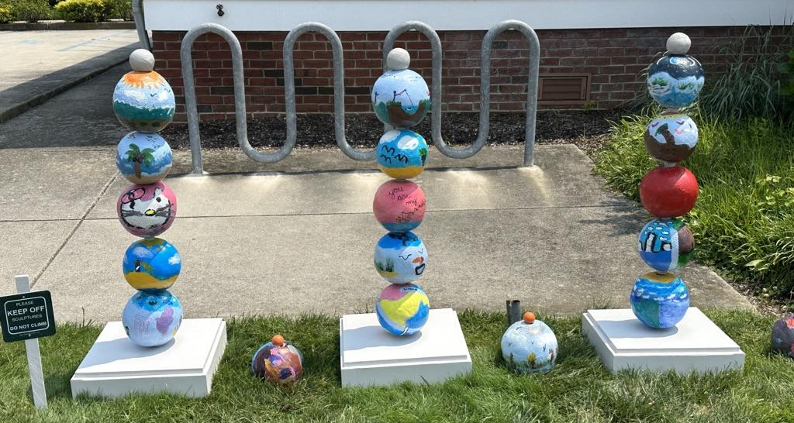
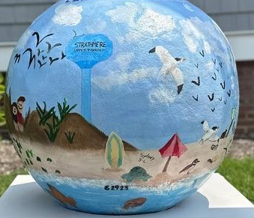
Make it Personal and Local
Rita Schiavo Memorial Library, Strathmere, NJ

Slide 17
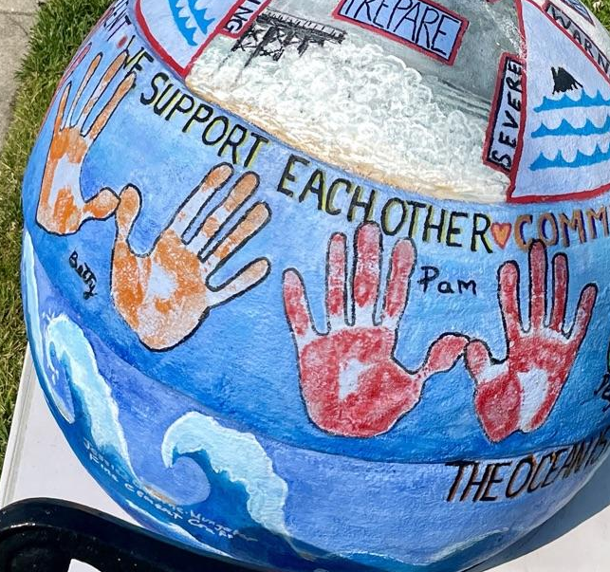
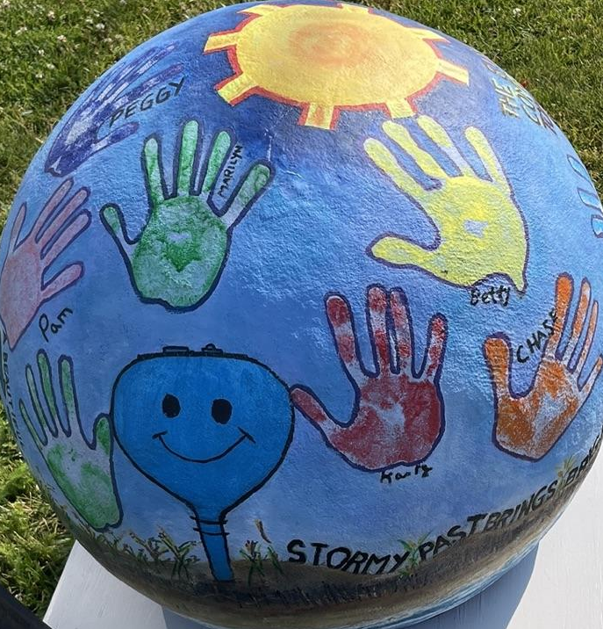
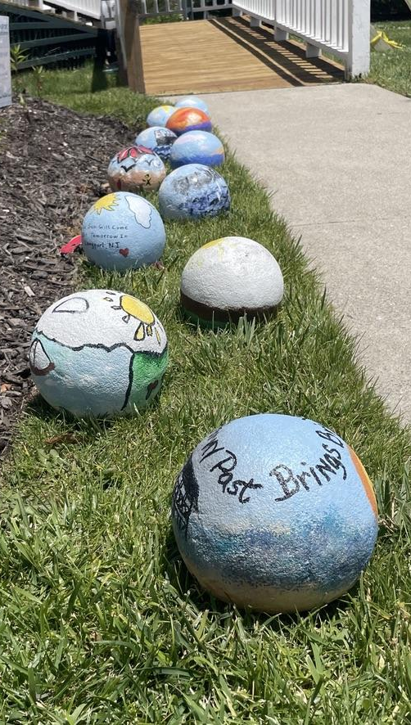
Make it Personal and Local
Longport Historical Museum, Longport, NJ

Slide 18
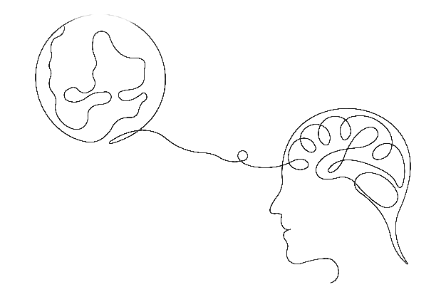
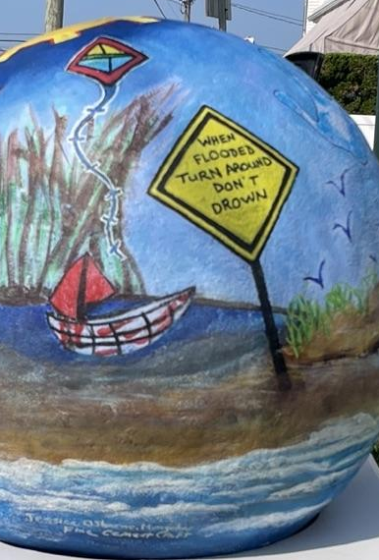
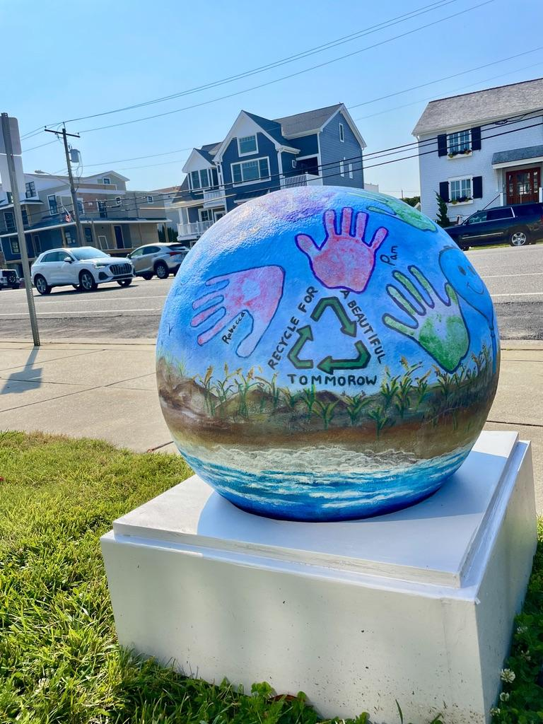
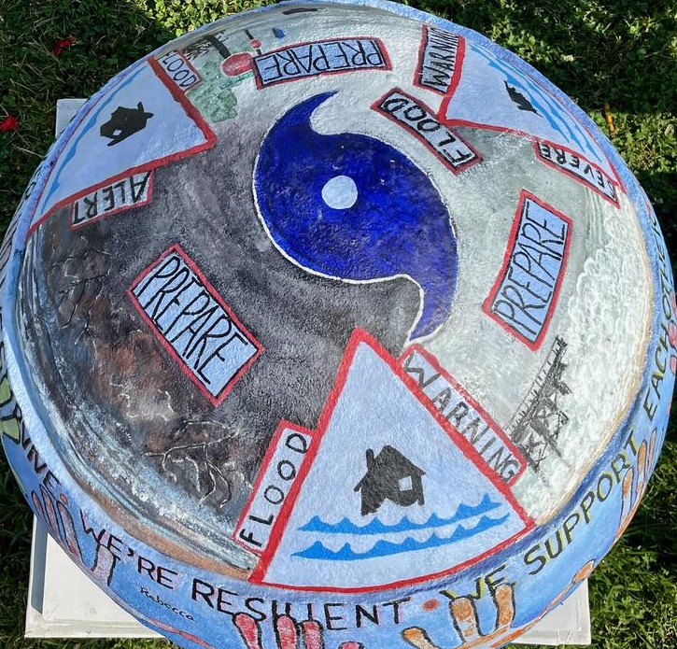
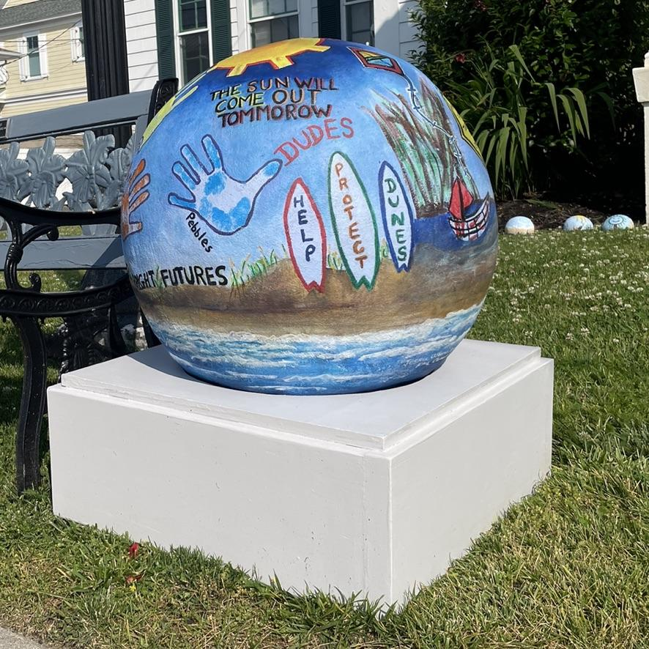
Captures Complexity
Longport Historical Museum, Longport, NJ

Slide 19
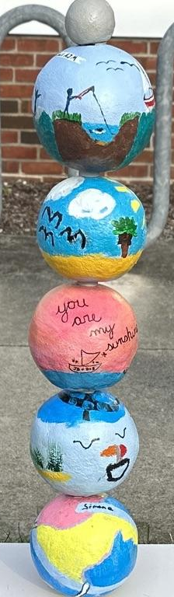
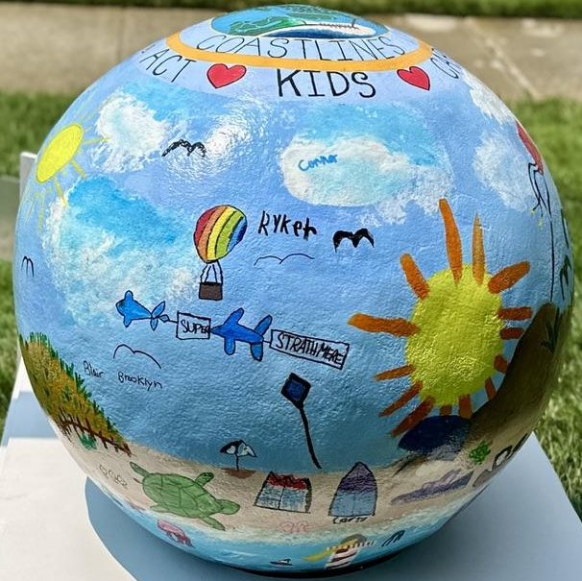
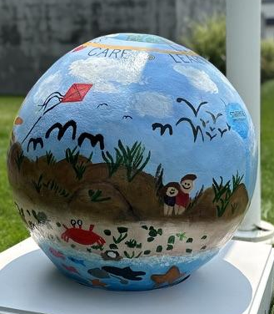
Captures Complexity
Rita Schiavo Memorial Library, Strathmere, NJ

Slide 20
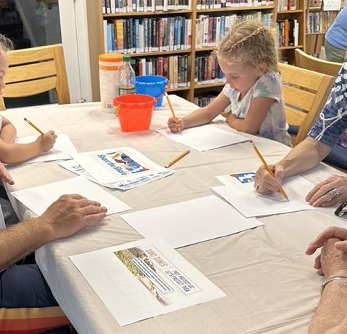
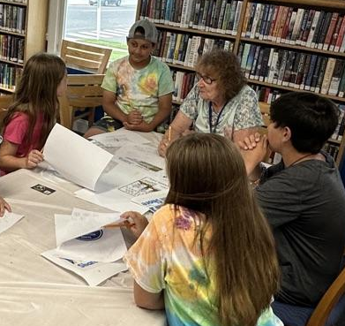
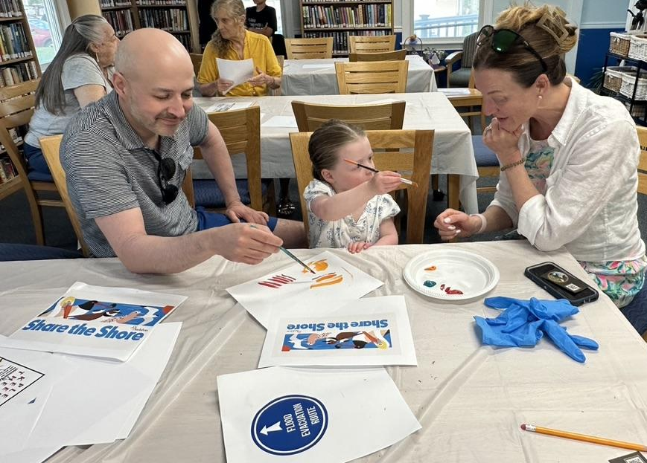
Builds Critical Thinking

Slide 21
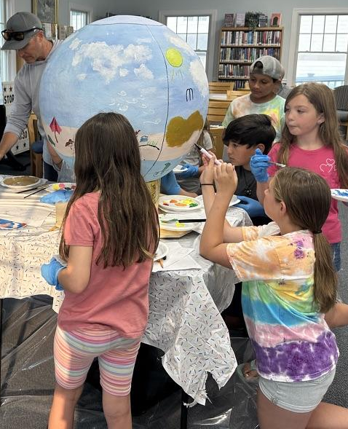
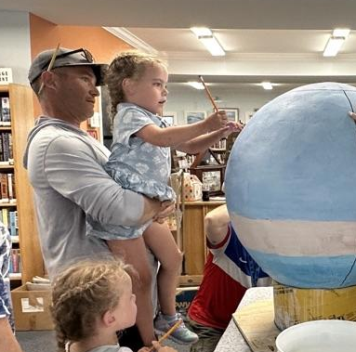
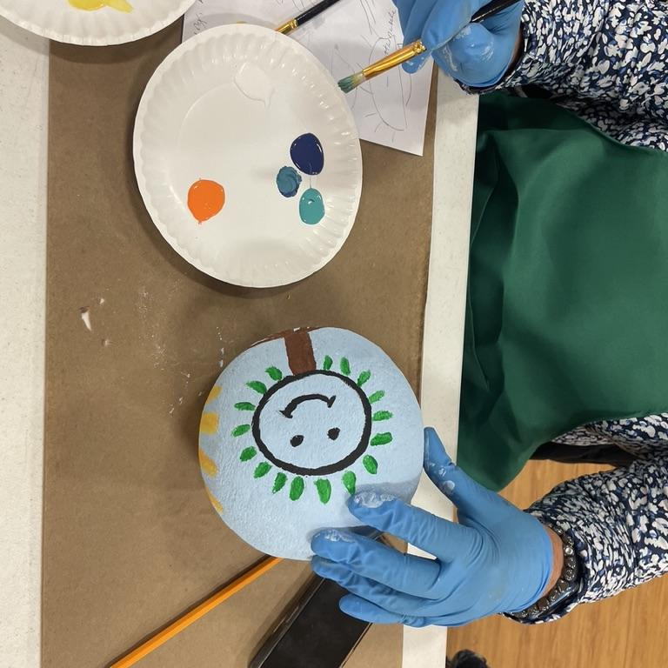
Removes Knowledge Hierarchies

Slide 22
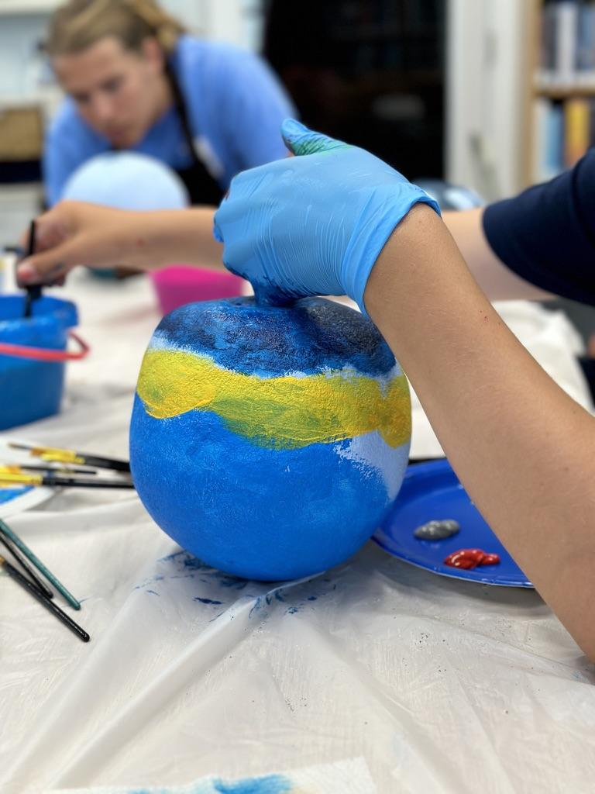
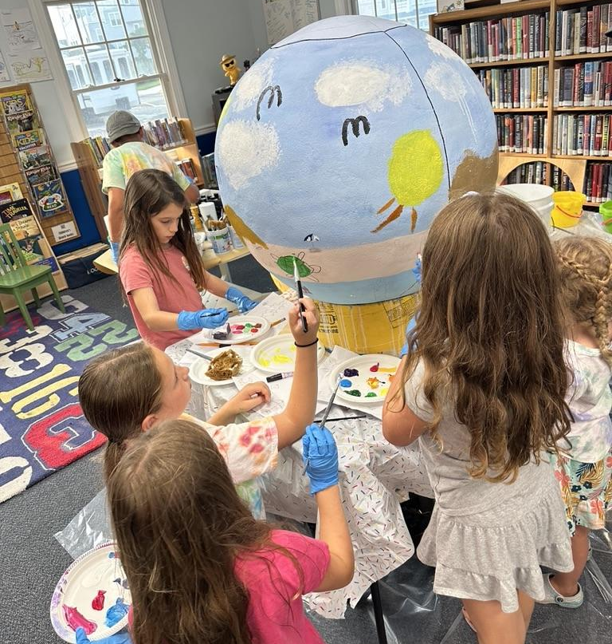
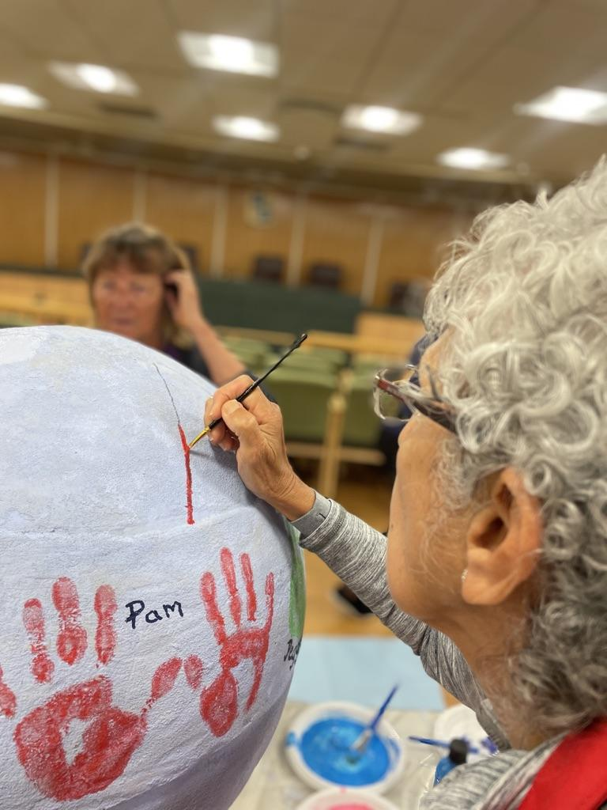
Community Driven - Immersed

Slide 23
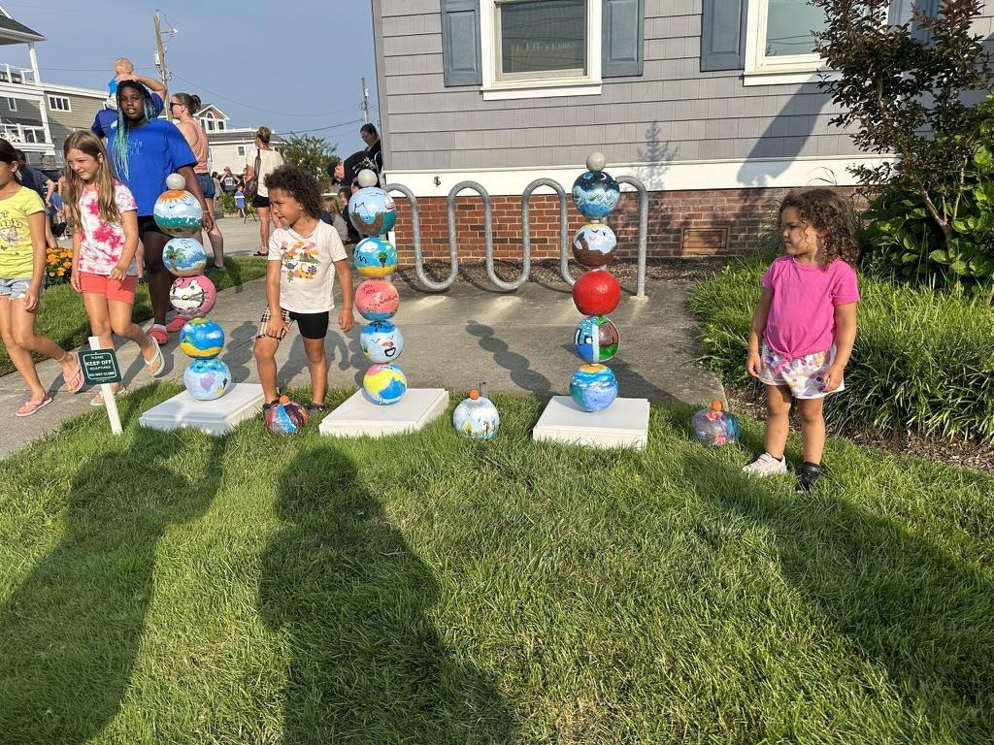
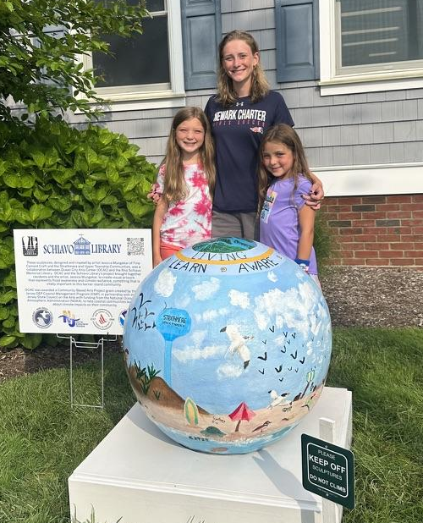
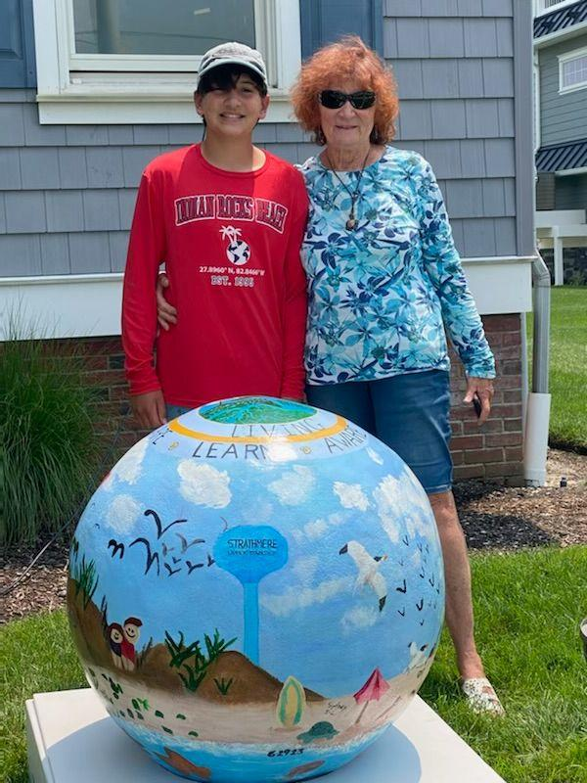
Empowers Community Ownership
Rita Schiavo Memorial Library, Strathmere, NJ

Slide 24
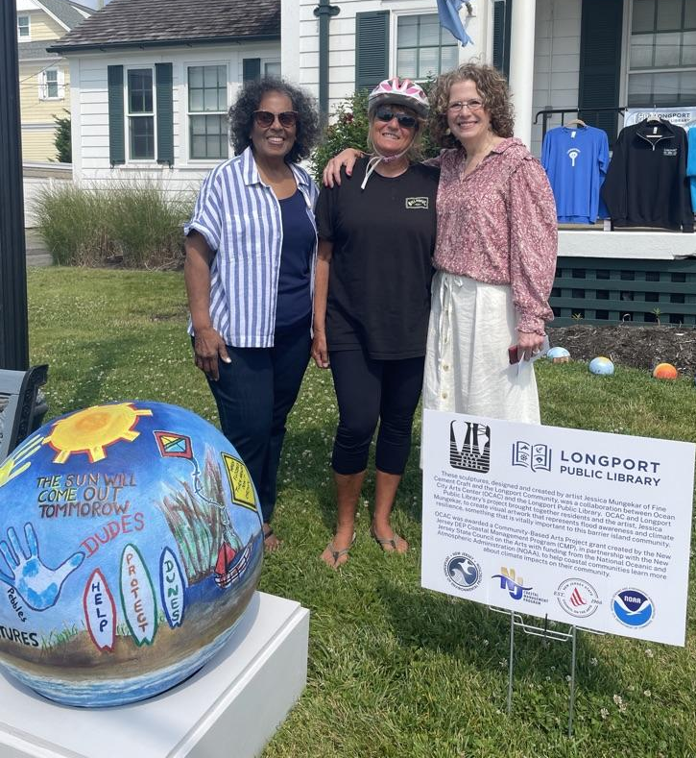
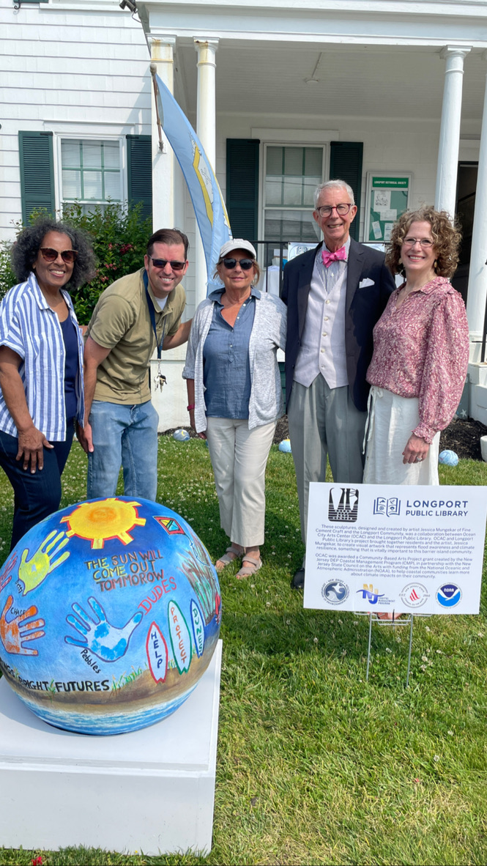
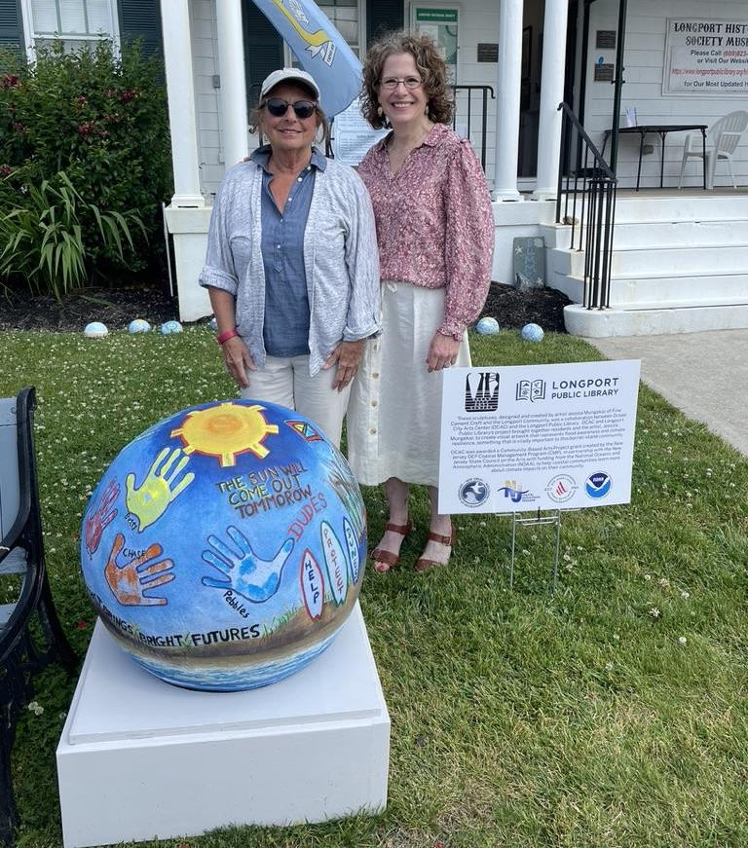
Empowers Community
Ownership
Longport Historical Museum, Longport, NJ

Slide 25
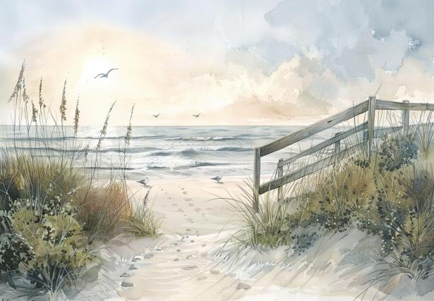
So what was the process?

Slide 26
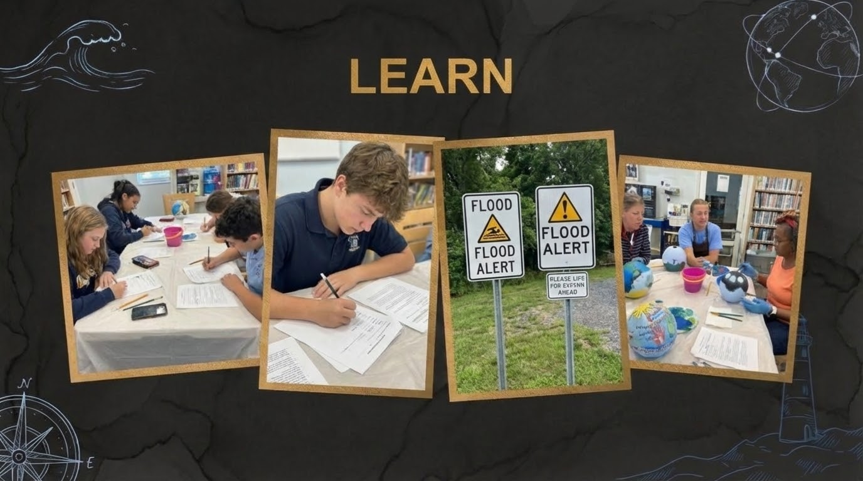

Slide 27
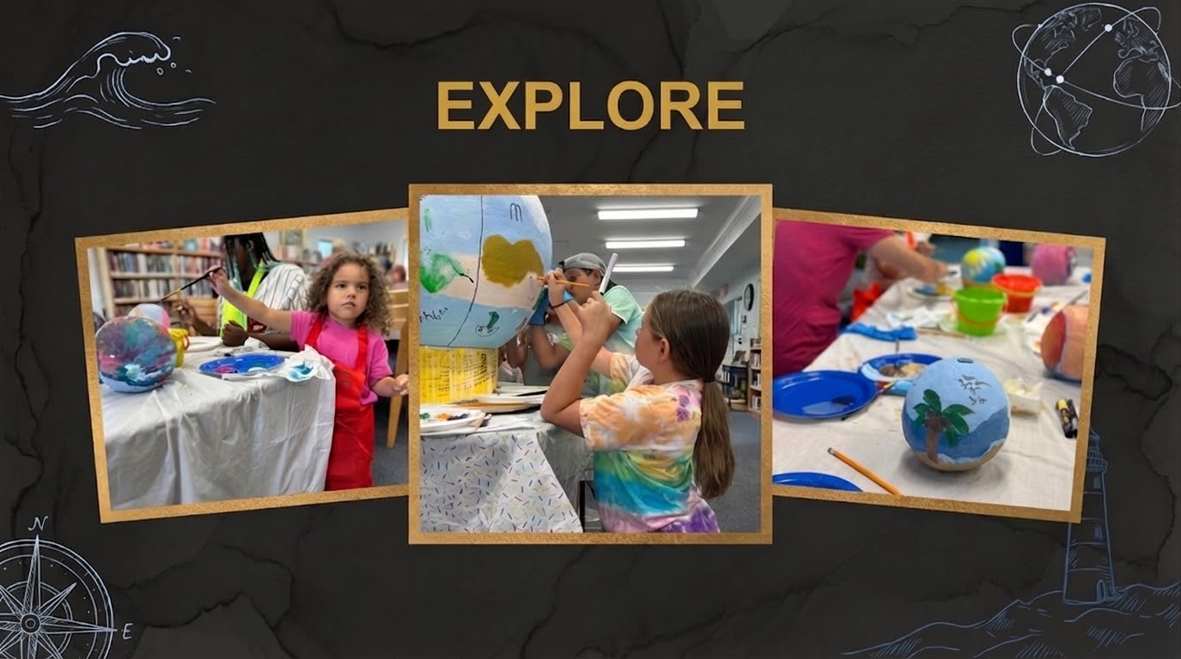
Notes:
Art captures complexity and ambiguity that linear logic alone cannot convey Art as a mode of play bridges the gap between scientific and non-scientific minds. Participants explore freely.

Slide 28
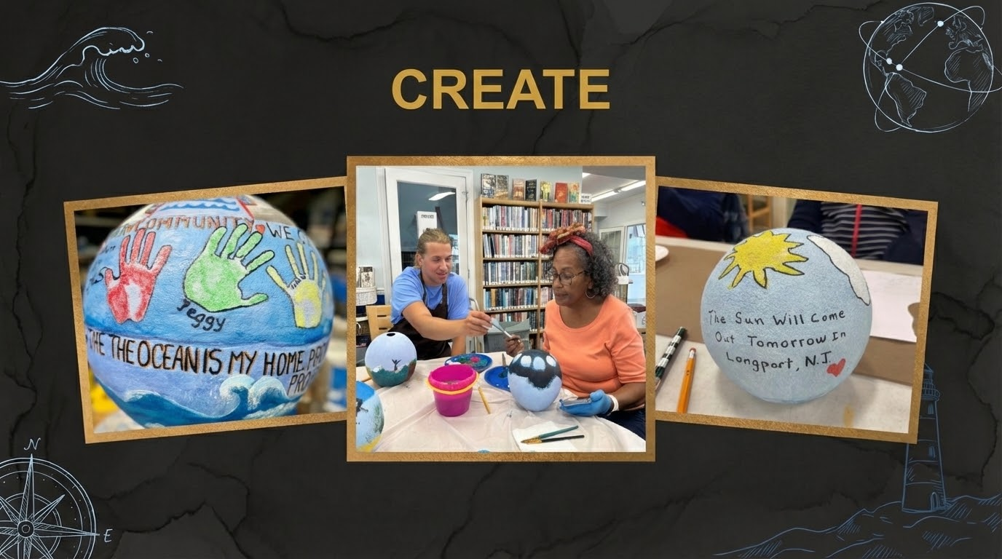
Notes:
The audience becomes author. Community members contribute directly — driving content, themes, and direction. Shifts the sender-receiver dynamic, removing hierarchies between scientists and community

Slide 29
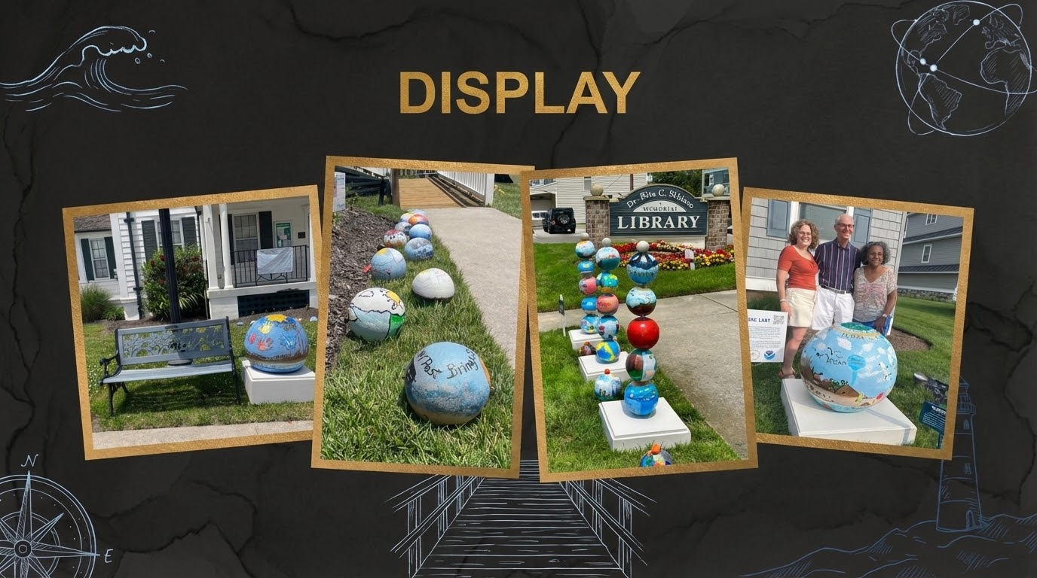
Notes:
Empowers people to take ownership of their community and its future. Seeing work on display excites participants, sparks ongoing conversation and motivates further climate action.

Slide 30
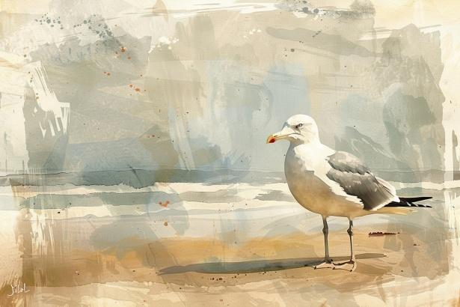
So what did all of this add up to?

Slide 31
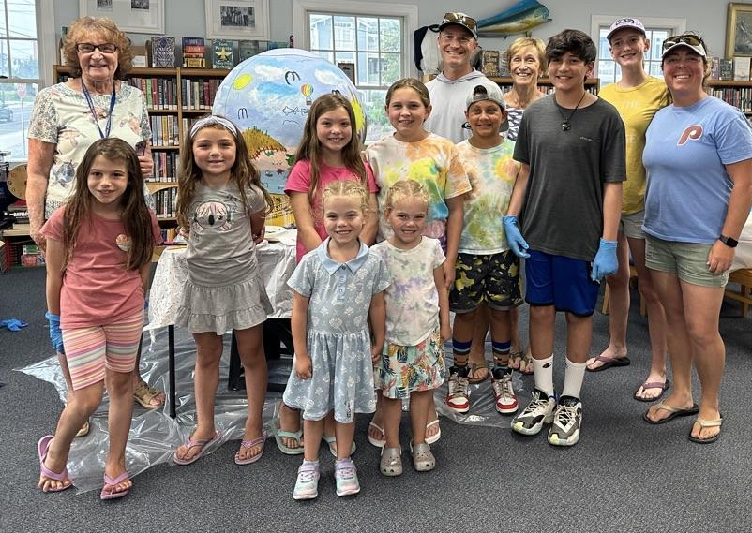
Art doesn't just describe the problem —
it becomes part of the solution.
When people create together, they build the future together.

Slide 32
Works created and on display at :
Longport Historical Museum, Longport, NJ
&
Rita Schiavo Memorial Library, Strathmere, NJ
Jessica Mungekar, BFA, MSW, LSW
Independant Sculptor and Mindful Arts Facilitator

