Slide 1
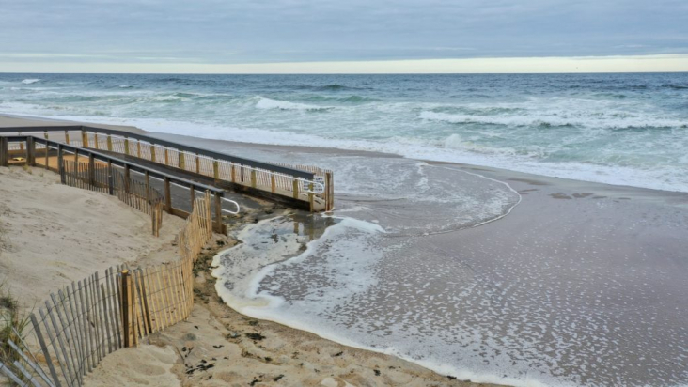

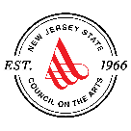
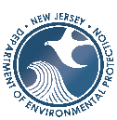

Risk Communication: A Campaign for Coastal New Jersey
Community Creators
Art Bridging the Gap in Coastal Hazard Communities
Community-Based Art Grant Program
Flood Communication Efforts

Slide 2
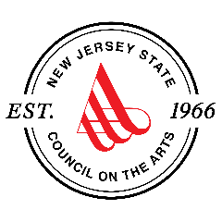
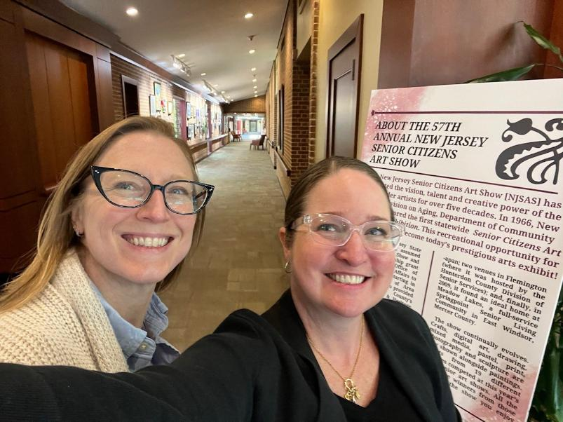
Danielle Bursk, Director of Community Partnerships & Artist Services (right) Stephanie Nerbak, Artist Services Manager (left) New Jersey State Council on the Arts artscouncil.nj.gov

Slide 3
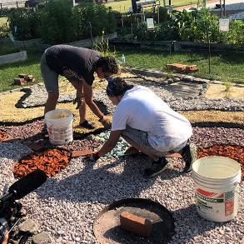
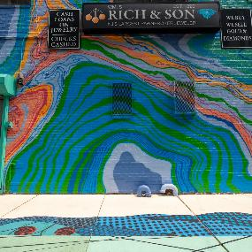
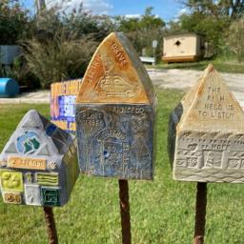
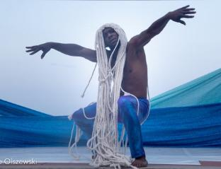
Program Goals
Leveraging art to involve and inform the public about the coastal hazards impacts they will face and what actions they can take to mitigate!
Goal
Goal
Goal
Goal
Elevate public awareness about flooding related to climate change and what they can do about it;
Use innovative approaches that are tailored to the needs of local communities;
Advance resilience planning efforts in communities at greatest risk;
Effectively communicate the necessary behavior changes that will lead to greater resilience.

Slide 4
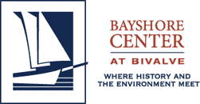

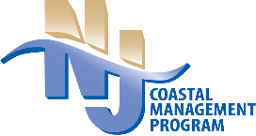

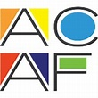
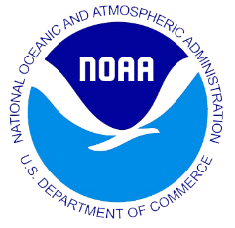

Community-Based Art Grant Program Players
Arts Council Creates Call for Artists and manages process for artist selection and matching
Funding from NOAA Project of Special Merit Program
NJCMP Creates Notice of Funds Available and manages grants to CBOs
Community-based Organizations and Artists create and share their projects
Notes:
New notes: funding came from NOAA PSM and the CMP wanted to work closely with another group to be able to reach communities and communicate the projects with them easily. how we selected the arts council, how we work with them, these are some of the projects
The community-based art grant program was formed because we recognized that we needed to communication about CC in a different way
Not everyone understands information in the same way
Complicated topics
Address the need to involve and inform the public about the coastal hazards impacts they will face and what actions they can take to reduce their risk.
Funding from NOAA through PSM
Reached out to the New Jersey State Council on the Arts (Arts Council) for their assistance
Create NOFA
Create Call Artists
The community-based organizations and artists will work together to address
the theme of climate resilience/coastal flooding
site-specific artwork and community engagement and events.
Each CBO and artist group is required to hold at least one community event and one installation event.
Chose CBOs to host these projects because they have firsthand coastal experiences in their communities and know what their community is interested in and want to get involved in.

Slide 5
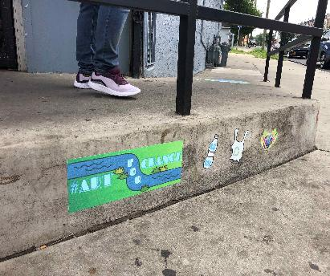
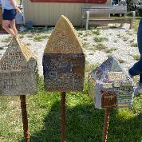
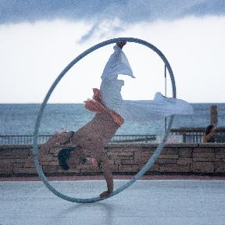
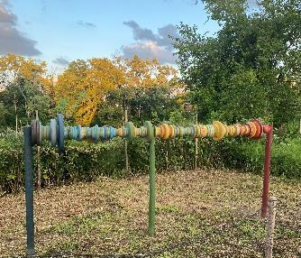

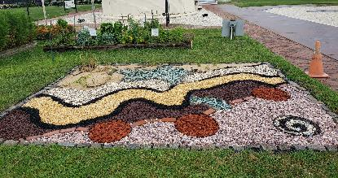
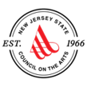
Community-based organizations (CBOs)
Atlantic City Arts Foundation 2021, 2022
Bayshore Center at Bivalve 2021
Monmouth Arts 2021
Passaic County 2021
Four Corners Public Arts 2022
Camden County Partnership 2022, 2023
Ocean City Arts Center 2023
City of Rahway 2023
Monmouth Conservation Foundation 2023
Northern NJ Community Foundation 2023
Artworks Trenton 2024/2025
Monmouth Arts 2024/2025
Perkins Center for the Arts 2024/2025
Wheaton Arts and Cultural Center 2024/2025
Next round of projects coming soon!
Notes:
NJDEP lead the NOFA process; State Arts Council lead the call for artists process; CBOs were part of the jury to select the artists
Through a NOFA application process 4 out of 11 CBO’s that applied were selected
Call for artist allowed for one artist or group of artists to be paired with one CBO.
CBO & Artist teams worked together to realize the artists' work in community settings. Artworks addressed coastal hazards impacts and what actions community members cab take to reduce their risk.
Each of the CBOs selected were spread throughout the state to represent that each risk can be perceived very differently by how populations that experience similar kinds of events based on culture, economic practices, education, and length of flooding events.
The four CBO’s that were selected and an image from their project is included as seen on this slide
Atlantic City- Water Table (Top left) Inground water table to show how rainfall or flooding can react with different permeable surfaces.
Bayshore Center at Bivalve- Residences for Resilience (Top Right) Mosaic Houses created by the artists as well as the community were put together on stilts to inform and educate the visitors about coastal flooding the causes and solutions to flooding events.
Monmouth Arts- The Poseidon Project (Bottom Left) the narrative will include seven choreographed sections, each connecting to aquatic myth, legend, and nature. Costume designs and set construction feature upcycled fabrics and materials.
Passaic County- Units of Measure (Bottom Right) project was postponed due to Hurricane Ida but will contain 2 wooden posts around the park with markers to describe historic flooding events as well as possible future flooding event. The park will also include colorful banners on light posts to add to the wooden posts.
A Second Round of funding is currently under way for new CBOs and Artists

Slide 6
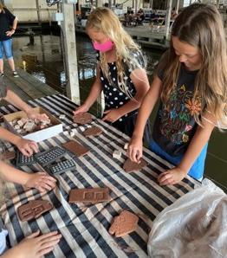
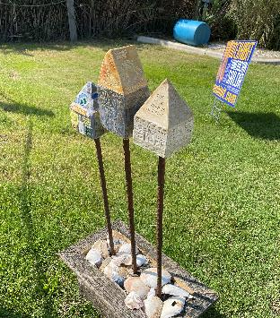
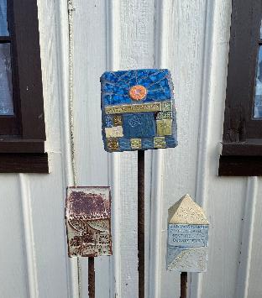
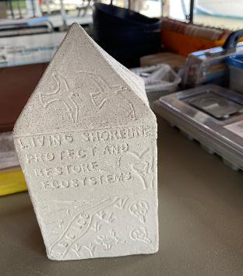
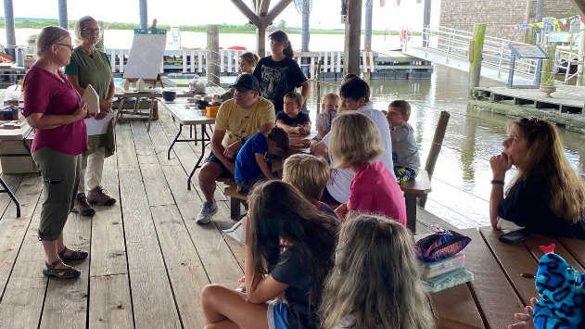
Bayshore Center Residences for Resilience
Artists: Gail Scuderi and Kathy Casper
Bayshore Center at Bivalve, Port Norris
July-October 2021
Notes:
-CBO/Artist team
-Project name
-Location
-Purpose project results in a variety of handmade mosaic tiles that will be used to adorn a grouping of tiny ceramic houses that will be displayed around the site. Tiles created by the community illustrate, in words, images and symbols, ways that people, animals and plants need to adapt to thrive in a changing environment.
-installation showcased houses around the complex visitors were able to find with pamphlets with map and QR codes at each station

Slide 7
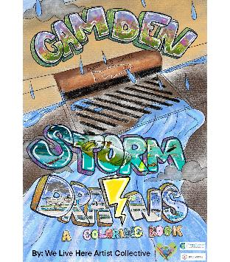
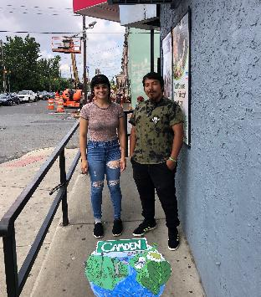
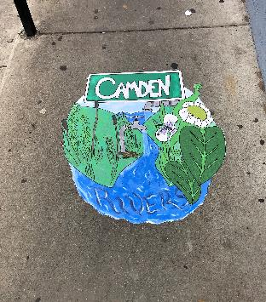
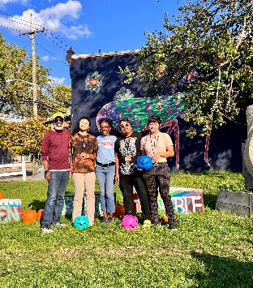
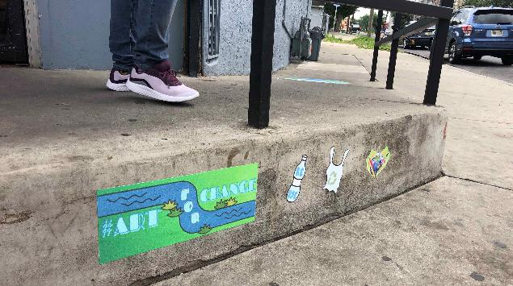
Camden Community Partnership
Artist: We Live Here Artist Collective
City of Camden; storm drains project
September – October 2022
Notes:
-CBO/Artist team
-Project name
-Location
Overall takeaway- each community engaged in different ways with the artists and the artwork. By funding community organizations, and matching them with artists, unique community engagements are able to happen that are specific and tailored to diverse geographies in the state.

Slide 8
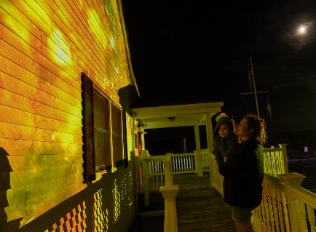
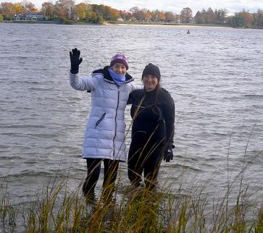
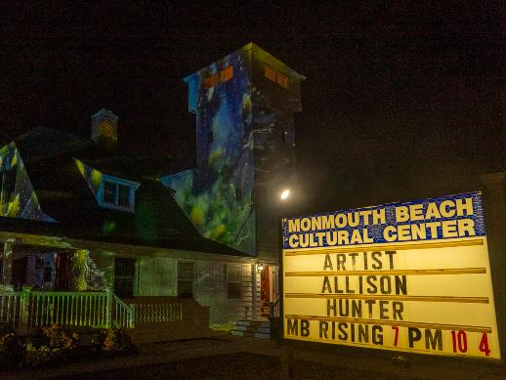
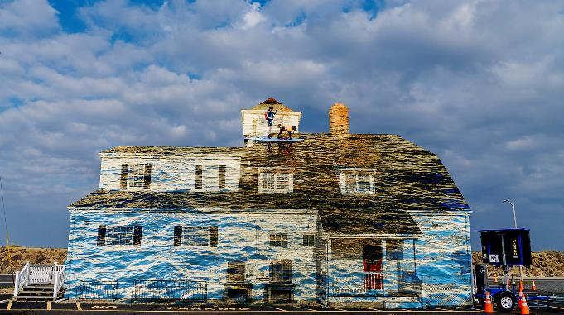
Monmouth Arts
Monmouth Beach Rising
Artist: Allison Hunter
Fall of 2025

Slide 9
In Conclusion Bridging the Gap with Strategic Partnerships
How are you, your organizations, or communities uniquely positioned to contribute to solutions?

