Slide 1


Coastal Resilience Begins at School: Building Partnerships to Transform Communities
Panelists: Dennis Blazak, Christa Delaney, Christine McCoid, Will Pirl, & Michelle Rebilas
Moderators: Sarah Sterling, Ross Gary, & Jessica Valenti
March 10, 2026
nj.gov/education

Slide 2
Welcome! As you settle in…
Think about how you engaged with your community during your adolescence. What were the benefits of this to you- and to them?
Be ready to share your story with a partner.

Slide 3



Moderator Introductions
New Jersey Department of Education
Sarah Sterling
Senior Climate Change Education Advisor
Ross Gary
Climate Change Education Specialist
Jessica Valenti, PhD
Climate Change Education Specialist

Slide 4
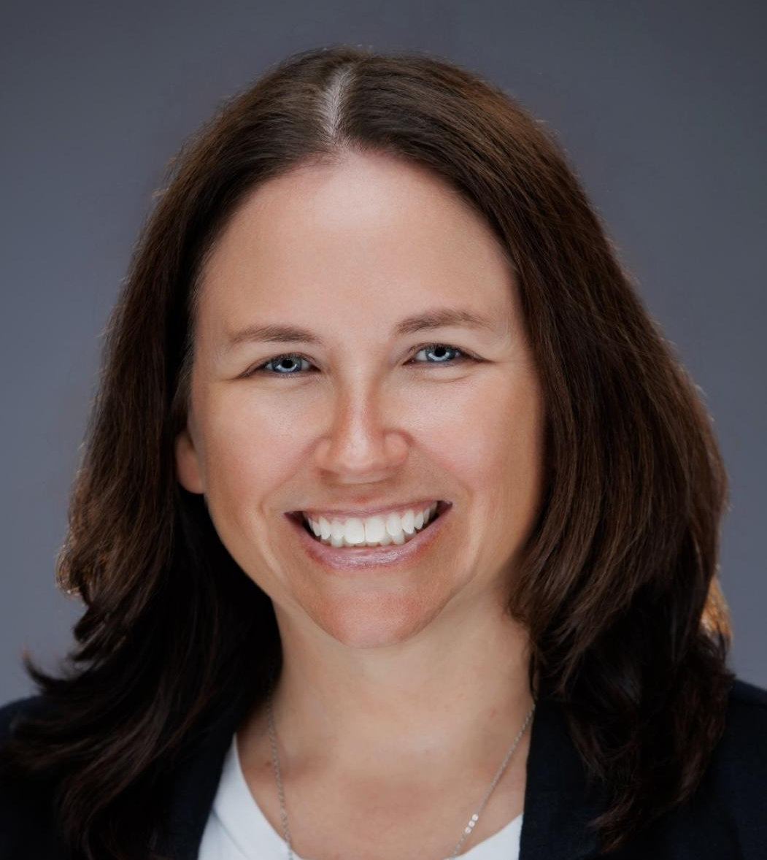
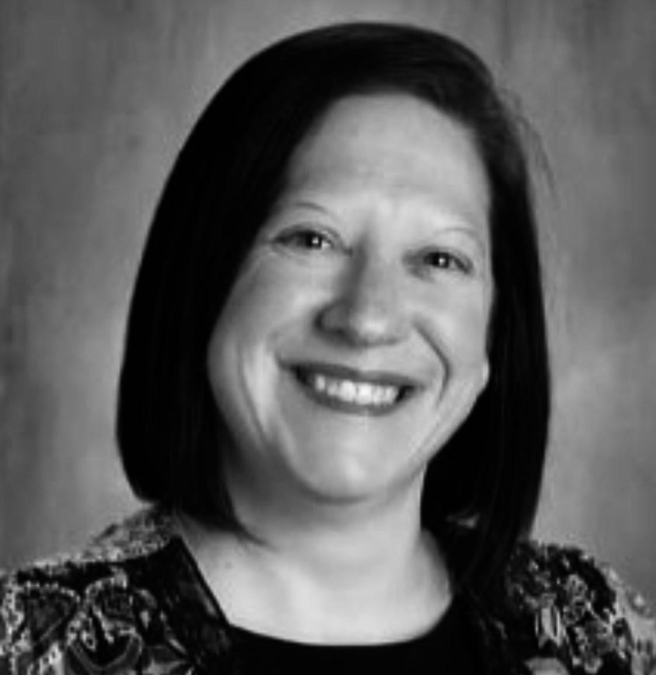
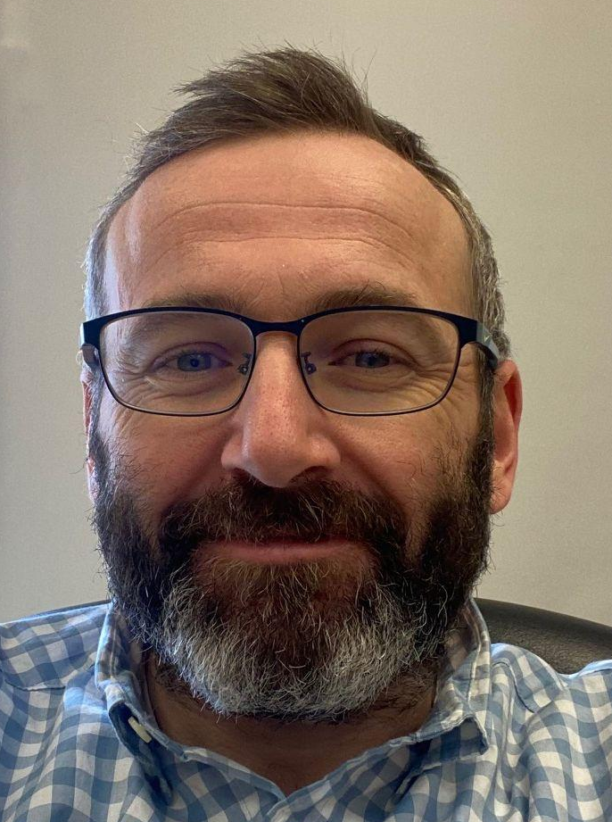
School District Panelist Introductions
Egg Harbor Township | Point Pleasant Borough
Christa Delaney
AP Environmental Science Teacher Egg Harbor Township High School
Christine McCoid, EdD
Director of Curriculum and Instruction
Point Pleasant Borough School District
Will Pirl
Science Teacher
Memorial Middle School
Point Pleasant Borough School District

Slide 5
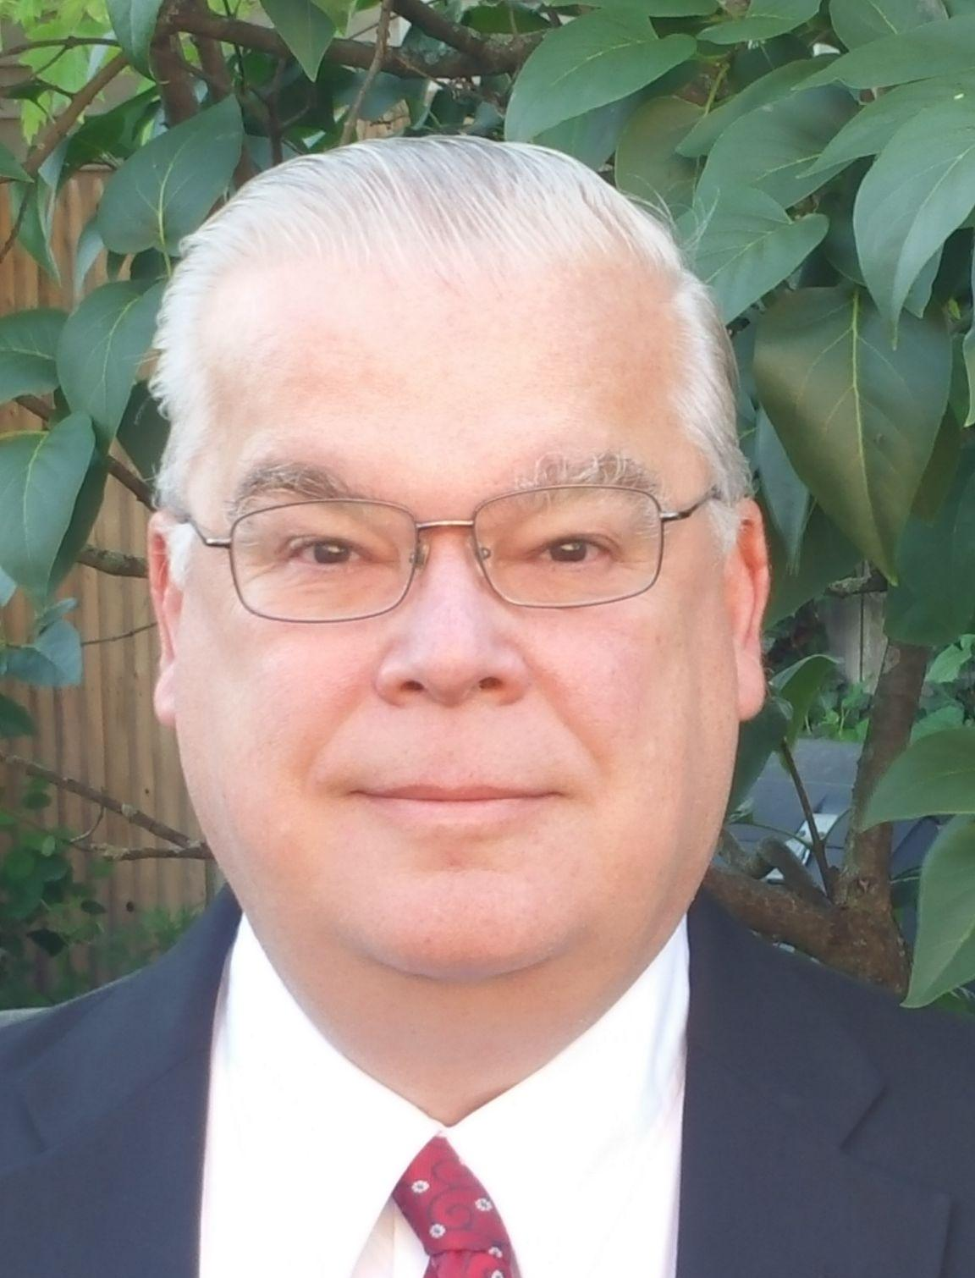
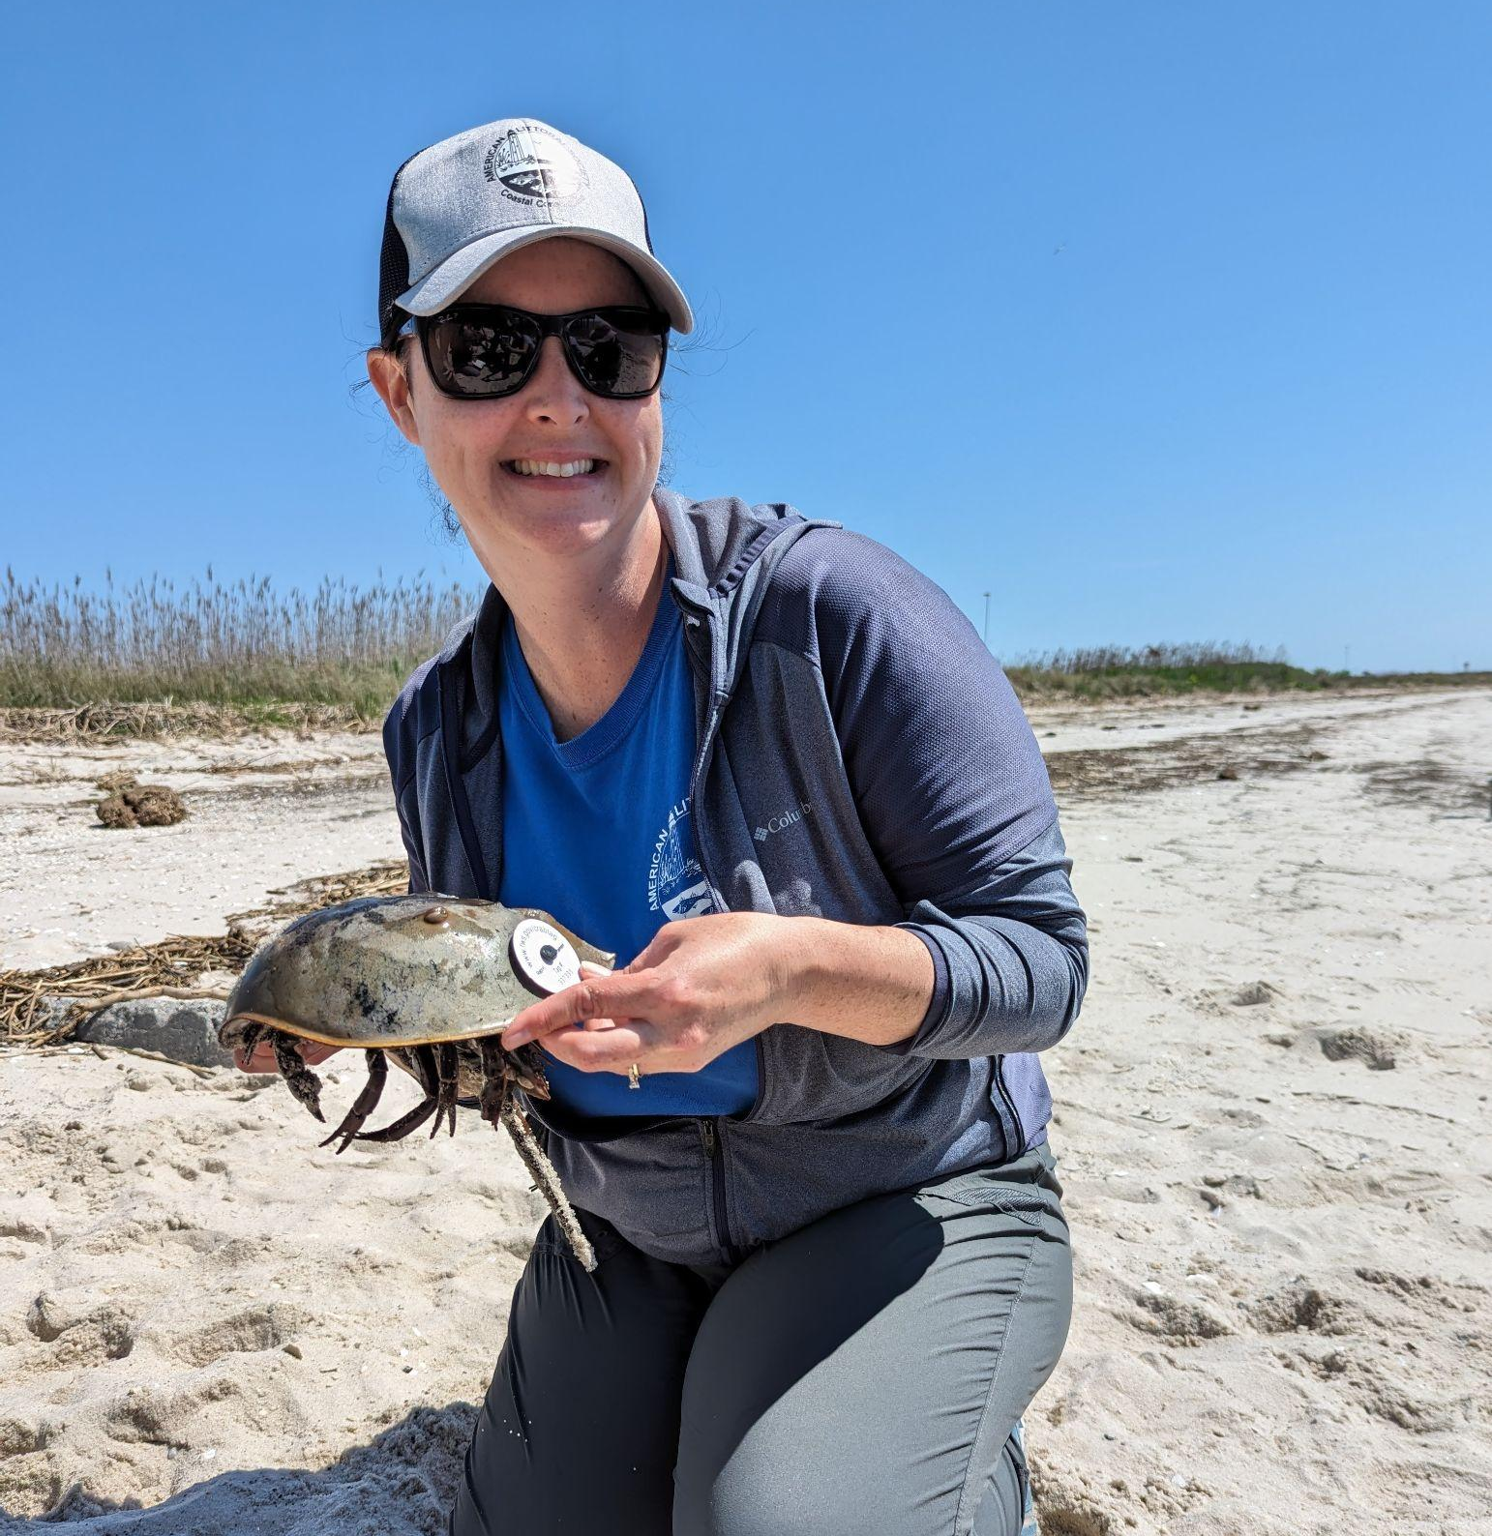
Community Partner Panelist Introductions
Point Pleasant Boro. Env. Commission | American Littoral Society
Dennis Blazak
Chairman, Point Pleasant Borough Environmental Commission
Michelle Rebilas
Director of Education
American Littoral Society

Slide 6
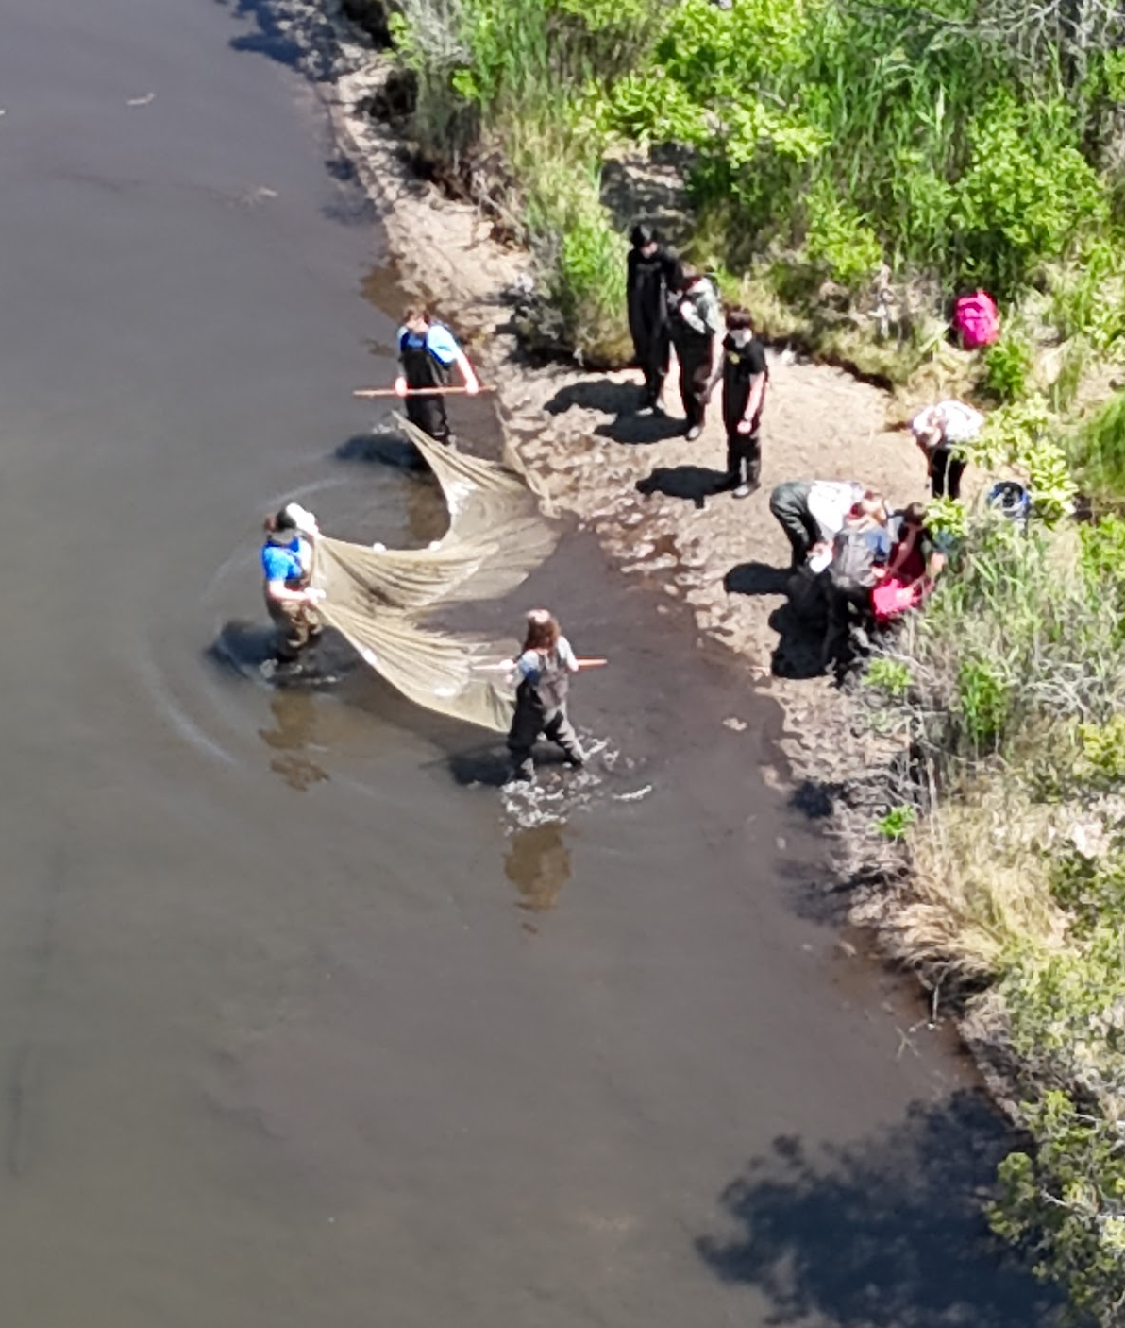
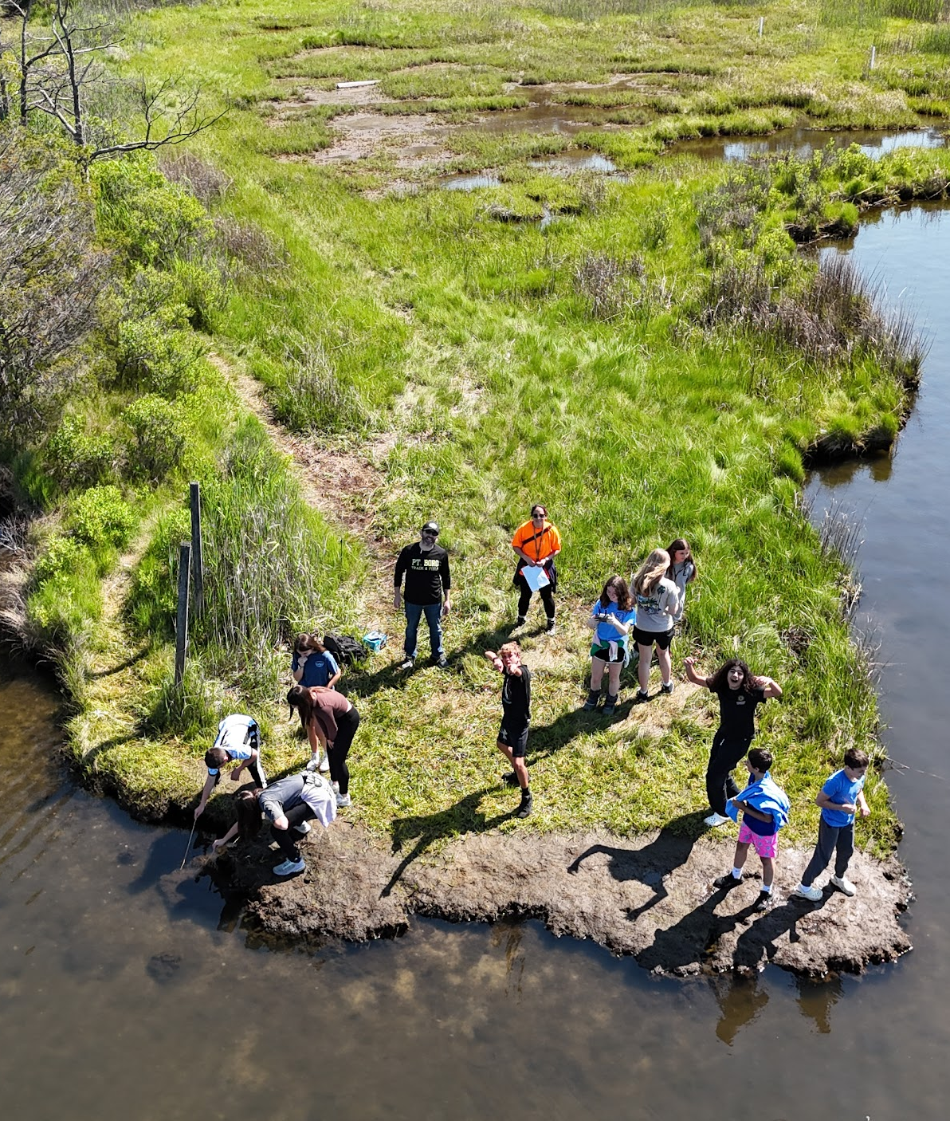
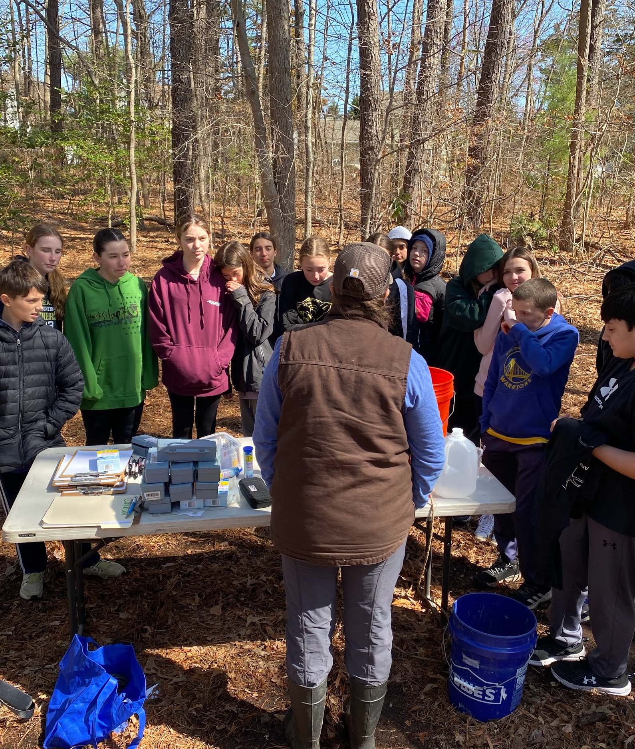
Point Pleasant Schools & American Littoral Society
Slade Dale Marsh Monitoring
Seining
Drone monitoring
Marsh edge erosion study

Slide 7
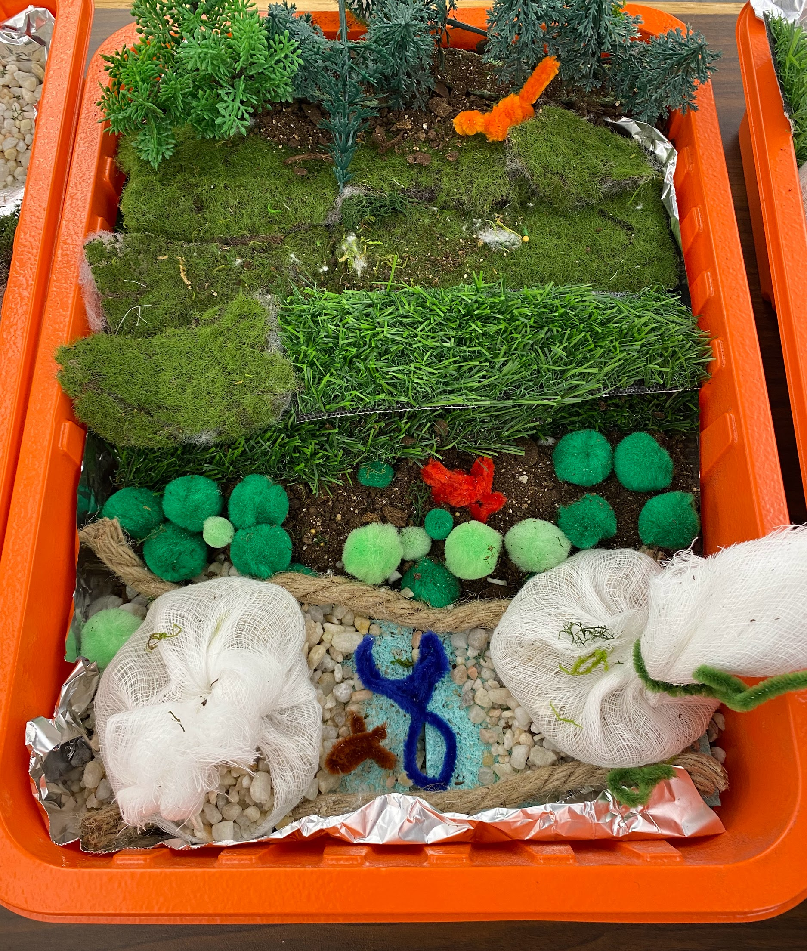
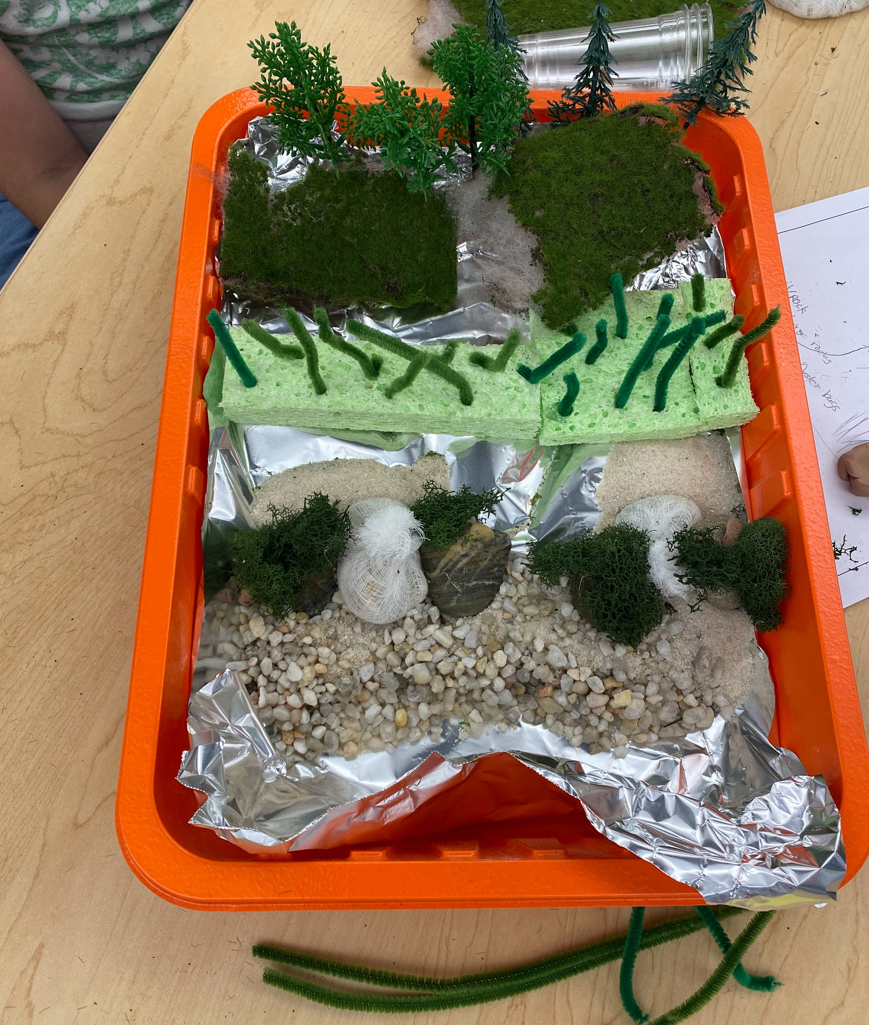
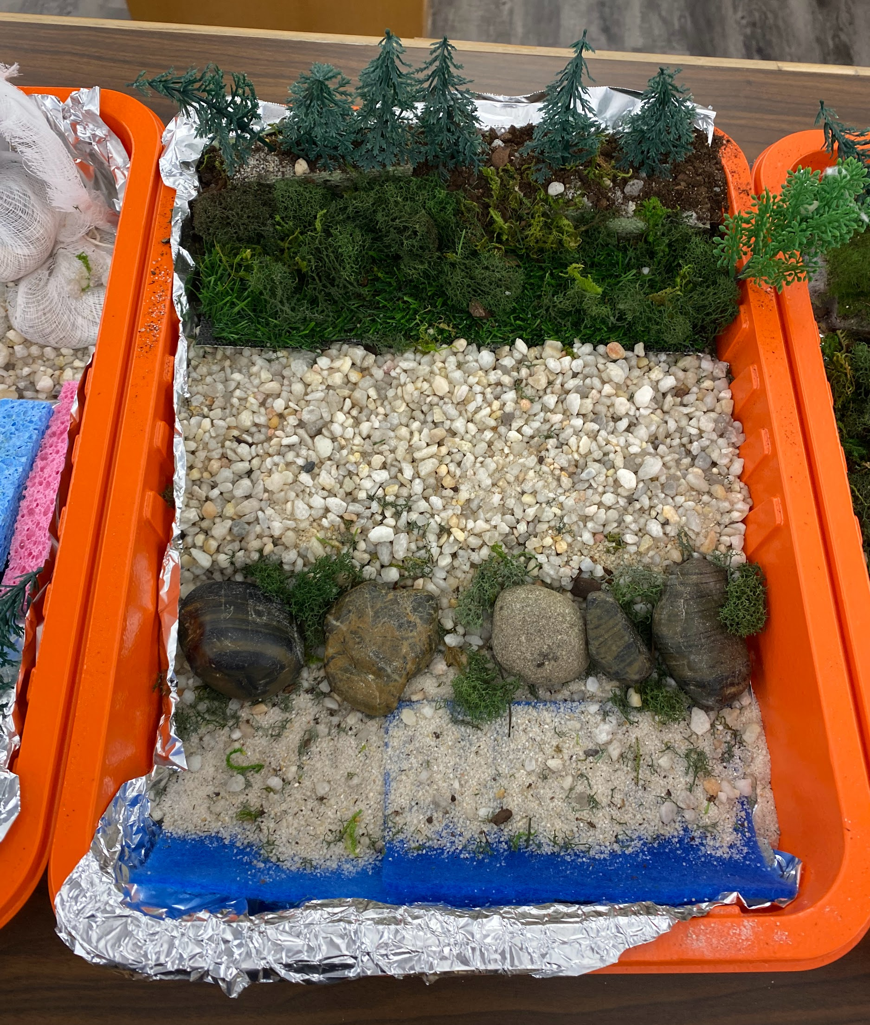
Point Pleasant Schools & American Littoral Society
Living Shoreline Modeling
Students learned about and modeled living shorelines to protect local saltmarsh.

Slide 8
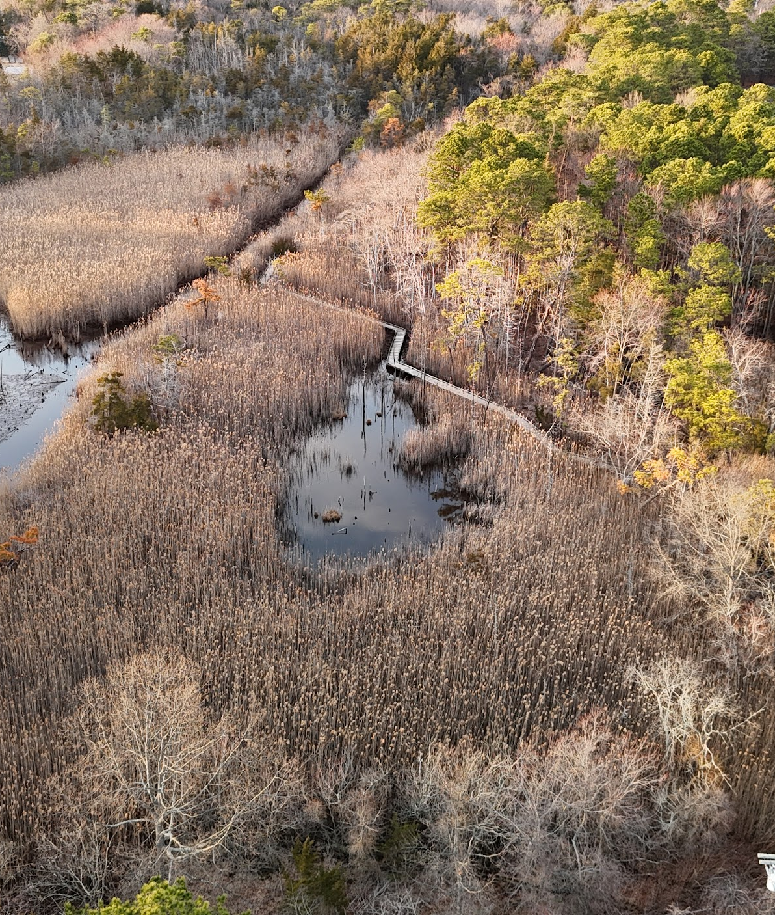
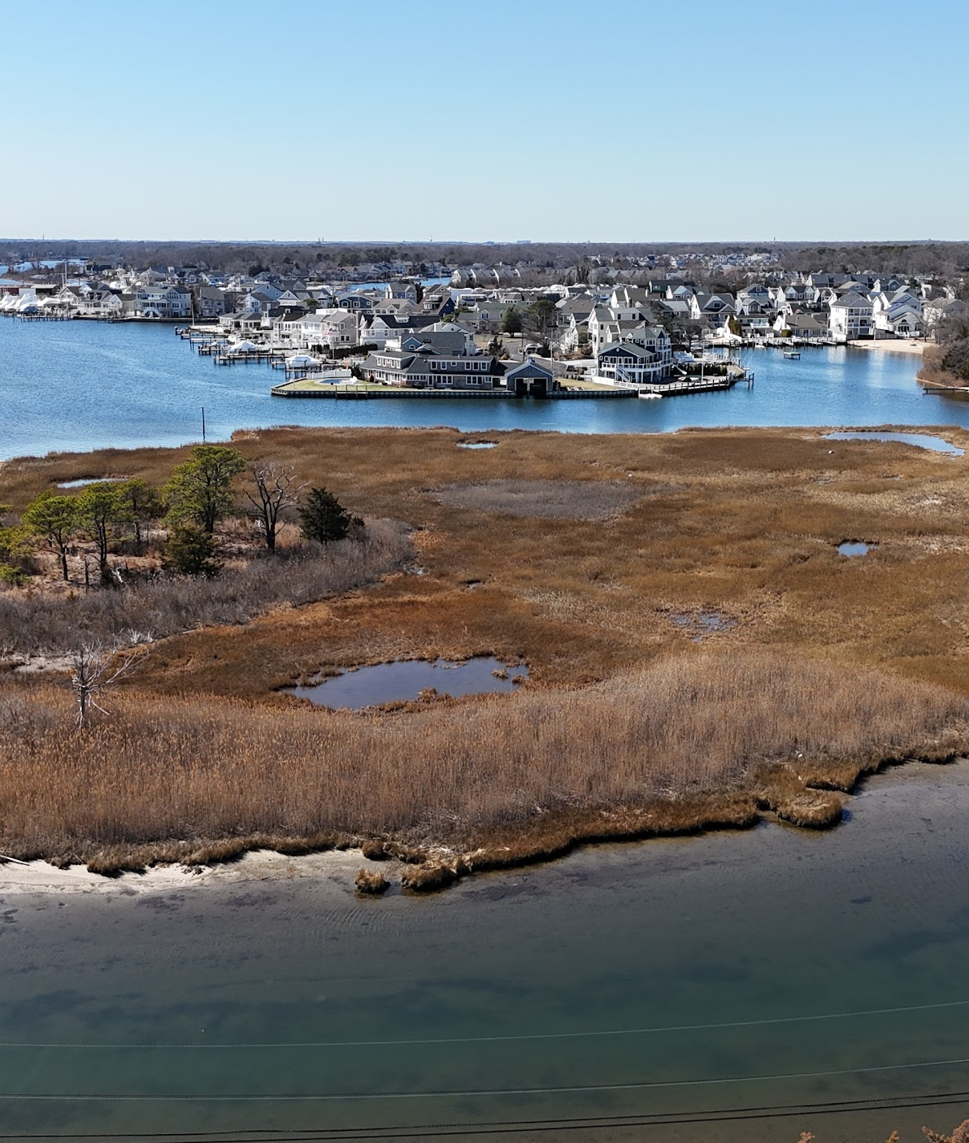
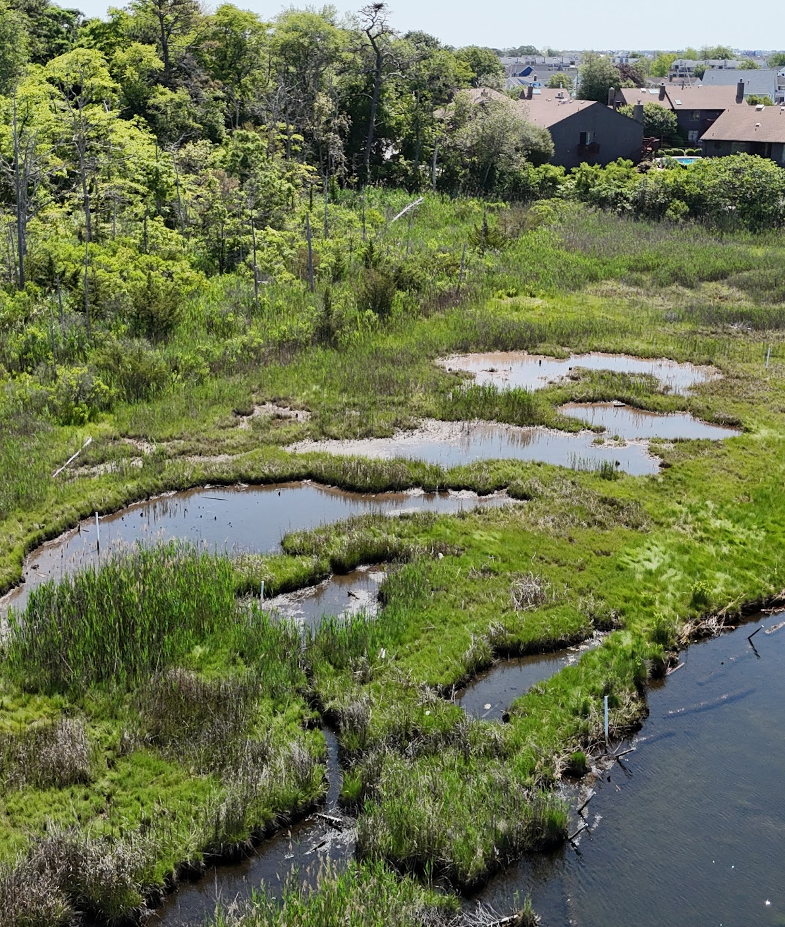
Point Pleasant Schools & Environmental Commission
Future Opportunities
Beaver Dam Park
Nellie Bennett Marsh
Slade Dale

Slide 9
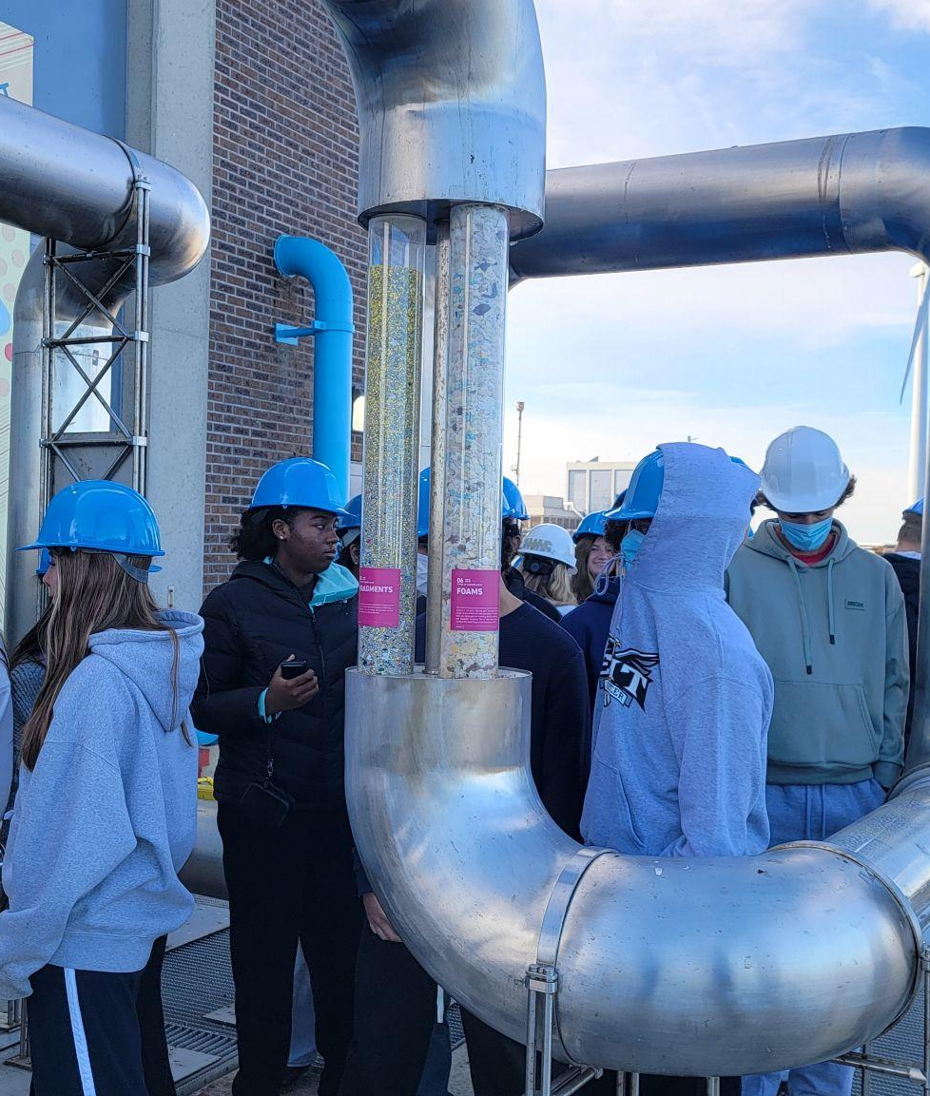
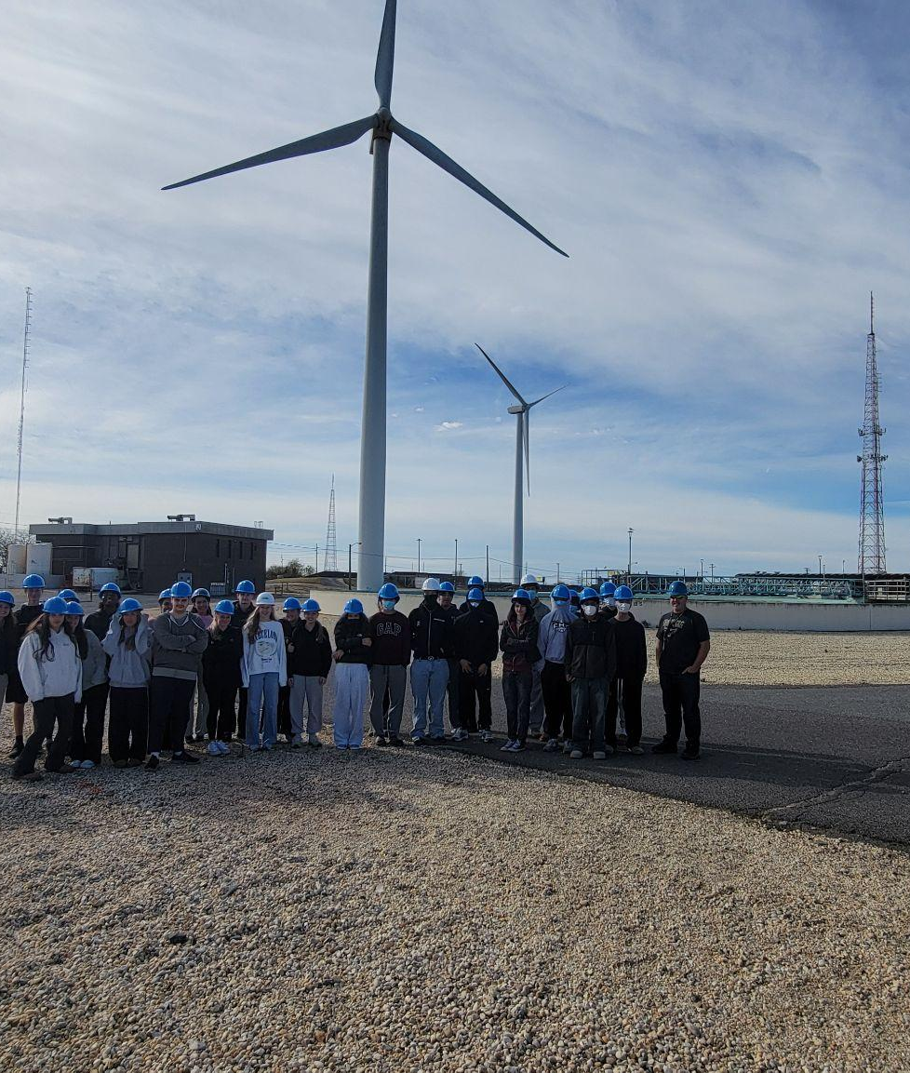
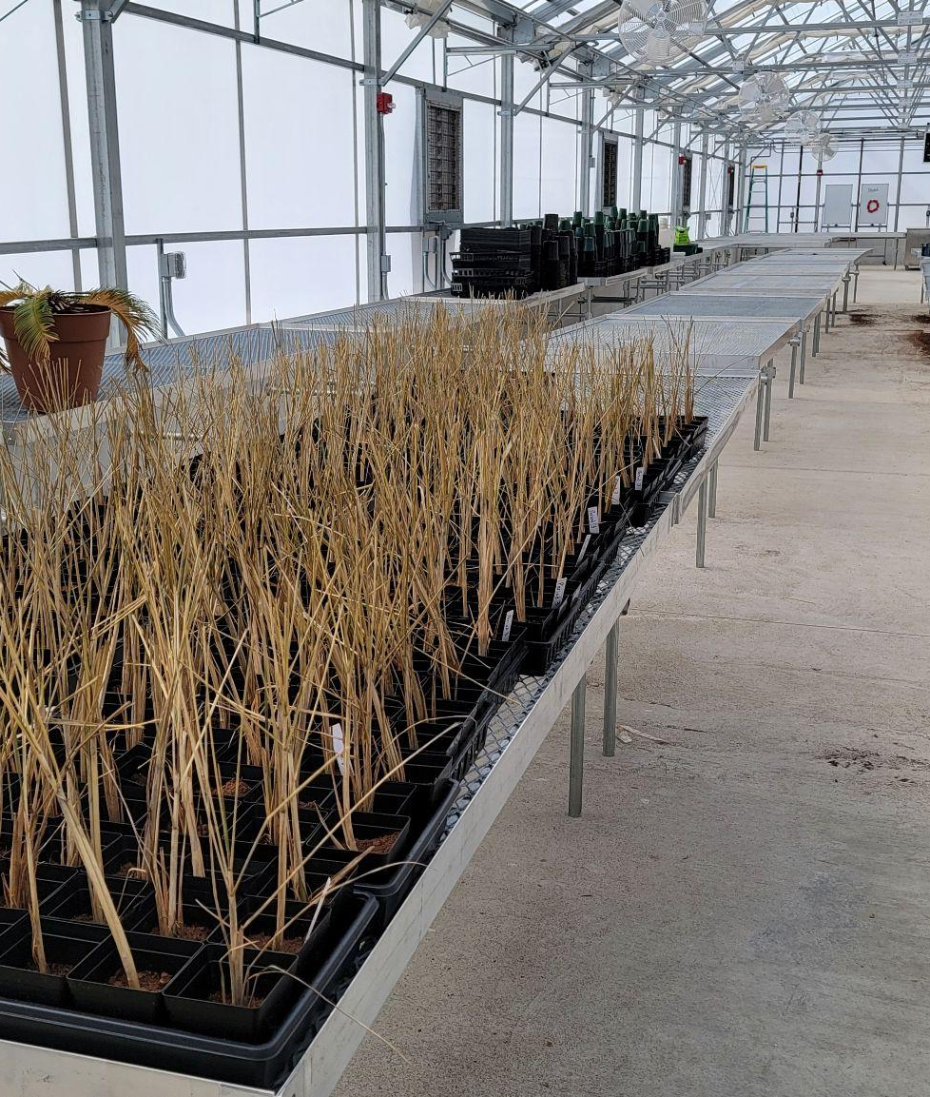
Egg Harbor Township High School
Experiential Learning Opportunities (1 of 3)
Atlantic County Utilities Authority field trip.
Dune grass in the greenhouse.

Slide 10
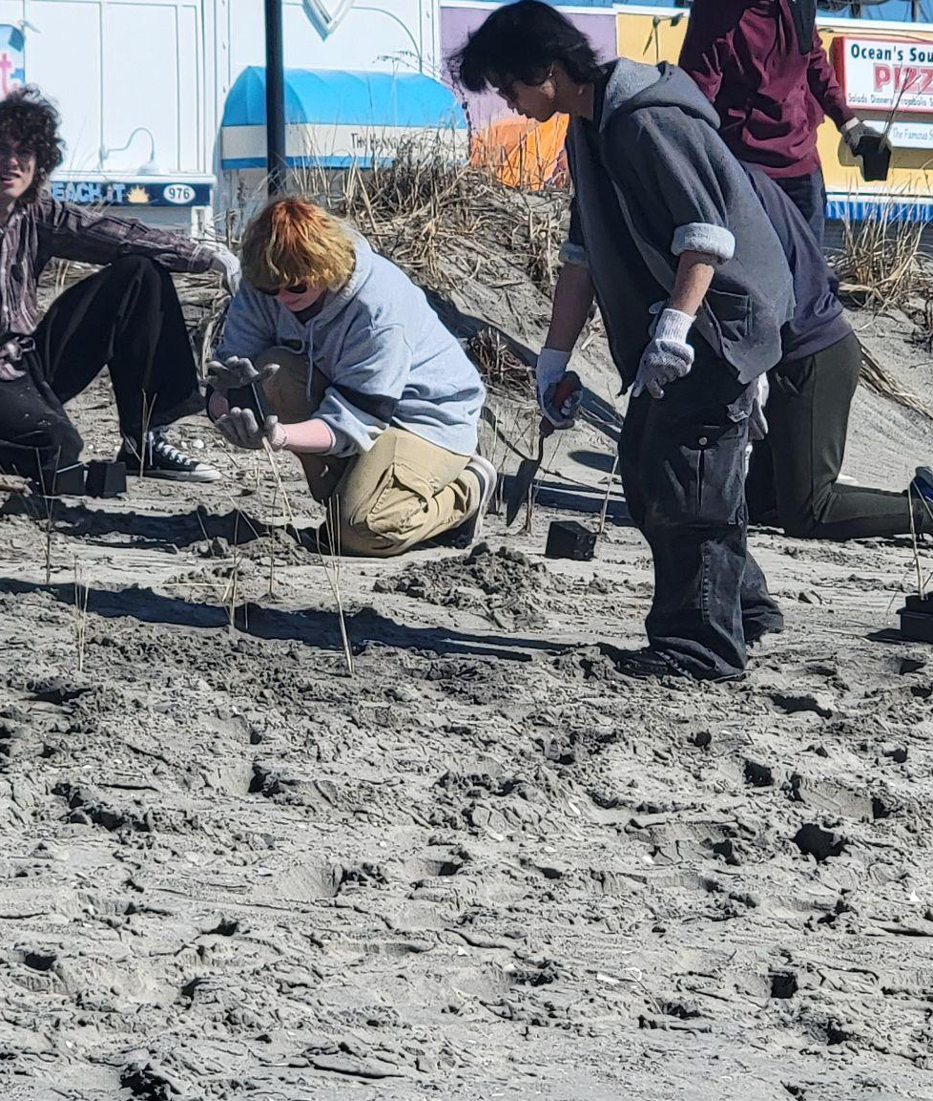
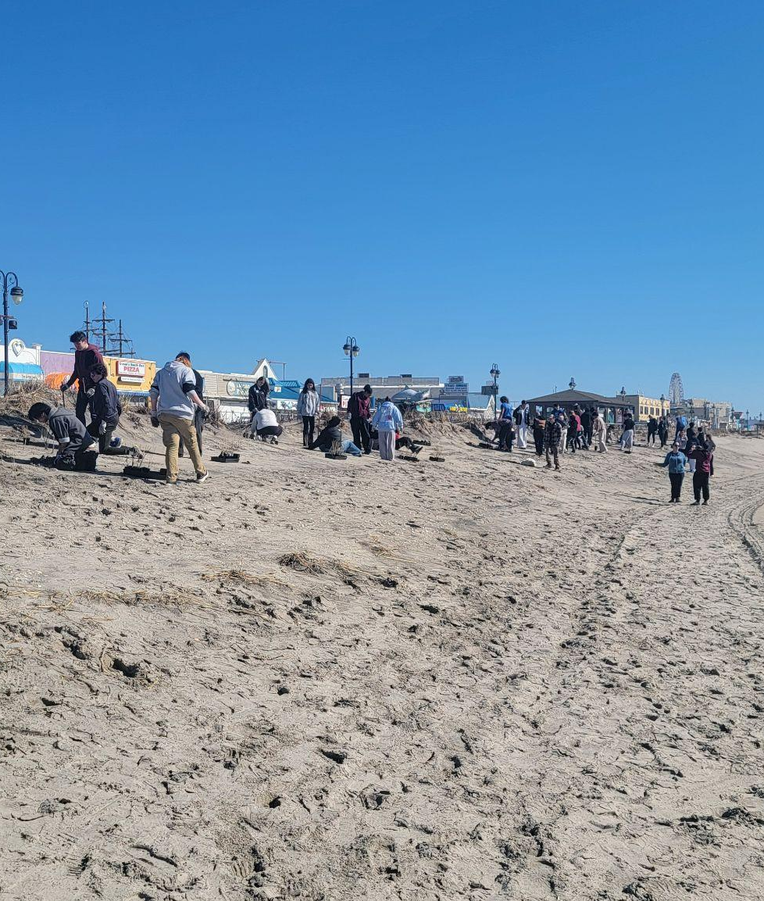
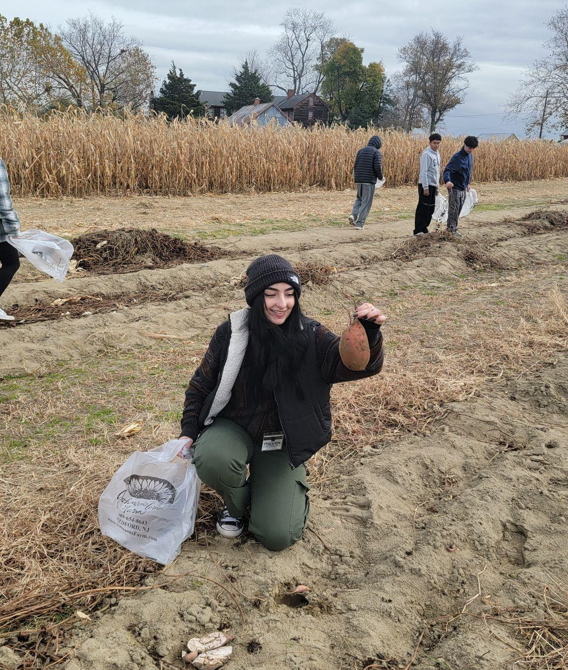
Egg Harbor Township High School
Experiential Learning Opportunities (2 of 3)
Dune grass planting in Ocean City.
Johnson’s Corner Farm

Slide 11
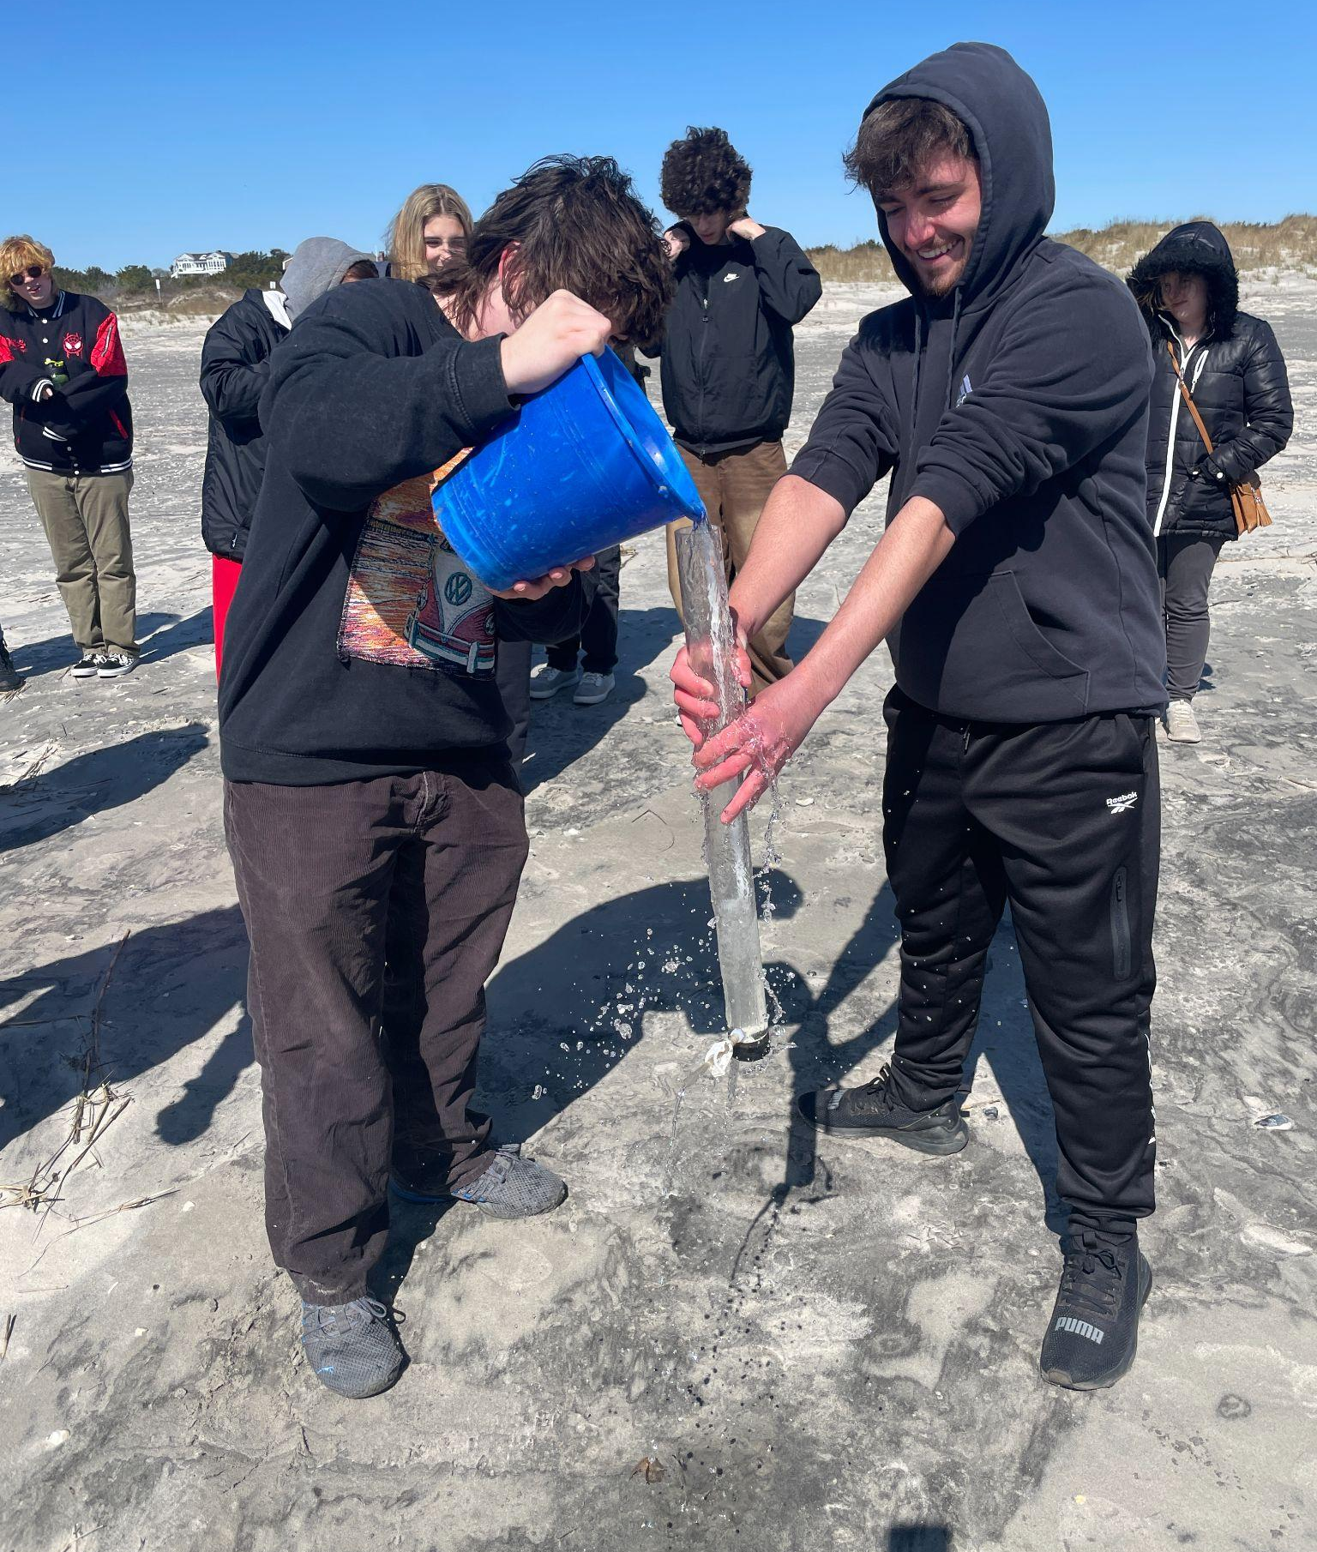
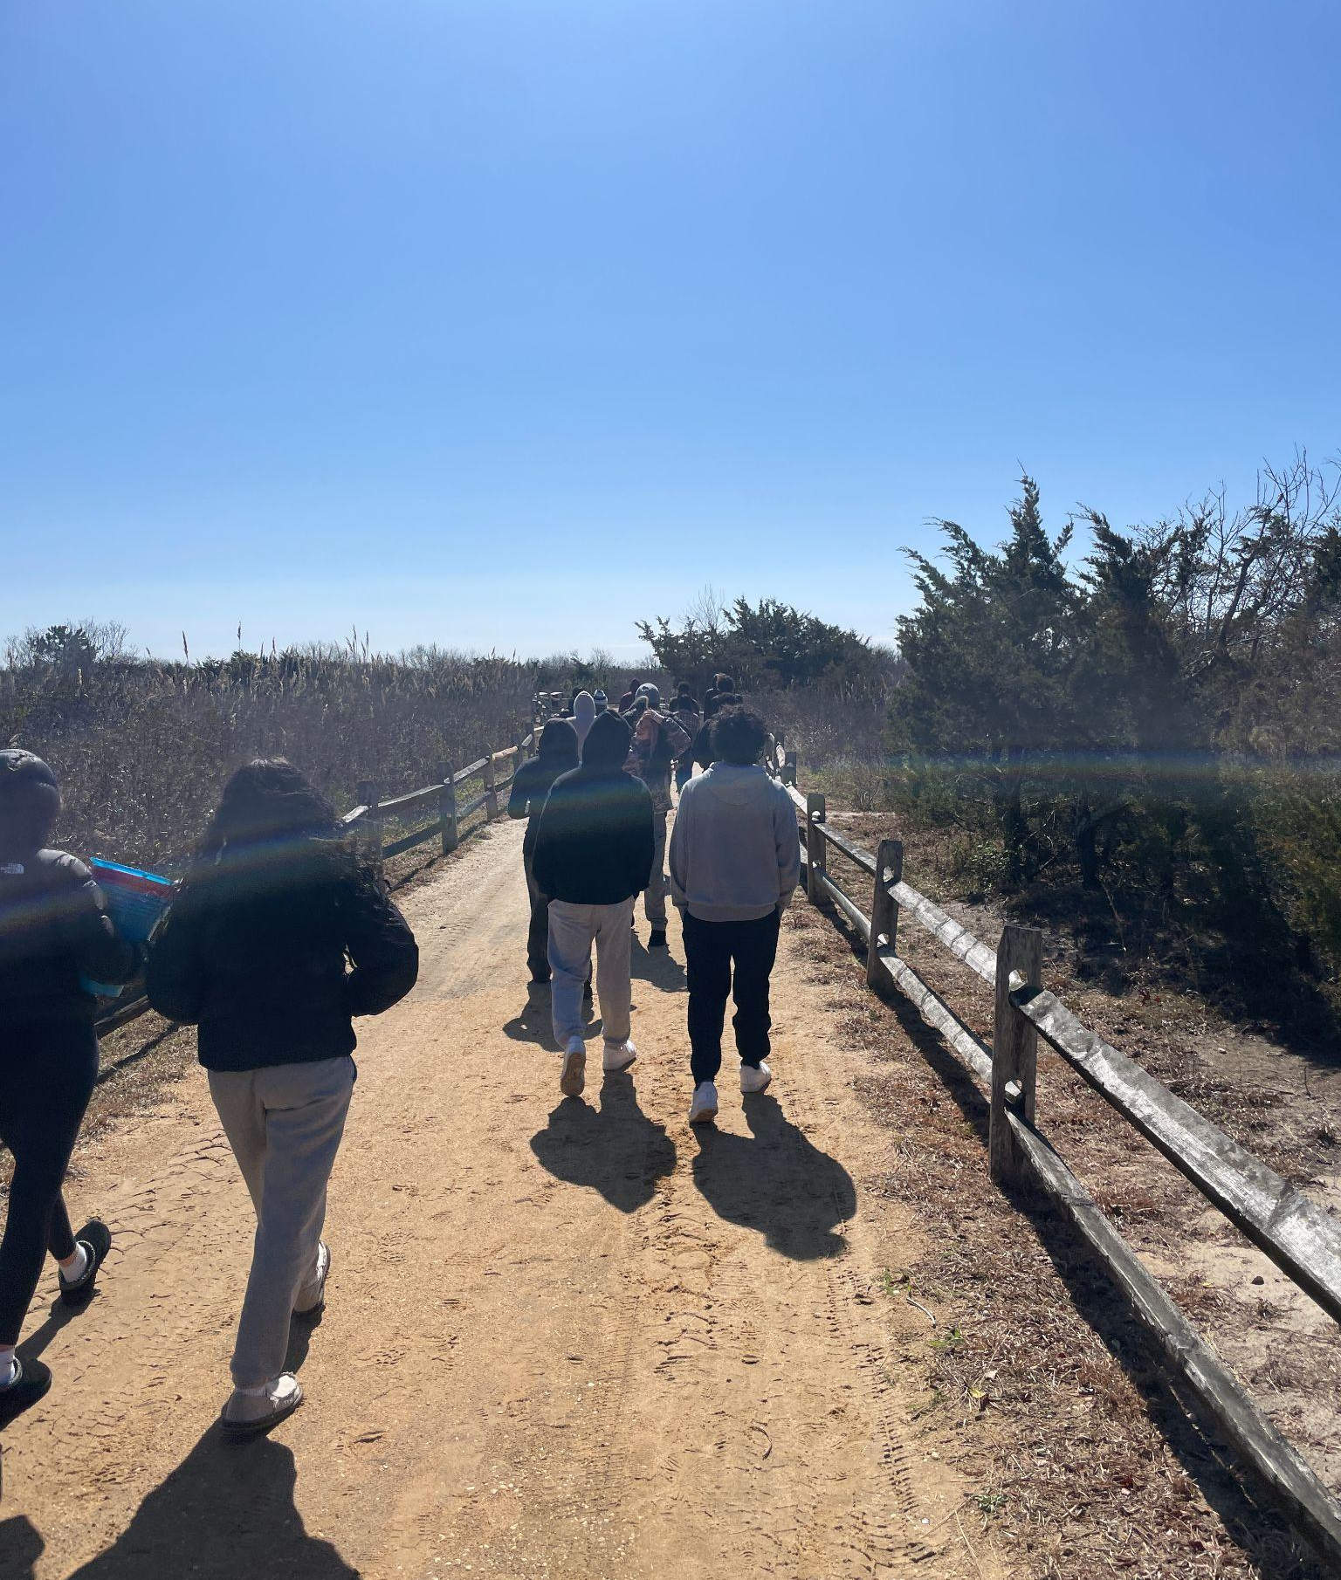
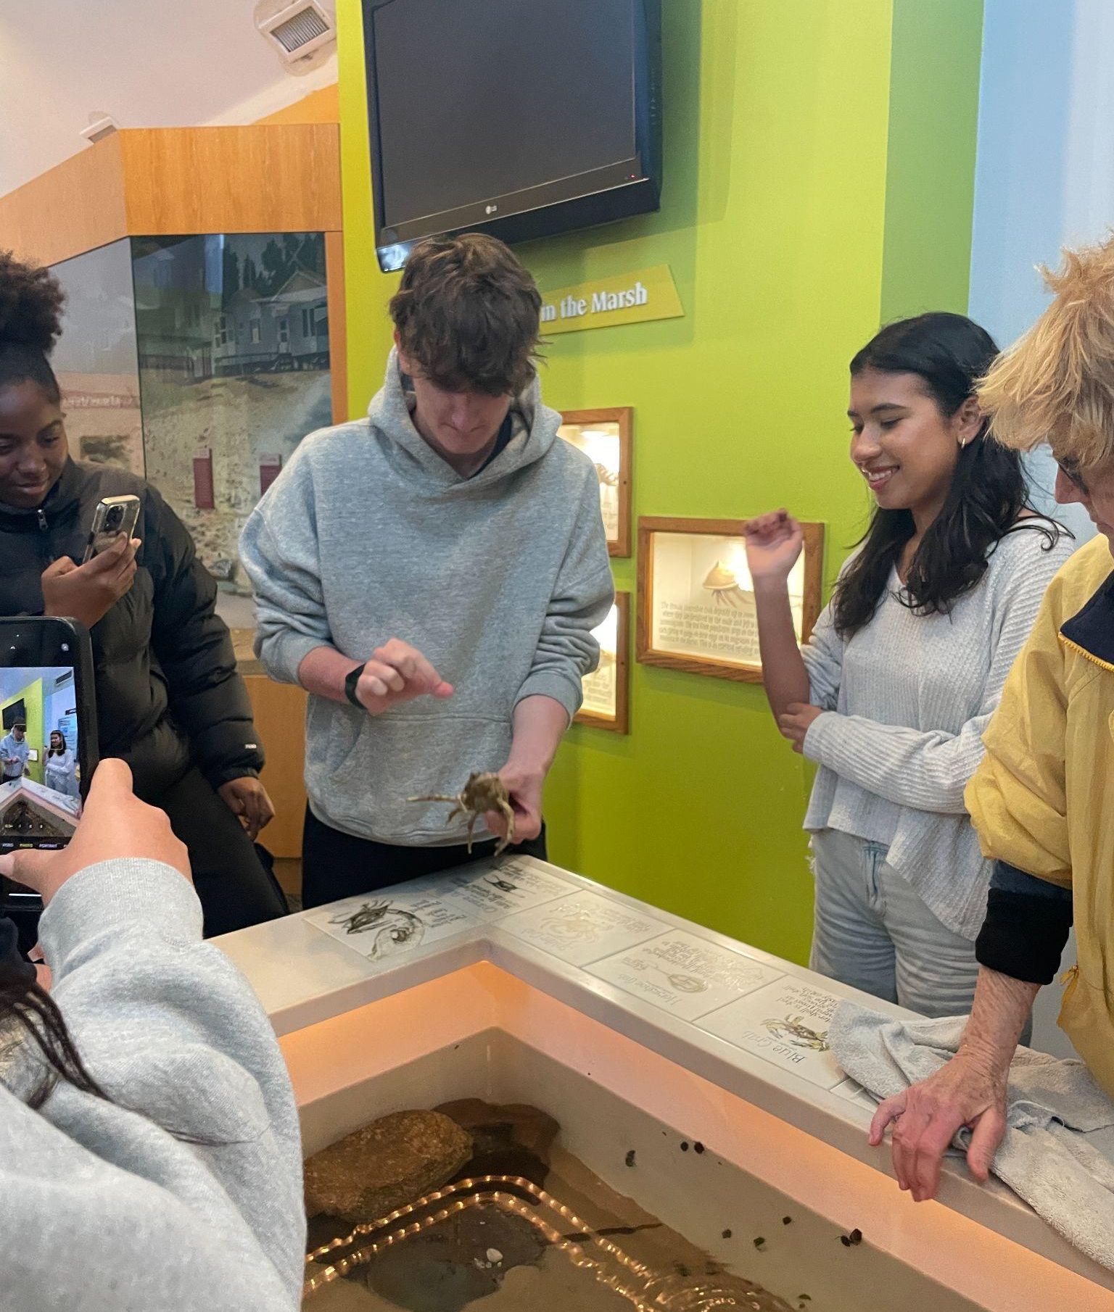
Egg Harbor Township High School
Experiential Learning Opportunities (3 of 3)
Students participated in a field trip to the Wetlands Institute.

Slide 12
Thinking about your field of work or study, what kind of opportunities could be created to provide younger learners access to your work and connect them to local community resilience issues where they can take action?

Slide 13
Questions?

Slide 14
Follow Us
Facebook @njdeptofed
X @newjerseydoe
Instagram @newjerseydoe
LinkedIn New Jersey Department of Education
nj.gov/education
Threads @newjerseydoe
YouTube @newjerseydepartmentofeduca6565

Slide 15

Thank You!
Dennis Blazak
Chairman
Point Pleasant Borough Env. Commission
cplonwse@gmail.com
Christa Delaney
AP Environmental Science Teacher
Egg Harbor Township School District
delaneyc@eht.k12.nj.us
Christine McCoid, EdD
Director of Curriculum and Instruction
Point Pleasant Borough School District
cmccoid@pointpleasant.k12.nj.us
Michelle Rebilas
Director of Education
American Littoral Society
michelle@littoralsociety.org
Sarah Sterling
Senior Climate Change Education Advisor
New Jersey Department of Education
sarah.sterling@doe.nj.gov

