Slide 1
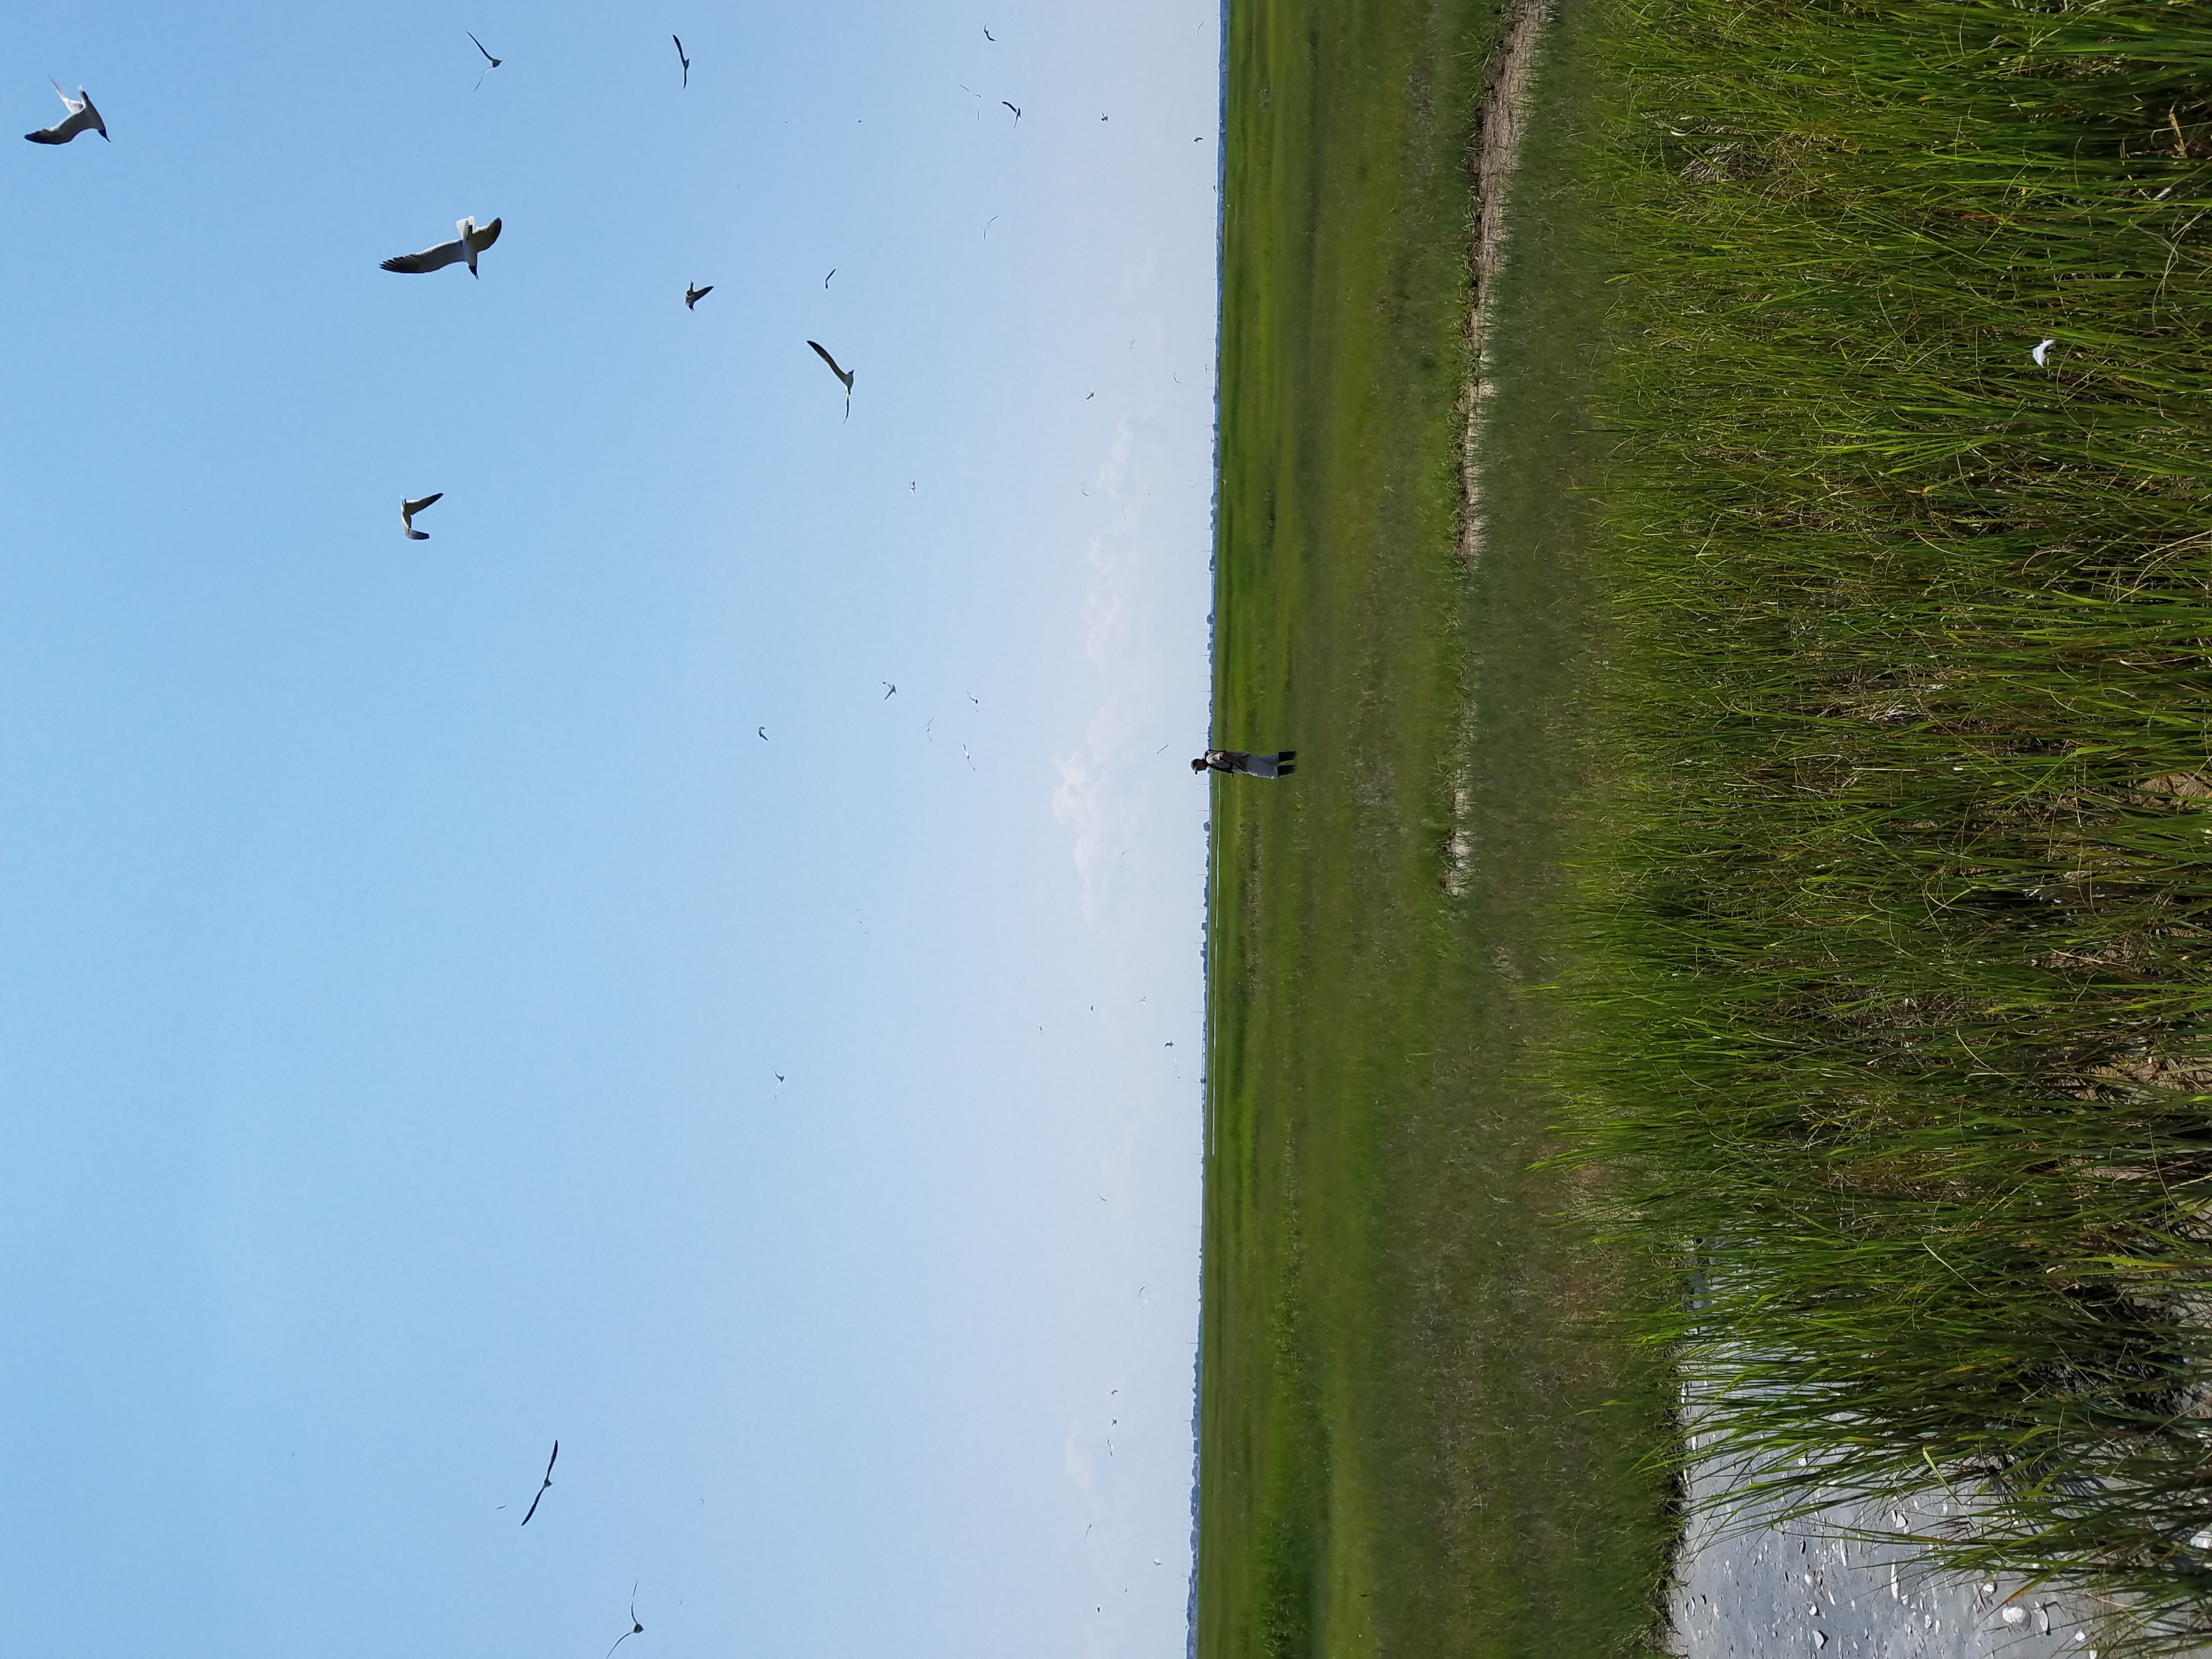
NJDEP Regulatory Process Improvements
and Resources for Nature Based Solution Projects
Colleen Keller – NJ Department of Environmental Protection Division of Land Resource Protection

Slide 2
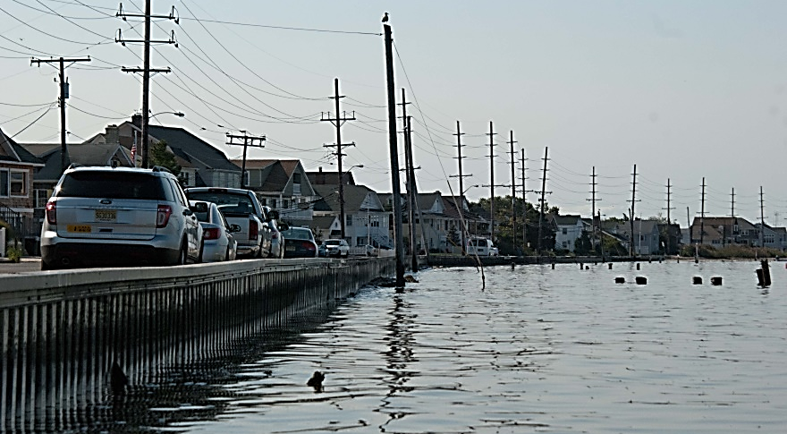
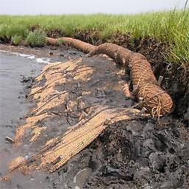
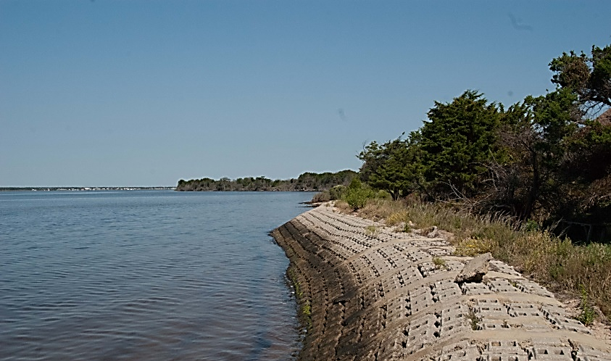
Pre-Sandy Permitting Constraints
Courtesy of the Partnership for the Delaware Estuary

Slide 3
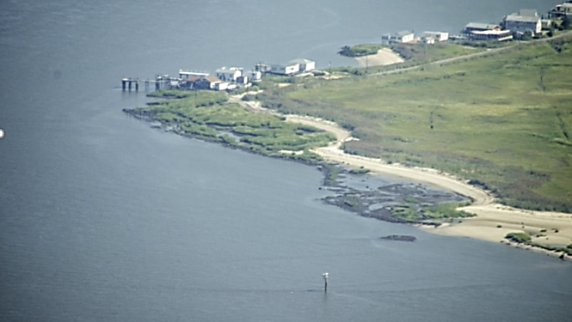
Revised Coastal Rules
June 2013 – Emergency adoption of New Coastal Zone Management Rules
Revisions made to Coastal Regulations to facilitate the establishment of NBS/living shoreline projects:
The general permit for habitat creation and enhancement was modified to include NBS/living shoreline activities (General Permit #24 - N.J.A.C. 7:7-6.24)
A new general water area rule was added for NBS/living shorelines (N.J.A.C. 7:7-12.24)

Slide 4
General Permit 24 (2013 rule adoption)
Living Shoreline/Habitat Restoration activities shall comply with the following:
Generally, <1 acre of disturbance below the mean high water but can be larger if the applicant is a county, state or federal agency that demonstrates the project size is necessary to satisfy goals.
The project shall disturb the minimum amount of special areas, as defined by N.J.A.C. 7:7-9, necessary to successfully implement the project plan.
Shall not exceed the footprint of the shoreline as it appeared on the applicable Tidelands Map adopted by the Tidelands Resource Council (base map photography dated 1977/1978)
Except for a structural component of the project intended to reduce wave energy

Slide 5
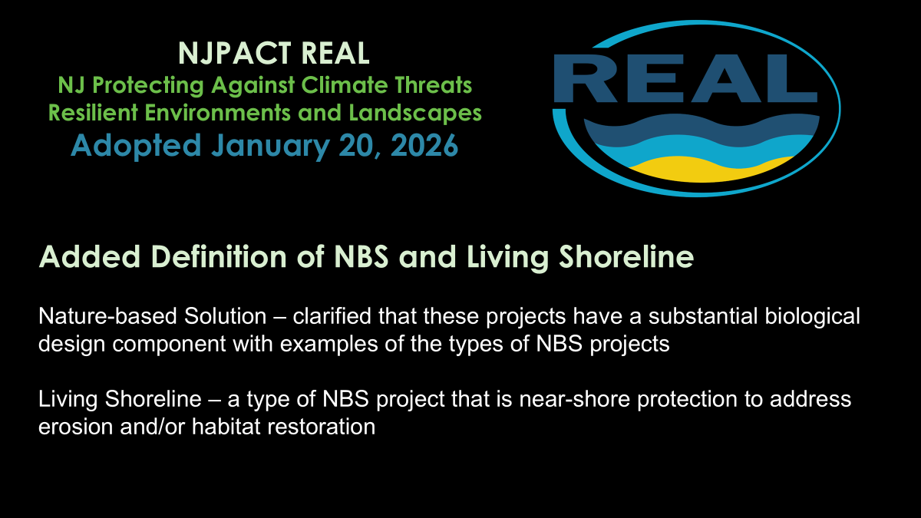

Slide 6
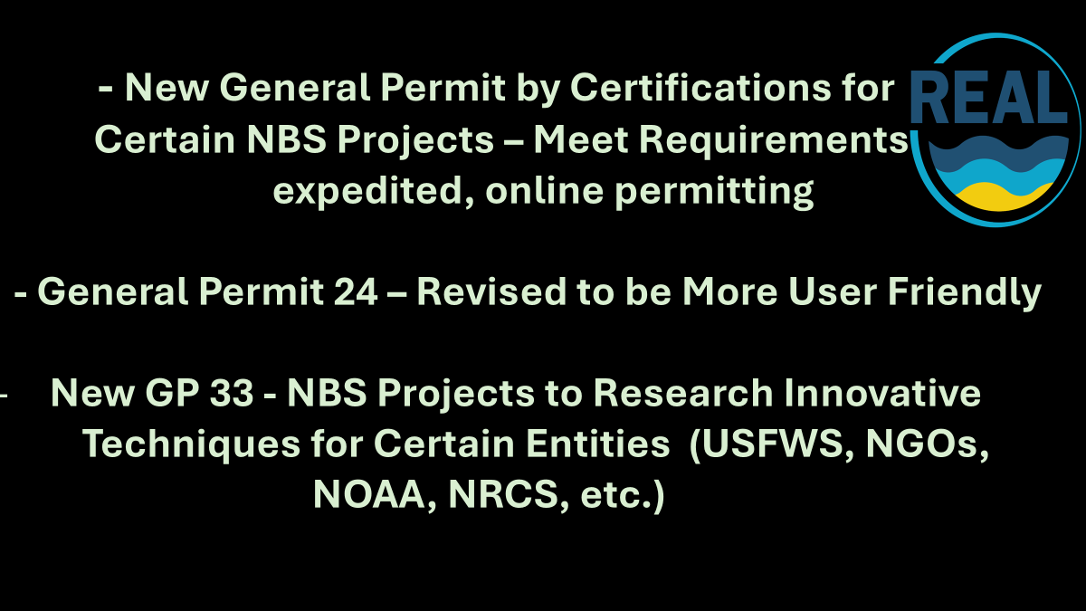

Slide 7
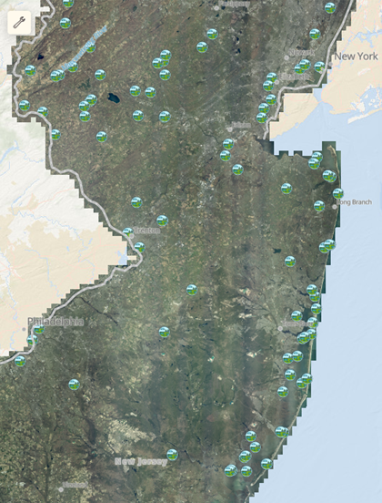
NBS Permitting Process Improvements – No Application Fee for NBS General Permit 24 -Electronic Submission for General Permits since 2021 -NJDEP NBS Workgroup for Better Internal Coordination -NBS Permit Review Team for NBS Experienced, Expedited Reviews -DLRP Managed CZM Grants for Research/Training to support NBS Projects
NJDEP DLRP has issued more than 175 Permits for NBS Projects

Slide 8

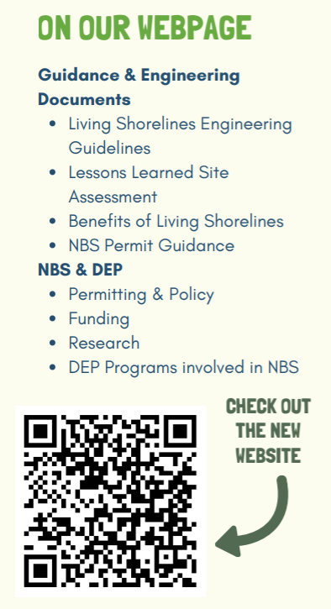
DLRP NBS Website https://dep.nj.gov/wlm/lrp/common-projects/nature-based-solutions

Slide 9
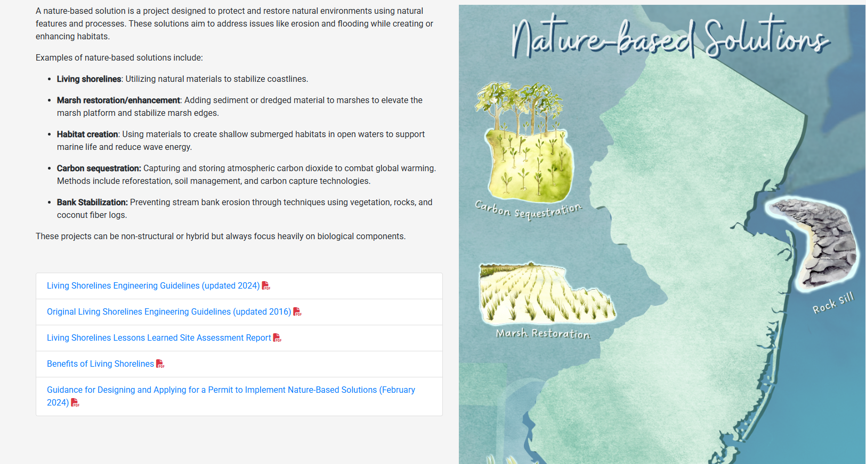

Slide 10
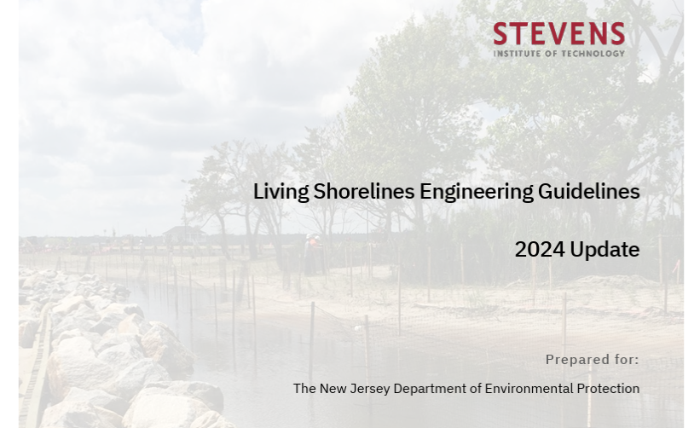
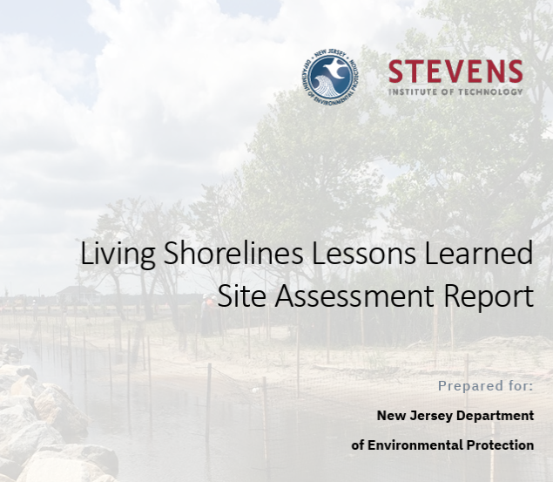
Engineering Guidelines & Lessons Learned Assessment of 10 NBS Constructed Projects Permitted by DLRP Developed for NJDEP by Stevens Institute of Technology

Slide 11
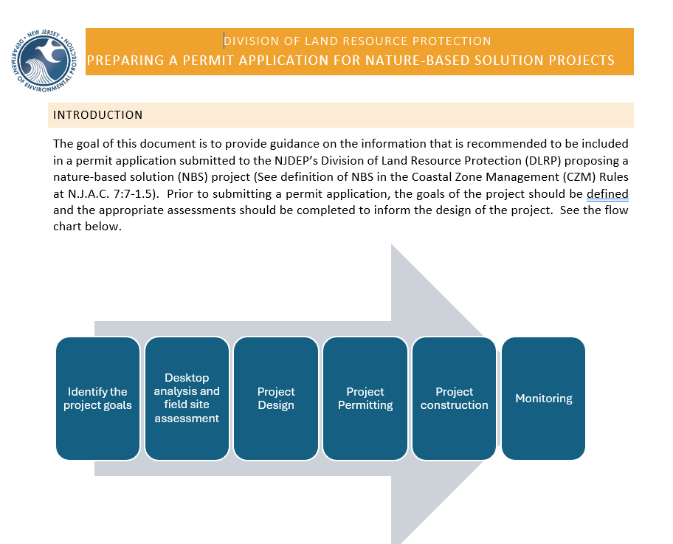
DLRP Guidance Document With Recommended Considerations
For Submittal of NBS Permit Application

Slide 12

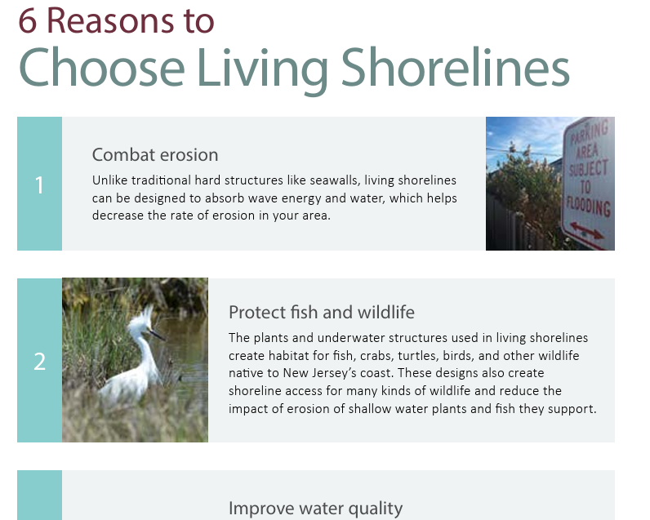
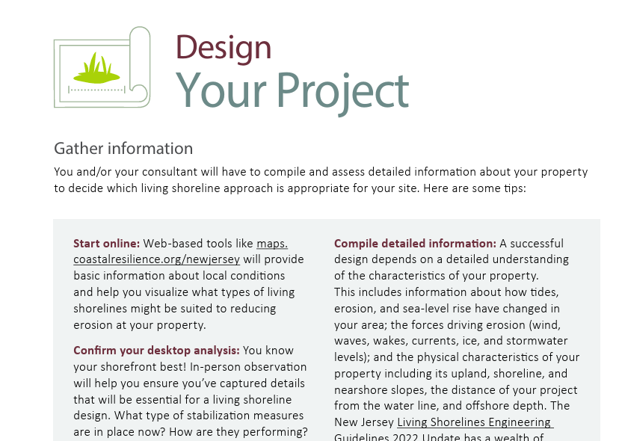
Media/Educational Info on Value of Choosing NBS
& Design Considerations

Slide 13
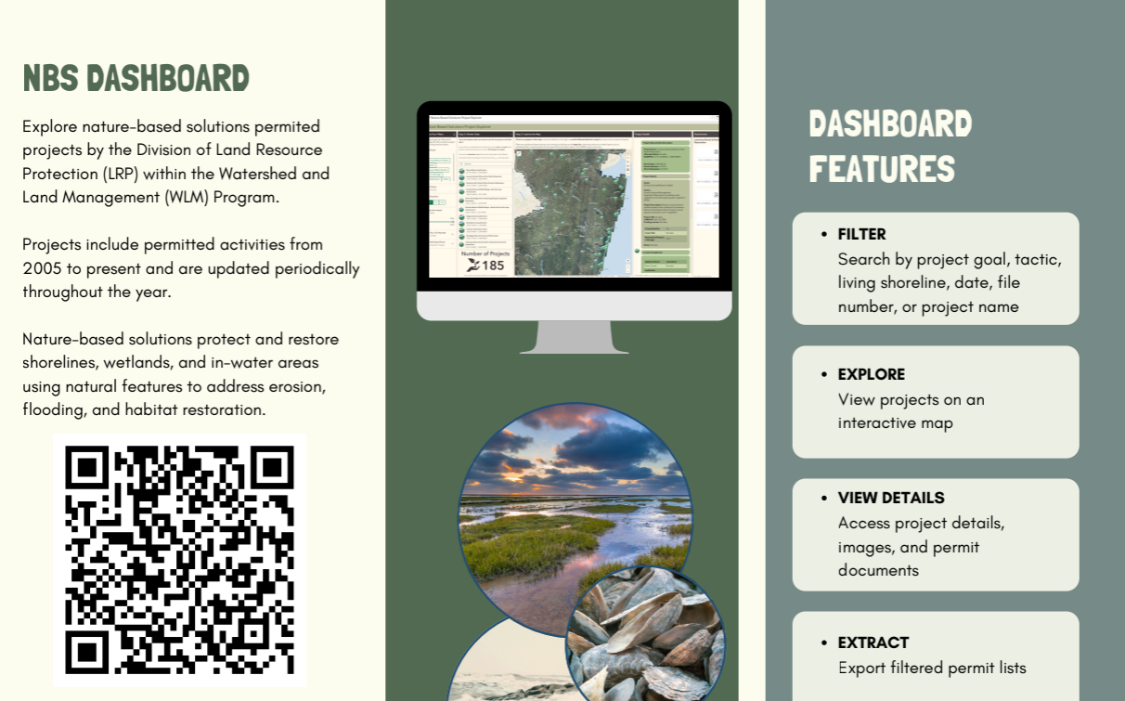

Slide 14
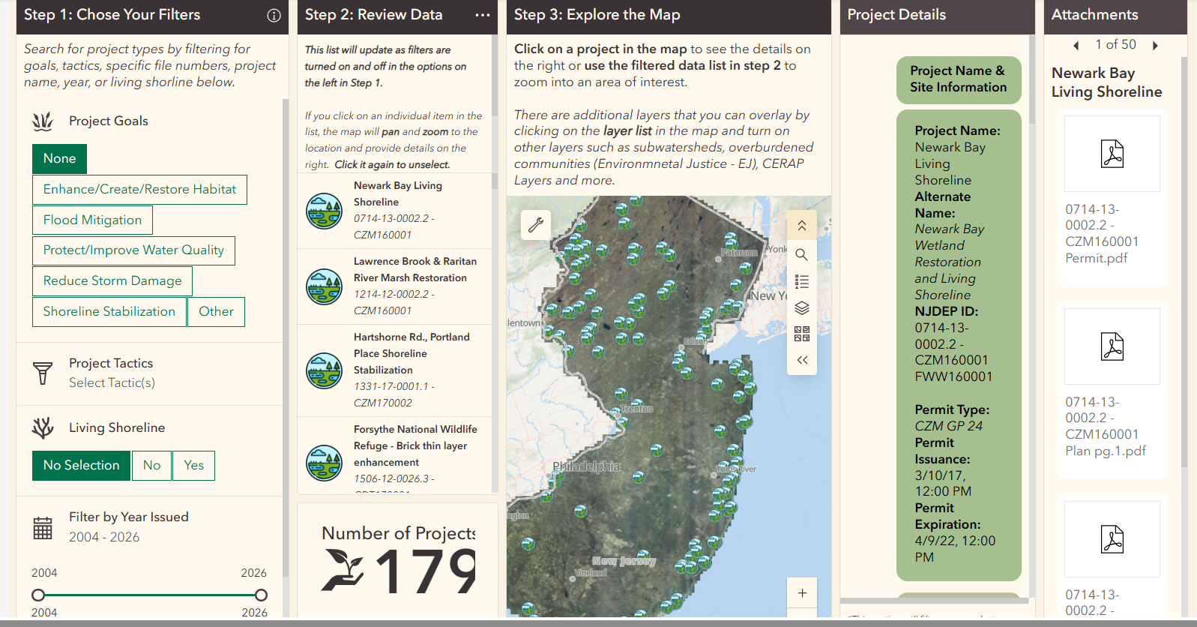

Slide 15



NJDEP DLRP CZM Grant Funded Training
Coming in June 2026
Stevens Institute of Technology Training on the Design of NBS
Projects for New Jersey Municipal Officials
& Non-Governmental Organizations

