Slide 1
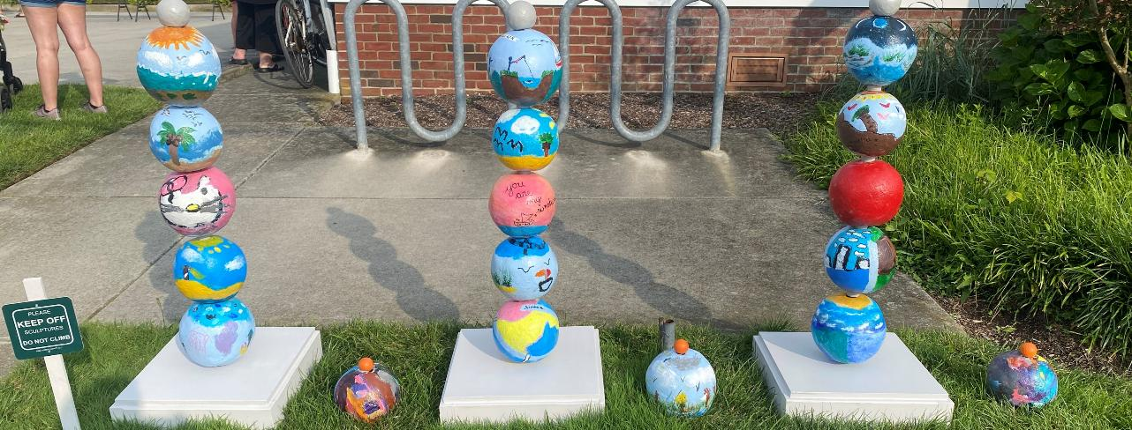
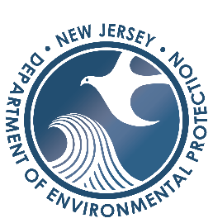
Community-Based Art
Grant Program- Overview
March 10, 2026
Notes:
Good afternoon everyone, we wanted to start off by thanking the Commissioner and his team for inviting us on the broadcast to share about our office and our work
I am Devon Haines I’m with NJDEP Bureau of Climate Resilience Planning Managed by Nick Angarone our State Chief Resilience Officer, our office administers the Coastal Management Program. I am the Project Managers for the Community Based Art Grant program which is funded through NOAA Coastal Zone Management Annual Funding.

Slide 2




What we do
Community-Based Art Grant Program
Release Notice of Funding, Select CBOs
Receive and review art proposals, finalize project details
Assist CBO through grant process
Participation at Community event/ Installations
Notes:
CBAGP was created in 2019 it is a risk communication project that connects 2 state agencies (NJDEP and NJSCA). We wanted to work with another state agency to expand our communication effects with community members. NJDEP felt that Arts was a great approach that opened the doors for creative communications and our partnership was born. In this program Community Based Organizations and Artists work with their community members to identify and address coastal hazards related to Climate Change by creating personalized installations and events for community members to attend and learn about what they are faced with, how it is impacting them and ways they can get involved to help their communities.
We start by Releasing a NOFA, once we receive applicants, the team creates a panel to review applications and select Community-Based Organizations to be award and host projects for that year.
NJSCA communicates with the Community-Based Organizations on their needs and creates a call for artists, once the team Receive art proposals we again review via a panel consisting of 1 representative from each organization along side the DEP and State council on the arts. Once the artists are awarded they work with Community organizations to communicate coastal hazards and finalize their art installation designs
We Share and promote Community Event and Installations through social media and newsletters as well as attend the events and engage with the community on their experience with coastal hazards and the project as a whole.

Slide 3
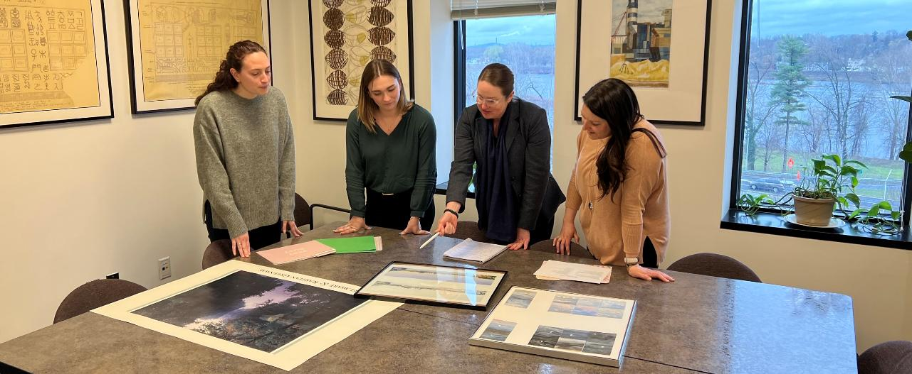
Department of Environmental Protection and State Council on the Arts
Notes:
Small but mighty team: Our team consists of 6 people, 4 from DEP Becky Hill who is the manager of our program, myself, and 2 contracting members Cathy Williams and Danielle Petacough, and 2 from the NJ state Council of the Arts Danielle Bursk and Steph Nerbak.
To date we have funded 20 projects (15 have been completed with 5 projected to be completed this year)
Atlantic City(x2)
Bayshore Center at Bivalve
Count of Passaic
Monmouth Arts (x2)
Camden Community Partnership (x2)
Newark Arts (Four Corners)
City of Rahway
Monmouth Conservation Foundation
Northern New Jersey Community Foundation
Ocean City Arts Center
Artworks Trenton
Perkins Center for the Arts
Wheaton Arts Center
Atlantic City Utilities Authority
Camden FireWorks
Hoboken
Long Beach Island Arts and Science Foundation

Slide 4
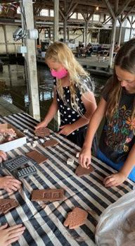
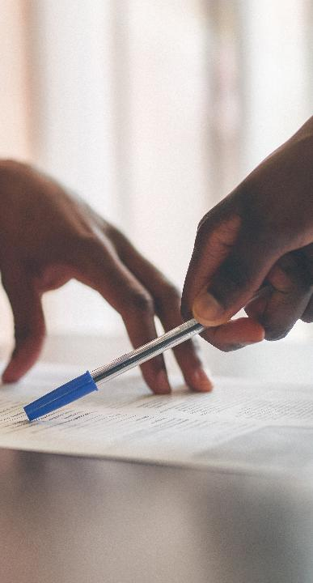
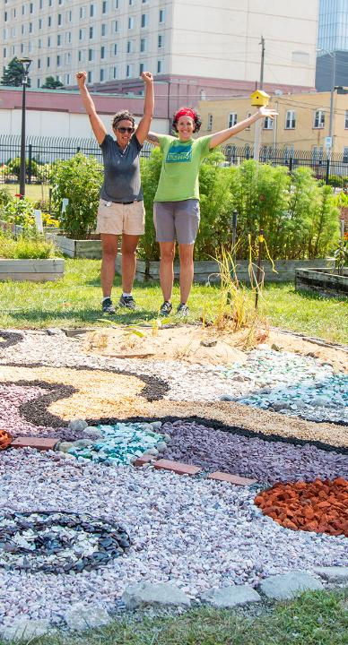
Why our work is important
Community Engagement
Making Information Available and Understandable
Different Coastal Hazards Dependent on Communities
Hands on Experience in their Communities
Firsthand Feedback to Evolve the Program
Notes:
Why is our work important? Our biggest goal through the project is increasing community engagement on coastal hazards.
We want to Make information available to the public, data, statistics and scientific information can be difficult to grasp. By giving community members a chances to engage with art allows information to be more approachable and easier to understand.
Across the state everyone face different coastal hazards, each year our goal is to have art installations in different areas across the coastal zone. By funding projects across the state, we can bring light to various issues as well as solutions to how communities may adapt to changes they are facing with hands on experience
The community event component allows DEP and The arts council to attend, see the progress of the project as well as hear feedback from community members on how they comprehend risk before and after the installation.

