Slide 1
Nature-Based Solutions Reimagined
A Parametric Approach to Dune Design
Ian J. Day
with Matthew S. Janssen and Jon K. Miller

Slide 2
Abstract
Nature-Based Solutions Reimagined: A Parametric Approach to Dune Design
Beach nourishment is widely considered the original Nature Based Solution, utilizing native materials and emulating natural processes. However, in practice, most projects optimize protection within limited footprints. The result along developed coasts like New Jersey are typically single large dunes with uniform cross-sections and steep slopes paired with flat uniform berms. While the storm damage reduction of these projects are notable and well documented, they provide limited ​ecological benefit with monolithic linear dunes, homogenous vegetation, and few habitat niches. This template misses the intent of Nature Based Solutions. To bridge this gap, we present a parametric design approach to facilitate analysis and design of ecologically enhanced nourishment projects. Herein, we demonstrate the utility of a physically informed vulnerability model to effectively analyze alternative project geometries while maintaining equivalent risk reduction under storm events. The model enables a broad assessment of the engineering performance of dissimilar beach-dune configurations, including natural or engineered dunes, hummocky dunes, or flat beaches. This allows for simple comparisons between standard design templates and novel nature-based alternatives. The intent is to facilitate consideration of alternative dune slopes, elevations, and irregular configurations that more closely mimic natural features while maintaining the protective function. We synthesize the use of the model, stressing its intended target audience of interdisciplinary teams including ecologists, engineers and planners. We apply the model to quantify existing variation in ‘natural’ and ‘engineered’ sections of the NJ coast.
For extended abstract next time, an add something like:
For example, where storm risk reduction is of primary concern, engineers can establish a maximum allowable risk as a design constraint and freely adjust template geometry while achieving the necessary protection. For ecologically focused projects, a minimum risk may be defined to allow for dynamic natural processes to shape the system and create habitat.

Slide 3
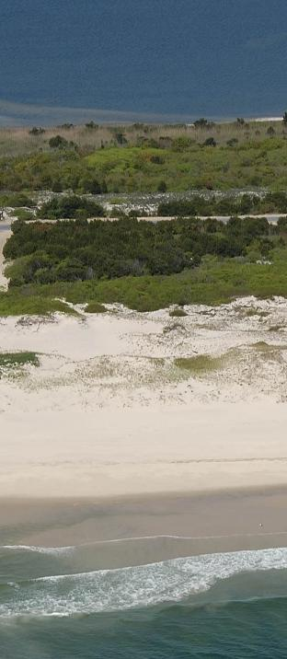
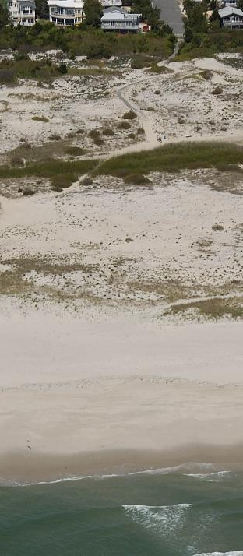
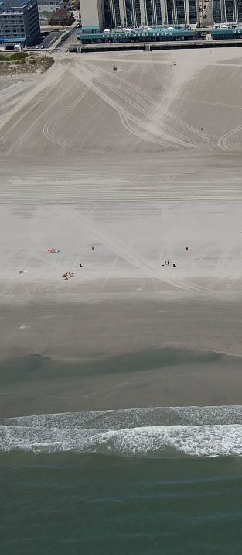
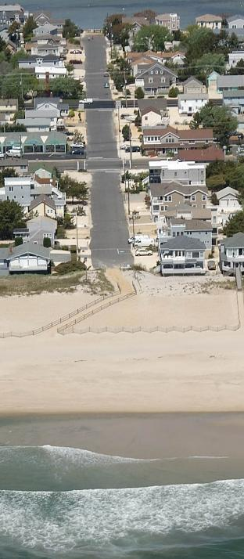
Natural Dunes
Wide Dune Fields
No Dunes
Engineered Dunes
Morgan et al. (2015)
Notes:
Opening Teaser: Engineered vs Natural Dunes
Which one is more protective, WHY?
How “much” of each beach to match performance?
NEXT: Why dunes?

Slide 4
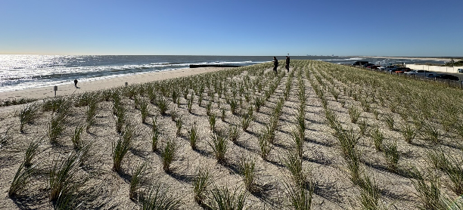
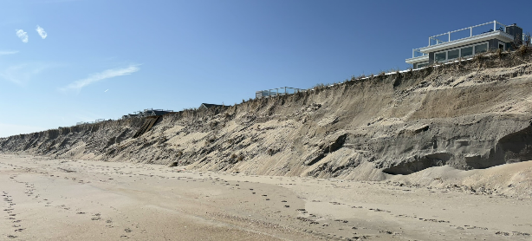
Why do we use dunes in coastal engineering?
Goal
  Coastal Storm Risk Management
Mechanism
  Physical barrier
  Reservoir of Sand
  Erosion = dissipation
Co-Benefits
  Recreational & Aesthetic Value
  Habitat?
Notes:
Compared to hard structures which reflect waves & erode fronting beaches
FLIP PERSPECTIVE: Ecological side
NEXT: USACE Designs

Slide 5
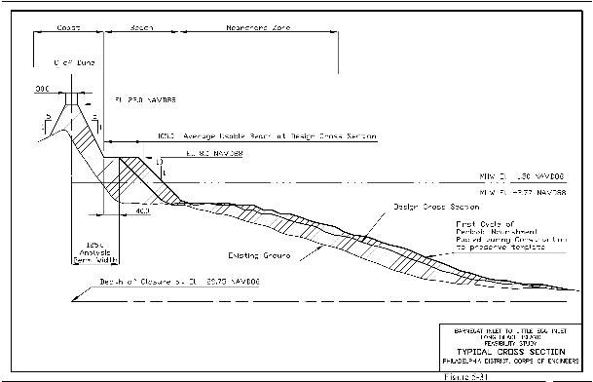
How does USACE Design dunes?
Numerical modeling (SBEACH)
Benefit-cost analysis
Tall, linear dunes stabilized with fences and vegetation
  → not great for nature ☹
Notes:
NOT AN EXPERT ON THEIR PROCESS
Maximizing protection with limited material/footprint
1 CLICK TO TRANSITION
NEXT: Need for nature

Slide 6
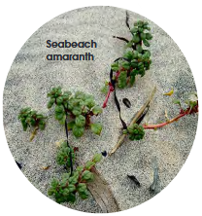
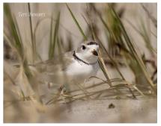
Need for nature-based beach-dune design
Elko et al. (2016); Maslo et al. (2011); Nordstrom (2008); Wootton et al. (2016)
Beaches and dunes are important habitats for sensitive species
  Piping Plover, Lest Tern, Black Skimmer
  Seabeach Amaranth
Coastal squeeze threatens species by limiting habitat
  Beach nourishment can maintain some space
Engineered dunes are very different from natural dunes
  Minimal habitat value
What can we do to enhance ecological value while maintaining protection?
How can we compare engineering function of beaches?
Notes:
1 CLICK: Broad question
2 CLICK: Specific focus right now
Analogy of Tensile Strength – a quantified material property
NEXT: EDP

Slide 7




A Novel Design Parameter: Background
$$\text{EDP}= \frac{\text{Storm} \text{Intensity} \text{Metric}}{\text{Beach} \text{Resilience} \text{Factor}}$$
EDP-Based Design Framework (Janssen and Miller, 2022)
“Moment of Inertia”
Why parametric design? How does the EDP help?
  Based on project constraints (cost, material, viewshed, ecological), determine optimal placement of sand and compare vulnerability
  Faster than numerical modeling, good for conceptual design
  Use (resilience or) risk as design parameter
$Rf=V_{D}×$ $W_{B}^{2}$
$$V_{D}$$
MHW
$$W_{B}$$
Notes:
START – What is EDP
1 CLICK – What is Rf
2 CLICK – Why Rf
Emphasize importance of WIDTH
But not width alone
Mention multiple words for Resilience/Resistance/Etc.
NEXT: 4 pictures again

Slide 8
Natural Dunes
Wide Dune Fields
No Dunes
Engineered Dunes
Morgan et al. (2015)
Notes:
Prep for next slide: Why we are doing all this additional math
EDP (and others) limit thinking to LINEAR FOREDUNE

Slide 9





Natural Dunes
Engineered Dunes
$$+z$$
MHW
$$+x$$
$$+z$$
MHW
$$+x$$
$$x_{MHW}$$
Morgan et al. (2015)
Notes:
Prep for next slide: Why we are doing all this additional math
EDP (and others) limit thinking to LINEAR FOREDUNE

Slide 10





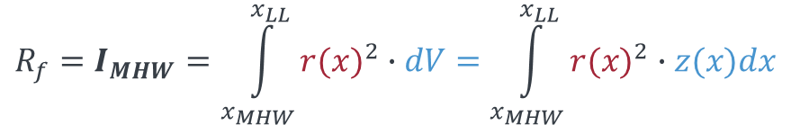






A Novel Design Parameter: Ongoing Development
$${R_{f}=I}_{D}=W_{B}^{2}∙V_{D}$$
Integrated Moment of Inertia (Second Moment of Area)
Erosive Resistance
$$V_{D}$$
$$W_{B}$$
Simple moment of inertia has been proven useful with EDP (Day et al., 2023; Janssen and Miller, 2022)
Logically, a complete Moment of Inertia should be a better metric
  Accounts for volume/elevation in the berm
  Avoids complications from dune feature definition
MHW
$${R_{f}=I}_{MHW}=\int_{x_{MHW}}^{x_{LL}}{{r(x)}^{2}∙dV}=\int_{x_{MHW}}^{x_{LL}}{{r(x)}^{2}∙z(x)dx}$$
$$dV$$
$$+z$$
$$z$$
$$r$$
MHW
$$dx$$
$$x_{LL}$$
$$+x$$
$$x_{MHW}$$
Notes:
CLICK 1 – 2 – 3 – 4
Conceptual model: More sand farther from shoreline = better
If we can prove the theory,

Slide 11



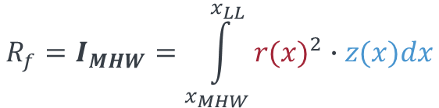


A Novel Design Parameter: Ongoing Development
Natural Dunes
Wide Dune Fields
Integrated Moment of Inertia
(Second Moment of Area)
Erosive Resistance
$${R_{f}=I}_{MHW}=\int_{x_{MHW}}^{x_{LL}}{{r(x)}^{2}∙z(x)dx}$$
$$+z$$
$$r$$
MHW
$$+x$$
$$x_{MHW}$$
$$x_{LL}$$
Notes:
Calculation on any shaped beach
First? resilience metric that can be applied to any beach
(aside from bulk volumes, simple widths/elevations)

Slide 12
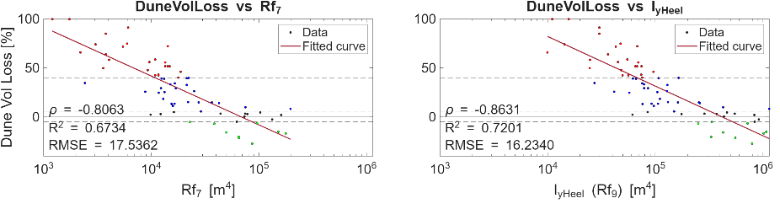
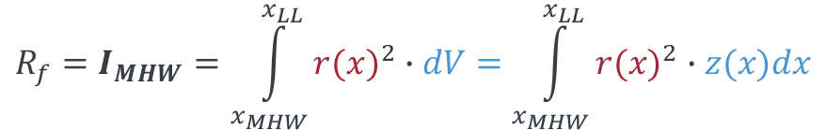



Evaluating the Model
Florida: Hurricane Idalia at Pinellas County
$${R_{f}=I}_{MHW}=\int_{x_{MHW}}^{x_{LL}}{{r(x)}^{2}∙dV}=\int_{x_{MHW}}^{x_{LL}}{{r(x)}^{2}∙z(x)dx}$$
$${R_{f}=I}_{D}=W_{B}^{2}∙V_{D}$$
$$dV$$
$$V_{D}$$
$$W_{B}$$
$$+z$$
$$z$$
$$r$$
MHW
MHW
$$dx$$
$$x_{LL}$$
$$+x$$
$$x_{MHW}$$
Notes:
So far – works well for dune erosion
(isolating for Rf here, constant storm intensity)

Slide 13
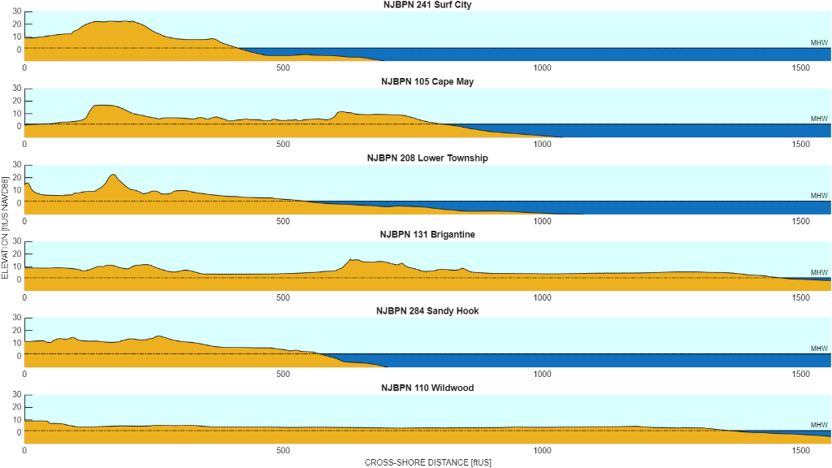

Slide 14
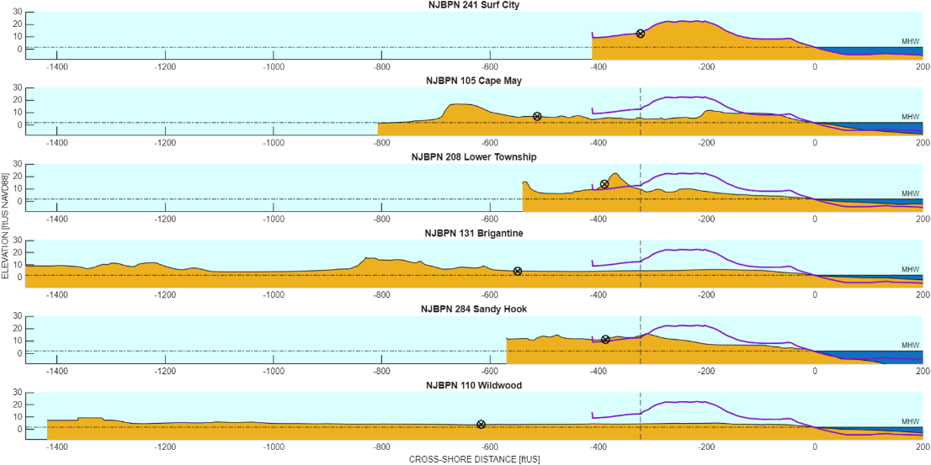

Slide 15
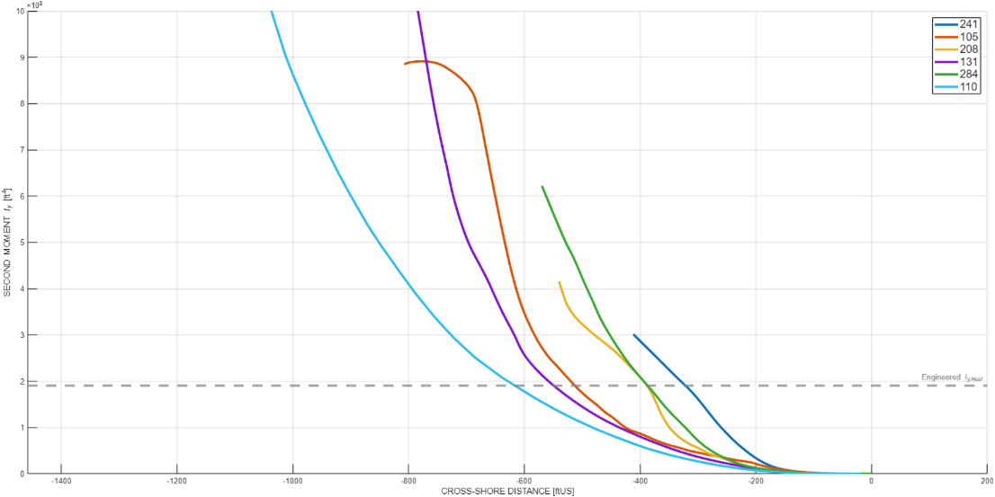
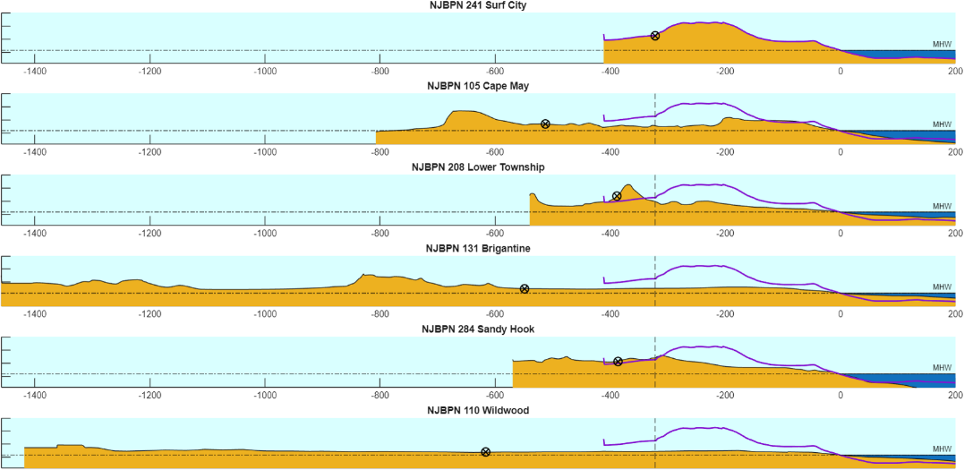

Slide 16
Summary
Motivation
  Nature-based nourishment design templates
  Method to efficiently evaluate templates
Model
  “Moment of Inertia” model of erosive resistance
  Easy to calculate with a cross-shore profile and a computer
  Works for any beach configuration… but needs further testing
Potential Use Cases
  Nature-based design: Evaluate and compare very different configurations
    What if we built a wider beach and allowed dune to grow naturally?
  Storm Preparedness: Find weak spots along an entire coastline
  Historical Analysis: How has the resilience of a beach changed in time?

Slide 17
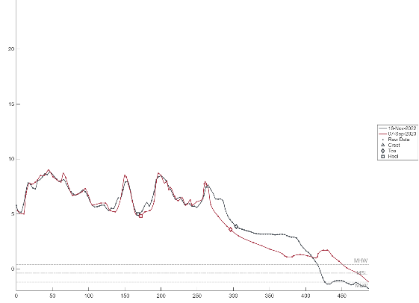


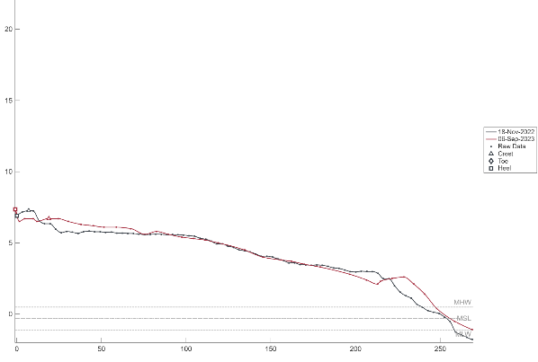
Next Steps
Moving beyond Feature Extraction
Complex/Hummocky Dunes
No Dunes (“Barrier” profiles)
Impact Metric?
Notes:
CLICK 1
“Impact Metric?”

Slide 18
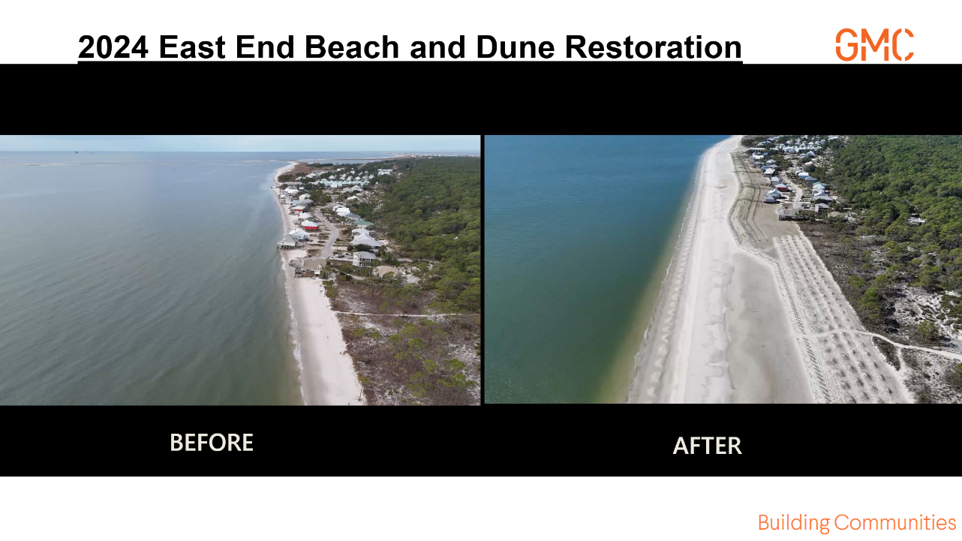
GMC and Town of Dauphin Island (2025)
Notes:
Example of novel more natural dunes

Slide 19
References
Day, I.J., Janssen, M.S., MacLachlan, H., Fanning, A., Miller, J.K., 2023. Quantifying the influence of profile variability on dune impacts during Hurricane Sandy. Shore & Beach 92, 27–38. https://doi.org/10.34237/1009144
Elko, N., Brodie, K., Stockdon, H., Nordstrom, K., Houser, C., McKenna, K., Moore, L., Rosati, J., Ruggiero, P., Thuman, R., Walker, I., 2016. Dune Management Challenges on Developed Coasts. Shore & Beach 84, 15–28.
Janssen, M.S., Miller, J.K., 2022. The Dune Engineering Demand Parameter and Applications to Forecasting Dune Impacts. Journal of Marine Science and Engineering 10, 234. https://doi.org/10.3390/jmse10020234
Maslo, B., Handel, S.N., Pover, T., 2011. Restoring Beaches for Atlantic Coast Piping Plovers (Charadrius melodus): A Classification and Regression Tree Analysis of Nest-Site Selection. Restoration Ecology 19, 194–203. https://doi.org/10.1111/j.1526-100X.2010.00709.x
Nordstrom, K.F., 2008. Beach and Dune Restoration. Cambridge University Press, Cambridge. https://doi.org/10.1017/CBO9780511535925
Wootton, L., Miller, J., Miller, C., Peek, M., Williams, A., Rowe, P., 2016. New Jersey Sea Grant Consortium Dune Manual. New Jersey Sea Grant Consortium.
Images
Morgan, K.L.M., Hapke, C.J., Himmelstoss, E.A., 2015. Baseline coastal oblique aerial photographs collected from Owls Head, Maine, to the Virginia/North Carolina border, May 19-22, 2009 (USGS Numbered Series No. 946), Data Series. U.S. Geological Survey, Reston, VA. https://doi.org/10.3133/ds946
GMC, Town of Dauphin Island, 2025. DI East End Beach & Dune Restoration - Project Performance Year 1. URL https://www.townofdauphinisland.org/di-east-end-beach-dune-restoration

Slide 20
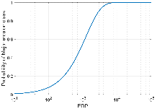



Vulnerability Models
Engineering Demand Parameter (EDP)
(Janssen and Miller, 2022)
$$\text{EDP}= \frac{\text{Storm} \text{Intensity} \text{Measure}}{\text{Beach} \text{Resilience} \text{Factor}}$$
$$\text{EDP}=\frac{{\text{PEI}}^{4}}{V_{D}×r^{2}}$$
Description
Dimensionless Parameter
Fragility Curves
Probabilistic Output
Considers storm intensity and beach state independently*
*PEI has morphological parameters which have been held regionally constant in past work
Input Parameters
PEI
  Wave Height
  Water Level
Dune Volume
Dune Setback
(≈ Berm Width)
$$V_{D}$$
~
$$r$$
MHW
Motivation
Proposal
Application
Overview
Notes:
Ratio: Combine storm intensity
And beach resilience

Slide 21
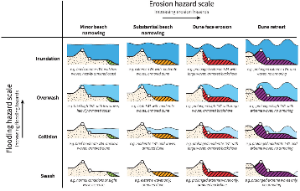
Vulnerability Models
Engineering Demand Parameter (EDP)
(Janssen and Miller, 2022)
$$\text{EDP}= \frac{\text{Storm} \text{Intensity} \text{Measure}}{\text{Beach} \text{Resilience} \text{Factor}}$$
$$\text{EDP}=\frac{{\text{PEI}}^{4}}{V_{D}×r^{2}}$$
Impact Regimes
Dune erosion (Moderate/Major)
  Collision
  Overwash
Limitations
Only applicable to single dune profiles
No consideration of berm elevation/volume
$$V_{D}$$
~
$$r$$
MHW
Motivation
Proposal
Application
Overview
Notes:
Ratio: Combine storm intensity
And beach resilience

Slide 22
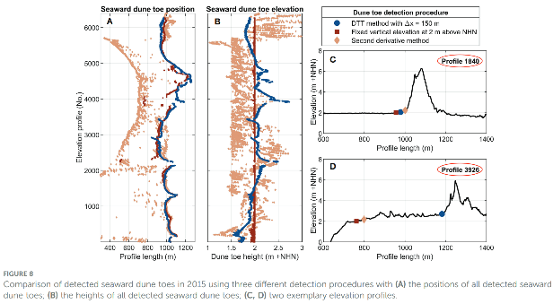
Vulnerability Models
Feature Extraction
(Brodie and Spore, 2015; Mehrtens et al., 2023)
Most models require some form of feature extraction
Manual point selection is time consuming and inconsistent
Automated methods are imperfect and need manual verification
  Dune toe/heel are hard to define
What if we have multiple dunes?
Different methods of feature extraction provide different answers (Mehrtens et al. 2023)
Motivation
Proposal
Application
Overview

Slide 23
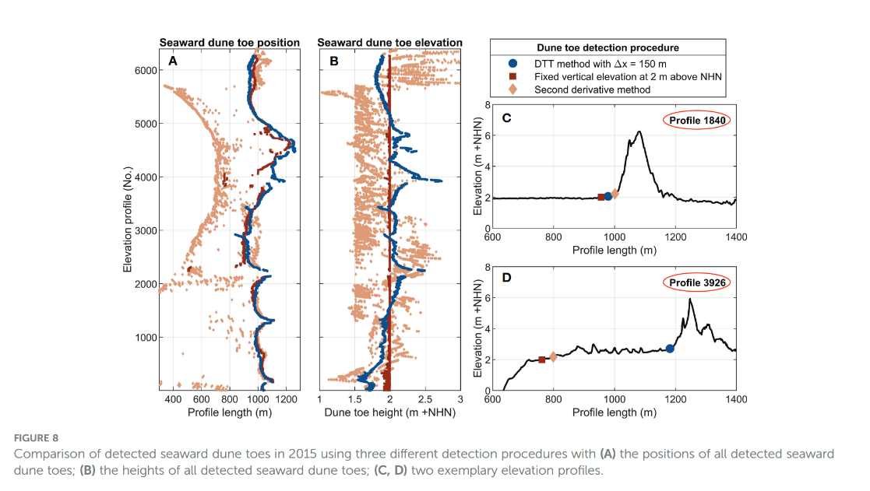
(Mehrtens et al. 2023)
Motivation
Proposal
Application
Overview

Slide 24
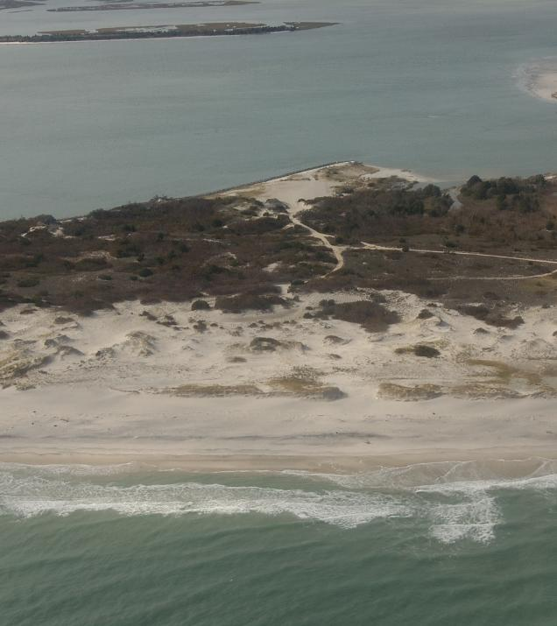
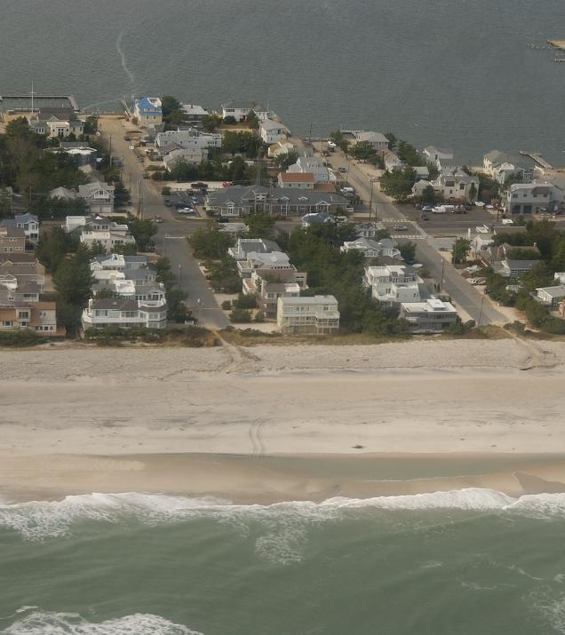
Natural Dunes
Engineered Dunes
Morgan and Krohn (2014)

Slide 25
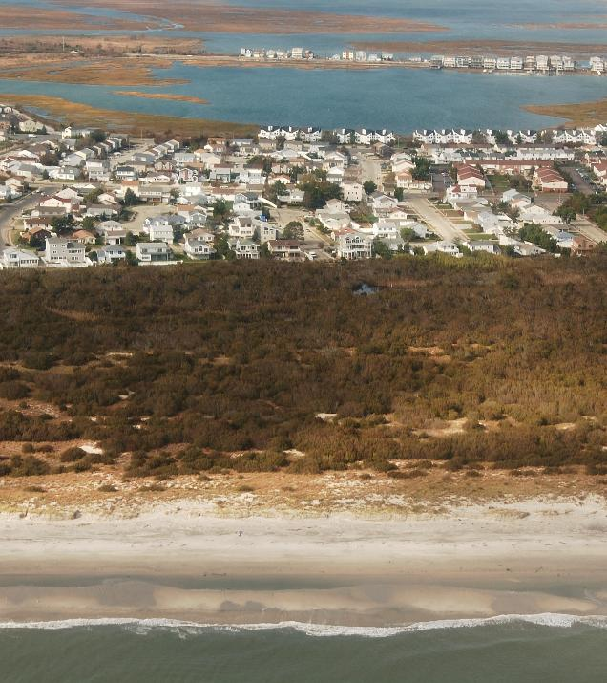
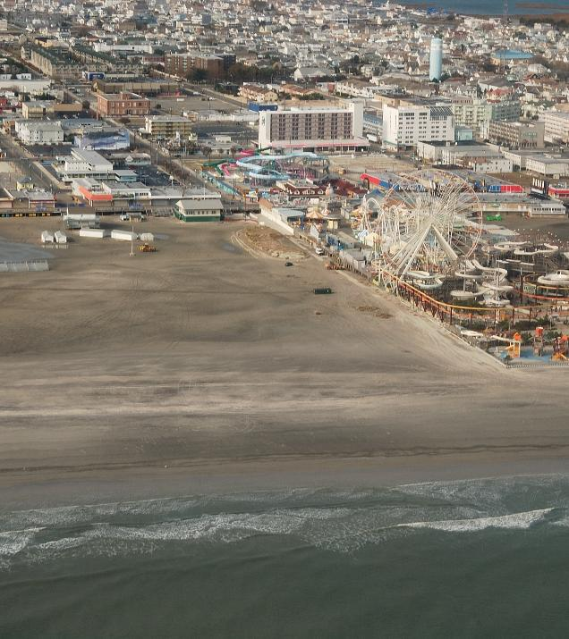
Wide Dune Fields
No Dunes
Morgan and Krohn (2014)

Slide 26
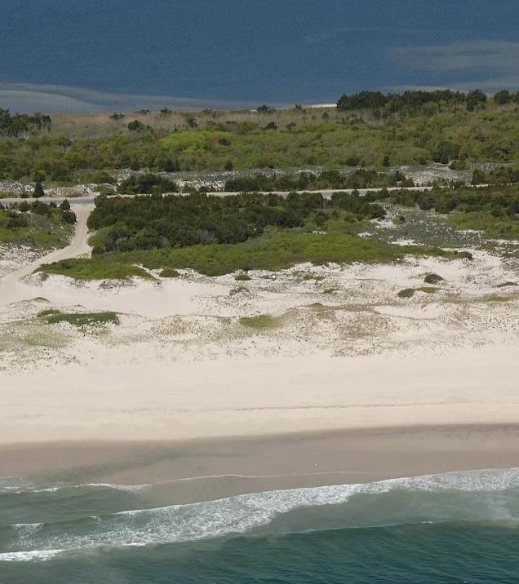
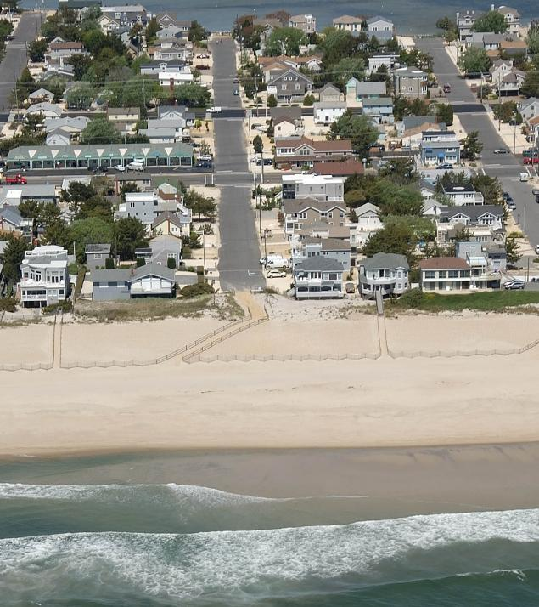
Natural Dunes
Engineered Dunes
Morgan et al. (2015)

Slide 27
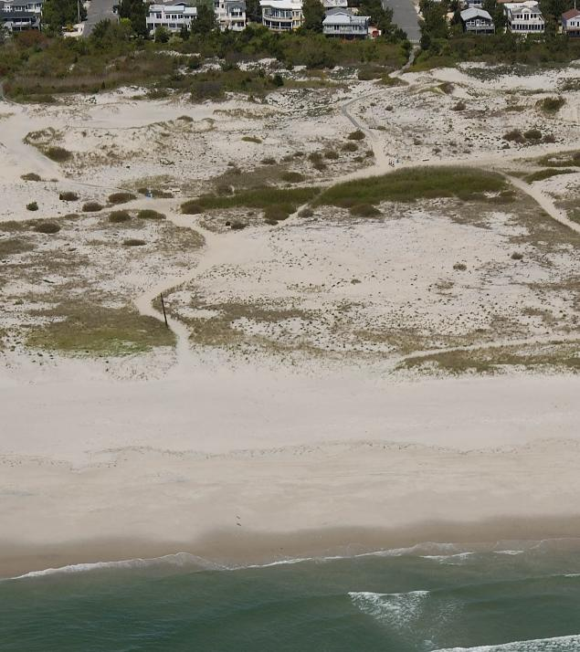
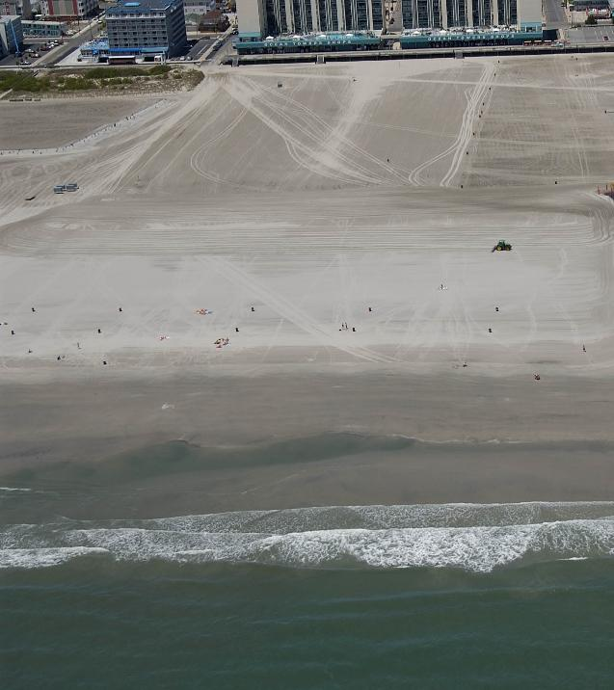
Wide Dune Fields
No Dunes
Morgan et al. (2015)

