Slide 1

Innovative Dredging and Marsh Restoration: A Resilience Model for Resource-Limited Municipalities
Presented to:
New Jersey Coastal Resilience Collaborative
March 9, 2026

Slide 2
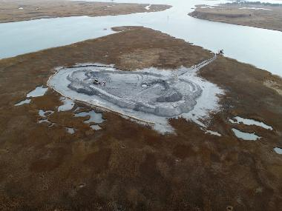
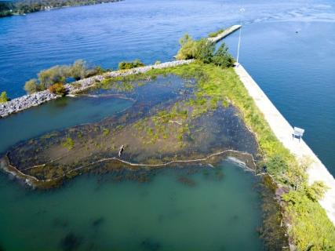

Innovative Dredging and Marsh Restoration: A Resilience Model for Resource-Limited Municipalities March 9, 2026
RESTORATION PROJECTS NEED SEDEMENT
To enhance coastal restoration efforts, utilizing dredge material is essential. Here are key points to consider:
Dredge material provides necessary sediment for rebuilding eroded shorelines.
It helps create habitats for marine and coastal wildlife.
The material can be used to restore wetlands and improve water quality.
Dredging can remove pollutants, enhancing ecosystem health.
Properly managed dredge material can support recreational areas and tourism.
KEEPS THE NATIVE SOIL AND SEDIMENTS IN THE ECOSYSTEM!
Google Earth Image -Colors represent potential material thicknesses from bathymetry collected in 2019.

Slide 3
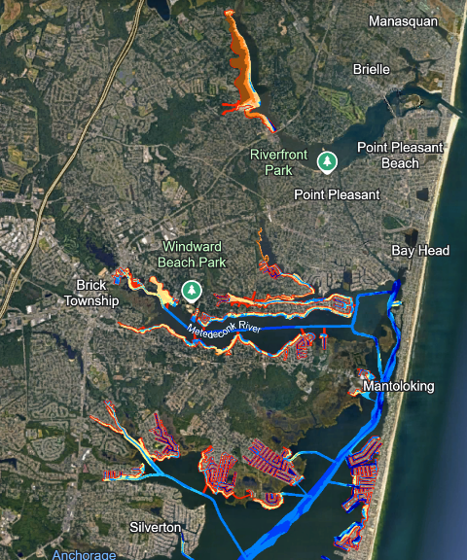
Innovative Dredging and Marsh Restoration: A Resilience Model for Resource-Limited Municipalities March 9, 2026
2022 Permit to Dredge Entire Coastal Municipality
1,878,376 Cubic Yards
Google Earth Image -Colors represent potential material thicknesses from bathymetry collected in 2019.

Slide 4


Innovative Dredging and Marsh Restoration: A Resilience Model for Resource-Limited Municipalities March 9, 2026
🏛️ What municipal property taxes typically pay for
Municipal governments use their share of the property tax levy to fund essential operations, including:
Police, fire, and emergency services — salaries, equipment, training, and facilities.
Public works — road maintenance, snow removal, stormwater systems, sanitation, and municipal buildings.
Parks and recreation — playgrounds, fields, community centers, and recreational programming.
Municipal administration — governing body operations, clerk’s office, finance, planning, zoning, and code enforcement.
Libraries and cultural services — when funded as part of the municipal budget.
Debt service — repayment of municipal bonds for capital projects.
Other services allowed by law — such as open space preservation or dedicated levies approved by voters.
These services are part of the municipal portion of the tax bill, which is one of three major components: municipal, county, and school.

Slide 5
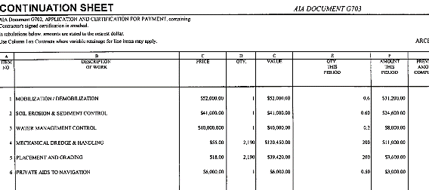
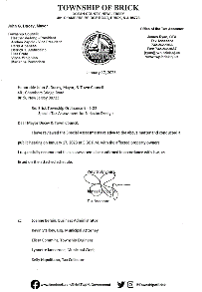
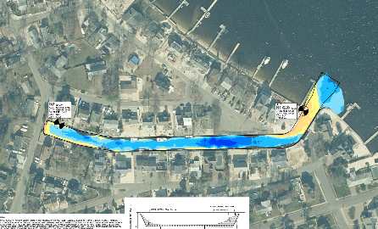
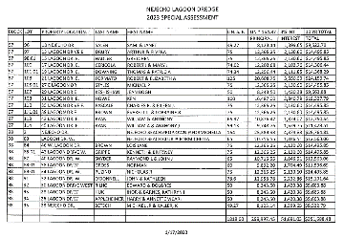
Beneficial Reuse Reduces the Cost of Dredging
Innovative Dredging and Marsh Restoration: A Resilience Model for Resource-Limited Municipalities March 9, 2026

Slide 6
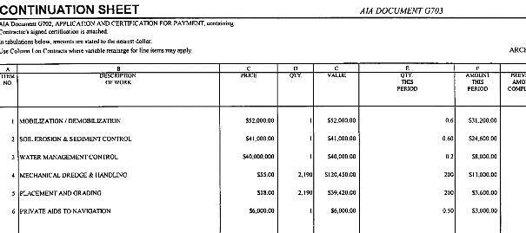
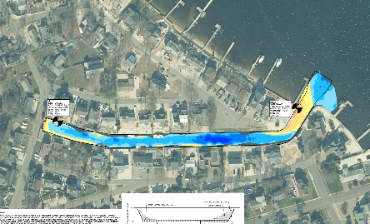
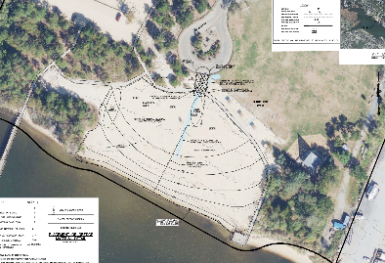
Beneficial Reuse Reduces the Cost of Dredging
Innovative Dredging and Marsh Restoration: A Resilience Model for Resource-Limited Municipalities March 9, 2026

Slide 7
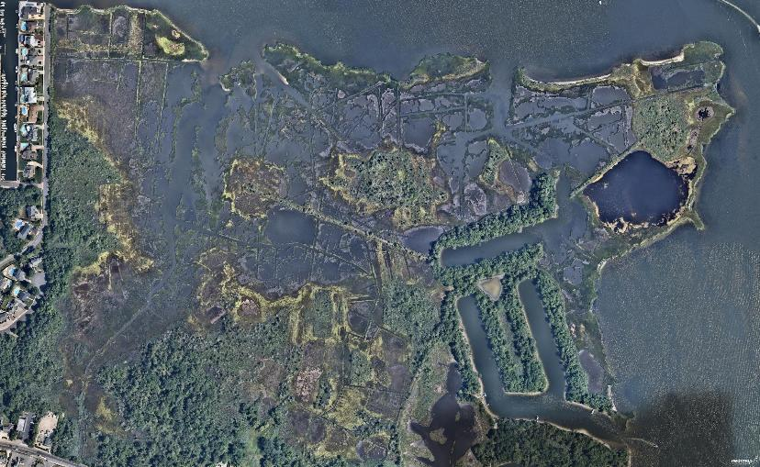
Edwin B Forsythe Wildlife Refuge
Innovative Dredging and Marsh Restoration: A Resilience Model for Resource-Limited Municipalities March 9, 2026

Slide 8
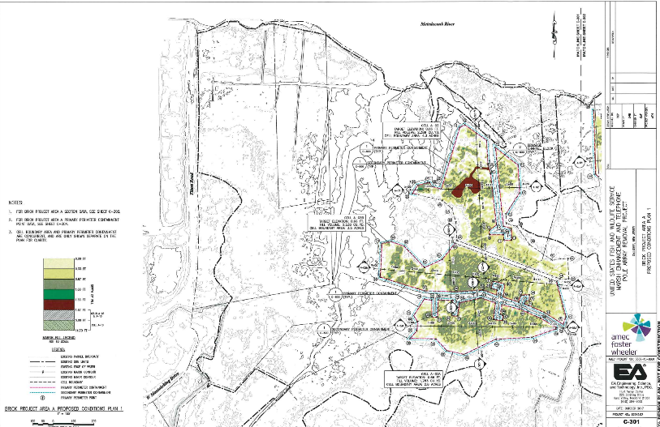
Edwin B Forsythe Wildlife Refuge
Innovative Dredging and Marsh Restoration: A Resilience Model for Resource-Limited Municipalities March 9, 2026

Slide 9
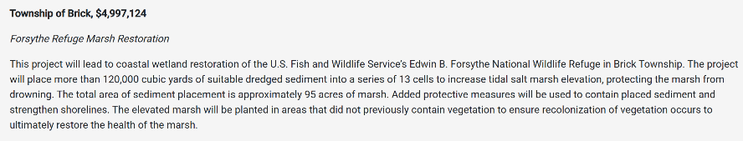
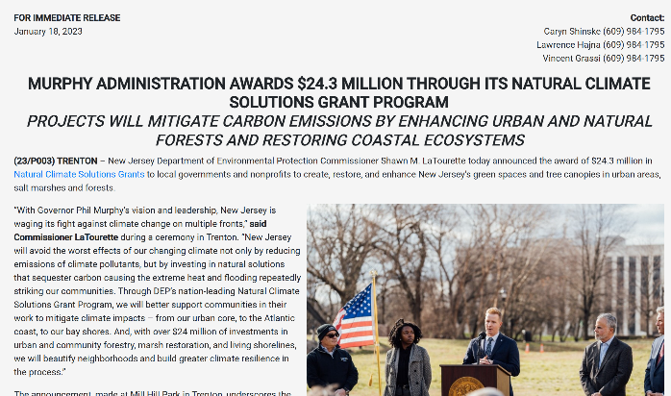
NJDEP RGGI Funding - $5 Million
Innovative Dredging and Marsh Restoration: A Resilience Model for Resource-Limited Municipalities March 9, 2026

Slide 10
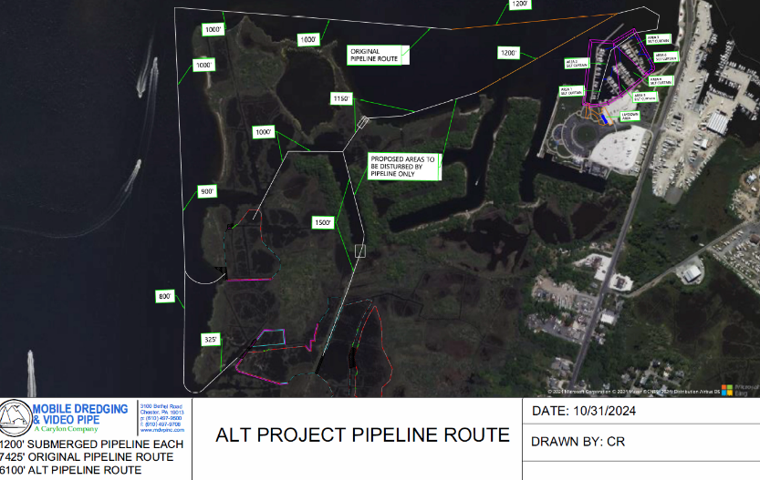
Edwin B Forsythe Wildlife Refuge
Innovative Dredging and Marsh Restoration: A Resilience Model for Resource-Limited Municipalities March 9, 2026

Slide 11
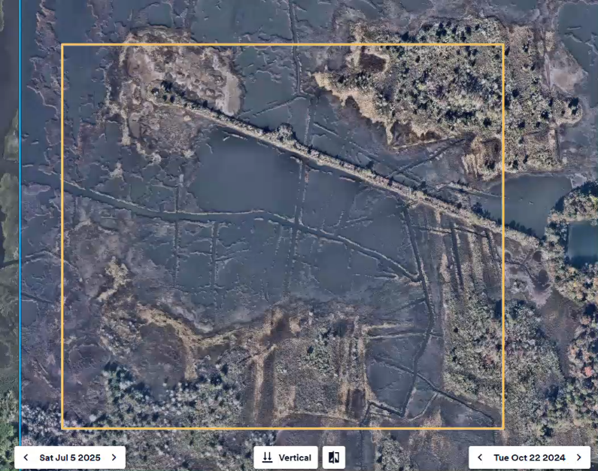
Innovative Dredging and Marsh Restoration: A Resilience Model for Resource-Limited Municipalities March 9, 2026

Slide 12
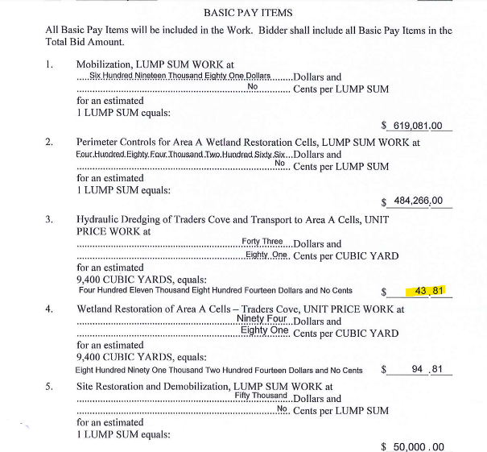
Beneficial Reuse Reduces the Cost of Dredging
Innovative Dredging and Marsh Restoration: A Resilience Model for Resource-Limited Municipalities March 9, 2026

Slide 13
Innovative Dredging and Marsh Restoration: A Resilience Model for Resource-Limited Municipalities March 9, 2026
TOWNSHIP MODEL
MUNICIPAL BOND
GRANT REIMBURSABLES FOR CONTAINMENT, PLACEMENT & MONITORING
SPECIAL TAX ASSESSMENT
DREDGING

Slide 14

COMMUNITY ENGAGEMENT
Innovative Dredging and Marsh Restoration: A Resilience Model for Resource-Limited Municipalities March 9, 2026
Written Notification
Vote
Concept Design
Public Information Session
Preliminary Cost Estimate
Individual Estimated Cost

Slide 15


CATCH 22
Innovative Dredging and Marsh Restoration: A Resilience Model for Resource-Limited Municipalities March 9, 2026

Slide 16
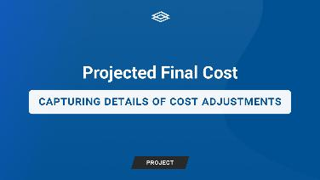
CATCH 22
Innovative Dredging and Marsh Restoration: A Resilience Model for Resource-Limited Municipalities March 9, 2026
FINAL CONTRACT AWARD
RESIDENT COMMITMENT
BID
ADVANCE DESIGN
CONSTRUCTION DOCUMENTS
SEDIMENT SAMPLING
AUD
DEP AUTHORIZATION
MATERIAL TESTING
ADVANCE DESIGN
F&W APPROVAL

Slide 17
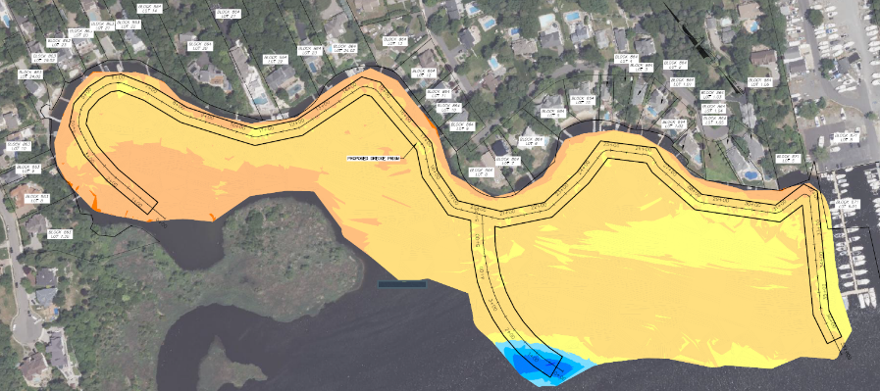
Innovative Dredging and Marsh Restoration: A Resilience Model for Resource-Limited Municipalities March 9, 2026

Slide 18
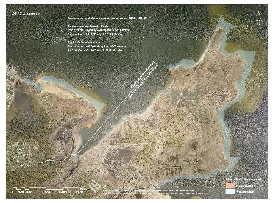
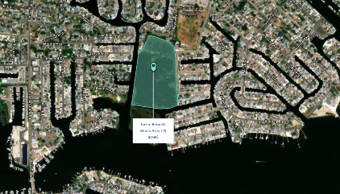
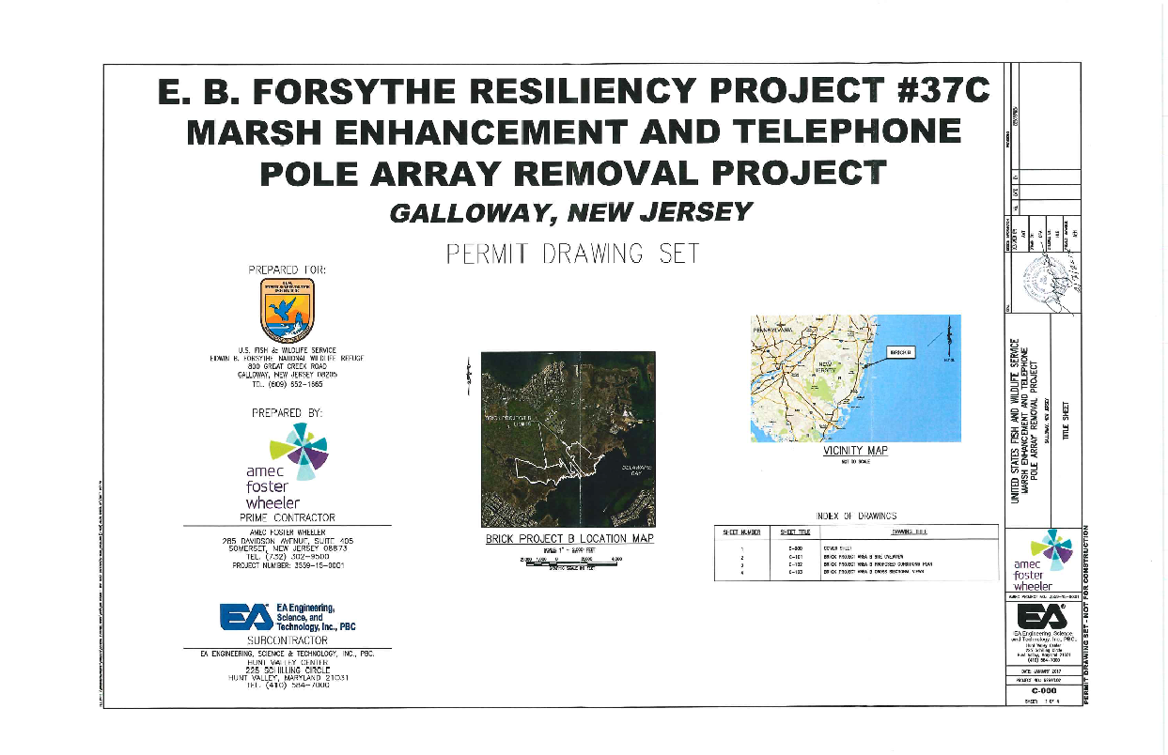
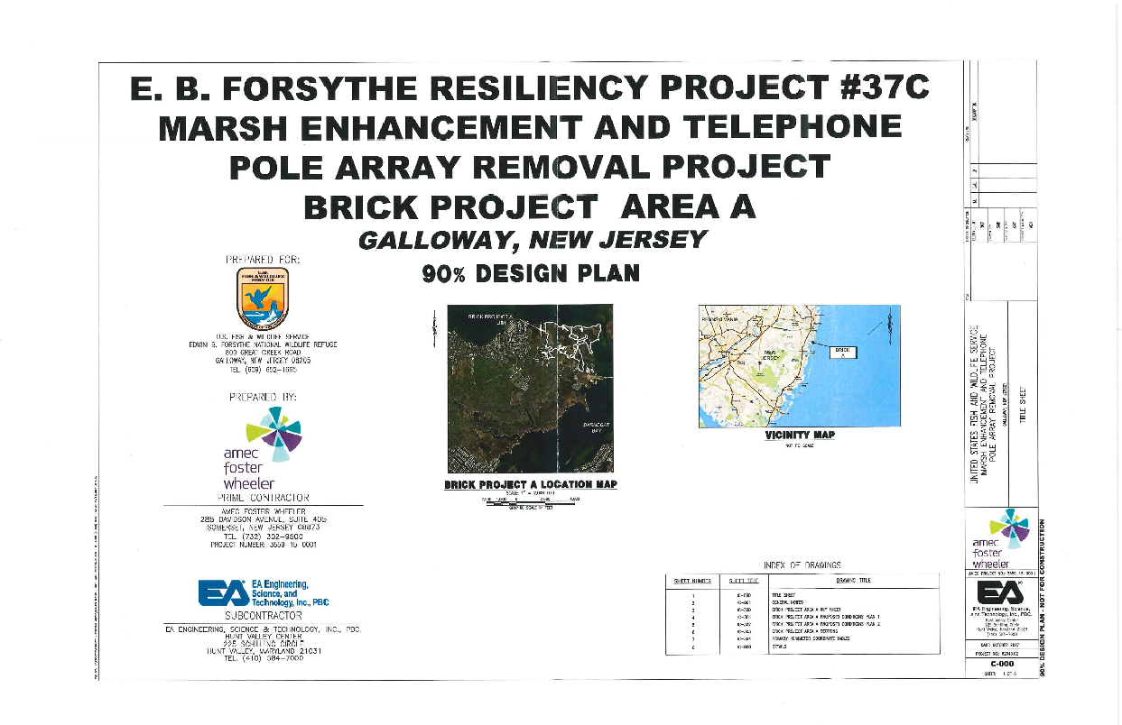
Potential Partnerships
Innovative Dredging and Marsh Restoration: A Resilience Model for Resource-Limited Municipalities March 9, 2026

Slide 19
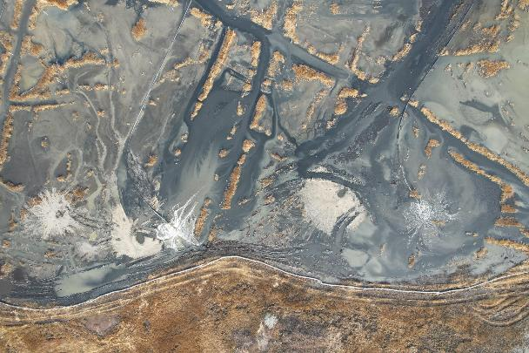
Innovative Dredging and Marsh Restoration: A Resilience Model for Resource-Limited Municipalities March 9, 2026
Thank you
Presented by:
Elissa C. Commins, PE PP CME CPWM CFM
Township of Brick
Township Engineer & Floodplain Manager
ecommins@twp.brick.nj.us

