Slide 1
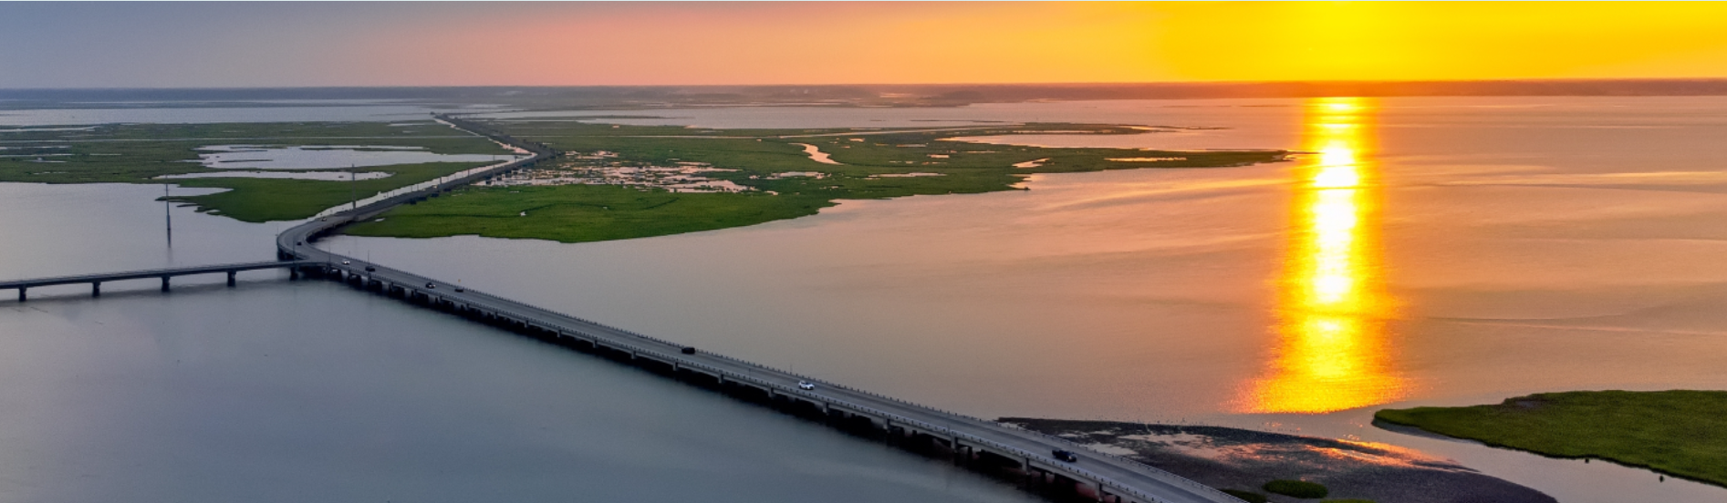
A presentation of what matters most to the residents of Chincoteague Island, VA
Shore Strong

Slide 2
VA’s Planning District Commissions
In accordance with Virginia Regional Cooperation Act, Virginia has 21 planning district commissions (PDCs)
  The Accomack-Northampton PDC is the regional PDC for the Eastern Shore of Virginia
  The PDCs are a voluntary association of local governments
The purpose of the Virginia PDCs is to:
  Foster intergovernmental cooperation by bringing together local elected and appointed offices and involved citizens to discuss common needs and determine solutions to regional issues.
  Encourage and facilitate local government cooperation in addressing, on a regional basis, problems of greater than local significance.
  Develop a regional strategic plan
  Coordinate efforts and oversee development for other, specific plans
    Hazard Mitigation Plan
    Water Supply Plan
  Provide technical assistance to local governments for regional needs, grant funding opportunities, community outreach, and other duties in the Regional Cooperation Act

Slide 3
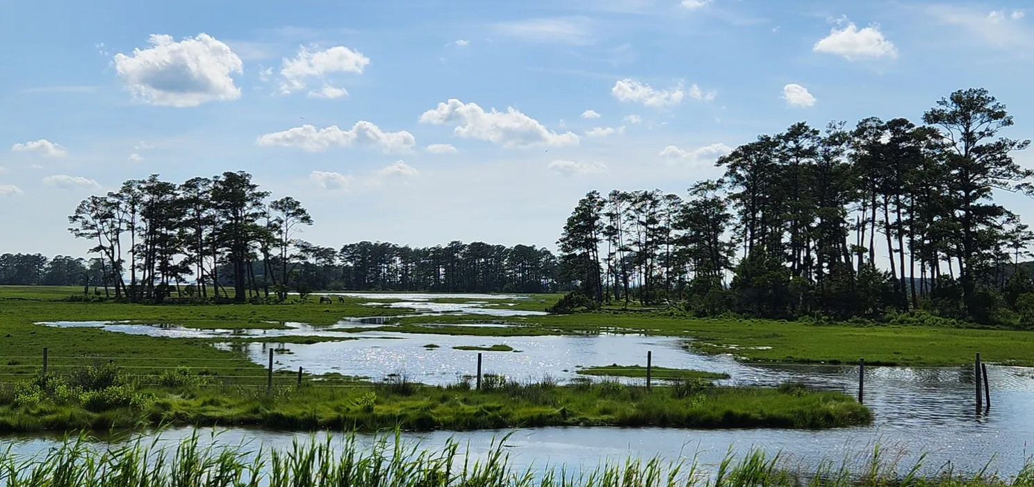
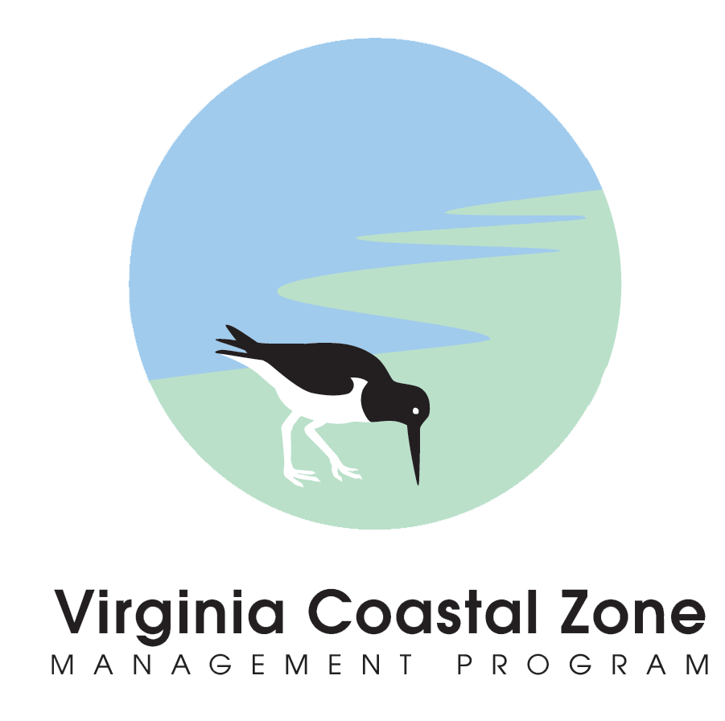
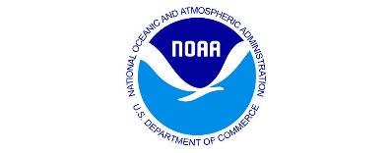

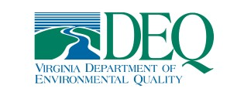
What is Shore Strong?
A project funded by NOAA, with VA’s Department of Environmental Quality, Coastal Management Zone managing the deliverables in partnership with Accomack-Northampton Planning District Commission staff.
A method for citizens to capture what is important to them about their community that they would like to see preserved for future generations.
Community members use pictures and captions to capture what is most important to them and prepare them for an exhibit for the Chincoteague community, including local government leaders.
Local town leadership uses this input for resilience project planning.
The project provides a forum for community members, partners in resilience planning, and local government representatives to come together to share ideas and gain insights.
Chincoteague Island Shore Strong participants provided and presented 89 photos and captions as well as suggestions for resilience projects at the final Shore Strong Exhibit, including segments related to commerce, wildlife refuges, historic building preservation and habitat preservation, among others.

Slide 4
The Process - Preparation
Identify Facilitator and Co-Facilitator for the project
Identify and book meeting space location for kick-off, working meetings, and final exhibit reception
Prepare press releases, advertisements, flyers
Solicit Volunteers
  Press release for local newspaper (include project description, kick-off meeting date, potential “working” meeting dates (2 – 3), Final Exhibition Date)
  Notify local radio/TV stations for community announcement
  Set-up email address for responses (e.g., info.ShoreStrong@gmail.com)
  Flyers posted at local Post Offices, Libraries, Town Hall Building(s), other public places
  Posting to Facebook and website
  Photographer to give a “Tips for Great Photos” lesson at first meeting. Include the process to “pin” the location to the photograph for future reference

Slide 5
The Process - Working
Confirm participants, meeting space, dates and times
Kick-off meeting – Get to know the participants and set expectations, beginning of community-building between the facilitators and the community
  Establish communication methods, share contact information
  How will photos and captions be captured? Padlet or other application; instructions for use
  Set timeline for gathering of photos and captions
    Allow for participants to bring photos from other community members who may want to participate but can’t dedicate the time to the working meetings or are disabled
Working meetings
  2 – 3 meetings to organize, refine captions, prepare the final exhibit reception
    How will the photos and captions be displayed? Framed?
    What method will be used to capture public comments?
    How will public vote for their favorites?

Slide 6
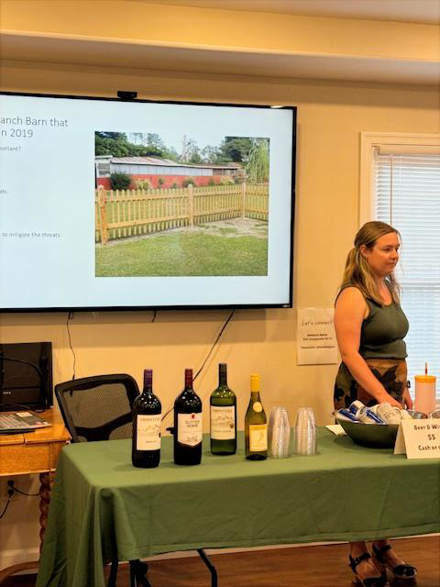
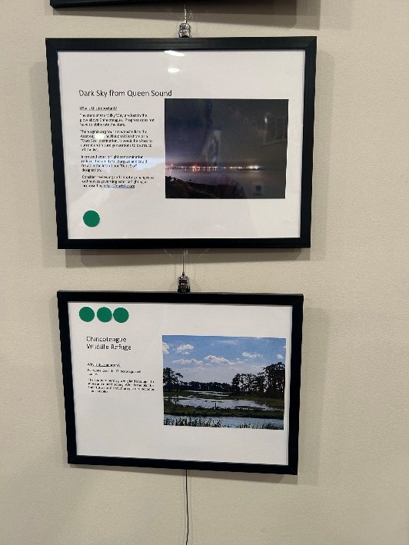
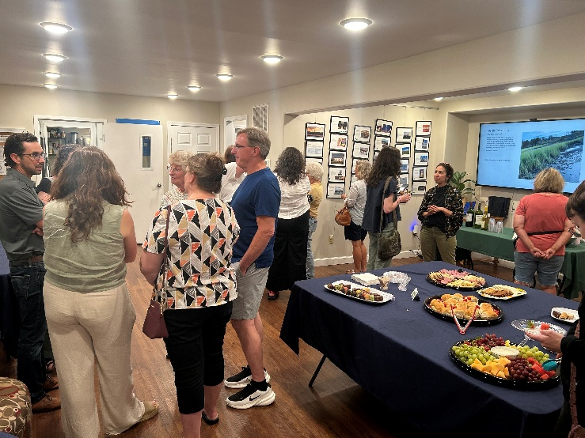
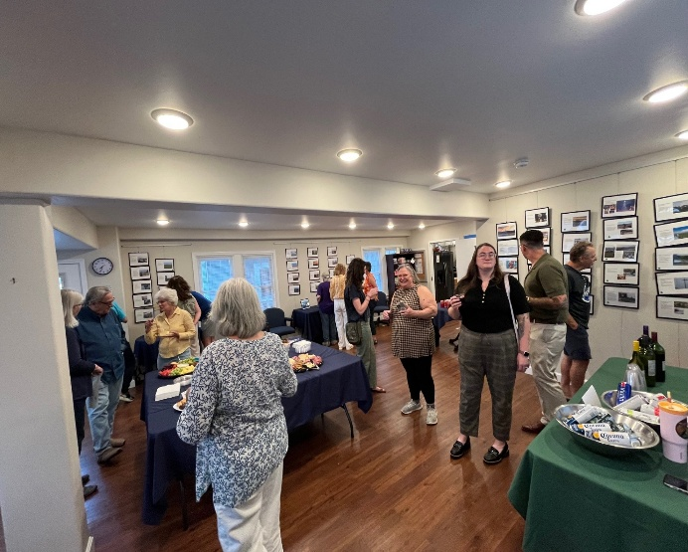
The Process – Final Exhibit and Reception
Prepare and distribute Invitations; should be held in the evening and/or weekend
  Newspaper, radio, TV
  Local government leadership
  Public Invitations, flyers, Facebook, website notices
Schedule time with volunteers to prepare the exhibit at chosen location
Order catering, or drinks/food for the exhibit, be creative with procuring if necessary →
Assign photographer to take photos of the reception

Slide 7
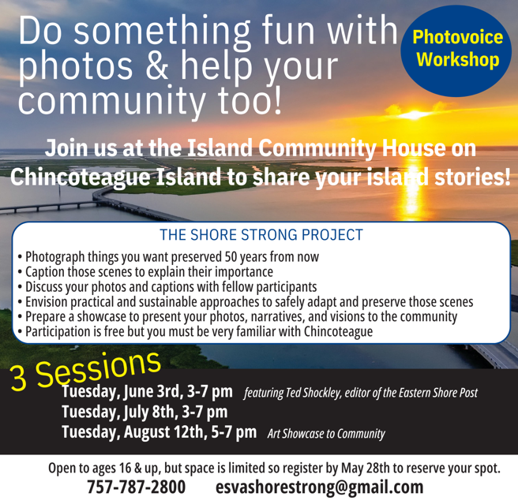
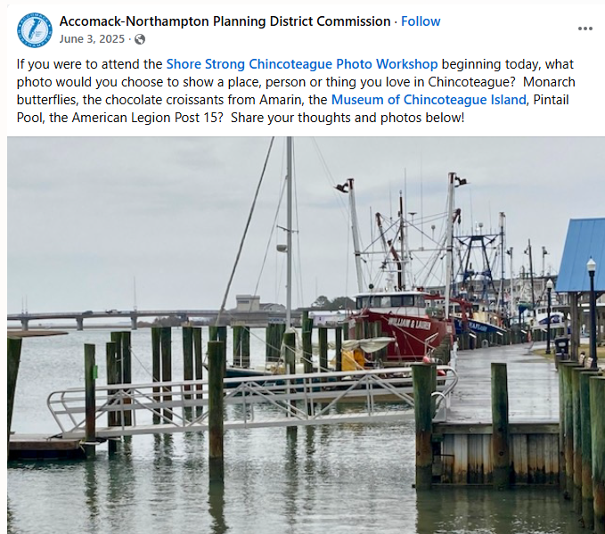
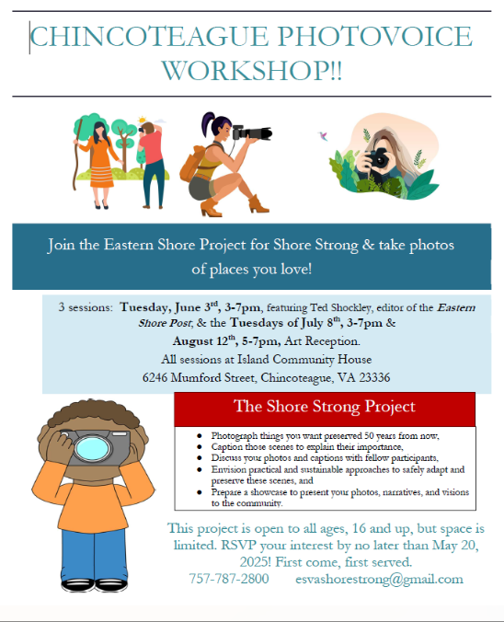
FACEBOOK POST
ALTERNATE FLYER
For use in high schools, civic clubs, other places
NEWSPAPER AD
Also used as flyer posted in multiple public places

Slide 8
Examples of Photos and Captions
Submitted by Participants

Slide 9
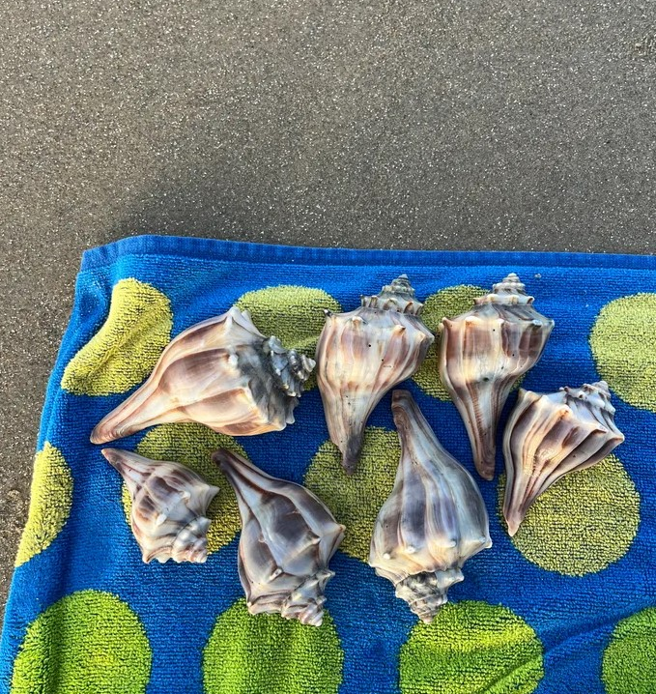
Protection of Marsh Life
Why is this important?
Lightning whelks are a beautiful species of whelk native to the Eastern Shore. Living in shallow marshy areas, there are fewer whelks today than in years past. Chanel whelks and knobbed whelks are also found locally.
Potential Threats to Marsh Life:
Changing habitats
Overharvesting

Slide 10
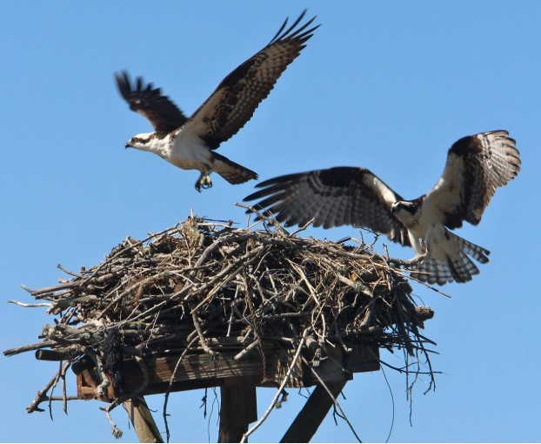
Osprey
Why is this important?
It is a common site to see Osprey on the Island, along with many other types of birds and waterfowl. The Osprey build their nests up high. They are great fishermen, too!
Pesticides nearly doomed the osprey. When we spray for ticks and other insects, we are also destroying necessary food for birds fledging from May through July.
Preserving and conserving our land, air, and water helps ensure the preservation of the Osprey and other wildlife that call our Island home.

Slide 11
Island Wildlife
Threats and Mitigation
The Chincoteague National Wildlife Refuge is one of the most heavily visited refuges in the National Wildlife Refuge System, and acts as a gateway to the accessible barrier islands on the East Coast. A visitor center, bird checklists, beach access, and an array of wildlife species make this one of the nation’s premier sites for easily accessible wildlife viewing.
Potential Threats
Habitat loss and alteration – Coastal erosion, sea level rise and human development
Pollution – Lead ammunition, plastic pollution, and water quality
Invasive Species – Plants, overgrazing of marsh grass
Changes in temperature, precipitation patterns, ocean acidification, and disruptions to food webs
Overpopulation
Possible Mitigations
Monitor and develop short and long-term plans to include risk analysis, changes to set-backs, beneficial use of dredging materials to supplement high risk areas of erosion
Transition to lead-free ammunition; implement regulations on plastic pollution; ban balloon release; monitor and report on water quality; regulate use of pesticides and fertilizer
Monitor plant diversity and growth patterns; move herds to underutilized forage areas
Monitor the population of wildlife and their habitats

Slide 12
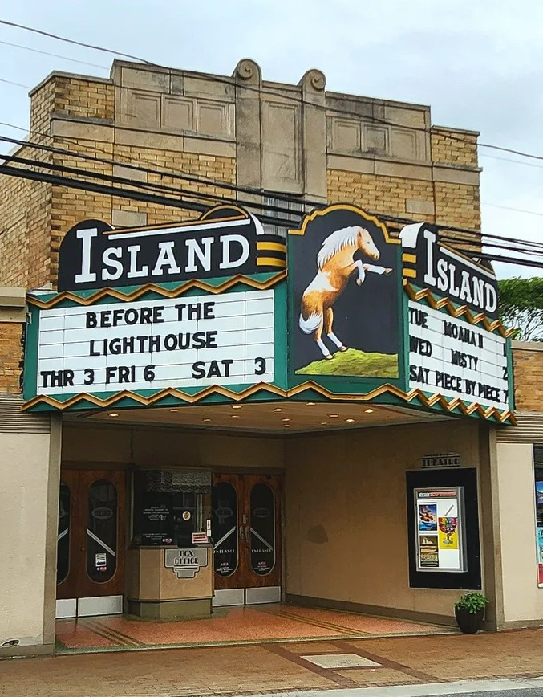
Historic Island Movie Theater
Why is this important?
The Island Theatre, a historic U.S. building of the Art Deco style, originally opened in 1945. It still serves as an operational movie theater today. In 2011, the Chincoteague Island Arts Organization raised money to restore the Main Street attraction with new seating, improved lighting, and a new screen projector.
Originally named Island Theatre, the theatre was renamed Island Roxy from the 1980s until the name was reverted to Island Theatre in 2013.
Today, the theater has become a hot spot for the Chincoteague community, offering game nights, plays, concerts, and more.

Slide 13
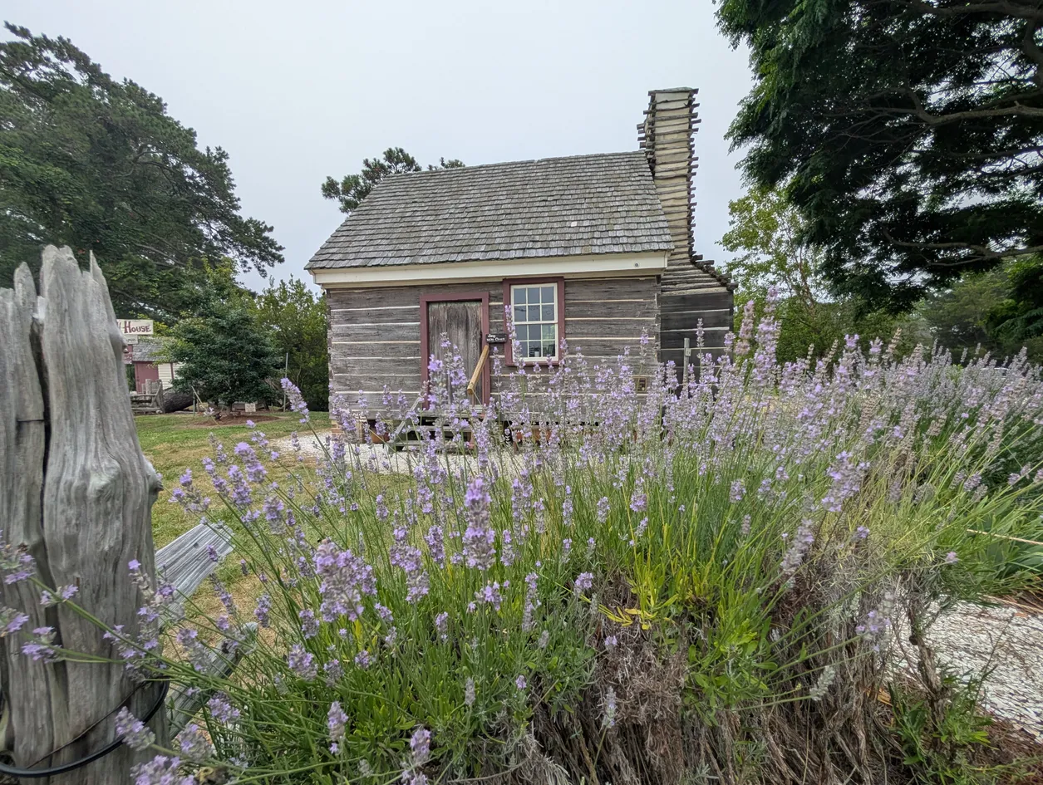
Historic Timothy Hill’s House
Why is this important?
Timothy Hill's House is a historic dwelling on Chincoteague. It's a wonderful reminder of what houses looked like way back then.
Legend has it that Timothy Hill came to Chincoteague in dramatic fashion, as a teenaged shipwreck survivor, and then stayed for the rest of his life. In census records, he identified himself as a sailor from New York. He worked for a shipping company for a while, then started up his own firm, delivering seafood and other goods to Philadelphia and other cities.
Experts say the 17’ x 16’ house was built around 1800 and was moved to its current location in the 1980s. It is one of just 2 houses in Virginia with a wooden chimney!
We still have many wonderful old waterman cottages across the island, but I'm afraid that they will not be able to withstand the pressure and lure of new development.

Slide 14
Main Street
Threats and Mitigation
Chincoteague’s Main Street is home to many historic homes and buildings, some of which have fallen into disrepair and some have been preserved. The old architecture invites us to remember the past, even as we plan for the future.
Possible Mitigations
Partner with non-profit organizations to restore and repair when possible, rather than tear down
Develop programs to assist homeowners with limited resources to maintain their property
Promote responsible property ownership through special tax sales to parties who will restore them
Demolish abandoned properties that cannot be rehabilitated, particularly if they are unsafe
Enforce codes related to blight
Engage and educate the public on the value of maintaining historic buildings for public use
Potential Threats
Poverty
Negative Public Perception
Age and condition of structures
Blight, increased crime
New development vs. rehabilitation
Storms, wind damage

Slide 15
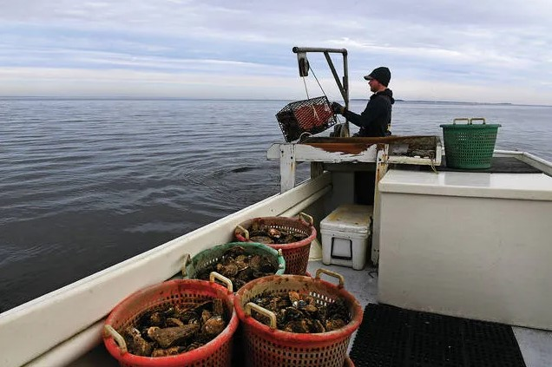
Industry &
Commerce

Slide 16
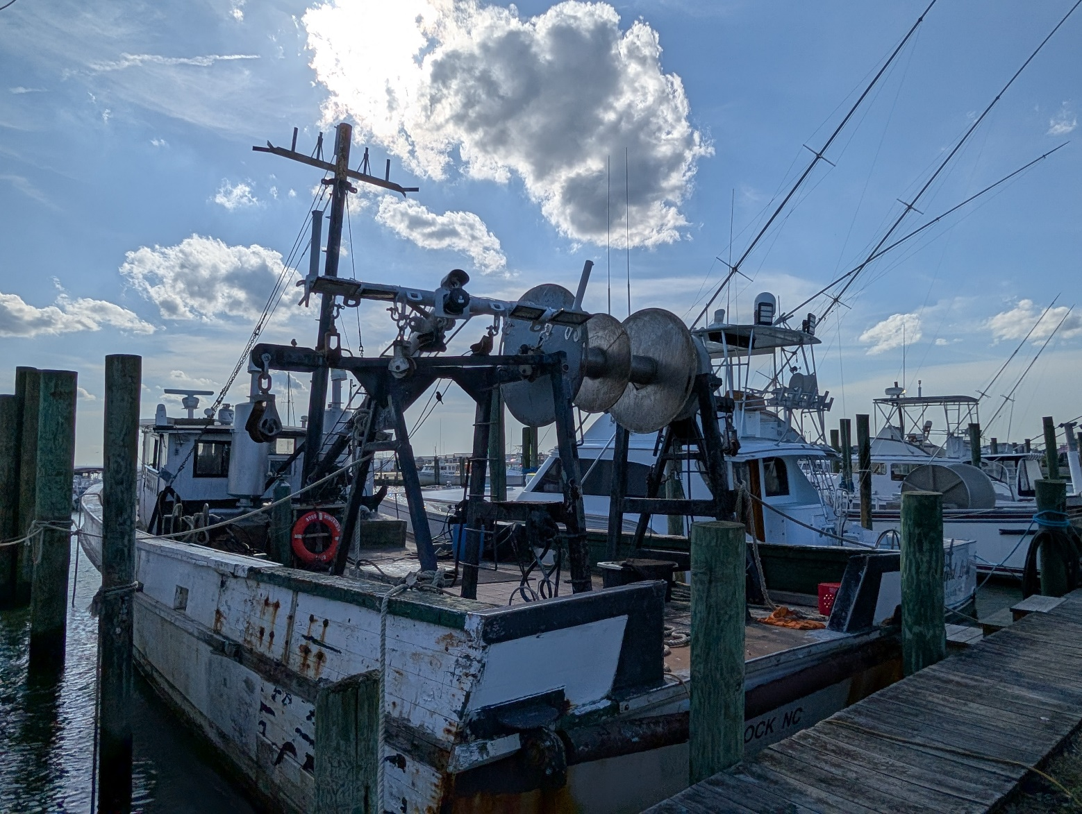
The Future of CI’s Seafood Industry
Why is this important?
Chincoteague Island became first known for its seafood. I love that we still have so many watermen and women making a living off the sea.
Will this be true for the years to come, or will shrimp and fishing trawlers be replaced by boats catering to tourists?

Slide 17
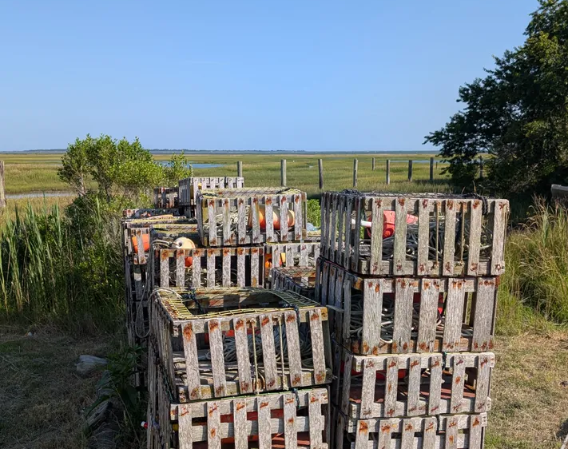
The Future of the Crabbing Industry
Why is this important?
Protecting the crabbing industry on Chincoteague Island, Virginia involves a combination of regulations, habitat restoration efforts, monitoring, and addressing threats posed by climate change.
Underwater Grass Restoration: Blue crabs rely on underwater grass beds (SAV) as nursery habitats, feeding grounds, and protection from predators. Efforts to restore these habitats are crucial for the health of the crab population.
Water Quality Improvements: Maintaining good water quality is essential for blue crab survival. This involves managing pollution and agricultural runoff that can negatively impact the Bay ecosystem.
Saltmarsh Protection and Restoration: Salt marshes provide vital habitat for various species, including blue crabs, and are vulnerable to shoreline development and sea level rise. Measures such as limiting shoreline hardening and engaging in salt marsh restoration help mitigate these threats.
Crab pots at Curtis Merritt Harbor

Slide 18
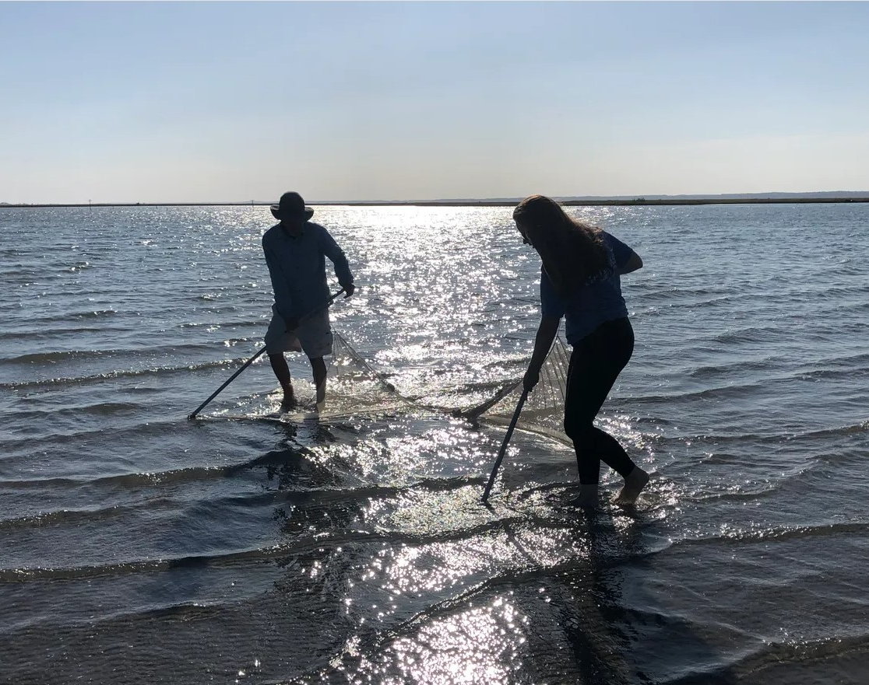
Educational Component
Why is this important?
A Chincoteague boat tour guide shows an island visitor how to use a seine net. The island has several boat tour businesses that provide a unique service — not only are the boat rides fun and the views pretty, but there is also an educational component that teaches visitors about coastal ecology.

Slide 19
Industry and Commerce
Threats and Mitigation
Chincoteague’s economy is heavily reliant on tourism with a secondary but significant focus on the seafood industry. Visitors are drawn to the island’s natural beauty, wildlife and family-friendly atmosphere. Tourism fuels a wide range of businesses, including hotels, restaurants, shops, tour operators, and recreational facilities. The seafood industry has been a cornerstone of the economy since its early settlement and continues to be today.
Possible Mitigations
Encourage and provide incentives to support local, small businesses
Educate the public on the importance of local “flavor”
Provide small business education and support to local businesses
Enforce fishing regulations and protect fishing areas
Support legislation that helps protect and support the fishing industry
Add an educational component to recreational opportunities
Restore, preserve, and enhance marshland and underwater grasses, manage storm water
Potential Threats
Chain franchises with recognized names vs. small, local businesses
Loss of local, small town atmosphere to over-development
Flight of next generation to more urban areas
Overfishing and pollution
Erosion, flooding, and pollution of crab and oyster habitats
Increasing environmental pressures

Slide 20
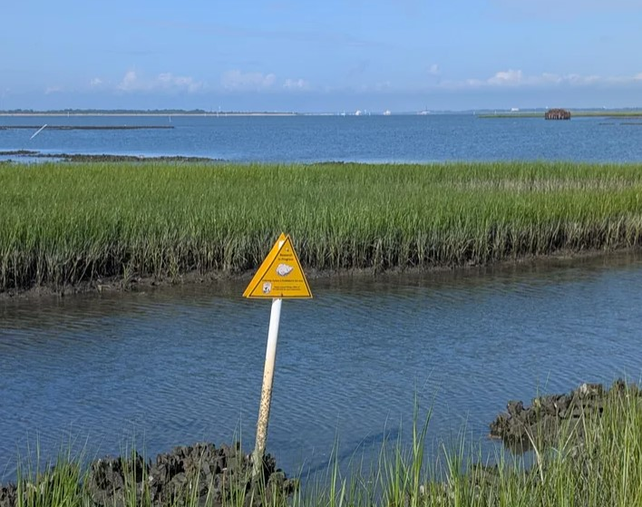
Protecting Fragile Land
Why is this important?
An intact marsh and oyster banks are two important components of our ecosystem that protect our precious but vulnerable islands.
Keeping those existing buffers in place while finding additional sustainable interventions will be crucial to withstanding future erosion and storms.

Slide 21
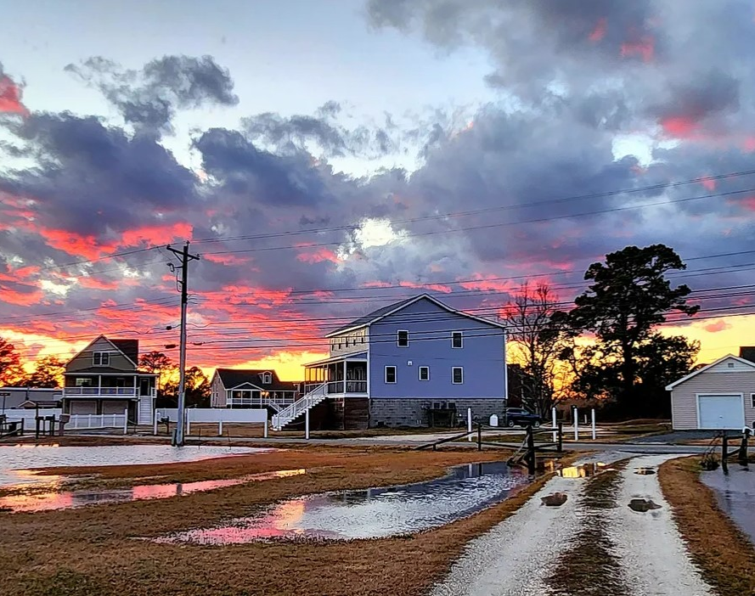
Flood Resiliency
Why is this important?
It's easy to get used to a little flooding on the island after a big rain or storm, but flooding is increasing. How do we help residents prepare for the increase over time? Homeowner's and flood insurance is getting harder to find and prices are going up.
Sea level rise and the increased number and severity of storms contribute to flooding.
By building a flood resiliency strategy we can help mitigate the impacts of water on our environment and on the folks who live here.

Slide 22
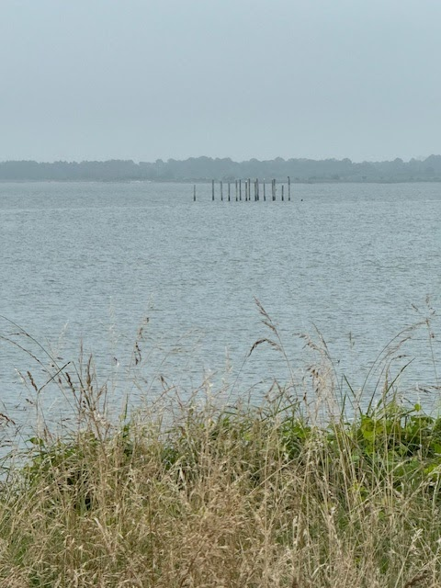
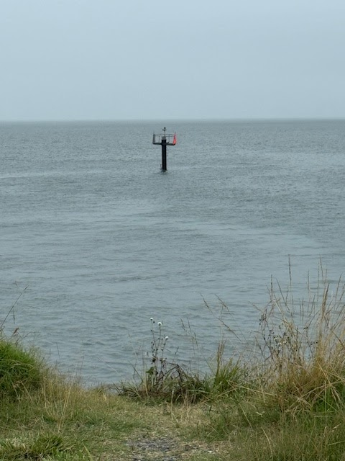
A House and a Buoy once at Water’s Edge
Why is this important?
These photos show the erosion of the shoreline at Mariner’s Point. The buoy and remnants of what once was a structure are now approximately 200 ft. off the point.
Continued sea level rise and erosion eat away at the shoreline.
The pilings you see out in the water were once the foundation of a home, now lost to erosion.

Slide 23
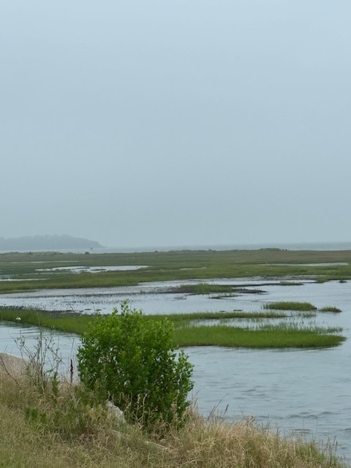
Marsh land at Mariner’s Point
Why is this important?
Marshland off of Mariner’s Point is being encroached upon by sea level rise as well as the invasive plant species, phragmites.
Phragmites, also known as the common reed, is an invasive wetland plant that can dominate marsh ecosystems
Phragmites aggressively outcompete native plants in wetlands, reducing biodiversity and impacting wildlife habitats. Its dense growth can alter wetland hydrology, increase fire risk, and negatively affect recreational uses.

Slide 24
Resiliency and Sustainability
Threats and Mitigation
Chincoteague Island, nestled between Assateague Island and Wallops Island, is home to the Chincoteague National Wildlife Refuge, one of the most visited refuges in the country, with over one million visitors each year. Surrounded by salt marshes and beautiful beaches, the island is about 8 miles long and 2 miles wide. Chincoteague Inlet, a break in the barrier island system, occurs near Chincoteague Island, at the southern end of Assateague Island. Assateague shelters Chincoteague from the Atlantic Ocean and stretches north almost 30 miles.
Possible Mitigations
Build physical barriers, breakwaters, and seawalls
Clear drainage ditches and systems
Acquire and move or raise flood-prone properties
Restore and conserve natural habitats and wetlands
Monitor and reduce well pumping rates
Install filters and treatment to public and private wells
Control building and development
Regulate buffer zones around wetlands
Educate public on use of non-toxic household cleaners
Practice effective storm water control such as use of permeable surfaces, rain gardens
Cut phragmites underwater to drown them out
Potential Threats
Sea level rise and flooding
Strong wind and waves
Impact of heightened storm surges and erosion
Salt water intrusion into shallow aquifer
Contamination of water supply such as PFAS
Over development
Habitat loss of marsh ecosystems
Invasive species

Slide 25
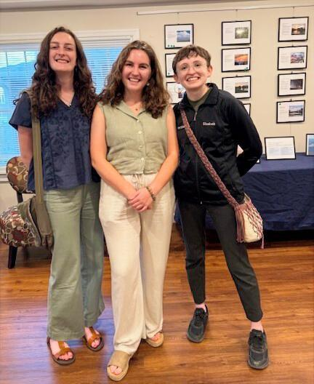
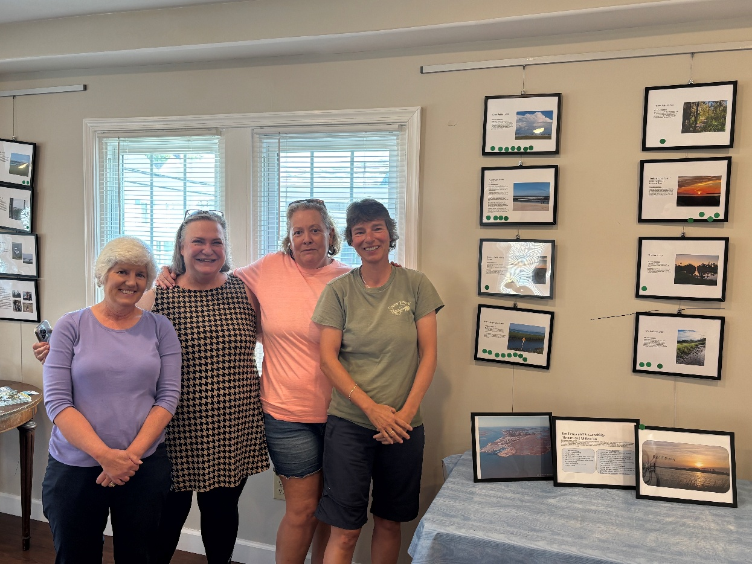
Recruited Committed, Engaged Volunteers
Many rural PDCs are under-resourced and volunteers can help us with projects in various ways.

Slide 26
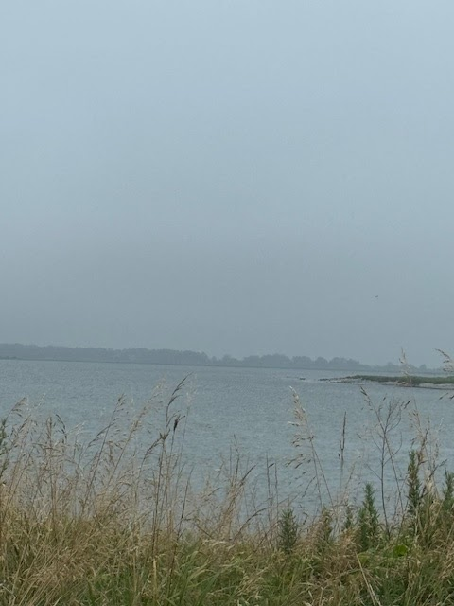
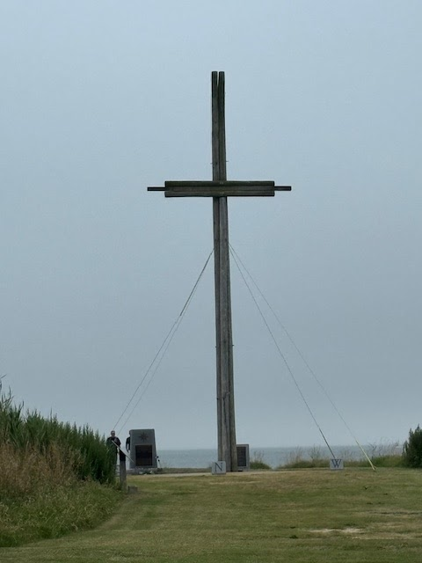
Project Focus Afterward – Mariner’s Point
Work Study to address erosion at Mariner’s Point
Partnership with Old Dominion University research program
Preservation of Mariner’s Point set as Legislative Priority
Potential beneficial use of dredge material
Surrounding marsh needing restoration
Memorial to watermen lost at sea

Slide 27
Questions?

