Slide 1
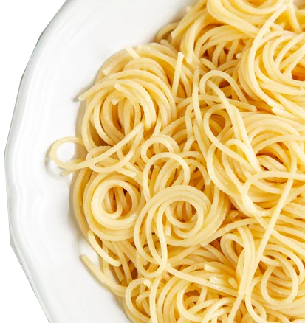

Chucking Restoration Spaghetti – What Sticks?
Finding Successes and Learning Lessons in Habitat Restoration
Shane Godshall, CERP
Habitat Restoration Project Manager
American Littoral Society

Slide 2
To Berm or Not To Berm – That’s Not Really a Question

Slide 3
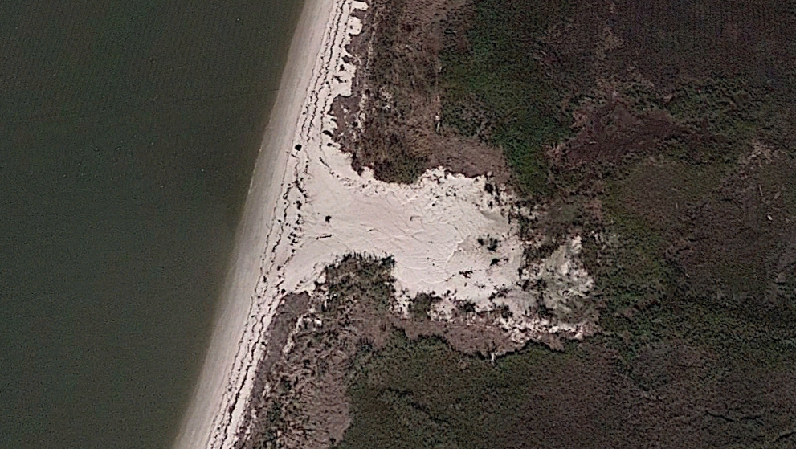
Overwashes can be good sometimes in some places.

Slide 4
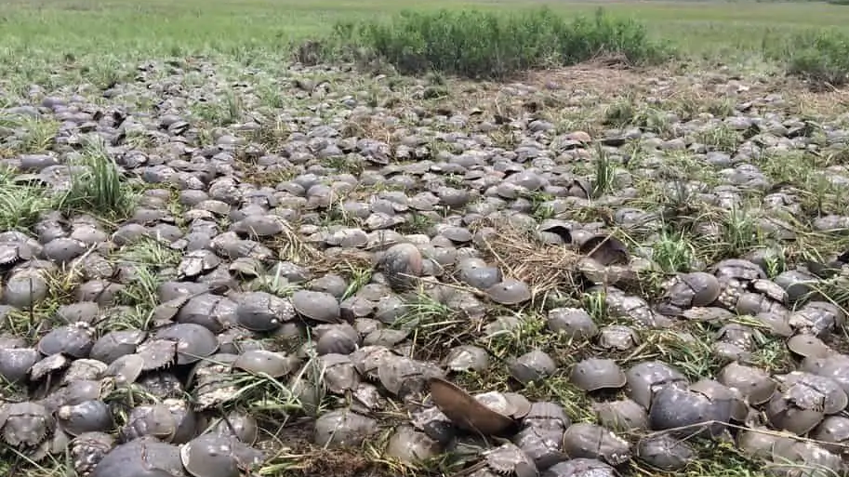
But overwashes in the Delaware Bay are often Horseshoe Crab Traps

Slide 5
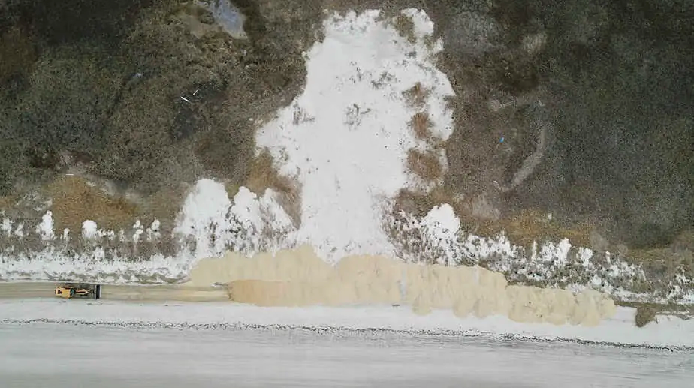
Berm Constructed

Slide 6
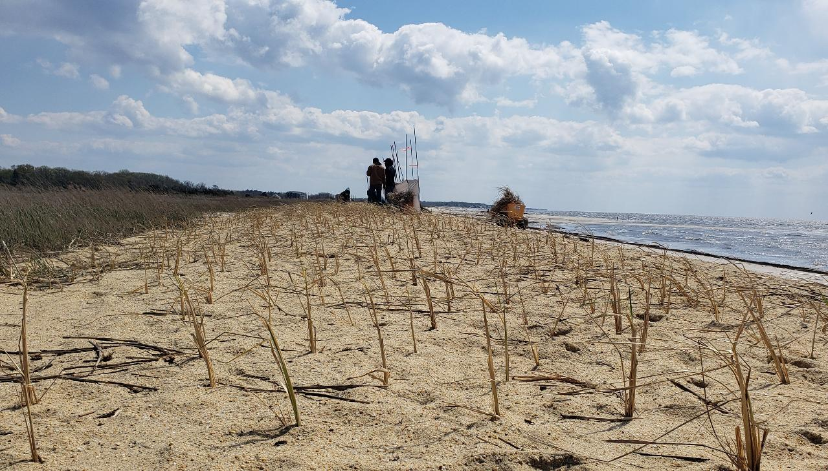
And planted

Slide 7
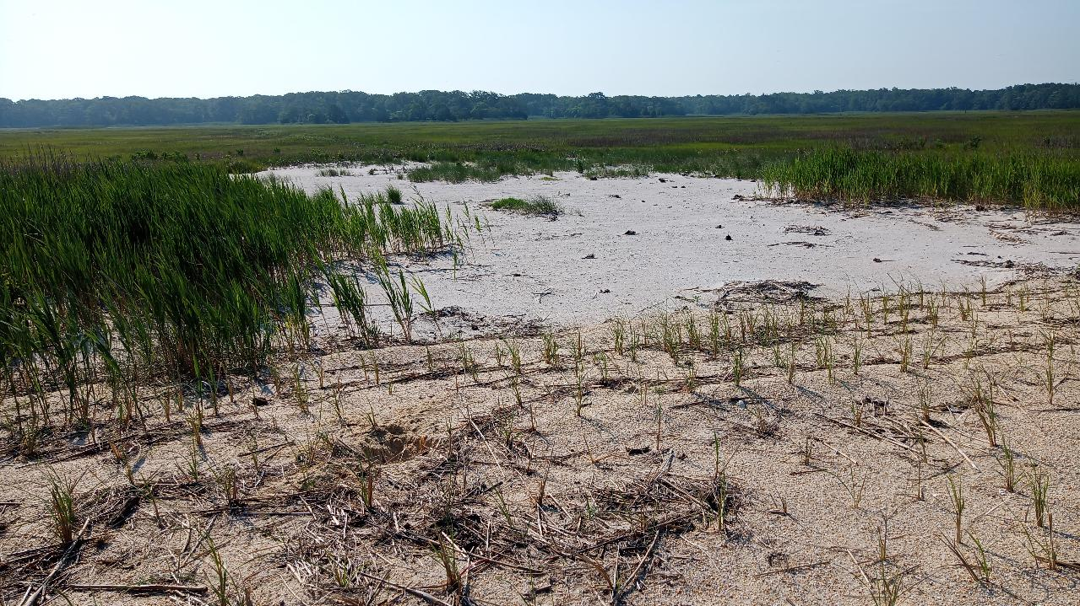
A notable lack of dead horseshoe crabs at the end of first HSC season after implementation.

Slide 8
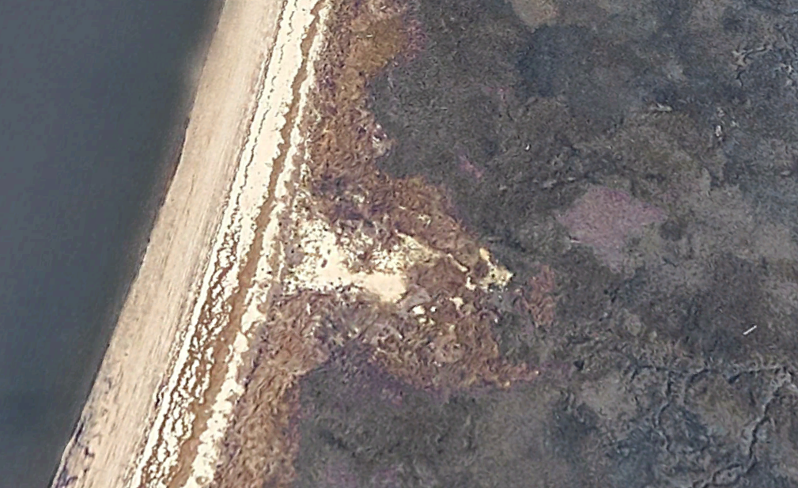
4 years post

Slide 9
Mud can be difficult.

Slide 10
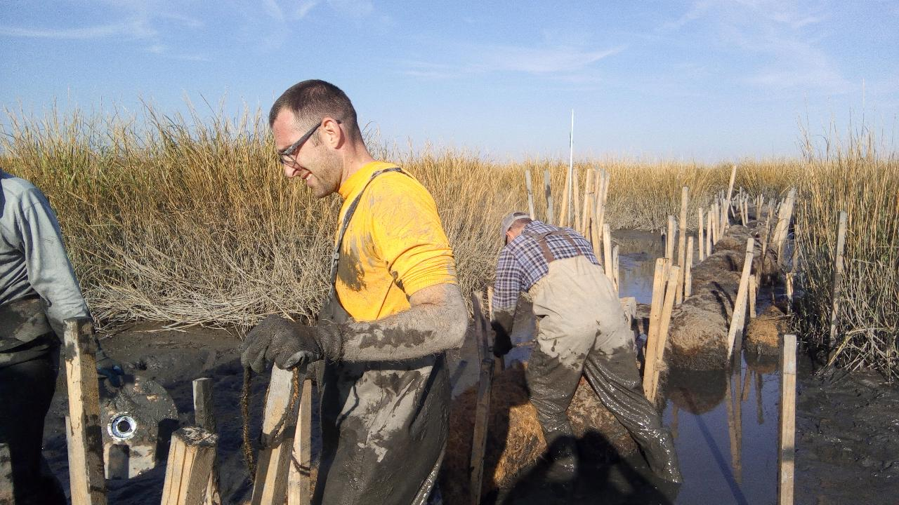
Up to our knees in places, we used coir mats as walkways

Slide 11
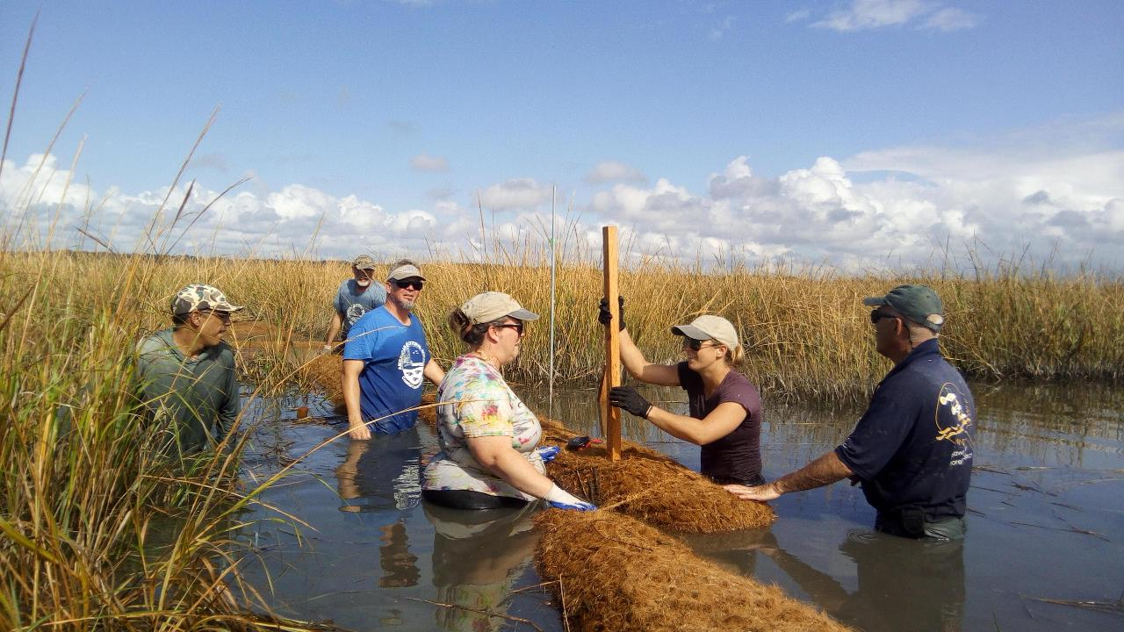
Floating in materials via Jon Boat and positioning what we could during the falling tide.

Slide 12
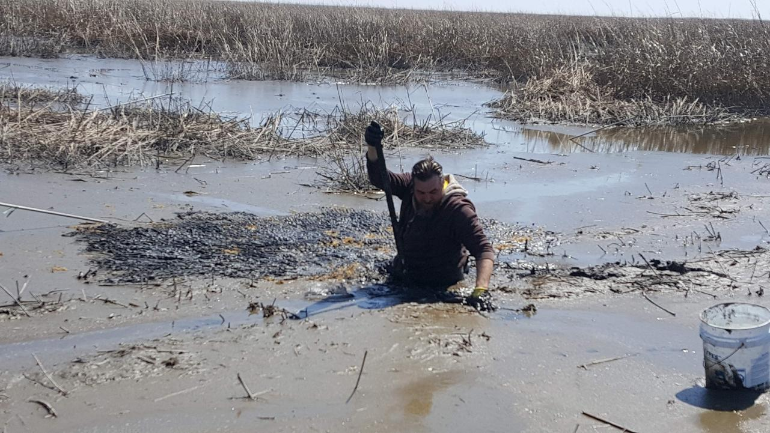
Don’t try walking in a newly restored marsh to plant seed. Revegetation worked out fine without seeding.

Slide 13
Your boots will always be a half inch too short.

Slide 14
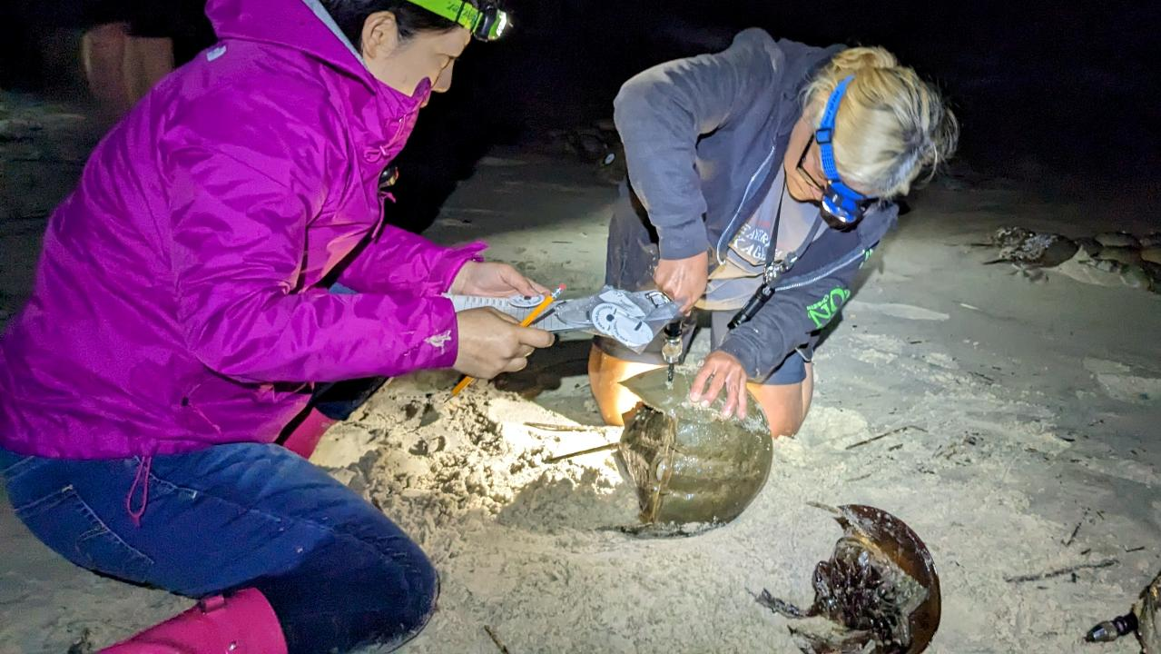
Just figure you’re gonna get wet.

Slide 15
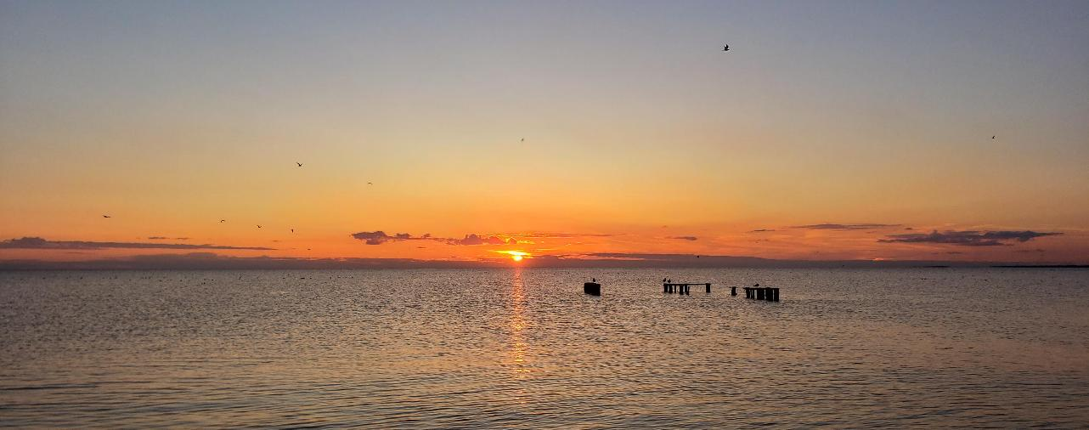


Thank You
Shane Godshall, CERP
Habitat Restoration Project Manager
American Littoral Society
shane@littoralsociety.org
www.LittoralSociety.org
Funding provided by National Fish and Wildlife Foundation
The views and conclusions contained in this document are those of the authors and should not be interpreted as representing the opinions or policies of the U.S. Government or the National Fish and Wildlife Foundation and its funding sources. Mention of trade names or commercial products does not constitute their endorsement by the U.S. Government, or the National Fish and Wildlife Foundation or its funding sources.
Source funding: USFWS
Notes:
Open to suggestions for monitoring and data sharing.

