Slide 1
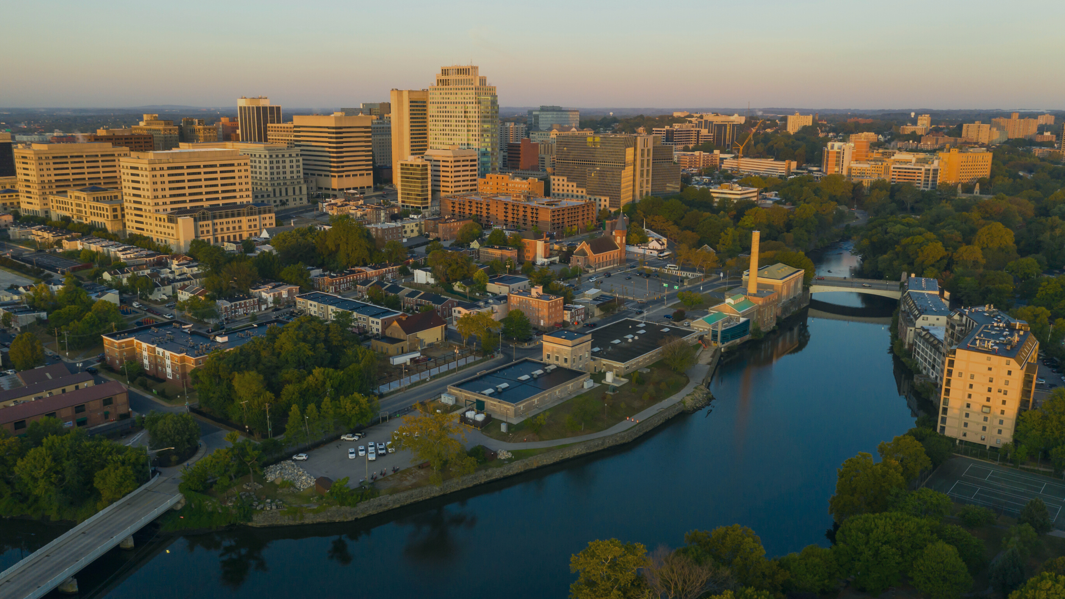


Building Statewide Resilience and Sustainability Through Collaboration
The Role of RASCL in Delaware’s Climate Adaptation
New Jersey Climate and Coastal Resilience Conference | March 9, 2026
Jana Savini, Coastal Collaboration Manager, RASCL Coordinator
Partnership for the Delaware Estuary

Slide 2
What is RASCL?
The Delaware Resilient And Sustainable Communities League (RASCL) is a collaborative network of state agencies, non-profit organizations, and academic institutions that convenes partners, leverages limited resources, and coordinates efforts to build a more resilient and sustainable Delaware.
Notes:
So, RASCL was created because, for years, Delaware had many agencies and organizations doing really similar resilience and sustainability work—but they were doing it in silos. And in a small state like Delaware, that kind of disconnected approach just doesn’t make sense. We were duplicating efforts, missing opportunities, and competing for the same communities’ attention.
So, the idea behind RASCL was very simple: if we work together, we can work smarter, not harder. By building a unified network, we can accomplish more than any organization could on its own. We just kicked off RASCL’s 10th anniversary last week, and I have been at the helm for the last 5. In that time, RASCL has become a force‑multiplier—helping our member organizations expand their reach and connect Delaware’s communities with resources, knowledge, and support that’s grounded in science and best practices.
Ultimately, RASCL is about strengthening Delaware’s resilience and sustainability through coordinated, community‑focused collaboration.

Slide 3
Our Mission
To support all Delaware communities in taking the necessary actions to thrive in the face of changing environmental conditions through collaboration, information sharing, and technical assistance.

Slide 4
Guiding Principles
Strength in Collaboration
Excellence Through Shared Learning
Holistic Approaches
Inclusive and Community-Driven Solutions
Empowering Local Capacity
Forward-Thinking Planning
Science-Based Decision-Making
Authentic Community Engagement
Adaptability and Resilience

Slide 5
Core Topics
Climate Resilience
Sustainable Land Use and Infrastructure
Hazard Mitigation and Emergency Management

Slide 6
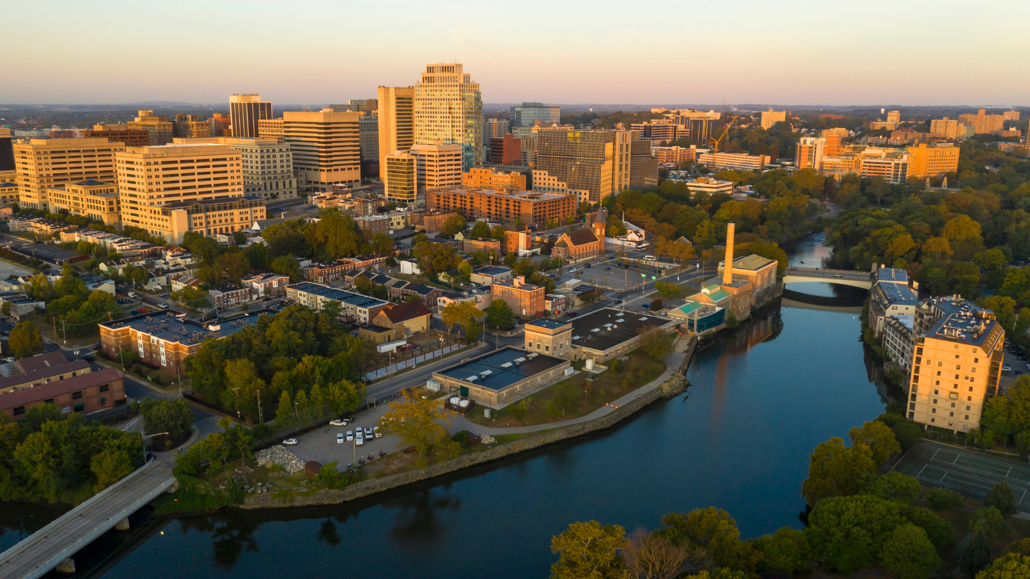
Who is RASCL?
State Agencies
Emergency Management Agency, Department of Environmental Resources and Environmental Control, Department of Transportation, Division of Libraries, Division of Public Health, Forest Service, Office of State Planning Coordination, Housing Authority
Non-Profit Organizations
Center for the Inland Bays, League of Local Governments, Delaware Nature Society, Sustainable Energy Utility, Voluntary Organizations Active in Disaster, Green Building United, National Wildlife Federation, The Nature Conservancy, Partnership for the Delaware Estuary, Sussex County Land Trust
University Partners
Geological Survey, Center for Environmental Monitoring Analysis, Environmental Institute, Delaware Sea Grant, Coastal Resilience Design Studio, UD Office of Sustainability, UD Water Resources Center, University of Maryland Environmental Finance Center
RASCL member organizations leverage their diverse expertise and work together to support Delaware communities in adapting to and mitigating environmental changes.
Notes:
RASCL is made up of 28 member organizations—state agencies, nonprofits, and university partners. We draw an important distinction between members and end users. Members are the people and organizations creating tools, programs, and resources. End users are the communities who ultimately use them.
We separate those roles on purpose so we’re not asking community members to both give input and help build the tools themselves. Their job is to tell us what they need—our job is to build it.
For their efforts, RASCL offers several benefits to it’s member organizations.
This first amplified and expanded outreach. RASCL lets organizations reach a much broader combined audience than they could alone. For example, people who get the libraries’ newsletter may not also follow State Planning, or the League of Local Governments, or the DNREC Division of Water, but through RASCL, everyone receives the same information.
Members also get a dedicated space to collaborate without having to worry about things like budgets or logistics. They can just show up and create.
And maybe the biggest benefit is the networking. Because of our diverse member pool, RASCL brings almost everyone you need to talk to into the same room.
That said, limiting membership does create a blind spot around end‑user feedback and oversight. Hold onto that thought—we’ll come back to it later in the presentation.”

Slide 7
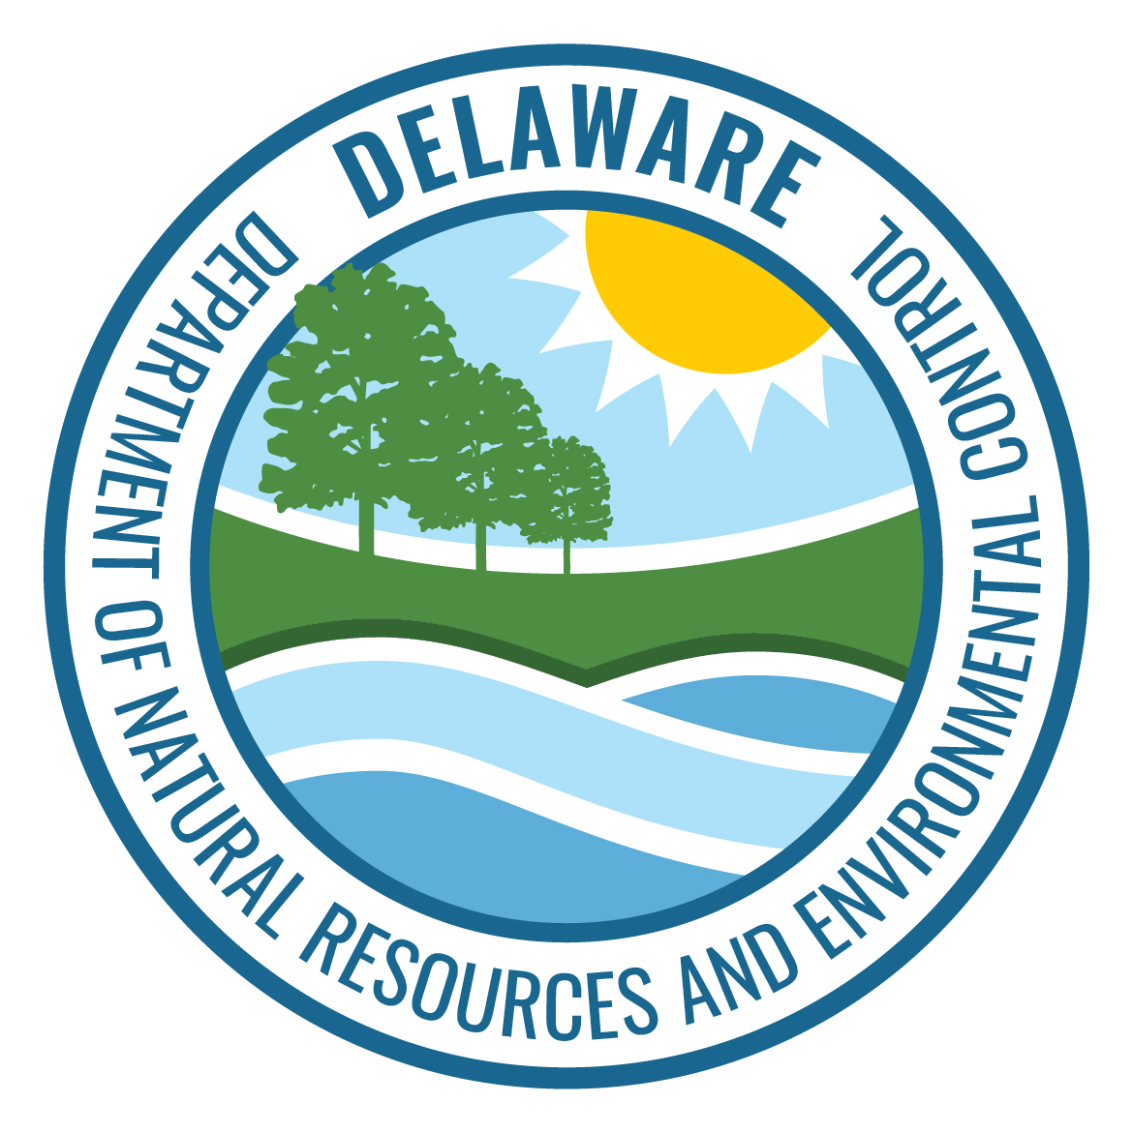
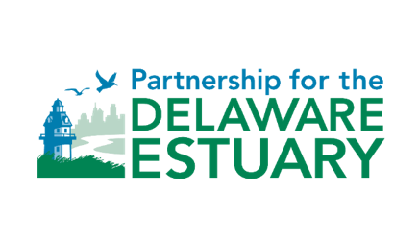
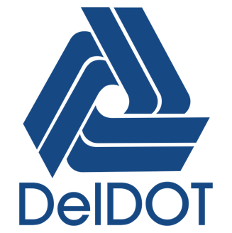
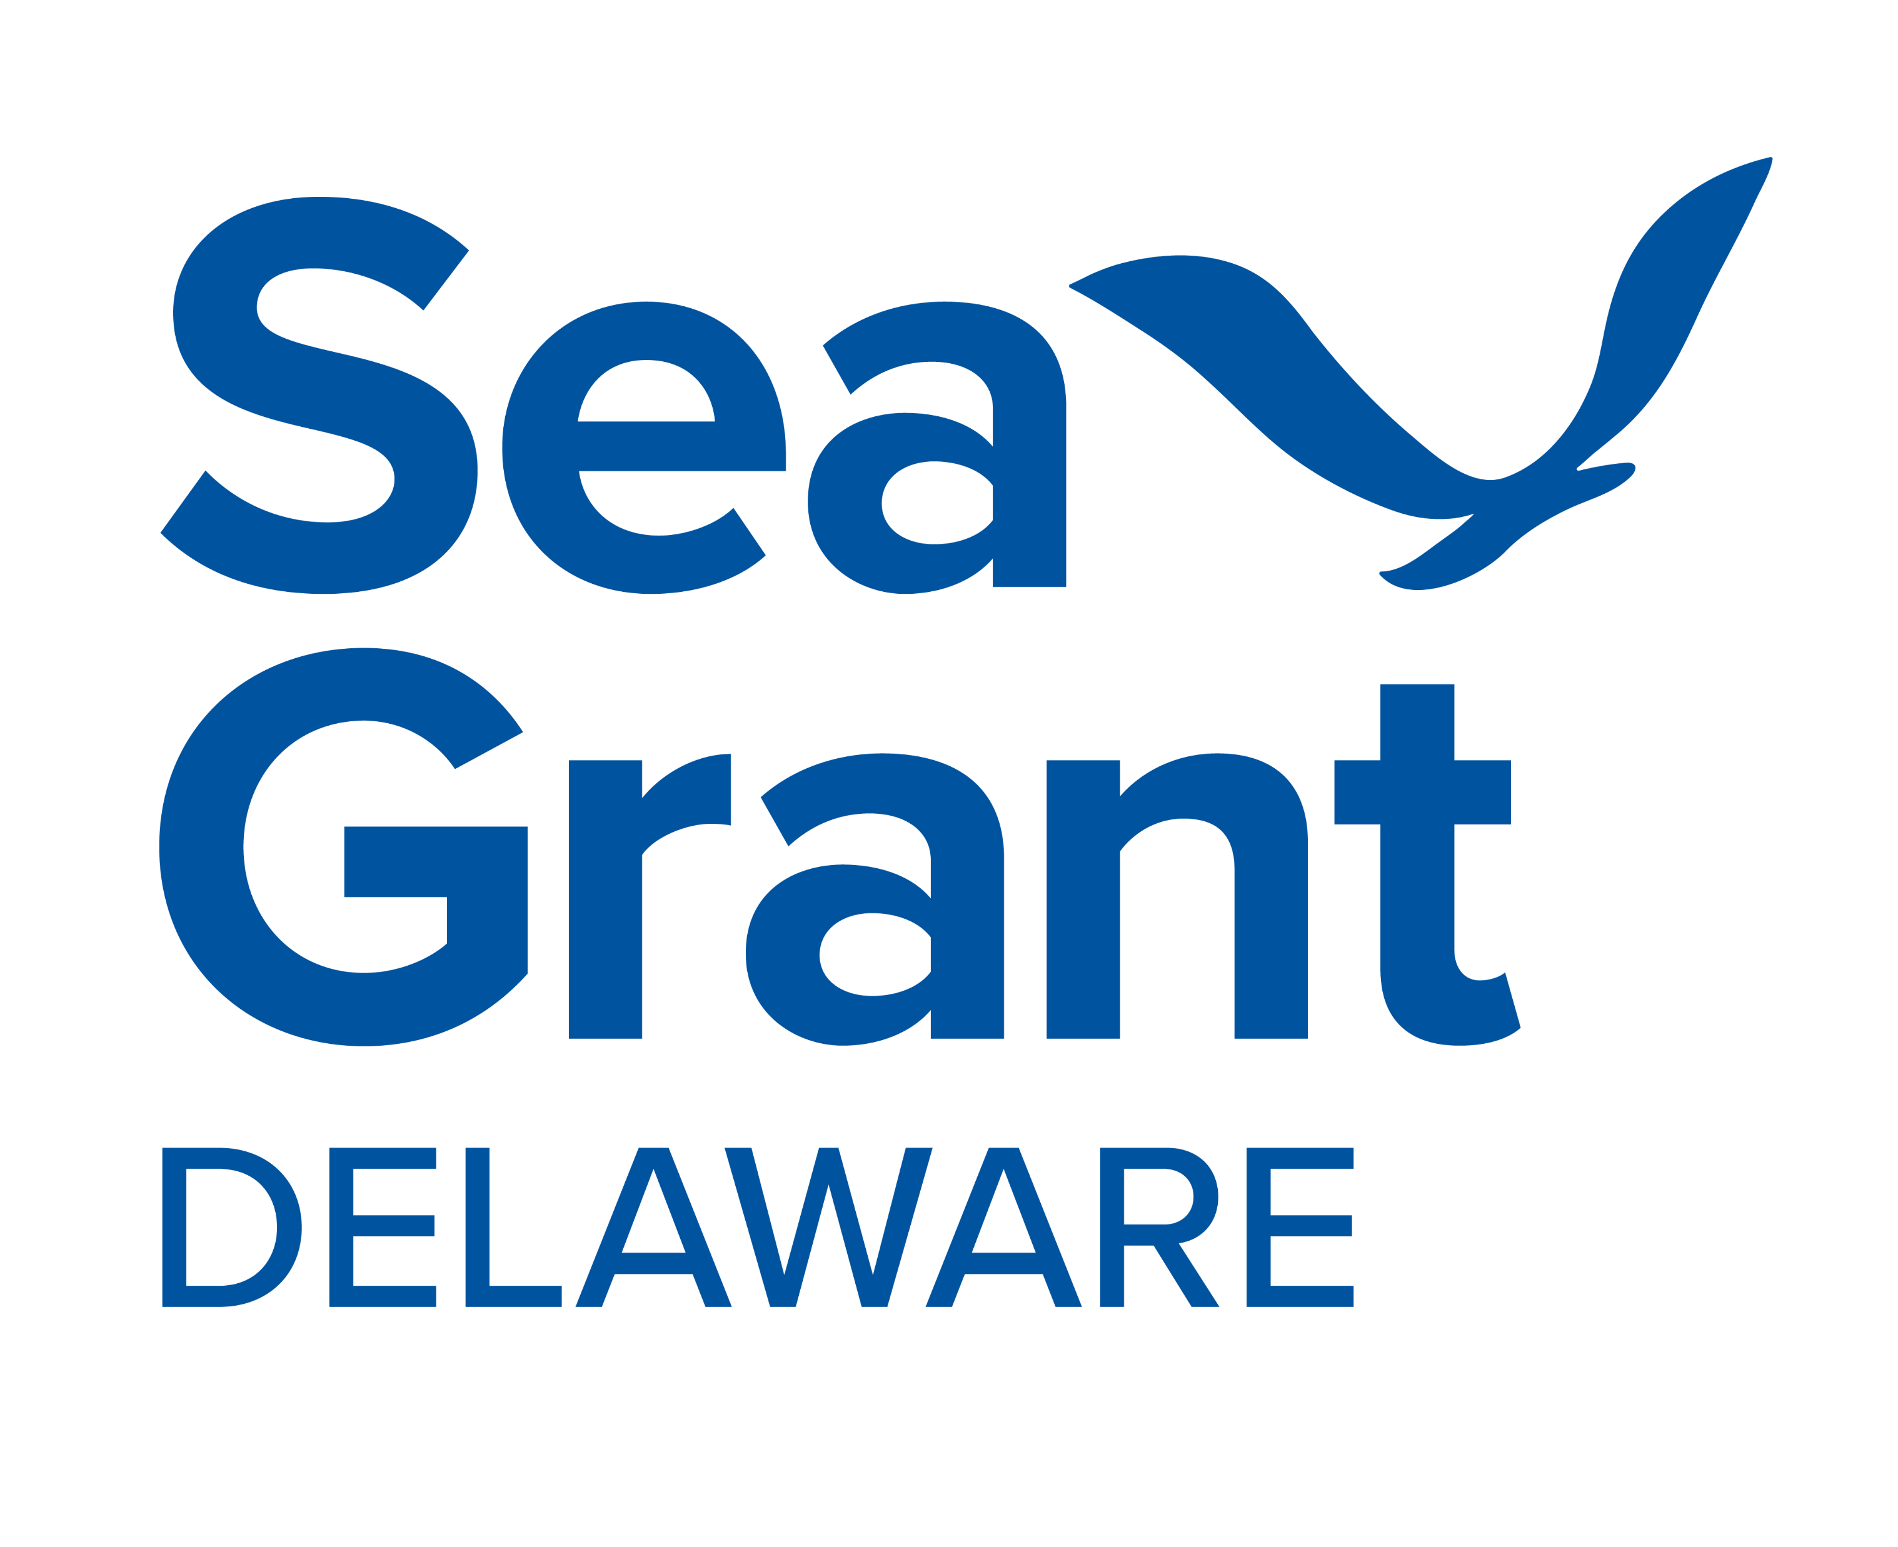
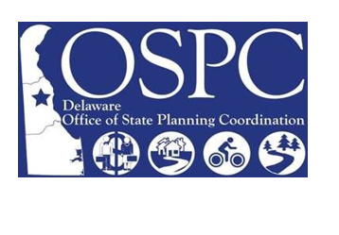
RASCL Steering Committee
Provides strategic direction and leadership for RASCL in accordance with the goals of the Strategic Plan and the will of the membership. Ensures RASCL projects, programs, and messaging align with the established RASCL goals and core topics.
Notes:
The RASCL Steering Committee is comprised of the Delaware Department of Natural Resources and Environmental Control, the Delaware Department of Transportation, Delaware Sea Grant, the Delaware Office of State Planning Coordination, and the Partnership for the Delaware Estuary.
With the exception of State Planning—who joined later that the others—each of these groups contributes financially in some way to keep the network running.
DNREC covers a large portion of the administrative and program costs that keep RASCL going day‑to‑day.
DelDOT funds the annual RASCL Summit, which is our largest event of the year.
Delaware Sea Grant supports the network by providing graduate student interns.
The Partnership for the Delaware Estuary serves as the fiscal and administrative host for the entire network. So that’s where I fit in—I work for the Partnership. Our team handles all the behind‑the‑scenes operations like managing budgets, contracts, invoicing, paying the bills, hosting the website, and managing the online platforms.
We also go after additional funding for new and emerging programs that aren’t yet part of the normal operating budget.

Slide 8
Why State Support Matters
State Investment
Support for Network Coordinator
Member-Generated Programs
Community Engagement
Community Trust
Foundation of Resilience Networks
  State support is essential for building effective, functional resilience networks with sustained impact.
Capacity Growth and Strategic Development
  State investment enables coordinator capacity to expand from just administrative tasks to strategic development and program engagement.
Consistency and Sustainability
  Well-funded networks provide consistency and ensure long-term sustainability beyond federal grants or workload spikes.
Multiplier Effect on Communities
  Expanded coordinator capacity increases member participation and community support, creating a statewide multiplier effect.
Notes:
So before we go any further, I want to pause on some terms you’re going to hear me use a lot today. The first is state support.
And when I say state support, I mean funding, but not funding that just magically appears. Like I don’t come into the office and find an envelope on my desk labeled “state funding for RASCL” It starts with a program champion inside a state agency. Someone who believes in the work strongly enough to push for it, advocate for it, and ultimately get the funding greenlit.
RASCL is in a good place now because, after ten years, we have several champions across the state. But it absolutely did not start that way. In the beginning, it was just one or two people who said, ‘This matters, and we’re going to find a way to fund it.’ That’s really the spark that gets resilience networks off the ground.”
The second is Network Coordinator or Coordinator. And while the day-to-day operations are my responsibility, network coordination includes the support staff who I mentioned in the last slide that help me with the administrative operations.
So, with that in mind, the foundation of a strong network like RASCL really comes down to state support—meaning start-up funding that turns an idea into something functional, stable, and impactful. And once the state invests in a coordinator role, that capacity can grow. Instead of being stuck in basic admin tasks, the coordinator can actually focus on strategic development, building programs, and engaging with members and communities in meaningful ways.
Stable funding also creates consistency. A network can’t rely solely on federal grants or people doing this in addition to their already full workdays. When the state invests, the network becomes sustainable even through workload spikes or shifting priorities.
And when coordinator capacity grows, you feel it everywhere. Members participate more, communities get more support, and the impact starts to multiply across the entire state. That’s the whole goal—the initial investment creating a ripple effect that benefits everyone.

Slide 9
How does RASCL build statewide resilience and sustainability?
Collaboration
Information Sharing
Technical Assistance
Notes:
So, on to what you came to here for. How exactly does RASCL build statewide resiliency?
I won’t bore you with popping our mission statement up there, but the gist of it is that RASCL helps Delaware’s communities become more resilient and sustainable by doing these three specific things. Collaboration, Information Sharing, and Technical Assistance.

Slide 10
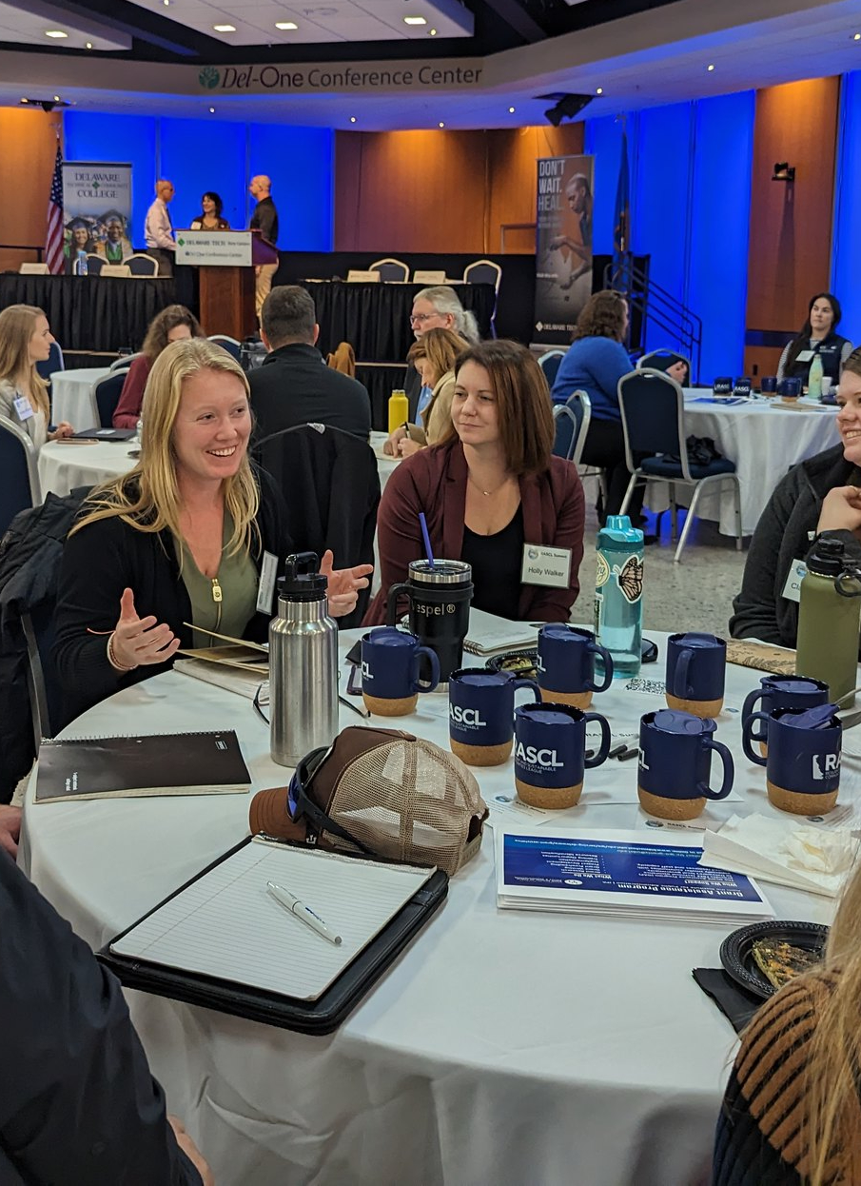
Collaboration
Make each other look good and robots, pirates and ninjas.
  RASCL collaboration is based on a symbiotic relationship between coordinator, member organizations and end users (municipalities) that builds overall resilience and sustainability.
Coordinator's Role (Robot)
  The coordinator organizes logistics, shapes agendas, and fosters open discussion to add value and alignment for members.
Members’ Contributions (Pirate)
  Members are encouraged to think big and create programs and resources that make their jobs easier.
Results for End Users (Ninja)
  Municipalities receive the information that RASCL puts forth and puts it to use.
Notes:
Ok, I know what you’re thinking – this woman has lost her mind. And . . . That might be true . . .but hear me out.
“Make each other look good” is a saying I learned in an improv class. I know – I’m not making this any better but I swear this is relevant.
Make each other look good the guiding principle I use when managing this big, statewide network of people with all different experience levels, professional responsibilities and goals, and personal interests.
What I mean when I say “Make each other look good” is don’t worry about how you are going to come off and instead direct all your energy into making your fellow work group members, your partners, and our end users look good. If I was just looking out for myself that’s only one person looking out for me. When I have a whole network of people who are focused on making me look good, that’s way more than one person and I’d rather take those odds.
But Jana, what about the pirates?
Again, this is an improv thing, but I’ve found it quite useful when managing the RASCL network and the broad range of expertise and personalities that comes with that
The way you make each other look good is by first taking care of yourself before your pour from your cup to give to the group. This includes acknowledging what your role in the group is, and where your skillset and expertise lie, and not dropping that to just go along with what everyone else says. This is the equivalent of putting your own oxygen mask on first, before helping those around you.
This is where the pirates come in
In very general terms, there are three categories of people needed for successful collaboration. Robots, pirates, and ninjas.
Robots do all the heavy lifting. If they’ve done their job well, they go unnoticed. In RASCL, the coordinator is the robot. So for me that looks like managing the administrative tasks like we’ve discussed, sharing RASCL programs and member news out to our our network, keeping the workgroup co-chairs on task with agenda prep, facilitating the meetings, providing a space for open and honest discussion, and this last one is a biggie for me – and that’s ensuring that participating in RASCL is a value-added experience and not an extra burden. It’s my job to make sure the workplans, activities, and deliverables are catalysts for our members’ work outside RASCL and not just another meeting their boss told them to go to.
Pirates are leading the charge. They have big ideas and want to make bold moves. The RASCL members are the pirates. They don’t have to spend time and energy on logistics or admin work so they can devote all of their time to dreaming big creating programs that are helpful to them and the communities they serve. I’m going to discuss what those programs are a little later in this presentation
Ninjas are waiting patiently and quietly while the robots and the pirates faff about. Our end users, our communities, are the Ninjas. When they interact with our programming and resources, they weigh in and give the work meaning, and context, and stakes. The practitioner network of RASCL is nothing without our local governments using our tools and letting us know what they think of them.

Slide 11
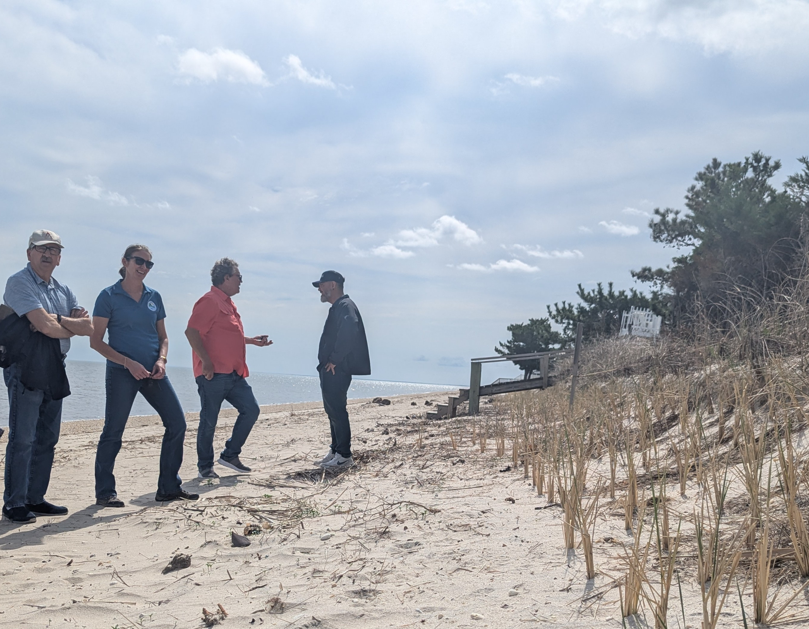
Information Sharing
Accessible Community Engagement
  Coffee Hours are free and rotate statewide to include all communities. The RASCL Summit registration is $15 thanks to state support.
Collaborative Learning Environment
  The RASCL Summit agenda and activities are crafted to draw practitioners, non-profits, consultants, local governments, academic partners, funders, and interested community members.
  Consistent Outreach
  The Outreach Workgroup connects with each of Delaware’s 57 municipalities annually with a flyer advertising our programs and contact information for each out our member organizations. It also serves as a personal invitation to the RASCL Summit.
Notes:
RASCL puts a huge emphasis on keeping information—and our members—as accessible, collaborative, and consistent as possible. Everything we do is built around meeting communities where they are, not asking them to come to us.
One way we do that is through our quarterly Coffee Hours. We host two virtual sessions and two in‑person sessions, and the in‑person ones rotate around the state so we’re bringing information and ourselves to different communities.
The photo on this slide is from a Coffee Hour on dune grass preservation last spring at Slaughter Beach. The folks you see there include DNREC program leads, the mayor, and local residents—and just outside the frame were an engineering consultant, the vice mayor, the town manager, a mayor from the next town, and some Delaware Sea Grant staff. It’s a great example of how we bring a full mix of people together in an informal, low‑barrier setting.
Our biggest event each year is the RASCL Summit—our one‑day statewide conference. We keep it one day on purpose so it’s doable for mostly everyone. Registration is only $15—we raised it from $10 just last year—and we work hard to keep the time, travel, and cost as low as possible so that our smallest towns can participate just as easily as the largest, best‑funded ones.
We also put a lot of thought into the agenda. We center community needs, and we make sure the content is actionable. And the mix of people in the room is incredible. It’s completely normal to find yourself in a conversation with an elected official, a division administrator, a funder, a researcher, and a reporter all at the same time. That can feel intimidating, especially for newer folks, so we’re really intentional about keeping the tone welcoming and making sure everyone feels like they’re on equal footing.
And because program champions are so important to the success of this work, staying in touch with our communities is a big priority. An ongoing challenge is staff turnover in municipalities. To help with that, we send a flyer every year to every municipality in Delaware. It reintroduces RASCL, outlines our programs and members, and includes a save‑the‑date for the Summit. At minimum, it guarantees we’ve made one connection with whoever is currently on staff, no matter how recently they’ve joined.”

Slide 12
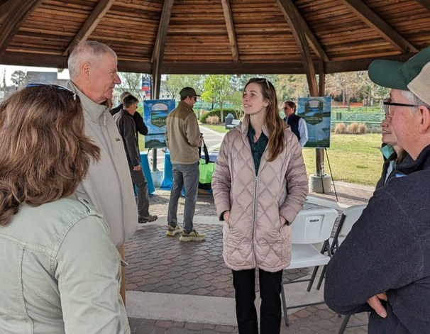
Technical Assistance
Project Guidance Group
  A free service designed for Delaware communities seeking advice and technical assistance to advance their resilience-related projects
  Resource Guides
  Translate legislation, best practices and community-identified needs into practical tools.
  Community-Based Research Needs
  Turns community needs into research questions and pairs them with available funding.
Staff Capacity and Impact
  Increased staffing capacity enabled programs to evolve from ideas into impactful statewide community resources.
Notes:
These were those big ideas I mentioned a few slides ago. Our members came up with three big program initiatives that they identified a need for
The Project Guidance Group connects communities who are stuck anywhere in the project pipeline to next steps. It’s not project management, but it’s a connection to information and options. We do this by finding the person or persons who the community needs to talk to, get everyone on a call together, then facilitate the conversation going forward until the community and the resource person have formed a working relationship. We don’t say call steve at the office of such and such, it’s the personal touch that really makes this program stand out
Resource guides are designed to address capacity gaps for our local governments. Like how to guides.
Research Needs, research forum, published list

Slide 13
In the last three years, state funding boost increased coordinator's time from under 20% to nearly 75%.
Can you guess what happened next?

Slide 14
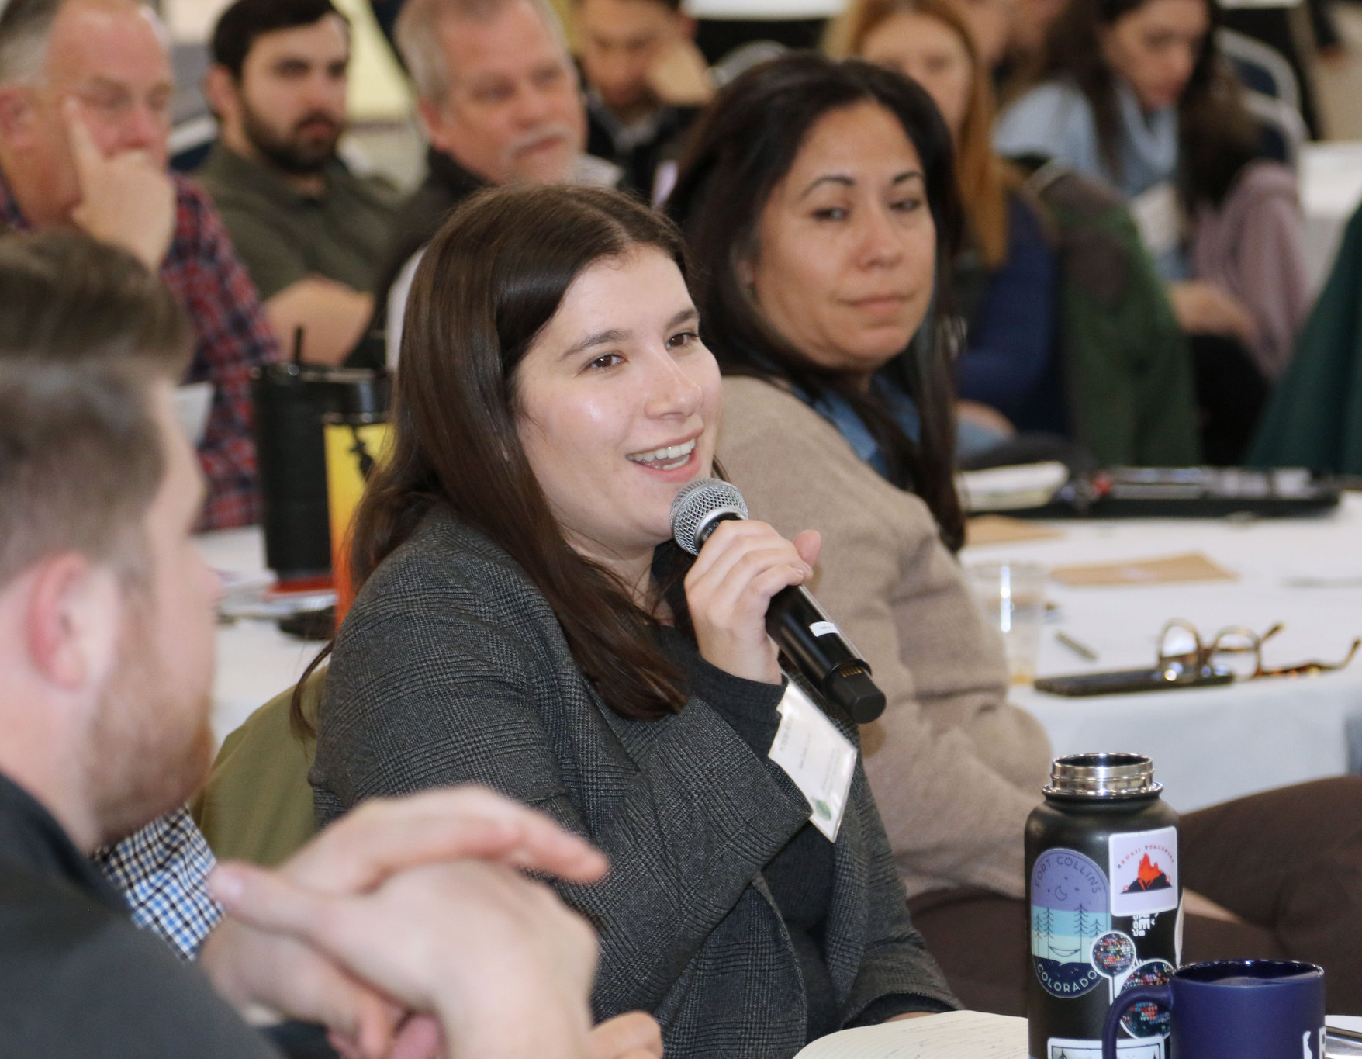
Capacity Expansion and Program Growth
Program Development Progress
  The Project Guidance Group, Resource Guides, and Community-Based Research Needs evolved from ideas on a page to active programs with measurable results.
New & Enhanced Engagement Activities
  Coffee Hours shifted to interactive site visits, boosting engagement and hands-on learning experiences. Convening our first ever Community Advisory Team.
Growth in Participation and Recognition
  RASCL Summit attendance grew from 150 to 225, featuring high-level officials. Our network grew from 17 to 28 member organizations. RASCL is referred to as a trusted resource and Delaware’s Climate Action Plan.
In-House Strategic Planning
  By updating our strategic plan ourselves, there’s a sense of ownership, accountability and connection among participants.
Notes:
“Yeah… we got a lot bigger, and we did a lot more stuff!
The Project Guidance Group is our free technical‑assistance program for communities that get stuck somewhere in the project pipeline. This went from an idea on paper turned to meeting with eight communities and helped streamline workplans across three of our member organizations.
We were able to respond to Senate Bill 237—that mandates counties and larger municipalities to include climate‑change considerations in their comprehensive plans by creating a resource guide to help with that. The photo you see is Kristie Arlotta, who was the Sustainability Coordinator for New Castle County at the time. She used our guide while writing the county’s first sustainability plan and has publicly credited it with helping her navigate the process. That workgroup is now developing a model ordinance for tree preservation
Several member organizations had goals around connecting community needs to research questions. So RASCL revived a dormant workgroup to host a Research Forum, where community leaders sat down with researchers to share their needs and turn them into research questions. Together, they refined the questions and aligned them with available funding. That effort produced RASCL’s first Community-Based Research Needs List.
Our Coffee Hours used to rely on free meeting rooms provided by our members and minimal funding. Now, we’ve expanded into true site visits—actually delivering information in communities instead of making people come to us. And I don’t know about you, but I’d rather be walking along the beach like we were in that picture among the dunes rather than learning about the program in a conference room.
Remember earlier when I talked about the blind spot created by separating members from end users? Recently we saw increased interest from organizations doing similar work but serving different audiences. Combined with that need for more direct community input, we launched a new Community Advisory Workgroup made up of towns, preservation coalitions, public works departments, planning offices, a health-care system, and hyper-local community coalitions. Their role is to tell us what’s working, what’s not, and what we haven’t even thought about yet.
The RASCL Summit like many events’ attendance dipped after the pandemic. We were averaging around 150–175 attendees. But the last two years we’ve actually sold out—and we only capped it where we did because of budget. Municipal participation doubled, from seven up to fifteen, and we’ve had the governor attend the last two Summits and state secretaries the last three. We actually just held the 2026 Summit four days ago—hence the under eye bags. This year We had 230 registered, over 200 onsite, participation from 15 Delaware municipalities, and for the first time ever—one from Maryland.
We saw member‑organization growth from 17 to 28, with another on deck.
RASCL was officially mentioned in Delaware’s updated climate action plan, released this January. That’s a huge recognition of the network’s value and a big step toward our goal of becoming a trusted resource.
Lastly, we were able to complete our strategic plan update in-house. I know most people aren’t like, “yes, I get to go to more meetings to write my own strategic plan”—but the result was worth it. The plan was written for the members by the members and is centered on community input. And because we quite literally wrote the whole thing ourselves, we feel a real sense of pride and ownership of it and want to see it be a success.
And none of this happened by accident. It’s not coincidence. Every bit of this growth was possible because of increased state funding, which allowed me and the team at PDE to support the members, who then had the capacity to grow these programs.”

Slide 15
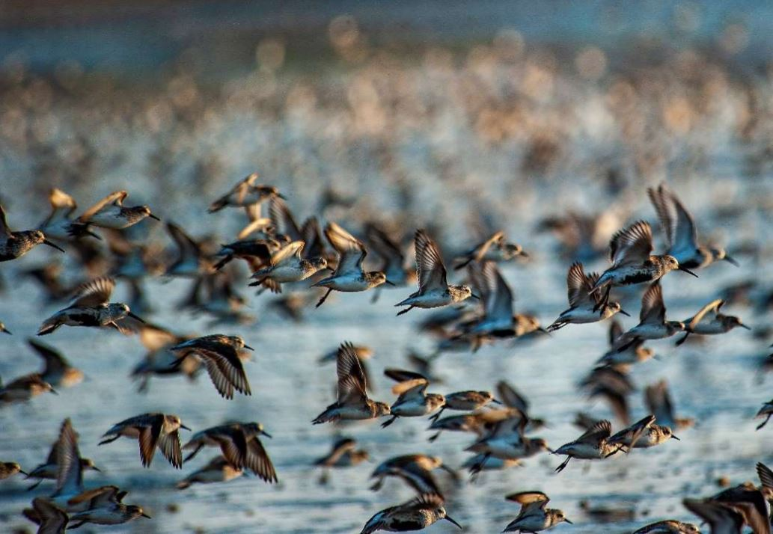
State Investment Is Foundational
Building Structural Backbone
  Initial state buy-in provides essential infrastructure for program development and partner coordination within networks.
Multiplying Impact Through Capacity
  State support enhances coordinator capacity, empowering members and growing network participation organically.
Essential for Resilient Communities
  State-level support is crucial for climate adaptation, sustainable growth, and resilience across diverse regions.
Notes:
So to pull everything together the big takeaway is this: state support is the backbone of networks like RASCL.
It starts with that initial buy‑in—someone inside a state agency who believes in the work enough to push for funding and help get the structure in place. That early support is what gives a network the infrastructure it needs to actually function, coordinate partners, and move from ideas to real programs.
Once that foundation is there, state investment multiplies the impact. When there’s funding for a coordinator, the role can shift from just handling logistics to doing real strategic development, building programs, engaging members, and supporting communities in meaningful ways. And when that capacity grows, participation naturally grows with it—members do more, communities get more support, and everything starts to build momentum.
And ultimately, this kind of support is essential for resilient communities. Climate adaptation, sustainable growth, and long‑term resilience don’t happen piecemeal. They require steady investment, coordination, and a network that’s strong enough to connect people, share resources, and respond to community needs across the entire state

Slide 16

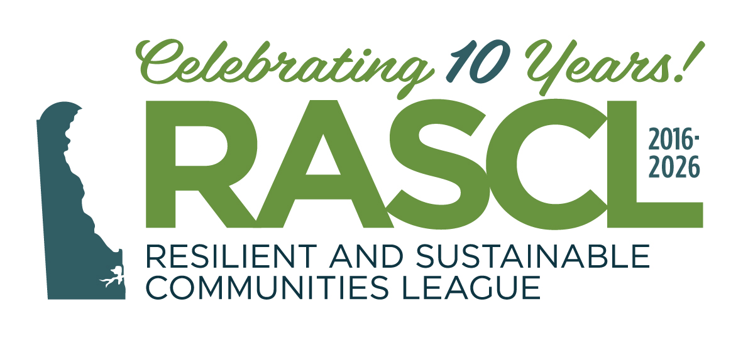
Let’s Connect
Jana Savini, Coastal Collaboration Manager, RASCL Coordinator
Partnership for the Delaware Estuary
jsavini@delawareestuary.org
www.derascl.org
Notes:
Thank you all so much for your time today. I’ll be around through the end of the day, so if you’d like to ask a question or talk more about any of this, please feel free to grab me at lunch or stop me in the hall.
After that, I’ll be heading back up to Wilmington—as we’re only two working days out from the RASCL Summit, I’m very much in post‑event wrap‑up mode.
So If we miss each other here, you can reach me at jsavini@delawareestuary.org, and if you want to learn more about RASCL, check out our website at www.derascl.org.
Thanks, everyone.

