Slide 1
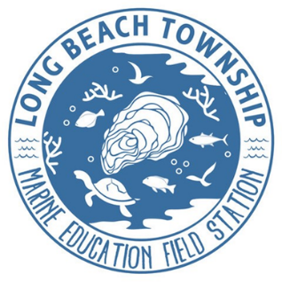

BUILDING RESILIENCE FOR MUNICIPALITIES
Long Beach Township, Ocean County
Angela C. Andersen, LBT Field Station director\ Resilience Program Manager

Slide 2
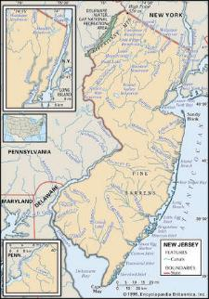
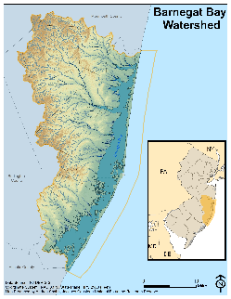
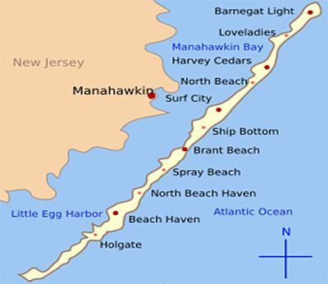
SENSE OF PLACE: Long Beach Township is the largest of the 6 towns on Long Beach Island in Ocean County:
12 non contiguous of the 18 mile island

Slide 3
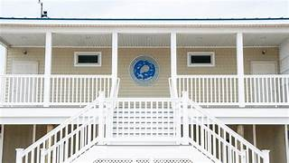

RESILIENCE HUB: utilizing open space trust acquired a vacant marina property. 2018. The township designed and built the facility.
2021 LBT opened the LBT Marine Education Field Station in Holgate
Creating an innovative resilience hub for public education & scientific research

Slide 4
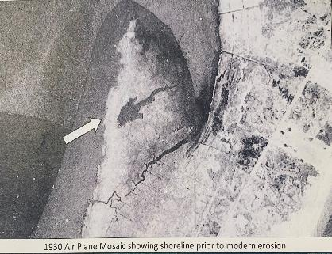
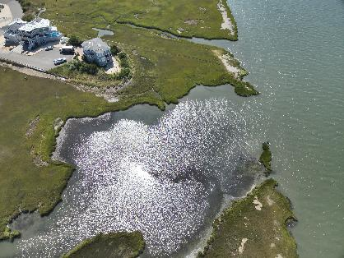
FUNDING SOURCES: Open Space Trust 2017
2018-LBT purchased the 22 acre saltmarsh naming it
Clam Cove Reserve
LBT in cost share (51%) w Ocean Co Natural Lands ( 49%)

Slide 5
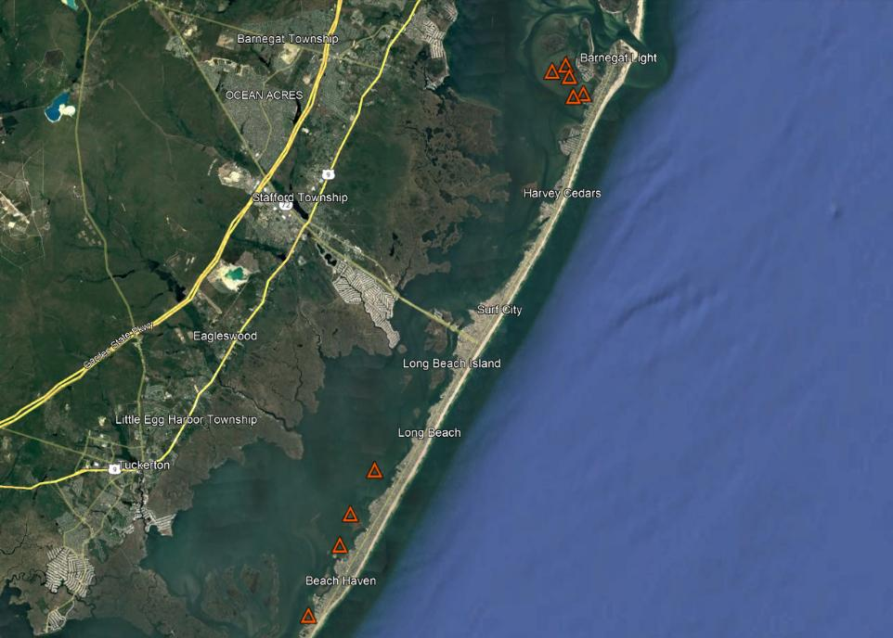
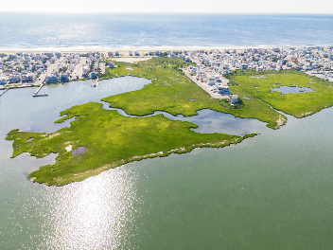

Clam Cove LBT
photo courtesy Krystal Aguilar 8/18/2022

Slide 6
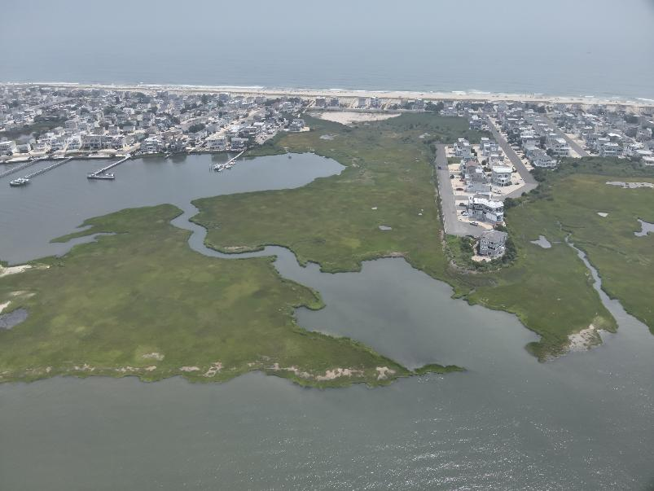
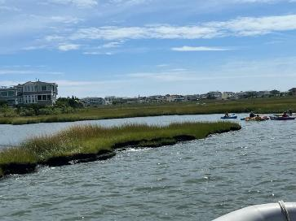
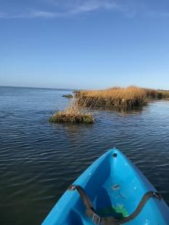
Time is not on our side. Needed to stabilize the most vulnerable part of the shoreline while we work through the federal grant process

Slide 7
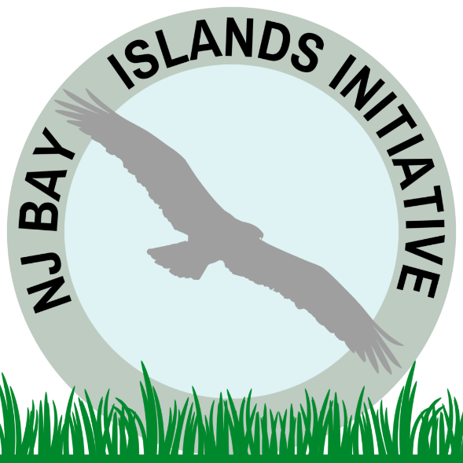
PARTNERSHIPS:
Njbayislands.org co-founded by LBT est. 2020
For the resilience of the natural habitats & developed communities of NJ bays.
A regional & coordinated approach to bay island restoration.
Goal to manage bay islands as a system

Slide 8
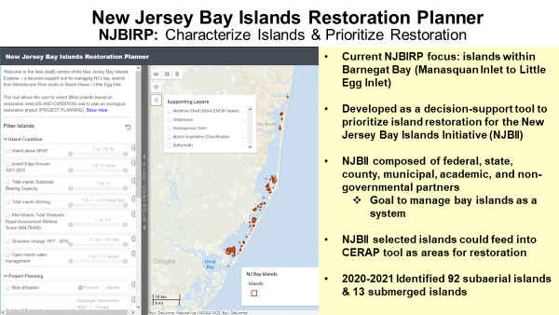

Slide 9
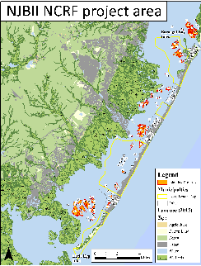

Project team formed & federal funding secured. Municipal-academia-NGO partnership
FEDERAL FUNDING:
2021 National Fish and Wildlife Foundation – National Coastal Resilience Fund Grant
Restoring Bay Islands for Community Resiliency – Long Beach Township NJ- for 5 islands of off Twp.
2024!! Funding for final design and permitting of top 2 islands.

Slide 10
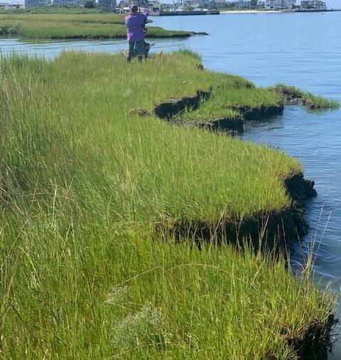
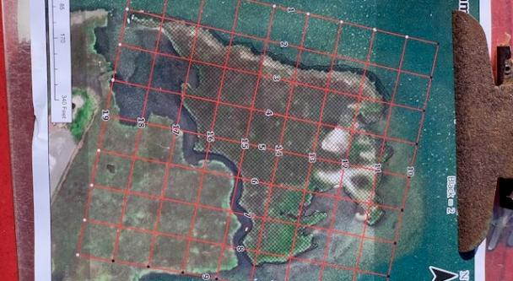
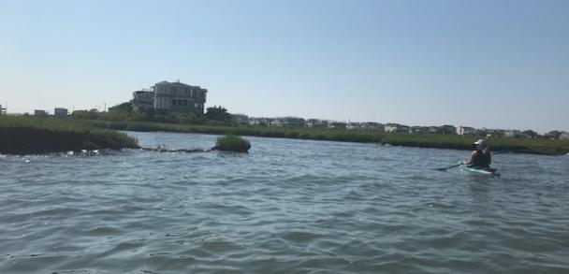
Notes:
Stockton Coastal Research Center field data collection and modeling

Slide 11
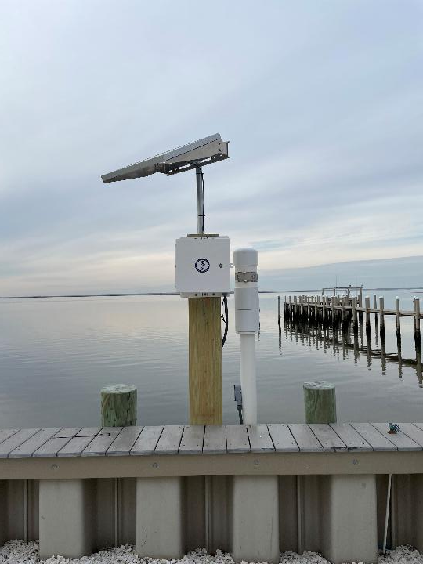
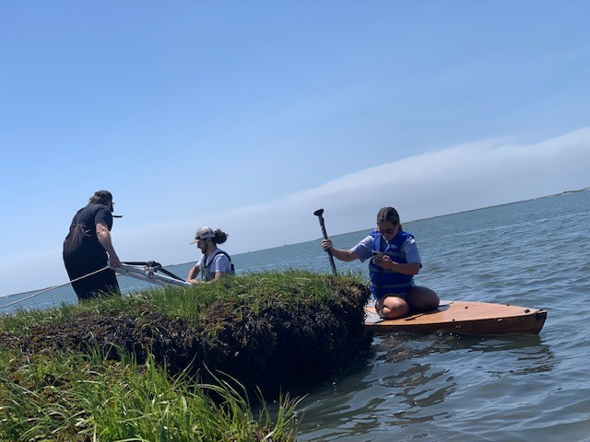
Notes:
Monmouth Urban Coast Institute – install tide gauge at the field station and monitoring the data.
University students working in the field at clam cove to test a new shallow water wave data collection unit.

Slide 12
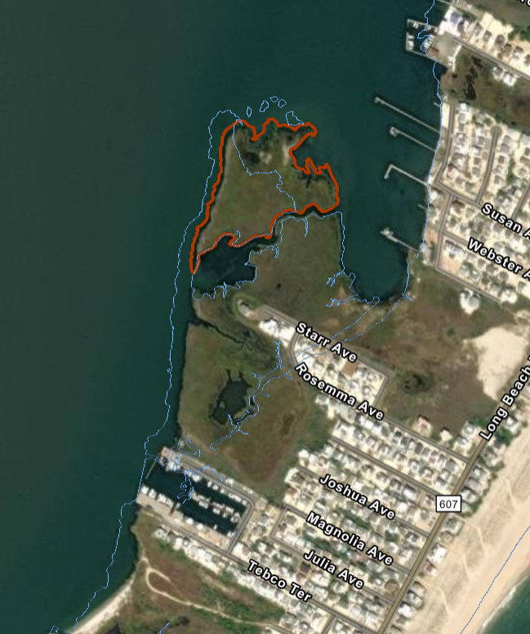
Mo
1977 Tideline
Sand Placement
S. Alterniflora Planting
Oyster/Shell Bag breakwaters
Notes:
Monmouth U preliminary design. Following the 1977 line.

Slide 13
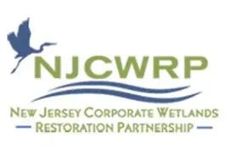
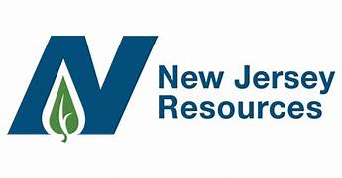
LOCAL FUNDING :
Secured private funding, obtained permits, ordered material, performed preconstruction site surveys.
& started construction.
NJR: Donation to Monmouth University- Urban Coast Institute -January
NJCWRP: Grant to Long Beach Township- June
Jan-June 2025- NJDEP permit GP #24 received, Tidelands License confirmed & ACOE NW#54 secured
October- field work underway and construction started
November- working around the weather and install continues

Slide 14
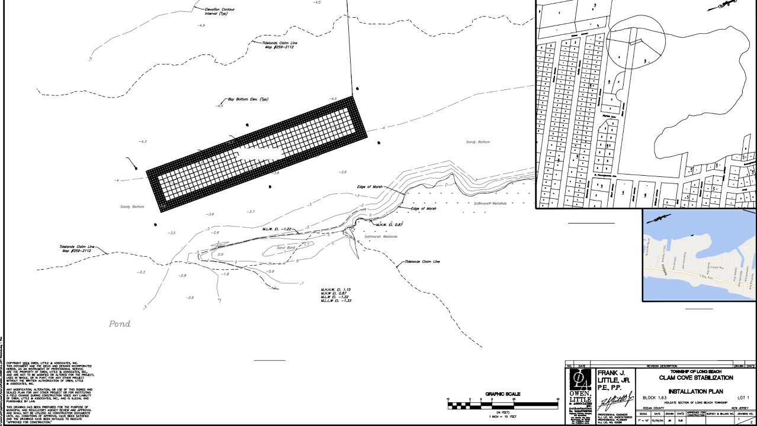

Slide 16
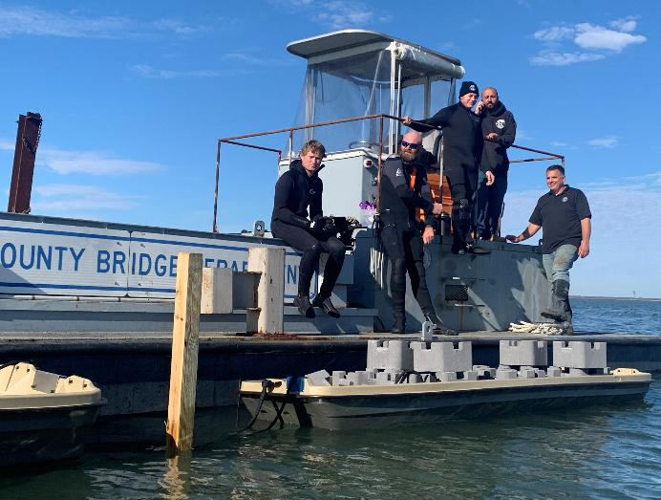
WORKFORCE DEVELOPMENT:
LBT DPW- understands that marsh islands are part of municipal infrastructure
Township acquired a retired hopper barge from Ocean County. It was a good partner contribution to arrange for the township to purchase it for $1

Slide 17
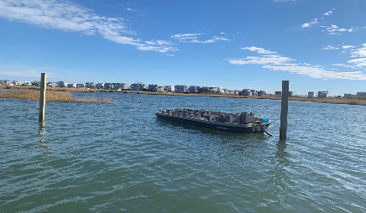
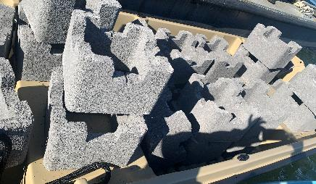
Oyster castles designed for:
- oyster spat retention
- creating reefs
- strengthening shorelines
We purchased 32 pallets for this project.

Slide 18
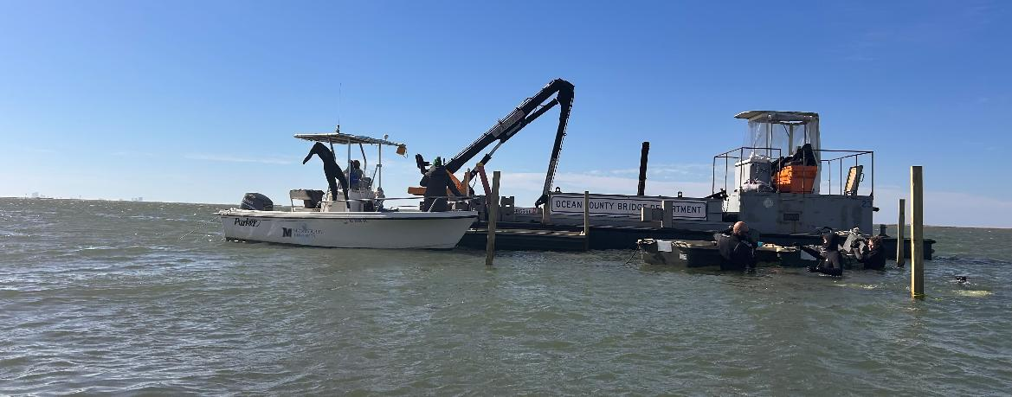

Slide 19
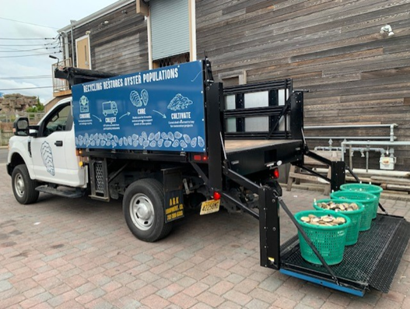
INNOVATION IN GOVERNANCE:
2017
LBT became first town in NJ to collect shell
2020-NJDEP ReX award for leadership
Still the only town to collect shell
The State program has expanded through Atlantic & Cape May & recently w/ sysco

Slide 20
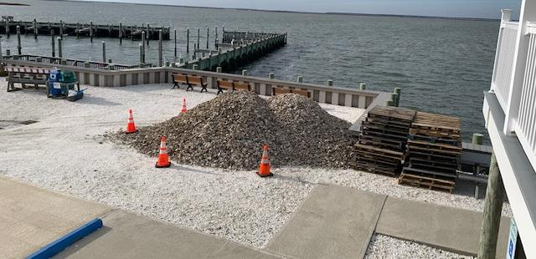
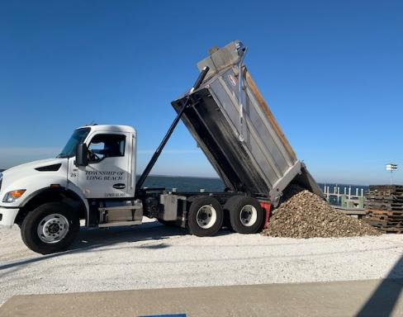
VOLUNTEERS:
2023 & 2024 shell used in this project
Cured shell is bagged up at LBTFS

Slide 21
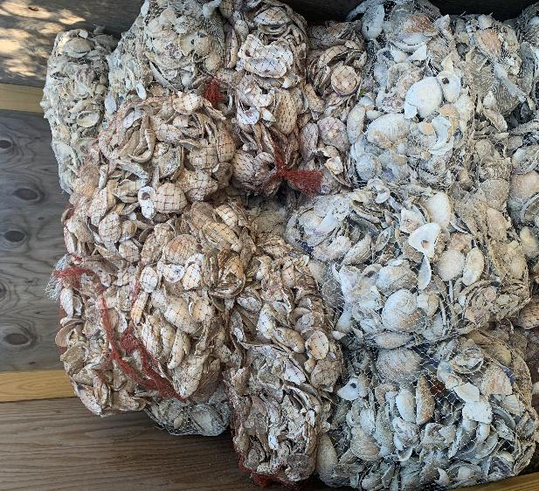
RESEARCH & DATA COLLECTION
5 types of bag material to research how to use less plastic in the design.
TRANSFERABILITY
The breakwater will stabilize the eroding shoreline & create reef habitat & inform the rest of the shoreline project & other bay islands.

Slide 22
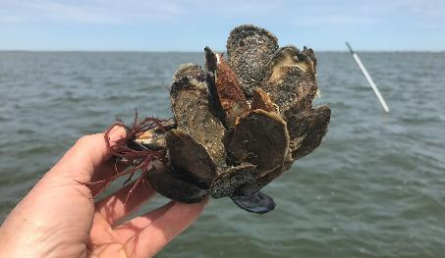
PROJECT TEAM:
Monmouth Urban Coast Institute, Stockton Coastal Research Center, LBT-DPW, Holgate Marina, and countless volunteers that got us here!
The Clam Cove team is designing a transferable model to utilize oyster reefs to stabilize & restore bay islands

Slide 23
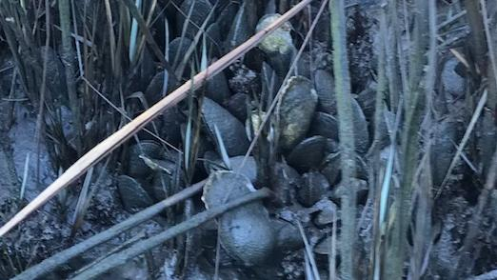
Notes:
Wild oysters on ribbed mussel in a healthy wetland edge

Slide 24

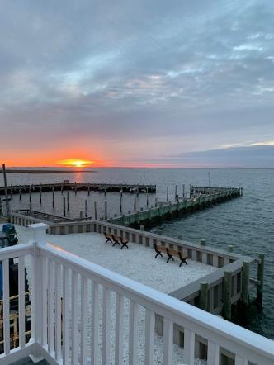
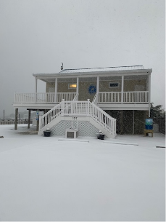
127 W. Osborn Ave, Holgate
www.lbtfieldstation.com
Angela C. Andersen
andersen@longbeachtownship.com
609-361-6641
@lbtfieldstation

