Slide 1
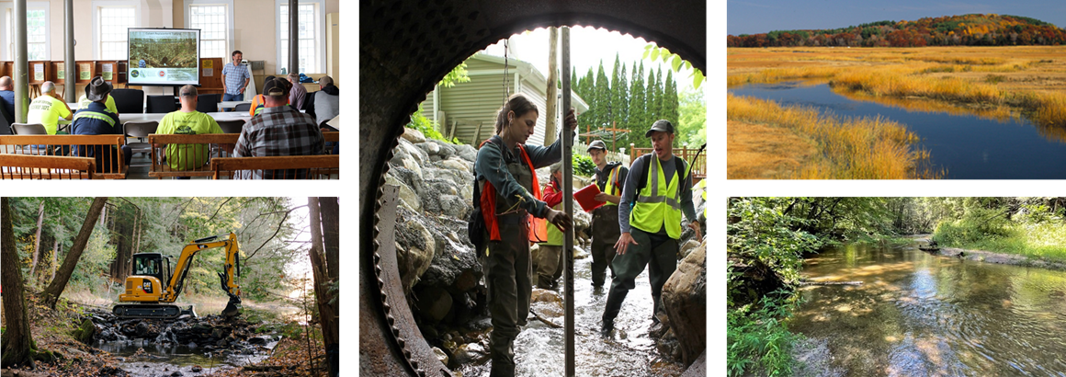
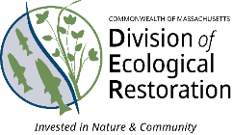
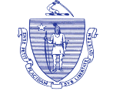
The Division of Ecological Restoration:
a state government approach to scaling river
and wetland restoration
Maura T. Healey
Governor
Kimberley Driscoll
Lieutenant Governor
Beth Lambert, Director
Notes:
My name is Beth Lambert. I’m the Director of the Massachusetts Division of Ecological Restoration, a state agency in Massachusetts. In 2009, EEA, the Commonwealth established DER to raise awareness, drive momentum, and build capacity for river and wetland restoration efforts.

Slide 2
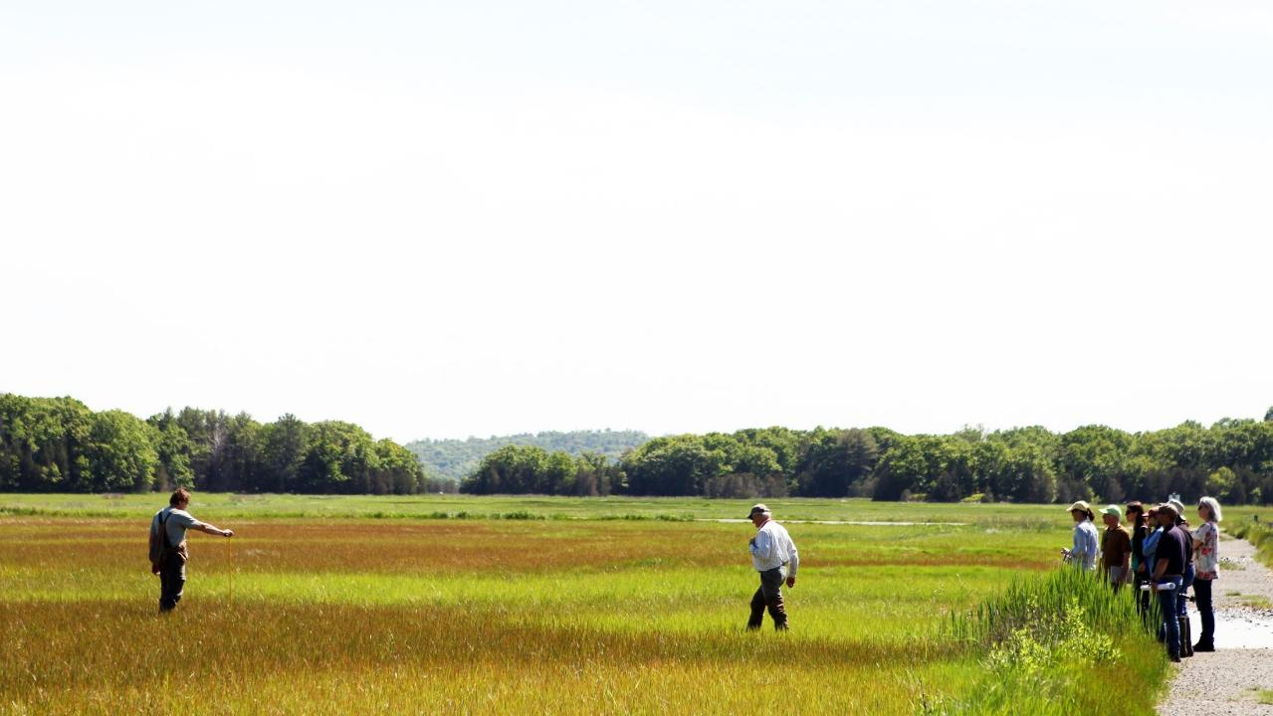
The MA Division of Ecological Restoration (est. 2009) restores and protects rivers, wetlands, and watersheds for the benefit of people and the environment
  30 staff
  Mission-driven
  Science-based
  Non regulatory
  Motivated by nature and partnerships
  User-friendly
  Build programs based on community need
Notes:
2400 acres of freshwater and coastal wetlands restored

Slide 3
Division of Ecological Restoration
Wetlands Restoration Program, Coastal Zone Mgmnt
1998-2009
Riverways Program, Dept. Fish & Game
1987-2009
2000s: Salt marsh led by small state Wetland Restoration Program (CZM).
2003-2005 Riverways Program (DFG) leads dam removal, culvert replacement projects
2005: Government and NGO task force on opportunities to advance restoration with prioritized recommendations
  Recommended creation of a non-regulatory unit to lead and support river and wetland restoration
2009: Leaders merge CZM’s Wetlands Program (3 FTEs) with DFG’s Riverways Program (10 FTEs) to create DER
Merge
Division of Ecological Restoration, Dept. Fish & Game
2009 -

Slide 4
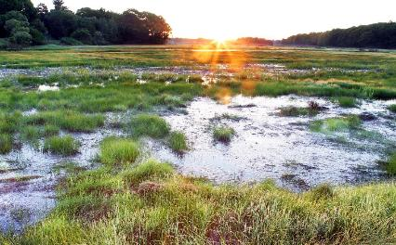
DER recently doubled in size
Growing need and demand for restoration assistance
Towns want to remove aging dams, upgrade culverts, restore marshes BUT
Limited municipal capacity to manage projects
DER fills the capacity gap
Salt marshes under threat
3000 dams & 25,000 culverts
Notes:
But! We have only addressed a small piece of the overall restoration need. Ecosystem stressors are widespread across the landscape in Massachusetts. For example, 3000 dams and 25,000 chop rivers and streams into tiny segments. Septic systems and nutrients threaten our salt marshes, already under stress from sea level rise. And, rising over all, is climate change. As we think about ramping up, and accelerating restoration, we need to fit the approach to the scale of the stressors. For Massachusetts, we need to make restoration part of doing business for every community and landowner.

Slide 5
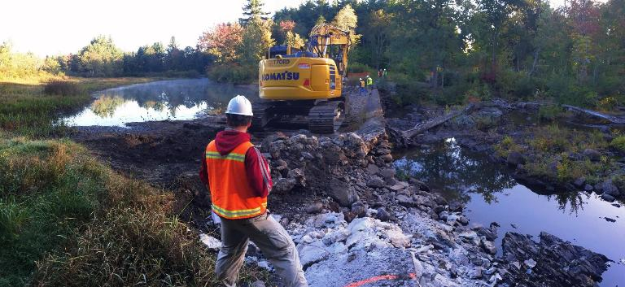
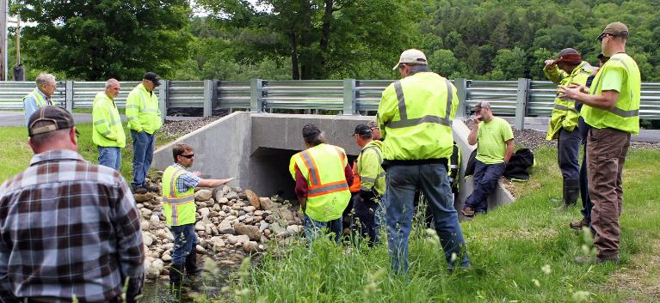
DER’s approach
Lead / manage river and wetland restoration projects
Help others build capacity to lead and support restoration
Share restoration knowledge
Notes:
Three things that our Division is doing, and then I’ll describe three others that are critical but outside our control.
Over the last seven years, in response to demands from communities, we’ve doubled our restoration project management. Staff who work in the trenches with cities and towns to remove aging dams, restore wetlands, and restore coastal wetalnds. 60 projects underway.
We’re going to share our restoration knowledge with those who need it to lead and support restoration. Translating into tools, products, SOPs, trainings, and other shareable products.

Slide 6
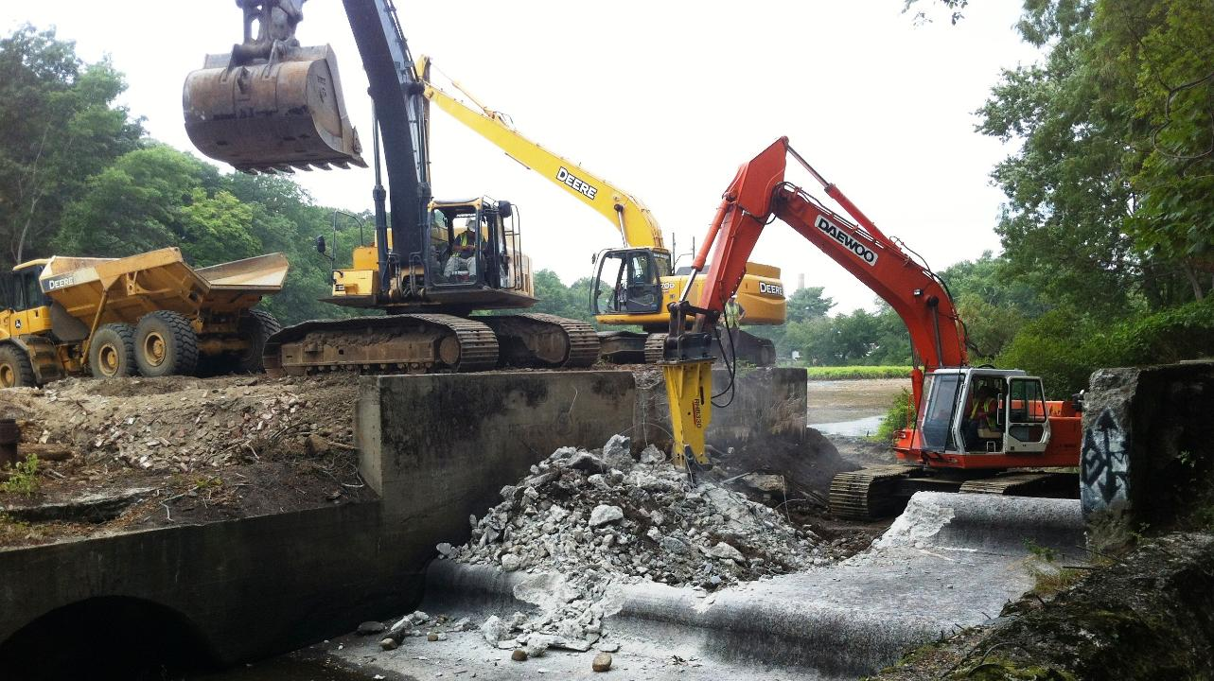
Remove obsolete dams
Hopewell Mills Dam Removal, 2012
Notes:
We have expertise in the following restoration practices:

Slide 7
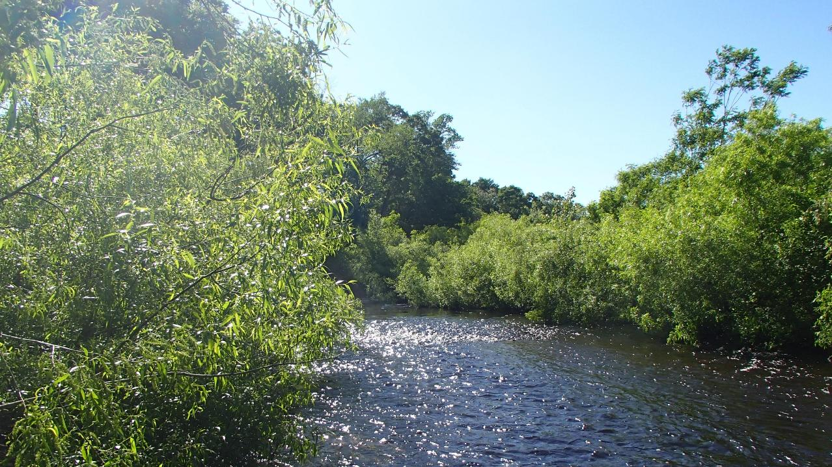
Hopewell Mills Dam Removal, Taunton, 2022

Slide 8
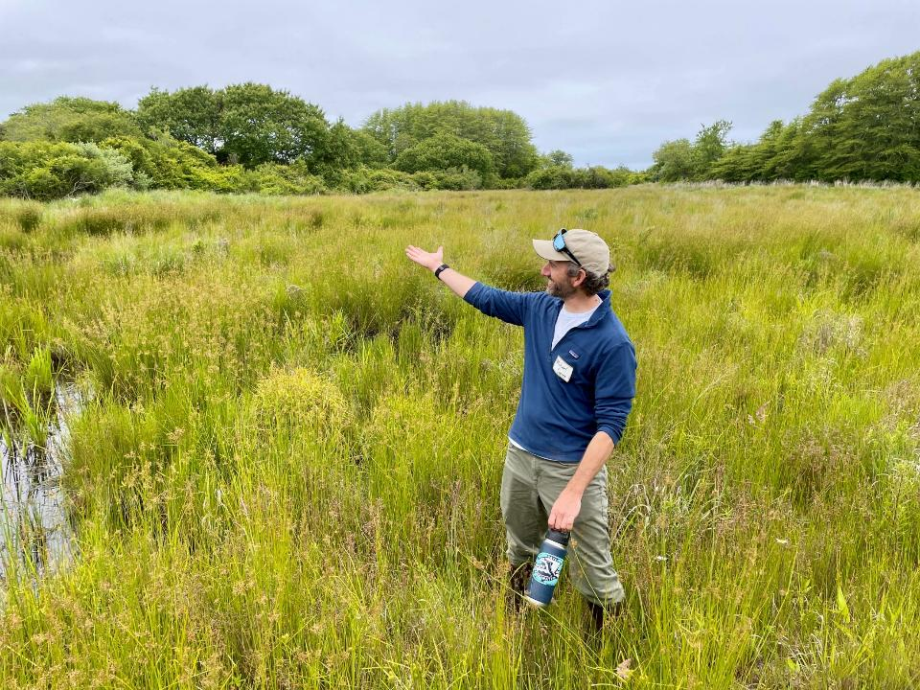
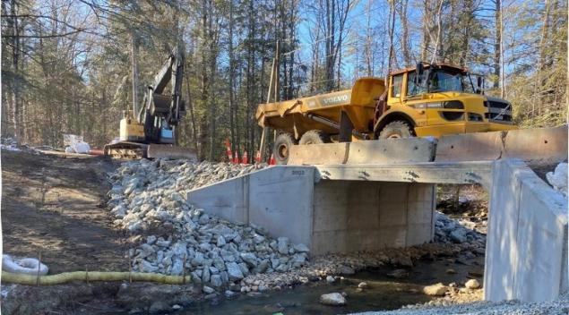
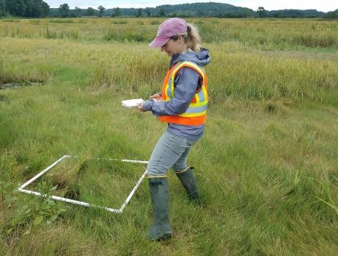
Rewild former cranberry farmland
Replace undersized culverts
Restore coastal salt marshes
Notes:
We are known for…

Slide 9
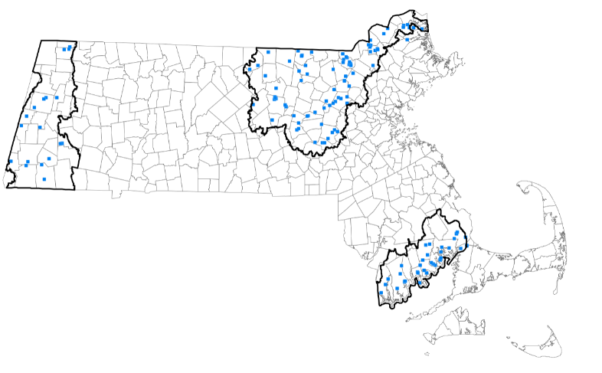
Build restoration capacity statewide
Establish regional restoration partnerships at watershed associations, RPAs
DER gives funding for planning / project management and technical support
Each partnership IDs priority projects and advances them
Expanding program this year
Restoration partnership regions and projects
Notes:
Scale up our regional restoration partnerships program. Through this program, we give sustained funding to watershed and other regional organizations, enabling them to lead and support restoration within their geographies. Model has been proven in the western US, and we’re tailoring it for Massachusetts. In just the few years it’s been in existence so far, this program has already developed a solid pipeline of high value river and wetland restoration projects led by watershed and other organizations. This is one of the best ways to scale up restoration in Massachusetts.
Outcomes:
In less than 5 years, the 3 Regional Restoration Partnerships have shown what’s possible:
Built regional coalitions – connecting municipalities, NGOs, and agencies across watersheds.
Established priorities & plans – identified stressors, set restoration goals, and created regional strategies centered around a shared restoration vision.
Created a pipeline of high-value projects – including dam removals, culvert replacements, wetland and salt marsh restoration.
Leveraged external funding – every $1 state investment has attracted ~$6 from other sources.
Accelerated measurable outcomes – restored habitat, improved stream and wetland function, and reduced flood risk.
Expanded community capacity & networks – more staff, stronger local knowledge, and broader collaboration.
If scaled up, the Partnerships could become a cornerstone mechanism for accelerating restoration statewide.
UPDATED 9/15/2025

Slide 10
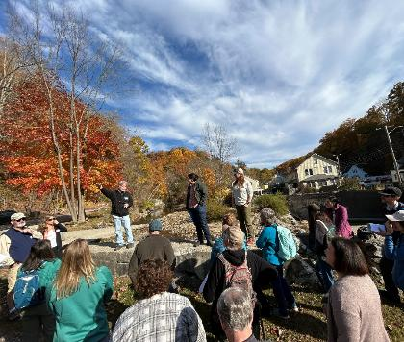
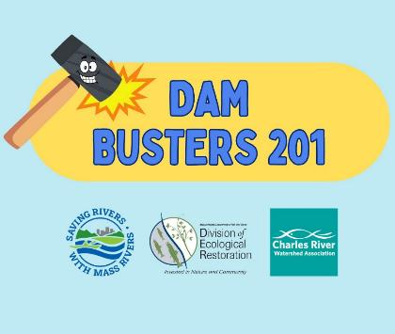
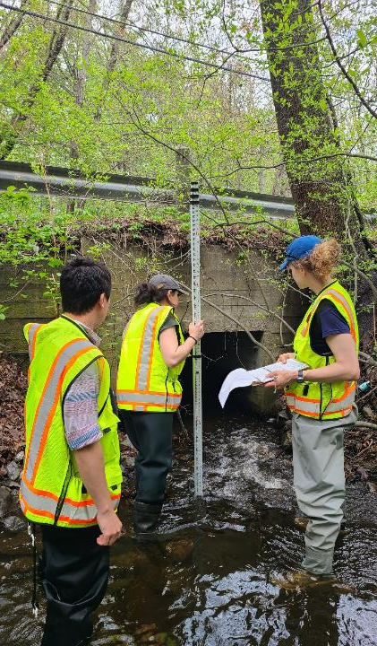
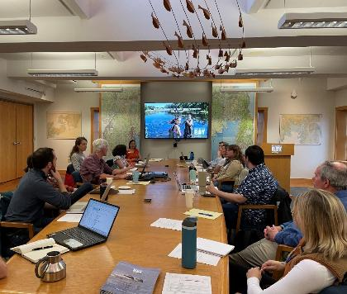
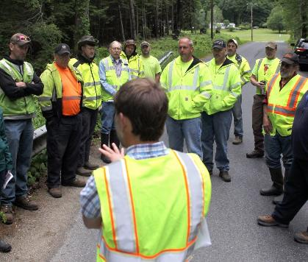
Share restoration knowledge
Notes:
We also have a deliberate focus on building the capacity of others to lead and support restoration, which is how we’re going to achieve restoration at scale. What that looks like is trainings,

Slide 11
2025

Slide 12
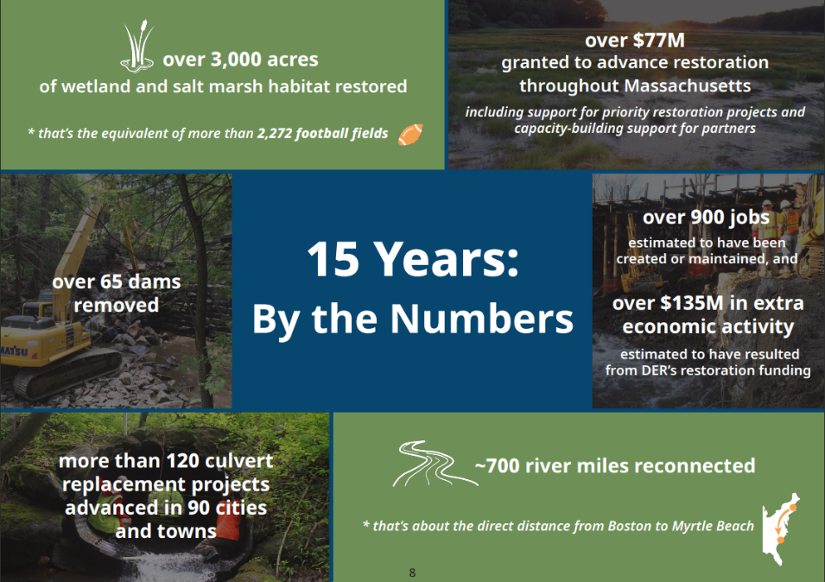
Notes:
The state created the Division of Ecological Restoration around 15 years ago to bring momentum and attention to river and wetland restoration. We are non-regulatory, meaning that all of our restoration work takes place through voluntary partnerships. Over the last 15+ years, our collective work, together with our partners, has delivered 3000 acres restored; 65 dams removed; 900 jobs created and maintained, and many other restoration metrics.
But these successes represent only a fraction of the work still needed—a drop in the bucket compared to the scale of restoration demand across Massachusetts.

Slide 13
DER’s funding
Capital Budget
Engineering, permitting, some construction, monitoring, grants to partners for project costs
Funding comes from Env. Bond Bill
~ $8 million / year
One-time Funds
American Rescue Plan Act funds:
  $35 million in 2022
  $6 million in 2023
Operational Budget
Determined by the legislature annually via budget process
  Salaries (30 FTEs), travel, equipment, training, Partnerships grant program, $5 million
  Culvert TA $2.8 million
Grants
DER staff and partners apply for many federal and other grants to cover the full cost of restoration projects.
Leverage rate is ~1:5 – 1:12 depending on the year.

Slide 14
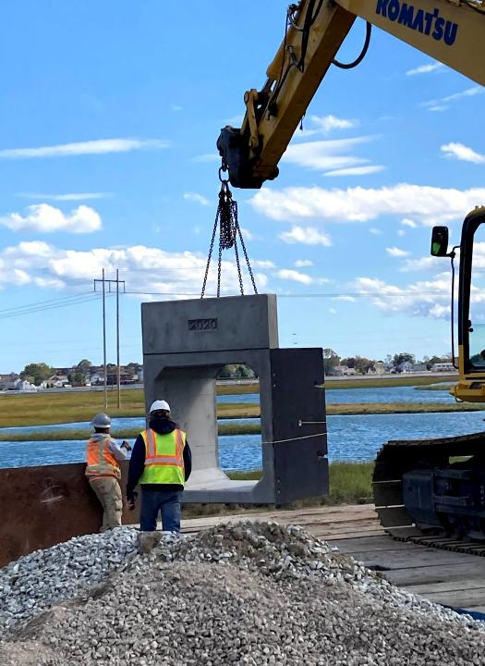
Practical benefits to the Commonwealth from DER
Hands-on help for small towns with limited capacity
Larger towns get training / guidance / nudges in the right direction
DER brings federal $$ to communities that don’t have capacity to write grants
Restoration is integrated into state strategies, plans, policies
Restoration is seen as a good business decision for communities, not a niche activity

Slide 15
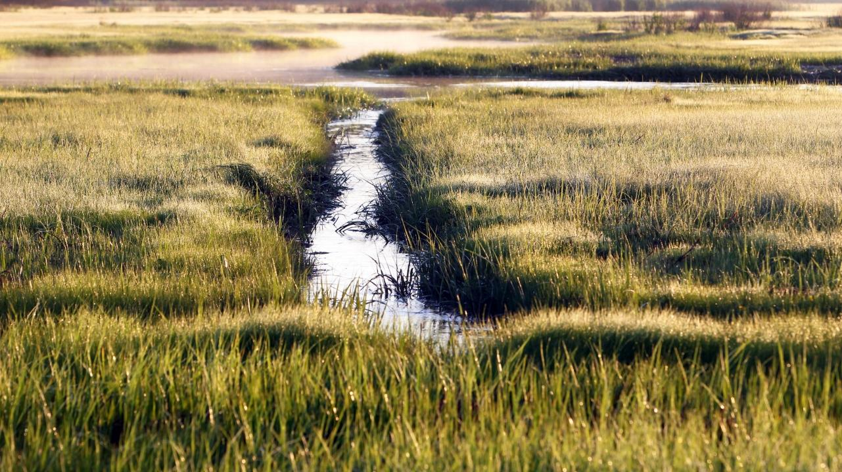
Thank you!
Beth.Lambert@mass.gov
Notes:
Close with a few bigger picture thoughts.
First, Massachusetts is a leader nationally in this arena – this model that we’ve collectively developed. We can serve as an example for other states to follow.
Second, the benefits of restoration to people go beyond public safety, habitat, and access to nature. There’s a hope and optimism that comes with the restoration experience, the experience of working together with others towards a common goal; to seeing a vision made real; the gut level knowledge that action makes a difference. We are at a point in society where we need these hopeful experiences. We need the skills of taking action and working towards common goals; to believe that our actions bear fruit.
We have an exciting vision for the future. It relies on each of us in this room and outside doing what we can to build capacity across all levels of government and across organizations and landowners. I invite you to join us in refining, sharing, and making this vision real. Thank you for your partnership over the last 10 years. I look forward to working together in the years ahead.

Slide 16
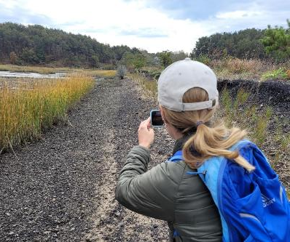
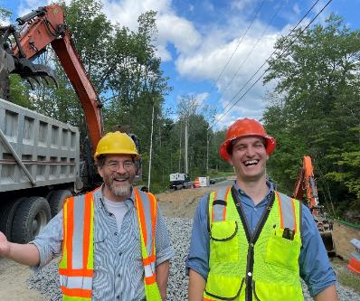
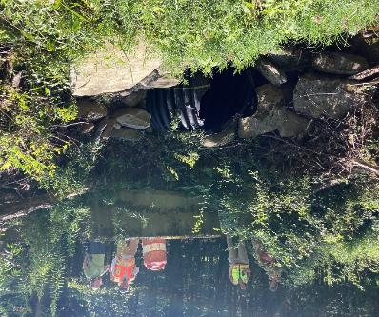
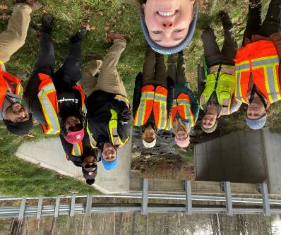
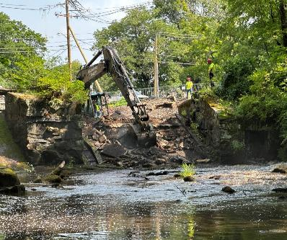
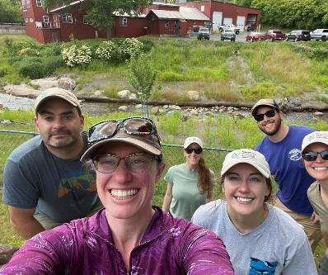

Slide 17
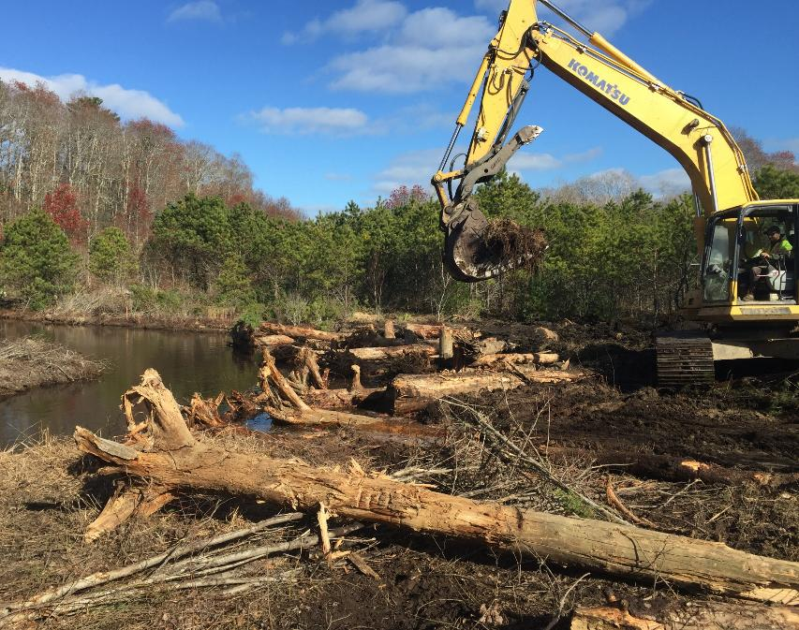
Today’s Presentation
Background on the MA Division of Ecological Restoration (DER)
What DER does
Lessons learned from building a statewide river and wetland restoration program
Vision for the future

Slide 18
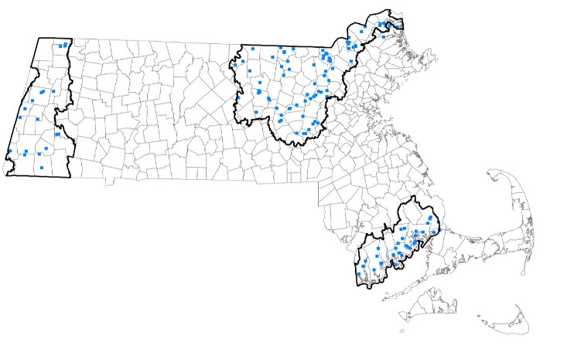
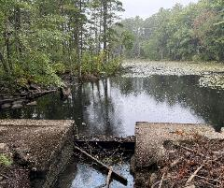
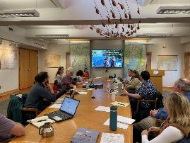
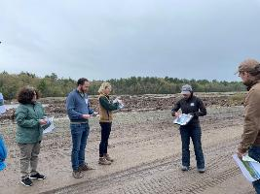
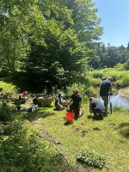
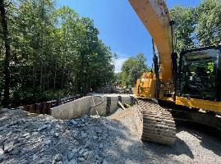
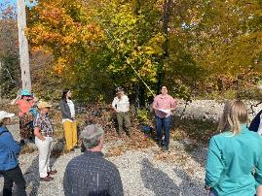
3. Build restoration capacity statewide
Establish additional regional restoration hubs at watershed orgs, other regional orgs.
Combine incentive funding with technical assistance
Based on needs assessment, build new programs for restoration knowledge-sharing, training
If scaled up, Partnerships Program could be a major mechanism for ramping up restoration across the state.
Notes:
Scale up our regional restoration partnerships program. Through this program, we give sustained funding to watershed and other regional organizations, enabling them to lead and support restoration within their geographies. Model has been proven in the western US, and we’re tailoring it for Massachusetts. In just the few years it’s been in existence so far, this program has already developed a solid pipeline of high value river and wetland restoration projects led by watershed and other organizations. This is one of the best ways to scale up restoration in Massachusetts.
Outcomes:
In less than 5 years, the 3 Regional Restoration Partnerships have shown what’s possible:
Built regional coalitions – connecting municipalities, NGOs, and agencies across watersheds.
Established priorities & plans – identified stressors, set restoration goals, and created regional strategies centered around a shared restoration vision.
Created a pipeline of high-value projects – including dam removals, culvert replacements, wetland and salt marsh restoration.
Leveraged external funding – every $1 state investment has attracted ~$6 from other sources.
Accelerated measurable outcomes – restored habitat, improved stream and wetland function, and reduced flood risk.
Expanded community capacity & networks – more staff, stronger local knowledge, and broader collaboration.
If scaled up, the Partnerships could become a cornerstone mechanism for accelerating restoration statewide.
UPDATED 9/15/2025

Slide 19
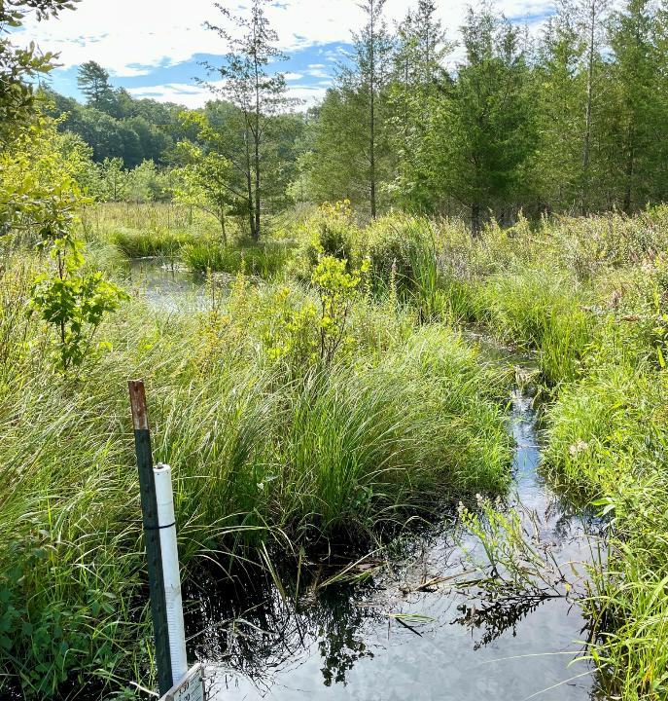
Scaling up cont’d
4. Reduce cost and accelerate speed of regulatory process
5. Codify the Division of Ecological Restoration in state statute
6. Establish dedicated funding source for aquatic habitat restoration
Notes:
Three other steps that are necessary to create enabling conditions for scaling up river and wetland restoration. These are beyond the purview of my agency, but we champion and support those who are leading these.
Reduce the cost and accelerate speed of regulatory process – to make restoration the path of least resistance, rather than path of more resistance
Codify our Division in state law, and memorialize the state’s commitment to ecological restoration. This makes the state’s approach permanent.
Lastly, establish a dedicated revenue stream for habitat restoration. Restoration projects take many years to plan and construct. Yet, funding for restoration is depends on annual decisions by the legislature and the state administration. We are fortunate to have support currently, but that has not always been the case. A dedicated funding stream, whether by diverting a portion of a state tax, diverting a fee, or other means, is critical for expanding restoration.

Slide 20
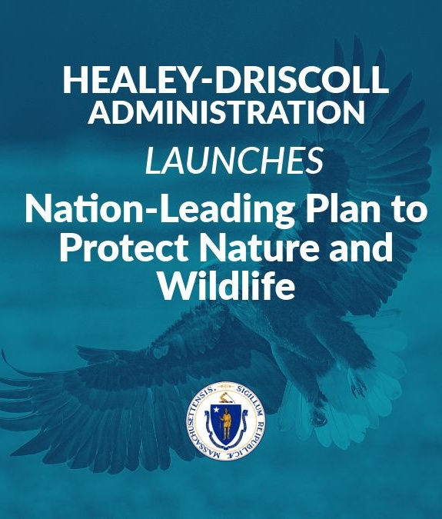
Notes:
Some of these last three items are underway. Our Governor, Governor Maura Healey recently released biodiversity goals for the Commonwealth, along with an ambitious plan for achieving the goals. That plan includes recommendations for regulatory streamlining and calls for a dedicated funding source.

