Slide 1
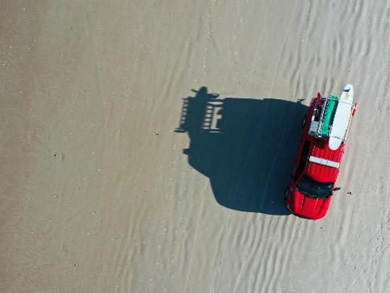
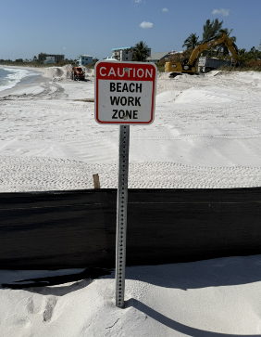
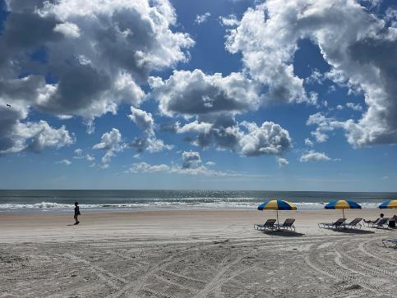

2026 New Jersey Coastal and Climate Resilience Conference
^{March 9, 2026| 12:00 PM}
^{Where Planning Meets Action:}
Strategies for Smarter Coastal Resilience
^{Wendy Laurent, P.E., WEDG}

Slide 2
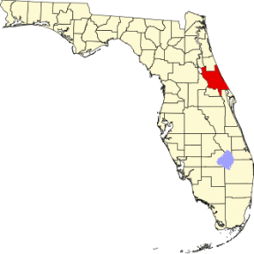
Purpose and Presentation Outline
OUTLINE
Fort Pierce Beach– permit flexibility supports rapid action
Volusia County Beaches– countywide planning + foundational community support
Martin County SPP– template modifications for SLR adaptation
Healthy, well-maintained beaches are essential to resilient coastal communities
  Benefits of beaches:
    Reduce storm-related forces, minimizing damage to landward infrastructure
    Dynamic features that allow for recovery following storms
    Naturally adapt to the impacts of SLR
    Also support recreation, enhance ecological value, and contribute to local economies
Lessons Learned from three case studies
  Demonstrate how proactive planning and strategic decision-making can strengthen beach management practices
2
1
3

Slide 3
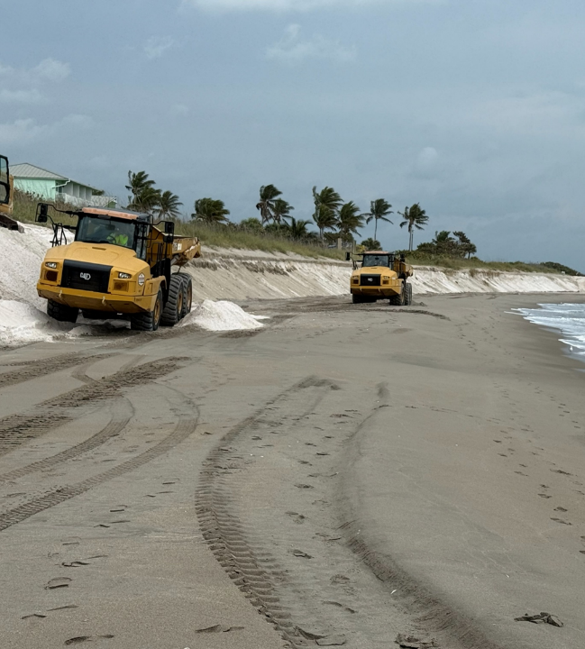
Fort Pierce Beach
PERMIT FLEXIBILITY SUPPORTS RAPID ACTION

Slide 4
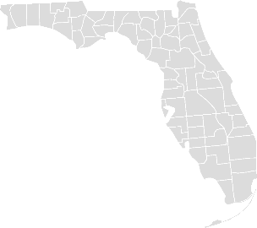

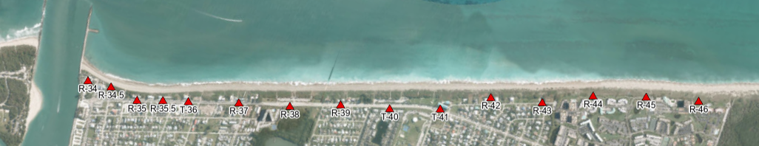
Fort Pierce Project Background
Location– Fort Pierce Beach, St. Lucie County, FL
Erosion hot spot has led to numerous studies and changes to the federal project
  First constructed in 1971, 5-year nourishment interval
  2006 Limited Reevaluation Report → 2-year nourishment interval
  2026? General Reevaluation Report/Section 203 Study → erosion control structures
Project Area, ~1.4 miles
Monitoring Area, ~1 mile

Slide 5
Fort Pierce Project Background
NOURISHMENT STATS
Federal dredging events
6,700,000 cy
Year | Nourishment Type
2018 | Dredge (Federal)
2020 | Truck Haul (County)
2021 | Dredge (Federal)
2023 | Dredge (Federal)
2025 | Truck Haul (County)
2026 | Dredge (Federal)
since initial construction
7,600,000 cy
Supplemental County events
900,000 cy
= ~140,000 cy per year
= ~240,000 cy per year
Project Area, ~1.4 miles
Monitoring Area, ~1 mile

Slide 6
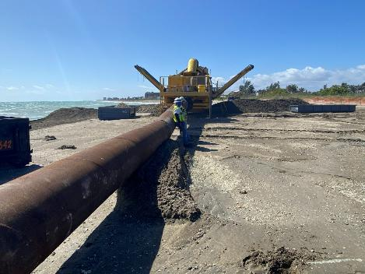
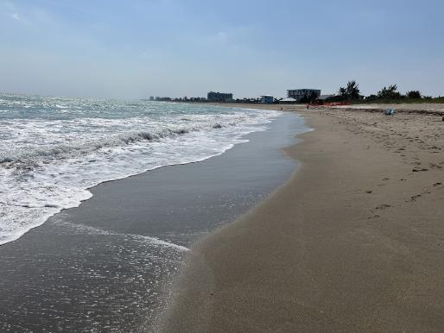
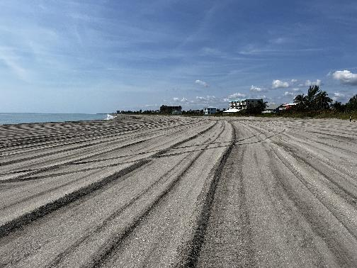
2023 Federal Nourishment
Fort Pierce Beach During Construction 2023
March – May 2023
Placed ~490,000 cy across ~1.4 miles
Fort Pierce Beach Pre-Construction Condition 2023
Fort Pierce Beach Post-Construction Condition 2023

Slide 7
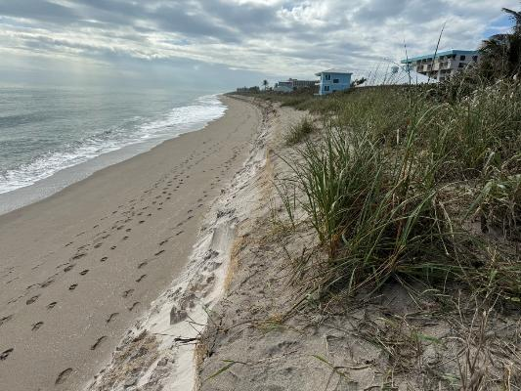
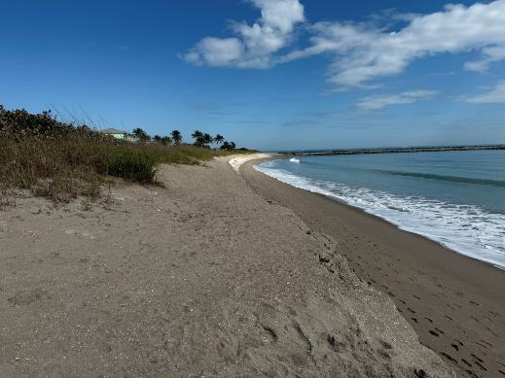
2025 Federal Nourishment
Planned 2025 USACE nourishment
  First solicitation (October 2024)– no bids received
  Second solicitation (January 2025)– bids 2x government estimate
Project postponed 1 year
Erosion too close for comfort going into hurricane season
Fort Pierce Beach February 2025 Conditions

Slide 8
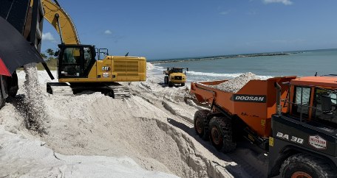
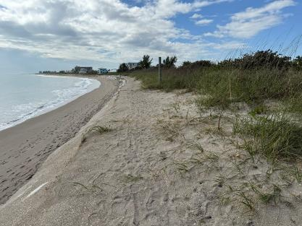
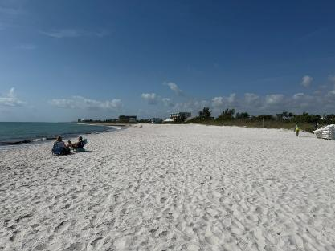
2025 Emergency Truck Haul
Pivot from dredging project to emergency truck haul project before the summer season
  Contractor mobilized within 1 month after postponed project
  March – April 2025; placement of ~95,000 cy in the erosion hot spot
Fort Pierce Beach Construction 2025
Fort Pierce Beach Pre-Construction Condition 2025
Fort Pierce Beach Post-Construction Condition 2025

Slide 9
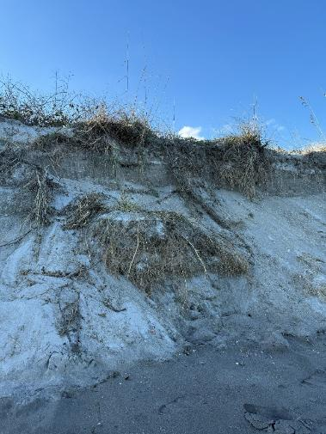
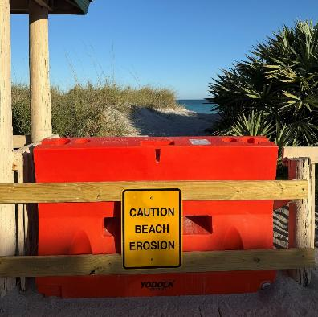
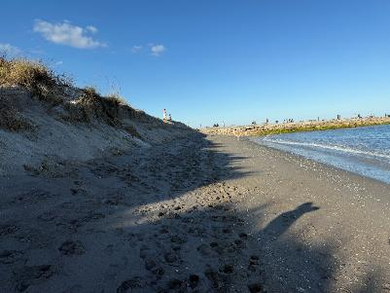
2026 Federal Nourishment
USACE held Industry Day– Consolidate projects? Bid all separately?
  Bids received! Anticipated mobilization late March 2026 (not soon enough…); planned placement of ~400,000 cy across ~ 1 mile
Fort Pierce Beach January 2026 Condition
Fort Pierce Beach Closure Due to Erosion
Fort Pierce Beach January 2026 Condition
Notes:
No hurricanes in 2025 but beach still eroded significantly due to nor’easters

Slide 10
Lessons Learned & Proactive Project Management
BUILD FLEXIBILITY INTO PERMITS
EMERGENCY SAND PLACEMENT CONTRACTS
PLAN AHEAD

Slide 11
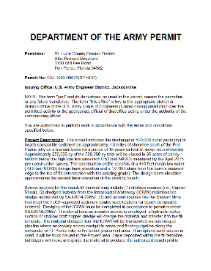
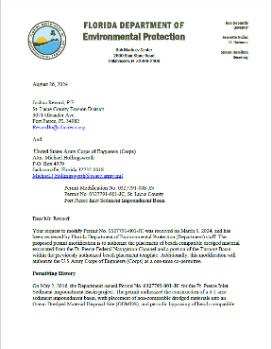
Lessons Learned & Proactive Project Management
BUILD FLEXIBILITY INTO PERMITS
Sand sources
  Borrow area
  Upland sand mine
  Channel/AIWW/Fort Pierce Harbor
  Sand Trap
Placement methods
  Dredge
  Truck Haul
EMERGENCY SAND PLACEMENT CONTRACTS
PLAN AHEAD

Slide 12
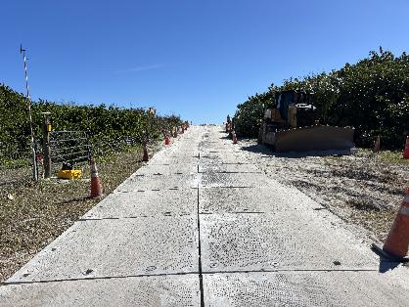
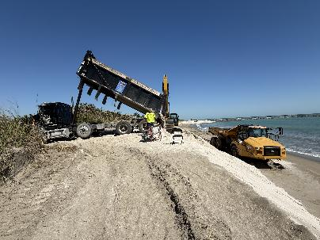
Lessons Learned & Proactive Project Management
BUILD FLEXIBILITY INTO PERMITS
EMERGENCY SAND PLACEMENT CONTRACTS
Expedite contracting
Contractor ready to mobilize *almost* immediately
PLAN AHEAD
Contractor Mobilization One Month After Postponed Federal Project
Permits, environmental timelines
Industry availability
  Host industry days
    Projects in the same region
    Projects with similar means and methods

Slide 13
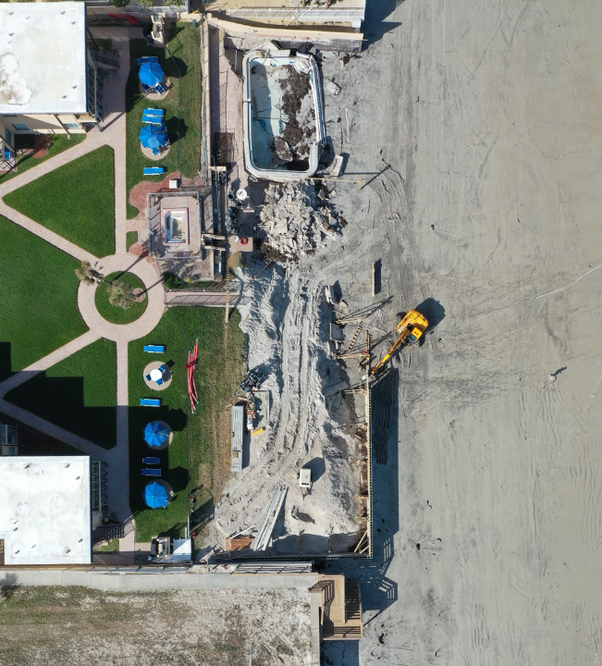
Volusia County Beaches
COUNTYWIDE PLANNING + FOUNDATIONAL COMMUNITY SUPPORT

Slide 14
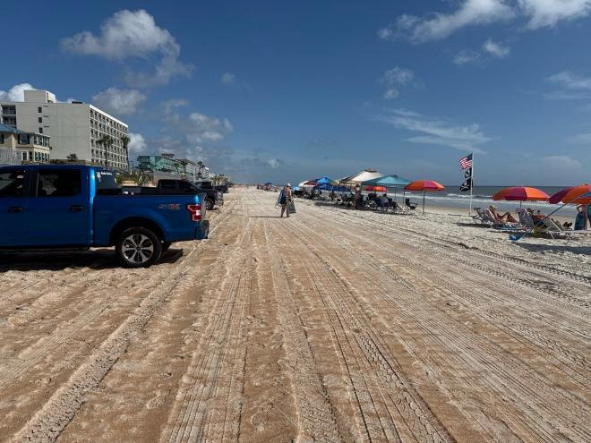
Volusia County Beaches
47 total miles of beach with 15 miles designated for beach driving and 27+ miles classified as critically eroded
Key destinations include Daytona Beach and New Smyrna Beach
Annual beach tourism generates $4.3 billion in regional economic impact
Severely impacted by Hurricanes Ian and Nicole (2022)
  Erosion of 6.4 Mcy (-34 cy/ft)
  Sand starved environment
Limited active beach management

Slide 15
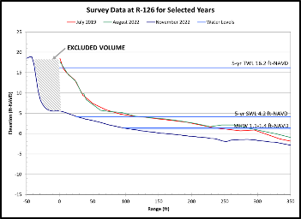
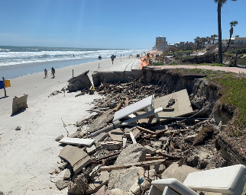
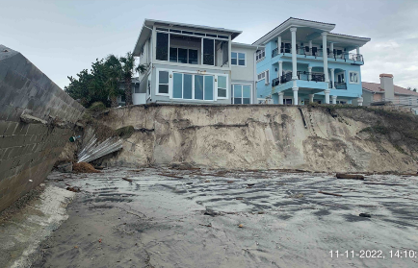
Volusia County Beaches
47 total miles of beach with 15 miles designated for beach driving and 27+ miles classified as critically eroded
Key destinations include Daytona Beach and New Smyrna Beach
Annual beach tourism generates $4.3 billion in regional economic impact
Severely impacted by Hurricanes Ian and Nicole (2022)
  Erosion of 6.4 Mcy (-34 cy/ft)
  Sand starved environment
Limited active beach management

Slide 16
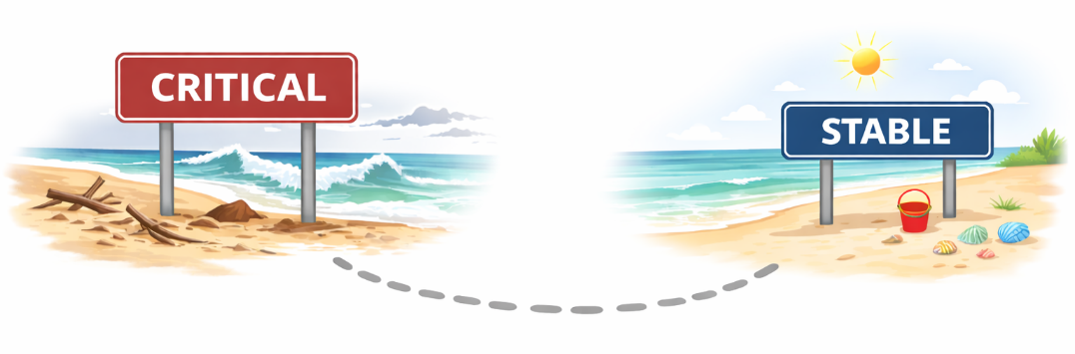
Path to Stability

Slide 17
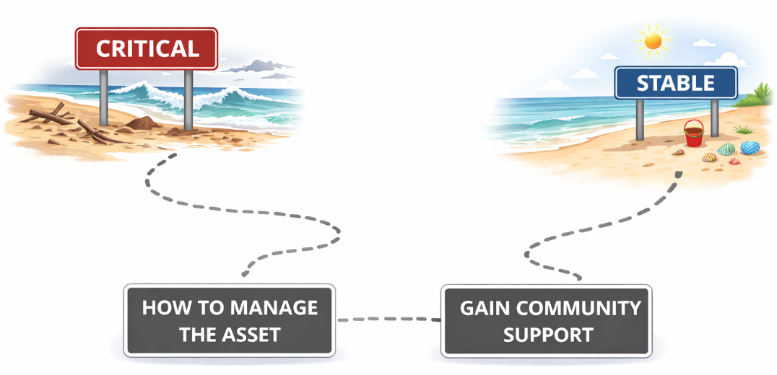
Path to Stability

Slide 18

Path to Stability
WHO
WHAT
WHERE
WHEN
WHY
ALTERNATIVES ANALYSIS
RISK ASSESSMENT
OUTREACH & ENGAGEMENT

Slide 19
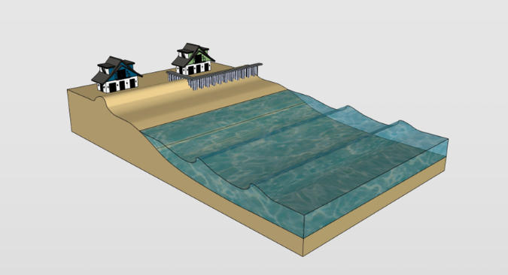
WHERE→ Risk Assessment – Methodology
vulnerability parameters → community risk index
1
Shoreline Encroachment
the horizontal distance (or “buffer”) between the MHW shoreline position and infrastructure
…
2
Infrastructure exposure
or the “elevation buffer”; Percentage of parcels where infrastructure is within or below 1 ft of the USACE SACS 1% AEP SWEL
2
1
3
Historical Erosion Rate
the average shoreline change rate since 2016 calculated via linear regression
…
Other Factors
armoring presence and exposure; SBEACH storm response; community demographics; etc.

Slide 20
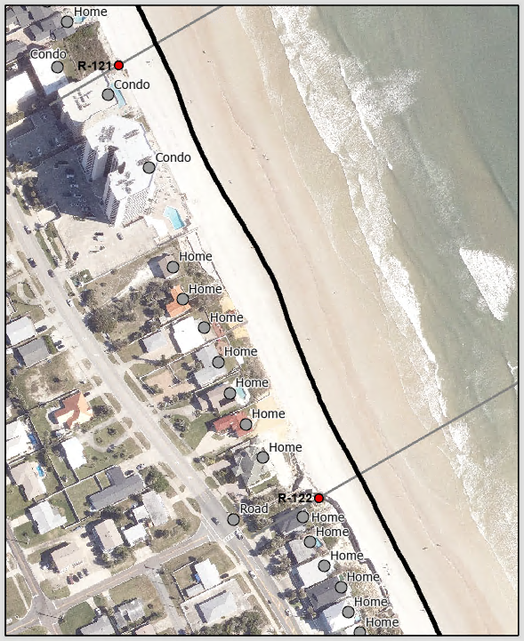
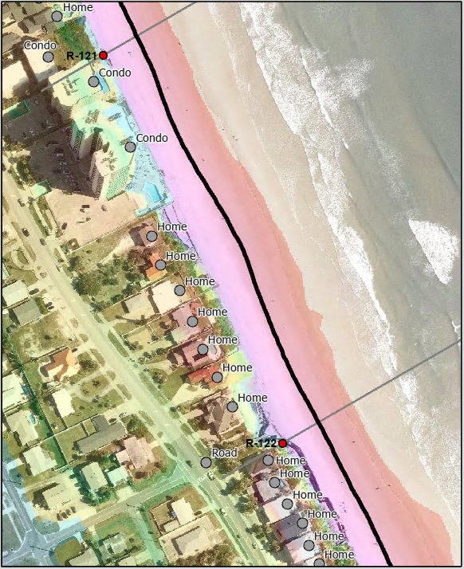
Geospatial Analysis
Parcel-by-parcel→ community average
  Categorized and marked upland infrastructure for each parcel
    Non-essential, accessory components of a property not included
    Coastal armoring features
Calculated the elevation at each infrastructure/armoring point using LiDAR data
  Distance between significant feature- infrastructure, armoring, MHW
Structure to MHW: 150 ft
Structure Elevation: + 23 ft-NAVD88
MHW

Slide 21

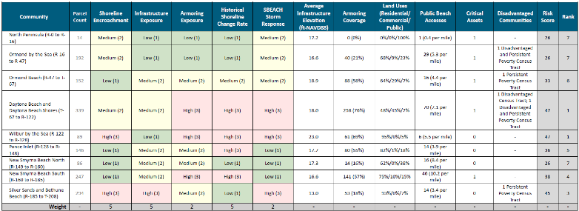
Risk Assessment – Results
POINTS
Quantified risk utilizing a high/medium/low scoring system
  Bins based on results
  Each community received a score and rank
  Easily comprehended by the public
Included additional information for decision making
Allows for prioritization of projects across communities
=
risk
points

Slide 22
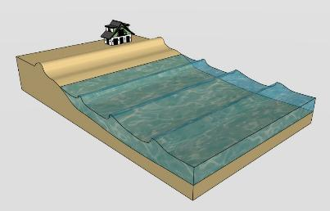
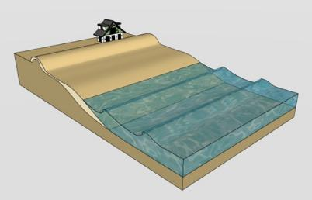
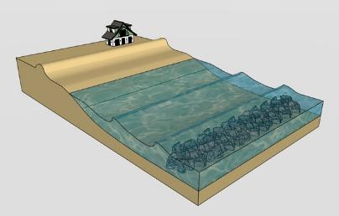
WHAT→ Shoreline Alternatives Analysis
Investigate beach management alternatives and their applicability to the County’s shoreline reaches
Alternatives include
  No Action
  Structural Relocation
  Flood Proofing and Structural Elevation
  Seawalls
  Revetments
  Beach Nourishment
  Groins
  Nearshore Sand Placement
  Breakwaters
  Nearshore Artificial Reefs
No ACTION
Beach Nourishment
BREAKWATERS

Slide 23






Shoreline Alternatives Analysis – Methodology
1
COMPILE BACKGROUND INFORMATION
function, benefits and drawbacks, risk and uncertainties, social considerations, large-scale feasibility, $$$
2
DEFINE OBJECTIVES
Reduce coastal storm damages to structures, critical infrastructure, and cultural resources
Reduce risk of natural resource loss
Reduce risk to life safety
Avoid impact to recreation
Minimize impacts to threatened and endangered species and their habitats
Comply with federal, state, and local policies and regulations
3
RANK OBJECTIVES
fully meets objective
partially meets objective
does not meet objective
DOWN SELECT ALTERNATIVES → APPLY JUDGMENT → RECOMMENDATIONS
Taylor Engineering | 23

Slide 24
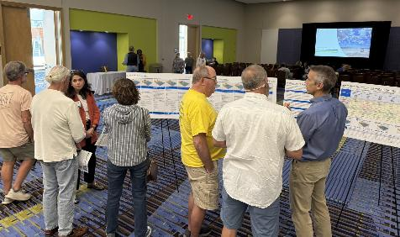
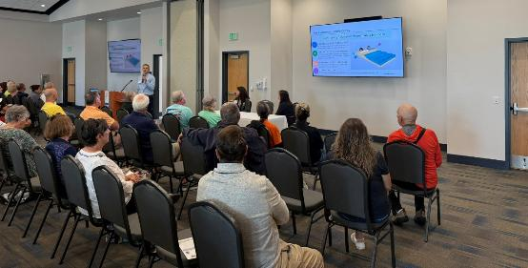
Outreach and Engagement
Two series of meetings– 3 hours/evenings/locations
  Brief presentations to introduce topics followed by poster sessions
  Meeting 1 study kickoff- introduced the study and reviewed current beach conditions
  Meeting 2 results & preliminary recommendations- shared risk assessment findings; discussed shoreline management alternatives; presented top ranked alternatives
Two public surveys
  Beach usage and quality– over 12,000 responses!
  Future management of beaches

Slide 25

Volusia’s Path Toward Stability
Current Management Actions
Risk
Feasibility Study
Management Actions
Shoreline Alternatives
Analysis
Community Feedback

Slide 26
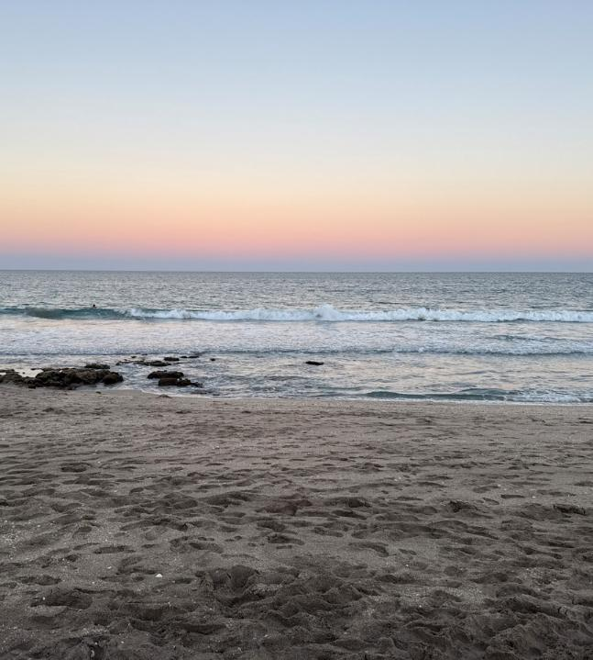
Martin County SPP
TEMPLATE MODIFICATIONS FOR SLR ADAPTATION

Slide 27
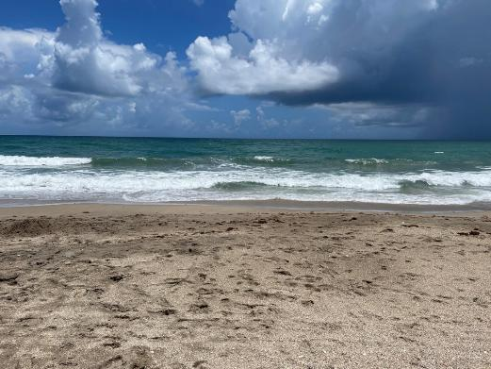
Martin County Shore Protection Project (SPP)
Northern-most 4 miles of Martin County– Stuart & Jensen Beach
Consistent overtopping of the berm + increased nourishment
The County asked Taylor Engineering to investigate options to modify the project design to increase the performance of the beach fill and enhance resilience
    Summarize project history & available data
    Analyze historic beach trends
    Initiate discussions with project partners + permitting agencies
    Model current and alternative templates using XBEACH
    … recommendations and next steps

Slide 28
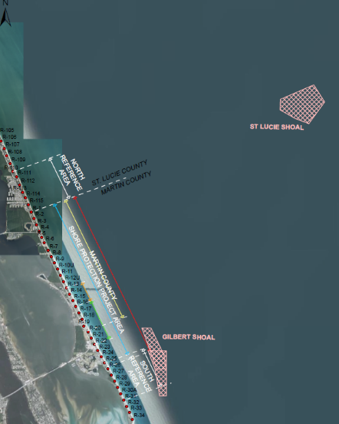
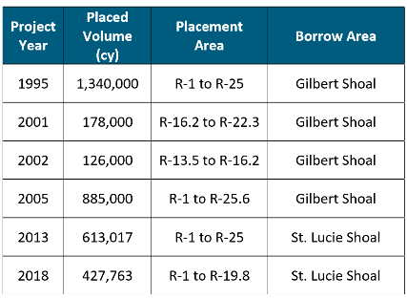


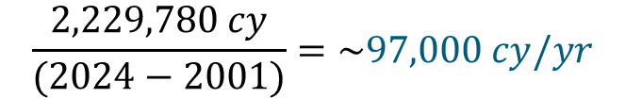
Beach Nourishment History
3,567,780 cy
2,229,780 cy
GDM: Renourishment of 589,000 every 11 years (53,600 cy/yr)
LRR: Renourishment of 787,800 cy every 13 years (60,600 cy/yr)
Some quick math of what has been occurring…
$$\frac{2,229,780 cy}{(2024−2001)}=\sim 97,000 cy/yr$$

Slide 29
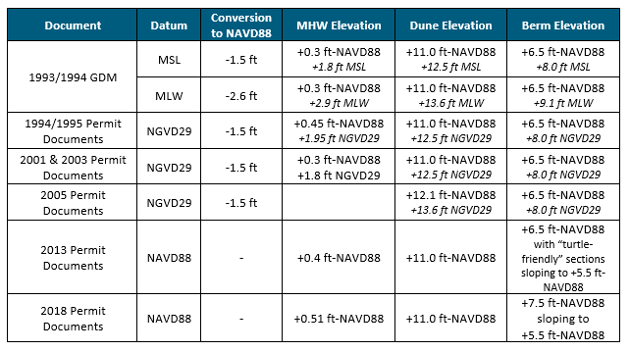
Project Design Parameters
4 construction templates
Variable reference datums
  Tidal vs geodetic datums
    MHW; MSL; MLW
    NAVD88; NGVD29
MHW varies over project design life
  Construction template elevations consistent

Slide 30
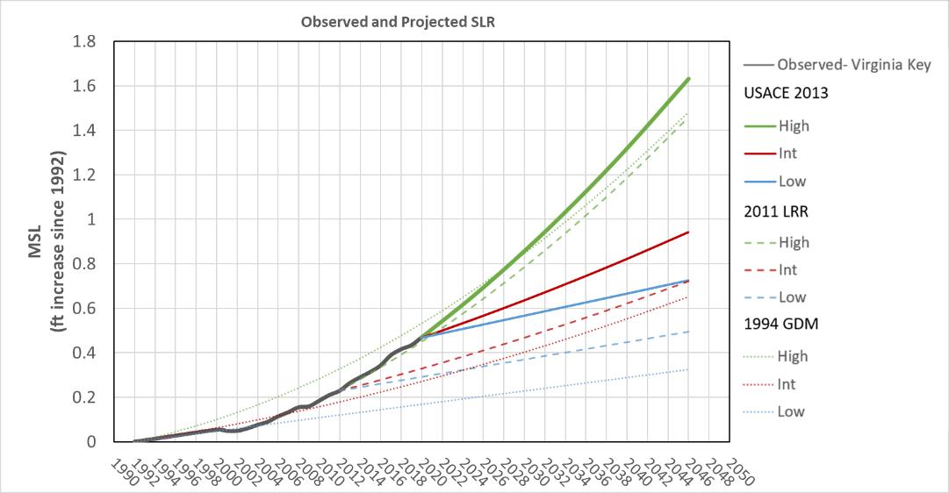
Water Level History and Projections
Observed

Slide 31


Water Level History and Projections
Observed
Martin County SPP’s 1993 General Design Memorandum:

Slide 32
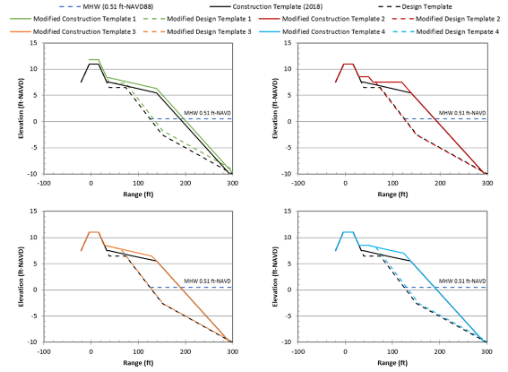
Alternatives Analysis
authorized design dependent on tidal datum → increase in SLR (high) → increase in volume?
Coordination with USACE
Analysis of four alternate construction templates (XBEACH modeling)
  Design limitations
  Analyze performance through contour tracking; volume changes; profile wetting
  Iterative process to optimize design
  Back berm

Slide 33
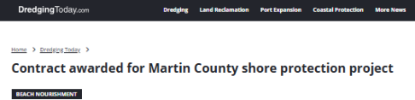
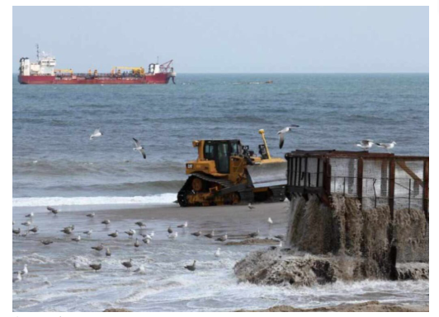
Successes and Lessons Learned
Planned renourishment (March 2026) is implementing the new modified template!
How do we make changes to a project over the project lifetime due to SLR or increased erosion rates? Authorizing documents lay the foundation
Beach resilience directly related to “buffer” volume and recovery time/conditions
  Increased volume and strategic sand placement led to increased performance
Project partner relationships are critical for success

Slide 34
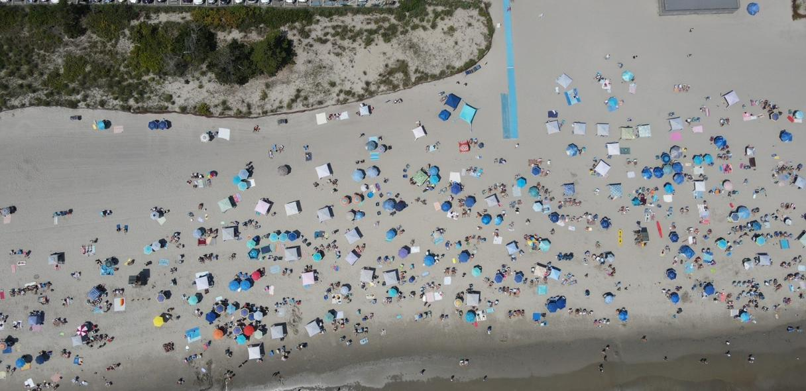

TOGETHER, THESE CASE STUDIES UNDERSCORE THE IMPORTANCE OF PROACTIVE PLANNING, ADAPTIVE PERMITTING, AND COMMUNITY ENGAGEMENT FOR RESOURCE MANAGERS AND DECISION-MAKERS WORKING TO PROTECT INFRASTRUCTURE, ENHANCE COASTAL RESILIENCE, AND ENSURE LONG-TERM COMMUNITY SUSTAINABILITY
THANK YOU
QUESTIONS?
Wendy Laurent, P.E., WEDG
Associate Vice President, Coastal Engineer, Philadelphia Office Lead
wlaurent@taylorengineering.com

