Slide 1
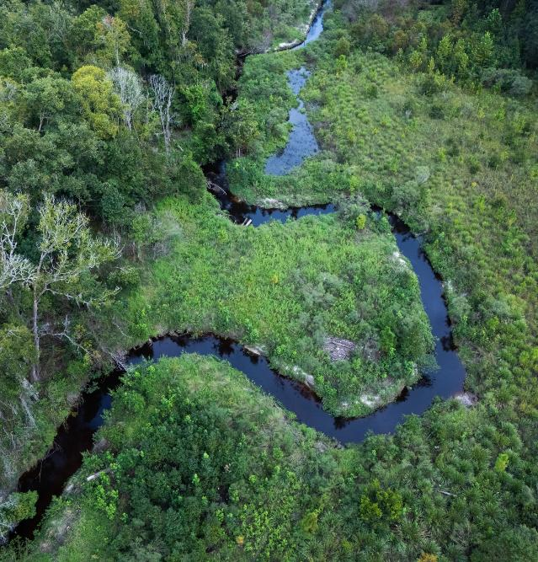
Expanding the BMP Palette: Ecosystem Restoration Strategies for Improving Water Quality
Megan Long, PE
Black & Veatch
Edwards Bottomlands Restoration. Starke, FL

Slide 2
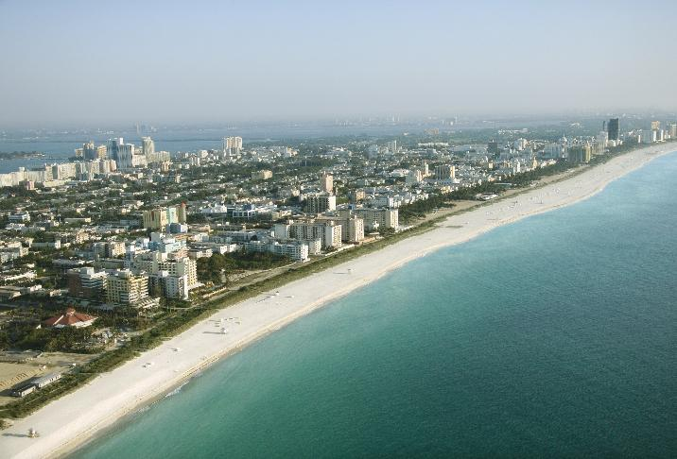
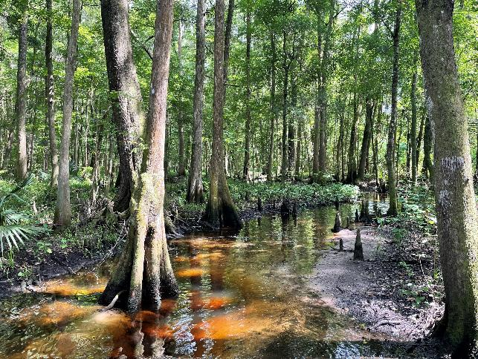
Coastal & Riparian Systems
Notes:
Coastal and Riparian systems are shaped and governed by interconnection of their Hydrology, Geology, & Biology.
The mechanisms driving the form and function of coastal/estuarine vs. inland riparian systems may differ,
but these systems do share many similar concerns: flooding, erosion, habitat loss, and water quality issues,
all of which can threaten infrastructure, human health and safety, and industries that depend on these systems being intact and healthy.
An ecosystem restoration approach can help achieve the primary concern driving the project, along with additional co-benefits like water quality, flooding, resilience, and recreation

Slide 3
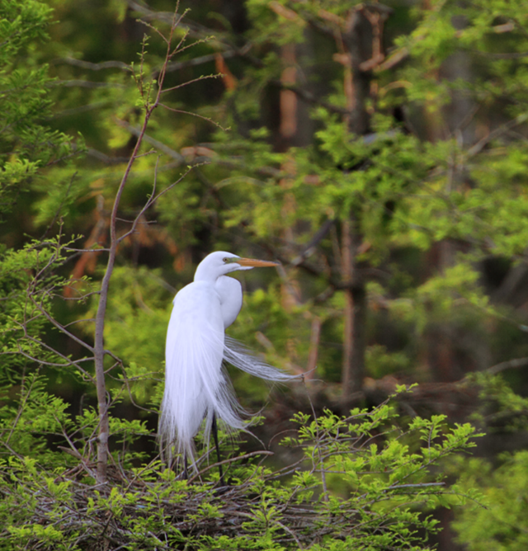
EXAMPLE PROJECTS
Ecosystem restoration approaches used to enhance water quality and additional co-benefits
Hickey Branch Stream & Wetland Restoration at YR 20
Photo by John Kiefer

Slide 4
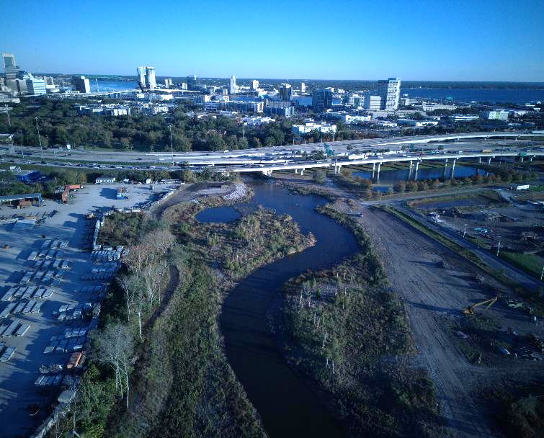
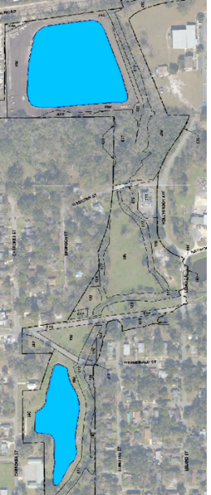
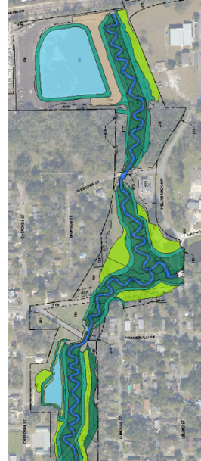

McCoys Creek Restoration – Jacksonville, FL
Branches treat
~2,400 AC
Pond C treats
~ 72 AC
Notes:
Primary Driver- flooding
Restore natural meandering bankfull channel and wide wetland floodplain crossing from fresh water into the tide. Bank stabilization & in-stream metabolization of N. Majority of benefit from ample floodplain to capture & settle out particles and wetland treatment.
In study area, stream restoration provided 10-30x the load reduction compared to SW pond. Regional BMP, treating 30x the contributing area.

Slide 5
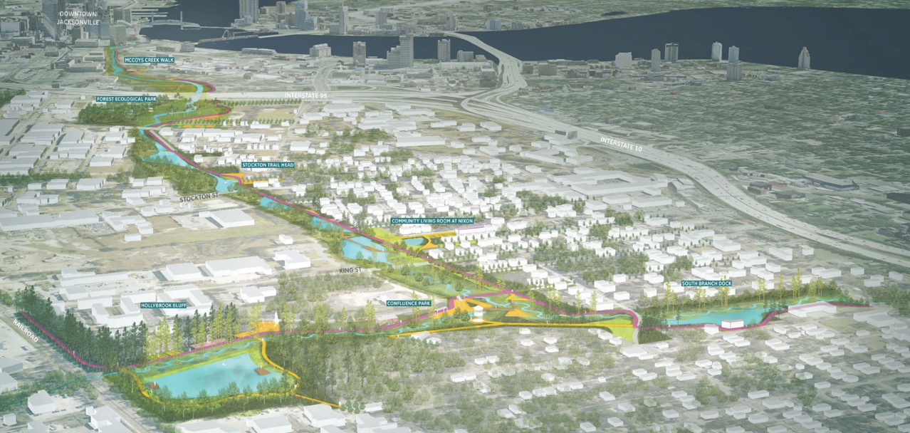
McCoys Creek Restoration – Jacksonville, FL
Rendering by SCAPE Studio
Notes:
Lots of co-benefits in addition to flooding and WQ., fisheries habitat, safe recreation. Designed to adapt to sea level rise & make community more resilient to large storm events..

Slide 6
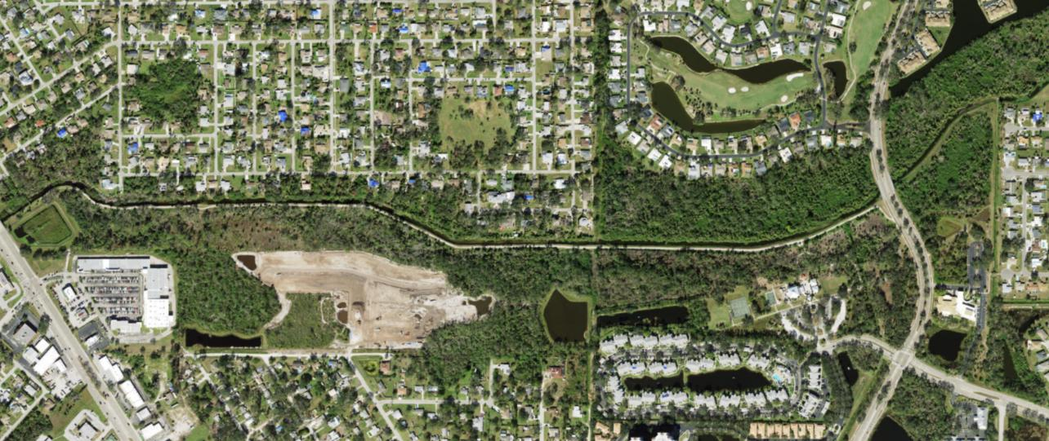
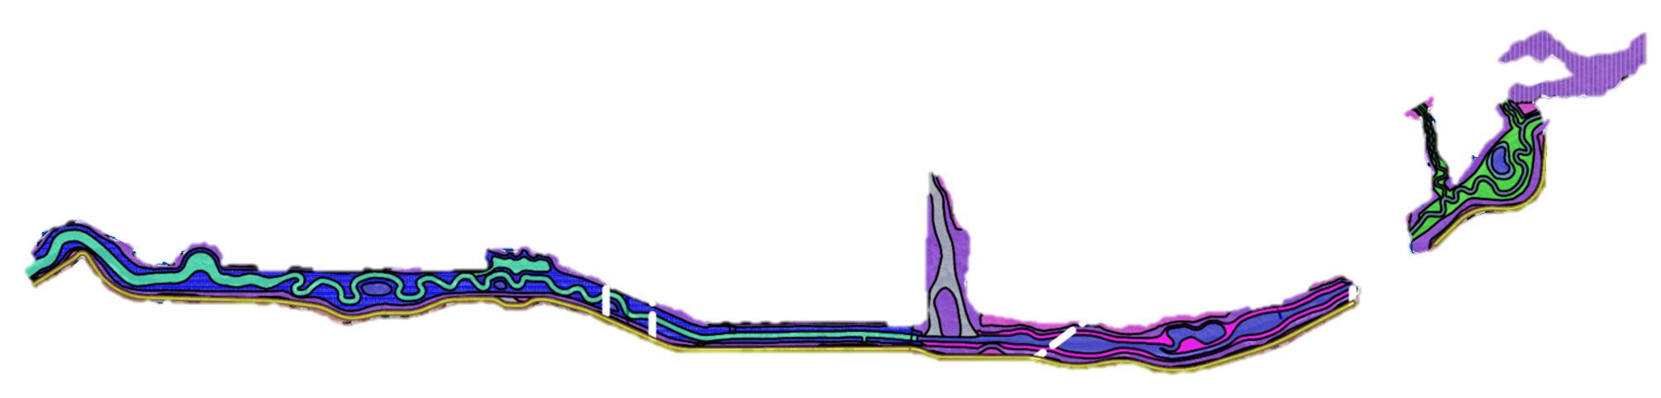
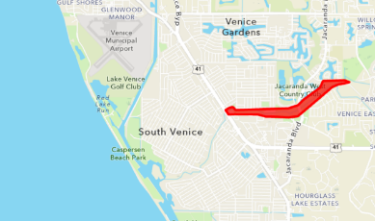
Alligator Creek Restoration – Venice, FL
Project Area
Gulf
Notes:
Similar restoration of urban ditched stream and wetlands crossing into the tide.
As mentioned with McCoys, stream and floodplain restoration provides major nutrient & sediment benefits, but added some pilot elements to treat additional N – one element along the project boundaries, and one here in a lateral canal.

Slide 7
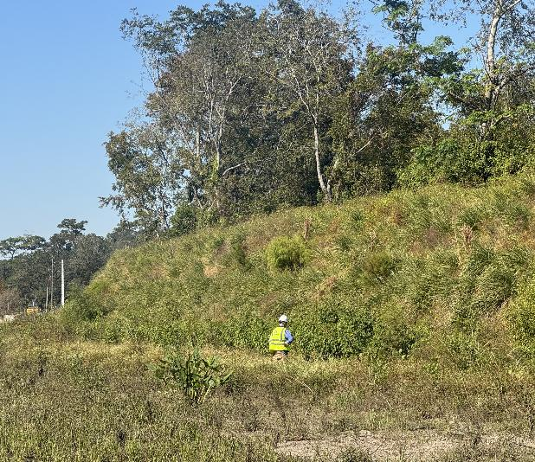
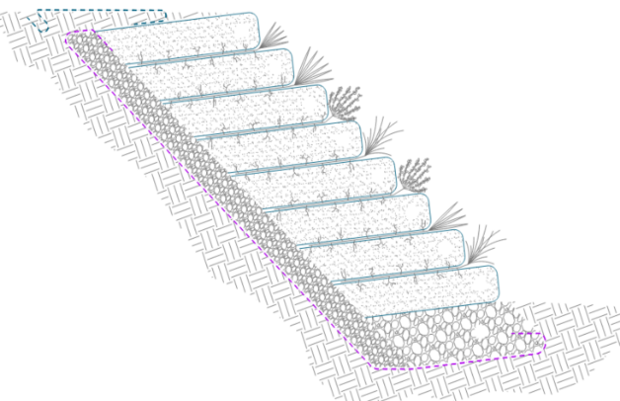
Soil Bioengineering with Bioactive Media
Geotextile-Wrapped
Soil Lifts
Native Live Plantings
BAM mix in backdrain gravel
Notes:
In urban stream restoration, we’re often constrained by existing infrastructure and need to find ways to maximize the restored floodplain area within a narrow footprint.
VRSS allows us to achieve steeper slopes while still providing aesthetic and habitat benefit that gets stronger over time as the roots and vegetation mature.
Our VRSS designs always include backdrain gravel to prevent groundwater sapping failures. In this project we added BAM media into the backdrain layer to provide additional microbial treatment of N in the shallow groundwater seeping into the creek as baseflow. Depending on the media used and site conditions, BAM can treat around 30-90% of influent N, and can also provide removal of P, coliform bacteria, and PFAS through adsorption.

Slide 8
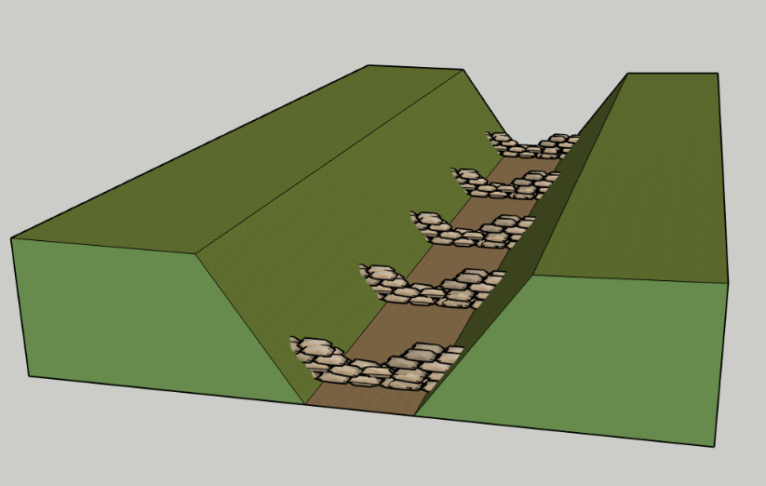
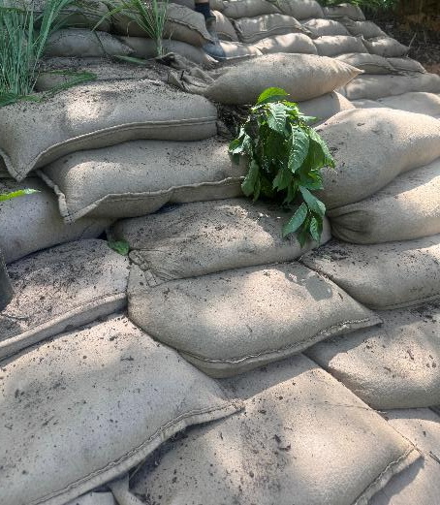
Geobag Riffles with Bioactive Media
Notes:
In one of the lateral canals to Alligator Creek, we were too constrained to restore the ditch, but we designed a series of riffle structures to help induce pools and create more diverse fish habitat. The design uses a system of interconnected geotextile bags filled with soil and BAM. We’ve used geobags on other projects because they’re modular, easy to install, can be planted, and can handle steep slopes and high velocities. The addition of BAM in this project should provide additional water quality treatment at lower flows.

Slide 9
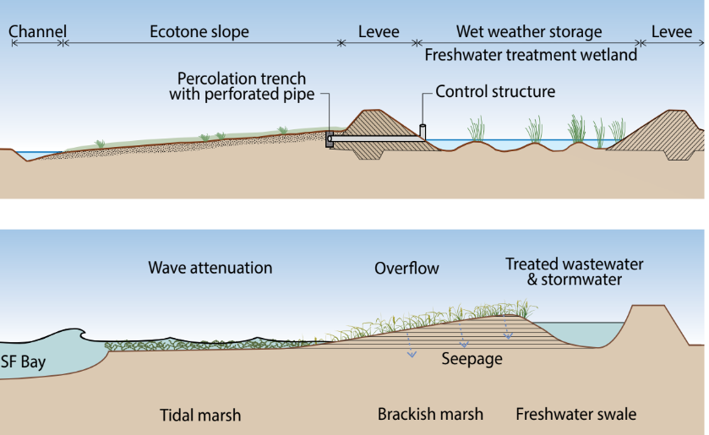
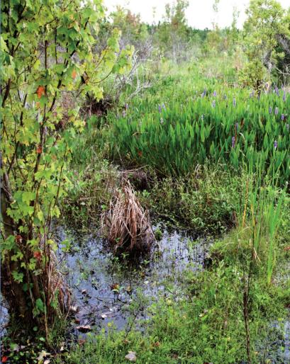
Horizontal Levees with Habitat and Treatment Value
Graphic by ESA & Oro Loma Sanitary District
Photo by Mosaic Company
Notes:
Flood control levees are a common civil engineering solution in coastal, estuarine, and riparian systems where flooding and SLR are concerns.
There are ways to design these systems to mimic coastal marsh and dune systems and seepage slope wetlands. In addition to being able to restore beautiful ecosystems, horizontal levees also provide wave attenuation or energy dissipation and water quality benefits. According to incredible research being done by UC Berkely, Oro Loma Sanitary District, and their other project partners, the subsurface seepage or percolation flow through the horizontal levees removes nutrients and other contaminants through adsorption, denitrification, precipitation, and plant uptake. These can be really impactful projcts.

Slide 10
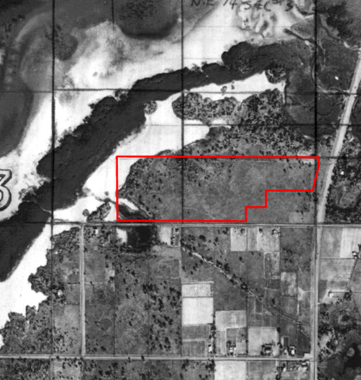
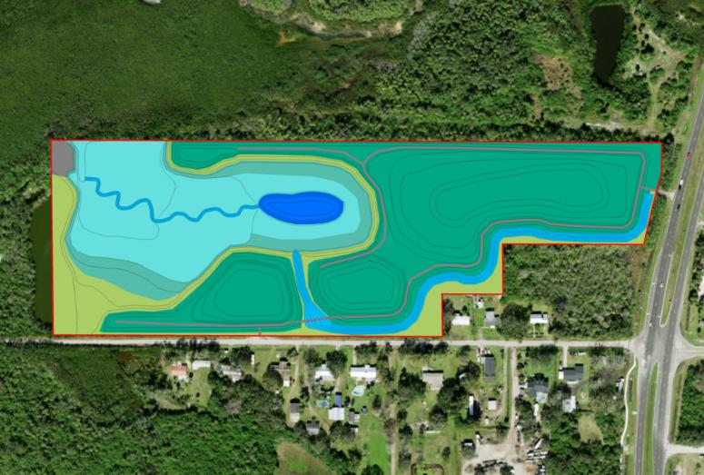
Tidal Marsh Restoration with Horizontal Levee
Notes:
One of our projects along the Tampa Bay involves restoring a fish farm back into tidal wetland and coastal upland ecosystems. In regional water master planning, this site was identified as a potential receiving site for treated wastewater reclaim. Drawing inspiration from the Oro Loma system, our team has designed a horizontal levee that could integrate into the ecosystem restoration design that would percolate potential reclaim down the tidal wetland slopes and provide additional nutrient removal.
Intertidal marsh, mangrove swamp, high marsh, maritime hammock, and coastal scrub habitats.

Slide 11
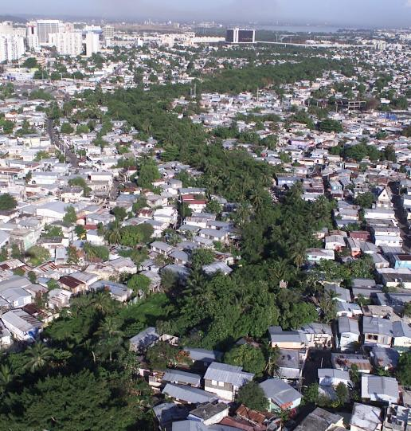
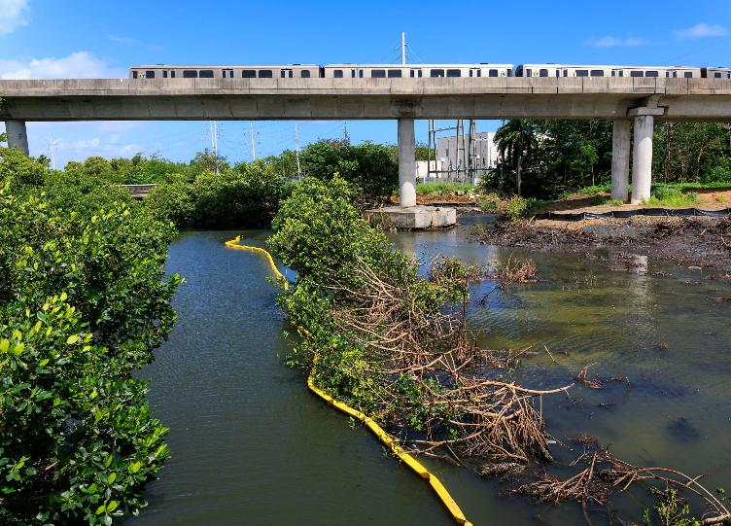
Tidal Flow Reconnection
Proyecto ENLACE del Caño Martin Peña
Photo by Ramon “Tonito” Zayas
Notes:
In some coastal/estuarine systems where levees or causeways block tidal exchange and circulation, water quality issues such as low DO and HAB can arise.
Caño Martin Peña in Puerto Rico. Major multi-phase Army Corps project to relieve flooding and uplift the community.
The dredging and bank stabilization design includes special breaks in the canal walls to allow tidal flow between the canal and a restored mangrove buffer. The reconnection will allow a healthier mangrove ecosystem which will also provide water quality treatment to the water flowing through the canal.
Flows between San Jose Lagoon and San Juan Bay through San Juan, PR.
https://www.primerahora.com/noticias/puerto-rico/notas/esperanza-en-el-cano-martin-pena-con-el-inicio-del-segundo-contrato-del-dragado/

Slide 12
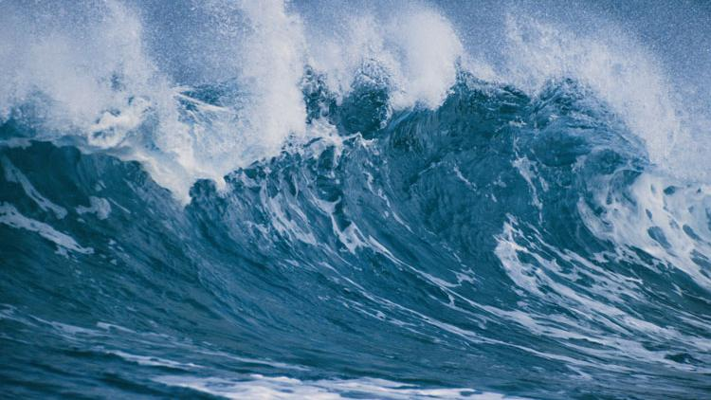

Primary Driver
CO-BENEFITS
Ecosystem Restoration
Water Quality
Flood Protection
Coastal Resilience
Fisheries Improvement
Recreation
Community Uplift
Habitat Mitigation
Notes:
Whatever the driver of a water resources project is (erosion control, flood reduction etc.)
There is very likely an ecological improvement approach that can meet it and offer water quality improvement along with a host of other co-benefits that help meet other needs of the community. The more co-benefits you can squeeze into one project, the more you can unlock different funding partners and sources. It is worth it to explore ecosystem restoration solutions because you’re able to address many needs with one project

Slide 13
THANK YOU
Megan Long
LongM1@bv.com

Slide 14
Concerns for coastal & riparian communities
Flooding
Sea Level Rise
Storm/Runoff Intensification
Sedimentation reducing drainage network capacity
Water Quality
Red tide & harmful algal blooms
CSO contamination
Community & Infrastructure
Post-wildfire erosion & sediment transport
Levees & causeways cutting off tidal exchange
Coastal bluff erosion
Stream valley bank collapse
Safe access to natural amenities
Natural Environment
Habitat destruction
Barriers to fish passage
Sediment smothering of habitat
Trophic cascades

