Slide 1
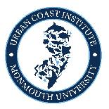
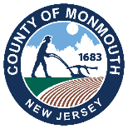
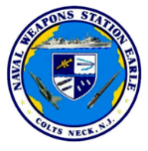

From Base to Bay:
NWS Earle's Coastal Resilience Blueprint
2026 Climate and Coastal Resilience Conference
March 11, 2026

Slide 2
Our Speakers
Nicholas Ginther, Community Planning and Liaison Officer, NWS Earle
Harriet Honigfeld, Supervising Planner, Monmouth Co. Division of Planning
Meredith Comi, Coastal Restoration Practitioner, Monmouth University Urban Coast Institute
Kevin Dahms, Hudson River Bioregion Team Leader, Biohabitats
March 11, 2026

Slide 3


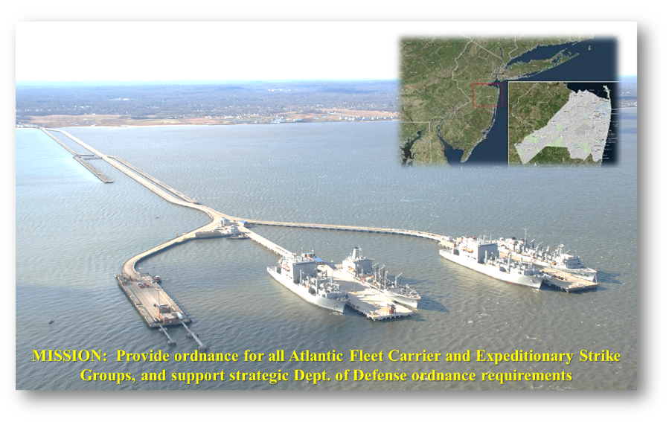
Naval Weapons Station Earle
Notes:
Covers nearly 12,000 acres
Integral to the Navy’s ammunition supply capabilities
Ordnance transported from central Monmouth County to a 2.9-mile-long pier in Middletown (the Navy’s longest).
Transportation managed primarily via privately owned and operated railway, linking parts of Wall, Howell, Tinton Falls and Colts Neck to the waterfront in Leonardo (Middletown).

Slide 4
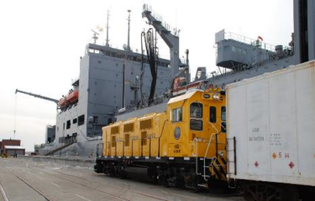
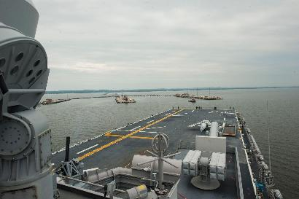
Navy Mission Under Pressure
Encroachment is the term used in the DoW to describe external pressures that may negatively impact military missions and operations.
Community engagement helps prevent encroachment by reviewing legislation, planning studies and local development applications prevent incompatible development and protect Navy mission.
Extreme weather events and associated hazards pose a major encroachment threat to the mission at NWS Earle:
Sea Level Rise & Coastal Erosion
Storm Surge & Flood Vulnerability
Stormwater Storage Capacity
Wildfire Risk on 11,851 Acres
Energy Infrastructure & Water Supply
Strategic Road & Rail Transportation Corridor Access (STRAHNET)
Notes:
Sustained $50 million in damage during Superstorm Sandy
Another local base, Fort Monmouth, closed in 2011
Top issues: climate & coastal resilience, storm surge, incompatible land use, encroachments, water supply, wildfire

Slide 5
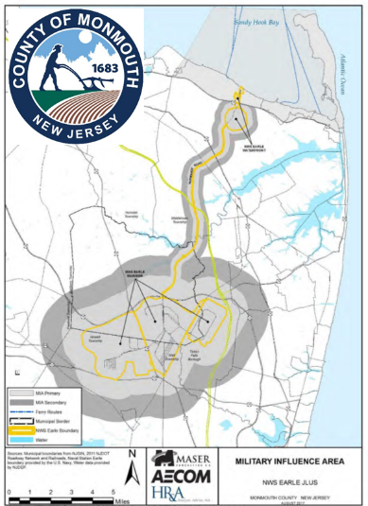
Community Planning Efforts
NWS Earle covers 11,851 acres of land in 5 different municipalities in Monmouth County, operates over 85 miles of rail, and a 2.9-mile “trident” pier complex in Sandy Hook Bay.
Another local base, Fort Monmouth, closed in 2011 due to the BRAC process.
In an effort to protect the installation, the “Monmouth County Joint Land Use Study (JLUS) for NWS Earle” was developed in 2017, w/ wide stakeholder participation.
Original and subsequent studies assessed the following;
Economic impacts of the base, which employs a total combined workforce of over 1,200 persons, with 280 full-time residents. With commuters traveling to the site from across the state, including New York and Pennsylvania.
Established primary and secondary Military Influence Areas (MIA) around the installation.
Reviewed local zoning code(s) and uses for compatibility.
Wide-ranging mission and economic impacts due to the effects of climate change and development pressure.
Notes:
Sustained $50 million in damage during Superstorm Sandy
Another local base, Fort Monmouth, closed in 2011
Top issues: climate & coastal resilience, storm surge, incompatible land use, encroachments, water supply, wildfire

Slide 6
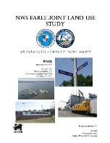
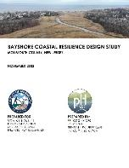

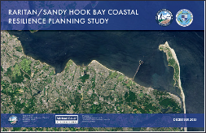

Monmouth County’s NWS Earle-related Resilience Efforts
Joint Land Use Studies
Climate and Coastal Resilience Partnership Projects
Land Preservation with Support from REPI
Additional Grants

Slide 7
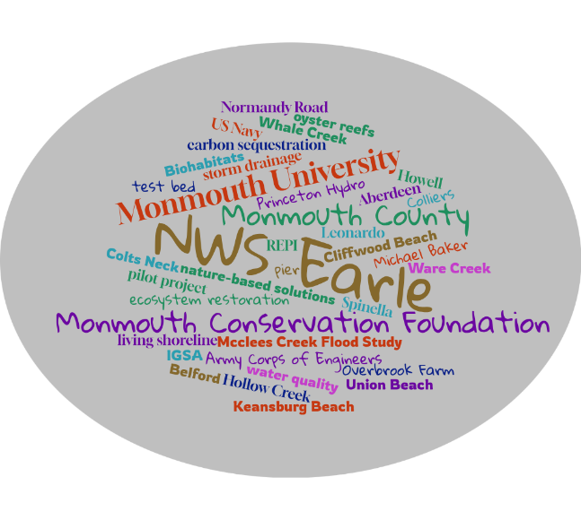
Partnership Projects
Many agencies and organizations are working together to advance projects including the US Navy, Monmouth University, Monmouth County, Monmouth Conservation Foundation, and various municipalities

Slide 8
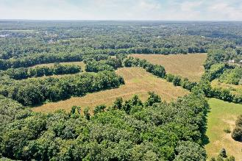
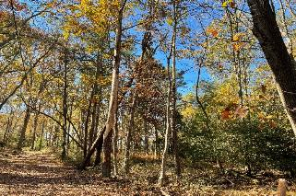
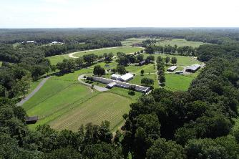
Land Preservation Supported by REPI Funds
Multi-year Agreement among Monmouth County, Monmouth Conservation Foundation, and Navy
Preserved 3 properties so far totalling 339 acres
Complementary farmland and open space preservation also occurring in project area

Slide 9

Leveraging Grants
$592,500 in OLDCC grants awarded to Monmouth County for planning & design studies (10% in-kind match required)
Implementation grants to county & partners include those from:
REPI Land Preservation Program - US Navy ($8.5 million)
REPI Challenge Cooperative Agreement with Monmouth U ($6.7 million)
DON Resilience & Carbon Sequestration Program ($1.2 million)
NDAA Office of Naval Research ($2.9 million via 2 grants, cancelled)
National Fish and Wildlife Foundation ($776k)
NJDEP Water Quality Restoration Grant ($1 million)
Shared Services Agreement w/County ($1 million)
HEP Ecosystem Restoration Program ($2.27 million+)
Municipal cost share for REPI easements ($1 million)
IGSA w/ NJDEP – Keansburg Beach ($50k)

Slide 10
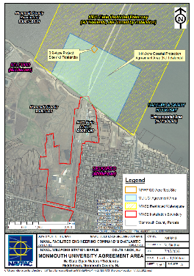
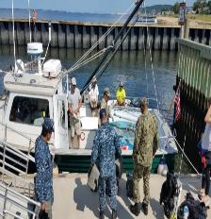
History of Oyster Restoration Efforts in Raritan Bay
2001-2004: reefs established and set with oysters in Keyport Harbor and Navesink River
2010: NJDEP Banned shellfish research in contaminated waters
2012: Baykeeper partners with NWSE
2016: 0.9 acre project site established to the west of the NWSE Pier
2023: Restoration Program moves to MU
Approx. 800 oyster castles set with oysters placed between 2016 and 2025 and approx. 500,000 juvenile oysters and oyster seed planted
Castles/structures are set with juvenile oysters each year and deployed as stacked pyramids on the bay bottom.
Goals: Create subtidal habitat, introduce oysters, shoreline protection
Notes:
After Superstorm Sandy, NWSE wanted to address resilience needs through living shorelines, coastal restoration, and Nature-based solutions, so programming at NWSE evolved to incorporate NbS in the form of oyster castles set with oyster larvae that would provide wave attenuation and habitat.
Approximately 800 oyster castles set with shell and over 500,000 juveniles and oyster seed have been planted since 2012.
The ongoing projects at NWSE offer a valuable opportunity to evaluate the effectiveness of NbS as shoreline protection strategies in an urban environment.
Project designs are based on site assessment findings and the site-specific conditions of NWSE, which Kevin will discuss.
As Harriet and Nick mentioned, numerous stakeholders and governmental entities are engaged in efforts that align with this project at the local, county, state, and federal level. These include regional coastal resilience planning studies, site-specific shoreline monitoring, and ecological design pilot projects.

Slide 11

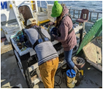

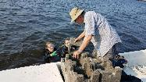
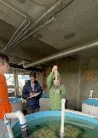
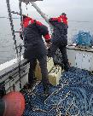
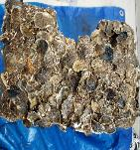
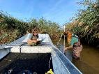
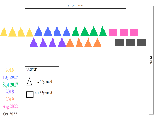

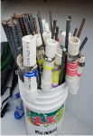

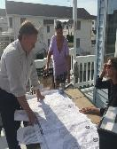
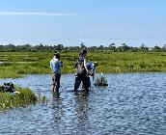
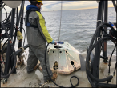
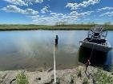
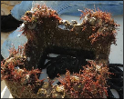
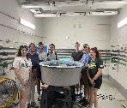
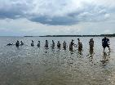
Data Collection & Research
Project Design & Implementation
Monitoring
Student and Community Engagement
Notes:
Activities at NWSE include:
Aquaculture operations
Reef building
Reef monitoring
Research
Student and Community Engagement - woven through every part of our work

Slide 12

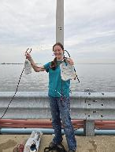
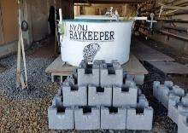
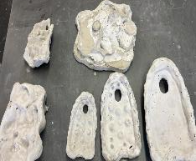
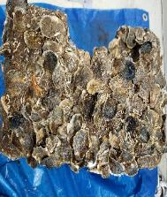
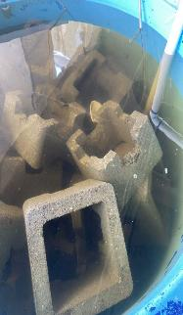
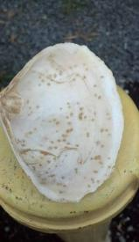
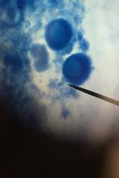
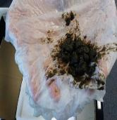
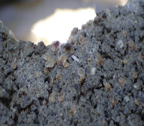
Aquaculture Facility
Facility provides oysters for restoration and resilience projects at NWSE
“Set" millions of oyster larvae on oyster castles or other substrates
Monitor setting rate, growth rate and water quality of tanks
LARVAE
SPAT
Notes:
A lack of substrate and larvae in the system requires us to remote set onto shell or substrate prior to deploying reef elements.
Due to regulatory restrictions, all oysters for NWSE projects are produced at the aquaculture facility, which is located on base.
In addition to using oyster castles, we are beginning to incorporate biomimicry concepts and products into our projects, including 3D printed structures and proprietary structures from Natrx, Reefball Foundation, etc.. Kevin will discuss some of these techniques in a bit.
This past year UCI collaborated with Monmouth U’s Art Department to develop 3D printed molds of various oyster reef topographies to include in our tanks and research plot.

Slide 13
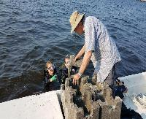
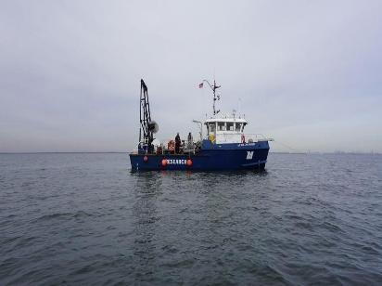
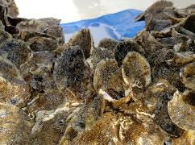
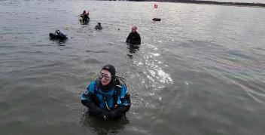
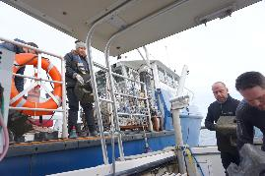
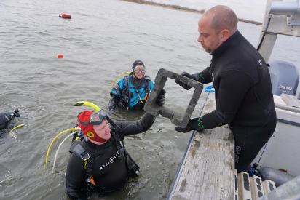
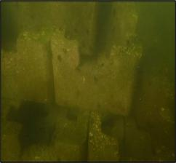
Notes:
Reef building and project monitoring occurs at the NWSE Complex.
Reef Building - Design and implementation, permitting and vetting, careful coordination with NWSE Staff, vessel logistics
Project Monitoring - primarily done with instrumentation and SCUBA since the reef is subtidal. Many challenges, but partnerships help.
Research - aimed at understanding which NbS work best in an URBAN system

Slide 14
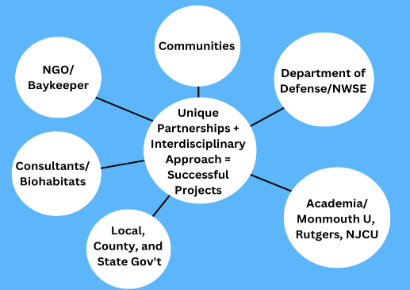
PARTNERSHIPS ARE KEY!
An interdisciplinary approach to projects results in more successful projects.
Allows for robust data collection from all disciplines resulting in better informed projects
Cost sharing, equipment sharing, labor sharing, etc. provides match and can keep project costs down
Allows smaller entities to advance meaningful projects
Expansion of 0.9 acre LS; final designs for 3,200 LF of NbS; 8-acre USACE Project; expanded aquaculture facility; policy shifts; state-wide involvement
2012: 0.25-acre plot & aquaculture
14 years
Notes:
Capacity Building for identifying, prioritizing and planning community and ecosystem resilience projects is the necessary first step to understanding and identifying resilience needs that benefit all community stakeholders.
Once complete the community can use the plan collectively or independently to advance the identified projects
The engagement and planning process does not need to be at a technical level, it can be scaled to the size of the desired resilience projects
Project coordination will result in projects that are permittable at the state and federal level.
Cooperative Agreements/MOUs formed between local/state/federal levels provide a mechanism for handling and distributing complicated and large project awards.
I will now hand it over to Kevin who will discuss one of the projects this partnership has been working on.

Slide 15
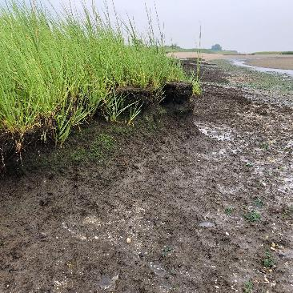
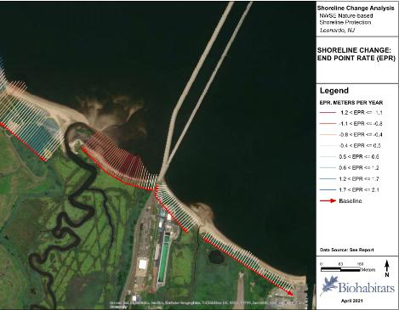
Ware Creek Nature-Based Shoreline Protection
Project Drivers
Erosion of shoreline protecting Ware Creek Marsh and NWSE
Loss of marsh fringe habitat
Limited bottom habitat
Risk of storm damage to NWSE

Slide 16





Ware Creek Nature-Based Shoreline Protection
Site Assessment
Vegetation Mapping & Monitoring
Shoreline Change Analysis
Topographic & Bathymetric Survey
Geotechnical Investigations

Slide 17




Ware Creek Nature-Based Shoreline Protection
Site Assessment - Modeling
Hydrodynamic & Sediment Transport Model
Water Level & Wave Monitoring

Slide 18



Ware Creek Nature-Based Shoreline Protection
Site Assessment - Modeling

Slide 19


Ware Creek Nature-Based Shoreline Protection
Tidal Datum & Sea Level Rise Analysis
NJ STAP Report (2019 and 2025)
Kopp, et al. New Jersey’s Rising Seas and Changing Coastal Storms: Report of the 2025 Science and Technical Advisory Panel. Rutgers, The State University of New Jersey. Prepared for the New Jersey Department of Environmental Protection. Trenton, New Jersey.

Slide 20



Ware Creek Nature-Based Shoreline Protection
Biological Benchmark Collection at East Creek, Union Beach
Notes:
Compare biobenchmarks to

Slide 21
Ware Creek Nature-Based Shoreline Protection
Sediment Transport Modeling - Delft3D

Slide 22


Ware Creek Nature-Based Shoreline Protection
Design Drivers
Erosion
Wave Climate & Marsh Threshold
Unsuitable Existing Elevations
Intertidal & Subtidal Shellfish Habitat
Design Objectives
Attenuate Wave Energy
Accrete Sediment
Re-establish & Protect Marsh Fringe
Create Oyster & Bottom Habitat
Adapt to Sea Level Rise
Roland and Douglass 2005

Slide 23

Ware Creek Nature-Based Shoreline Protection

Slide 24

Ware Creek Nature-Based Shoreline Protection

Slide 25


Ware Creek Nature-Based Shoreline Protection

Slide 26
Ware Creek Nature-Based Shoreline Protection
Design Features: Low Sill Breakwater
Design Analysis
Design Elements

Slide 27
Ware Creek Nature-Based Shoreline Protection
Design Features: Marsh Restoration/Enhancement
Design Analysis
Design Elements

Slide 28
Ware Creek Nature-Based Shoreline Protection
Lessons Learned
Backup monitoring equipment
Need for regionally specific data for wave tolerances, SLR, etc. for marsh establishment
Local and site-relevant biological benchmark data
Early & frequent coordination with regulators (2+ pre-app meetings with NJDEP, USACE, NOAA, etc.)
Early coordination with adjacent landowners and management activities (beach nourishment) to promote desirable coastal processes vs. what’s possible on-site

Slide 29
Ware Creek Nature-Based Shoreline Protection
Current Status
Permits submitted
Seeking construction funding

Slide 30
THANK YOU
Questions & Answers

