Slide 1
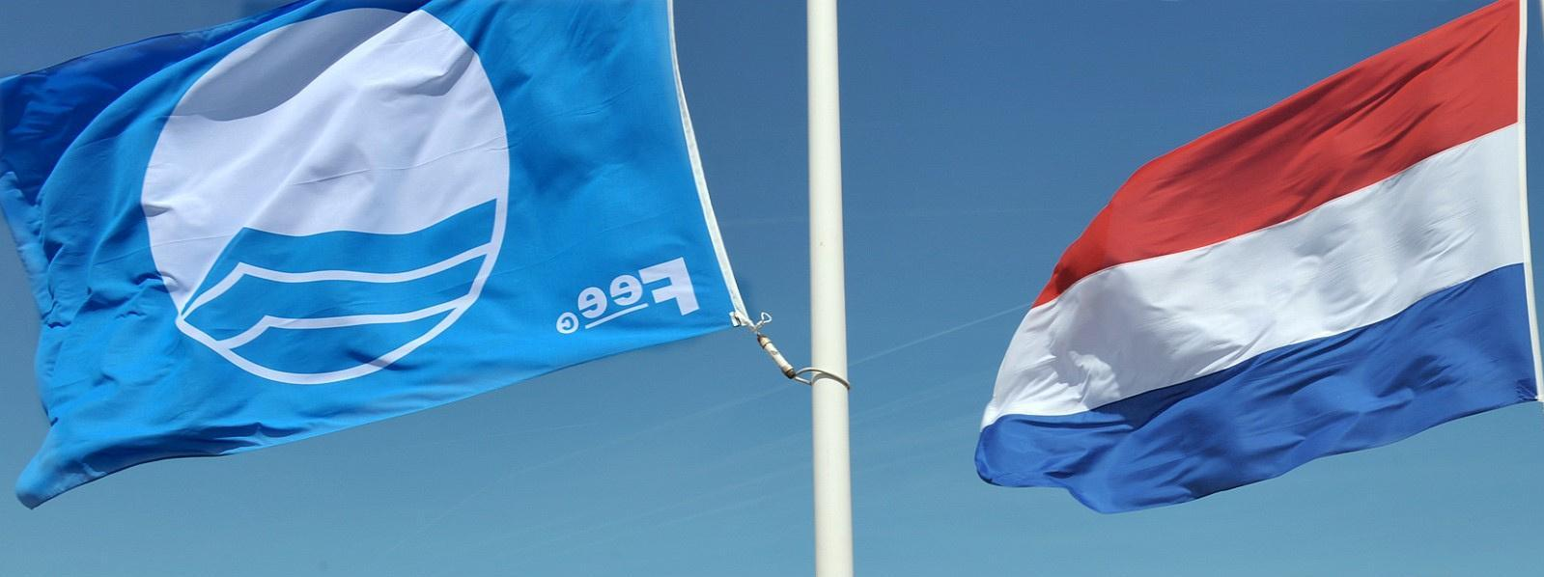
EDUCATION, SUSTAINABILITY, AND
TOURISM
PRESERVING, PROTECTING, AND ENHANCING PRODUCTIVE COASTS: THE BLUE FLAG FRAMEWORK FOR STORYTELLING
Presented by the American Shore and Beach Preservation Association
Annie Mercer, Program Coordinator
Notes:
Hello I am annie mercer and I have the great privilege of telling US coastal research and management stories at the national and international levels. Today I am going share how our organization shares coastal stories nationally and how the international blue flag award can be used to tell your communities unique environmental story in a way that preserves, protects and enhances the coastline.

Slide 2
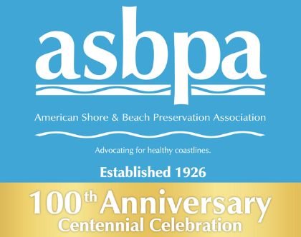
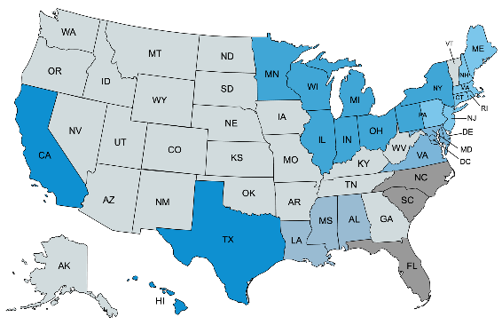
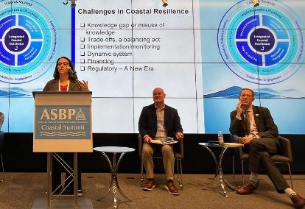
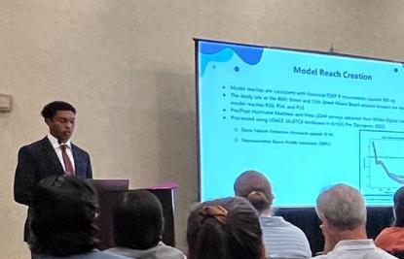

Our Mission
Preserving, protecting and enhancing our coasts by merging science and public policy for 100+ years.
Who We Are
What We Do
Stories We Tell
Coastal Summit (DC, March 24-26)
Committees
Resources
Shore & Beach Peer-Reviewed Journal
National Nourishment Database
Coastal Universities Guide
Monthly E-Newsletters
Southeast Coastal Communities Water Level Observation System
Science and Technology
Government Affairs
Shore & Beach Editorial Board
Chapter Presidents
Conference Steering
National Coastal Conference (Atlantic City, October 5-8)
California, Texas, Hawai'i Chapters
Central Gulf Coast Chapter (CGC)
Great Lakes Chapter (GLSBPA)
Northeast Chapter (NSBPA)
Mid-Atlantic Chapter (MAC)
ASBPA Partners
Notes:
the American shore and beach preservation association is a national organization representing coastal practitioners, academics, state and federal agencies with coastal missions, industry and students from all four coasts.
our mission is to preserve, protect, and enhance our nation's coasts & shorelines by merging science and public policy. Our members help promote local challenges and successes to the national level by serving on committees and engaging with our resources
ASBPA shares coastal stories nationally through:
- a peer reviewed journal
- newsletters and
- two conferences a policy summit in DC and a technical conference this fall in Atlantic city.

Slide 3
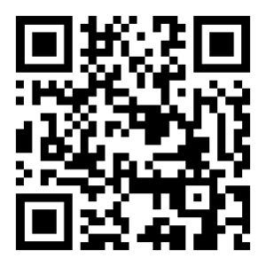
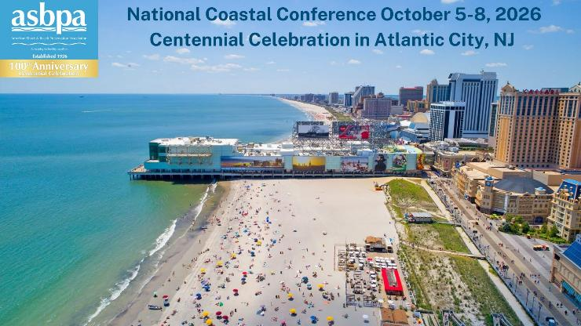
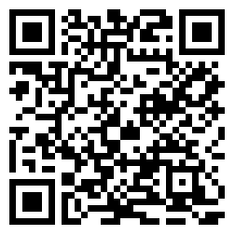

Celebrate a century of coastal restoration excellence!
Vote for your favorite ASBPA Best of the Best Restored Beach Award
New Jersey Nominees
2020 Keansburg
2018 Thompsons Beach
2006 Sea Bright to Manasquan Beach
2005 Cape May Inlet to Lower Township
Scan to Vote at ASBPA.org
ASBPA’s annual Best Restored Beach Award raises public awareness of the recreational and economic value of restored beaches from coast to coast and the U.S. territories.
Nominate your project for the 2026 Best Restored Beach Award at ASBPA.org!
ASBPA Best of the Best:
Best Restored Beach Award Nominees
Notes:
asbpa also gives or administers several awards. ASBPA noticed the public was not always aware of the restoration efforts communities were taking to provide the recreational and economic opportunities tourists were taking advantage of.
ASBPA established the Best Restored beach award in 2002. For our 100th anniversary we are highlighting the nations restored beaches and invite you to vote for the best of our best restored beach awards.

Slide 4
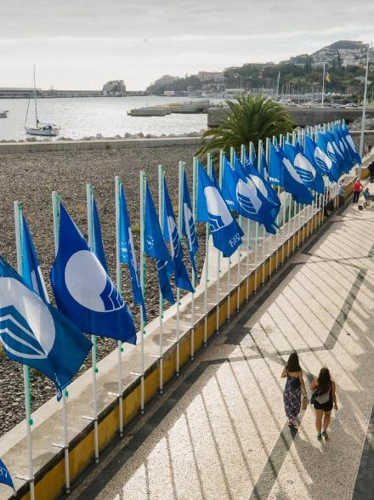
What is the Blue Flag Award
Sustainable Development through Environmental Education
A framework for sustainability
An international eco-award
criteria areas include: water quality, environmental management, environmental education, safety and accessibility, and responsible tourism
operating in 50 countries and has over 5,000 sites
An experienced program
40 years of experience & best practices
A strict review
sites are reviewed for adherence to 30+ criteria
Notes:
The blue flag is an international eco award for beaches marinas and tourism boats with a mission of sustainable development through environmental education.
The program is one of five educational programs offered by the foundation for environmental education and internationally headquartered in Copenhagen but has member organizations administering the program in 50 countries with over 5000 sites.
ASBPA was drawn to administering this award in the united states because the over 30 criteria for beaches build off the BRB award and highlight the daily management decisions which ensure our coasts are productive places to live, work, and play.
Criteria fall into several categories that make up a framework for coastal sustainability. As I have worked with communities in the US and operators in other countries the criteria are the bones of the program and they provide multiple benefits but implementation allow communities to thoughtfully craft a their unique resilience narrative for locals and visitors.

Slide 5

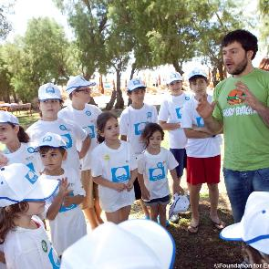
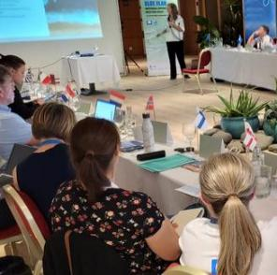

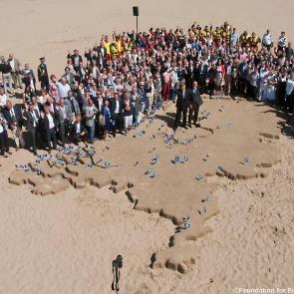
THE AWARD STRUCTURE
Assessment
Application
Jury Review
Review of current priorities & operations
Annual environmental monitoring touch point
International Press
Local Award Ceremonies
Award Season
Continuous Monitoring
Local Campaigns
National Media
Notes:
crafting this narrative starts at the beginning of the award process.
Assessment - what are you doing really well, what are things we can increase awareness of and look to get help from visitors.
Applications - a touch point for looking at environmental monitoring and share impacts or adjust styles
Jury Reviews - national and international, two opportunities to communicate excellence, international press & they run a best practice competition providing additional amplification
Award Season - monitoring of criteria and environment, running of local communications campaigns about the award, about the required educational activities, and then nationally we broadcast information about our sites through various campaigns - BF Americas Week, other award applications, requests from media outlets like expedia, usa today, or travel agencies.

Slide 6
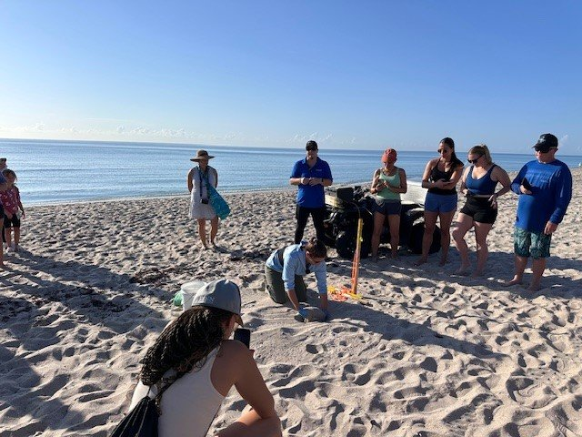
Preserve
Connection
Sea Turtle Education in FL
Notes:
The breadth of the criteria requires several departments and partners to connect in furtherance of broad community goals;
preserve local biodiversity and meet state guidance - shirts

Slide 7
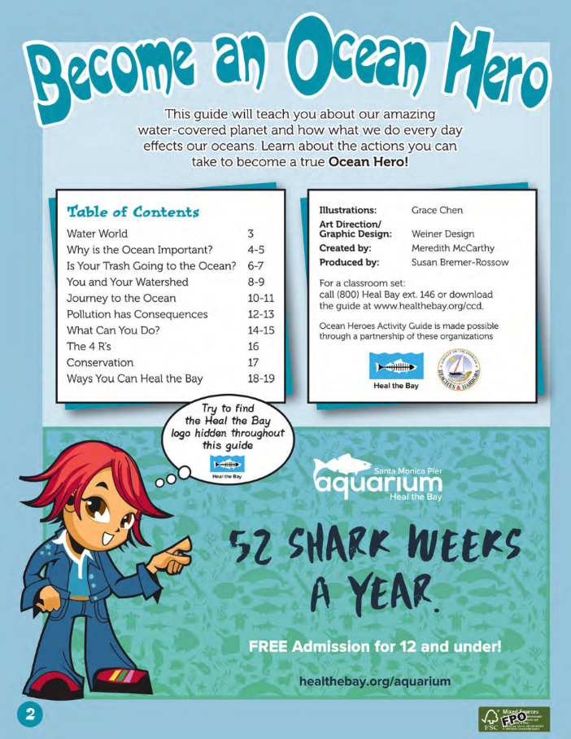
Preserve
Connection
Sea Turtle Education in FL
Litteracy
Ocean Heroes in Los Angeles
Notes:
looks to use the focus on environmental education to increase environmental literacy as a way to support local ordinances;
supports litteracy through a medium that is attractive to youth. fun games mixed with facts about pollution and waste management and actions to help conserve water.

Slide 8
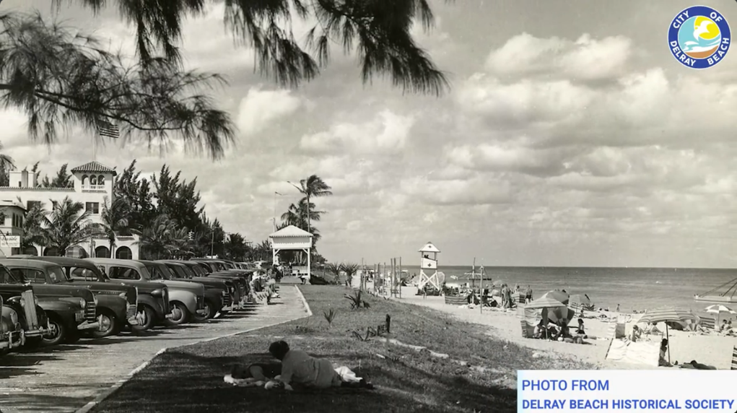
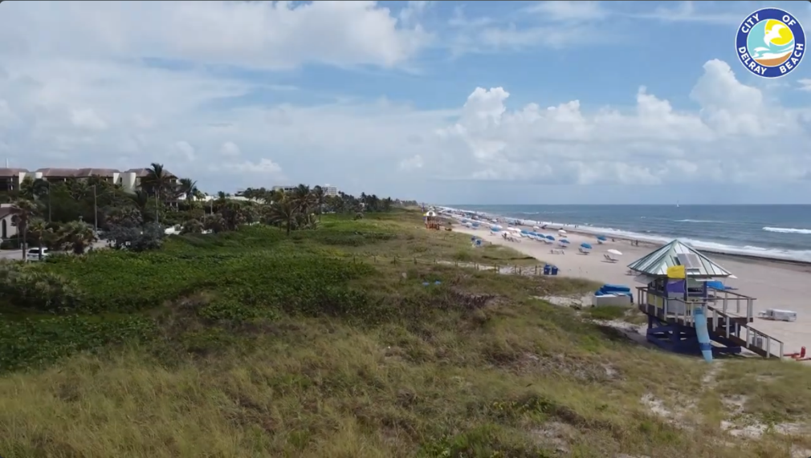
Preserve
Connection
Sea Turtle Education in FL
Litteracy
Ocean Heroes in Los Angeles
Resilience
Delray Natural Dune Video
Notes:
and gives coastal management a continuous channel for engaging stories about your work.
produced a video to share how management decisions have led to more infrastructure protection, gives multiple opportunities for local engagement on protecting dunes.

Slide 9
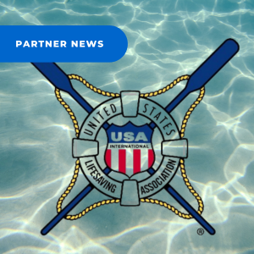
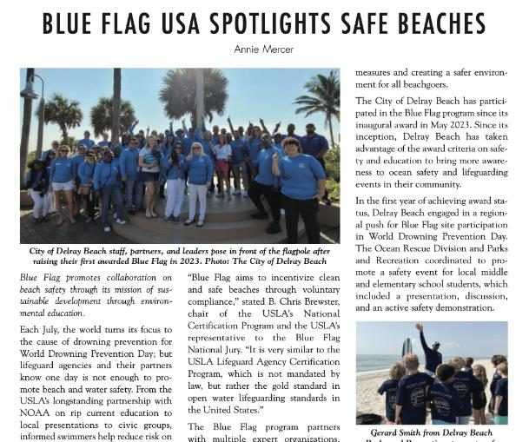
Protect
Connection
Water Safety Events with Ocean Rescue
Notes:
several departments and partners to connect in furtherance of broad community goals;
connected to highlight safe recreation - a snorkel the wreck activity which covered how to snorkel safety and respect local species

Slide 10
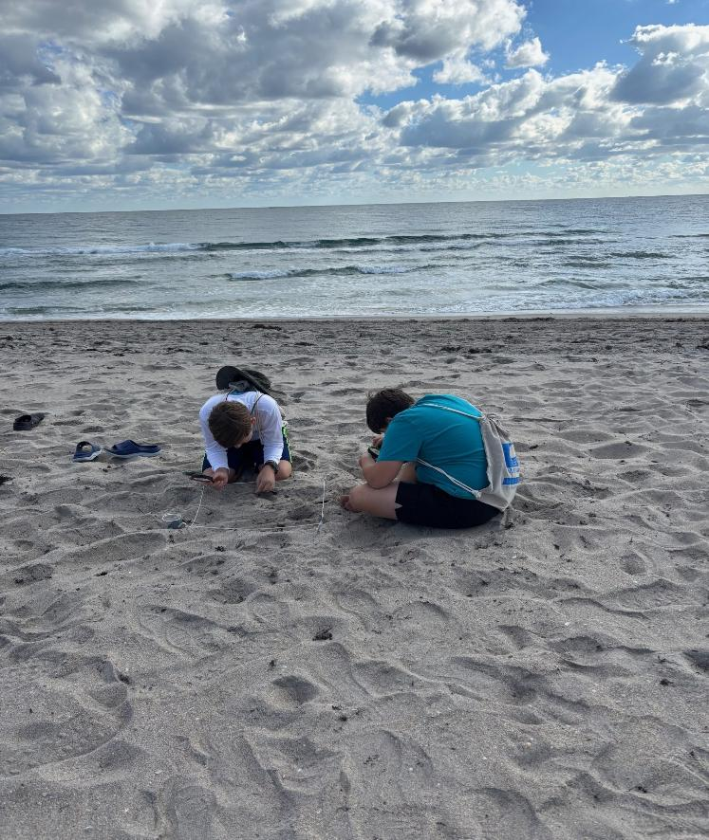
Protect
Connection
Water Safety Events with Ocean Rescue
Litteracy
Microplastic Inventories
Notes:
looks to use the focus on environmental education to increase environmental literacy as a way to support local ordinances;
a hands on inventory activity which focused on how impacts to one habitat can impact another in an effort to support individual actions to keep beaches clean.

Slide 11
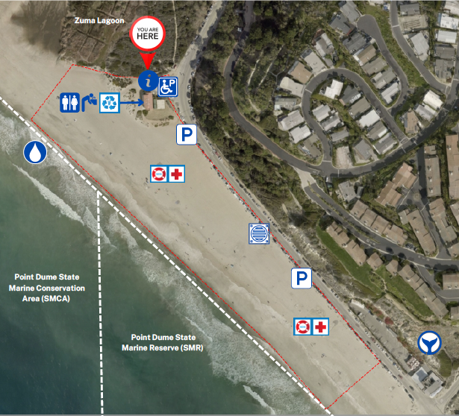
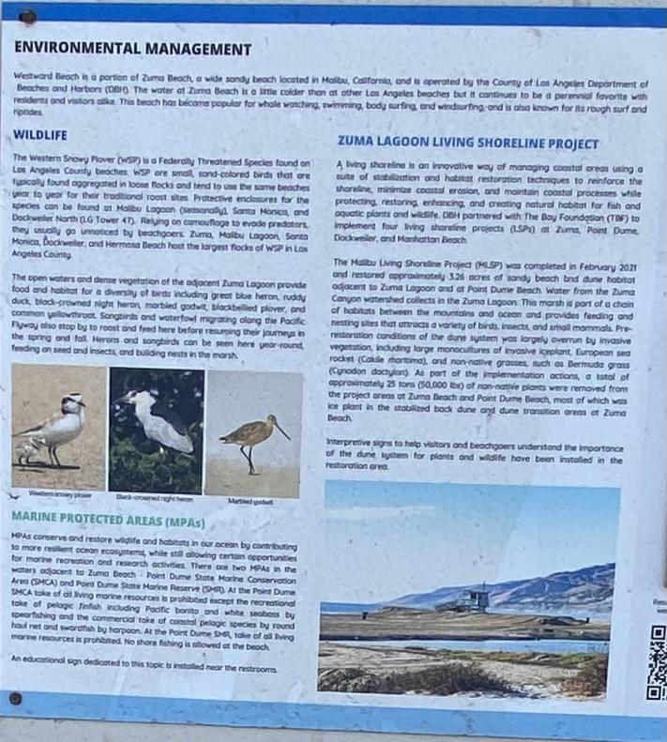
Protect
Connection
Water Safety Events with Ocean Rescue
Litteracy
Microplastic Inventories
Resilience
Marine Protected Areas in CA
Notes:
and gives coastal management a continuous channel for engaging stories about your work.
Protects the diversity and abundance of marine life. This site actually sits between two and so we make sure visitors and locals are aware of the different rules and take limits and provide additional local habitat information.

Slide 12
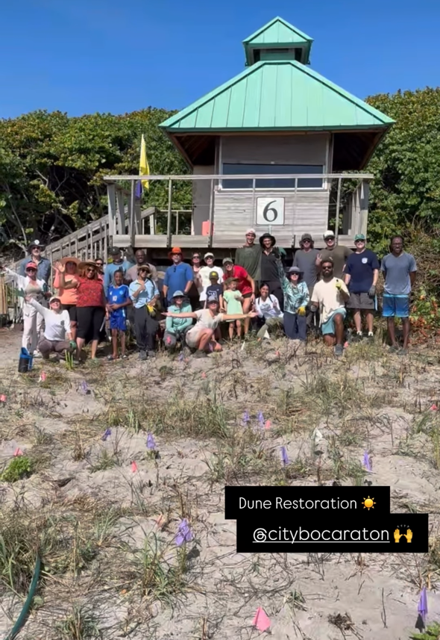
Enhance
Connection
Dune Restoration in Boca Raton
Notes:
several departments and partners to connect in furtherance of broad community goals;
work with partners to enhance - remove invasive and plant natives. engages locals in these projects as well as visitors. makes memories in the coast alongside science.

Slide 13
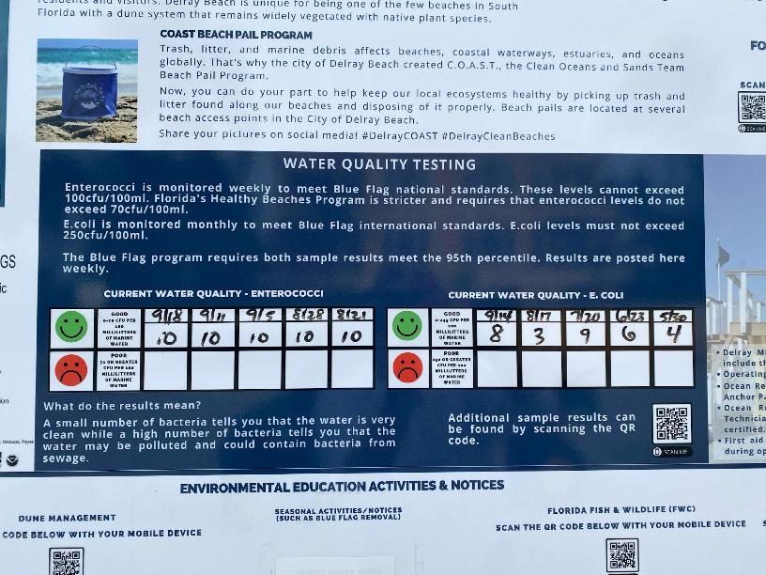
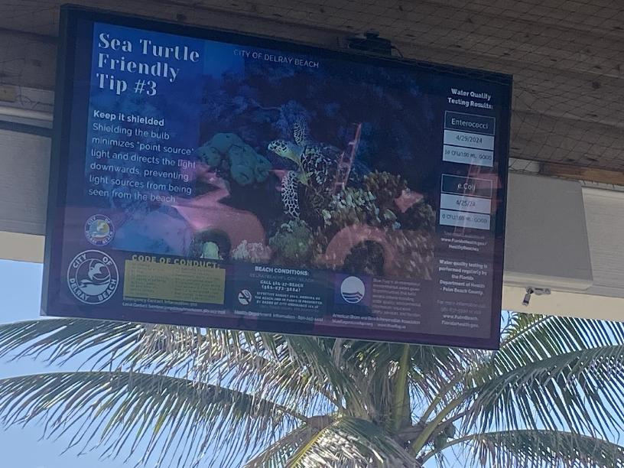
Enhance
Connection
Dune Restoration in Boca Raton
Litteracy
Water Quality Results at Site
Notes:
looks to use the focus on environmental education to increase environmental literacy as a way to support local ordinances;
environmental literacy on water quality by sharing sampling results at the site. delray was able to make this faster by implementing virtual board that update automatically.

Slide 14
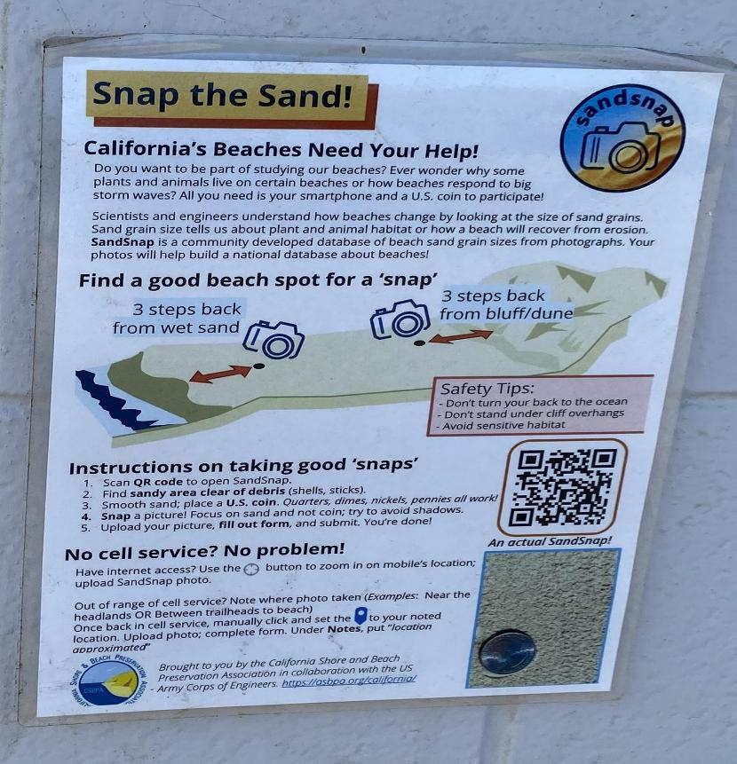
Enhance
Connection
Dune Restoration in Boca Raton
Litteracy
Water Quality Results at Site
Resilience
Citizen Science for Management
Notes:
and gives coastal management a continuous channel for engaging stories about your work.
finally one of our sites has run a snap the sand activity to support the USACE sandsnap project. We are looking to expand this to all of our sites this year and collect information from all of our US sites and regionally in N&S america. to help inform management decisions.

Slide 15
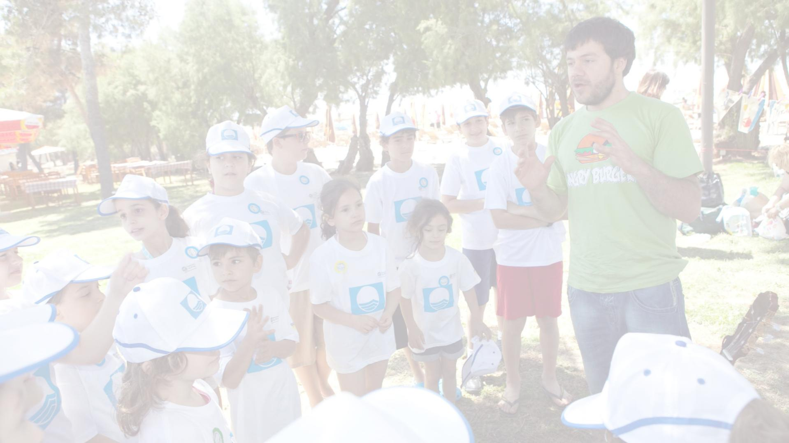
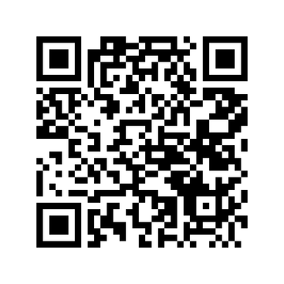
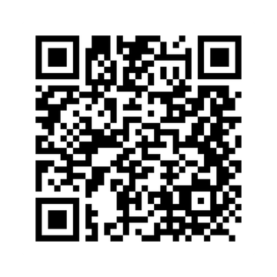
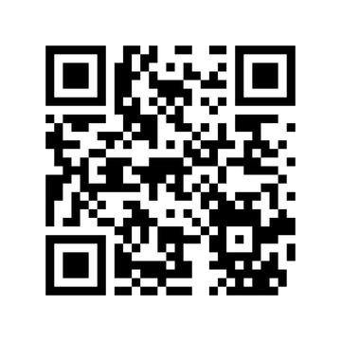
KEEP IN TOUCH
Facebook
Instagram
Twitter/X
BLUEFLAGUSA@ASBPA.ORG
BLUEFLAG.US

Slide 16
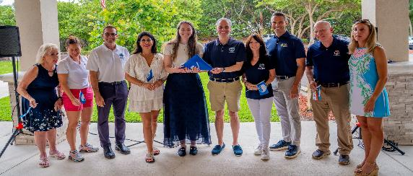
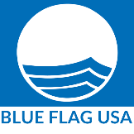
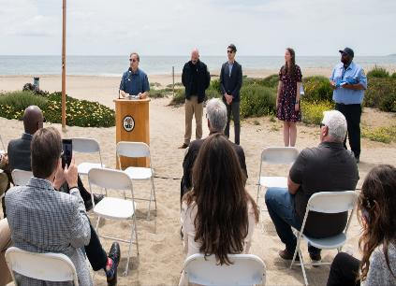
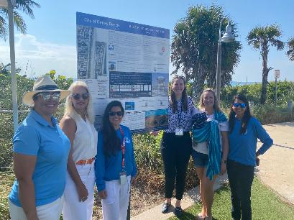
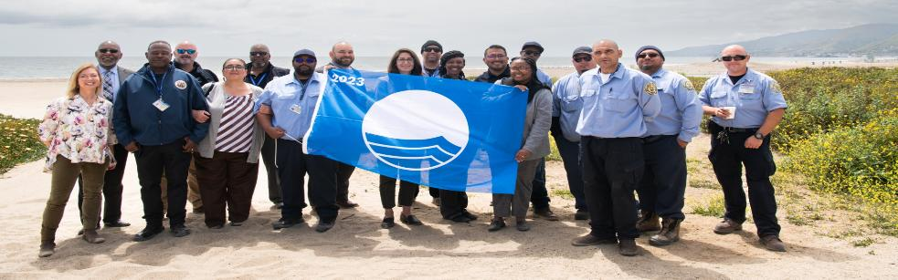
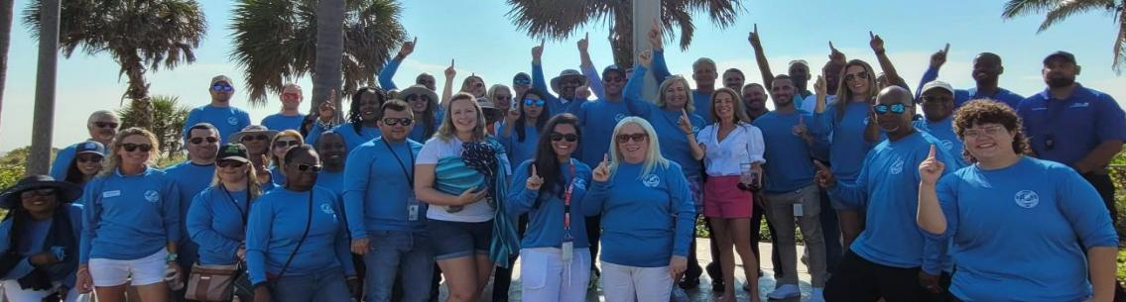
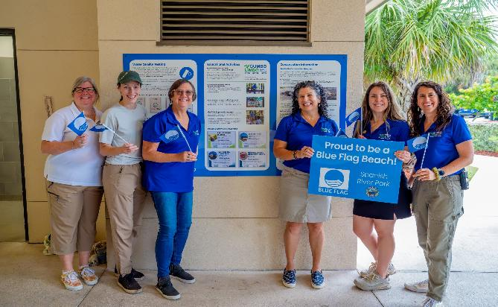
Blue Flag USA – eco-award
for local communities

Slide 17
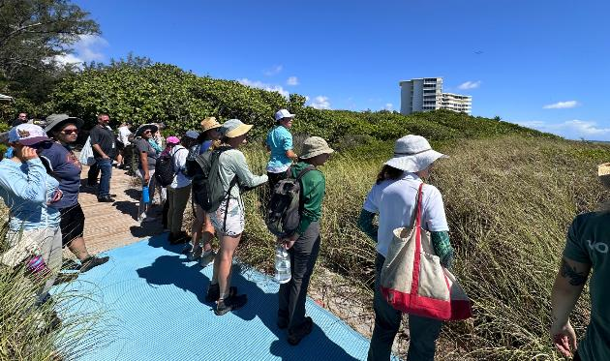
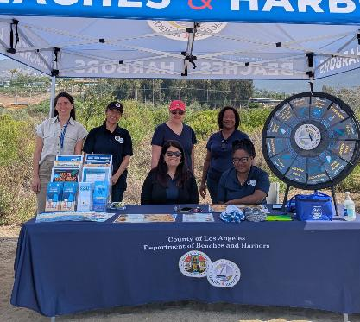
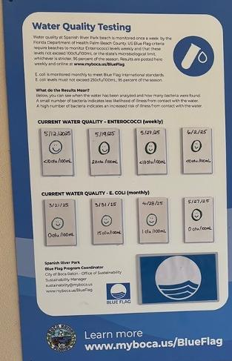
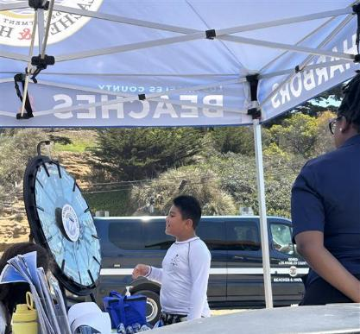

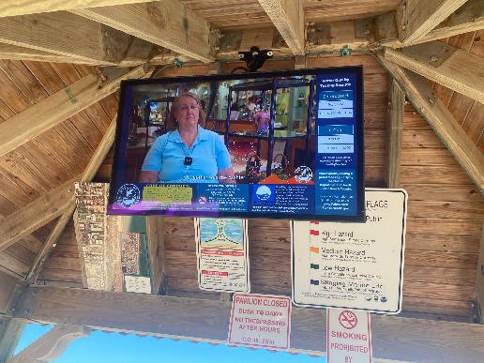
Blue Flag USA - eco-award for the ecosystems supporting economies

Slide 18
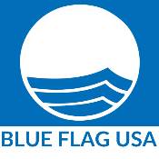
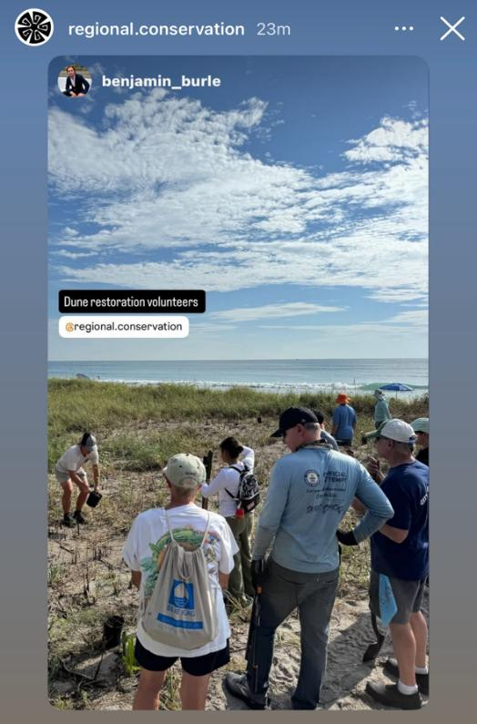
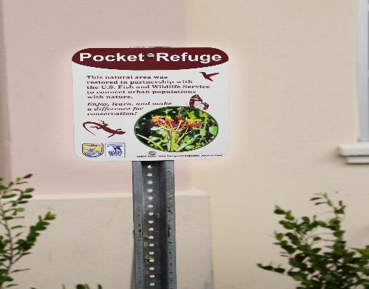
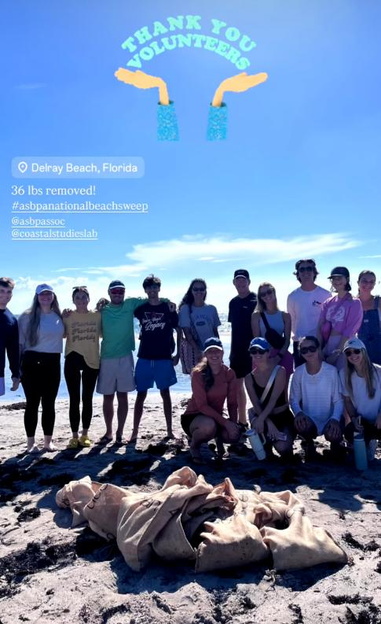
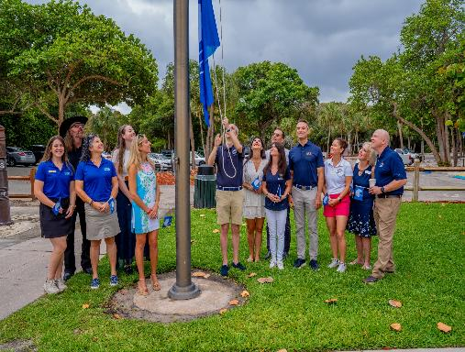
Blue Flag USA – eco-award to inspire & mobilize

