Slide 1
An argument for allowing more natural Nature based Solutions
Stevens CERG
Jon K. Miller

Slide 2
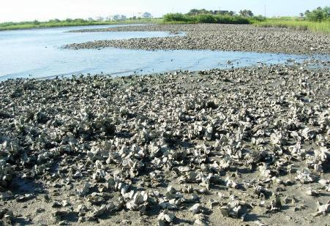
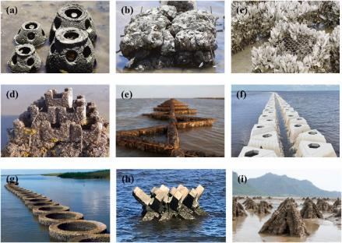
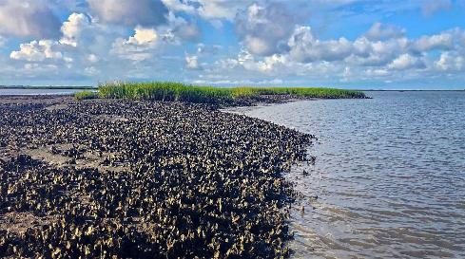

Nature
NbS
https://www.chesapeakebaymagazine.com/fl-oyster-reef-study-gives-chesapeake-clues/
https://www.pew.org/en/research-and-analysis/articles/2020/07/08/atlantic-and-gulf-coast-oyster-reefs-are-at-historic-lows-but-can-recover

Slide 3
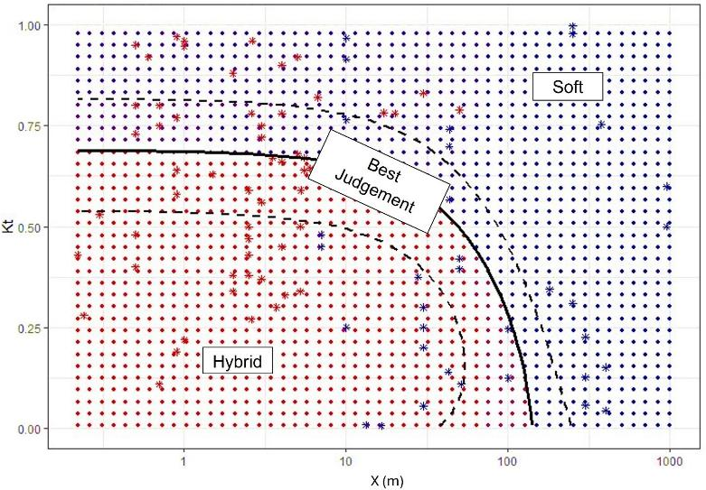
Amy Bredes, Georgette Tso, Rachel K. Gittman, Siddharth Narayan, Tori Tomiczek, Jon K. Miller, Rebecca L. Morris, 2024. A 20-year systematic review of wave dissipation by soft and hybrid nature-based solutions (NbS), Ecological Engineering, Volume 209, 2024,107418, ISSN 0925-8574,https://doi.org/10.1016/j.ecoleng.2024.107418.
Less Attenuation
Natural
More Attenuation
Narrower
Width
Wider

Slide 4
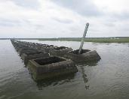

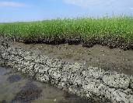
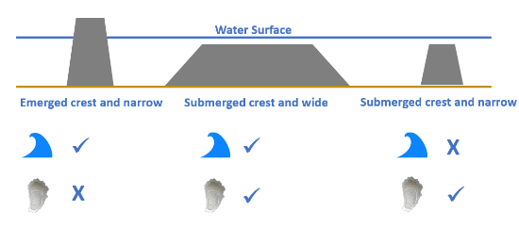
Key difference?
Natural systems tend to be low relief and wide
NbS tend to be high(er) relief and narrow
  Why?
  Most efficient wave height reduction for a given footprint, but is it the best approach?
Morris, R. L., M. K. La Peyre, B. M. Webb, D. A. Marshall, D. M. Bilkovic, J. Cebrian, G. McClenachan, K. M. Kibler, L. J. Walters, D. Bushek, E. L. Sparks, N. A. Temple, J. Moody, K. Angstadt, J. Goff, M. Boswell, P. Sacks, and S. E. Swearer. 2021. Large-scale variation in wave attenuation of oyster reef living shorelines and the influence of inundation duration. Ecological Applications 31(6):e02382. 10.1002/eap.2382

Slide 5
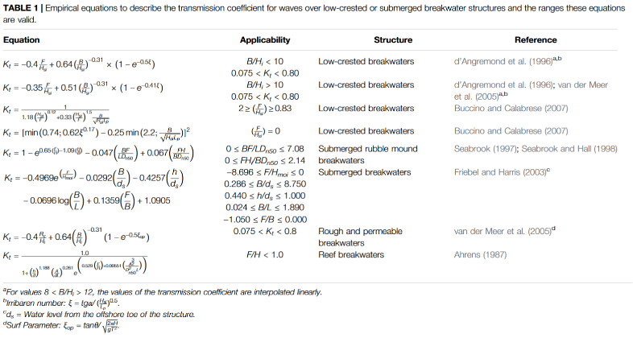

Typical Wave Attenuating Structure Design & Evaluation
Determine a target energy (wave height)
Determine the energy at the site (design conditions)
Adjust geometry/location to achieve desired energy (wave height) reduction
Evaluate
K_{t} is primarily a function of elevation and to a lesser extent width
Bredes AL, Miller JK, Kerr L and Brown DR (2022) Observations of Wave Height Amplification Behind an Oyster Castle Breakwater System in a High-Energy Environment: Gandys Beach, NJ. Front. Built Environ. 8:884795. doi: 10.3389/fbuil.2022.884795

Slide 6
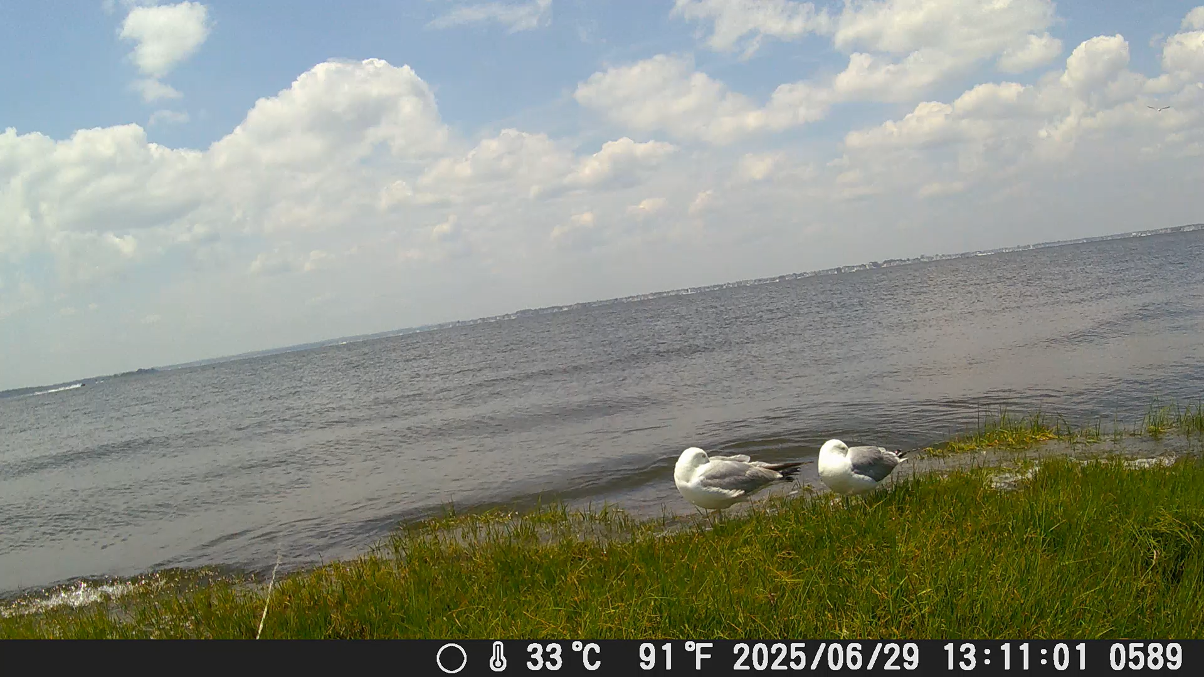
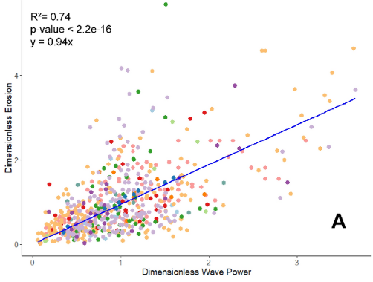
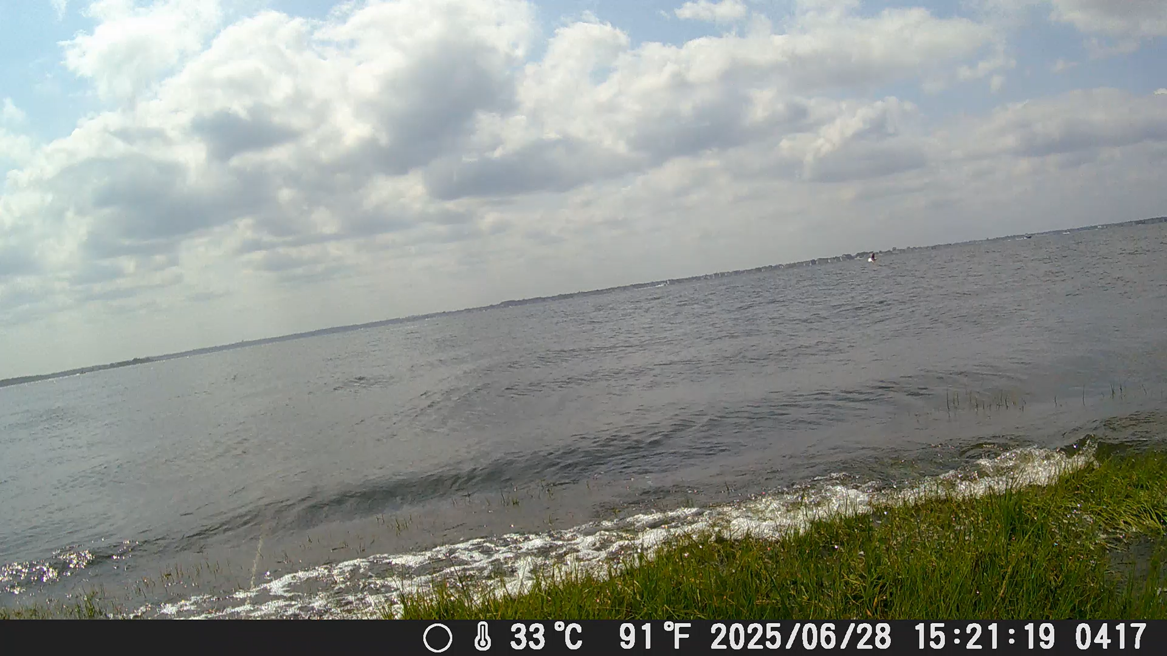
Is wave height even the correct metric?
Wave Energy (height) vs Power (height & speed)
Houttuijn Bloemendaal, L.J., FitzGerald, D.M., Hughes, Z.J. et al. Reevaluating the wave power-salt marsh retreat relationship. Sci Rep 13, 2884 (2023). https://doi.org/10.1038/s41598-023-30042-y

Slide 7
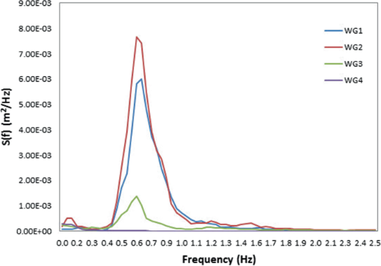
Why does it matter?
Both wave energy and wave power are proportional to wave height squared
  Wider structures dissipate more energy but it’s a second order and often neglected in K_{t} formulas
Wave power also considers wave speed (group velocity) which is related to the wave frequency/period
  As waves move across submerged structures the energy shifts to lower frequencies
  This is related to width
Wave energy can increase (K_{t}>1) while wave power decreases (P_{t}<1)
Peak shifts
Thuy, P.T., Trung, L.H., Linh, N.M. (2021). Experimental Measurements of Wave Transformation on Coral Reefs. In: Bui-Tien, T., Nguyen Ngoc, L., De Roeck, G. (eds) Proceedings of the 3rd International Conference on Sustainability in Civil Engineering. Lecture Notes in Civil Engineering, vol 145. Springer, Singapore. https://doi.org/10.1007/978-981-16-0053-1_31

Slide 8
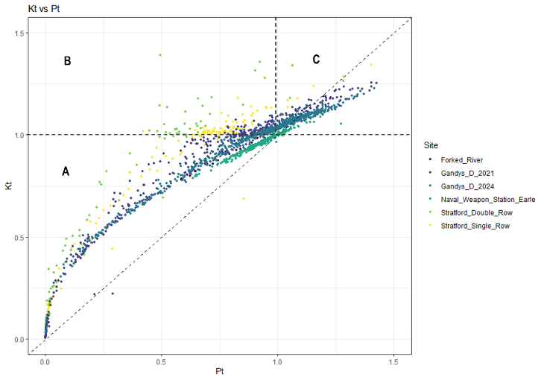
Why does it matter?
If we agree marsh edge erosion is related to wave power designing and evaluating projects on the basis of wave energy may be misleading
  In region A, both K_{t} and P_{t} <1 indicating an “effective” project, i.e. reduced energy/power
  In region B, K_{t} > 1 suggesting an ineffective project, while P_{t} < 1 indicate the structures successfully reduce the wave power
Bredes, Amy L. 2025. Understanding Wave Attenuation of Constructed Oyster Reefs: Field Observations, Trends, and Design Approach. PhD diss., Stevens Institute of Technology.

Slide 9
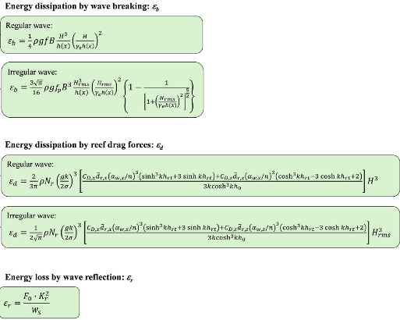
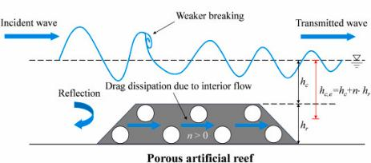
How does this relate to width?
Wave transmission is related to wave reflection, wave breaking, and drag
For wider, more permeable structures, wave energy/power transmission is more complex
Existing simple empirical formulations do not work
For wider, more permeable structures, wave energy/power transmission is more complex
Jianjun Huang, Ryan J. Lowe, Marco Ghisalberti, Jeff E. Hansen, 2024. Wave transformation across impermeable and porous artificial reefs. Coastal Engineering, Volume 189,104488, ISSN 0378-3839,
https://doi.org/10.1016/j.coastaleng.2024.104488.

Slide 10
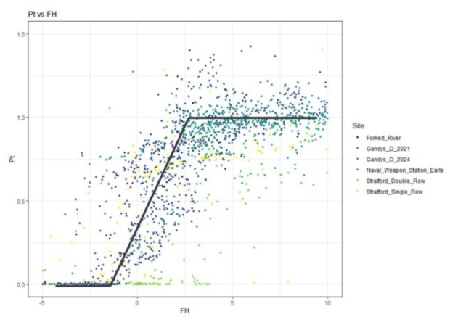
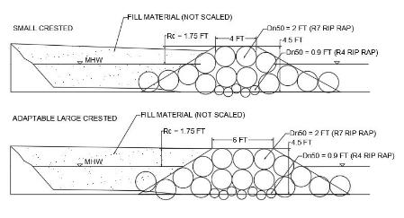
Width also important for
Adaptability to SLR
Increased Transmission (reduced effectiveness)
Reduced freeboard (rising seas)

Slide 11
Summary
Both natural and NbS interact with and modify the incident wave field
Natural systems are generally low in elevation, and rely on width to dissipate wave energy
NbS tend to be peaky and narrow and rely on elevation to dissipate energy
Many simple empirical formulas exist for estimating wave (height) transmission
Marsh edge erosion has been more closely linked to wave power
Recent studies show wave power transmission is not the same as wave height transmission
Wave power is more impacted by structure width
Few (if any) simple empirical formulas exist for estimating wave power transmission
Wave power provides impetus for reconsidering the importance of width in NbS design
There is a need for the development of simple engineering design tools that can more fully assess the impact of structure width on the incident wave field beyond just wave height

