Slide 1
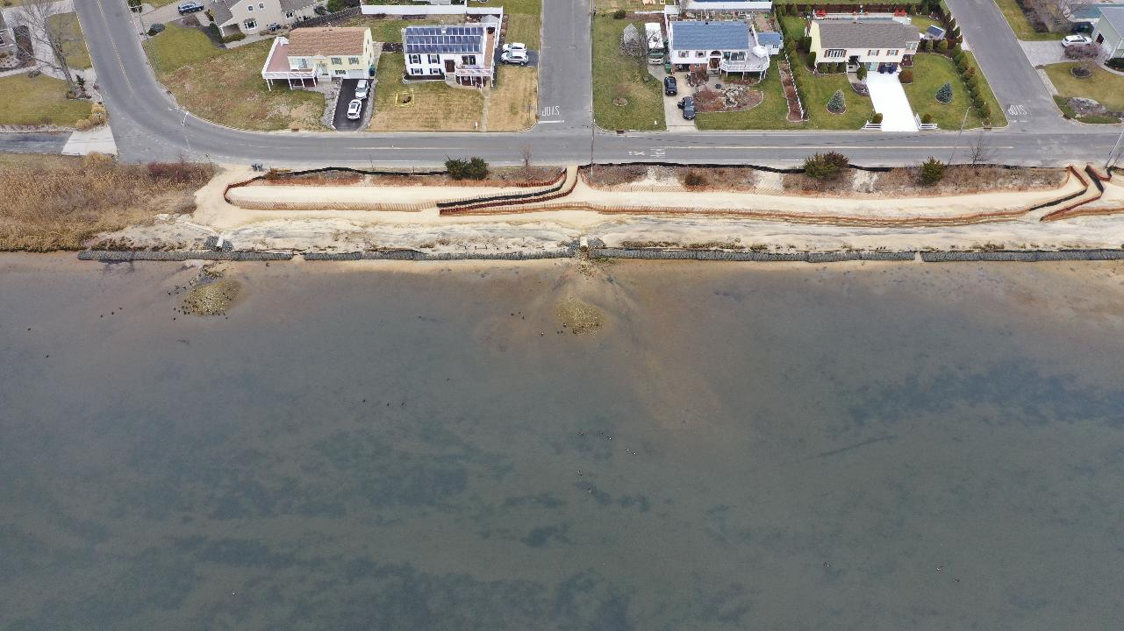
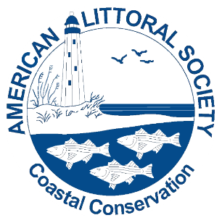

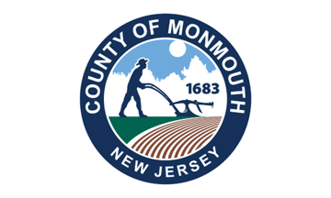
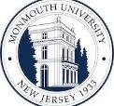
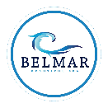




Shark River Roundtable: Bringing Communities Together on a Regional Level in the Face of Climate Change
Capt. Alek Modjeski
Habitat Restoration Program Director
Certified Ecological Restoration Practitioner/Coastal Ecologist
American Littoral Society

Slide 2
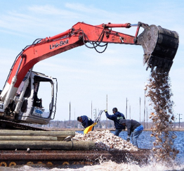
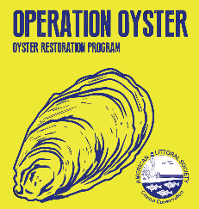
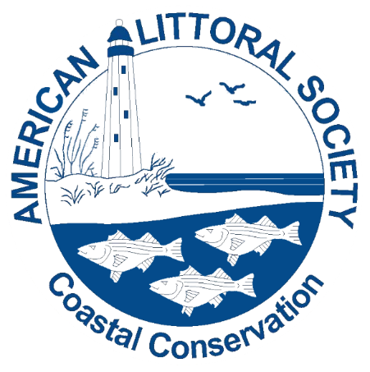
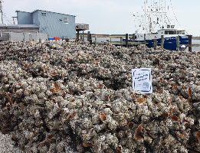
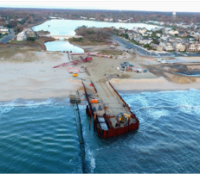
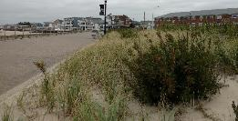
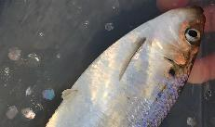
www.littoralsociety.org
Notes:
2016 – adding another beach, 4 more reefs, starting marsh restoration, and continue our monitoring efforts
If you’d like more info check out our website LittoralSociety.org or the project website restoreNJbayshore.org

Slide 3
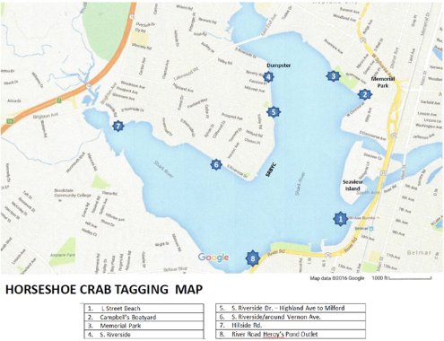
Shark River
The Shark River Watershed comprises approximately twenty-three square miles in Monmouth County
The Watershed encompasses three sub-watersheds including the Jumping Brook sub-watershed (HUC 02030104090050) and two Shark River sub-watersheds, one above (HUC 02030104090040) and one below (HUC 02030104090060) Remsen Mill gage.
The entire Shark River Watershed is located within Watershed Management Area 12.

Slide 4
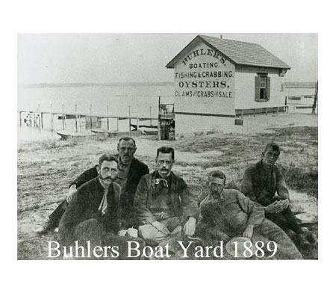
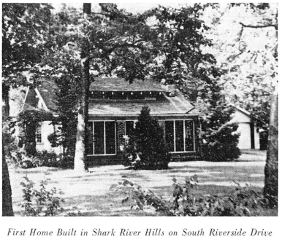
Brief History of Shark River
Originally known as the Nollecquest River by the Lenni Lenape
The name “Shark River” first recorded in colonial deed dated July 25, 1689
By 1740, area settled by Europeans
Named Hogs Pond in 1781 for the hog farming that took place on the banks of the Shark River.
Early commerce included farming, fishing, milling, oyster harvesting, and boat building
Over 300 one-acre oyster leases by 19th century and over 100 families made a living clamming and harvesting oysters
Industry collapsed by 1920
In 1913, the Shark River Hills Company purchased 728 acres for development
Wooden bulkheading installed along shoreline in 1920s
Notes:
The modern living shoreline concept was developed in the mid-1970s by Dr. Edgar Garbisch Jr., a chemist and heir to part of the Chrysler fortune, who wanted to restore the marshes on his property along the Chesapeake Bay in Maryland.
He placed a line of rocks in the water a few yards from shore, filled sand behind the rocks, and planted marsh grasses in the sand.

Slide 5
More History of the Shark River
Harbor & Waterfront Planning: Birdsall Engineering Inc. was involved in consulting for the Shark River waterfront and dredging plans for the borough. (2006 DMMP)
Shark River Round Table formed and disbanded for 20 years
Infrastructure Improvements: In 1961-1962, the borough enacted ordinances for the improvement of the Belmar Harbor and Marine Basin.
Historic Context: Claude W. Birdsall was a key figure in the formation of South Belmar (now Lake Como) in 1924, serving as an engineer.

Slide 6
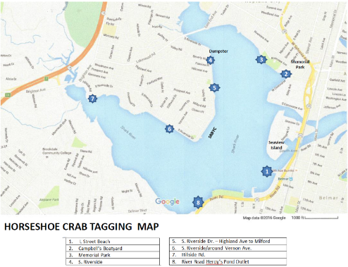
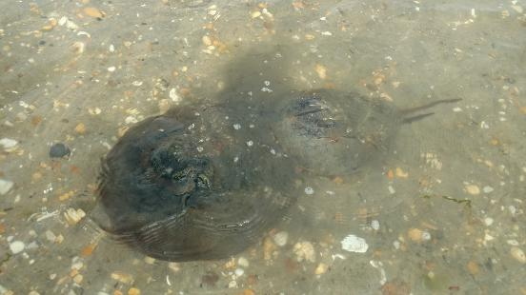
Shark River Today
Heavily developed
Residential and light commercial
Marinas
Utilized for recreational fishing and watersports (kayaking, SUP, boating, etc.)
Biological Resources include:
Hard Clam
Horseshoe Crab
1,600 crabs have been tagged since 2007 (Capt. Al and SRCC)
111 re-sightings
Blue Crab/Fish
Eagles, Skimmers, Herons, Shorebirds

Slide 7
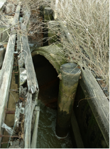
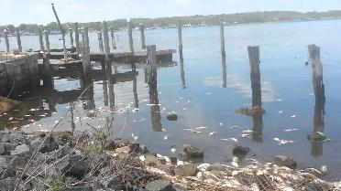
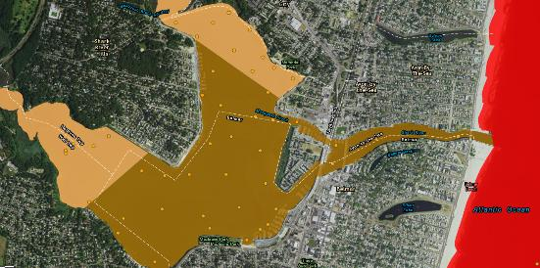
Other Shark River Estuary Issues
Environmental and Community Issues:
Poor water quality – fecal bacteria (sewage/wastewater), excess nutrients, low dissolved oxygen
Restrictions on shellfish harvest
Beach closures
Fish kills
Overdevelopment and loss of natural habitat landward
Sedimentation
Flooding

Slide 8
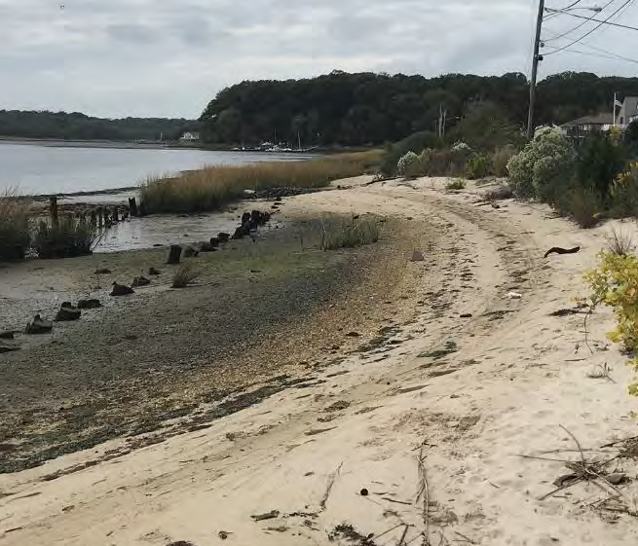
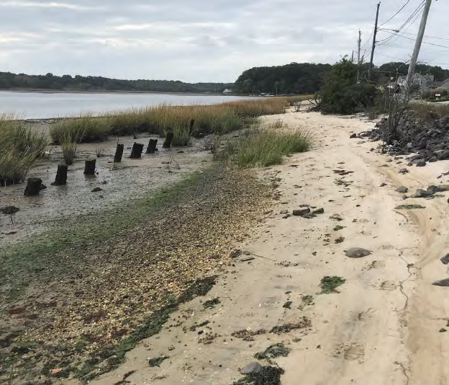
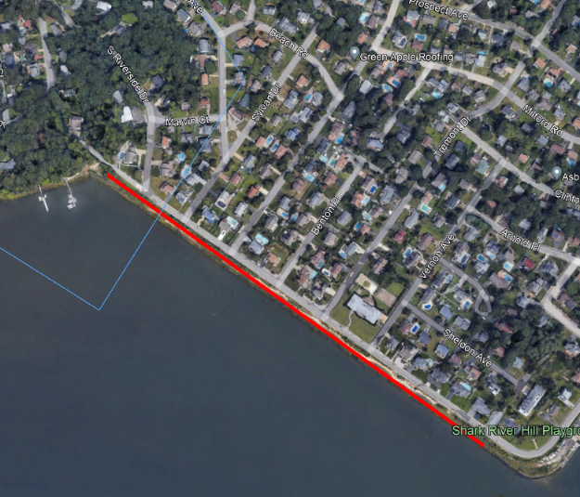
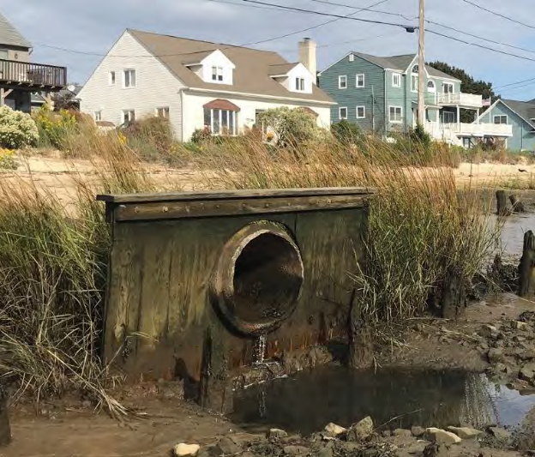
Additional Concerns
Low elevation beaches vulnerable to erosion (loss of habitat)
Homes vulnerable
Dilapidated outfalls
Nuisance flooding
Biology/Ecology
HSC Spawning
Fiddler Crabs
Birds
Forage Fish
Marsh
Project Location

Slide 9
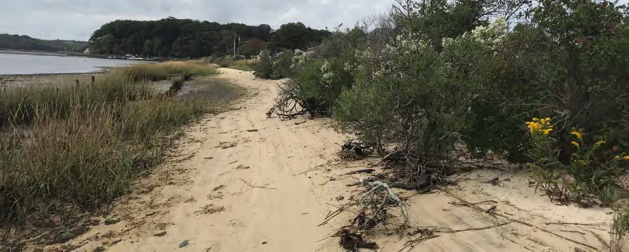
What is needed!
A holistic, united approach to improve resiliency
Reduced flood risk and mitigation for impact of storm events
Improve and protect existing beach and marsh habitat (value to people and horseshoe crabs)

Slide 10
Shark River Round Table Reformed 2025
First formed in 2005 – Reformed 2025
5 municipalities
Monmouth County
3 NGOS
Resilient NJ Grant awarded in December 2025
Prioritize and identify needs in a Plan
NJDOT and beneficial use

Slide 11
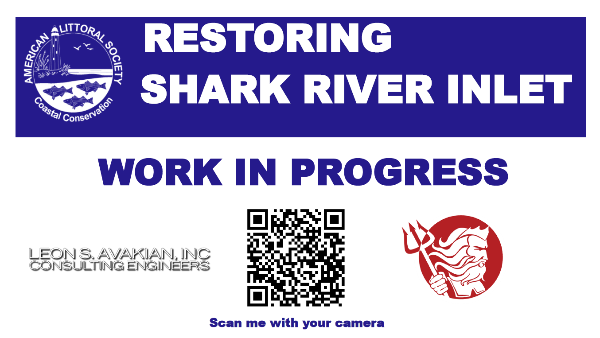

Slide 12

S. Riverside Drive Living Shoreline Phase 1
Neptune Township
Department of Public Works
Police
OEM
Engineering
American Littoral Society
Leon S. Avakian, Inc
Albert Marine Construction, Inc.
Stockton University
Shark River Cleanup Coalition (monitoring support)
Corporate Wetlands Restoration Partnership
RVE Engineering
Monmouth County
You
FEMA Pre-Disaster Mitigation Grant (2010)
Approx. $835,000 + Cost Share

Slide 14
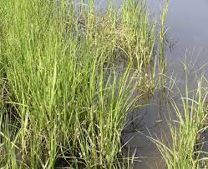
The Approved Restoration Project
Beach Restoration
Add 3,888 cubic yards of sand and grade the beach to a 1:8 slope
Berm Restoration and Creation
Create a sandy berm (approximately 2’ high) near the roadway
The berm will be encapsulated by snow/drift fencing to keep the sand in place and planted with native vegetation in spring 2023
Marsh Sill
A marsh sill will be created offshore. The sill will consist of a series of Tensar mattresses laid end-to-end along the length of the project. Each mattress is 24 feet long, 5 feet wide, and 1 foot high and will be filled with a mix of rock and shell. We will place gaps in the sill ever 100 feet.
Marsh Improvements and Restoration
Coir logs will be installed at the waterward extent of the existing marsh to trap sediment and raise the elevation of the marsh. In spring 2023, we will plant additional Spartina alterniflora
Outfall Upgrades
The 7 outfalls will be replaced and upgraded with inline check valves to prevent the backflow of water

Slide 15
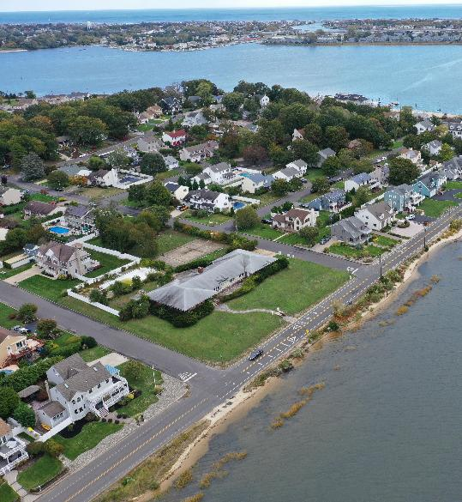
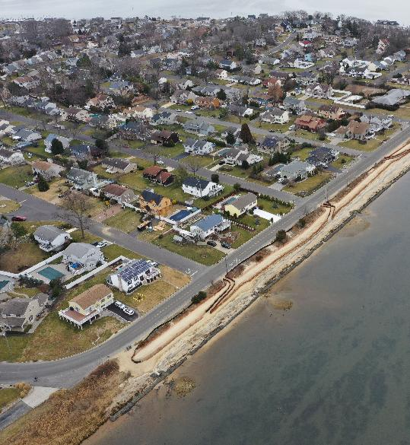
October 2022
February 2023
Photos K. Bascom
Photos K. Bascom

Slide 16
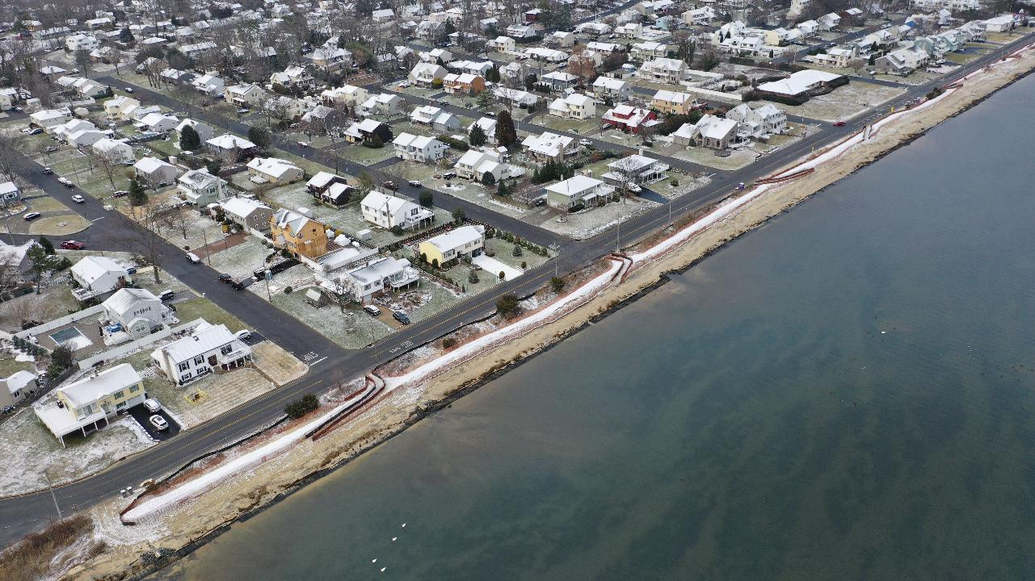
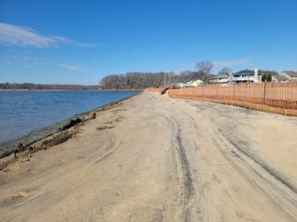
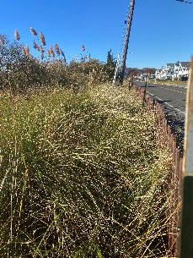
Overall……..By the Numbers
7 outfalls repaired or replaced
7 tide valves added
275 trucks of sand
4,566 cy of sand placed
46,000 dune plants planted
78 shell/rock mattresses placed
336 coir logs placed totaling 4,032 lf
4,600 lf of snow fence and 3,000 lf of silt fence
Improved beach access
Final elevations of berm 7.0’
Final elevations of beach 3.0’ upper, 2.0’ lower
No flooding reported or recorded since built
1 NJ Governor’s Environmental Excellence Award
Estimated amount of Spartina planted – 7,300 units
Replanted and Repaired in 2024 and 2025
But this is only 1 shoreline more needs to be done

Slide 17
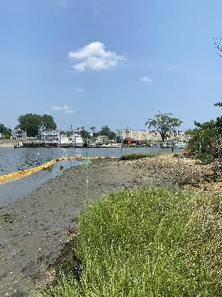
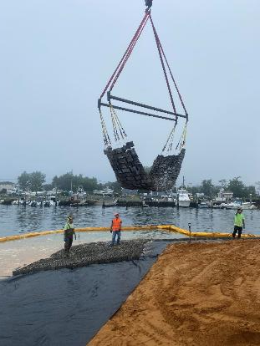
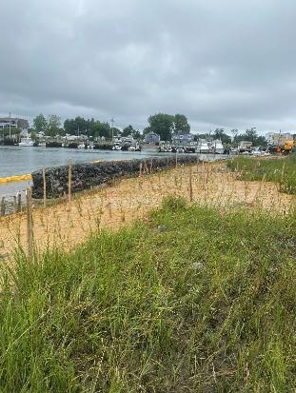
Shark River Island
Renova, Neptune, Monmouth County, Volunteers Marsh Replanting on April 12, 2025
Notes:
Core Partners and funders

Slide 18
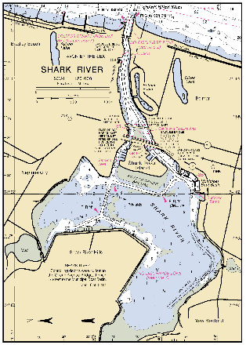
S. Riverside Drive Living Shorelines Coming!
Phase 2
$1.5M
In permit process
From marina to yacht club
Phase 3
$2.45M
Close to East End bridge
Other nature-based projects

Slide 19
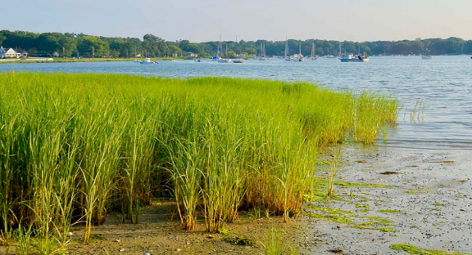
Round Table and Resilience: In summary
A regional approach was needed
Multiple entities working together
Resilient NJ Plan
Bring Community Leaders Together
Inform and Engage Communities

Slide 20
Thank You
Capt. Alek Modjeski
Habitat Restoration Program Director
Certified Ecological Restoration Practitioner/Coastal Ecologist
American Littoral Society

